Slide 1
III }Bone : Type of connective tissue. With calcified ECM specialized to support the body , protect many internal organs and body′s Ca⁺⁺ reserves.
●components of bone tissue.
Cells :
Osteoblasts :- synthesizes the organic components of the matrix { the ECM}
b. Osteocytes :- are found in cavities {Lacunae} between bone matrix layers {Lamellae} with cytoplasmic processes extending in to small canaliculi between Lamellae.
c. Ostioblasts :- multinucleated giant cells involved in the desorption and remodeling of bone tissue.

Slide 2
2. Bone matrix: organic and inorganic extracellular matrix.
NOTE :- the inner surface of the bone lining by endosteum and the outer surface covered by periosteum bothe are connective tissue.
●Types of bones:
Compact (cornical) bone :- The ECM present as Lamellae arrange as Circles around A center canal contain nerves and blood vesicles .

Slide 3
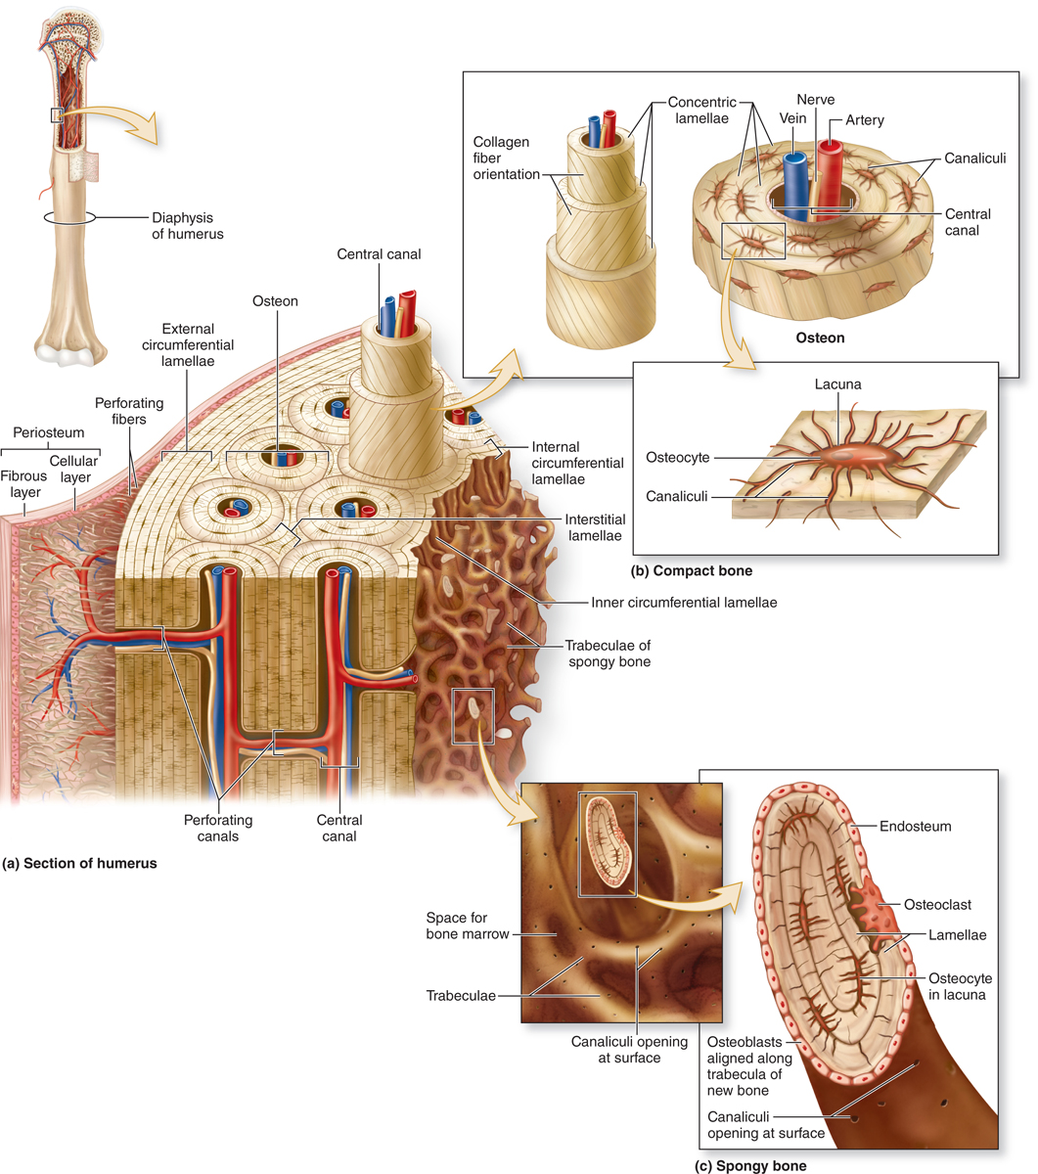
Figure 8-1
Notes:
Figure 8–1 Components of bone.
A schematic overview of the basic features of bone, including the three key cell types: osteocytes, osteoblasts, and osteoclasts; their usual locations; and the typical lamellar organization of bone. Osteoblasts secrete the matrix that then hardens by calcification, trapping the differentiating cells now called osteocytes in individual lacunae. Osteocytes maintain the calcified matrix and receive nutrients from microvasculature in the central canals of the osteons via very small channels called canaliculi that interconnect the lacunae. Osteoclasts are monocyte-derived cells in bone required for bone remodeling.
The periosteum consists of dense connective tissue, with a primarily fibrous layer covering a more cellular layer. Bone is vascularized by small vessels that penetrate the matrix from the periosteum. Endosteum covers all trabeculae around the marrow cavities.

Slide 4
●Osteon {Haversion system} :- refers to complex of concentric lamellae surrounding small central canal between successive lamellae are lacunae each with one osteocytes , each osteon is parallel to the long axis of the bone.
●Volkmann canal {perforating canal} :- Transverse canal connect osteons together {The central canal of osteon communicate with marrow cavity and periosteum by Volkmann canal}.
2) Spongy Bone {cancellous bone} ;- Interconnected thin trabeculae located in the inner region of the bone . EX-spongy bone and medullar bone .

Slide 5
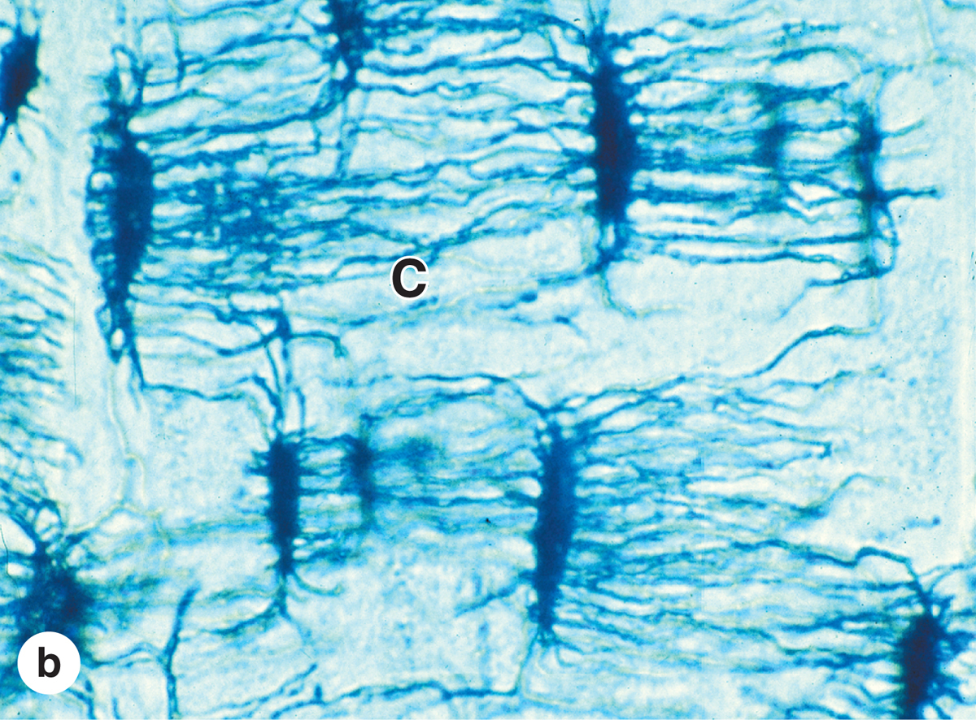
Figure 8-5
Notes:
Figure 8–5 Osteocytes in lacunae.
(a) TEM showing an osteocyte in a lacuna and two dendritic processes surrounded by matrix. Such processes are extended as osteoid is being secreted, and this material calcifies around the processes, giving rise to canaliculi (C) in the bony matrix.
(b) Photomicrograph of bone, not decalcified and sectioned, but ground very thin to demonstrate lacunae and canaliculi. The lacunae and canaliculi (C) appear dark and show the communication between these structures through which nutrients derived from blood vessels diffuse and are passed from cell to cell in living bone. X400. Ground bone.
(c) SEM of non-decalcified, sectioned, and acid-etched bone showing lacunae and canaliculi (C). X400.
(Part c with permission, from Dr Matt Allen, Indiana University School of Medicine, Indianapolis.)

Slide 6
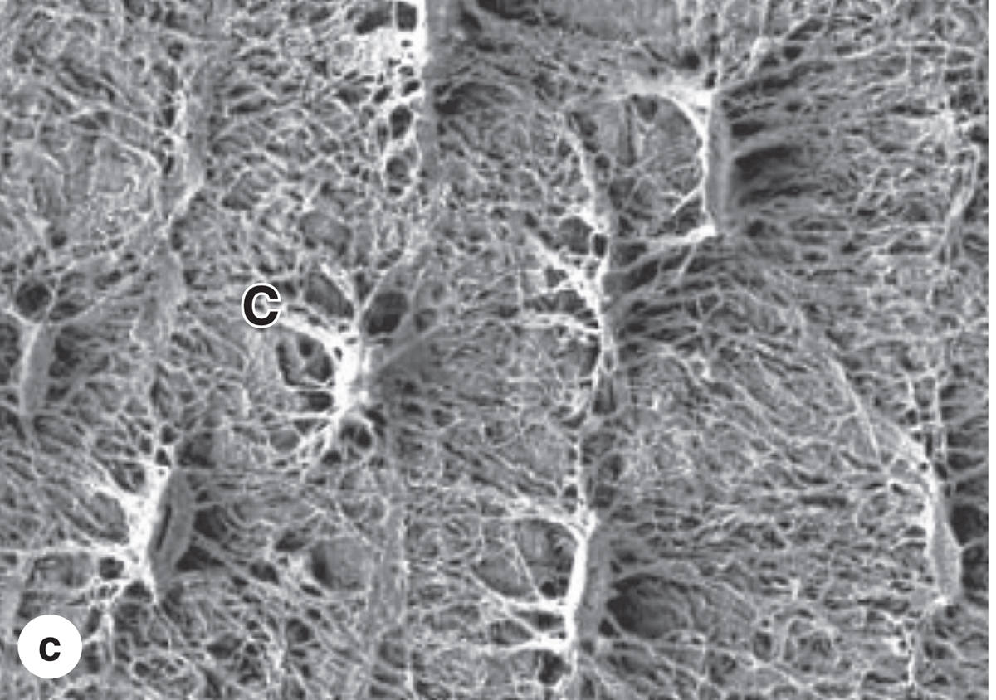
Figure 8-5
Notes:
Figure 8–5 Osteocytes in lacunae.
(a) TEM showing an osteocyte in a lacuna and two dendritic processes surrounded by matrix. Such processes are extended as osteoid is being secreted, and this material calcifies around the processes, giving rise to canaliculi (C) in the bony matrix.
(b) Photomicrograph of bone, not decalcified and sectioned, but ground very thin to demonstrate lacunae and canaliculi. The lacunae and canaliculi (C) appear dark and show the communication between these structures through which nutrients derived from blood vessels diffuse and are passed from cell to cell in living bone. X400. Ground bone.
(c) SEM of non-decalcified, sectioned, and acid-etched bone showing lacunae and canaliculi (C). X400.
(Part c with permission, from Dr Matt Allen, Indiana University School of Medicine, Indianapolis.)

Slide 7
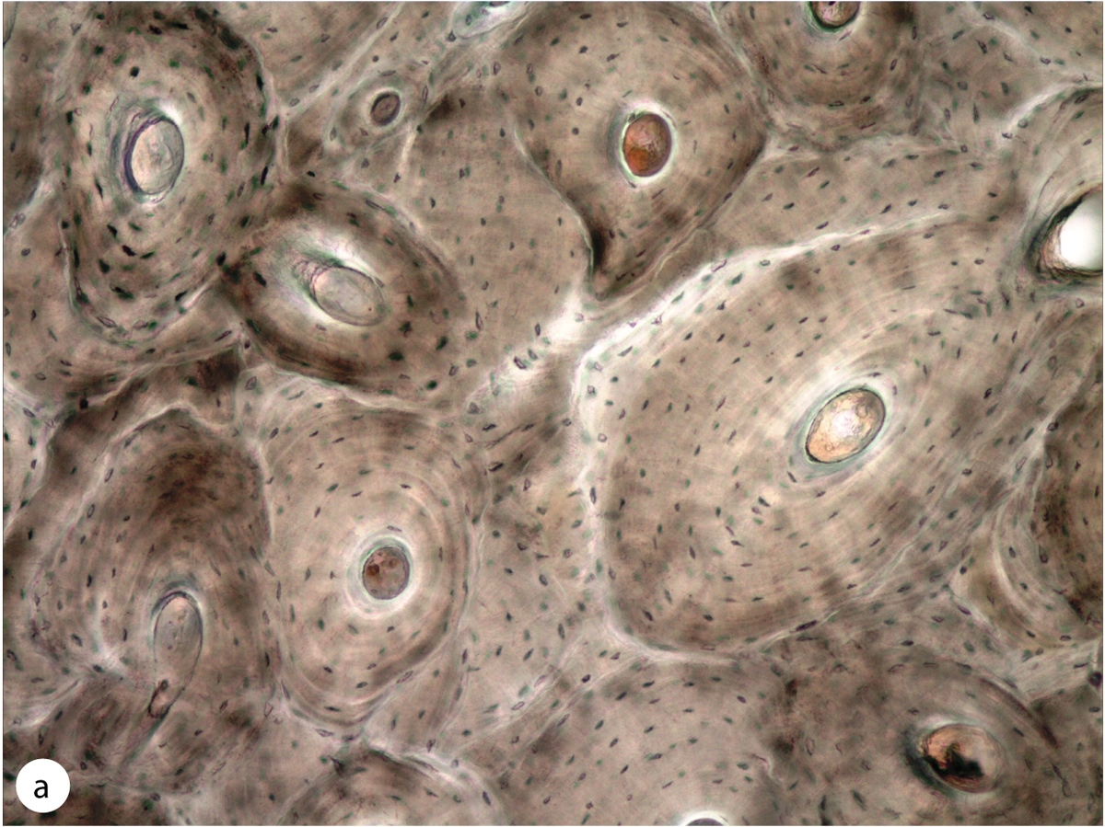
Figure 8-8
Notes:
Figure 8–8 Lamellar bone.
Two photographs of the same area of an unstained section of compact bone, showing osteons with concentric lamellae around central canals. Lamellae are seen only faintly by bright-field microscopy (a), but they appear as alternating bright and dark bands under the polarizing light microscope (b). Bright bands are due to birefringence from the highly ordered collagen fibers in a lamella. Alternating bright and dark bands indicate that fibers in successive lamellae have different orientations, an organization that makes lamellar bone very strong. Both X100.
(With permission, from Dr Matt Allen, Indiana University School of Medicine, Indianapolis.)

Slide 8
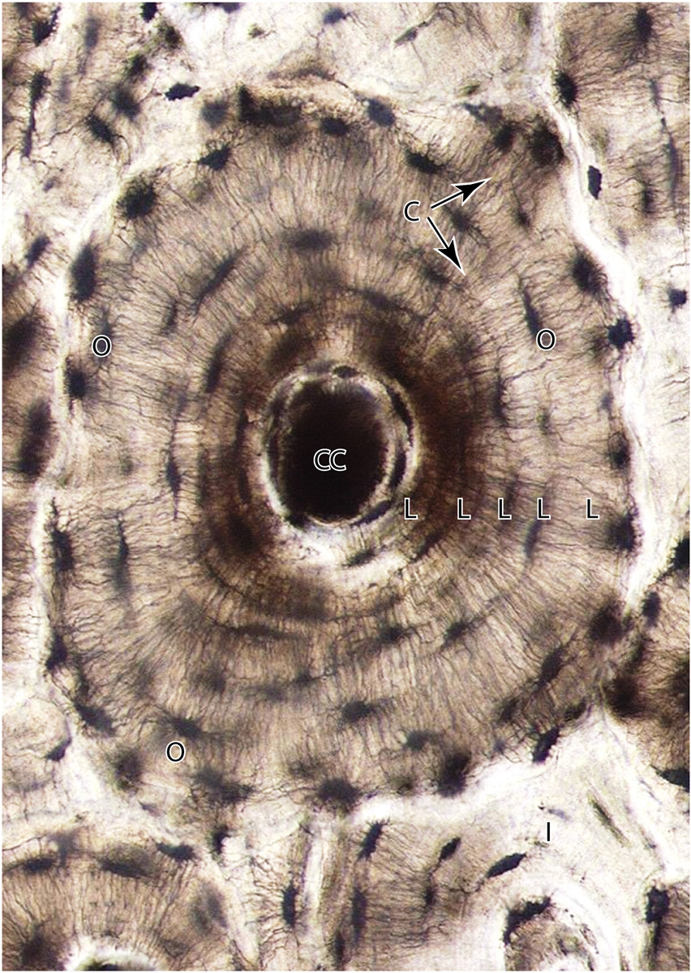
Figure 8-9
Notes:
Figure 8–9 An osteon.
Osteons (Haversian systems) constitute most of the compact bone. Shown here is an osteon with four to five concentric lamellae (L) surrounding the central canal (CC). Osteocytes (O) in lacunae are in communication with each other and with the central canal and periphery of the osteon via through hundreds of dendritic processes located within fine canaliculi (C). Also shown are the partial, interstitial lamellae (I) of an osteon partially eroded when the intact osteon was formed. Ground bone. X500.

Slide 9
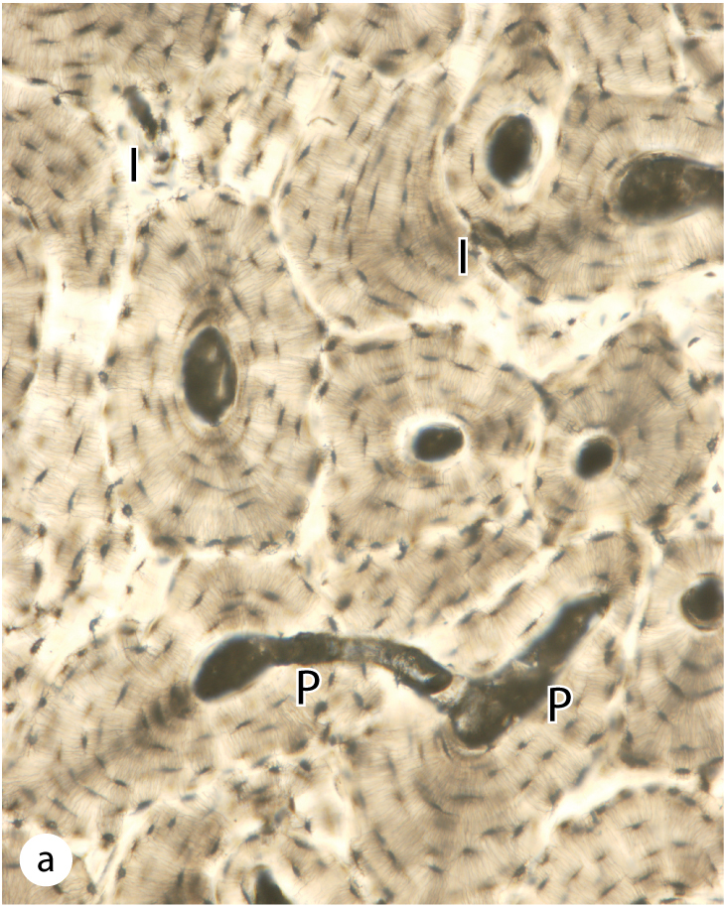
Figure 8-10
Notes:
Figure 8–10 Lamellar bone: Perforating canals and interstitial lamellae.
(a) Transverse perforating (Volkmann) canals (P) connecting adjacent osteons are shown in this micrograph of compact lamellar bone. Such canals “perforate” lamellae and provide another source of microvasculature for the central canals of osteons. Among the intact osteons are also found remnants of eroded osteons, seen as irregular interstitial lamellae (I). Ground bone. X100.
(b) Schematic diagram shows remodeling of compact lamellar bone with three generations of osteons and their successive contributions to the formation of interstitial lamellae. The shading indicates that successive generations of osteons have different degrees of mineralization, with the most newly formed being the least mineralized. Remodeling is a continuous process that involves the coordinated activity of osteoblasts and osteoclasts, and is responsible for adaptation of bone to changes in stress, especially during the body’s growth.

Slide 10
IV } Blood :- A unique specialized connective tissue composed of cells and plasma.
A ) Blood cells :
Erythrocytes [Red Blood Cells].
Platelets [Thrombocytes].
Leukocytes [White Blood Cells]. Divided to
Granulocytes .
Neutrophils.
Eosinophils.
Basophils.
A grnaulocytes :
Lymphocytes
Monocytes.
●Hemopoitic Tissue:- Production of blood cells by bone marrow according to body needs .

Slide 11
●Hemopoitic Tissue:- Production of blood cells by bone marrow according to body needs .
Types of bone marrow
Red bone marrow :- active in hemopoietic .its color is produced by an abundance of blood at gross examination .EX- rips and vertebrates .
2. Yellow Bone marrow :- filled with adipocytes.

Slide 12
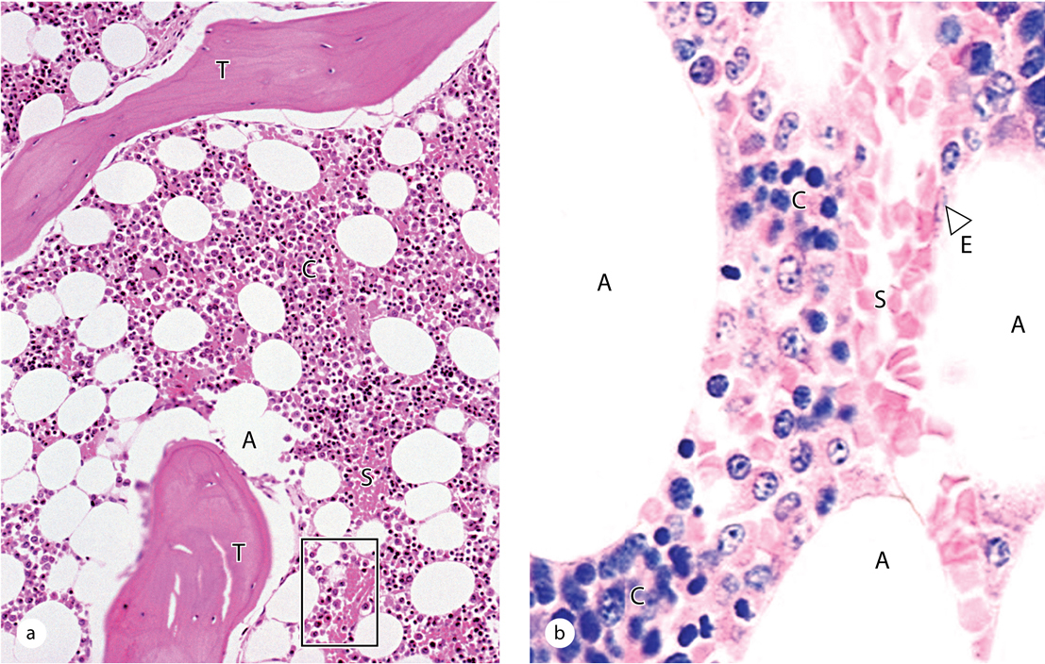
Figure 13-4
Notes:
Red bone marrow (active in hemopoiesis).
Red bone marrow contains adipocytes but is primarily active in hemopoiesis, with several cell lineages usually present. It can be examined histologically in sections of bones or in biopsies, but its cells can also be studied in smears. Marrow consists of capillary sinusoids running through a stroma of specialized, fibroblastic stromal cells and an ECM meshwork with reticular fibers. Stromal cells produce the ECM; both stromal and bone cells secrete various CSFs, creating the microenvironment for hemopoietic stem cell maintenance, proliferation, and differentiation.
(a) Sections of red bone marrow include trabeculae (T) of cancellous bone, adipocytes (A), and blood-filled sinusoids (S) between hemopoietic cords (C) or islands of developing blood cells. X140. H&E. (b) At higher magnification the flattened nuclei of sinusoidal endothelial cells (E) can be distinguished, as well as the variety of densely packed hemopoietic cells in the cords (C) between the sinusoids (S) and adipocytes (A). Most stromal cells and specific cells of the hemopoietic lineages are difficult to identify with certainty in routinely stained sections of marrow. X400. H&E.

Slide 13
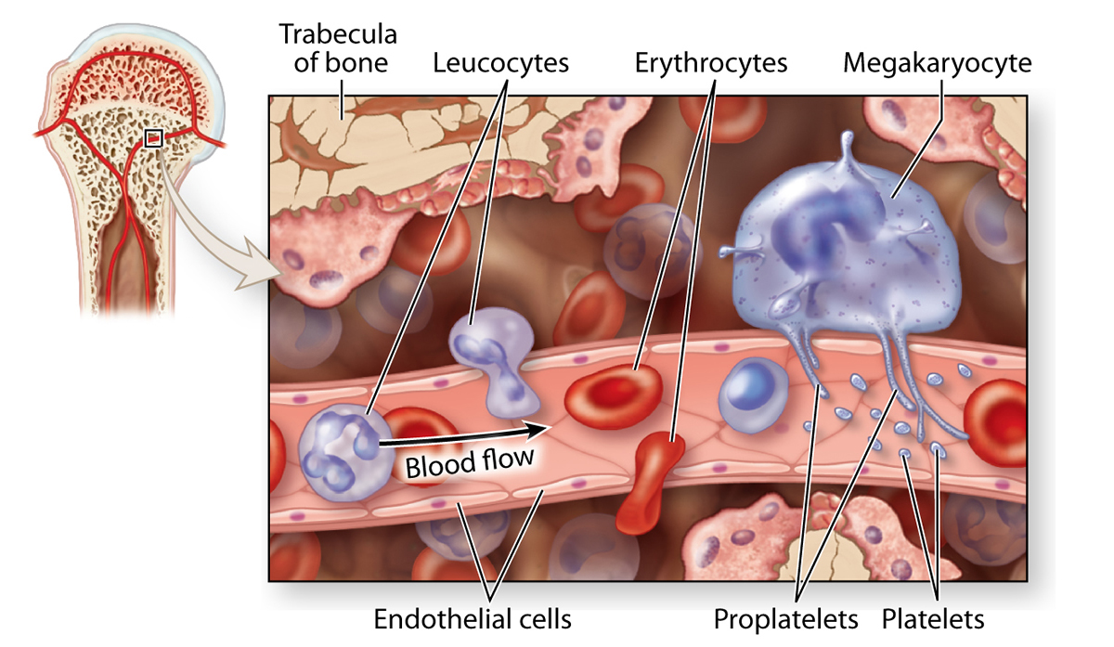
Figure 13-5
Notes:
Sinusoidal endothelium in active marrow.
The diagram shows that mature, newly formed erythrocytes, leukocytes, and platelets in marrow enter the circulation by passing through the discontinuous sinusoidal endothelium. All leukocytes cross the wall of the sinusoid by their own activity, but the non-motile erythrocytes cannot migrate through the wall actively and enter the circulation pushed by a pressure gradient across the wall. Megakaryocytes form thin processes (proplatelets) that also pass through such apertures and liberate platelets at their tips.

