Slide 1
AL-Mustansiriyah University College of science Biology Dept. Zoology 4th class
ENOCRINOLOGY LAB.
(6)
D
NAME :

Slide 2
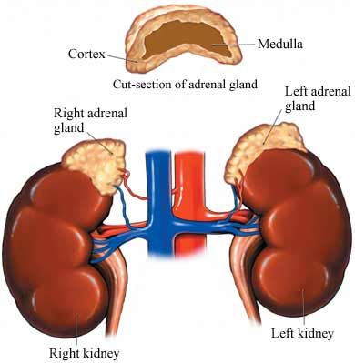
Adrenal glands
The adrenals are orange-colored glands that sit on top of the kidneys near the spine, just underneath the last rib and extending down about an inch. The right adrenal is shaped something like a pyramid, whereas the left is shaped more like a half moon.

Slide 3
Each adrenal gland is composed of two endocrine components:
medulla (inner part) that constitutes 20% of the gland
cortex (outer part) that constitutes the remaining 80%. The cortex consists of three zones.
The medulla and each of the zones in the cortex each produce different hormones that serve a variety of functions in your body.

Slide 4
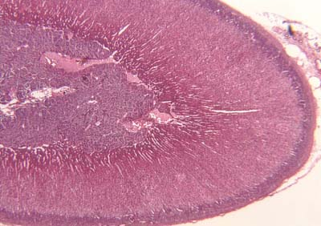
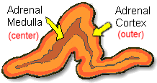
Adrenal Glands

Slide 5
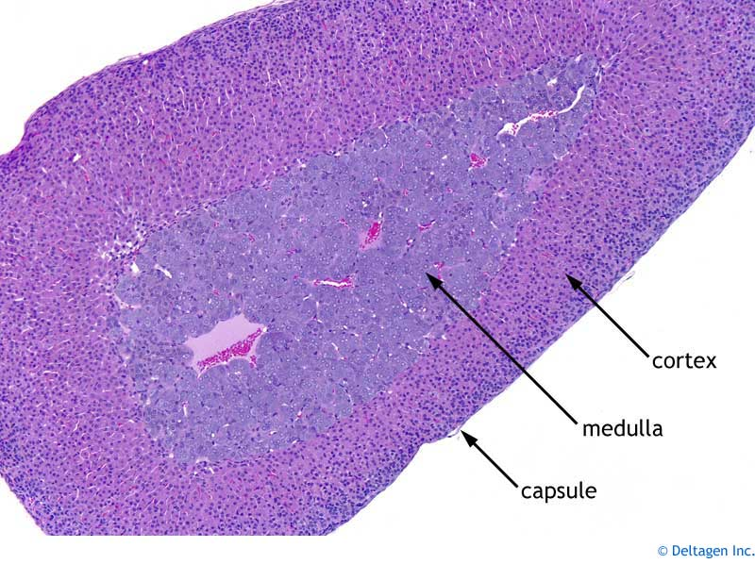

Slide 6
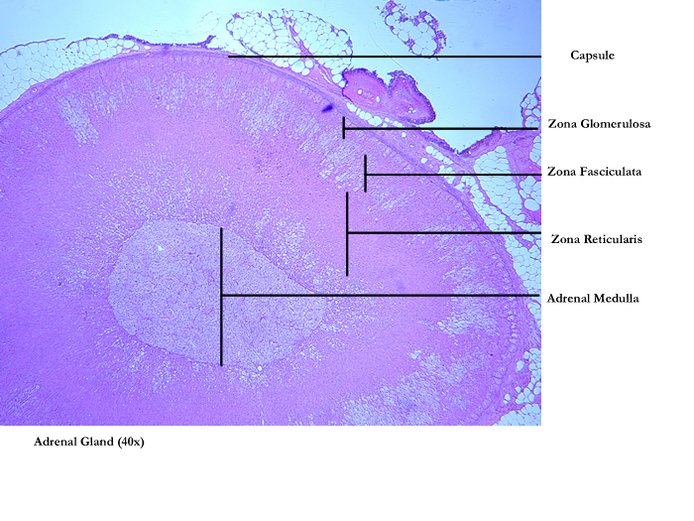

Slide 7
Cortex
The Adrenal Cortex
1. Zone of glomerulosa
The adrenal cortex is divided into three zones which each secrete different hormones that carry out specific functions throughout your body.
2
3
1. Zone of glomerulosa
Medulla
Aldosterone is secreted from this zone which is the major hormone controlling the sodium and potassium levels, and thus fluid balance, within your bloodstream, cells and interstitial fluids.

Slide 8
The Adrenal Cortex
Cortex
1. Zone of glomerulosa
2. Zone of fasciculata
Coritsol (hydrocortisone) is produced, affects glucose, amino acid and fat metabolism, which is called glucocorticoids.
2
Zone of fasciculata
3
Zone of reticularis
3. Zone of reticularis
Medulla
Dehydroepiandrosterone (DHEA)- This zona manufactures an ancillary portion of sex hormones for each sex and also produces male hormones in women and female hormones in men to keep the effects of the dominant sex hormones in balance .

Slide 9
Adrenals
CORTEX
Zona Glomerulosa
Mineralocorticoids (Aldosterone)
Na+, K+ and water homeostasis
Zona Fasciculata
Glucocorticoids (Cortisol)
Glucose homeostasis and many others
Zona Reticularis
Sex steroids (androgens)
Medulla: “Catecholamines”
Epinephrine, Norepinephrine, dopamine

Slide 10
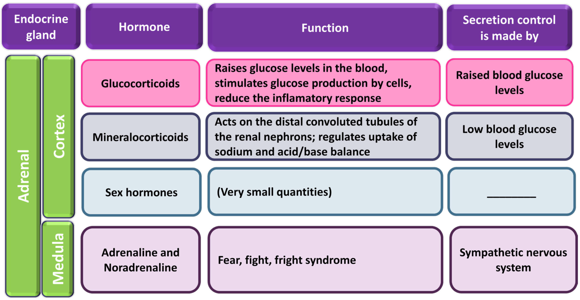

Slide 12
Damage/Malfunction of Gland
Cushing Syndrome
Too much cortisol is produced.
Symptoms vary, but most people have upper body obesity, rounded faces, increased fat around neck, and thinning arms and legs.
Weakening of the bones and easy bruising of the skin is also common.
Cushing Syndrome is caused by either an abnormality in the adrenal cortex such as a tumor, or because the pituitary gland is producing too much ACTH (the hormone that causes the adrenal cortex to produce cortisol).

Slide 13
Addison Disease
Occurs when adrenal cortex does not produce enough cortisol.
Symptoms include weight loss, muscle weakness, fatigue, low blood pressure, and sometimes darkening of the skin.
This could be caused again by adrenal cortex abnormalities or inadequate secretion of ACTH.
If symptoms worsen suddenly due to a stressful event (addisonian crisis) it can be fatal

