Slide 1
AL-Mustansiriyah University College of science Biology Dept. Zoology 4th class
ENOCRINOLOGY LAB.
(5)
D
NAME :

Slide 2
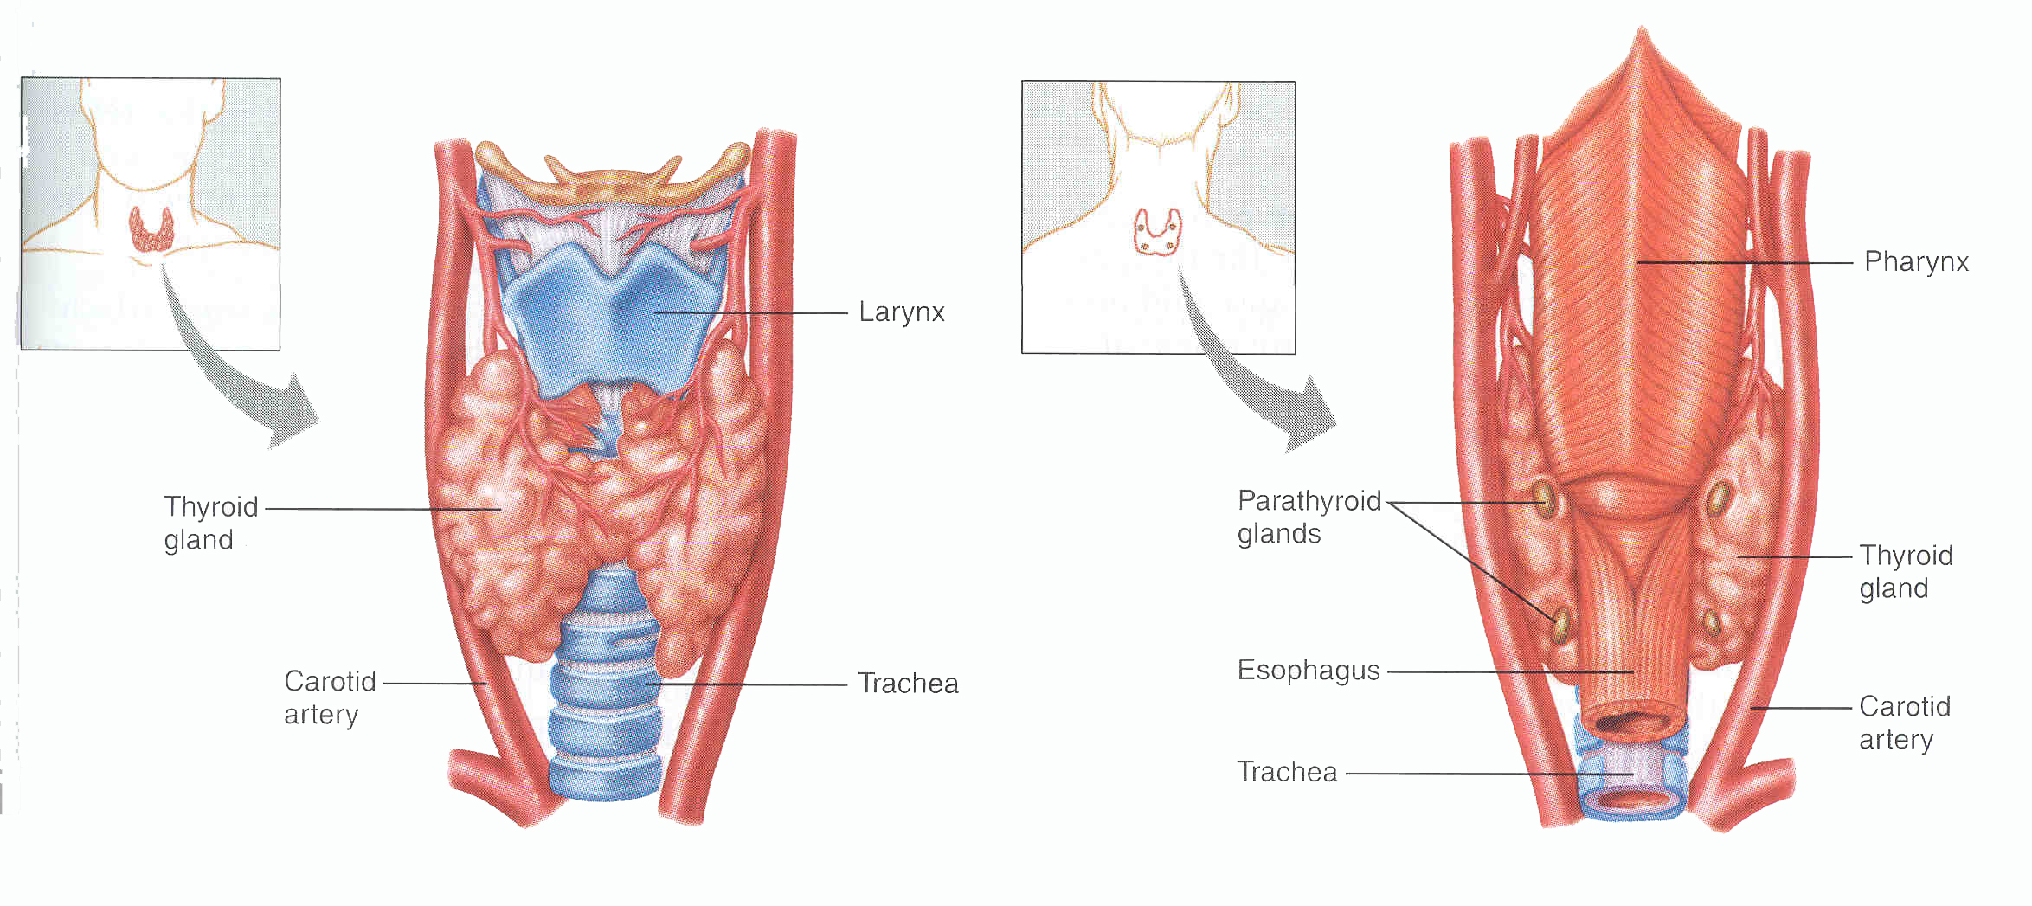
Parathyroid glands
1. Usually four – two on each side
2. Lie on the posterior surface of thyroid
3. May be embedded within thyroid gland
4. Regulate calcium/phosphate levels
5. Required for life

Slide 3
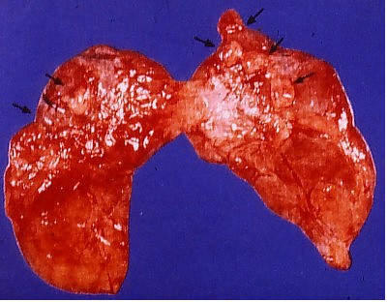
Parathyroid Glands (Post. view of thyroid)
Parathyroid Glands are located on the posterior aspect of the thyroid; sometimes the tissue is embedded within thyroid tissue.

Slide 4
Histology
50/50 parenchymal cells, stromal fat
Chief cells – secrete PTH
Waterclear cells
Oxyphil cells

