Slide 1
AL-Mustansiriyah University College of science Biology Dept. Zoology 4th class
ENDOCRINOLOGY LAB.
(3)
NAME :

Slide 2
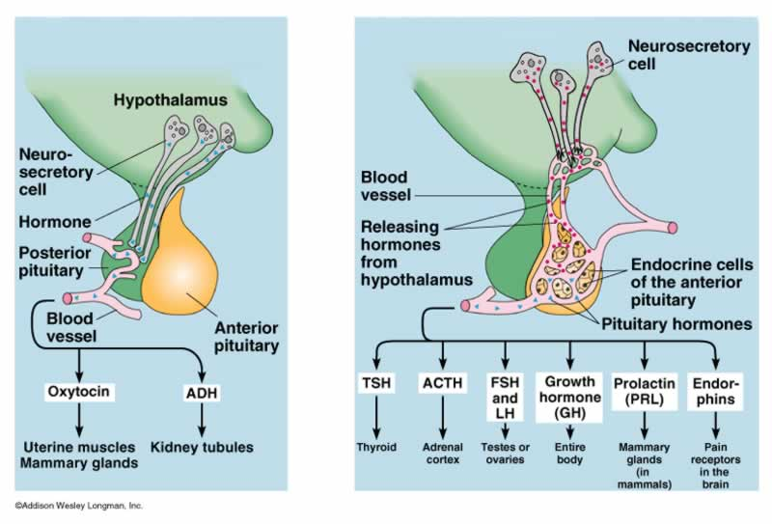
Antidiuretic Hormone

Slide 3
Physiology of the Posterior Pituitary
The posterior pituitary gland secretes two hormones which are:
oxytocin ,
increase uterine contractions during parturition
Contraction of mammary glands to secret milk
and vasopressin or arginine vasopressin (AVP) (or Antidiuretic Hormone ‘ADH’)
contract vascular smooth muscle and thus raise blood pressure
promote reabsorption of water by renal tubules
Oxytocin and AVP are stored in and secreted by the posterior pituitary gland, but are synthesized by the hypothalamus

Slide 5
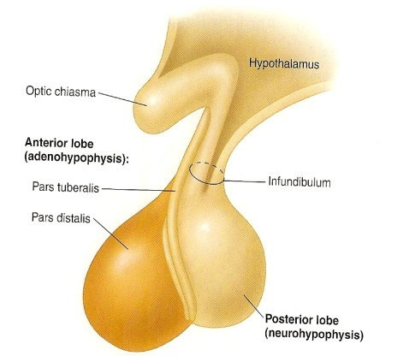
2. oxytocin
Contraction of smooth muscles of the uterus →
enhance labor.
Contraction of mammary gland myoepithelial cells of the alveoli & the ducts → Ejection of milk as a reflex in lactating women.
3. In men → ↑ ejaculation.
Remember: Oxytocin is concerned with releasing or ejection of milk, while prolactin is concerned with synthesis & production of milk.

Slide 6
Hypopituitarism
Hypopituitarism is manifested by diminished or absent secretion of one or more pituitary hormones
Hypopituitarism is either:
a primary event
caused by destruction of the anterior pituitary gland
or a secondary phenomenon
resulting from deficiency of hypothalamic stimulatory factors normally acting on the pituitary

Slide 7
Gonadotropins Disorders
Hyposecretion
leads to amenorrhoea,
sterility
and loss of sexual potency.
In the young, the sex organs and secondary sexual characteristics fail to develop (delayed puberty)
Hypersecretion
extremely rare,
in children it could lead to sexual precocity (excessive premature development)

Slide 8
Thyrotropin Disorders
Hyposecretion
produces a clinical picture similar to primary thyroid deficiency
Hypersecretion
gives the symptoms of hyperthyroidism similar to Graves’ disease (also known as toxic diffuse goiter), is an autoimmune disease that affects the thyroid.

Slide 9
Corticotropin Disorders
Hyposecretion
rare
causes failure of cortisol secretion,
a general lack of health and well being,
a reduced response to stress and skin depigmentation
Hypersecretion
due to a pituitary microadenoma,
will result in Cushing’s syndrome

Slide 10
Prolactin Disorders
Hyposecretion
leads to failure of lactation in women
Hypersecretion
may result from a pituitary tumour
principal symptoms are infertility and menstrual complaints
in men, decreased libido,
inadequate sperm production and impotence, whereas in women, there may be a complete lack of menstruation
inappropriate (non-pregnant) milk production
Notes:
Dopamine, some drugs

Slide 11
GHRH Disorders
Hyposecretion
caused by hypothalamic or pituitary dysfunction
In childhood this leads to impairment of growth (dwarfism)
Hypersecretion
This usually results from a benign pituitary tumour
In young patients, this leads to gigantism
In adults, leads to acromegaly

Slide 12
Vasopressin Disorders
Hyposecretion
caused by damage or dysfunction of the hypothalamus,
can lead to diabetes insipidus,
excessively large amounts of dilute urine (10–15 liters/day) are produced by the kidneys
Hypersecretion
rare condition of inappropriate AVP production is known as syndrome of inappropriate ADH (SIADH)

