Slide 1
AL-Mustansiriyah University
College of science
Biology Dept.
Zoology
4th class
ENDOCRINOLOGY LAB.
(1)
NAME :

Slide 2

How have you changed over the past year?
What has caused those changes?
How do you think you will change in the next few years?
Notes:
1. Encourage the students to think about many aspects of how they have changed, from appearance, to how much knowledge they have, to maturity.
They may say hair color, hair style, type of clothes they wear, height, intelligence, personality, interests, maturity, friends….
Try to get students to think of social and biological reasons that they have changed. They may say fashions have changed so they changed their style. They may say that their body is causing them to mature and grow.
Answers will vary-most will hope to grow taller, mature more, get “smarter.”

Slide 3
Endocrine system
is the collection of glands that produce hormones that regulate metabolism, growth and development, tissue function, sexual function, reproduction, sleep, and mood, among other things.
Endocrine Glands
are glands of the endocrine system that secrete their products, hormones, directly into the blood rather than through a duct. like the pituitary gland, pancreas, ovaries, testes, thyroid gland, parathyroid gland, hypothalamus and adrenal glands.

Slide 4

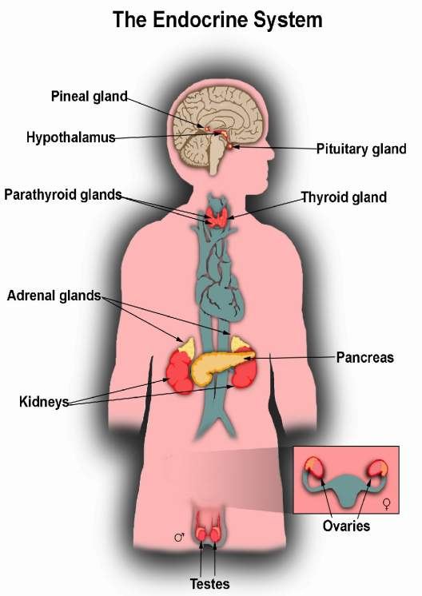
The Endocrine Glands are the organs of the Endocrine System.
They produce and secrete (release) Hormones.
They are located all over your body.
Notes:
Picture from:
http://www.childrensdayton.org/images/endo_system2.jpg

Slide 5

The Endocrine System regulates, coordinates and controls:
  Growth and development.
  Male and female development.
  How your body uses energy.
  Levels of salts and sugars in your blood.
  The amount (volume) of fluid in your body.
  Appetite.
  Many other body functions.

Slide 6

Gland | What it Regulates( in general)
Pituitary | “Master Gland” that regulates all other Endocrine Glands, also releases growth hormone
Thyroid | Metabolism, body heat, bone growth
Parathyroids | Use of Calcium and Phosphorous
Hypothalamus | Links nervous system to endocrine system
Adrenal | Response in emergency or stressful situations, metabolism, blood pressure, salt balance
Pancreas | Blood sugar
Ovaries | Production of eggs; female characteristics
Testes | Production of sperm; male characteristics
Thymus | Parts of the immune system
Notes:
Point out that there are more endocrine glands, this is just a sample of some.

Slide 7
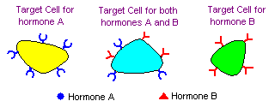
Q. How do you think the endocrine glands get their jobs done ???
Hormone :is any member of a class of signaling molecules produced by glands in multicellular organisms that are transported by the circulatory system to target distant organs to regulate physiology and behavior.
Target Cells
Hormones only work on certain cells, called target cells.
The target cells have special receptors that “recognize” the hormones and allow them to influence that cell.
These receptors recognize the hormones.
They “fit” like a lock and key.

Slide 8



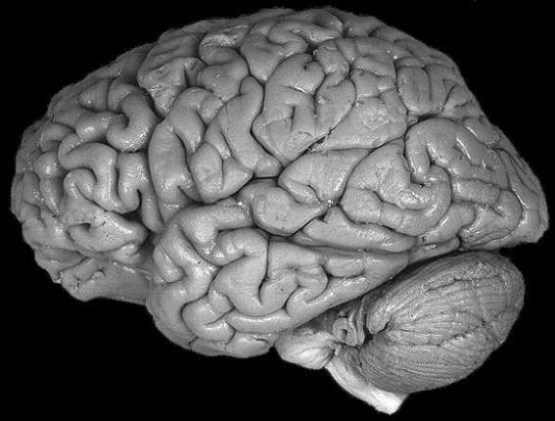

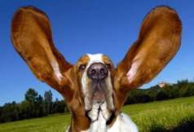
External stimuli
Internal stimuli
by way of nerves from the sensory organs in the nervous system ( outside of the body)
by way of nerves and other hormones from inside the body
Notes:
Nerves and various hormones act on the brain to affect the what the brain does. Such action can affect both behavior and certain control functions of the brain on the body (including feedback control on the level of hormones). External stimuli through the sense organs can also act on the brain to affect what it does.
Picture from: http://lh3.ggpht.com/lisa.onizuka/RuK2pQkjzXI/AAAAAAAAG7I/nLrq-VHgYnE/f86ed9857df50f43c9d6b75ab96ace11_full.jpg

Slide 9
 | Endocrine system | Nervous system
Signal type | Hormone | Action potential Neurotransmitter( electrical )
Speed of transmission | Slow ( about a minute) | Fast ( 120 m/s)
Target | General ( Got a receptor) | Specific
Effect of Action | Slow | Fast

Slide 10




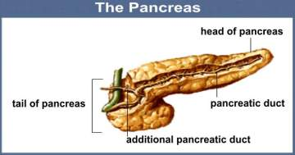



Negative feedback means that when enough hormone is in the body, the body stops producing the hormone until it is needed again.
You eat. Glucose (sugar)
in the blood increases.
Increased glucose is detected by receptors
that notify the brain. It sends a message
to the pancreas to produce insulin.
Pancreas stops making insulin.
Insulin tells muscle and liver to take up
glucose from the bloodstream and use it for energy
or store it for later. Brain reduces appetite.
Blood glucose level drops as
it is removed by the cells.
Notes:
Have students locate the places where there are stimuli and responses. Note that these stimuli are internal (within the body).
Point out the places where the pancreas produces insulin when blood sugar is high, but then stops producing insulin when the blood sugar drops.
This ties into the activities of building the dog watering device and the cup demonstration activity.
Description:
A good example of negative feedback is the hormone insulin. Insulin is a hormone that is made by the pancreas. Insulin is released by the pancreas when you eat glucose (a kind of sugar). The glucose goes from your stomach to the blood. The amount of glucose in the blood goes up. The pancreas sees this high glucose level. It makes insulin and releases it into the blood. Then the insulin goes through the whole body and tells cells to take glucose out of the blood. Cells use some of this for energy. But some extra is also saved in the cells to use later. When cells take up glucose from the blood this makes the glucose level go down. The pancreas sees this and stops making insulin. When the pancreas stops sending this message (insulin), the cells in the body stop taking extra glucose out of the blood.
So the negative feedback works to keep the blood glucose level normal. If glucose is high, the pancreas makes insulin. The insulin causes the glucose to fall. Then this lower level of glucose tells the pancreas to stop making insulin.

Slide 11

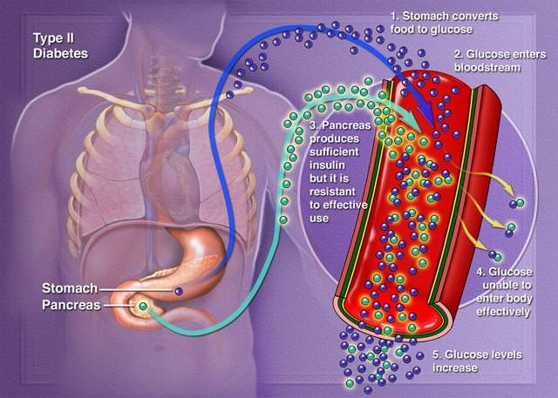
Diabetes
In the case shown in this picture, the body produces insulin but the target cells become resistant and unresponsive to it. Diabetes can also be caused by the body not producing enough insulin. The glucose does not enter the muscle and liver cells like it should and it builds up in the blood causing complications.
Notes:
Picture from: http://savvyhealthfitness.com/wp-content/uploads/2009/01/diabetes_type2.jpg
In diabetes, either the body does not produce enough insulin or the cells ignore the insulin. Insulin is necessary for the body to be able to use glucose for energy. When you eat food, the body breaks down all of the sugars and starches into glucose, which is the basic fuel for the cells in the body. Insulin takes the sugar from the blood into the cells. When glucose builds up in the blood instead of going into cells, it can lead to diabetes complications.

Slide 12
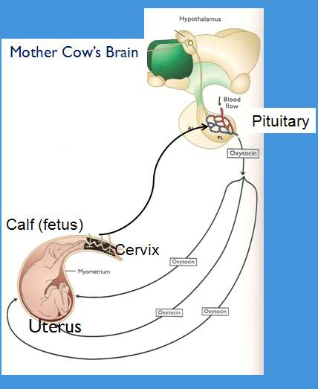
A few hormone systems are positive feedback systems:
The pituitary gland sends a signal by way of the hormone oxytocin to the uterus causing contractions. The pressure of the fetus on the cervix sends a signal back to the brain which then stimulates the release of more oxytocin. This causes more contractions. The fetus pushes harder on the cervix. More oxytocin is released. The system continues until birth occurs.
Notes:
Vocabulary:
Fetus- The unborn baby calf
Uterus-the reproductive organ that holds the developing fetus
Cervix- the lower part of the uterus that is tightly closed until birth, upon which it opens to allow the baby to pass through to be born
Again, have students identify the stimuli and responses.
Description of picture:
An example of positive feedback is the hormone that causes childbirth (when babies are born.) The hormone that causes this is oxytocin. When the baby is ready to be born, it stretches the muscle in the cervix (the bottom of the womb.) Nerves in the cervix send a message to the pituitary. This message makes the pituitary release more oxytocin. The oxytocin then causes the muscles of the womb to contract, or squeeze. This causes more stretching in the cervix. This stretching then tells the pituitary to make even more oxytocin. So levels of oxytocin keep rising until the squeezing or contractions of the womb force the baby out. (The womb is also called the uterus.)

