Slide 1
Object-Oriented Programming
Lecture 2
Objects and Object Model

Slide 2
The Object Model
Object-oriented technology is built upon a sound engineering foundation, whose elements we collectively call the object model. object model principles:
Abstraction
Encapsulation
Modularity
Hierarchy
Typing
Concurrency
Persistence

Slide 3
The Objects

Slide 4
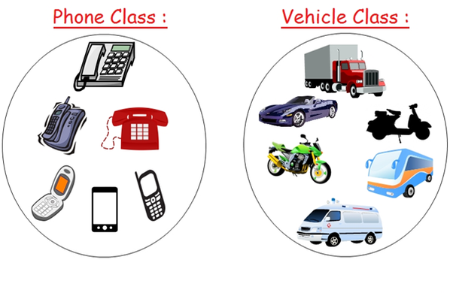
The Goal
We will show clearly what object-oriented development is and what it is not
How it differs from other methods through its use of the seven elements of the object model.

Slide 5
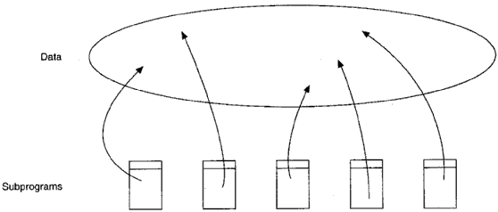
The Evolution of the Object Model
Trends in Software Engineering
The Generations of Programming Languages based on:
The shift in focus from programming-in-the-small to programming-in-the-large
The evolution of high-order programming languages
First-Generation Languages (1954-1958)
FORTRANI Mathematical expressions
ALGOL 58 Mathematical expressions
Flowmatic Mathematical expressions
IPL V Mathematical expressions

Slide 6
Second-Generation Languages (1959~1961)
FORTRANII Subroutines, separate compilation
ALGOL 60 Block structure, data types
COBOL Data description, file handling
Lisp List processing, pointers, garbage collection

Slide 7
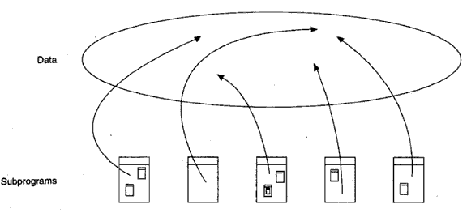
Late 2nd and 3rd GL
Third-Generation Languages (1962-1970)
PL/1 FORTRAN + ALGOL + COBOL
ALGOL 68 Rigorous successor to ALGOL 60
Pascal Simple successor to ALGOL 60
Simula Classes, data abstraction

Slide 8
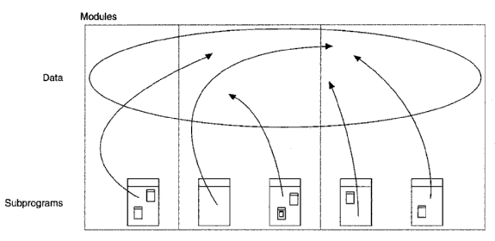
Late 3rd Generation Language
Ex., Fortran II
Start modules programming

Slide 9
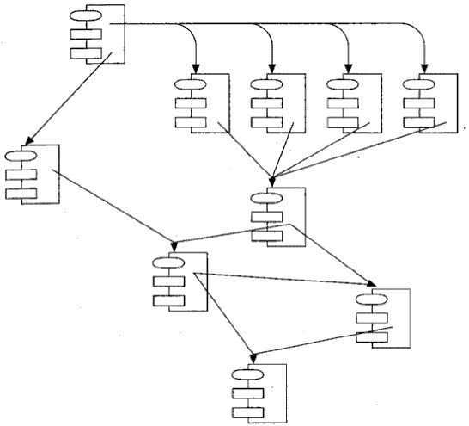
The Generation Gap (1970-1980)
Many different languages were invented, but few endured.
The Topology of Object-Based and Object-Oriented P. L.
data abstraction to mastering complexity is clearly stated

Slide 10
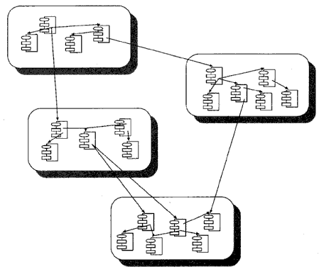
Object-Based or Object-Oriented Lang.
Formulated by classes (blocks) and objects (inside blocks)

Slide 11
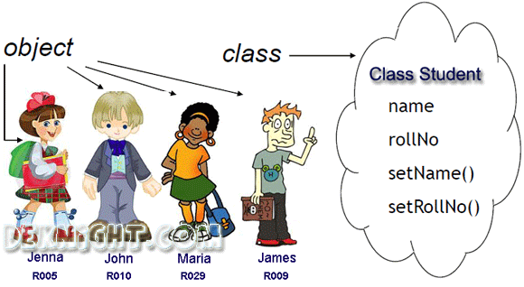
Foundations of the Object Model
Structured design methods evolved to guide developers who were trying to build complex systems using algorithms as their fundamental building blocks. (Early languages)
Similarly, object-oriented design methods have evolved to help developers exploit the expressive power of object-based and object-oriented programming languages, using the class and object as basic building blocks. (OO languages)
Obj. Oriented Analysis
Obj. Oriented Design
Obj. Oriented Program.

Slide 12
Object Oriented Trends
Object-Oriented Analysis
Object-oriented analysis is a method of analysis that examines requirements from the perspective of the classes and objects found in the vocabulary of the problem domain.
Object-Oriented Design
Object-oriented design is a method of design encompassing the process of object-oriented decomposition and a notation for depicting both logical and physical as well as static and dynamic models of the system under design.
Object-Oriented Programming
Object-oriented programming is a method of implementation in which programs are organized as cooperative collections of objects, each of which represents an instance of some class, and whose classes are all members of a hierarchy of classes united via inheritance relationships.

