Slide 1
3rd and 4th lecture of molecular biology
(by Dr. Sawsan Sajid)
DNA & RNA as Macromolecules
Basic structure and roles

Slide 2
Type of Macromoleculesالجزيئات العملاقة
Nucleic acid :including DNA {Deoxribonucleic acid} & &RNA { Ribonucleic acid}.
Proteins
Polysaccharid
THE NUCLEIC ACIDS :
DNA is the most importent molecule in living cells and contains all the information that the cell need to live and to propagate itself .with RNA they maintain the cell through Gene expression. Nearly all of the DNA present in eukaryotic cells can be found in the cell nucleus but it is present in cytoplasm in bacteria.

Slide 3
Basic structure of DNA
A Nucleic Acid is a polymer consisting from nucleotides (the main structural units in nucleic acid) each nucleotide has the 3 following components:
Cyclic five carbon sugar called ribose (in RNA) and as it devoid hydroxyl group attached to carbon no. 2 DNA structure thus it called deoxyribose,
Nitrogen base the purine {adenine A and guanine G}and pyrimidine {cytosine C, thymine T and uracile U} .the first type consist from 2 rings while second type contain only one ring .
A phosphate group (phosphoric acid) attached to the 5 carbon atom of the sugar by a phosphoester linkage .this phosphate group is responsible for the strong negative charge of nucleic acid

Slide 4
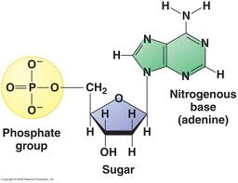
structure of DNA nucleotide

Slide 5
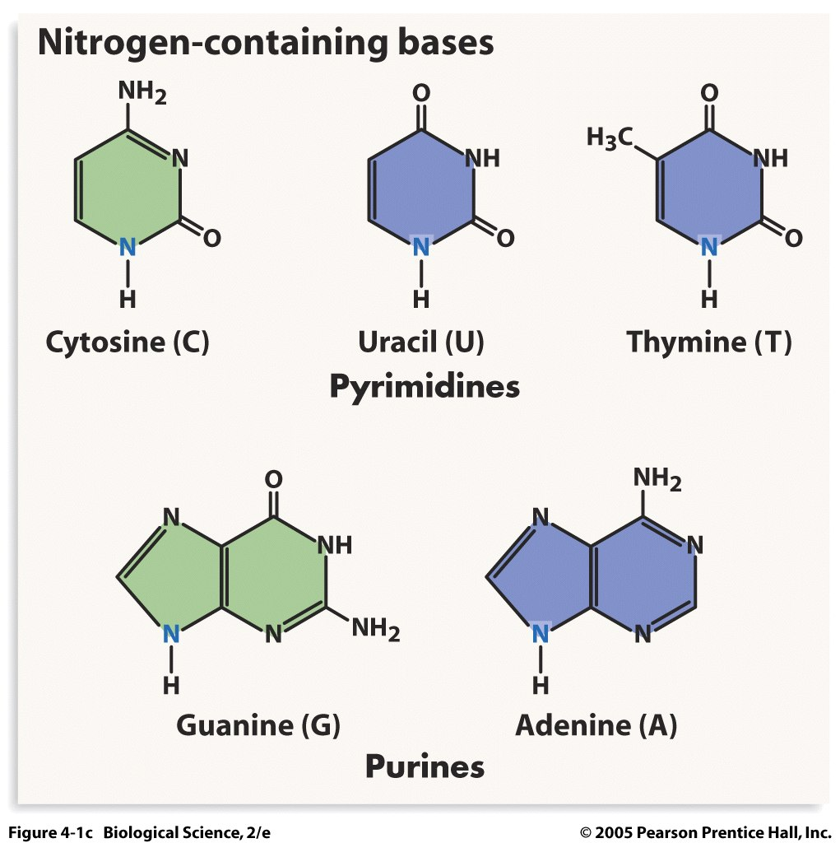
5 Nitrogen base :the blue nitrogen atom represent the place where the sugar attached to the nitrogen base

Slide 6
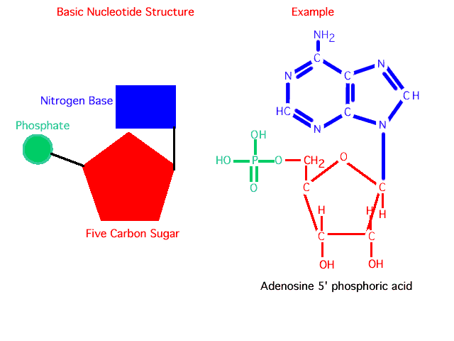
N base +sugar→ Nucleoside via N-glycosylic bond
N base +sugar+ phosphate group→Nucleotide

Slide 7
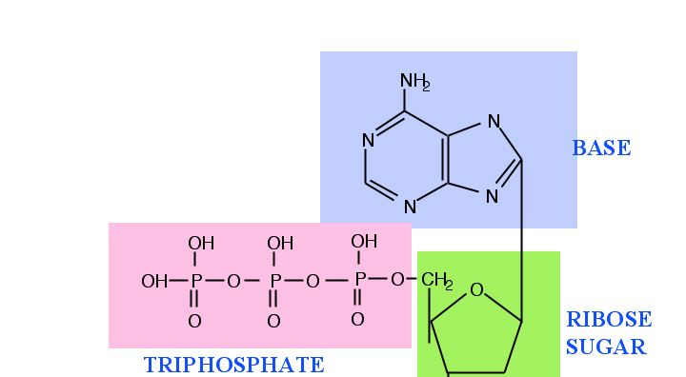
The bond between base and sugar is N- glycosylic bond the bond between sugar and phosphate is estar bond the bond between 2 bases is hydrogen bond

Slide 8
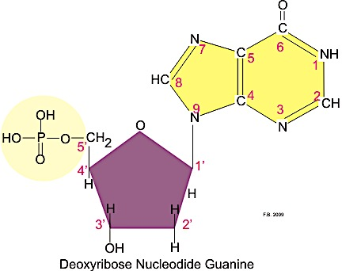
Carbon no:1 in Sugar attached to nitrogen NO. 9 in case of purine

Slide 9
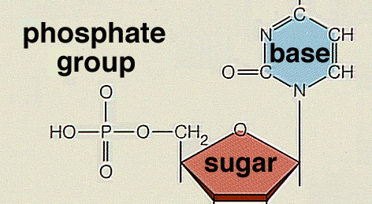
Carbone no:1 in Sugar attached with nitrogen N0.1 in case of pyramidine

Slide 10
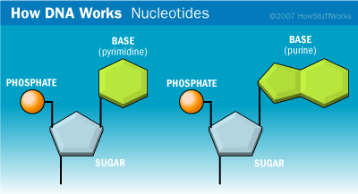
Nucleotides the basic unit in nucleic acid

Slide 11
According to nitrogen base type the nucleotide is named
N.B Nucleoside Nucleotide
1-Adenine Deoxyadenosine Deoxyadenylic acid (d AMP)
2-Cytosine Deoxycytidine Deoxycytidylic (d CMP)
3-Guanine Deoxyguanosine Deoxyguanylic (d GMP)
4-Tymine Deoxythymidine Deoxythymidylic (d TMP)
5- Uracil Uridine Uridylic acid
For the phosphate group:
Usually the nucleotide come with 3 phosphate group (α β γ) when it bind to DNA strand it will lose two groups (pyrophosphate) leafing only one group α attached to the helix . The attachment only from one side (the 3́ OH free end)

Slide 12
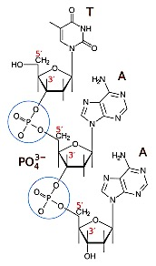
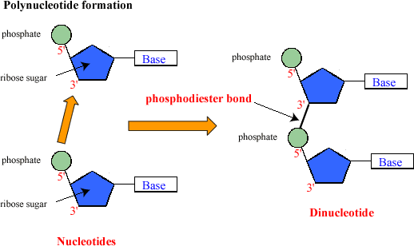
The attachment always occur from 3́ end ,the bond between 2 adjacent nucleotide is called 3́ 5́ phosphodiester bond

Slide 13
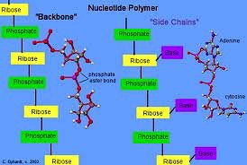

Slide 14
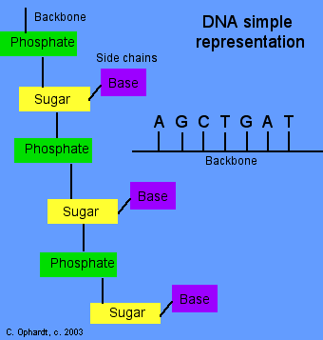
The primary structure of DNA represent one single strand ,not branched, result from binding polymer of nucleotides between the 3́ OH free end of the upper sugar with the 5́ P end
(Pe phosphate) of the following nucleotide

Slide 15
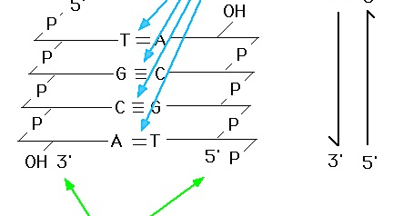
The secondary structure of DNA represent by binding two single strand via hydrogen bond A=T and G≡C .the two strand are anti parallel to each (opposite direction )that is to say 3́ end face the 5́ end twisted together .

Slide 16
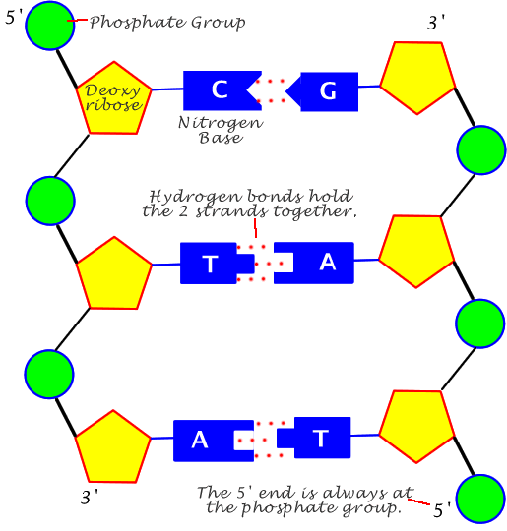
Formation of double helix

Slide 17
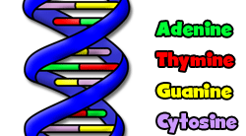
Nitrogen base in DNA : A T G C without U (Uracile only in RNA) .the back bone is the sugar- phosphate

Slide 18
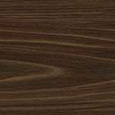
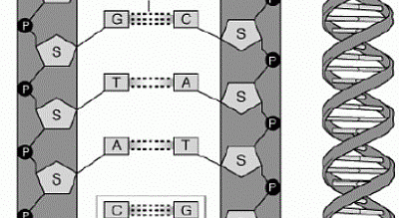
Usually DNA is stored inside the cell as super helix rather than linear to reduce the it size thus DNA is longer than the cell itself

Slide 19
Other type of DNA rather than chromosomal DNA
Plasmid DNA :It is a double stranded super helix DNA (extra chromosomal genetic material) usually found in bacterial cytoplasm .plasmid are not confined to bacteria but they have been isolated from yeast, protozoa and plants
Mitochondrial DNA (mtDNA or mDNA) is the DNA located in organelles called mitochondria, structures within eukaryotic cells that convert chemical energy from food into a form that cells can use, adenosine triphosphate (ATP).In humans, mitochondrial DNA can be assessed as the smallest chromosome coding for only 37 genes and containing only about 16,600 base pairs. Human mitochondrial DNA was the first significant part of the human genome to be sequenced.
Chloroplast DNA: present inside chloroplast responsible for its activity

Slide 20
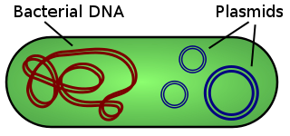

Slide 21
DNA in E. coli bacteria is made up of 4 million base pairs and the whole genome is thus one millimeter long. The single-cell bacterium can copy its genome and divide into two cells once every 20 minutes.
The DNA of humans, on the other hand, is composed of approximately 3 billion base pairs, making up a total of almost a meter-long stretch of DNA in every cell in our bodies.
In order to fit, the DNA must be packaged in a very compact form. In E. coli the single circular DNA molecule is curled up in a condensed fashion, whereas the human DNA is packaged in 23 distinct chromosome pairs. Here the genetic material is tightly rolled up on structures called histones.

Slide 22
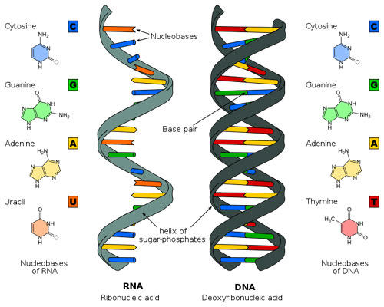
The main difference between DNA and RNA is that the former is double strand while the latter is single strand and Thymine T is replaced by Uracile U

Slide 23
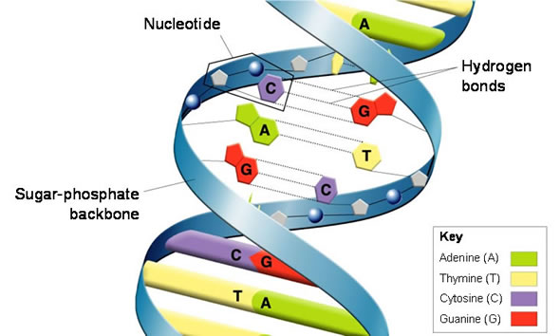
The Double helix model as proposed by Watson &Crick 1953

Slide 24
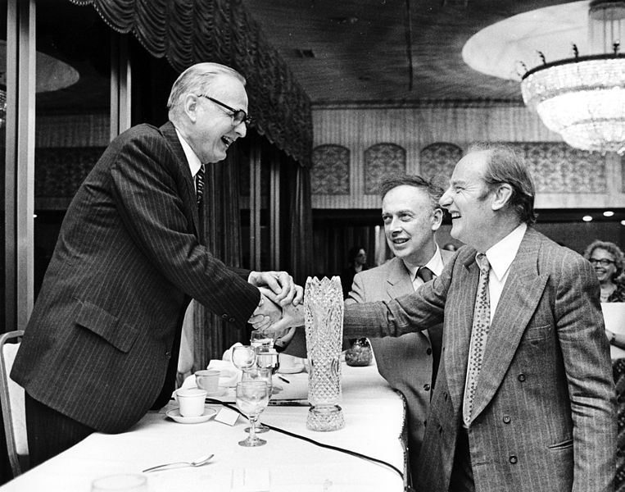
Maclyn McCarty with
Francis Crick and James Watson

Slide 25
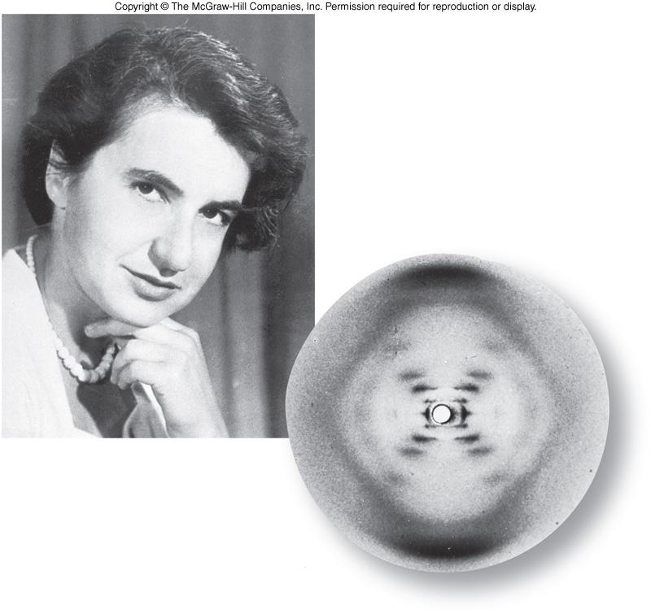
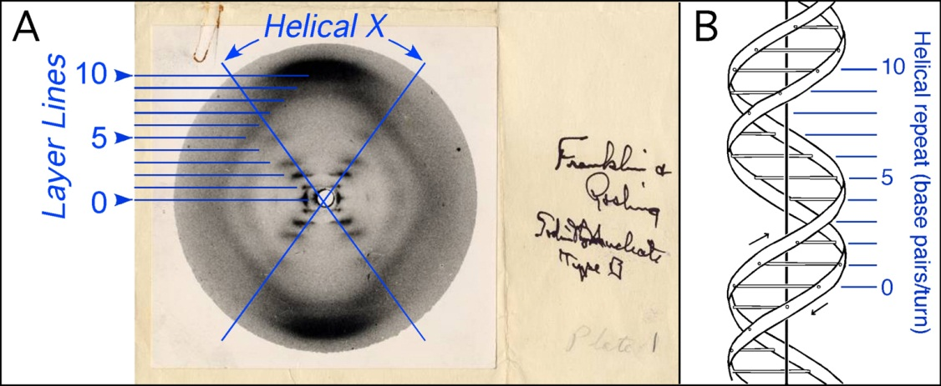
Watson and Crick used stick-and-ball models to test their ideas on the possible structure of DNA. They depend on structure conformation shape proposed Rosalind Franklin and Maurice Wilkins, who were using X-ray diffraction to understand the physical structure of the DNA molecule.

Slide 26
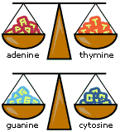
Basic role in DNA double helix B form :
1-purines equal to pyrimidine bases within the anti parallel strand l
2-The DNA double helix is stabilized primarily by two forces: hydrogen bonds between nucleotides and base-stacking interactions among aromatic nucleobases
3-It contain 2 groove, the major groove, is 22 Å wide and the other, the minor groove, is 12 Å wide.
4-the backbone directed outside the helix while N.B oriented inside

Slide 27
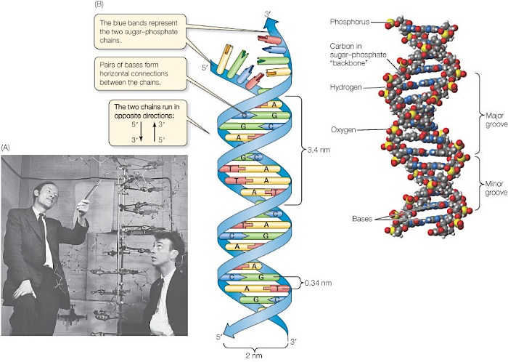

Slide 28
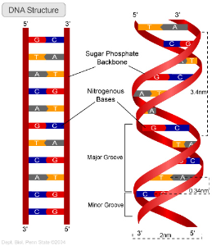
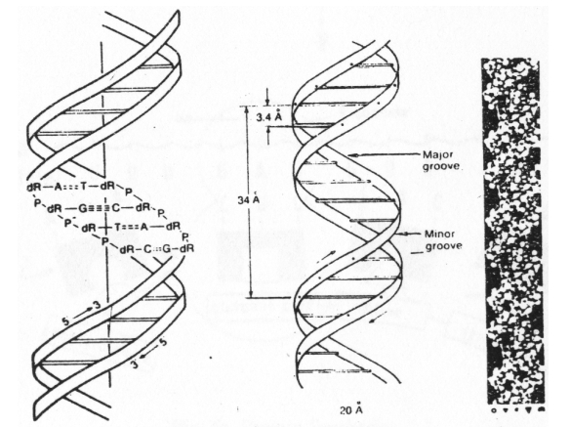

Slide 29
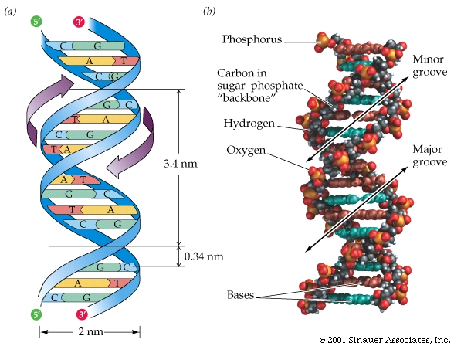

Slide 30
Compared to B-DNA, the A-DNA form is a wider right-handed spiral, with a shallow, wide minor groove and a narrower, deeper major groove. The A form occurs under non-physiological conditions in partially dehydrated samples of DNA, while in the cell it may be produced in hybrid pairings of DNA and RNA strands, as well as in enzyme-DNA complexes.
Segments of DNA where the bases have been chemically modified by methylation may undergo a larger change in conformation and adopt the Z form. Here, the strands turn about the helical axis in a left-handed spiral, the opposite of the more common B form. These unusual structures can be recognized by specific Z-DNA binding proteins and may be involved in the regulation of transcription.

Slide 31
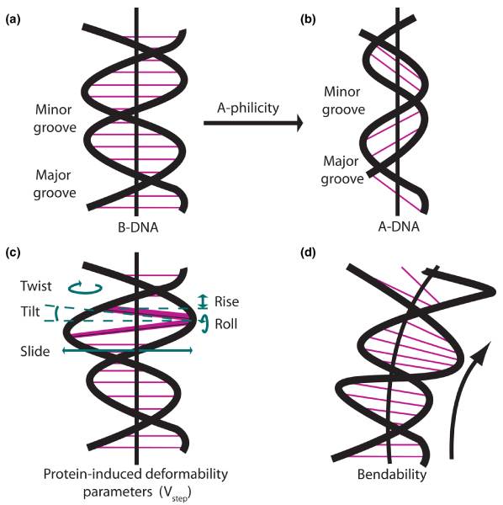
DNA conformation (A .B.Z SHAPE)

Slide 32
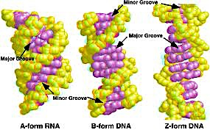

Slide 33
Compares between 3 conformation DNA shape depending on Xray
Geometry attribute | A-form | B-form | Z-form
Rotation/bpدرجة دوران الحلزون | 33° | 36° | 60°/2
Base pair /turn عدد ازواج القاعدة بكل لفة | 11 | 10. | 12
Rise/bp along axis ارتفاع كل زوج قاعة | 2.6 Å (0.26nm) | 3.4 Å (0.34 nm) | 4.56 Å (0.45 nm)
Pitch/turn of helixارتفاع لفة كاملة | 28.2 Å (2.82 nm) | 34 Å (3.4nm) | 45.6 Å (4.56 nm)
Diameterقطر الحلزون | 23 Å (2.3 nm) | 20 Å (2.0 nm) | 18 Å (1.8 n

Slide 34
DNA display different shapes:
During DNA preparation in lab and in electrophoreses processes this molecule may appear either
1- linear (L form )start with 5́ end to 3́ end .it could be turn to circular form by binding the two ends by ligase enzyme and losing H2O molecule .Also there is linear double stranded can convert to double closed circular relaxed form unwinding double helix
2- Open circular(OC) :when a nick occur in one of the double circular strands. it could be turn to closed circular
3- super coiled (also called CCC triple C) : The covalently (completely ) closed circular DNA usually exist in side the cell .run faster in gel electrophoreses ,

Slide 35
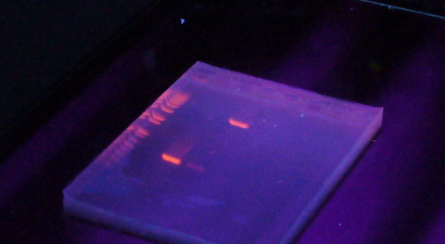
figure for electrophoresis's gel . The shiny bands is the DNA stained with ethidium bromid which is a chelating dye

Slide 36
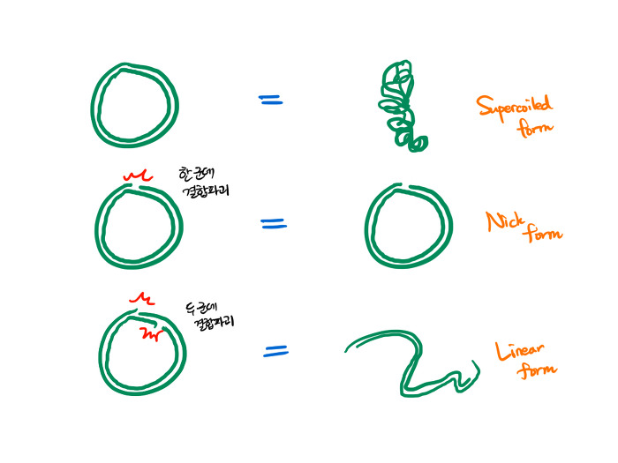

Slide 37
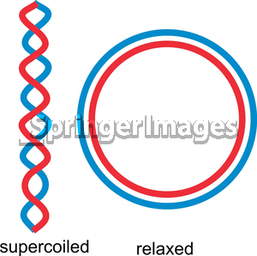
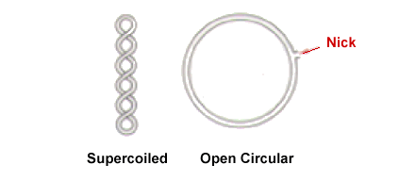
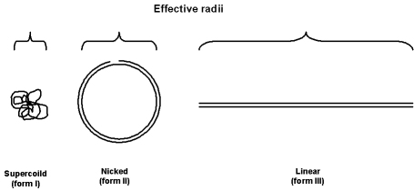

Slide 38
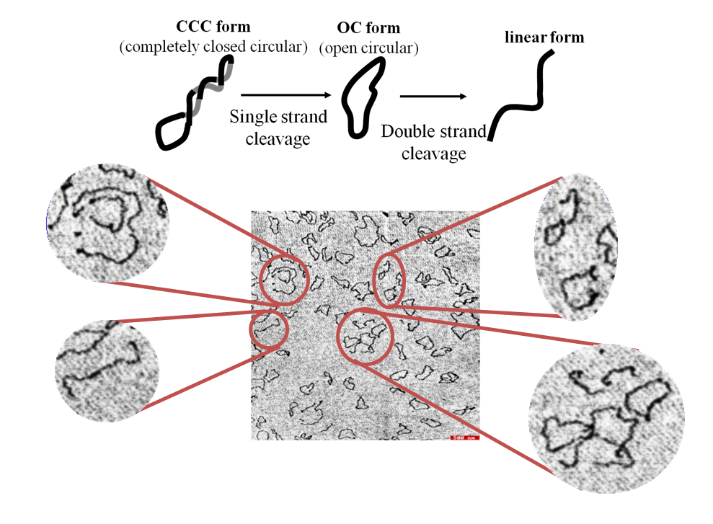
Cleavage occur through endonuclease (enzymes break DNA) attack

Slide 39
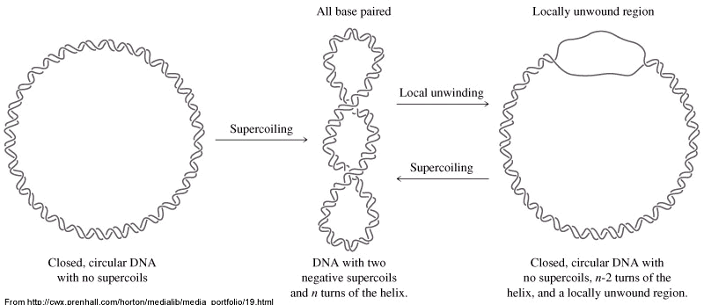

Slide 40
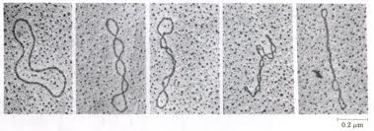
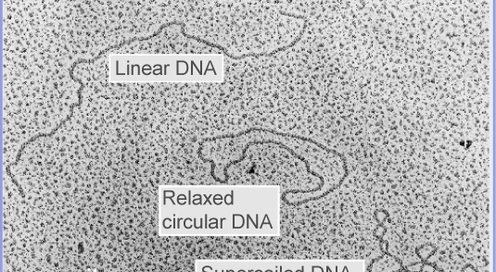
Electron microscope image for different DNA shape

Slide 41
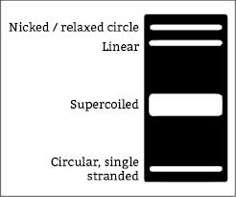
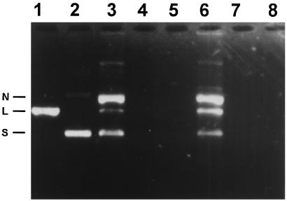
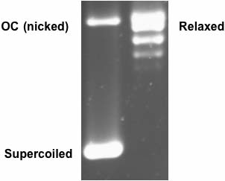
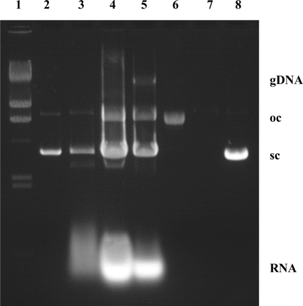

Slide 42
