Slide 1
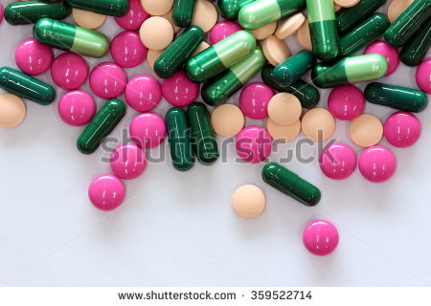
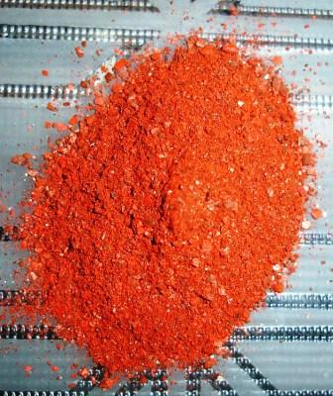
Chloramphenicol as protein synthesis inhibitor
Rifampicin as RNA polymerase inhibitor
by Dr. Saswan Sajid
Dr.Ibtesam G.Auda

Slide 2
Rifampicin, also known as rifampin is made from Amycolatopsis rifamycinica is an antibiotic used to treat a several types of bacterial infections. This includes tuberculosis, leprosy, and Legionnaire's disease. It is almost always used along with other antibiotics, except when given to prevent Haemophilus influenzae typ b and meningococcal disease in those who have been exposed to those bacteria
Mechanism of action
Rifampicin inhibiting bacterial DNA-dependent RNA polymerase. rifampicin binds to RNA polymerase at a site adjacent to the RNA polymerase active center and prevents RNA synthesis by physically blocking the formation of the phospho diester bond in the RNA backbone, preventing extension of RNA more than 2 to 3 nucleotides
Mechanism of resistance
Resistance to rifampicin arises from mutations that alter residues of the rifampicin binding site on RNA polymerase, resulting in decreased affinity for rifampicin. Resistance mutations map to the rpoB gene, encoding the beta subunit of RNA polymerase
Resistance in tuberculosis
Mycobacterial resistance to rifampicin may occur alone or along with resistance to other first line anti-tubercular drugs. Early detection of such multi-drug or extensively drug-resistant tuberculosis is critical in improving patient outcomes by instituting appropriate second-line treatments, and in decreasing transmission of drug-resistant TB. Rifampicin can be used as mono therapy for a few days as prophylaxis against meningitis, but resistance develops quickly during long-term treatment of active infections, so the drug is always used against active infections in combination with other antibiotics.

Slide 3
Spectrum of activity :Rifampicin is used for the treatment of tuberculosis in combination with other antibiotics, such as pyrazinamide, isoniazid, and ethambutol مهم . For the treatment of tuberculosis, it is administered daily for at least 6 months. Combination therapy is utilized both to prevent the development of resistance and to shorten the length of treatment. Resistance of Mycobacterium tuberculosis to rifampicin develops quickly when it is used without another antibiotic Rifampicin can be used alone in patients with latent tuberculosis infections to prevent the development of active disease because only small numbers of bacteria are present.
Rifampicin is also used to treat non-tuberculous mycobacterial infections including leprosy (Hansen's disease) and Mycobacterium kansasii
Rifampicin is sometimes used in the treatment of methicillin-resistant Staphylococcus aureus (MRSA) in combination with fusidic acid, including in difficult-to-treat infections such as osteomyelitis and prosthetic joint infections.

Slide 4
Adverse effects
The most serious adverse effect is hepatotoxicity.The more common side effects include fever, gastrointestinal disturbances, rashes, and immunological reactions. Taking rifampicin usually causes certain bodily fluids, such as urine, sweat, and tears, to become orange-red in color . Other adverse effects include:
Liver toxicity — hepatitis, liver failure in severe cases
Respiratory — breathlessness
Cutaneous — flushing, pruritus, rash, hyperpigmentation, redness and watering of eyes
Abdominal — nausea, vomiting, abdominal cramps, diarrhea
Flu-like symptoms — chills, fever, headache, arthralgia, and malaise. Rifampicin has good penetration into the brain, and this may directly explain some malaise and dysphoria in a minority of users.
Allergic reaction — rashes, itching, swelling of the tongue or throat, severe dizziness, and trouble breathing

Slide 5
Chloramphenicol is a bacteriostatic by inhibiting protein synthesis. It prevents protein chain elongation by inhibiting the peptidyl transferase activity of the bacterial ribosome. It specifically binds to A2451 and A2452 residues in the 23S rRNA of the 50S ribosomal subunit, preventing peptide bond formation
it is an antibiotic useful for the treatment of a number of bacterial infections.This includes as an eye ointment to treat conjunctivitis.it is used to treat meningitis, plague, cholera, and typhoid fever.
Chloramphenicol was discovered after being isolated from Streptomyces venezuelae in 1947. Its chemical structure was identified and it was first artificially made in 1949, making it the first antibiotic to be made instead of extracted from a micro-organism.
Spectrum
Chloramphenicol has a broad spectrum of activity and has been effective in treating ocular infections caused by a number of bacteria including Staphylococcus aureus, Streptococcus pneumoniae, and Escherichia coli. It is not effective against Pseudomonas aeruginosa.

Slide 6
Resistance
Chloramphenicol resistance may be carried on a plasmid that also codes for resistance to other drugs . One example is the ACCoT plasmid (A=ampicillin, C=chloramphenicol, Co=co-trimoxazole, T=tetracycline), which mediates multiple drug resistance in typhoid (also called R factors).. Three mechanisms of resistance to chloramphenicol are known:
1- reduced membrane permeability, and this is the most common mechanism of low-level chloramphenicol resistance.
2- mutation of the 50S ribosomal subunit, ( are rare).
3- producing modifying enzyme the chloramphenicol acetyltransferase . High-level resistance is conferred by the cat-gene; this gene codes for an enzyme called chloramphenicol acetyltransferase, which inactivates chloramphenicol by covalently linking one or two acetyl groups, derived from acetyl-S-coenzyme A, to the hydroxyl groups on the chloramphenicol molecule. The acetylation prevents chloramphenicol from binding to the ribosome.

Slide 7
Adverse effects
A plastic anemia The most serious side effect of chloramphenicol treatment This effect is rare and sometimes fatal. The effect usually occurs weeks or months after treatment has been stopped, and a genetic predisposition may be involved.
Bone marrow suppression :Chloramphenicol may cause bone marrow suppression during treatment; this is a direct toxic effect of the drug on human mitochondria..It is fully reversible once the drug is stopped
Leukemia:cancer of the blood or bone marrow,characterized by an abnormal increase of immature white blood cells. The risk of childhood leukemia is increased with length of treatment.
Gray baby syndrome Intravenous chloramphenicol use has been associated with the so-called gray baby syndrome.This phenomenon occurs in newborn infants because they do not yet have fully functional liver enzymes (i.e. UDP-glucuronyl transferase), so chloramphenicol remains unmetabolized in the body. This causes several adverse effects, including hypotension and cyanosis. The condition can be prevented by using the drug at the recommended doses, and monitoring blood levels.
Hypersensitivity reactions :Fever, macular and vesicular rashes, a urticaria, and anaphylaxis may occur.
Neurotoxic reactions Headache, mild depression, mental confusion, Optic and peripheral neuritis have been reported, usually following long-term therapy.

