Slide 1
Inorganic Spectra
By Dr. Ahmed Hussein
Lecture: 5 &6
Electronic Spectra of
coordination compounds

Slide 2
Charge Transfer Transitions: There is another important class of transition in which the electron moves from a molecular orbital centered mainly on the ligand to one centered mainly on atom , or vice versa . In these the charge distribution is considerably different in ground and excited states, and so they are called Charge Transfer Transitions.
The absorption band, can be very intense; it is responsible for the vivid colors of some of the halogens in donor solvents.
The metal on charge transfer (CT) gives rise to intense absorptions, whereas ‘d–d’ bands are much weaker. In some spectra, CT absorptions mask bands due to ‘d–d’ transitions, although CT absorptions (as well as ligand-centred n – π* and π – π* bands) often occur at higher energies than ‘d–d’ absorptions.
There are two classes of these bands ; ligand to metal ( L M ) and metal to ligand ( M L ). In general , most of CT are of the first class. Charge transfer transitions usually lie at the extreme blue end of the visible spectrum, or in the ultraviolet region. Also, nearly all observed CT transitions are fully allowed, hence the CT bands are strong, and the extinction coefficient are typically 10³ to 10⁴ , or more . There are of course many forbidden CT transition that give rise to weak bands; these are seldom observed because they are covered up by the strong CT bands, which lie between 400nm corresponds to 25 000 cm^{_1}; 200nm corresponds to 50 000 cm^{_1} .

Slide 3
Such absorption bands involve the transfer of electrons from molecular orbitals that are primarily ligand in character to orbitals that are primarily metal in character (or vice versa). For example, consider an octahedral d ⁶ complex with σ-donor ligands. The ligand electron pairs are stabilized, as shown in Figure – 1 .
The possibility exists that electrons can be excited, not only from the t₂g level to the eg but also from the σ – orbitals originating from the ligands to the eg. The latter excitation results in a charge-transfer transition; it may be designated as charge transfer to metal (CTTM) or ligand to metal charge transfer (LMCT). This type of transition results in formal reduction of the metal. A CTTM excitation involving a cobalt (III) complex, for example.
Examples of charge-transfer absorptions are numerous. For example, the octahedral complexes [IrBr₆]⁻² (d ⁵) and [IrBr₆]⁻³ (d ⁶) both show charge-transfer bands. For [IrBr₆]⁻² , two bands appear, near 600 nm and near 270 nm; the former is attributed to transitions to the t₂g levels and the latter to the eg . In [IrBr₆]⁻³ the t₂g levels are filled, and the only possible CTTM absorption is therefore to the eg. Consequently, no low energy absorptions in the 600nm range are observed, but strong absorption is seen near 250 nm, corresponding to charge transfer to eg. A common example of tetrahedral geometry is the permanganate ion, MnO₄ ⁻ , which is intensely purple because of a strong absorption involving charge transfer from orbitals derived primarily from the filled oxygen p orbitals to empty orbitals derived primarily from the manganese(VII).

Slide 4
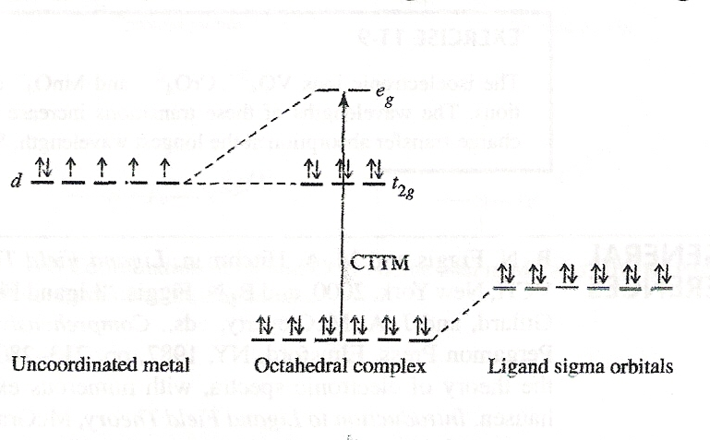
FIGURE – 1 Charge Transfer to Metal.

Slide 5
Similarly, it is possible for there to be charge transfer to ligand (CTTL), also known as metal to ligand charge transfer (MLCT), transitions in coordination compounds having π -acceptor ligands. In these cases, empty π* orbitals on the ligands become the acceptor orbitals on absorption of light. Figure – 2 illustrates this phenomenon for a d ⁵ complex.
CTTL results in oxidation of the metal; a CTTL excitation of an iron(III )complex would give an iron(IV) excited state. CTTL most commonly occurs with ligands having empty π* orbitals, such as CO, CN ⁻, SCN ⁻, bipyridine, and dithiocarbamate (S₂CNR₂⁻). In complexes such as [Cr(CO) ₆] which have both σ-donor and π –acceptor orbitals, both types of charge transfer are possible. It is not always easy to determine the type of charge transfer in a given coordination compound. Many ligands give highly colored complexes that have a series of overlapping absorption bands in the ultraviolet part of the spectrum as well as the visible. In such cases, the d-d transitions may be completely overwhelmed and essentially impossible to observe.
Finally, the ligand itself may have a chromophore and still another type of absorption band, an intraligand band, may be observed. These bands may sometimes be identified by comparing the spectra of complexes with the spectra of free ligands. However, coordination of a ligand to a metal may significantly alter the energies of the ligand orbitals, and such comparisons may be difficult, especially if charge-transfer bands overlap the intraligand bands.

Slide 6
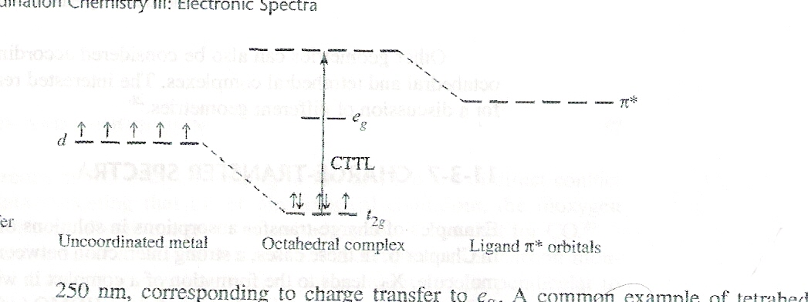
FIGURE – 2 Charge Transfer to Ligand.

Slide 7
Ligand to metal ( L M ): Most of metal complexes had this type of transition which can be expected to be divided to four types of transitions in octahedral configuration. Fig. 3, shows a partial MO diagram for such complexes, and each of transitions shown is a group of transitions, since the excited orbital configuration gives rise to several different of similar but not identical energies.
Transition of the ν1 type will obviously be of lowest energy. Second since the π and π* orbitals involved are both approximately non bonding , they will not vary steeply with M – L distance as the ligand vibrate. The bands for these transitions should be relatively narrow. A third factor that should assist in identifying the ν1 . Set of bands is that they will be missing whenever the π*(t_{2g} ) orbitals are filled (d ⁶ complexes). The energies for ν1 will be decrease in the sequence MCl₆, MBr₆ and MI₆ which is the order of decreasing the ionization potentials ( easier oxidizability ) of the halogen atoms. As the oxidation state of the metal increase (easier oxidizability ) like RuCl₆⁻³, RuCl₆⁻² ,its orbitals should be deeper , thus the transition should go to lower energy.
Transition of the ν2 type should give the lowest energy CT bands in t₂g⁶ complexes like those for PtX₆⁻² complexes. Since the transition is from a mainly the nonbonding level to a distinctly antibonding one, the bands should be fairly broad. The transition assigned to the ν2 sets all have half – widths of 2000 cm^{_1} to 4000 cm^{_1}. The shift of energy in these bands with change of halogen and change of metal oxidation state are again as expected for L M transitions.
Transition of the ν3 set are all expected to be broad and weak and are not observed. The ν4 transitions have been observed in a few cases, but in many cases they must lie beyond the range of observation.

Slide 8
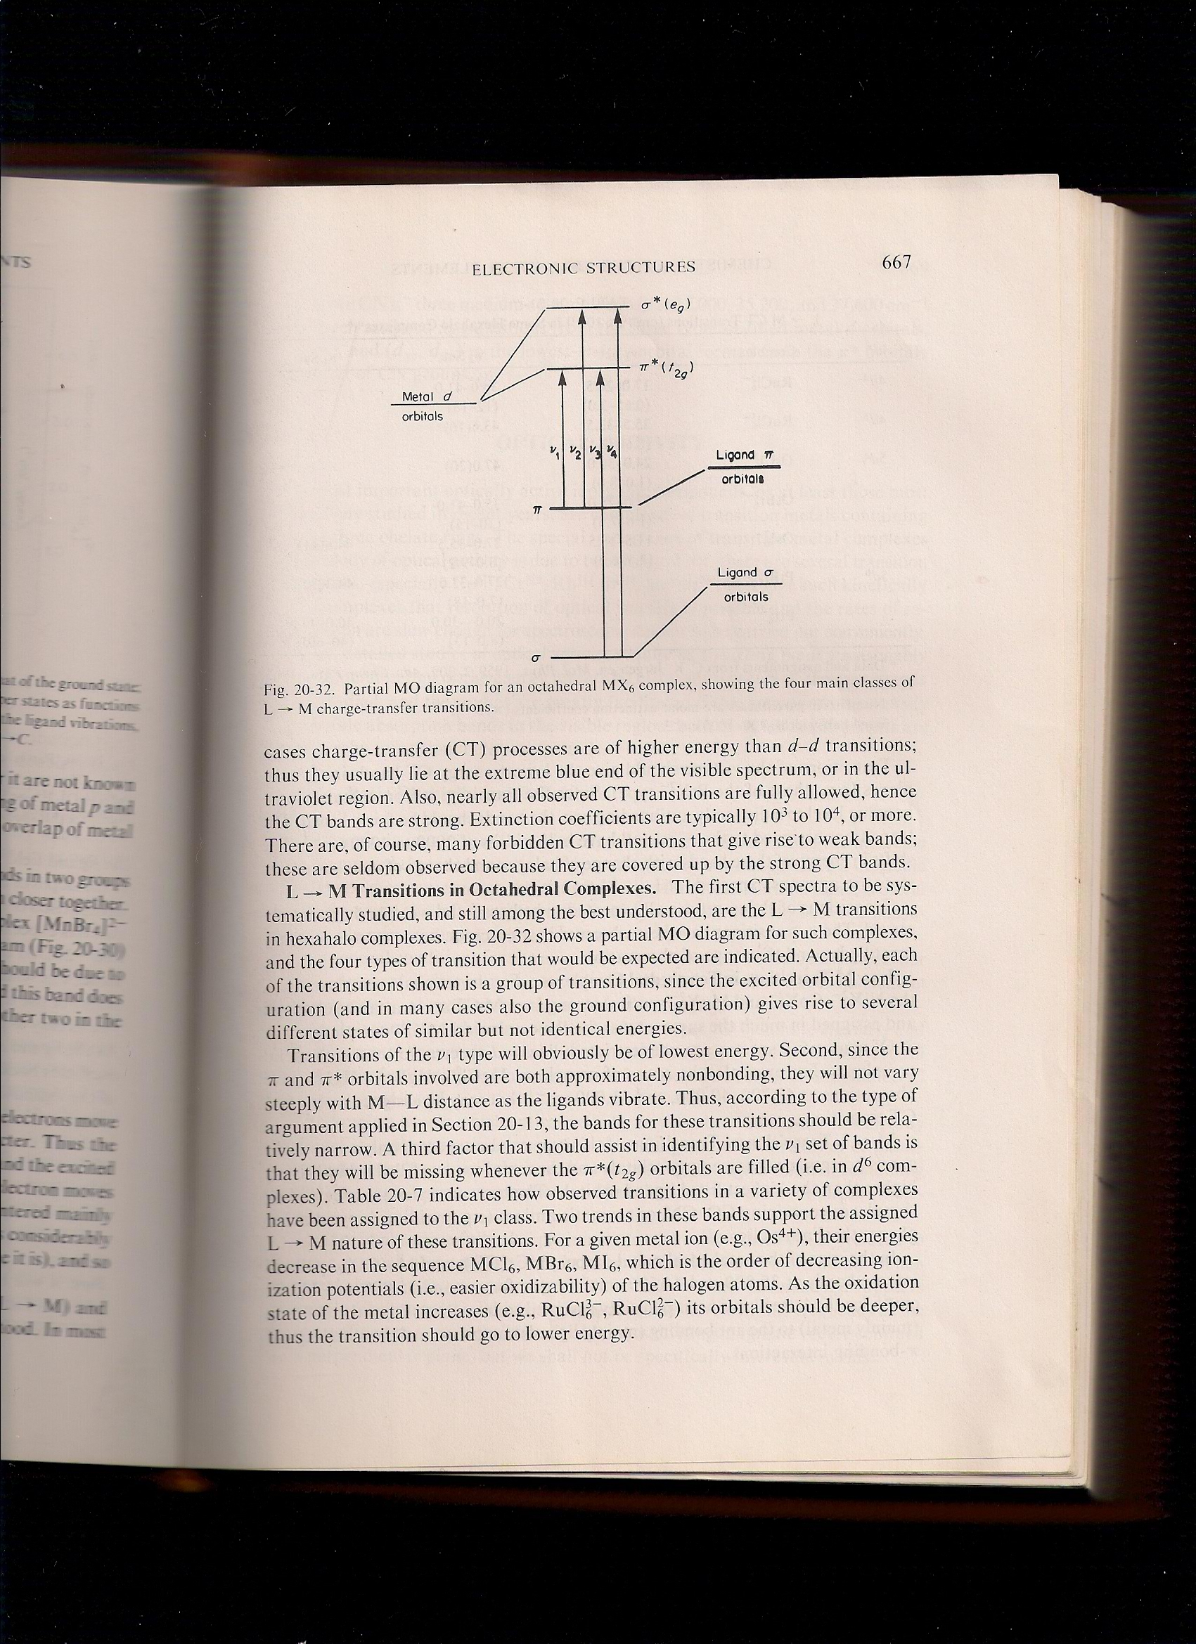
Fig. 3 Partial MO diagram for octahedral complex

Slide 9
In tetrahedral complexes like NiX₄⁻², CoX₄⁻² and MnX₄⁻² a strong L M spectra can be observed and assigned in much the same way as for octahedral complexes. For d ⁸ complexes like HgCl ₄⁻², HgBr₄⁻² and HgI₄⁻² a strong CT for L M transition and showed bands at 43,700 , 40,000 and 31,000 cm^{_1}
In the previous lecture we showed the spectrum of [Cr(NH₃)₆]⁺³ ,when one NH₃ ligand replaced by one weaker ligand (Cl ⁻ ) moves the lower energy band to lower energy than that for [CrCl(NH₃)₅]⁺² . That arises because the Cl⁻ ligands have π lone pair electrons that are not directly involved in bonding. The band is an example of an LMCT transition in which a lone pair electron of Cl⁻ is promoted into a predominantly metal orbital. The LMCT character of similar bands in is [CrX(NH₃)₅]⁺² confirmed by the decrease in energy in steps equivalent to about 8000 cm^{_1} as X is varied from Cl to Br to I .
Metal to Ligand( M L ): A transfer of charge of electrons from metal to ligands is most commonly observed in complexes with ligands that have low lying π* orbitals, especially carbonyl (CO ), cyanide ( CN ) and aromatic ligands (diimine, phenanthroline and dithiolene) Fig. – 4 . If the metal ion have a low oxidation number, in which case the d orbitals will be relatively high in energy, the transition will occur at low energy. A diimine ligand may also be easily substituted into a complex with other ligands that favor a low oxidation state. Two example are , [ W(CO)₄(phen)] and [ Fe(CO)₃(bipy))] .
In the case of octahedral metal carbonyl such as Cr(CO) ₆ and Mo(CO)₆ pair of intense bands at 35,800 and 44,500cm^{_1} for the former and 35,000 and 43,000 cm^{_1} for the later which can be assigned to transition from bonding (mainly metals) to the antibonding( mainly ligands)components of the metal ligands π bonding interactions.

Slide 10
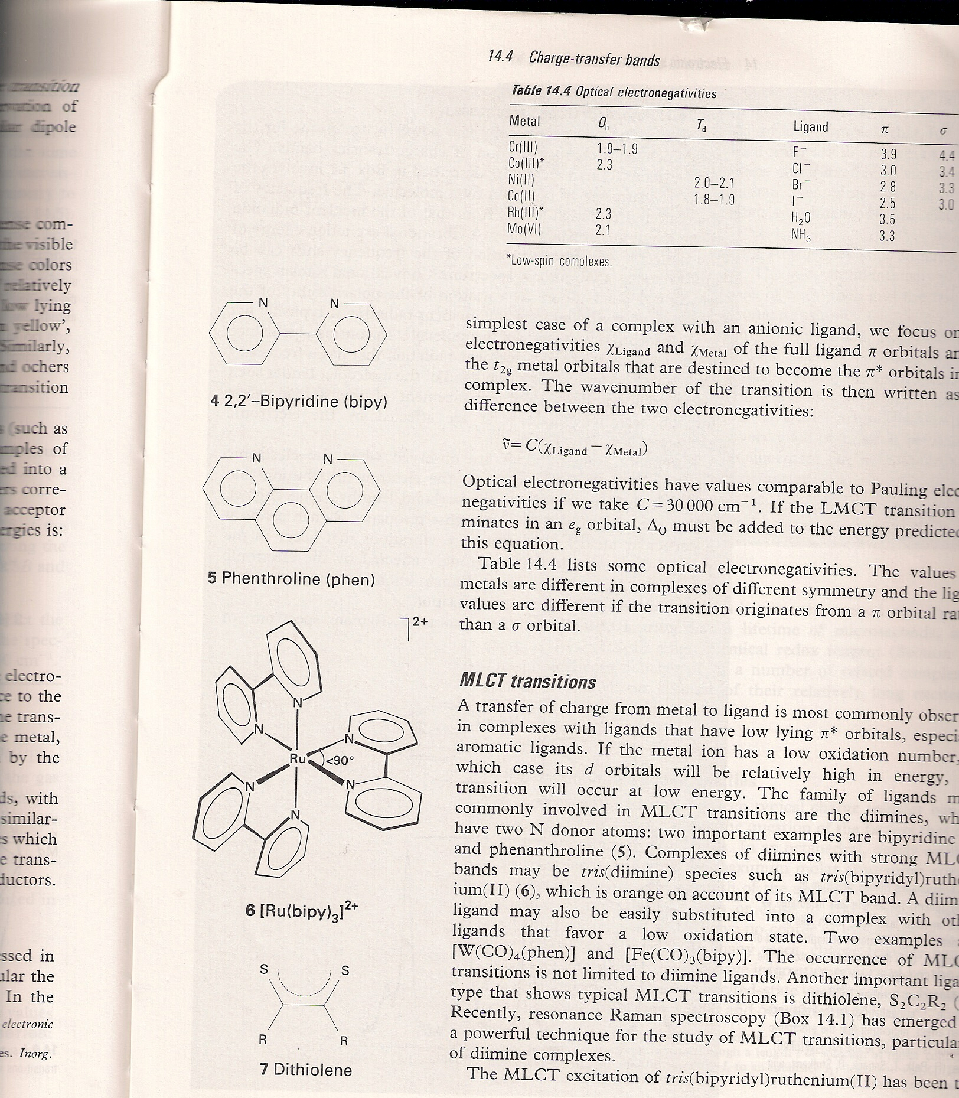
Fig. 4

