Slide 1
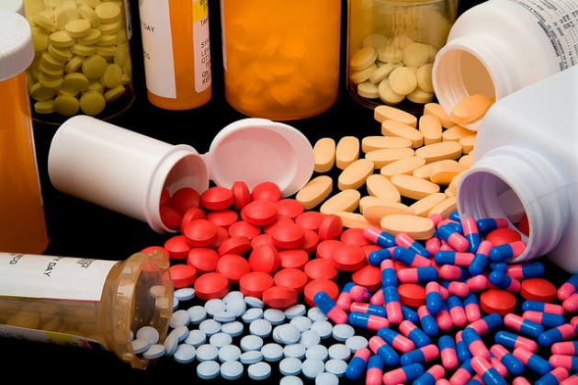
1st lecture in Antibiotics
Dr. Sawsan Sajid AL-Jubori
References :
1-Antimicrobial chemotherapy (fifth Edition , 2007 oxford)
2- Antibacterial Agents(first Edition , 2012, Wily )

Slide 2
Identification of Antibiotics and Antimicrobial Agents
An ANTIBIOTIC is a low molecular substance produced by a microorganism that at a low concentration inhibits or kills other micro organisms. ex. penicillin .The term antibiotics means “against life”; in this case, against microbes. There are many types of antibiotics—antibacterials, antivirals, antifungals, and antiparasitics. They are characterized by certain distinct physical, chemical, and biological properties which make them ideal potential chemotherapeutic agents for the treatment of infection
An ANTIMICROBIAL Agent is any substance of natural, semisynthetic or synthetic origin that kills or inhibits the growth of microorganisms but causes little or no damage to the host. ex: sulfa drug
All antibiotics are antimicrobials, but not all antimicrobials are antibiotics.

Slide 3
Microorganism produce Antibiotics
Actinomycetes :produce approximately 60-70 %of total kinds of antibiotics ex: Streptomyces spp
Fungi: produce approximately 20 %of antibiotics ex:Penicillium
Bacteria :produce about 10%of different antibiotics ex: Bacillus spp

Slide 4
History of Antibiotics
Foundation of the Antibiotic Era
the beginning of the modern “antibiotic era” associated with the names of Paul Ehrlich and Alexander Fleming. Ehrlich's idea of a “magic bulletالرصاصة السحرية ” that selectively targets only disease-causing microbes and not the host was based on an observation that synthetic dyes, which first became available at that time, could stain specific microbes but not others .This idea led him to begin a large-scale and systematic screening program (as we would call it today) in 1904 to find a drug against syphilis, a disease that was endemic and almost incurable at that time. This sexually transmitted disease, caused by the spirochete Treponema pallidium

Slide 5
Arsenicals : مركبات الزرنيخ
Ehrlich (1905) In his laboratory, together with chemist Alfred Bertheim and bacteriologist Sahachiro Hata, they synthesized hundreds of organoarsenic derivatives of a highly toxic drug Atoxyl and tested them in syphilis-infected rabbits.
In 1909 they came across the sixth compound in the 600th series tested, thus numbered 606, which cured syphilis-infected rabbits and showed significant promise for the treatment of patients with this venereal disease in limited trials on humans
(Ehrlich and Hata, 1910). the name of the new component was Salvarsan, was a great success and, together with a more soluble and less toxic Neosalvarsan, enjoyed the status of the most frequently prescribed drug until its replacement by penicillin in the 1940s

Slide 6
Sulfa drug (sulphanoamide )
During the earlier days of antibiotics research, a group of researchers discovered osulfa drugs, namely sulfonamidochrysoidine (KI-730, Prontosil red then prontosil ), which was synthesized Josef Klarer and Fritz Mietzsch and tested by Gerhard Domagk for antibacterial activity in a number of diseases (Domagk, 1935). They use it to treat Streptococcus pyogenes

Slide 7
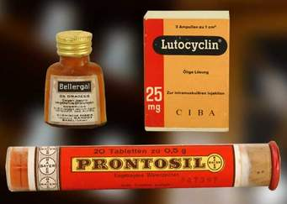

Slide 8
Prontosil, however, appeared to be a precursor to the active drug, and the active part of it, sulfanilamide,. As sulfanilamide was cheap many companies started producing of sulfonamide derivatives). Despite this, many continuously modified derivatives of this oldest class of synthetic antibiotics are still a viable option for therapy, and the action of and resistance to sulfanilamide is one of the best examples for the arms race between man and microbes. Two other classes of synthetic antibiotics successful in clinical use are the quinolones, such as ciprofloxacin, and oxazolidinones, such as linezoild).

Slide 9
Sulfanilamide was a great success in treating a whole range of bacterial infections, from puerperal sepsis to pneumonococcal meningitis, apart from one tragedy in 1937. An American company made an 'elixir of sulfanilamide' by dissolving it in the toxic solvent diethylene glycol; they added a dye and raspberry fragrance to make it more attractive. No one at the company had done any tests on it, or read about the properties of the poisonous solvent, and over a hundred people were killed, mainly children. The public outcry that followed this ultimately led to the passing of the 1938 Food, Drug & Cosmetic Act, which created safeguards for introducing new drugs in the US.

Slide 10
Discovery of antibiotics
Unknown to many, the first hospital use of a drug that we would name an antibiotic today was the so-called Pyocyanase prepared by Emmerich and Löw (1899) from Pseudomonas aeruginosa(formerly Bacillus pycyaneus). Importantly, Emmerich and Löw noticed that the bacterium as well as the prepared extracts were active against a number of pathogenic bacteria and thus tried to use the extract for treatment of various diseases. As the results of these treatments were not consistent and the preparation itself was quite toxic for humans, the treatment was eventually abandoned.

Slide 11
The discovery of these first three antimicrobials, Salvarsan, Prontosil, and penicillin, was exemplary, for future drug discovery research and followed by other researchers, resulted in a number of new antibiotics, some of which made their way up to the patient's bedside. The period between the 1950s and 1970s was indeed the golden era of discovery of novel antibiotics classes, with no new classes discovered since then. Therefore, with the decline of the discovery rate, the mainstream approach for the development of new drugs to combat emerging and re-emerging resistance of pathogens to antibiotics has been the modification of existing antibiotics

Slide 12
Penicillin: the story of an antibiotic
The antibacterial effect of penicillin was discovered by Alexander Fleming in 1929. He noted that a fungal colony had grown as a contaminant on an agar plate streaked with the bacterium Staphylococcus aureus, and that the bacterial colonies around the fungus were transparent, because their cells were lysing. Fleming had devoted much of his career to finding methods for treating wound infections, and immediately recognized the importance of a fungal metabolite that might be used to control bacteria. The substance was named penicillin, because the fungal contaminant was identified as Penicillium notatum. Fleming found that it was effective against many Gram positive bacteria in laboratory conditions, and he even used locally applied, crude preparations of this substance, from culture filtrates, to control eye infections. However, he could not purify this compound because of its instability, and it was not until the period of the Second World War (1939-1945) that two other British scientists, Florey and Chain, working in the USA, managed to produce the antibiotic on an industrial scale for widespread use. All three scientists shared the Nobel Prize for this work- penicillin rapidly became the "wonder drug" which saved literally millions of lives. It is still a "front line" antibiotic, in common use for some bacterial infections although the development of penicillin-resistance in several pathogenic bacteria now limits its effectiveness

Slide 13
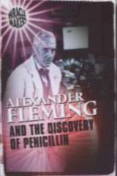

Slide 14
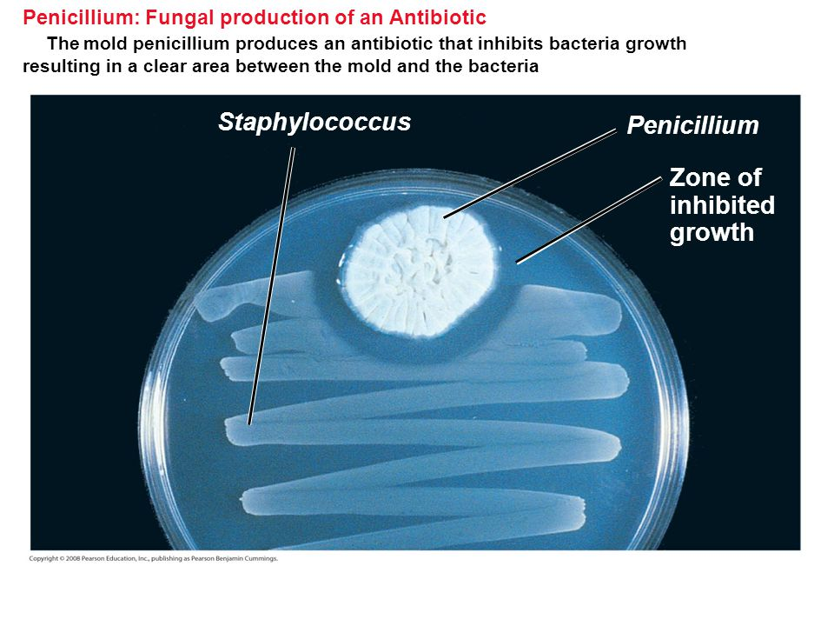
The action of penicillin is seen in Figure A. This shows an 'overlay plate', in which a central colony of the fungus Penicillium notatum was allowed to grow on agar for 5-6 days, then the plate was overlaid with a thin film of molten agar containing cells of the bacterium, Staphylococcus aureus. The production of penicillin by the fungus has created a zone of growth inhibition of the bacterium. This demonstration parallels what Alexander Fleming would have observed originally, although he saw inhibition and cellular lysis of the bacterium .

Slide 15
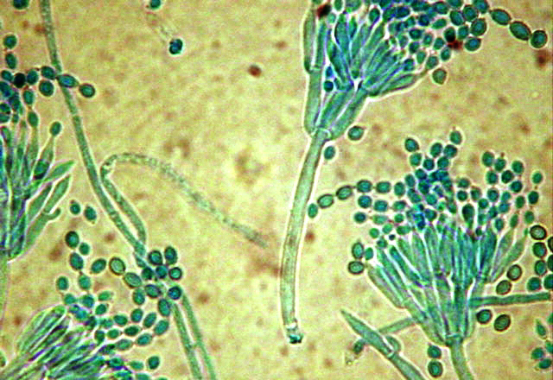
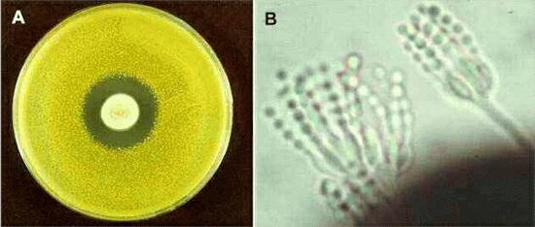
Figure B shows the typical asexual sporing structures of a species of Penicillium. The spores are produced in chains from flask-shaped cells which are found at the tips of a brush-like aerial structure.

Slide 16
Selman Waksman: the Father of Antibiotic
Selman Abraham WaksmanSelman Waksman, the microbiologist who discovered streptomycin, first used the word "antibiotic" in the medical sense in 1943. In 1952 he was awarded the Nobel Prize in Physiology or Medicine in recognition "for his discovery of "streptomycin," the first antibiotic active against tuberculosis." Waksman was later accused of playing down the role of Albert Schatz, a PhD student who did the work under Waksman's supervision to discover streptomycin.
In 2005 Selman Waksman was granted an ACS National Historical Chemical Landmark in recognition of the significant work of his lab in isolating more than fifteen antibiotics, including streptomycin, which was the first effective treatment for tuberculosis.he was the first scientist who use the term Antibiotics

Slide 17
Depending upon the killing or inhibiting ability of drugs, they can be classified into two categories
. Physicians use either one of these agents or sometimes a combination of these two when treating an infection and it
depends on the type of infection,
growth conditions of microorganisms,
bacterial density,
test duration
reduction rate of Bacteria.
Well known bactericidal and bacteriostatic agents are the antibiotics. Antibiotics can also be classified into bactericidal and bacteriostatic antibiotics based on their mechanism of action. However, in some cases, one antibiotic can be bactericidal for one strain of bacteria and may only inhibit the growth of a different strain. Therefore, all the aspects mentioned above should be clearly known before choosing an antibiotic.

Slide 18
Bactericidal
Bactericidal agents are used to kill microorganisms by inhibiting the synthesis of cell wall.
. Usually, endocarditis and meningitis are treated by bactericidal drugs
Examples for bactericidal antibiotics include; penicillin derivatives, cephalosporins, monobactams, and vancomycin. In addition, aminoglycosidic antibiotics are also considered as bactericidal, but they may also be bacteriostatic for some infections. The minimum concentration of a drug that is needed to kill a certain strain of bacteria is called the ‘minimum bactericidal concentration’ or MBC.

Slide 19
Bacteriostatic
are used to limit the growth and reproduction of microorganisms by interfering with their protein production, DNA replication, or other aspects of bacterial cellular metabolism. Unlike the bactericidal agents, the bacteriostatic agents must works together with the immune system to inhibit the microorganisms’ activities. According to drug concentration, the activity may vary. For examples, if we use high concentrations of bacteriostatic agents, they may act as bactericidal, whereas low concentration of bactericidal agents may act as bacteriostatic. In most urinary tract infections, it is recommended to use bacteriostatic antibiotics. The antibiotics include tetracycline, sulfonamides, spectinomycin, trimethoprim, chloramphenicol, macrolides and lincosamides are some examples for bacteriostatic agents. Minimum concentration of a drug that is needed to inhibit the growth of a certain strain of bacteria is known as ‘minimum inhibitory concentration’ or MIC.

Slide 20
Bactericidal vs Bacteriostatic
Bactericidal antibiotics kill bacteria directly, and bacteriostatic antibiotics stop bacteria from growing.
Bactericidal activities kill microbial cells, whereas bacteriostatic activities prevent the growth of microbial cells.
Number of microorganisms decreases in the presence of bactericidal agents, whereas the number of microorganisms remains the same in the presence of bacteriostatic agents.
Unlike the bactericidal agents, when bacteriostatic agents are used, microorganisms remain viable.
Unlike the bactericidal agents, bacteriostatic agents allow the immune system to deal with infections.
If the doses of bacteriostatic agents are high, those may act as bactericidal agents.
If the doses of bactericidal agents are low, those may act as bacteriostatic agents.
MIC (minimum inhibitory concentration) is the minimum concentration of drug need to inhibit bacterial growth by bacteriostatic agents. In contrast, MBC (minimum bactericidal concentration) is the minimum concentration of bactericidal drug needed to kill bacteria.

Slide 21
Mode of activity
Another important thing to remember about antibiotics is that they don't all work against all types of bacteria.
Narrow-spectrum antibiotics are only effective against a narrow range of bacteria it is effective against specific families of bacteria.Ex: penicillin G or erythromycin
whereas broad-spectrum antibiotics are effective against a broad range of bacteria. In this lesson, we'll look more closely at these general types of antibiotics, and we'll see what makes a given antibiotic fit into each category.EX: aminoglycoside group

Slide 22
Narrow-spectrum antibiotics are only effective against a narrow range of bacteria. For example, penicillin G is very effective at killing gram-positive bacteria, but not very effective against gram-negative bacteria.
1- Why is that? What causes an antibiotic to have a narrow spectrum of antimicrobial activity? Often, it has to do with the ability of the antibiotic to penetrate inside of the bacterium. Gram-positive bacteria have a relatively loose outer wall that many antibiotics can diffuse through. However, gram-negative bacteria have a complex outer layer that prevents the passage of many larger or fat-soluble molecules.
2- Another reason that antibiotics can have a narrow spectrum of activity can be their target molecules. If an antibiotic targets a molecule that a bacterium doesn't even have, of course it won't be effective against that bacterium. For example, isoniazid specifically targets mycobacteria, such as the bacterium that causes tuberculosis. It's specific because it prevents the synthesis of mycolic acids, which are found in the cell walls of mycobacteria, but not most other types of bacteria.
3- It's good to treat patients with antibiotics that have a narrow spectrum of activity, because then the 'good' bacteria that normally live inside of us won't all get killed off along with the pathogen that caused the infection. However, when a patient comes into a clinic with an infection, it's often not clear exactly which microbe is causing it. So in the case of severe infections, when it's really important that an antibiotic work quickly so that the patient can survive, narrow-spectrum antibiotics would not be the best choice.

Slide 23
GENERAL PROPERTIES OF ANTIBACTERIAL AGENTS
A. Selective Toxicity – drug harms the microbe without causing significant damage to the host. When searching for ways to treat disease, scientists look for differences between the human (or animal) host and the pathogen. Ex. Penicillin interferes with cell wall synthesis. Animal cells have no cell walls, so penicillin is not toxic to animals.
B. Spectrum of Activity – the range of different microbes against which an antimicrobial agent acts. Example: Broad spectrum: G(+) and G(-) bacteria vs. Narrow spectrum: G(-or + ) only;
C. Modes of Action (How Do the Drugs Work?)
1.Inhibition of Cell Wall Synthesis
2. Disruption of Cell Membrane Function
3. Inhibition of Protein Synthesis
4. Inhibition of Nucleic Acid Synthesis

Slide 24
ATTRIBUTES OF AN IDEAL ANTIMICROBIAL AGENT
الصفات المثالية للمضادات الحيوية
A. Solubility in body fluids
B. Selective toxicity against microbes
C. Toxicity not easily altered (no food or drug interactions)
D. Non allergenic
E. Stability (should be degraded and excreted by the body slowly)
F. Resistance by microorganisms not easily acquired
G. Long shelf life.
H. Reasonable cost
i. not evoke immune response
J . Reasonable side effects

