Slide 1
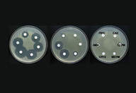
3rd lecture in Antibiotics
Mechanisms of Action for Antimicrobial Agents: General Principles and Mechanisms against Selected
Classes of Antibiotics
Prepared by
Dr. Sawsan Sajid AL-Jubori
Dr. Saad L. Hammed
Dr. Ibtessam K. Auda

Slide 2
In the previous lecture we took about the mechanism by which the antimicrobial agents can act against different pathogen .in this lecture we will demonstrate the mechanism of microbial resistance
So we have
Antibiotic action ----- against microorganism reaction
Antibiotic activity ------against microbial resistance
Antimicrobial resistance : is the ability of microbes to grow and multiply in the presence of antimicrobial agent that would normally kill them or limit their growth. The concentration of drug at the site of infection must inhibit the organism and also remain below the level that is toxic to human cells.

Slide 3
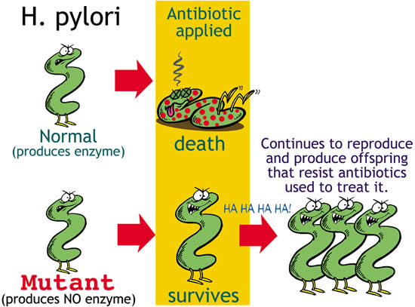

Slide 4

Sir Alexander Fleming introduction to resistance
In his 1945 Nobel Prize lecture, Fleming himself warned of the danger of resistance –
“It is not difficult to make microbes resistant to penicillin in the laboratory by exposing them to concentrations not sufficient to kill them, and the same thing has occasionally happened in the body… …and by exposing his microbes to non-lethal quantities of the drug make them resistant.”

Slide 5
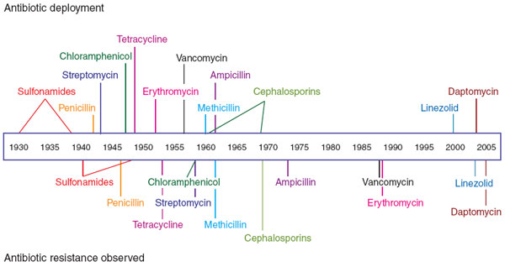
Timeline of Antibiotic Resistance

Slide 6
Why resistance is a concern
Resistant organisms lead to treatment failure
Increased mortality
Resistant bacteria may spread in Community
Low level resistance can go undetected
Added burden on healthcare costs
Threatens to return to pre-antibiotic era
Selection pressure
Resistance might be directed by bacteria , viruses ,fungi and even cancer cell can develop resistance

Slide 7
Mechanism Antibiotic Resistance
Intrinsic (Natural)
Acquired
Genetic Methods
Chromosomal Methods
Mutations
Extra chromosomal Methods
Plasmids

Slide 8
Intrinsic and acquired Resistance
Intrinsic resistance (ذاتية او طبيعية )might include
Lack target :lacking cell wall ex: as in Mycoplasma ; innately resistant to penicillin
Innate efflux pumps: Drug blocked from entering cell or ↑ export of drug (does not achieve in adequate internal concentration). Ex: as it happened E. coli, P. aeruginosa
Drug inactivation: ex: Cephalosporinase in Klebsiella
Extraordinary permeability barrier represented by the cell envelop of the gram –ve bacyeria ex: the envelop of Pseudomonase aeruginosa ables this bacteria to stand against many chemicals, dyes disinfectants and antibiotics

Slide 9
Acquired resistance
Either by Mutations within the chromosome
It refers to the change in DNA structure of the gene.
Occurs at a frequency of one per ten million cells.
Eg.Mycobacterium.tuberculosis,Mycobacterium lepra , Methicillin resistance Staphylococcus aerus
MRSA .
Often chromosomal mutants have reduced susceptibility to different antibiotics and in most cases the mutation occur due to alteration in the target sit of antibiotic action

Slide 10
Acquired resistance
Or by Extra chromosomal genetic elements :Plasmids are double helix DNA exist in the cytoplasm. They can replicate independently from them chromoseme ,otherwise they integrate with it and replicate once the chromosome replicated . Usually they Carrey resistant ( r-genes) are called R-plasmids.
These r-genes can be readily transferred from one R-plasmid to another plasmid or to chromosome.
Much of the drug resistance encountered in clinical practice is plasmid mediated

Slide 11
Mechanisms of Resistance Gene Transfer
A: Transfer of R-genes from one bacterium to another
Conjugation : Main mechanism for spread of resistance
The conjugative plasmids make a connecting tube between the 2 bacteria through which plasmid itself can pass
Transduction :Less common method The plasmid DNA enclosed in a bacteriophage and transferred to another bacterium of same species. Seen in Staphylococci , Streptococci
Transformation: also less common Free DNA is picked up from the environment (i.e.. From a cell belonging to closely related or same strain.
B: Transfer of R-genes between plasmids within the bacterium
  By transposons : are sequences of DNA that can move around different positions within the genome of single cell and between plasmid and chromosome
By Integrons :Integron is a large mobile DNA can spread Multidrug resistance Each Integron is packed with multiple gene casettes, each consisting of a resistance gene attached to a small recognition site.

Slide 12
mechanisms of antibiotic resistance
Many mechanisms of antibiotic resistance have been developed in the last decades. In general the mechanisms of antimicrobial resistance are:
1- producing modifying enzymes
2-Target Site Modification and protection
3-Prevention of drug accumulation in the bacterium(via Efflux pump or permeability barrier )
4-Using an alternative pathways for metabolic / growth requirements
5-Quorum sensing

Slide 13
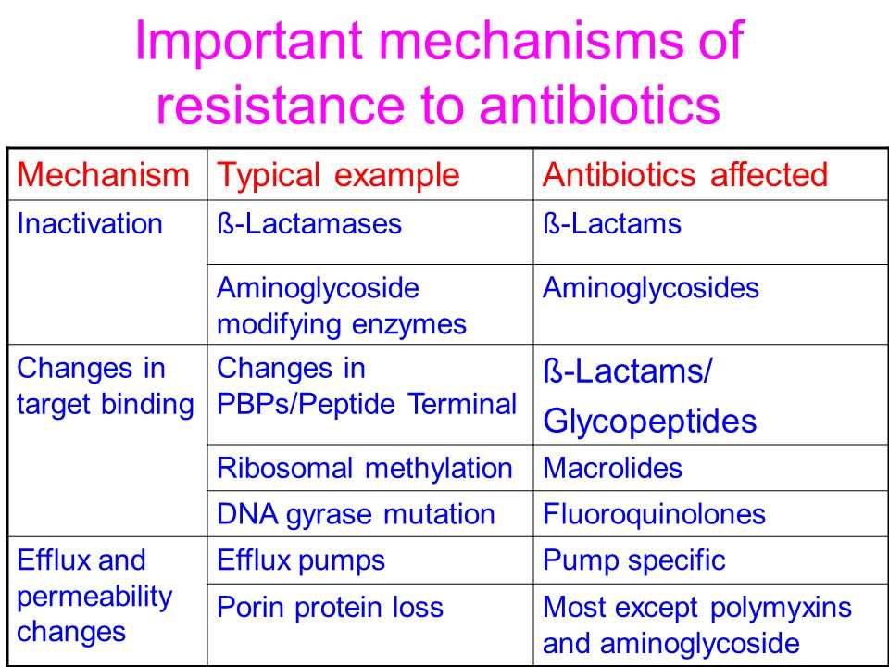

Slide 14
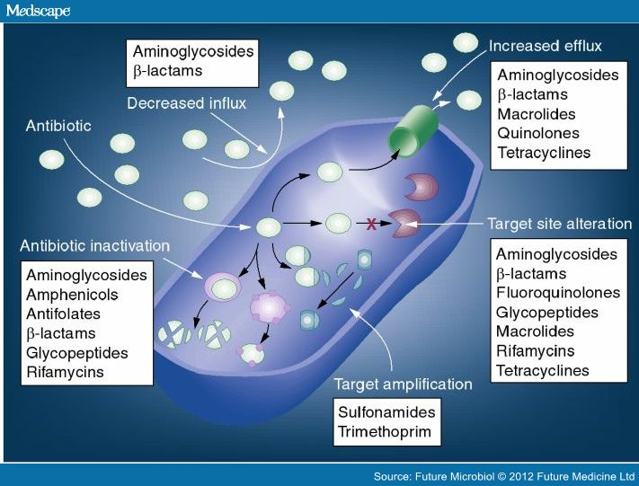

Slide 15
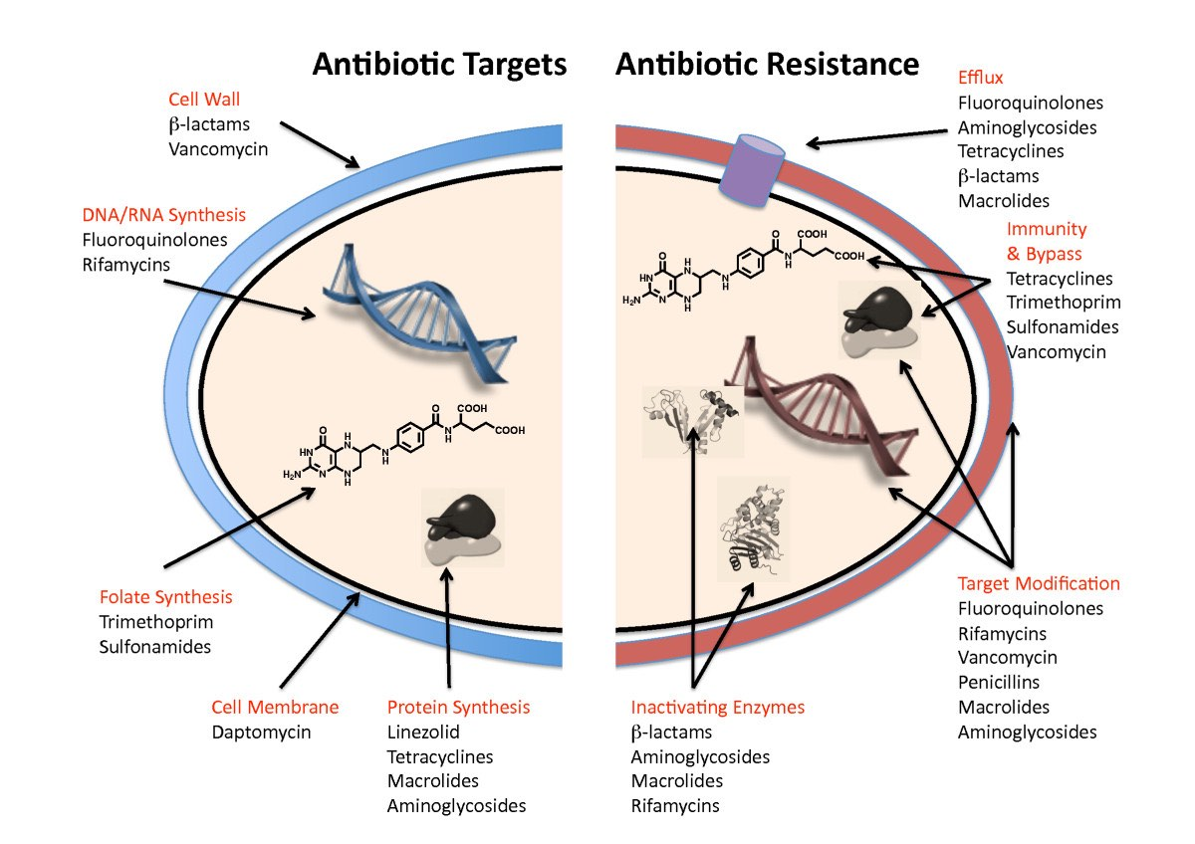

Slide 16
1-producing modifying enzymes that inactivate antibiotic
these include either hydrolysis the antibiotic molecules rendering them inactive , or transfer and addition of group and reduce their mechanisms
hydrolysis and Inactivation of b-lactam antibiotics ex: S. aureus , N. gonorrohoea , H.influenza, and most gr-ve bacteria Produce b-lactamase which cleaves four atom β-lactam ring
β-lactamases such as penicillinase aganist penicillin and cephalosporinase against cephalosporine , and carbapenemase against carbapenems .Penicillinase was the first β-lactamase to be identified: It was first isolated by Abraham and Chain in 1940 from Gram-negative E. coli even before penicillin entered clinical use,
Extended spectrum (ESBLs) are beta-lactamases that hydrolyze extended-spectrumcephalosporins including cefotaxime ceftriaxone, and ceftazidime, as well as monobactam ex: aztreonam .members of family Enterobacteriaceae commonly express plasmid-encoded ESBLs( related to TEM &SHV β-lactamases family ).more than 200 types related to different pathogenic bacteria have been identified

Slide 17
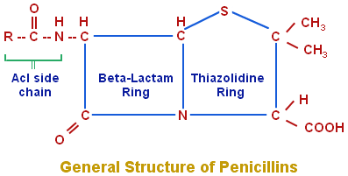
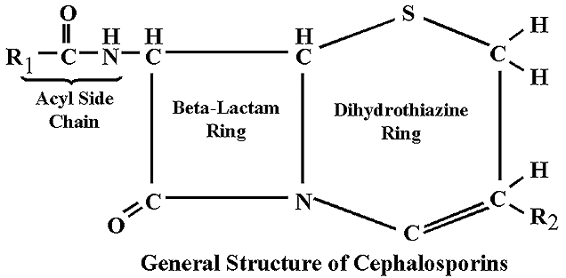
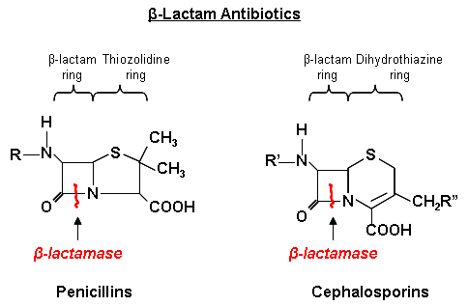

Slide 18
B -Aminoglycoside modifying enzymes
Addition of different group and Inactivation of Aminoglycosides group ,Present in gram +ve and gram –ve .there are different type of these enzymes
1-aminoglycoside N-acetyltransferases (AACs)
AACs belong to the N-acetyl transferase superfamily of proteins They catalyze the acetylation (adding acetyl group ) to −NH₂groups in the acceptor aminoglycoside antibiotic.
2-aminoglycoside O-nucleotidyltransferases (ANTs)
ANTs mediate inactivation of aminoglycosides by catalyzing the transfer of an AMP group from the donor substrate ATP to and hydroxyl group in the aminoglycoside molecule.
3- aminoglycoside O-phosphotransferases (APHs)
APHs catalyze the transfer of a phosphate group to the aminoglycoside molecule

Slide 19
C:Addition of acetyl group& Inactivation of Chloramphenicol by chloramphenicol acetyltransferase. It is constitutively(مستمر ( produced in Gram-ve bacteria ( higher resistance) while it is inducible gram +ve
D: Ciprofloxacin-Modifying Enzyme
Plasmid-mediated quinolone resistance was first identified in a clinical isolate of Klebsiella pneumoniae. Recently, a new mechanism of quinolone resistance was identified: transfer from species to species of a plasmid encoding aac(6′)-Ib-cr, a variant of aminoglycoside acetyltransferase that reduced susceptibility to ciprofloxacin and norfloxacin by N-acetylation of the amino nitrogen on its piperazinyl substituent. Genes responsible for plasmid-mediated quinolone resistance are thought to be linked to extended-spectrum β-lactamase

Slide 20
Step one : Antibiotic inactivation
Inactivating of antibiotic via enzymes
Antibiotic
Enzyme
Enzyme
Binding
Target site
Cell wall
Interior of organism

Slide 21
Second step :Antibiotic inactivation
Enzymes bind to antibiotic molecules
Antibiotic
Enzyme
binding
Enzyme
Binding
Target site
Cell wall
Interior of organism

Slide 22
Third step :Antibiotic inactivation
Enzymes destroy antibiotics or prevent binding to target sites
Antibiotic
destroyed
Antibiotic altered,
binding prevented
Antibiotic
Enzyme
Target site
Cell wall
Interior of organism

Slide 23
2-Target Site Modification and protection
Alteration in penicillin-binding protein (PBPs) leading to reduced affinity of beta-lactam antibiotics (Methicillin-Resistant Staphylococcus aureus, S. pneumoniae, Neisseria gonorrheae, Group A streptococci, Listeria monocytogenes)
Changes in peptidoglycan layer and cell wall thickness resulting to reduced activity of vancomycin: Vancomycin-resistant S.aureus
Alterations in subunits of DNA gyrase reducing activity of fluoroquinolones:
Alteration in subunits of topoisomerase IV leading to reduced activity of fluoroquinolones: Many Gram positive bacteria, particularly S.auerus and Streptococcus pneumoniae
Changes in RNA polymerase leading to reduced activity of rifampicin: Mycobacterium tuberculosis
Alteration of target enzyme due to Spontaneous chromosomal Mutations in dihydrofolate reductase gene leading to reduced activity of trimethoprim.
Ribosomal point mutation: resistance of Tetracyclines,Macrolides, Clindamycin and methylation in 23s rRNA causes Macrolides resistance
Alteration in 30s rRNA target site : resistance against Aminoglycoside group (في هذه النقطة عليك معرقه موقع عمل المضاد لمعرفة مكان حصول التغيير والمقاومة

Slide 24
Structurally modified antibiotic target site
1--Antibiotics normally bind to specific binding proteins on the bacterial cell surface
Antibiotic
Binding
Target site
Cell wall
Interior of organism

Slide 25
Structurally modified antibiotic target site
Antibiotics are no longer able to bind to modified binding proteins on the bacterial cell surface
Antibiotic
Modified target site
Cell wall
Changed site: blocked binding
Interior of organism

Slide 26
3-Prevention of drug accumulation in the bacterium(via Efflux pump or permeability barrier )
A- Efflux pumps are Cytoplasmic membrane transport proteins ( proteinaceous transporters) localized in the cytoplasmic membrane of all kinds of cells. They are active transporters, meaning that they require a source of chemical energy to perform their function . The genetic elements encoding efflux pumps may be encoded on chromosomes and/or plasmids( both intrinsic (natural) and acquired resistance respectively). In many cases, efflux pump genes are part of an operon, with a regulatory gene controlling expression. . Expression of several efflux pumps in a given bacterial species may lead to a broad spectrum of resistance Efflux systems that contribute to antibiotic resistance have been described from a number of clinically important bacteria, including Campylobacter jejuni ,E. coli , Pseudomonas aeruginosa ,Acinitobacter
B- For the reducing permeability barrier : in this case the porin channels will change either by reducing number or change the shape or affinity of binding

Slide 27
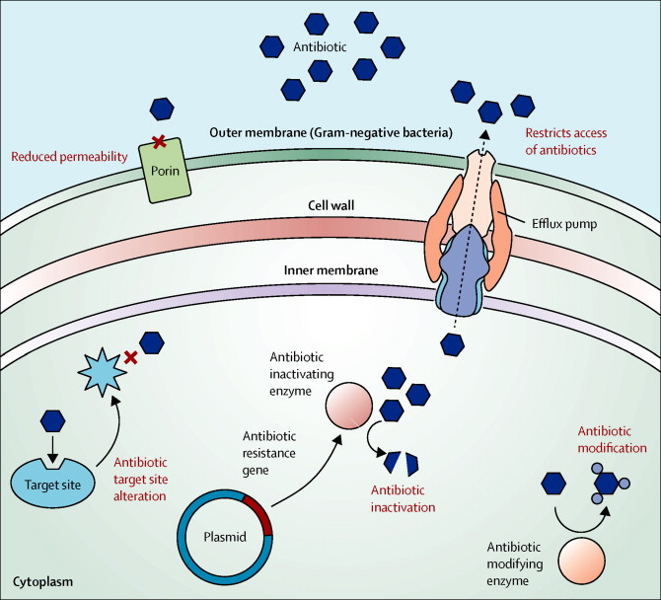

Slide 28
Decreased permeability: Porin Loss
Antibiotics normally enter bacterial cells via porin channels in the cell wall
Antibiotic
Porin channel
into organism
Cell wall
Interior of organism

Slide 29
Decreased permeability: Porin Loss
New porin channels in the bacterial cell wall do not allow antibiotics to enter the cells
Antibiotic
New porin channel
into organism
Cell wall
Interior of organism

Slide 30
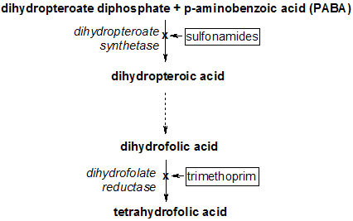
4-Using an alternative pathways for metabolic / growth requirements
Trimethoprim binds to dihydrofolate reductase and inhibits the reduction of dihydrofolic acid (DHF) to tetra hydrofolic acid (THF). THF is an essential precursor in the thymidine synthesis pathway and interference with this pathway inhibits bacterial DNA synthesis. Trimethoprim's affinity for bacterial dihydrofolate reductase is several thousand times greater than its affinity for human dihydrofolate reductase.
Sulfamethoxazole inhibits
dihydropteroate synthase, an enzyme involved further upstream in the same pathway.

Slide 31
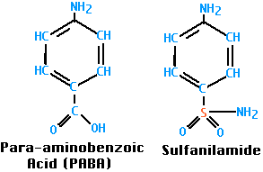
sulfa drugs inhibit a step in the pathway to make folic acid, an essential vitamin that bacteria need for their everyday functions. But some resistant bacteria have developed different metabolic pathways that allow them to make folic acid even in the presence of these drugs . Or some microorganism produce large quantity of PABA (Para Amino Benzoic Acid ) thus overcome the inhibition of sulfa drug to folic acid cycle(Compotation to enter the synthesis pathway
Note :folic acid doesn’t synthesis in
human thus
we take as a tablet and
specially given to pregnant
women

Slide 32
5- Quorum sensing
Recently discovered that the microbes communicate with each other and exchange signaling chemicals or so called Autoinducers. when its colony reaches a critical density , threshold of autoinduction is reached and gene expression starts
These autoinducers allow bacterial population to coordinate gene expression for virulence, conjugation, apoptosis, mobility and resistance
QS signal molecules AHL, AIP, AI-2 & AI-3 have been identified in Gm-ve bacteria
AI-2 QS –system is shared by GM+ve bacteria
Several QS inhibitors molecules has been synthesized which are analogues to AHL, AIP, and AI-2
QS inhibitors have been synthesized and have been isolated from several natural extracts such as garlic extract.

