Slide 1
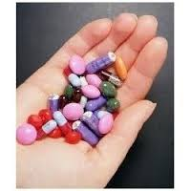
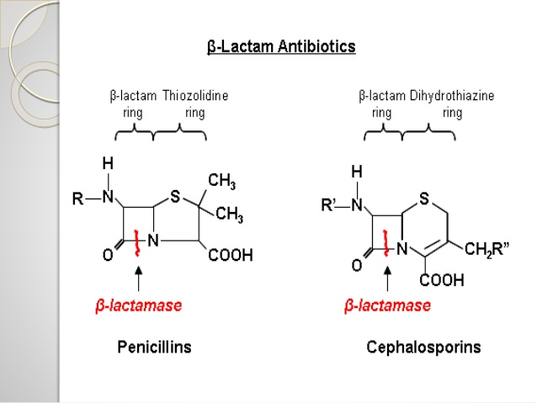
5th lecture in Antibiotics for biotechnology
BETA-LACTAM ANTIBIOTICS: by Dr.Sawsan Sajid
BETA-LACTAMS is the first group related to antibiotics, and represent the most successfully widely and safely used ever it is available as injections ,syrup, capsule and either coated or none coated tablets .It contain large number of antibiotics sharing the same B-Lactam ring and divided to 5 major subgroup which re-divided according to different criteria .

Slide 2
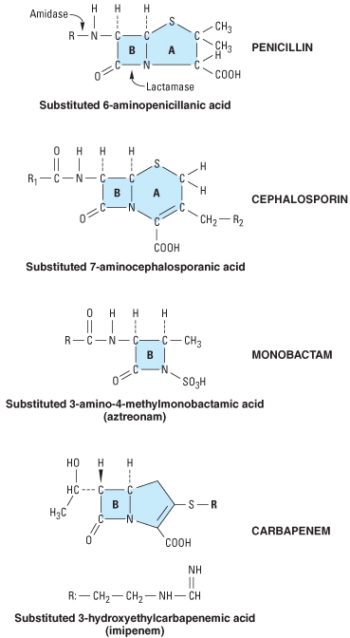
The major 5 subdivisions are:
(I)Penicillins(Penames)whose official names usually include or end in “cillin”
(II)Cephalosporins(Cephems)
which are recognized by the inclusion of “cef” or “ceph” in their official names.
(III)Carbapenems(e.g. meropenem,
imipenem)
(IV)Monobactams (e.g. aztreonam)
(V) beta-lactamase inhibitors (e.g)
clavulanic acid (known as Augmentin ), sulbactam .

Slide 3
All Beta- lactams sharing the following properties
1- These antibiotics are bacteriocidal and their mode of action by inhibiting cell wal synthesis by interfering with transpeptidation reaction due to covalently binding to Penicillin-binding protein (PBPs target site محاضرة 2 ) , Beta-lactams kill bacterial cells only when they are actively growing and synthesizing cell wall.
2-Mechanism of resistance : either by راجع محاضرة 3
a- modification in the target side (PBPs) due to chromosomal mutation
b- Efflux pump (chromosomal)
c- producing of Beta –Lactemase enzymes (more than 300 type have been detected )they break the bond in lactam ring converting
6 aminopenicillanic acid (6APA) → 6-aminopenicilloic acid (penicillin)
7-aminocephalosporanic to fragment molecules (cephalosporin )
3-adverse effect : allergic reaction including itching, rashes fever, and anaphylactic shock. The anaphylactic reaction involves specific IgE antibodies which can be detected in the plasma of susceptible persons. Other non allergic adverse effects including antibiotic-associated diarrhea due to using high dose and usually for a period of longer than 10 days result in alteration the normal intestinal flora with
Clostridium difficile

Slide 4
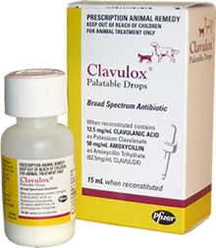

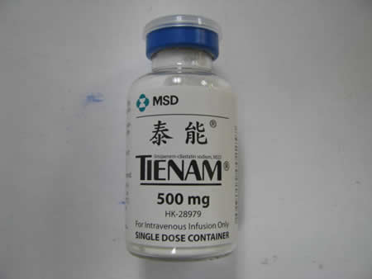
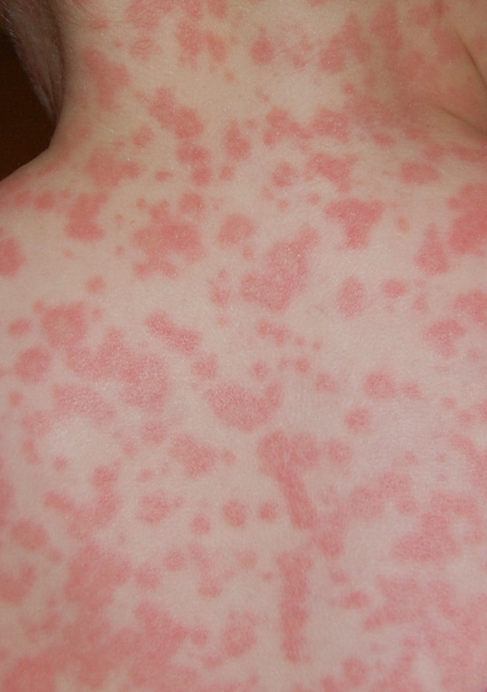
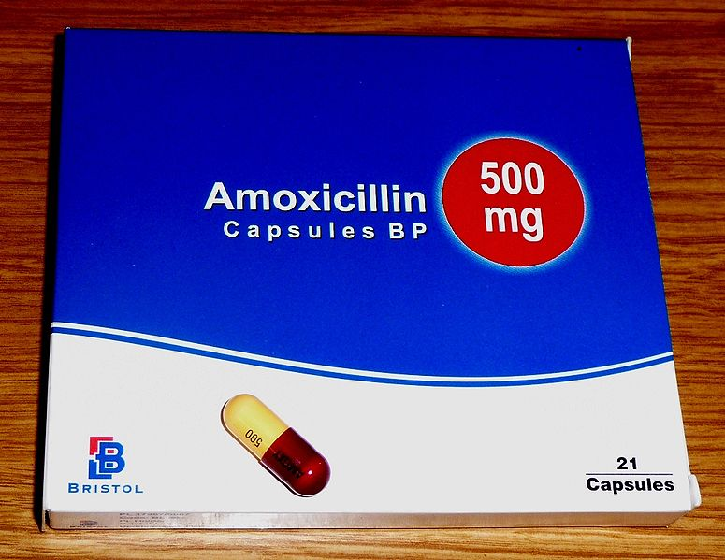
Augmentin injection causes swelling
and irritation
The most common adverse effects of carbapenems which tend to be more common with imipenem are nausea, vomiting, diarrhea, skin rashes, and reactions at the infusion sites
Amoxicillin: rash 11 hours after administration

Slide 5
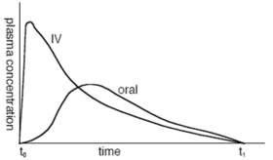
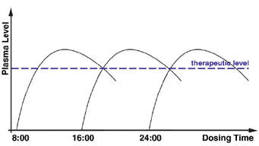
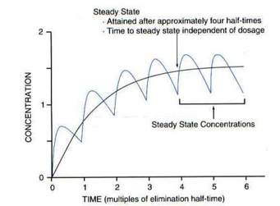
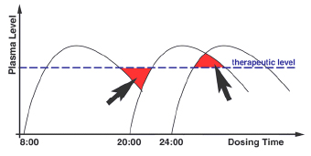
Is it necessary to regulate dosing time ?
Drugs are broken down (metabolized) by the body at different rates so different dosing intervals must taken ex: once, twice, three times or four times daily, or as required The time required for the body (usually the liver) to break down a drug from its initial plasma level to half the plasma level is called the elimination half-life
Fig1:intravenous reach faster than oral drug to plasma level
Fig2: antibiotic being taken three times a day to treat a bacterial infection. The dosing interval is every 8 hours if the patient keeps this regular manner he will reach the therapeutic level and the steady state condition .
Fig3:represent 6 doses and the steady state condition beside perfect therapeutic level .
Fig 4: the patient has taken the second dose four hours behind schedule, at 20:00 instead of 16:00. The effect of taking the dose later than scheduled is to let the plasma level drop below the therapeutic level for bactericidal effect (red arrow). During this the bacterium proliferates again. At the end of the scheduled period of treatment e.g. seven days , instead of the bacterium having been eradicated it may still be present at subclinical (low) levels so steady state condition reflect the constant plasma level depending on dosing time and it correlation with elimination half-life

Slide 6
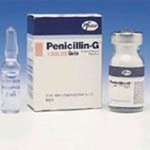
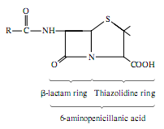
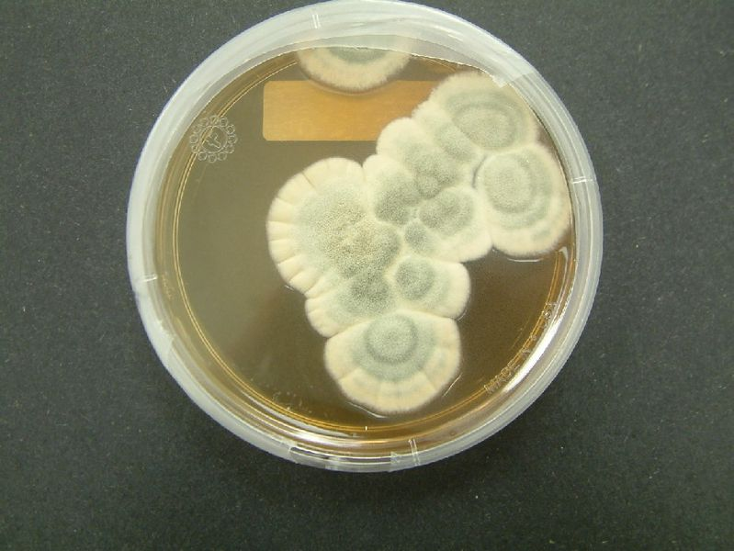
I.1 PENICILLINS
مجموعة البنسلينات
Alexander Fleming (1881–1955)
Discovery of Penicillin G from Penicillium. notatum
clinical use at 1941 by Flowrey and Chain

Slide 7
Classification of β-Lactams group
This group could be classified according to different criteria
A- According to spectrum of activity
A-1 : NARROW SPECTRUM PENICILLINS : it works against gr v+ rather than gr v- cose it devoid the ability to penetrate the OM of gr v-
ex: Biosynthetic (natural) penicillins G and Anti staphylococcal beta-lactamase resistant penicillins ex: Cloxacillin , Methicillin , oxacillin
A-2: BROAD SPECTRUM PENICILLINS: against both gr v+ and gr v-
ex : Aminopenicillins (Amoxacillin ) and Antipseudomonal penicillins like Carboxypenicillins (carbencillin ) and Ureidopenicillins( piperacillin )
B- According to chemical structure
B-1 : Biosynthesis Natural penicillins : Benzylpenicillin (PenicillinG®)the first synthesized penicillin contain the nucleus 6 amino penicillanic acid
B-2 :Semi synthetic penicillin : Adding new R side group to enhance the Activity and stability in the body Ex: most Beta –Lactams

Slide 8
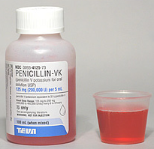
C-According to activity, chemical structure and nature
This is a comprehensive classification had been used for long time
C-1: Natural narrow spectrum penicillin : 1st generation EX :
❑ Penicillin G® is a drug of choice for infections caused by streptococci مكورات المسببه لالتهاب لوزتين , meningococci سحايا , penicillin- susceptible pneumococci لذات الرئه , non-β-lactamase-producing staphylococci, T. pallidum للسفلس, Clostridium species كلوستريديم لاهوائيه
Phenoxymethyl penicillin the oral form of penicillin(syrup)
can stand the acidity of stomach .it is used only in minor
Infections (e.g. tonsillitis) because of its poor bioavailability
Benzathine penicillin and Procaine Penicillin G® ابرة شهريه prolonged drug levels. A single i.m. injection of benzathine penicillin, is an effective treatment for β-hemolytic streptococcal tonsillitisالتهاب لوزتين مزمن ; given once every 3–4 weeks, it prevents re-infection. once a week for 1–3 weeks, is effective in the treatment of syphilis.
Procaine penicillin G is rarely used nowadays due to penicillin-resistantance
Note :benzathin and procaine will delay the excretion of penicillin outside the body

Slide 9
C-2: Narrow spectrum penicillinase resistant penicillin :2nd generation They are stable against penicillinase hydrolsis : ex : cloxacillin, or oxacillin), 250–500 mg orally every 4 to 6 h , is suitable for the treatment of mild to moderate localized staphylococcal infections . Methicillin are not clinically used but Methicillin Resistance Staph aureua (MRSA) are depend on its susceptibility .
C3- BROAD-SPECTRUM PENICILLINS Aminopenicillins (Amoxicllin and ampicillin) : have identical spectrum and activity, but amoxicillin is better absorbed orally They are effective against streptococci, enterococci, and some Gram-ve- (including H. pylori) but have variable activity against staphylococci and not effective against P. aeruginosa.
Ampicillin (but not amoxicillin) is effective for shigellosis. is useful for treating serious infections caused by penicillin- susceptible organisms, including anaerobes and beta-lactamase- negative strains of Gram-negative cocci and bacilli such as E. coli, and salmonella species. Non-beta- lactamase-producing strains of H. influenzae are generally susceptible. Many Gram-negative species produce beta-lactamases and are resistant.
Amoxicillin, These drugs are given orally to treat urinary tract infections, sinusitis, otitis, and lower respiratory tract infections.
C-4 : Carboxypenicillin ex: Carbenicillin and Ticarcillin
Carbenicillin, the very first antipseudomonal to be used to treat Pseudomonas aeruginosa .it is used to treat Otitis media and upper respiratory tract infections .only injections is available
C-5: Ureidopenicillin : piperacillin and azlocillin, are also active against selected Gram-negative bacilli, such as K. pneumoniae. Although supportive clinical data are lacking for superiority of combination therapy over single-drug therapy, because of the propensity of P. aeruginosa to develop resistance, an antipseudomonal penicillin is frequently used in combination with an aminoglycoside or fluoroquinolone for pseudomonal infections outside the urinary tract.

Slide 10
D- Final classification :Mostly according to activity and bacterial grouping and resistance to β-Lactemase hydrolysis
D-1- Narrow spectrum PENICILLINS(Natural &phenoxy penicillin
D-2 : Extend spectrum penicillin including , Aminopenicillin
D-3:Antistaphylococcal penicillins Isoxazolyl penicillins - Cloxacillin, Dicloxacilli Flucloxacillin, Oxacillin Methicillin Nafcillinهذه المجموعة تضم كل المضادات العاملة على بكتريا المكورات العنقودية
D-4:Antipseudomonasl penicillins (including carboxypenicillin, ureidopenicillins These drugs retain activity against streptococci and possess additional effects against Gram-negative organisms, including various Enterobacteriaceae and Pseudomonas
راجع المعلومات الخاصة بكل مجموعه مما سبق من سلايدات كونها المعلومات نفسها ولكن تم تصنيفها بشكل اخر غير انها تحمل الخواص والصفات نفسه كضم مجموعتي ا carboxypenicillin, ureidopenicillins ضمن مجموعة واحده هي المجموعة العاملة على بكتريا Pseudomonase aeruginosa

Slide 11
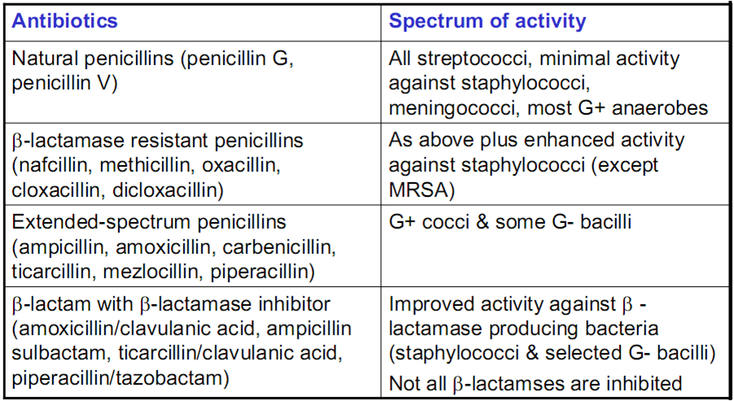
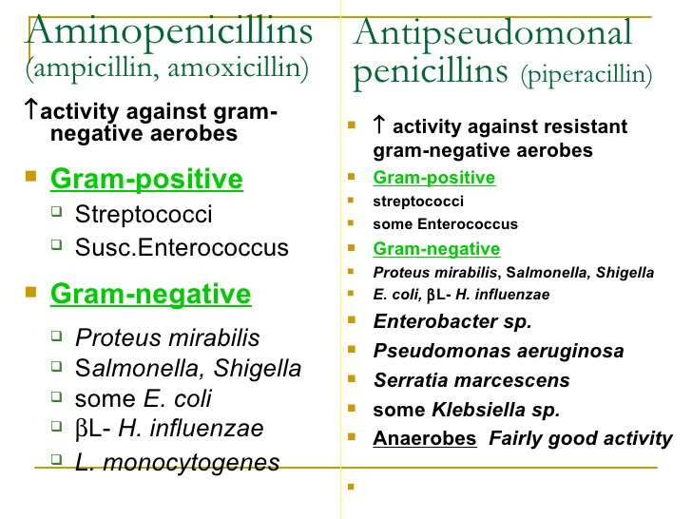

Slide 12
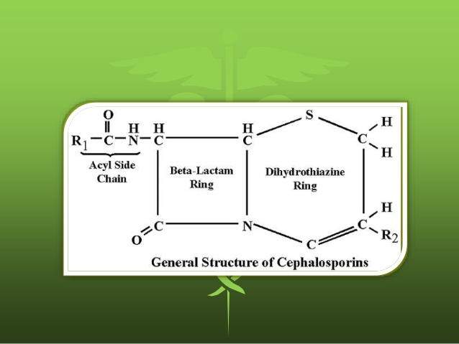
2. CEPHALOSPORINS)Cephems) Cephalosporin C by Acremonium chrysogenum
The nucleus is 7-aminocephalo-sporanic acid natural cephalosporins is low activity , but the attachment of various R₁ and R₂ groups has yielded highly active potent compounds of low toxicity. Cephalosporins can be classified into five major groups or generations, depending mainly on the spectrum of their antimicrobial activity
2-1:1st generation cephalosporiens
2-2: 2nd generation cephalosporiens
2-3 :3rd generation cephalosporiens
2-4: 4th generation cephalosporiens
2-5: 5th generation cephalosporiens
Cephalosporins are similar to penicillins,
but more stable to many bacterial
beta-lactamases therefore have a broader
spectrum of activity. However, strains of
E. coli and Klebsiella species expressing
extended-spectrum beta-lactamases
that can hydrolyze most cephalosporins
are becoming a problem

Slide 13
2-1: First-generation cephalosporins They do not cross BBB blood brain barrier لا تستعمل للالتهاب السحايا ex: cefazolin, cefalexin الكفلكس cefalothin
Although the first-generation cephalosporins are broad spectrum and relatively nontoxic, they are rarely the drug of choice for any infection, These drugs are very active against Gram-positive cocci (such as pneumococci, streptococci, and Staphylococci). Cephalosporins are not active against MRSA but E. coli, K. pneumoniae, and P. mirabilis are often sensitive.
NOT ACTIVE against Enterococci or P. aeruginosa nor Bacteroides fragilis.
Oral cephalosporins كفلكس (كبسول وشراب ) (cefalexin ) are absorbed from the gut. They may be used for the treatment of urinary tract infections, for staphylococcal, or for streptococcal infections including Tonsillitis cellulites or soft tissue abscess. However, oral cephalosporins should not be used on in serious systemic infections ex: meningitis
Cefazolin حقن فقط (i.m./i.v.)penetrates well into most tissues but not CNS (NOT for meningitis) . Cefazolin may be a choice to treat staphylococcal or streptococcal infections in persons with a history of penicillin allergy.. Cefazolin is an alternative to an antistaphylococcal penicillin for patients who are allergic to penicillin.
Cefalothin (حقن فقط) :very good activity against Strepotococcus pyogenes and pneumonia but not Staph aureus nor gram negative bacteria thus very narrow spectrum of activity

Slide 14
2.2:Second-generation cephalosporins cefaclor, cefamandole, cefotetan, cefuroxime, cefoxitin (not pass BBB except cefuroxime, no activity against Enterococci or P. aeruginosa. In general, they are active against organisms inhibited by first-generation drugs, but in addition they have extended Gr -ve coverage Klebsiella : Cefamandole and cefaclor are active against H. influenzae but not against Bacteroid . fragilis. In contrast, cefoxitin, and cefotetan are active against B. fragilis and some Serratia strains but are less active against H. influenzae. The 2nd generation oral Cefaclor is more susceptible to β-lactamase hydrolysis compared with the other agents and active against beta lactamase-producing H. influenzae and have been primarily used to treat sinusitis, otitis, or lower respiratory tract infections. Because of their activity against anaerobes (including B. fragilis), cefoxitin or cefotetan, can be used to treat mixed anaerobic infections such as peritonitis

Slide 15
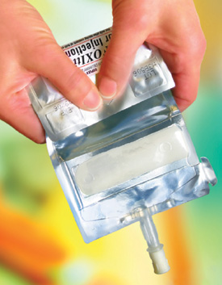
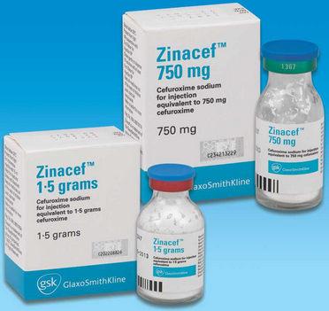
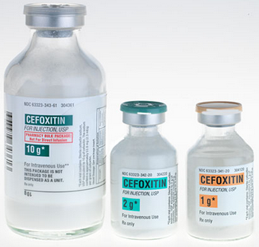
Cefuroxime
Zinacef™
Cefoxitin

Slide 16
3-3rdgeneration cephalosporins ceftazidime , cefotaxime, ceftriaxone
Compared with second-generation agents, these drugs have expanded Gram-negative coverage, and some are able to cross the BBB. Third-generation drugs are active against Citrobacter, Serratia marcescens, and Providencia. They are also effective against β-lactamase-producing strains of Haemophilus and Neisseria. Ceftazidime and cefoperazone are the only two drugs with useful activity against P. aeruginosa Like the second generation drugs, third-generation cephalosporins are hydrolysable by constitutively produced extended spectrum beta-lactamase . Third-generation cephalosporins are used to treat a wide variety of serious infections caused by organisms that are resistant to most other drugs.Strains expressing extended-spectrum beta-lactamases, however, are not susceptible .Ceftriaxone and cefotaxime are approved for the treatment of meningitis, including meningitis caused by pneumococci, meningococci, H. influenzae, and susceptible enteric Gram-negative rods, but not by L. monocytogenes.
.

Slide 17
Medical uses of 3rd generation cephalosporin's
Lower respiratory tract infections - e.g. pneumonia (most commonly caused by S. pneumoniae)
urinary tract infections (e.g. E. coli, S. epidermidis, P. mirabilis)
Bacteremia/septicemia - secondary to Streptococcus spp., S. aureus, E. coli, and Klebsiella spp.
Bone and join infections - S. aureus, Streptococcus spp.
CNS infections - e.g. meningitis due to N. meningitidis, H. influenzae, S. pneumoniae
Spectrum : active against numerous Gram-positive and Gram-negative bacteria, including several with resistance to classic β-lactams such as penicillin. infections of the lower respiratory tract, skin, central nervous system, bone, and intra-abdominal cavity. Staphylococcus aureus (not including MRSA) and S. epidermidis ,Streptococcus pneumoniae and S. pyogenes
Enterobacteriacae including Klebsiella spp. Enterobacter spp. Proteus mirabilis and P. vulgaris Escherichia coli and Salmonella
Also against Haemophilus influenzae Neisseria gonorrhoeae and N. meningitidis and anaerobic Bacteroides spp.
Ceftriaxone and cefotaxime are the most active cephalosporins against penicillin-resistant strains of pneumococci and MRSA .cose they can penetrate BBB they are used to treat Meningitis caused by highly penicillin-resistant strains of pneumococci .cefotaxime crosses the blood–brain barrier better than cefuroxime. meningitis caused by susceptible Enterobacteriace Other potential indications include therapy of sepsis of unknown microorganism in immunocompromised patient in this case , III-generation cephalosporins are often used with an aminoglycoside to get wide spectrum activity

Slide 18
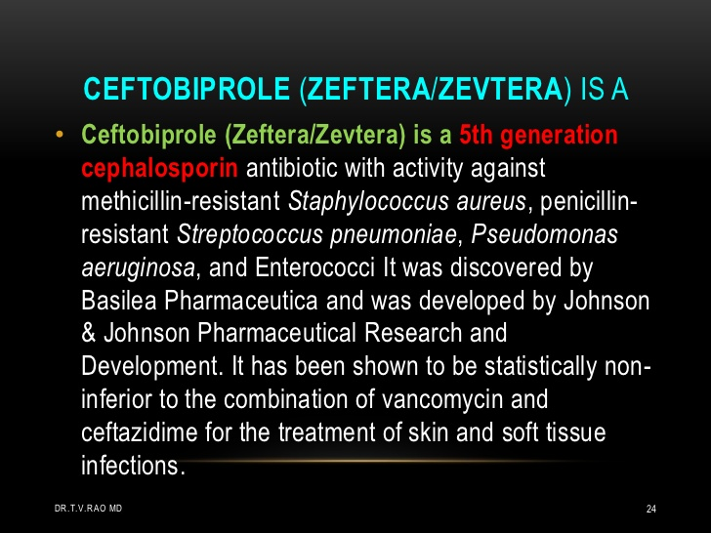
4. Fourth-generation cephalosporins :cefepime, cefpirome
is more resistant to hydrolysis by chromosomal beta-lactamases (eg, those produced by Enterobacter). It has good activity against P. aeruginosa, Enterobacteriaceae, S. aureus, and S. pneumoniae. Cefepime is highly active against Haemophilus and Neisseria. It penetrates well into the CSF cerebrospinal fluid. It has good activity against most penicillin-resistant strains of streptococci, and it may be useful in the treatment of Enterobacter infections.
5--5th Generation cephalosporin's ex: Ceftolozane and Ceftobiprole

Slide 19
III. CARBAPENEMSEx: Meropenem and imipenem/cilastatin compensation
Carbapenems penetrate body tissues and fluids well, including the cerebrospinal fluid. Highly resists to beta –lactamase but they are hydrolyzed by metallo-beta-lactamase and carbapenemases ,
usually are indicated for infections caused by susceptible organisms, e.g.
P. aeruginosa, which are resistant to other antibiotics and for the treatment of mixed aerobic and anaerobic infections. Carbapenems are active against many highly penicillin-resistant strains of pneumococci. A carbapenem is the beta-lactam of choice for the treatment of Enterobacter infections because it is resistant to destruction by the beta- lactamase produced by these organisms.
Imipenem has a wide spectrum with good activity against many Gram-negative rods, including P. aeruginosa, Gram-positive organisms, and anaerobes. It is resistant to most β-lactamases but not metallo-beta-lactamases. MRSA , C. difficile and some others microorganisms are resistant. Imipenem is inactivated by dehydropeptidases in renal tubules, resulting in low urinary concentrations. Consequently, it is administered together with an inhibitor of renal dehydropeptidase, Cilastatin, for clinical use.
Meropenem is similar to imipenem but has slightly greater activity against Gram-negative aerobes and slightly less activity against Gram-positives. It is not significantly degraded by renal dehydropeptidase and does not require an inhibitor.

Slide 20
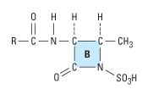
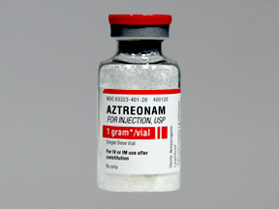
IV. MONOBACTAMS
Aztreonam(only one ring)
Monobactams are drugs with a monocyclic β-lactam
ring. It is a synthetic isolated from Chromobacterium violaceum. They are relatively resistant to beta-lactamases and active against Gram-negative rods (including Pseudomonas and Serratia). They have no activity against Gram-positive bacteria or anaerobes.
Aztreonam is poorly absorbed when given orally, so it must be administered as an intravenous or intramuscular injection (trade name Azactam ), or inhaled (trade name Cayston)

Slide 21
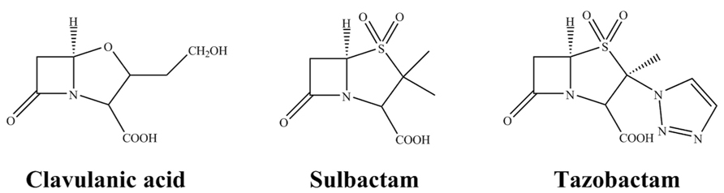
V. BETA-LACTAMASE INHIBITORS
β-lactemase inhibitors are group of chemical compounds ,alone it has no activity against bacteria but it is used as a combination with beta- lactams to enhance its activity by binding with beta –Lactemases enzymes cose they have similar B-Lactam ring .new beta lactam antibiotics that are more resistant to cleavage had developed called beta lactamase inhibitors. Although β-lactamase inhibitors have little antibiotic activity of their own,[they prevent bacterial degradation of beta lactam antibiotics and thus extend the range of any antibiotics The 3 beta –Lactemase inhibitors are :
Clavulanic acid Sulbactam Tazobactam
many antibiotics like
Ampicillin, amoxicillin, ticarcillin, and piperacillin are also available in combination with one of several beta-lactamase inhibitors: clavulanic acid, sulbactam, or tazobactam.

Slide 22
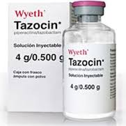
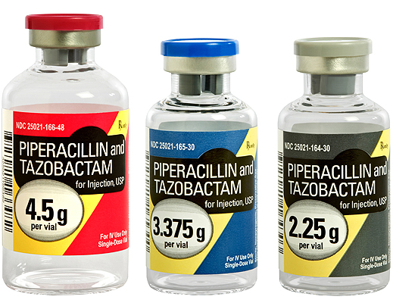
1-Clavulanic acid or clavulanate, usually combined with amoxicillin (Augmentin)
2- Clavulanic acid or clavulanate, usually combined with ticarcillin (Timentin)
3-Sulbactam, usually combined with ampicillin (Unasyn)
4- Sulbactam, usually combined with Cefoperazone (Sulperazon)
5-Tazobactam, usually combined with piperacillin (Tazocin)
6- Avibactam, approved in combination with ceftazidime (Avycaz),
Clavulox®
in VM
(Veterinary
Medicine!)

Slide 23
Production of penicillin
At 1957 fermentor used to grow Penicillium mould.Penicillin is a secondary metabolite of certain species of Penicillium and is produced when growth of the fungus is inhibited by stress. It is not produced during active growth.
α-ketoglutarate + AcCoA → homocitrate → L-α-aminoadipic acid → L-lysine + β-lactam
The by-product, l-lysine, inhibits the production of homocitrate, so the presence of exogenous lysine should be avoided in penicillin production.
The Penicillium cells are grown using a technique called fed-batch culture, in which the cells are constantly subject to stress, which is required for induction of penicillin production. The available carbon sources are also important: glucose inhibits penicillin production, whereas lactose does not. The pH and the levels of nitrogen, lysine, phosphate, and oxygen of the batches must also be carefully controlled.
The biotechnological method of directed evolution has been applied to produce by mutation a large number of Penicillium strains.Semisynthetic penicillins are prepared starting from the penicillin nucleus 6-APA.

Slide 24
Penicillin biosynthesis starts with the condensation of three amino acids, l-α-aminoadipic acid, L-cysteine, and L-valine, into the tripeptide δ-(l-α-aminoadipyl)-L-cysteinyl-D-valine (LLD-ACV). This step is catalyzed by the nonribosomal peptide synthetase δ-(l-α-aminoadipyl)-L-cysteinyl-D-valine synthetase. Next, the β-lactam ring is formed by isopenicillin N synthase (IPNS). After isopenicillin N enters the microbody, the l-α-aminoadipic acid side chain is replaced by an activated phenyl- or phenoxyacetyl group yielding penicillin G or V, respectively.

Slide 25
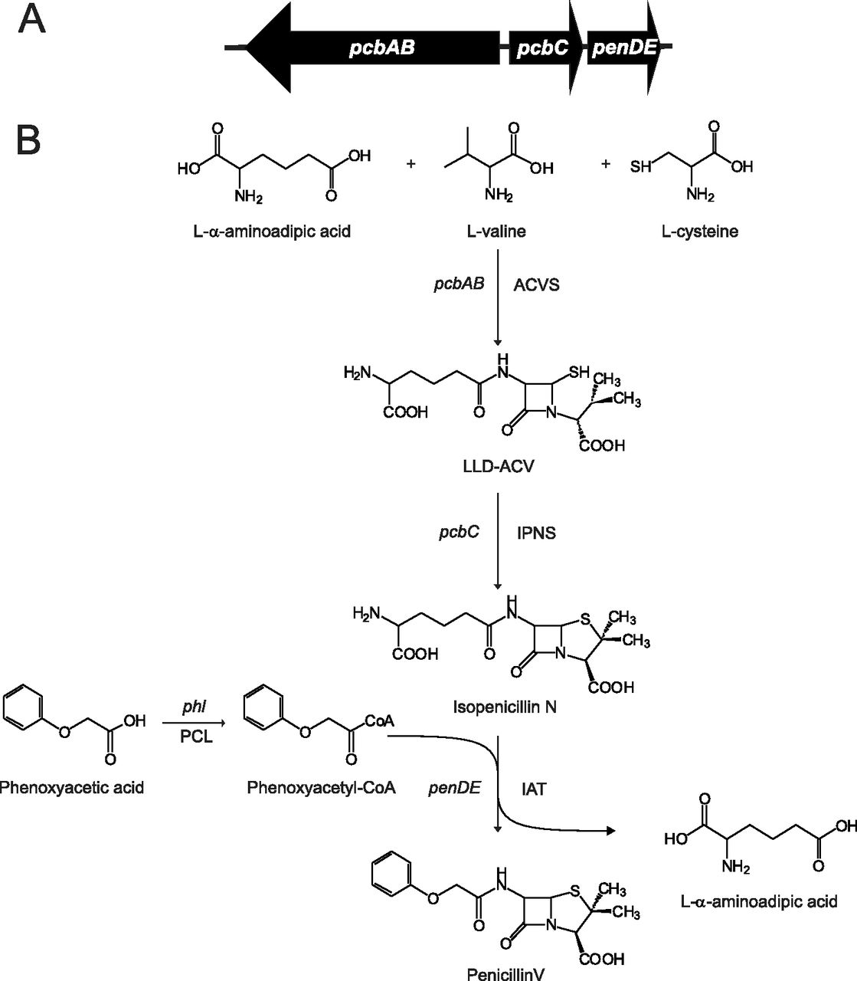

Slide 26
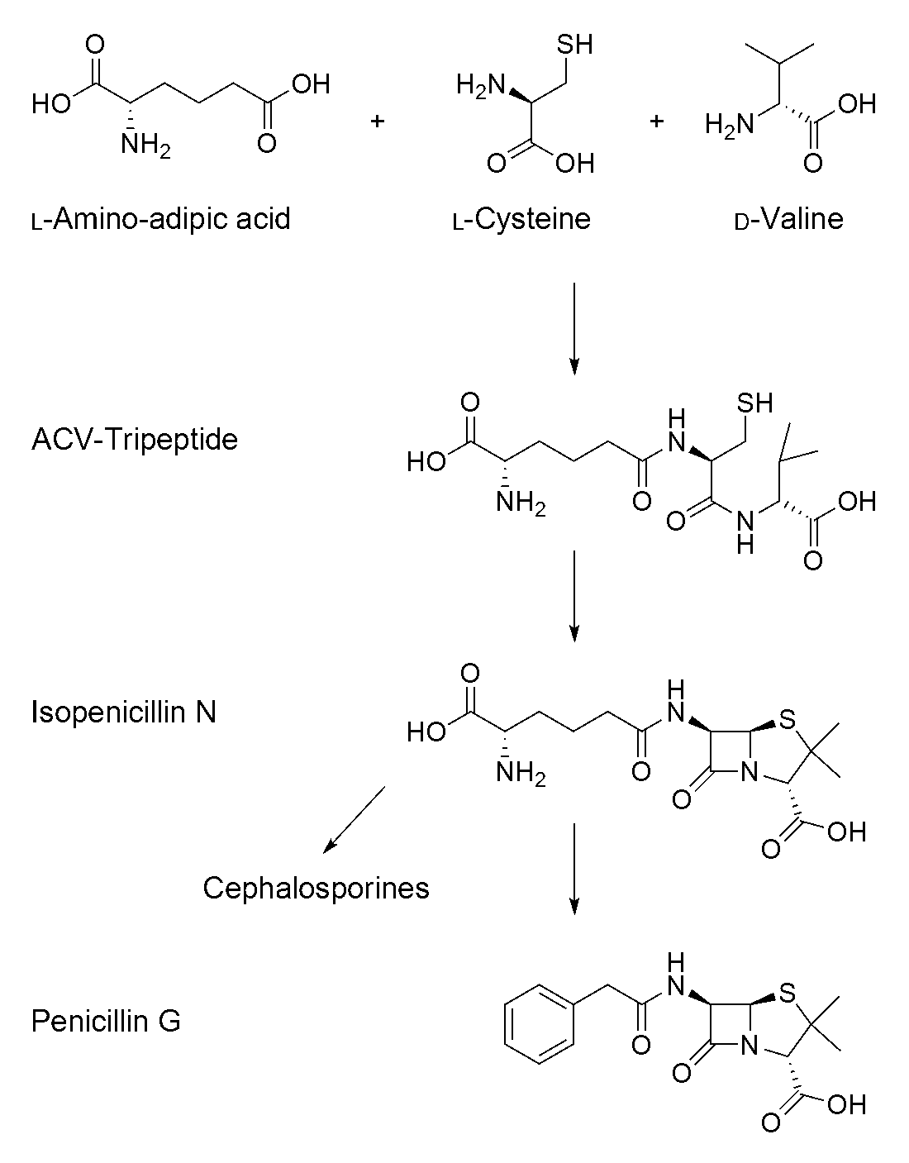

Slide 27
Recently, a “reverse engineering” study of the amplification of the penicillin biosynthetic gene cluster was carried out using a series of isogenic strains derived from a former industrial production strain, P. chrysogenum. These isogenic strains differed only in the number of biosynthetic gene clusters, and they showed high transcription levels of the biosynthetic penicillin

