Slide 1
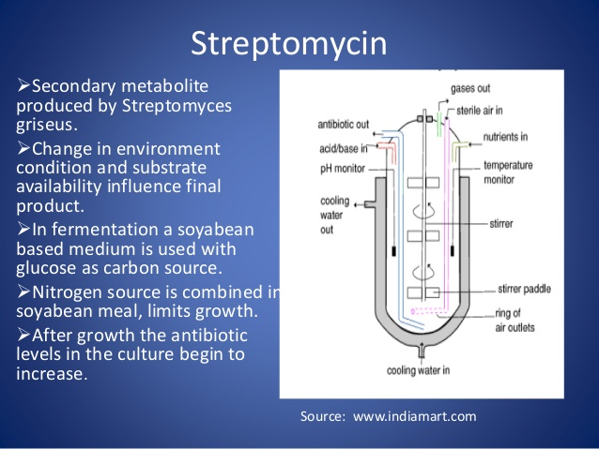
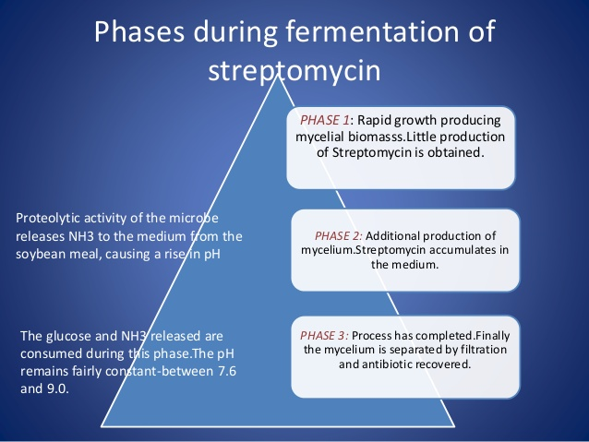

Slide 2
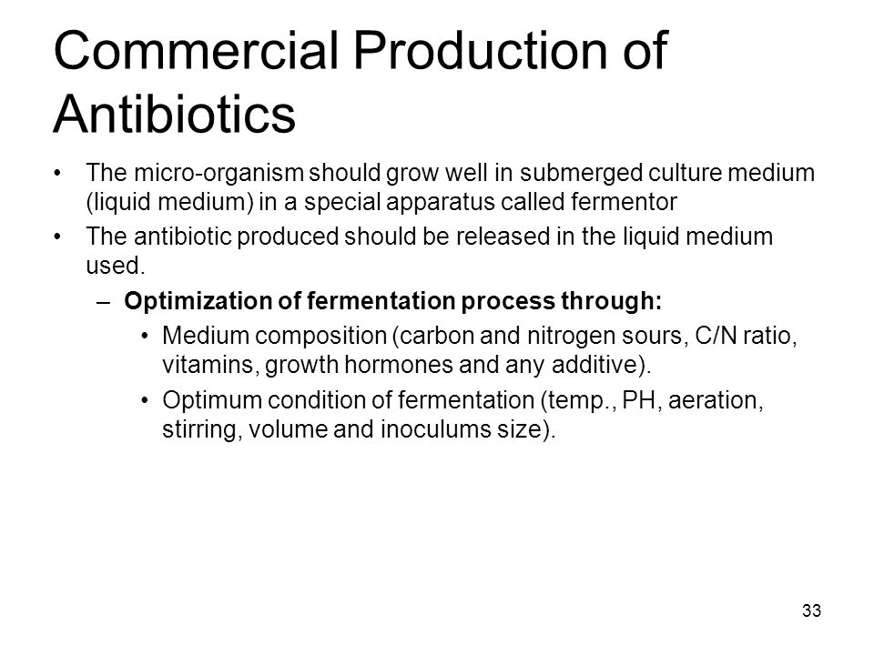
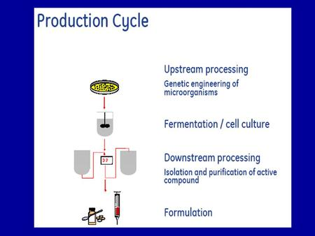

Slide 3
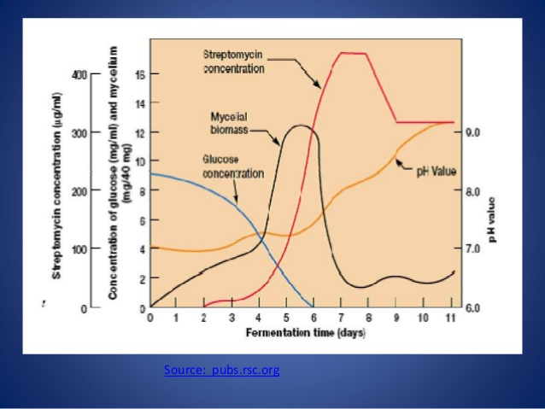
Streptomycin production :during fermentation glucose fermentation reduce by time streptomyces mass increase then reduce from the other hand streptomycin start to increase then stop

Slide 4
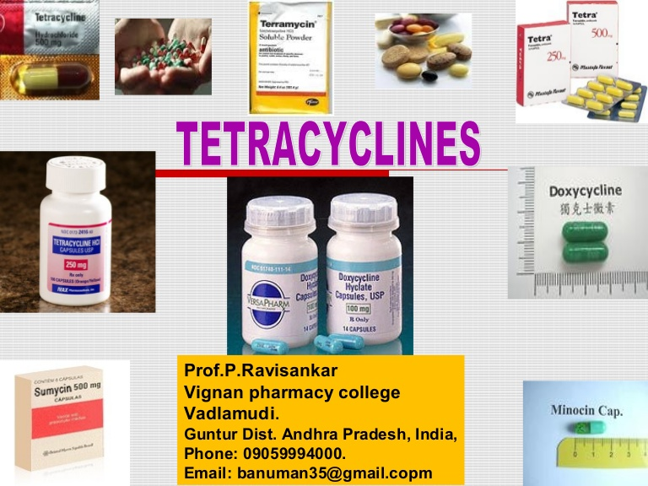
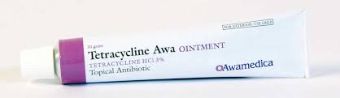
7th lecture in antibiotics Macrolides and Tetracyclins
Prepared by Prof Sawsan Sajid Al- Jubori

Slide 5
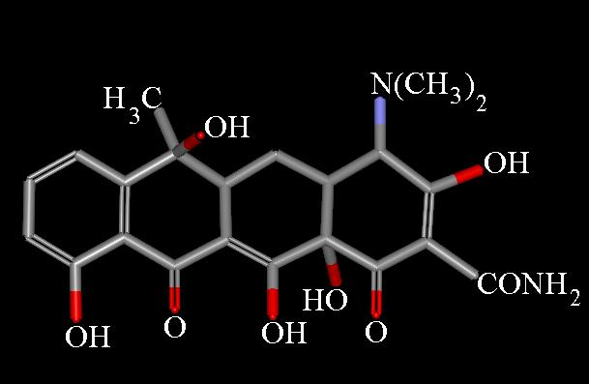
Protein inhibitor Antibiotics
  2- Tetracyclines : Source: Streptomyces rimosus
broad-spectrum antibiotics. The first of these compounds was chlortetracycline followed by oxytetracycline and tetracycline.
The term "tetracycline" is also used to denote the four-ring system of this compound; "tetracyclines" are related substances that contain the same four-ring system.
According to there nature it divided to
a) Naturally Tetracyclines :
1-tetracycline 2-chlortetracycline 3-oxytetracycline4-demeclocycline
B-Semisynthetic occurring:
1-doxycycline 2-minocycline 3-meclocycline 4-lymecycline
The drugs are amphoteric, meaning they will form salts with both strong acids and bases. Thus, they may exist as salts of sodium or chloride

Slide 6
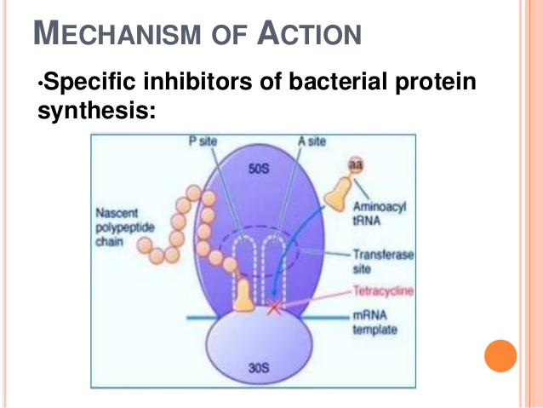
Quickly bacteriostatic drugs, but at high dosage they are also bactericidal. They reversibly bind to the 30S ribosomal subunit of bacteria, blocking the binding of
aminoacyl-tRNA to the site A on the mRNA ribosome complex. This prevents addition of amino acids to the Block the aminoacyl transfer RNA from entering the acceptor site → prevent introduction of new amino acid to nascent peptide chain
.

Slide 7
There are three types of tetracycline resistance: راجع محاضرة 3
Bacterial resistance to tetracyclines is mainly
due to the follow three mechanisms:
① Decreased intracellular accumulation owning to either impaired influx or increased efflux by an active transport protein pump;
② Ribosome protection owning to production of proteins that interfere with tetracycline binding to the target site.
③ Enzymatic inactivation of tetracyclines..

Slide 8
Spectrum of activity
Tetracyclines are effective against G+ and G-. They are weaker than penicilins and
cephalosporins against G+ organisms. But they are active against Rickettsiae, Mycoplasma, Chlamydiae Spirochete. They are effective against some protozoa
Clinical Uses
① First choice for rickettsial infections (typhus), chlamydial infections, and Mycoplasma pneumonia.
② They are effective for many spirochetal infections, including relapsing fever (first choice), leptospirosis, Lyme diseases, and syphilis.
③ They are also effective for treatment of various G+ and G- bacterial infections. Brucellosis, cholera, and tularemia can be treated with tetracyclines as the first choice.
④ Other uses: intestinal amebiasis, acne and actinomycosis

Slide 9
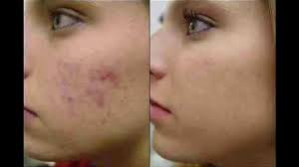
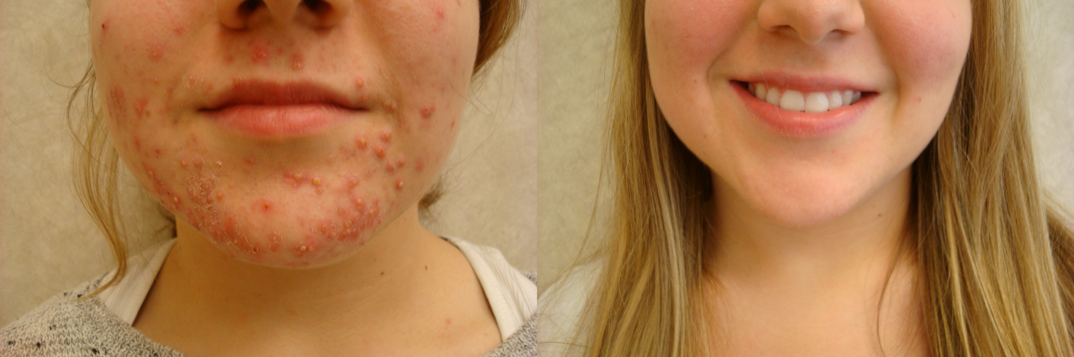
Cases :"Tetracycline was a miracle for me. I've had severe acne for 7 years and tried every medicine on the market, most of them made me sick or didn't work. I'm now 99% acne free. It is weird to wake up and not see a cyst or pimple on my face every day. I just hope it stays like this forever

Slide 10
Tetracycline side effects
Get emergency medical help if you have any of these signs of an allergic reaction: hives; difficulty breathing; swelling of your face, lips, tongue, or throat. Stop using tetracycline and call your doctor at once if you have any of these serious side effects:
severe headache, dizziness, blurred vision; fever, chills, body aches
severe blistering, peeling, and red skin rash; , flu symptoms;
pale or yellowed skin, dark colored urine, fever, confusion or weakness;
severe pain in your upper stomach spreading to your back, nausea and vomiting, fast heart rate; خاصة اذا على معدة فارغة صباحا
loss of appetite, jaundice (yellowing of the skin or eyes)
Tetracycline Uses: Tetracycline's primary use is for the treatment of a very wide range of infections including upper and lower respiratory tract infections but not for UTI .
Chlortetracycline used as antibacterial and anti protozoal agent. In veterinary medicine, it is commonly used to treat conjunctivitis in cats
Doxycyclines used in the treatment of chronic adult periodontitis. Brucellosis

Slide 11
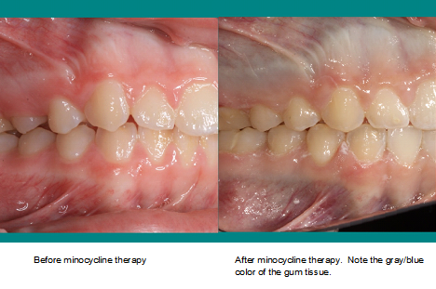
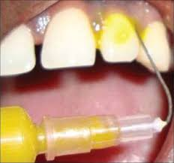
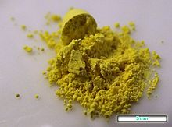
What should I avoid?
Avoid exposure to sunlight or artificial UV rays . Tetracycline can make your skin more sensitive to sunlight and sunburn may result.
Do not take iron supplements, multivitamins, calcium supplements, antacids, or laxatives within 2 hours before or after taking tetracycline. They will delay the absorption.
Do not take tetracycline with milk or other dairy products, unless your doctor has told you to. Dairy products can make it harder for your body to absorb the medicine.
Shake the oral suspension (liquid) well just before use
Avoid giving the drug to pregnant women (yellowish-grayish-brown discoloration of the teeth.↓

Slide 12
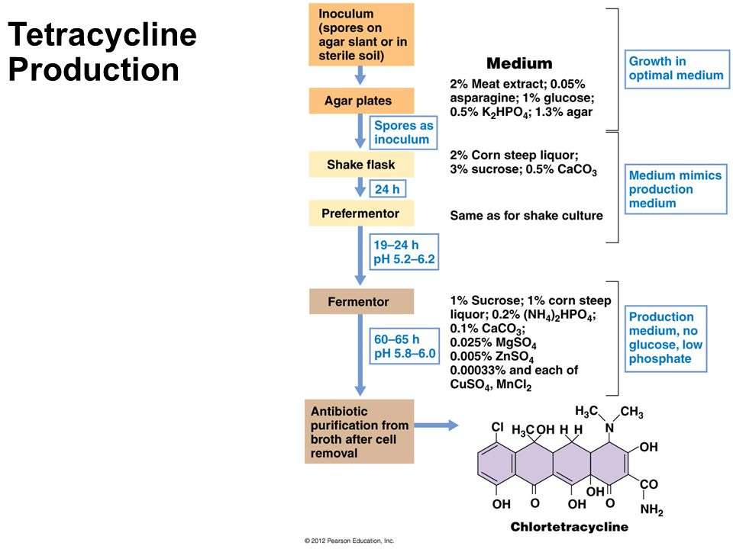

Slide 13
Protein inhibitor Antibiotics:
3- Macolides characterized by their large lactone ring structures and by their growth-inhibiting (bacteriostatic) They have large hydrophobic molecules and cannot penetrate both the inner and outer membranes of Gram-negative bacteria. The macrolides were first discovered in the 1950s, when scientists isolated erythromycin from the soil bacterium Streptomyces erythraeus. In the 1970s and 1980s synthetic derivatives of erythromycin, including clarithromycin and azithromycin, were developed.
Macrolide an antibiotics have a spectrum of activity only to gram-positive cocci (mainly staphylococci and streptococci) to gram-negative cocci, and intracellular bacteria (Chlamydia and Rickettsia species). Gram-negative bacilli are generally resistant, with some important exceptions (i.e., Bordetella pertussis, Campylobacter, Chlamydia, Helicobacter, and Legionella species). Macrolides are useful in treating respiratory, skin, soft tissue, sexually transmitted, H. pylori and atypical mycobacterial infections. Macrolides share a similar spectrum of antimicrobial activity with benzylpenicillin making them useful alternatives for people with a history of penicillin (and cephalosporin) allergy.

Slide 14
Mode of action:
Macrolides inhibit RNA-dependent protein synthesis by reversibly binding to the 50 S ribosomal subunits of susceptible microorganisms. They induce dissociation of peptidyl transfer RNA (tRNA) from the ribosome during the elongation phase. Thus, RNA-dependent protein synthesis is suppressed, and bacterial growth is inhibited. Macrolides are mainly bacteriostatic but can be bacteriocidal depending on bacterial sensitivity and antibiotic concentration.
Mode of resistance: Mechanisms of Resistance to macrolide and lincosamides antibiotics in 3 ways: (1) through target-site modification by Ribosomal Methylation of 23S rRNA(1956) soon after the introduction of erythromycin into therapy, resistance emerged in staphylococci . which leads to cross-resistance to macrolides, lincosamides, and streptogramins B or mutation that prevents the binding of the antibiotic to its ribosomal target, (2) through efflux of the antibiotic, (3)drug inactivation.

Slide 15
Adverse effects of Macrolides
gastrointestinal, such as abdominal discomfort and cramp, nausea, vomiting and diarrhea. upper stomach pain
difficult breathing; swelling of your face, lips, tongue, or throat.
headache with chest pain and severe dizziness
itching, tired feeling, loss of appetite, dark urine, clay-colored stools, jaundice
fever, sore throat, swelling in face or tongue, burning in eyes, skin pain, followed by a red or purple skin rash that spreads (especially in the face or upper body) and causes blistering and peeling.

Slide 16
Erythromycin: Erythromycin comes as a capsule, tablet, long-acting capsule, long-acting tablet, chewable tablet, liquid, and pediatric drops to take by mouth
it is used to treat Mycoplasma Pneumonia, Nongonococcal Urethritis, Otitis Media, Pharyngitis, Pneumonia, Skin or Soft Tissue Infection, Syphilis – Early, Upper Respiratory Tract Infection, Bronchitis, Chlamydia Infection, Legionella Pneumonia, Bacterial Endocarditis Prophylaxis, Erythromycin was previously recommended by the American Heart Association for prophylaxis prior to dental, oral and upper respiratory tract procedures in at-risk, penicillin-allergic patients. Erythromycin Ophthalmic Ointment For prophylaxis of ophthalmia neonatorum due to N. gonorrhoeae or C. trachomatis.

Slide 17
Azythromycin : usually given orally (capsule, tablet or suspension), intravenous and ophthalmic.
Spectrum of bacterial susceptibility
Azithromycin has relatively broad. It inhibits some Gram-positive bacteria, some Gram-negative bacteria, and many atypical bacteria..
Aerobic and facultative Gram-positive microorganisms
Streptococcus agalactiae, Staphylococcus aureus (Methicillin-sensitive only), Streptococcus pneumonia Streptococcus pyogenes
Aerobic and facultative Gram-negative microorganisms
Haemophilus influenzae, Moraxella catarrhalis Neisseria gonorrhoeae, Bordetella pertussis, Legionella pneumophila
Other microorganisms Chlamydia pneumoniae, Chlamydia trachomatis , Mycoplasma pneumoniae

Slide 18
Clarithromycin It is made from erythromycin Clarithromycin is acid-stable, so can be taken orally without having to be protected from gastric acids.
Spectrum of bacterial susceptibility
Aerobic Gram-positive bacteria, Staphylococcus aureus, Streptococcus pneumoniae and Streptococcus pyogenes
Aerobic Gram-negative bacteria Haemophilus parainfluenzae , Haemophilus influenzae, Moraxella catarrhali
Other bacteria
Chlamydia pneumoniae and Mycoplasma pneumoniae Helicobacter pylori Mycobacterium avium avium and Mycobacterium intracellulare
Aerobic Gram-Positive bacteria
Streptococcus (Groups C, F, G) and Viridans group streptococci
Aerobic Gram-Negative bacteria
Bordetella pertussis, Legionella pneumophila and Pasteurella multocida
Anaerobic Gram-Positive bacteria
Clostridium perfringens, Peptococcus niger and Propionibacterium acnes

