Slide 1
Mustansiriyah University
College of science
Biology Dept.
Zoology
4th class
Zoonoses lab. (7)

Slide 2
Cryptosporidium
Cryptosporidium is a spore producing parasite found in the intestine of infected people and animals.
Cryptosporidium spp. Is the most common cause of Cryptosporidiosis.

Slide 3
Cryptosporidium
History and Distribution
First observed in the gastric mucosal crypts of laboratory mice Tyzzer in 1907.
Causes diarrhea in humans and animals
Worldwide distribution
C.parvum and C.hominis causes human infections
One of the three most common diarrhea causing pathogens in the world.
One of the most common causes of waterborne illness in the world.

Slide 4
Definitive Host: Human
Reservoir Hosts: kittens, puppies, goats, calves, mice, …. Etc.
Disease: Cryptosporidiosis.
Habitat: Epithelial cells of the gastrointestinal tract, mainly jejunum
Transmission: Fecal-oral route.

Slide 5
Morphology
Infective form- oocyst
Spherical, oval, 5μm in
diameter
Does not stain with iodine
and is acid fast
Thick walled
Very hard and resistant.
Temperature-60ºC

Slide 6
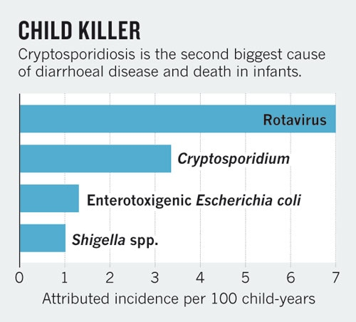
Transmission
Food and water
contamination of drinking water
Swimming pools
untreated groundwater or well water
an infected person or an asymptomatic
carrier contaminates a food supply
Animal-person transmission
Person-person transmission
Incubation period 2-14 days

Slide 7
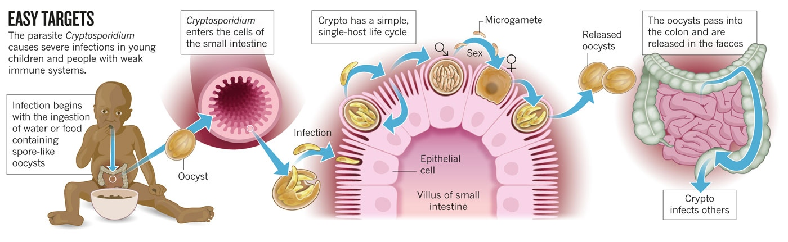

Slide 8
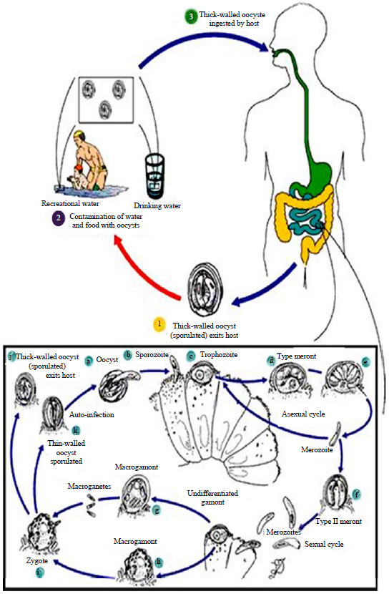

Slide 9
Diagnosis
Microscopy with an acid fast stained stool smear,which will stain the oocysts bright red.
Another form of microscopy is fluorescent microscopy using monoclonal antibody to oocyst wall
Direct immunofluorescence
antibody stain
acid-fast oocyst stain

Slide 10
Mouse small intestine infected with Cryptosporidium. Small bodies seem to be on the surface of epithelial cells are various developmental stages of C. parvum enveloped by host cell membrane. H & E stain.

Slide 11
Echinococcus granulosus
Echinococcus granulosus, also called hydatid worm belongs to class Cestoda
It causes cystic echinococcosis in livestock and humans being intermediate hosts and parasitize the small intestines of adult canids
It is a zoonotic disease
Definitive hosts are carnivorous predators like dogs,
wolves, foxes and lions. While sheep, goat, cattle, pigs
and rodents are intermediate hosts. Birds and arthropods act as mechanical vectors

Slide 12
Morphology
The adult tapeworm ranges in length from 2 mm to 7 mm and has three proglottids when intact — an immature proglottid, mature proglottid and a gravid proglottid.
It has scolex with four suckers and also has a rostellum with hooks.
Echinococcus is triploblastic, anus is absent and it has no digestive system.

Slide 14
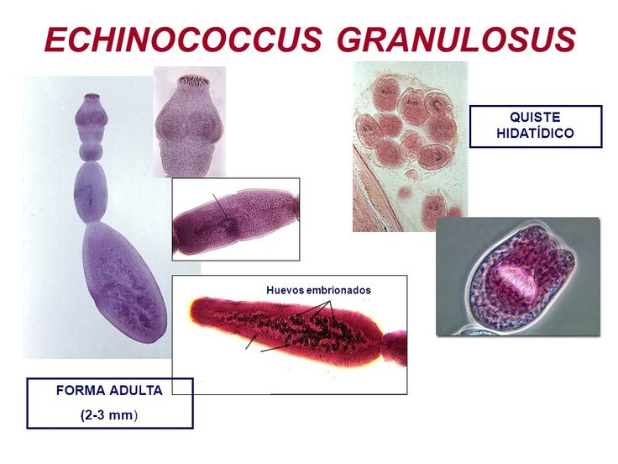

Slide 15
Transmission
Adult E. granulosus release eggs within the intestine
which will be transported out of the body via feces
When contaminated waste is excreted into the
environment, intermediate host has the potential to
contract the parasite by grazing in contaminated
pasture
It is transmitted from the intermediate host (sheep) to
the definitive host (dogs) by frequent feeding of offal.
Consuming offal containing Echinococcus granulosus can lead to infection

Slide 16
LIFE CYCLE
The adult is in the small intestines of the definitive host(dogs)
Gravid proglottids release eggs that are passed in the feces
The intermediate hosts are infected by ingesting eggs, the egg hatches in the small bowel and releases an oncosphere
The oncosphere penetrates the intestinal wall and moves through the circulatory system to various organs
In the organs they develop into cysts and enlarge gradually

Slide 17
LIFE CYCLE
The cysts produce protoscolices and daughter cysts
Definitive host eats the infected organs and becomes infected
After ingestion, the protoscolices evaginate, attach to the intestinal mucosa and develop into adult stages In 32-80 days, cycle starts over

Slide 19
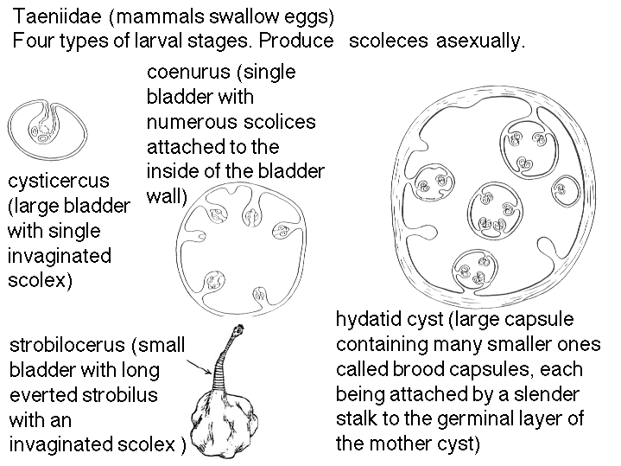

Slide 20
The growth rate of cysts is highly variable and may depend on
strain differences and cyst location. Estimates of the average
increase of cyst diameter vary

Slide 21
Gross pathology of membrane and
hydatid daughter cysts from human lung
Pathologically hydatid liver cyst has three distinct layers:

Slide 22
Histopathology of Echinococcus granulosus hydatid cyst in a sheep. Thick fibrous pericyst, hyaline ectocyst, and brood capsules filled with protoscolices are visible.

Slide 23
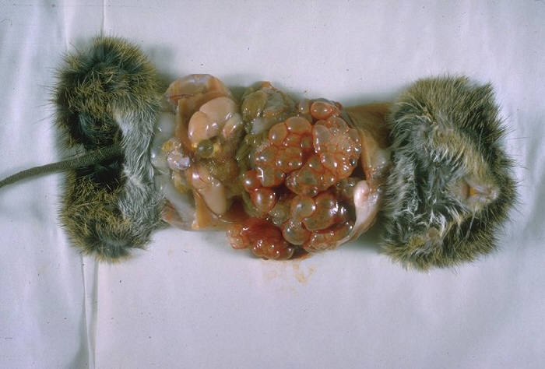
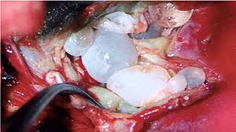
Hydatid cysts

Slide 24
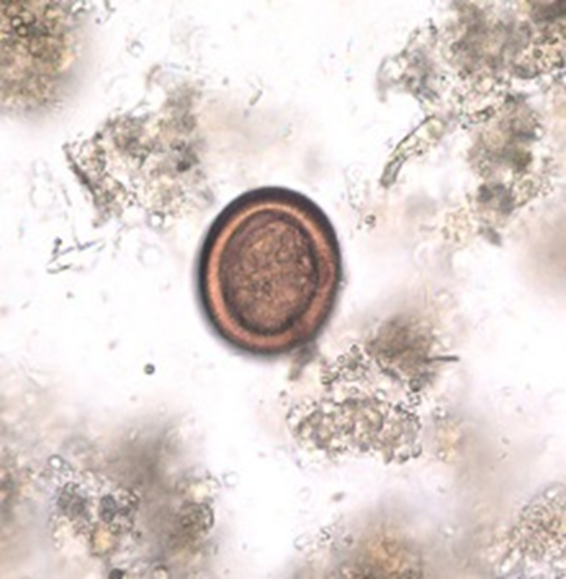
DIAGNOSIS
Diagnosis in the definitive host, the dog, is difficult by ordinary microscopy as it cannot demarcate between Taenia and Echinococcus eggs
Detection of antigens in feces by ELISA is currently the best available technique Other techniques are;
Imaging
Serologic testing
Examination of cyst fluid
Echinococcus eggs in feaces

