Slide 1

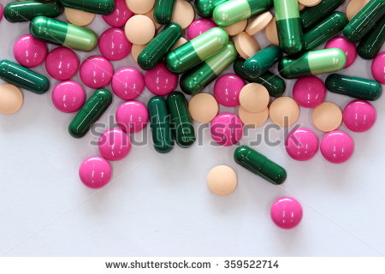
8th lecture in antibiotics : biotechnology
Other protein synthesis inhibitors Lincosamides and Streptogramins
by Dr.Sawsan Sajid & Dr. Ibtesam G.Auda

Slide 2
  Lincosamides is a class of antibacterials originates from a natural product, and was first characterized in the 1960s.
  lincomycin is the first lincosamide to be discovered , isolated from Streptomyces lincolnensis in a soil sample from Lincoln, Nebraska (hence the bacterial name).
  The semi synthetic derivatives are clindamycin and pirlimycin. now it is used to treat a broad spectrum of infections. It is mostly active against gram-positive organisms, but also finds use against selected gram-negative anaerobes and protozoa.
Mode of action :These antibiotics function by blocking microbial protein synthesis via binding to the 23S rRNA of the 50S subunit and mimicking the intermediate formed in the initial phase of the elongation cycle

Slide 3
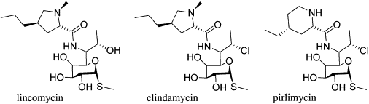
Structure of licncomycines

Slide 4
Spectrum of activity : Usage of lincomycin has been largely superseded by clindamycin which exhibits improved antibacterial activity. Clindamycin also exhibits some activity against parasitic protozoa and has been used for toxoplasmosis and malaria. Lincosamides are normally used to treat Staphylococcus and Streptococcus and have proved useful in treating Bacteroides fragilis and some other anaerobes. They are used in the treatment of toxic shock syndrome and thought to directly block the M protein production that leads to the severe inflammatory response.
مهم Lincosamide antibiotics are one of the classes of antibiotics most associated with pseudomembranous colitis caused by Clostridium difficile.

Slide 5
Resistance: increased antibiotic use leads to the development of resistance. Two of the most common routes of resistance to lincosamides include
Antibiotic modification, a route more prevalent in pathogenic gram-positive cocci, Organisms employing the antibiotic modification strategy inactivate lincosamides via adenylylation catalyzed by enzymes encoded by lin genes. These enzymes show amino acid sequence homology with the aminoglycoside antibiotic nucleotidyltransferase
Methylation of the ribosomal 23S rRNA by Erm methyltransferases, observed in many genera and resulting in co resistance to macrolide and type B streptogramin antibiotics.
Lincomycin : is used for treating serious bacterial infections caused by susceptible strains of streptococci, pneumococci, and staphylococci. Use of lincomycin is reserved for penicillin-allergic patients or when penicillin-based treatment is not appropriate. This antibiotic should only be used to treat serious infections because of rare but sometimes fatal intestinal problems have occurred (pseudomembranous colitis). Other Side effects of lincomycin are:nausea,vomiting,diarrhea,abdominal pain,rash, and itching.

Slide 6
Clindamycin : is frequently used to treat infections caused by streptococci and staphylococci . Clindamycin treatments have been limited in the past because of rapid development of resistance and gastrointestinal side effects. Recently, as the emergence of multidrug-resistant pathogens has become a grave concern, lincosamide use has been revisited. In particular, clindamycin has been found to be potent in treating methicillin-resistant Staphylococcus aureus (MRSA), a pathogen causing worldwide concern because of its increasing rate of incidence and limited treatments .This drug is available in many forms. It comes as an oral capsule, oral solution, topical foam, topical gel, topical lotion, topical swab, topical solution, vaginal suppository, and vaginal cream. It’s also available as an intravenous (IV) drug Common side effects include nausea, diarrhea, rash, and pain at the site of injection. It increases the risk of hospital-acquired Clostridium difficile colitis about fourfold
Clindamycin is used primarily to treat anaerobic infections caused by susceptible anaerobicbacteria, including dental infections, and infections of the respiratory tract, skin, and soft tissue
In people with hypersensitivity to penicillins, clindamycin may be used to treat infections caused by susceptible aerobic bacteria, as well. It is also used to treat bone and joint infections, particularly those caused by Staphylococcus aureus.Topical application of clindamycin phosphate can be used to treat mild to moderate acne.افضل علاج لحاله حب الشباب
Acne The use of clindamycin in conjunction with benzoyl peroxide is more effective in the treatment of acne than the use of either product by itself.

Slide 7
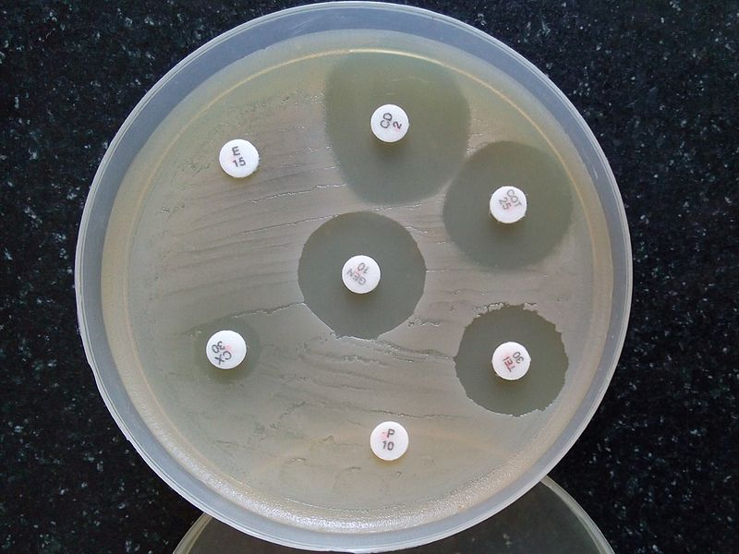
D-Test When testing a Gram-positive culture for sensitivity to clindamycin, it is common to perform a "D-Test" to determine if there is a macrolide-resistant sub-population of bacteria present. This test is necessary because some bacteria express a phenotype known as MLS_{B}, [Macrolide-lincosamide-streptogramin B resistance phenotypes in clinical Staphylococcus isolates] in which susceptibility tests will indicate the bacteria are susceptible to clindamycin, but in vitro the pathogen displays inducible resistance.
To perform a D-test, an agar plate is inoculated with the bacteria in question and two drug-impregnated disks (one with erythromycin,
one with clindamycin) are placed 15–20 mm apart on the plate. If the area of inhibition around the clindamycin disk is "D" shaped,
the test result is positive and clindamycin
should not be used due to the possibility of
resistant pathogens and therapy failure.
If the area of inhibition around the
clindamycin disk is circular, the test result
is negative and clindamycin can be used

Slide 8
Streptogramins
The streptogramin antibiotics were identified almost 50 years ago, but have only recently found clinical use as a consequence of the increase in multidrug-resistant bacteria irreversibly bind to the 50S ribosomal subunit. Group A streptogramins prevent peptide bond formation during chain elongation step, while group B components cause the release of incomplete peptide chains from the 50S ribosomal subunit. Streptogramins are effective in the treatment of vancomycin-resistant Staphylococcus aureus (VRSA) and vancomycin-resistant Enterococcus (VRE), two of the most rapidly growing strains of multidrug-resistant bacteria.
They fall into two groups: streptogramin A and streptogramin B. Streptogramin is used in the treatment of respiratory tract infections Streptogramins A and B synergically inhibit cell growth of gram positive, less so gram negative bacteria by inhibiting protein synthesis, but separately they are bacteriostatic. The molecular target of streptogramins is the 23S rRNA. Both streptogramin A and B bind to the P binding site of the 50S ribosome subunit. The type A streptogramin binding causes a conformational change to the 50S subunit, which increases the activity of the type B streptogramin by a 100-fold. Streptogramin B prevents the elongation of protein chains and causes the release of incomplete peptides

