Slide 1
Mustansiriyah University
College of science
Biology Dept.
Zoology
4th class
Zoonoses lab. (5)

Slide 2
Dermatomycosis {DERMATOPHYTES}
Dermatomycoses are infections of the skin, hair or nails by fungi. The principal causative agents are dermatophytes, which are subdivided into three groups (genera):
Microsporum spp.,
Trichophyton spp.
Epidermophyton floccosum.
The three genera are distinguished by the form of the spores, or macroconidia.

Slide 3
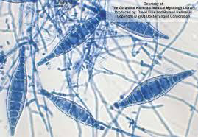
CHARACTERISTICS
Trichophyton: thin-walled, smooth, four to six septa
Microsporum: thick-walled, with projections five to more septa
Epidermophyton: thick-walled, pear to oval shaped four or fewer septa
Besides the dermatophytes, yeasts are also capable of causing skin disorders. The most frequent agents in this case are Candida spp. and Pityrosporum.

Slide 4
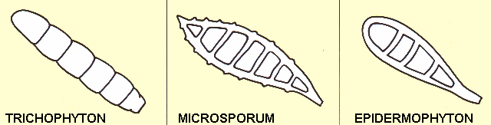
DERMATOPHYTES - CLASSIFICATION

Slide 5
DEVELOPMENT OF A DERMATOPHYTOSIS
direct contact with infected persons or animals, but it is more often a question of contact with fungal spores. These spores are contained in epithelial (skin) elements of infected persons everywhere in our environment. The floors of communal shower stalls and changing rooms are major sources of infection. For the development of an infection, however, more is needed than contact alone.
Dermatophytes prefer warm, moist conditions. This is why a dry, intact skin constitutes a virtually impenetrable barrier. But the chance of infection is encouraged by everything that has an adverse influence on the situation.

Slide 6
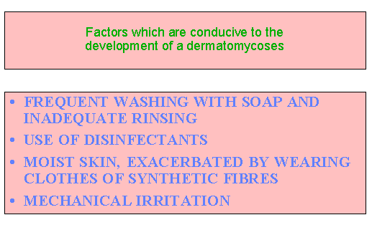

Slide 7
DERMATOPHYTES - PREFERRED SITES
OF INFECTION
Most dermatophytes have been found to have a preference for certain situs. A preference for growth in and around the hair, in the horny layer of skin, in the moist, warm folds of the skin, or just under the nails. Trichophyton species have been found to have the greatest adaptability.
Epidermophyton floccosum occurs principally in the large flexure lines and around the foot. Microsporum chiefly attacks the scalp and glabrous skin.
Furthermore, the preferred sites of infection of dermatophytes are, to a certain extent, also determined by the situs where the skin comes into contact with the fungal spores.

Slide 8
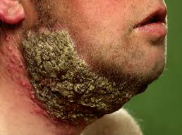
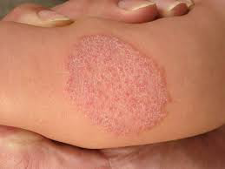
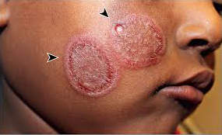
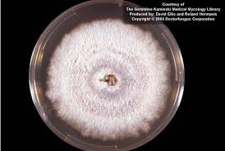
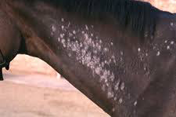

Slide 9
