Slide 1
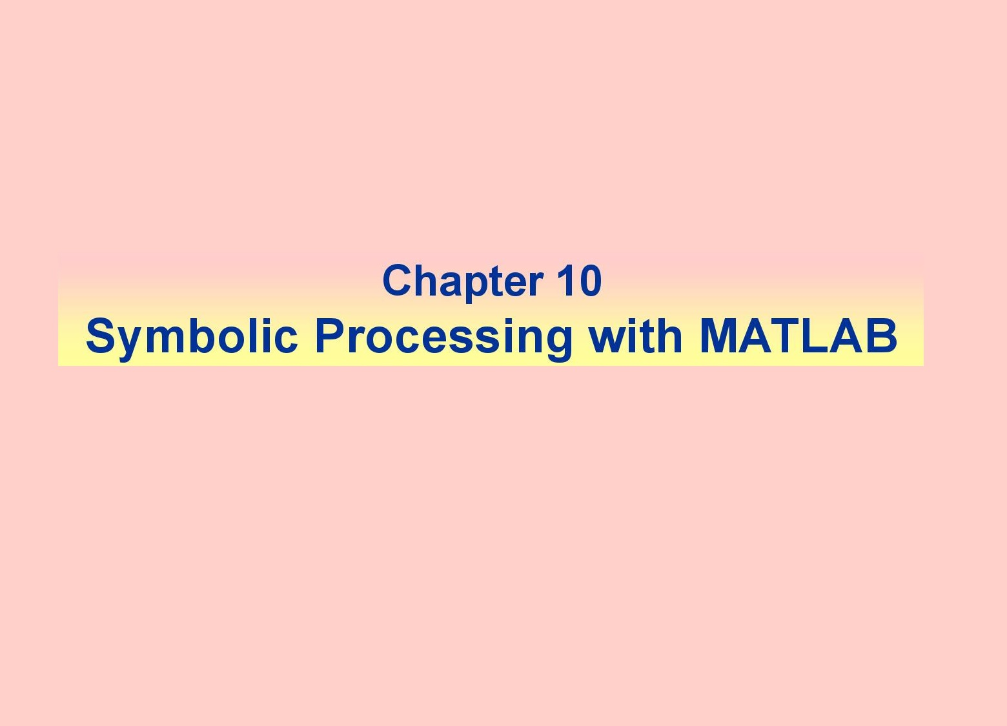


Slide 2
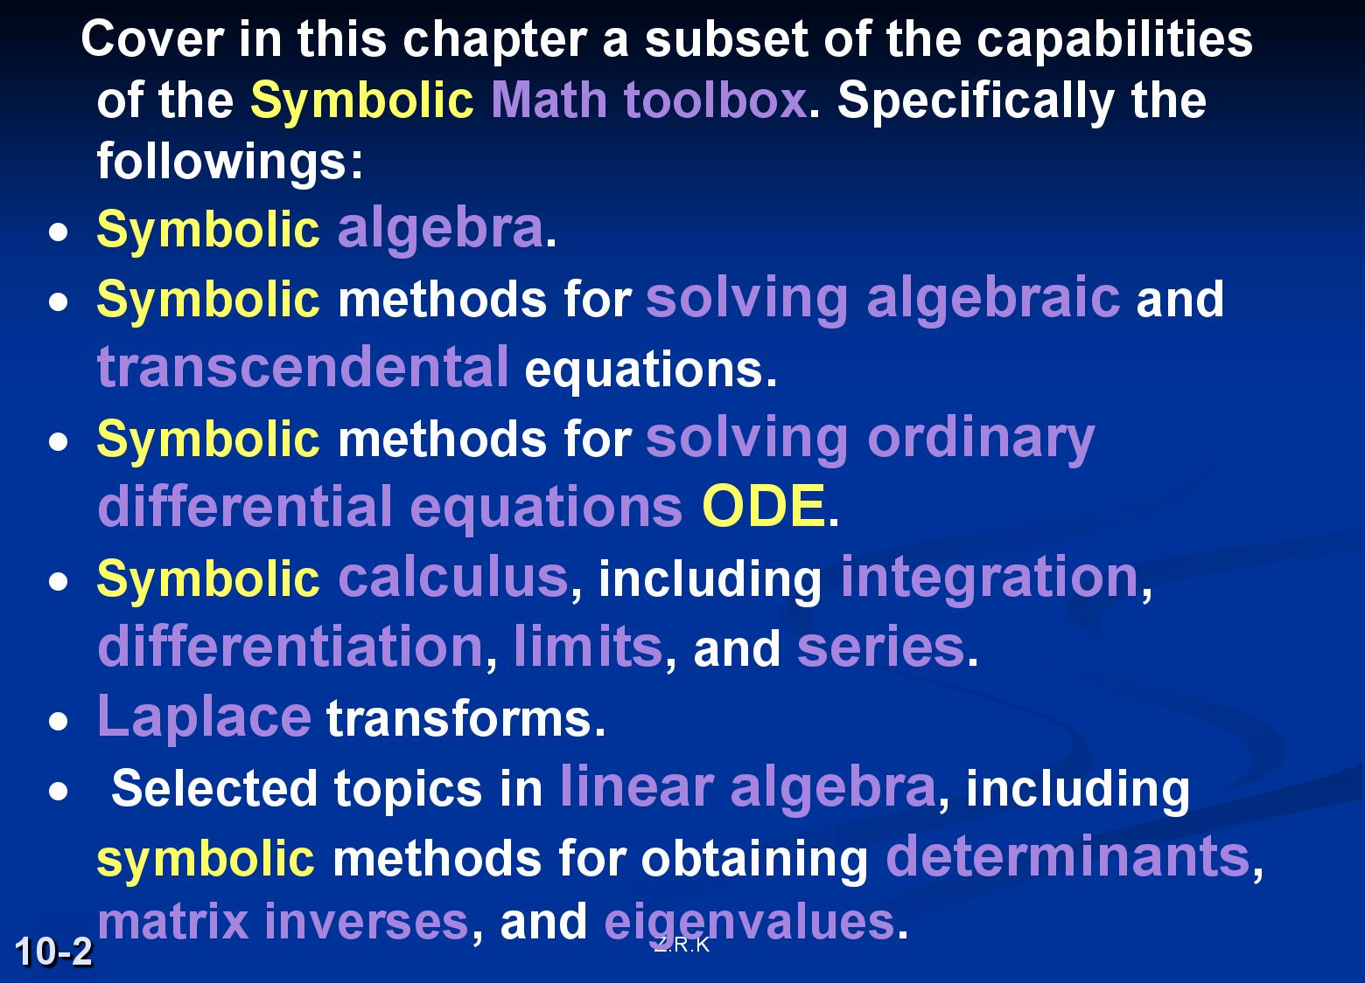

Slide 3
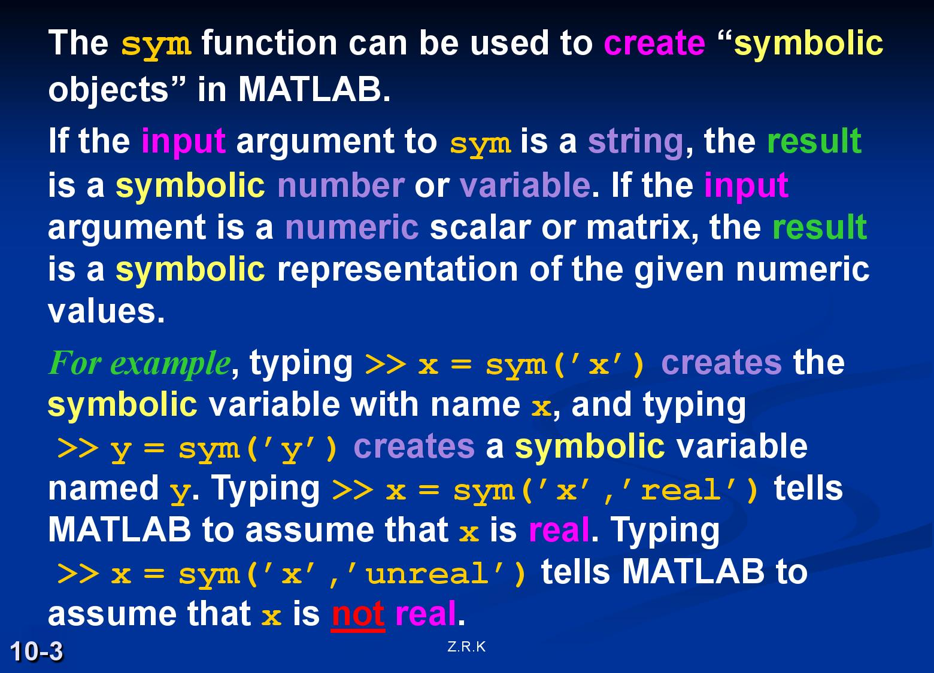

Slide 4
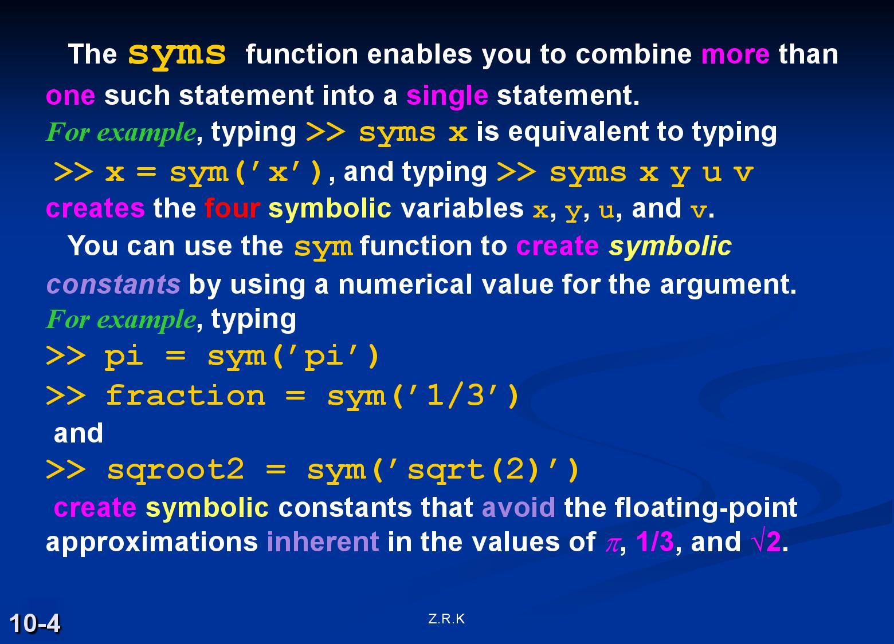

Slide 5
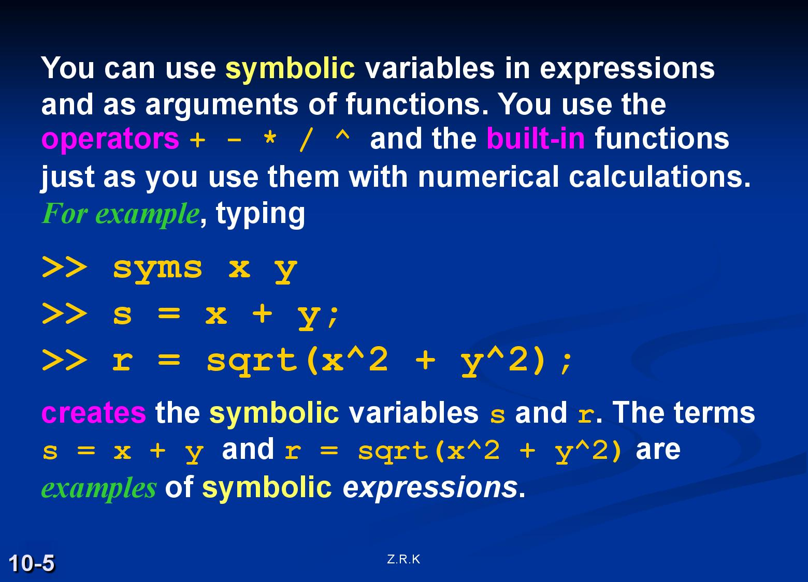

Slide 6
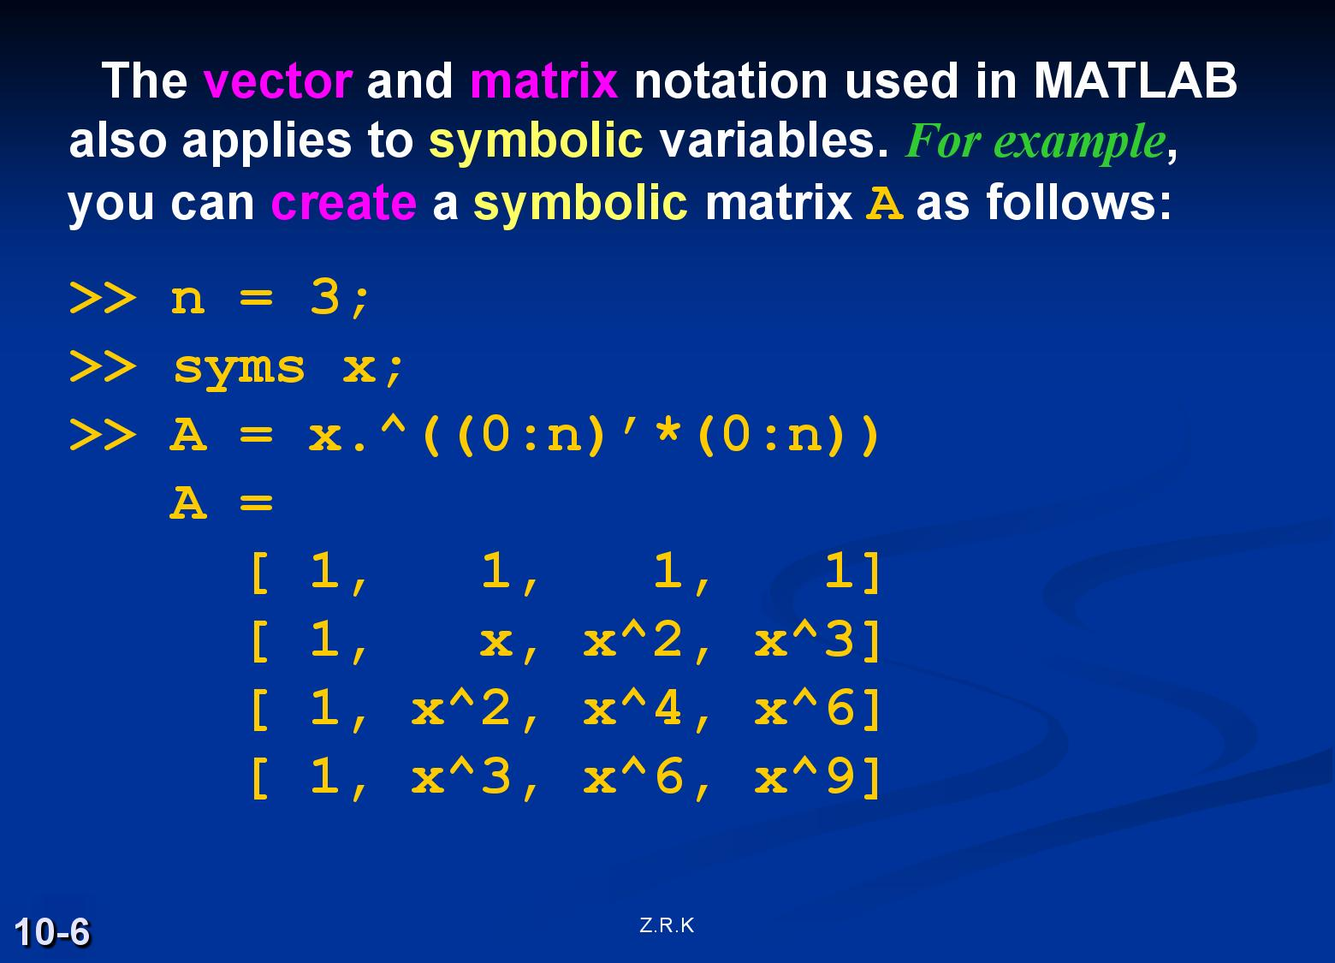

Slide 7
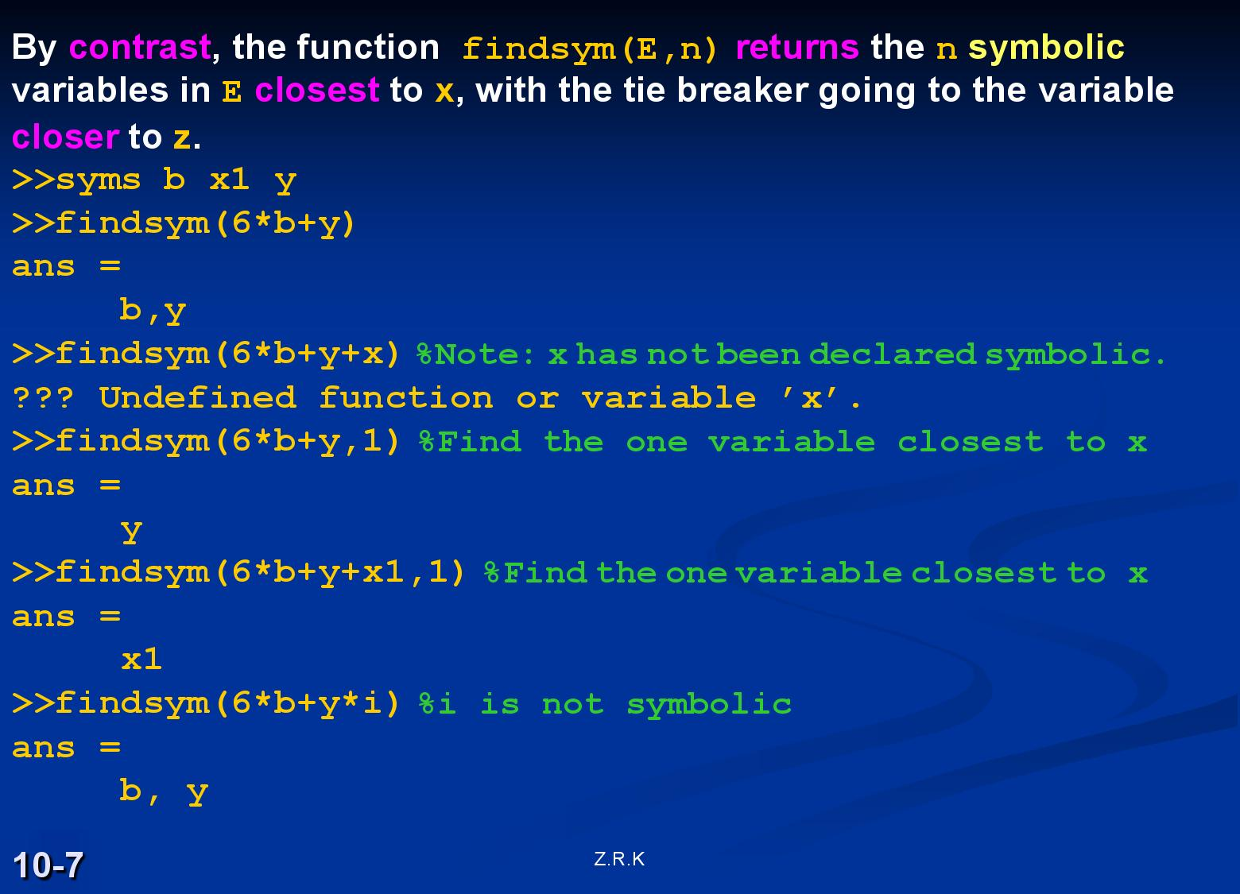

Slide 8
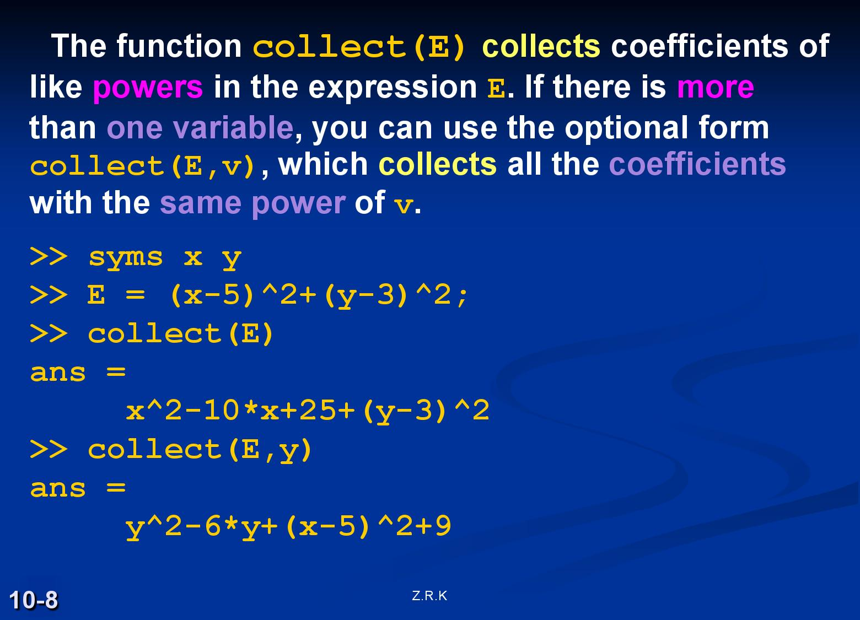

Slide 9
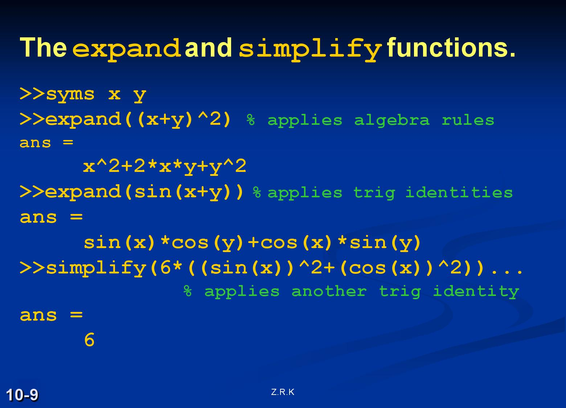

Slide 10
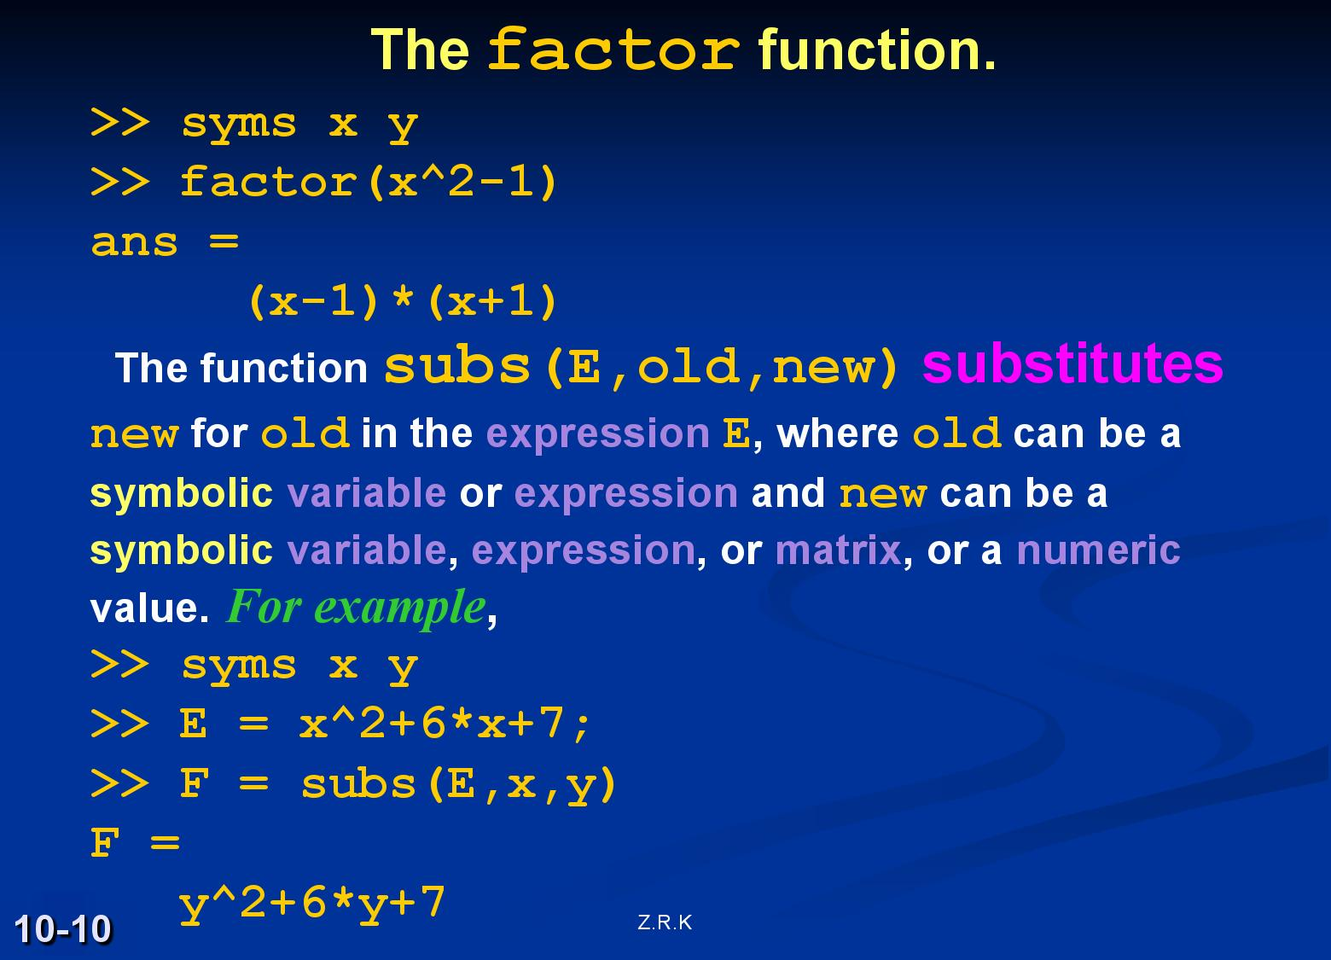

Slide 11
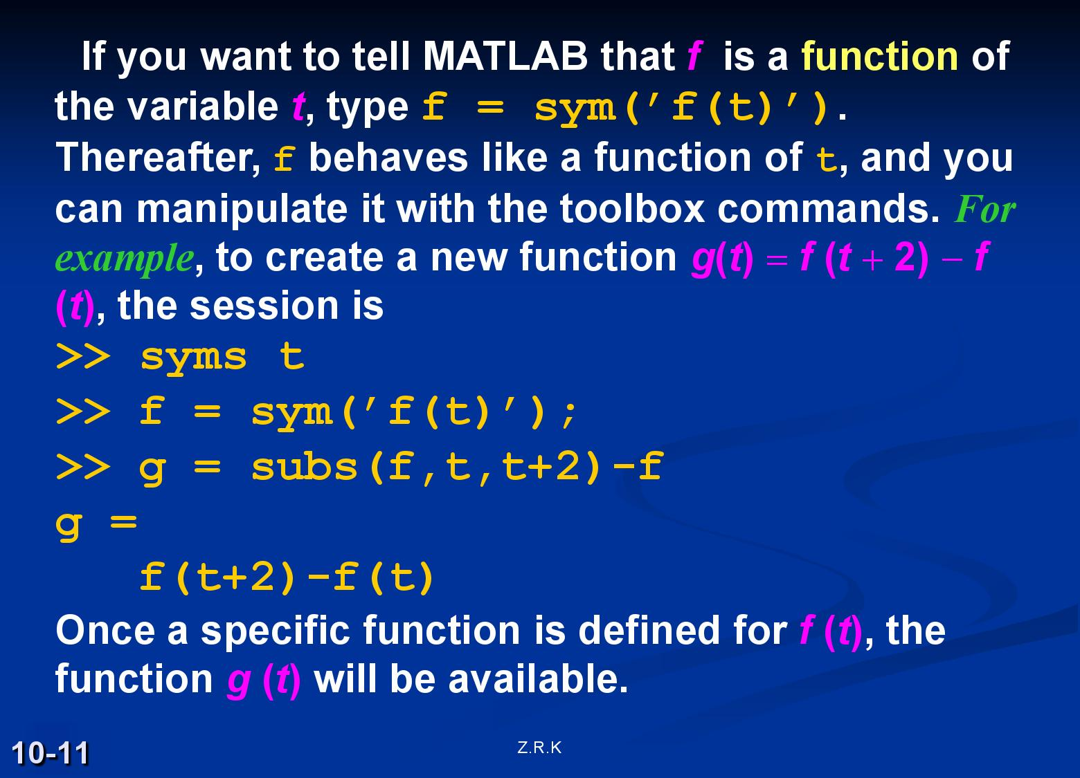

Slide 12
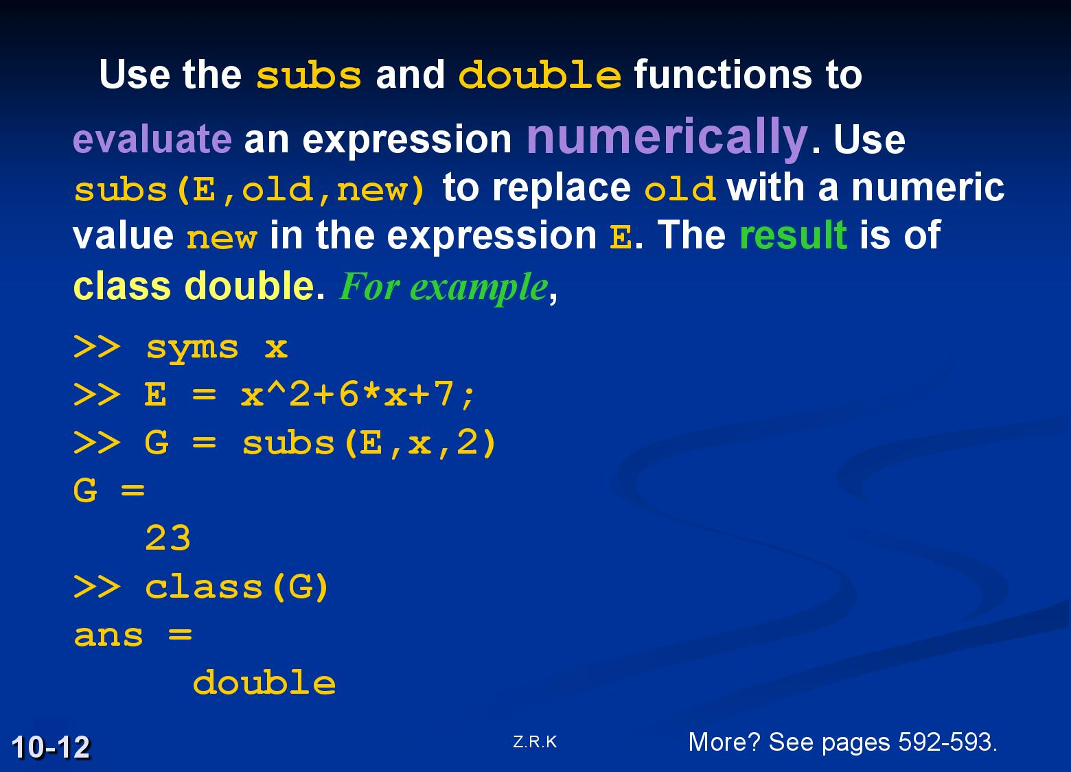

Slide 13
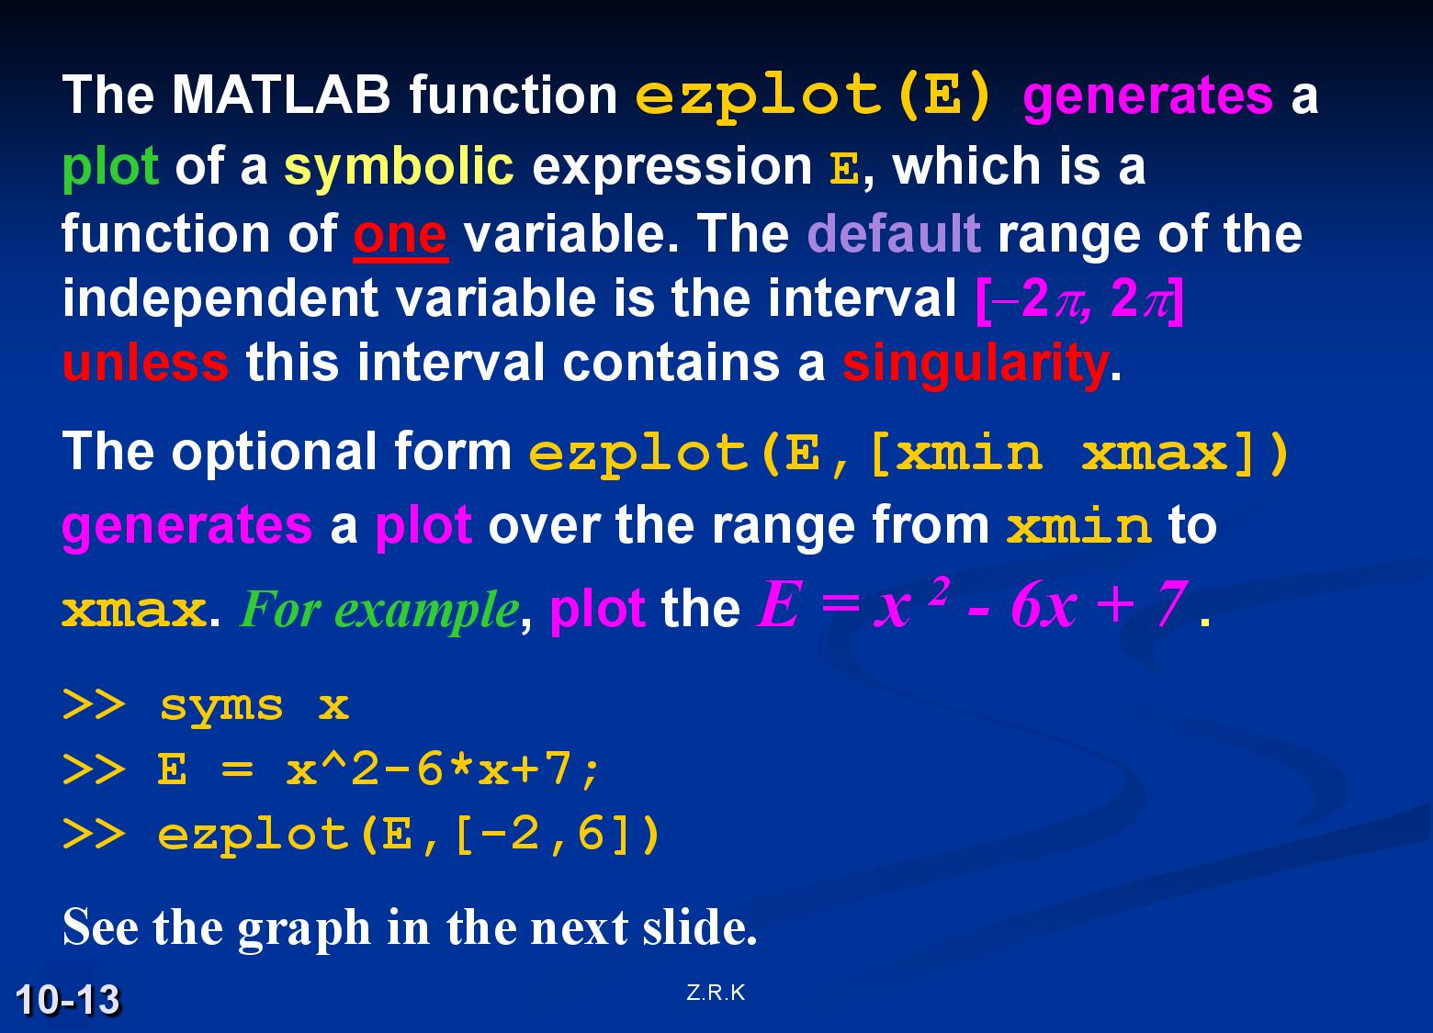

Slide 14
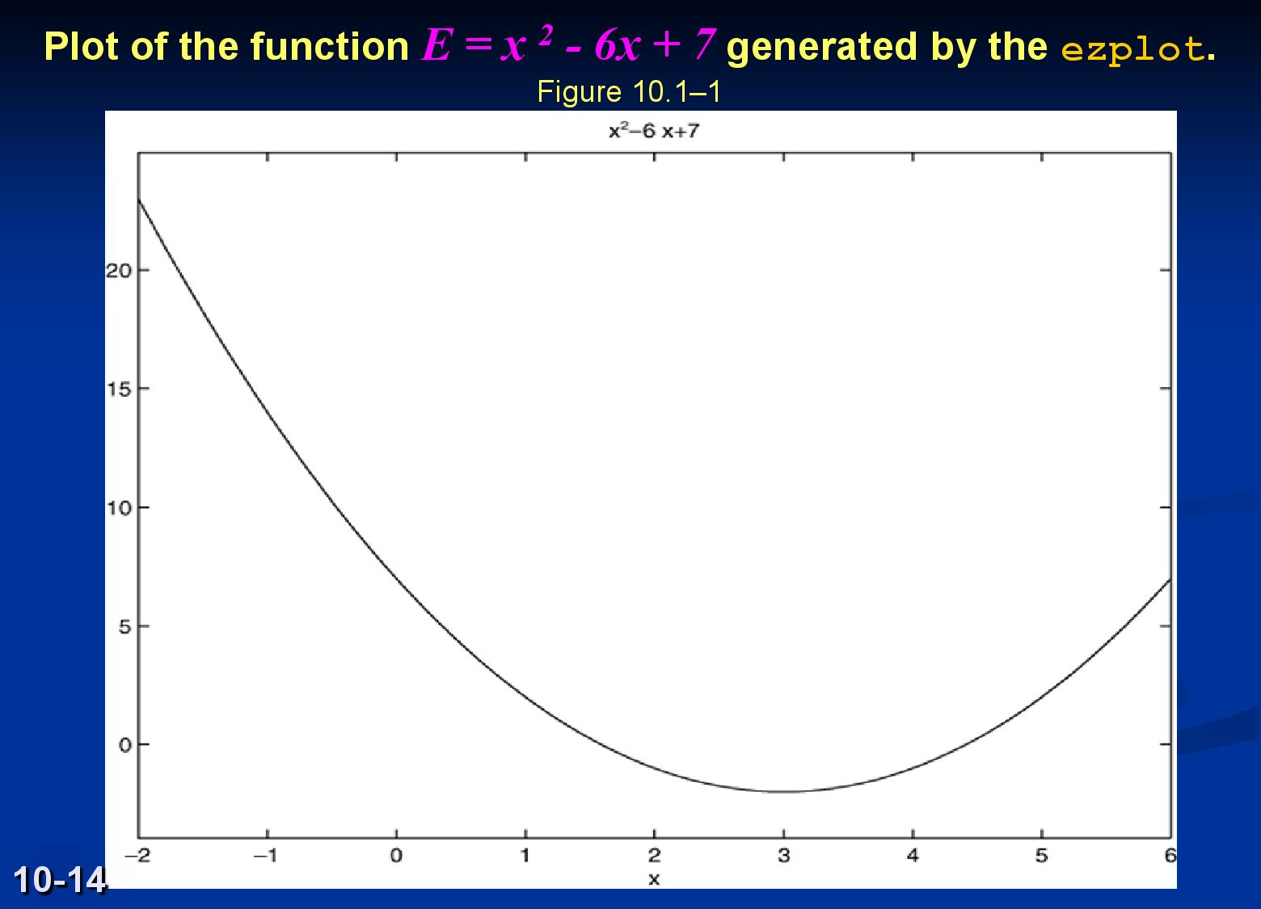

Slide 15
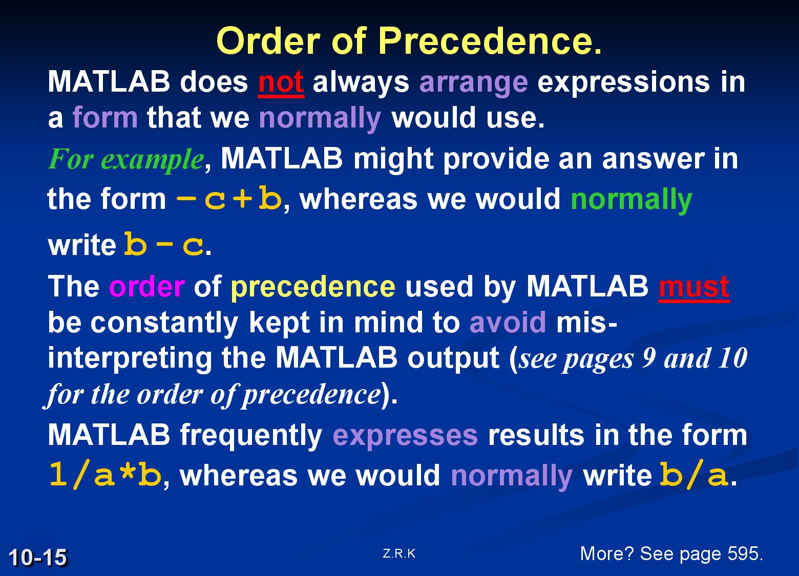

Slide 16
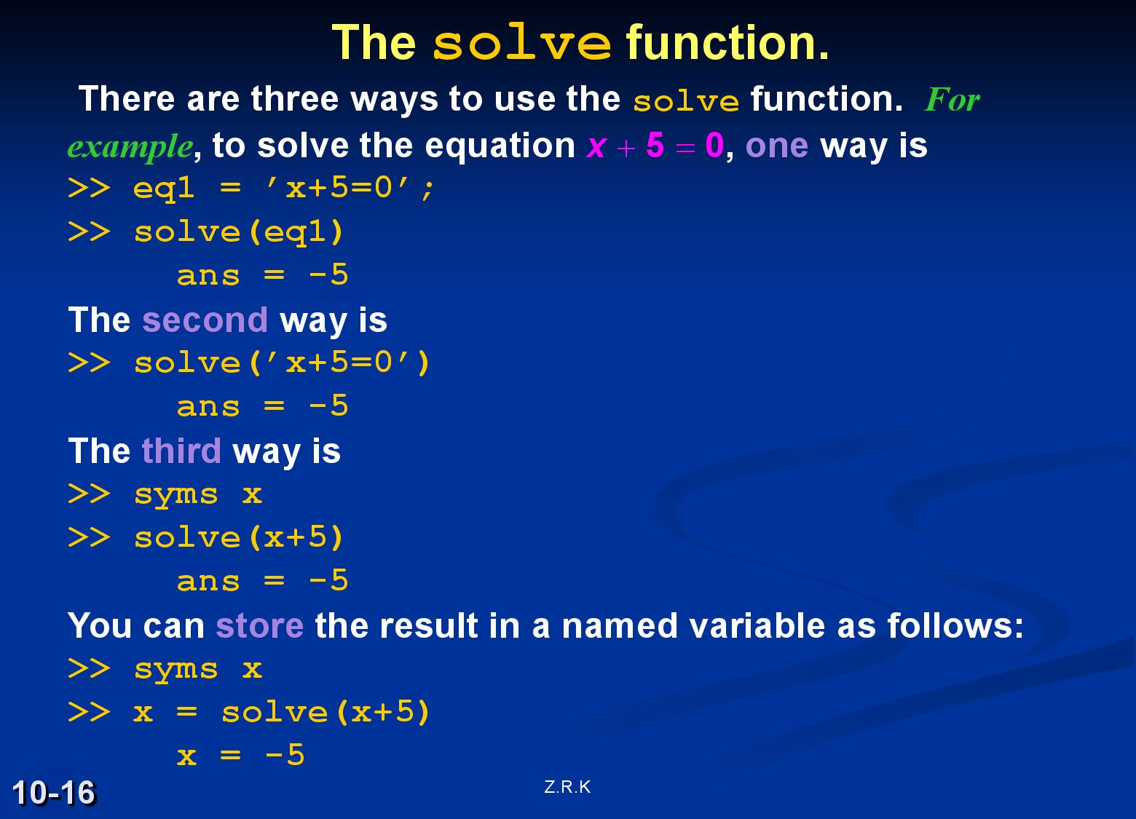

Slide 17
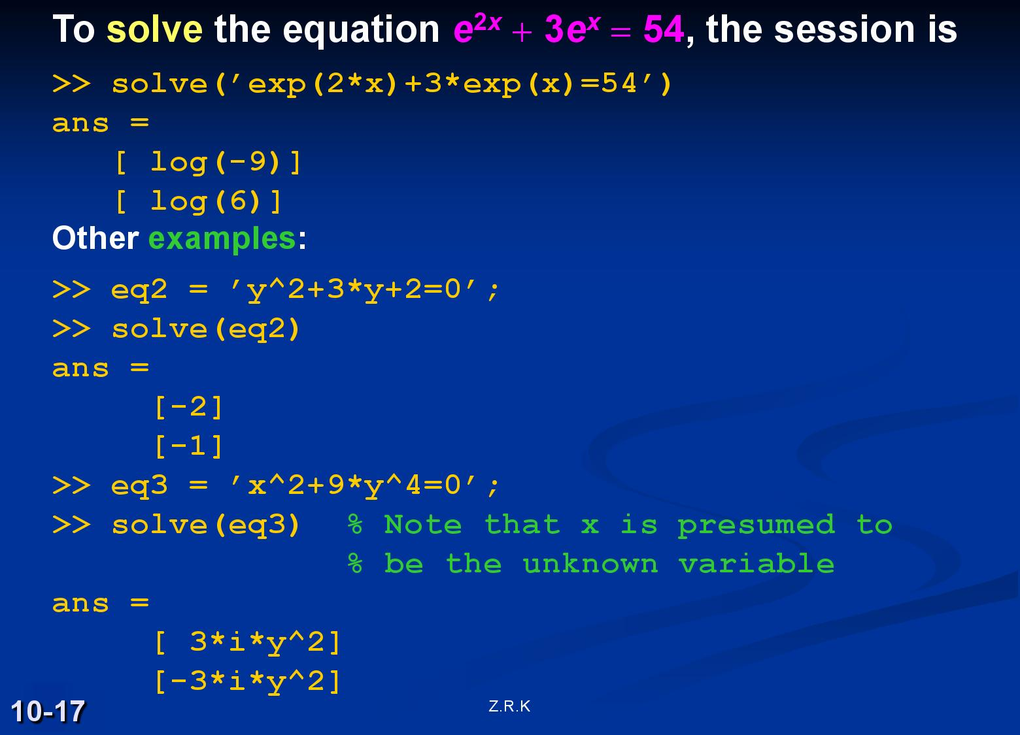

Slide 18
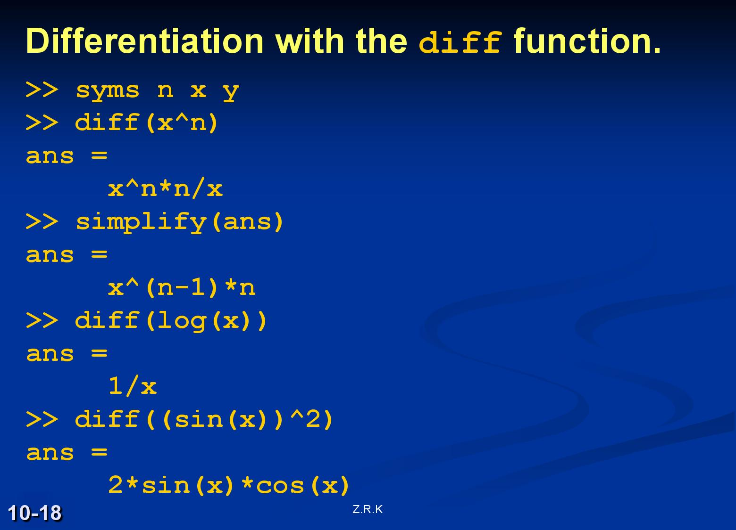

Slide 19
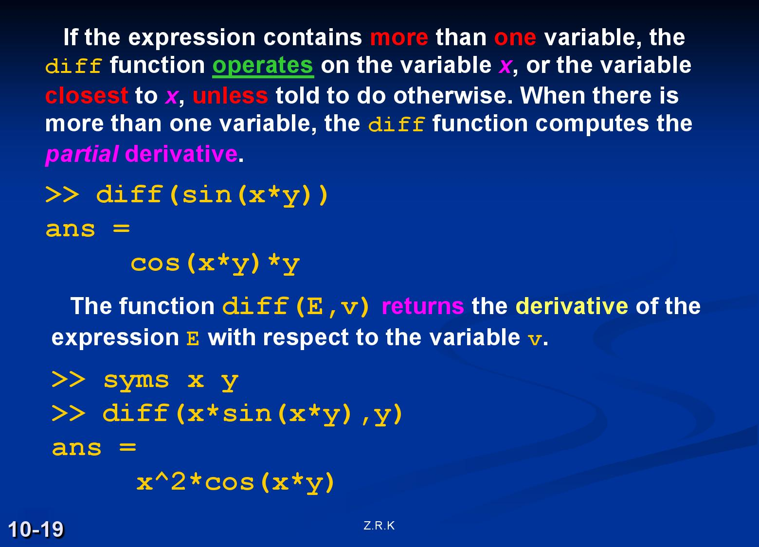

Slide 20
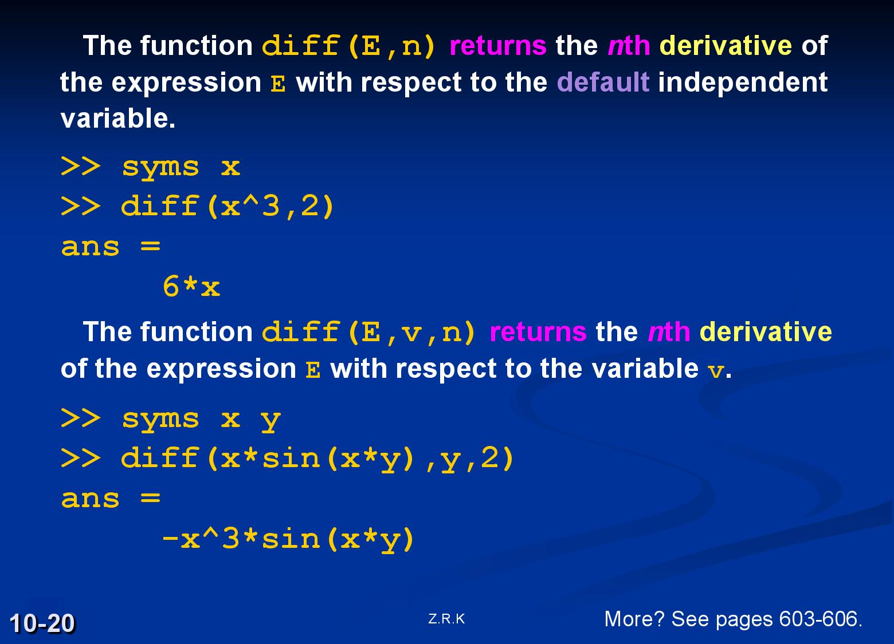

Slide 21
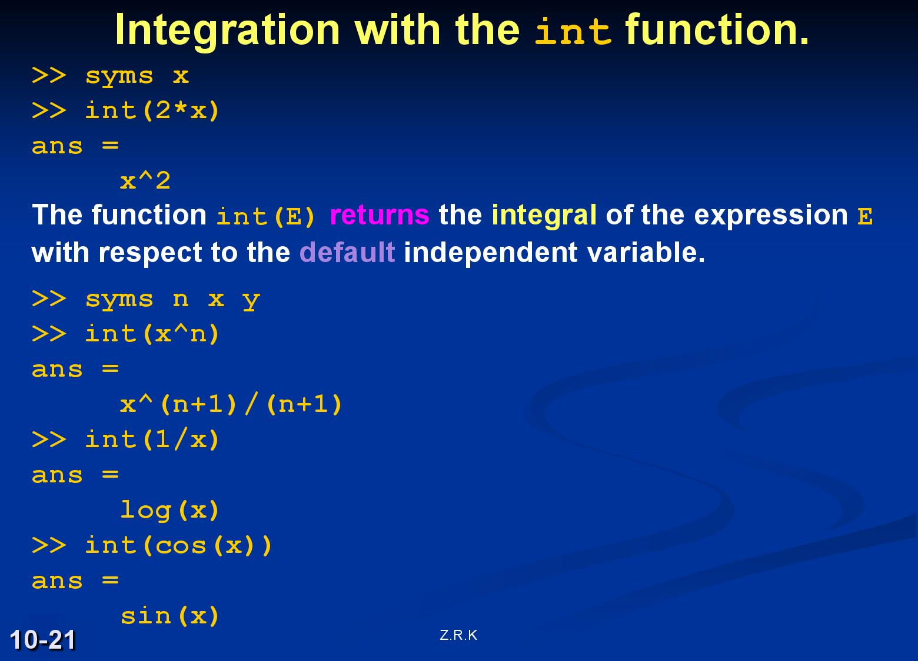

Slide 22
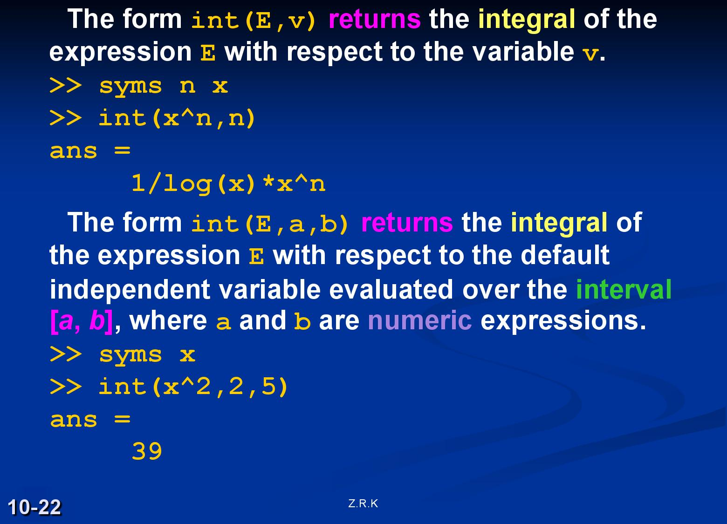

Slide 23
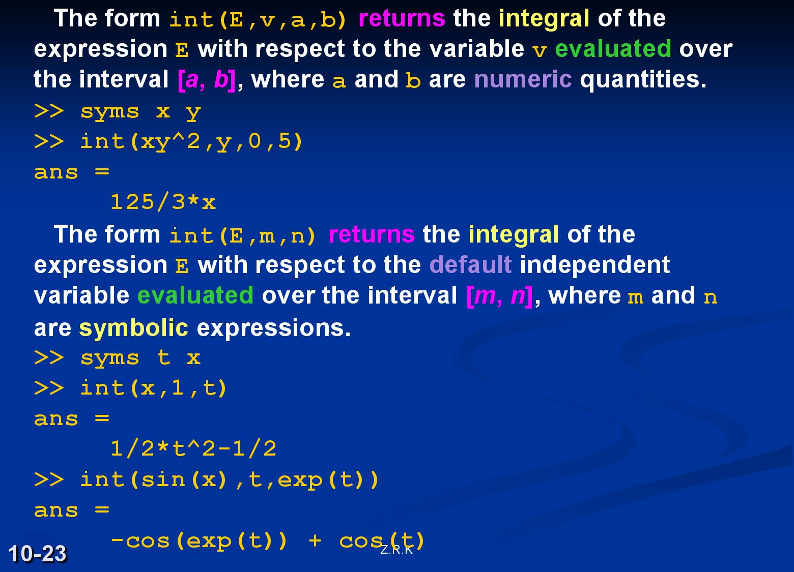

Slide 24
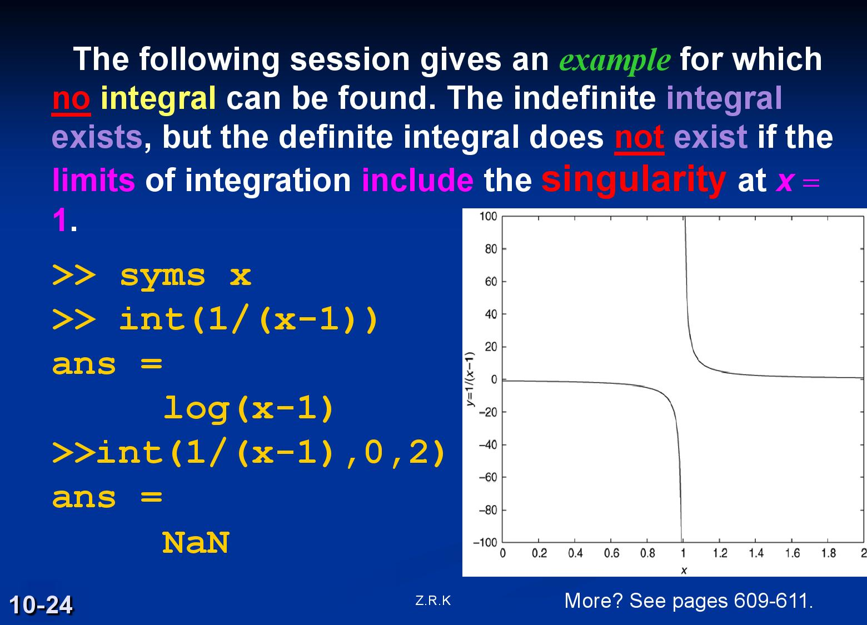

Slide 25
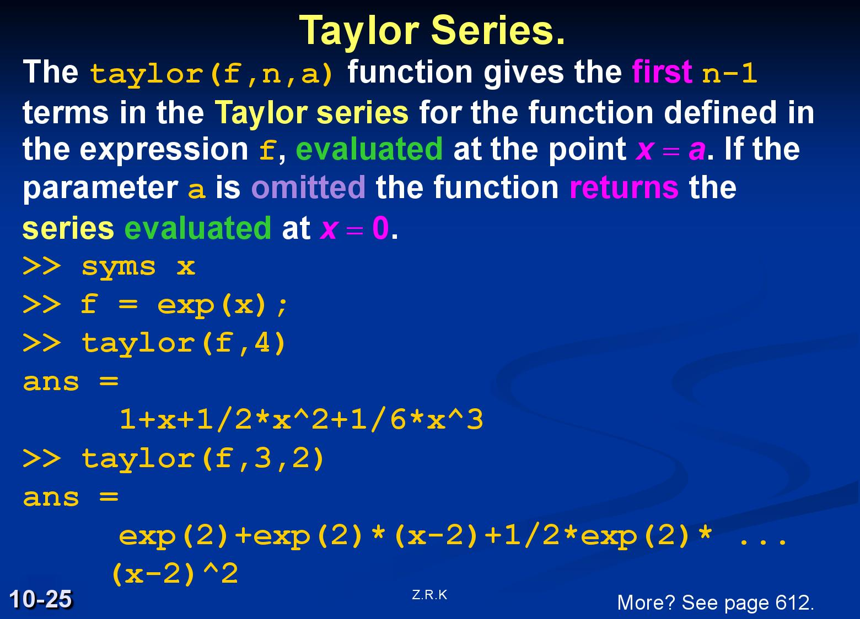

Slide 26
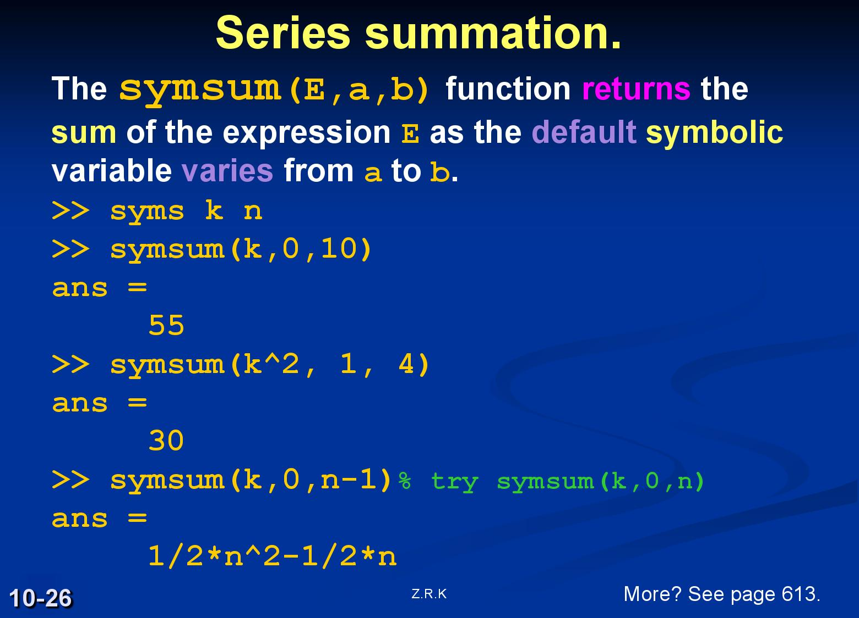

Slide 27
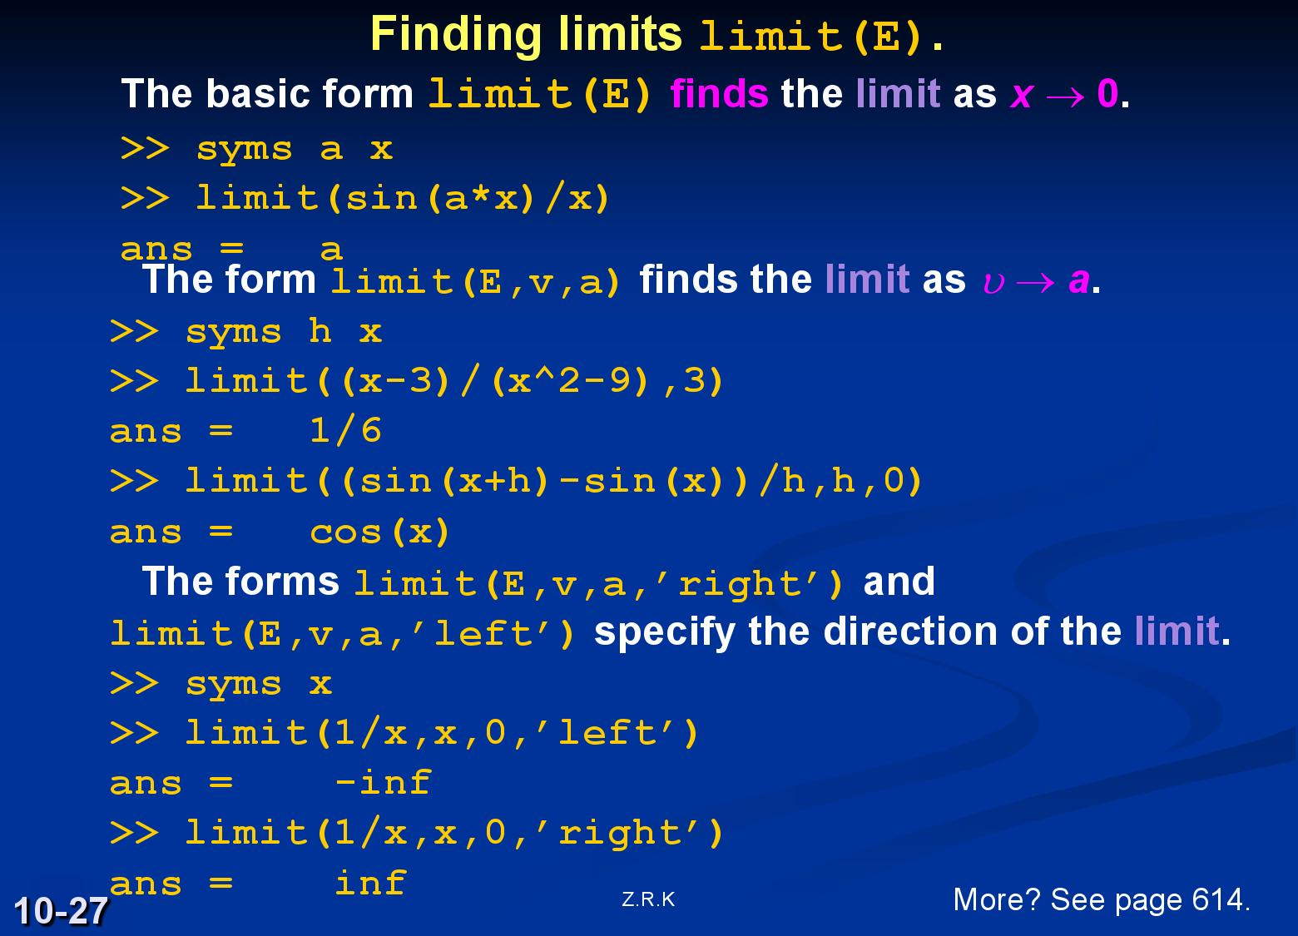

Slide 28
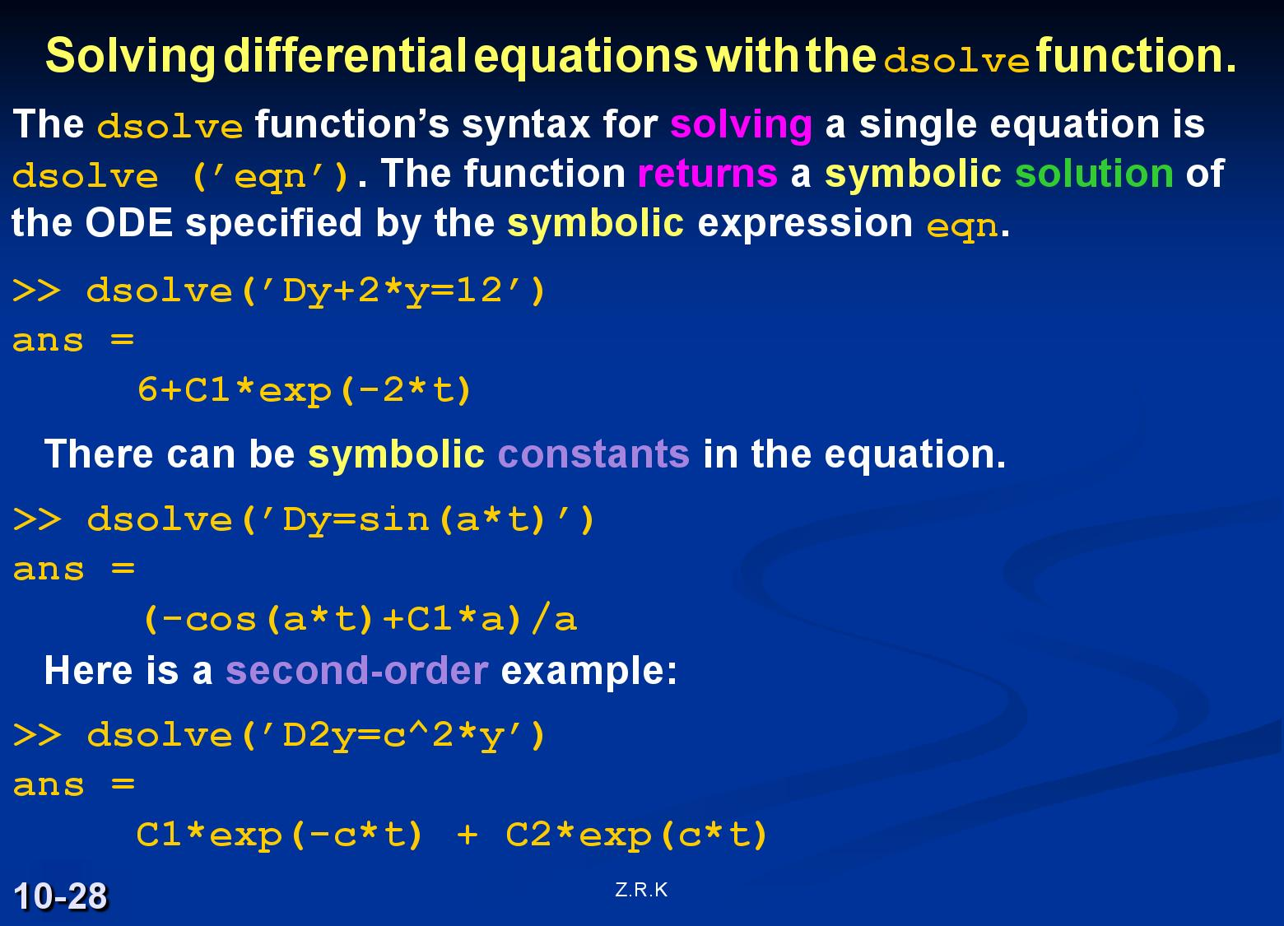

Slide 29
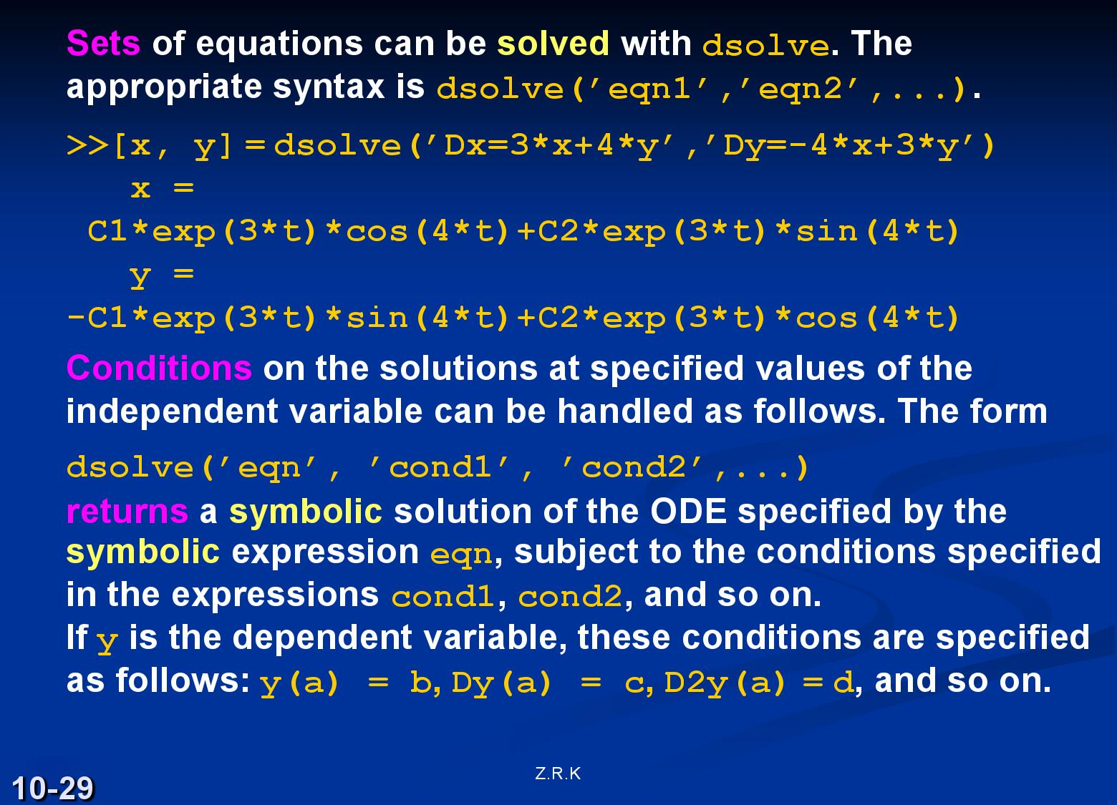

Slide 30
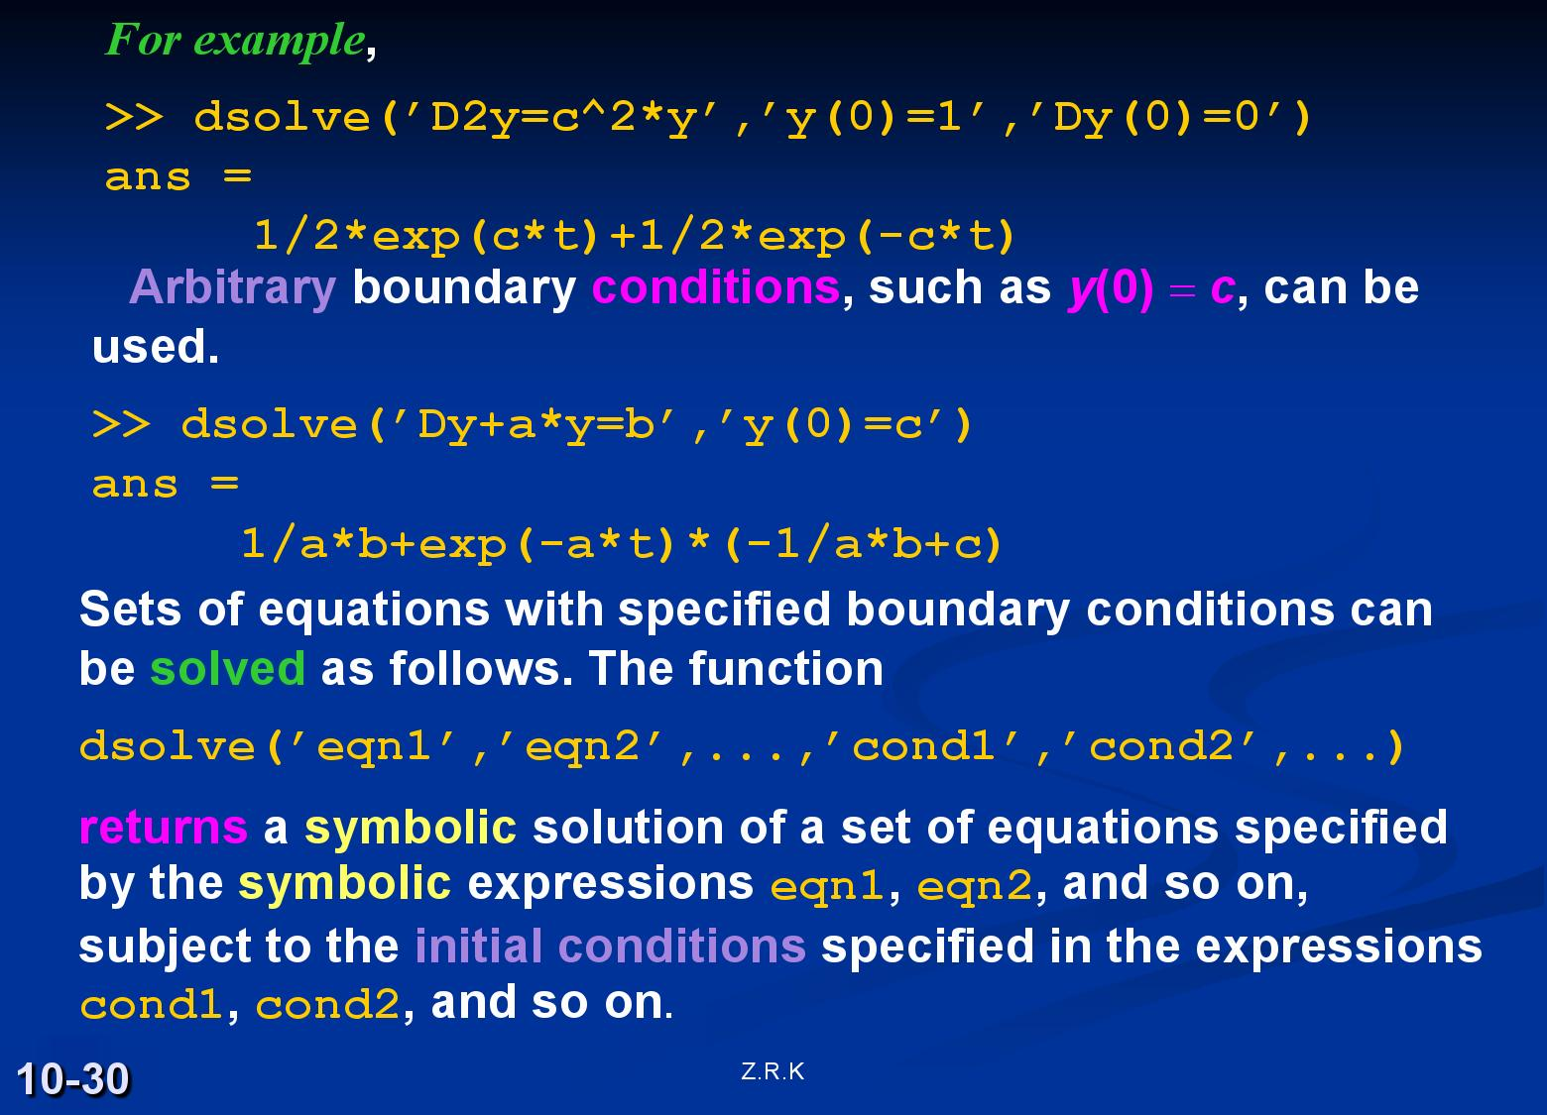

Slide 31
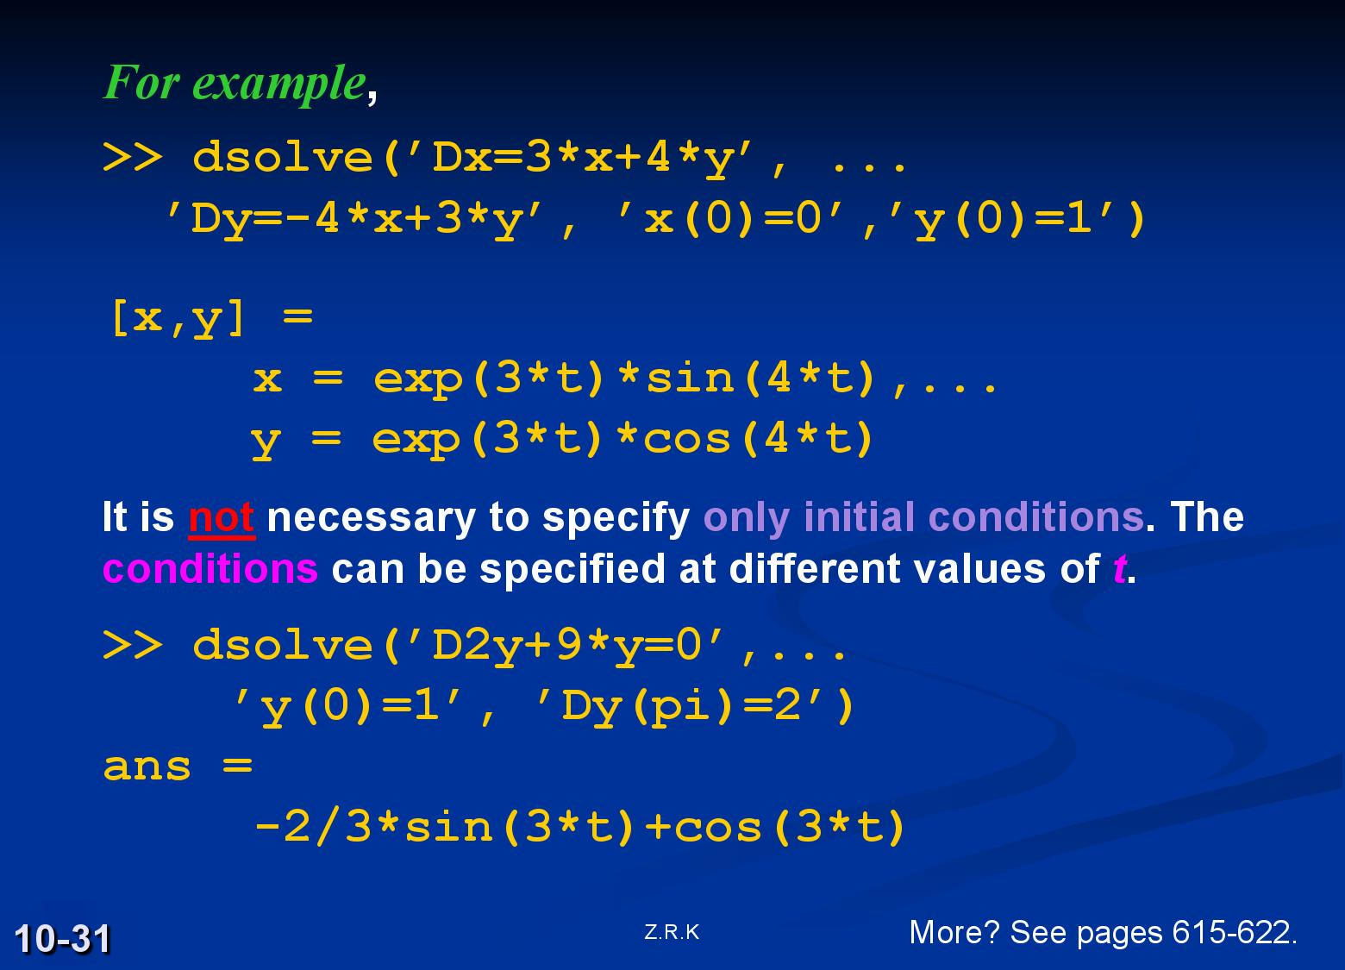

Slide 32
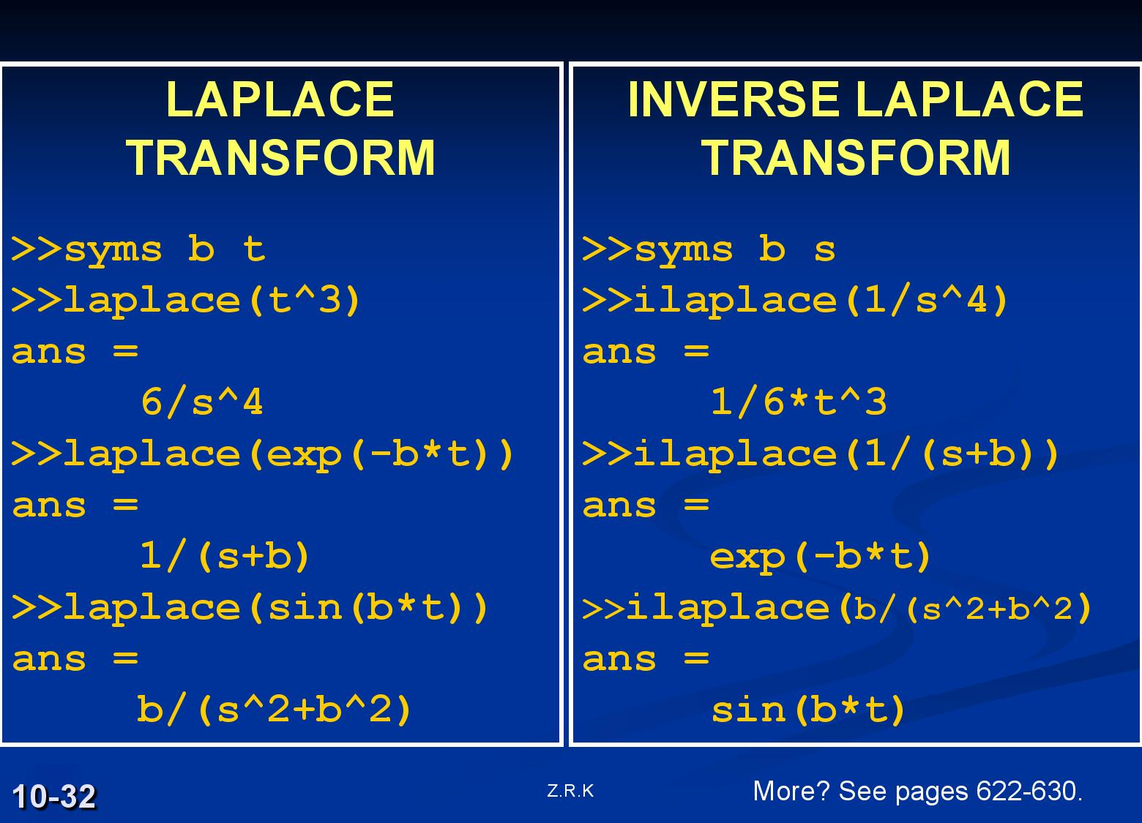

Slide 33
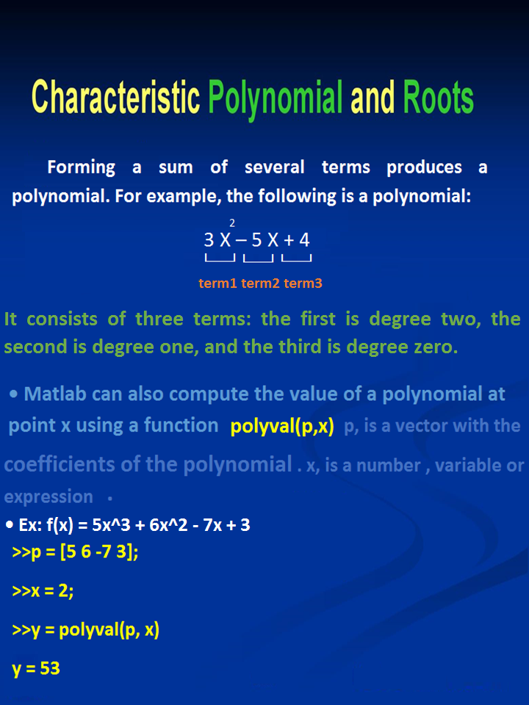

Slide 34
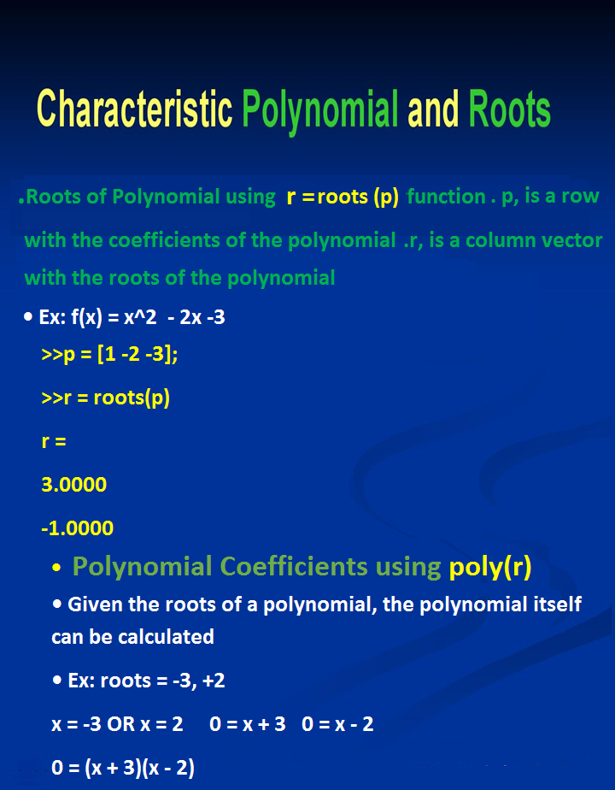

Slide 35
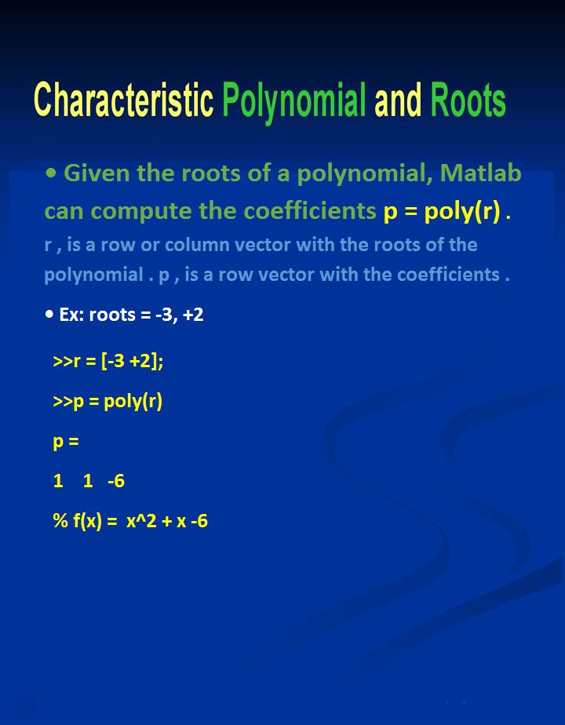

Slide 36
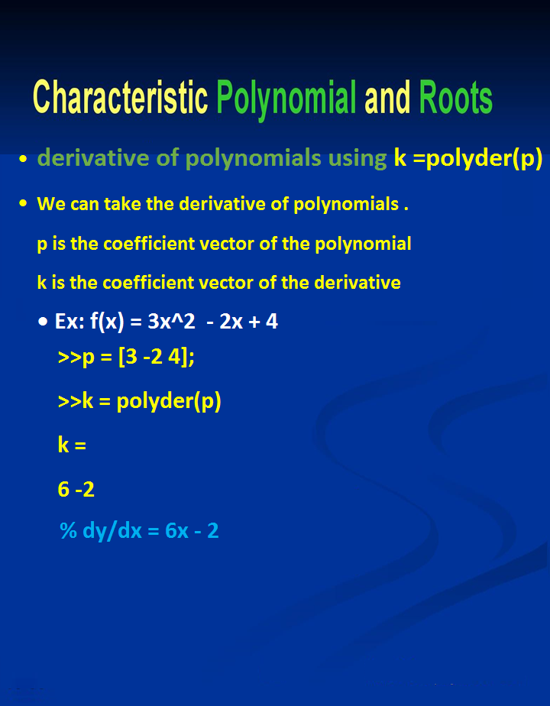

Slide 37
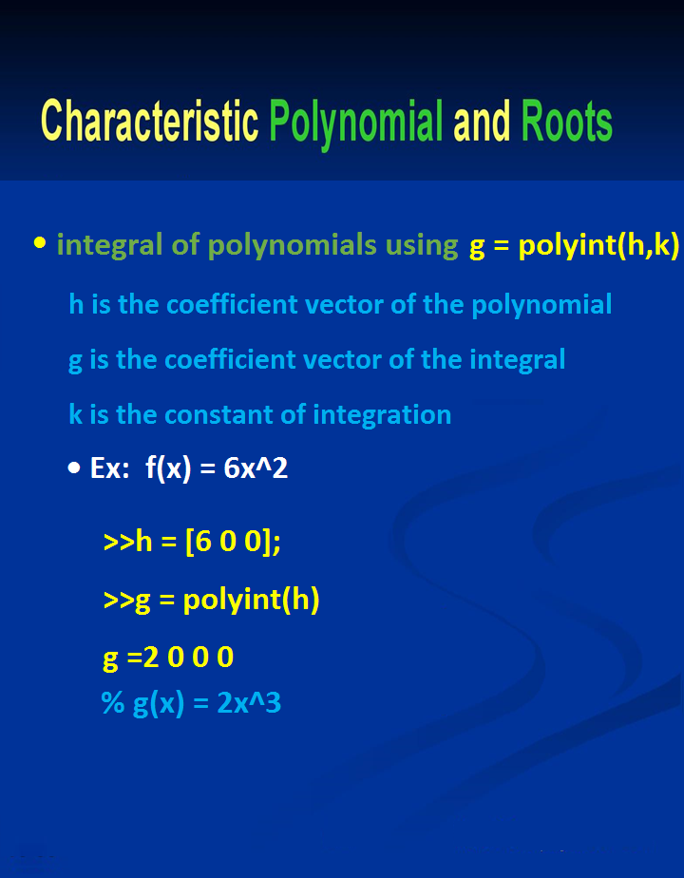

Slide 38
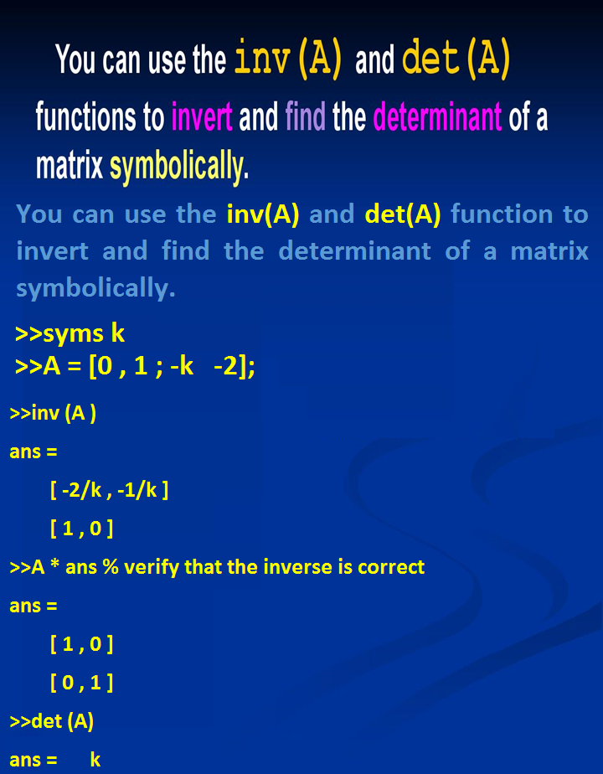

Slide 39
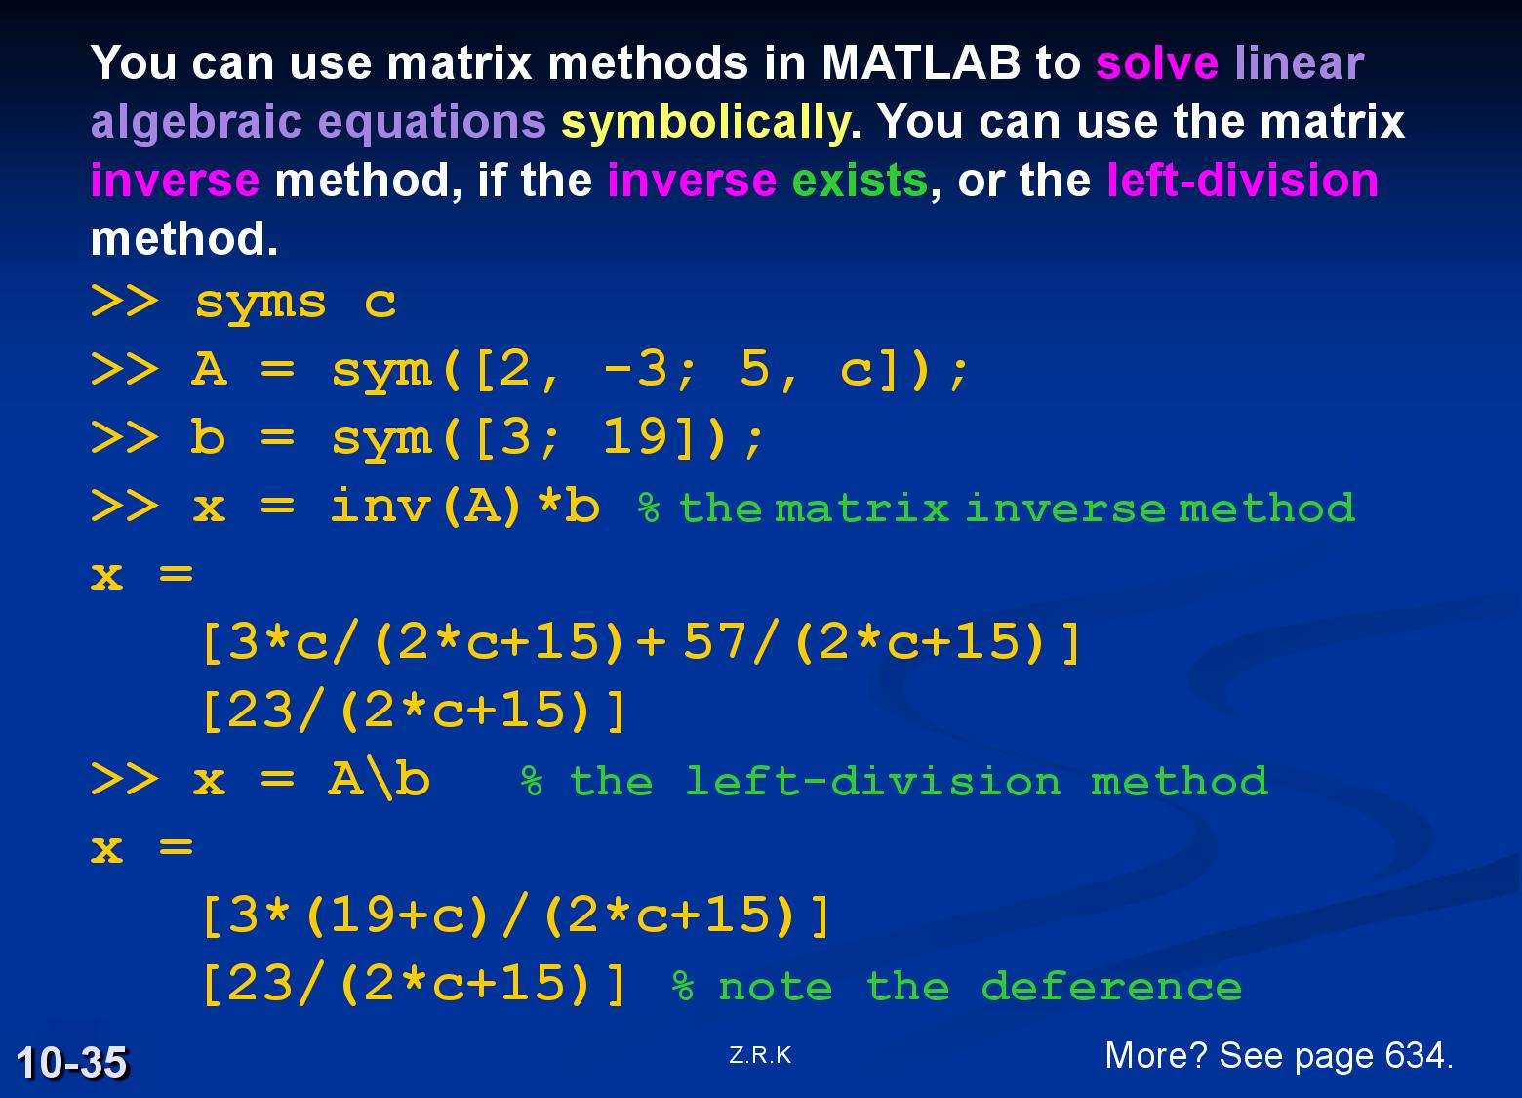

Slide 40

19- Interpolation
• Interpolation is estimating values between data points
• Simplest way is to assume a line between each pair of points
• Can also assume a quadratic or cubic polynomial curve connects each pair of points
yi = interp1(x, y, xi, /'method‘/)
interp1 - last character is one
x is vector with x points
y is a vector with y points
xi is the x coordinate of the point to be interpolated
yi is the y coordinate of the point being interpolated

Slide 41
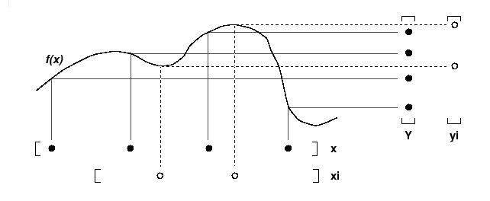
The interp1 command interpolates between data points. It finds values at intermediate points, of a one-dimensional function f(x) that underlies the data. This function is shown below, along with the relationship between vectors x, y, xi, and yi.

Slide 42
• method is optional :
\'nearest\' - returns y value of the data point that is nearest to the interpolated x point
\'linear\' - assume linear curve between each two points (default)
\'spline\' - assumes a cubic curve between each two points
Example 1:
>>x = [0 1 2 3 4 5];
>>y = [1.0 -0.6 -1.4 3.2 -0.7 -6.4];
>>yi = interp1(x, y, 1.5, \'linear\')
yi =
-1
>>yj = interp1(x, y, 1.5, \'spline\')
yj =
-1.7817

Slide 43
Example 2:
Generate a coarse sine curve and interpolate over a finer abscissa.
>>x = 0:10;
>>y = sin(x);
>>xi = 0:.25:10;
>>yi = interp1(x,y,xi);
>>plot(x,y,'o',xi,yi)

Slide 44
Example 2:
Generate a coarse sine curve and interpolate over a finer abscissa.
>>x = 0:10;
>>y = sin(x);
>>xi = 0:.25:10;
>>yi = interp1(x,y,xi,’spline’);
>>plot(x,y,'o',xi,yi)

