Slide 1
Mustansiriyah University
College of science
Biology Dept.
Zoology
4th class
Zoonoses lab. (4)

Slide 2
INFLUENZA
WHAT IS INFLUENZA?
Influenza, commonly called
"the flu," is an illness caused
by RNA viruses of the family
Orthomyxoviridae
the influenza viruses infect the
respiratory tract of many
animals, birds, and
humans.

Slide 3
WHAT IS ORTHOMYXOVIRIDAE?
The Orthomyxoviridae are a
family of RNA viruses that
includes five genera:
Influenza virus A
Influenza virus B
Influenza virus C
Isavirus .
Thogoto virus.
The first three genera contain viruses that cause influenza in vertebrates, including birds, humans, and other mammals; thogoto viruses infect vertebrates and Invertebrates.

Slide 4
INFLUENZA VIRUSES ARE DIVIDED INTO THREE TYPES:
Influenza A
Influenza B
Influenza C
INFLUENZA A (H1N1)
'Influenza' A (H1N1) virus is a subtype of influenza A virus and was the most common cause of human influenza (flu)

Slide 5
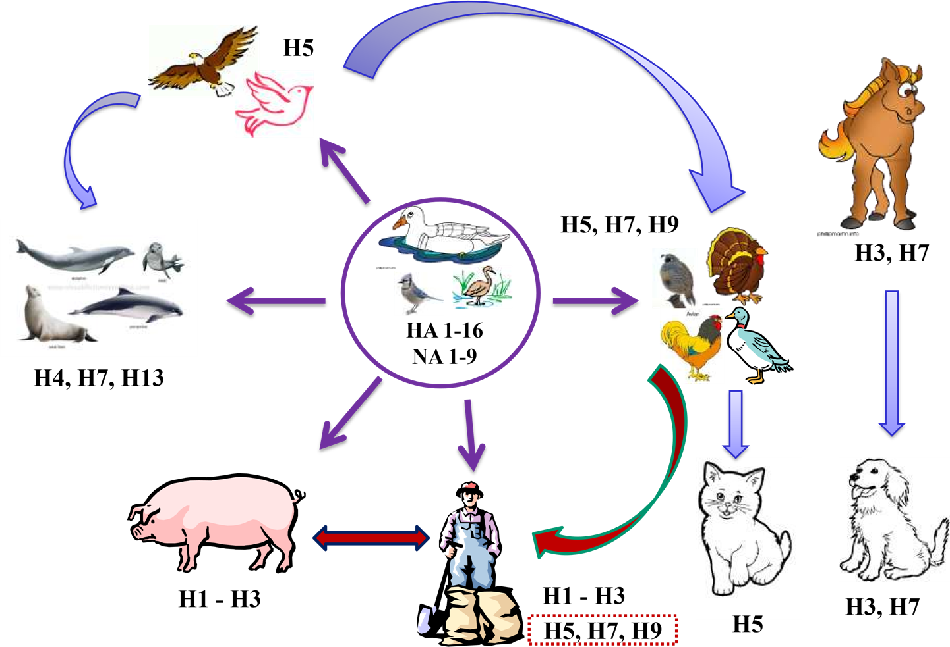

Slide 6
SWINE INFLUENZA(H1N1)
Swine influenza virus is common throughout pig populations worldwide. Transmission of the virus from pigs to humans is not common and does not always lead to human influenza, often resulting only in the production of antibodies in the blood.
AVIAN INFLUENZA (H5N1)- Mode of transmission
Direct or indirect contact with infected live or dead poultry
No evidence – cooked food
No human to human transmission

Slide 7
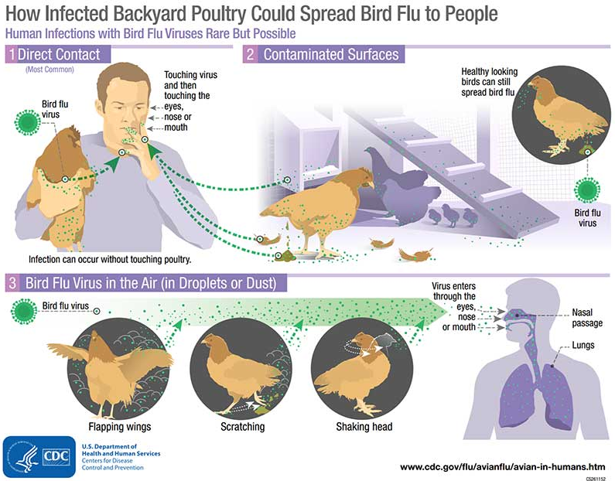

Slide 9
SIGNS AND SYMPTOMS
Fever (usually 100 F-103 F in adults and often even higher in children)
Cough,
Sore throat,
Runny or stuffy nose,
Headache,
Muscle aches,
Extreme fatigue

Slide 10
DIAGNOSIS
1} Virus Isolation
Nasopharyngeal secretions
are the best specimens for
obtaining large quantities of
virus–infected cells.
2} Paired Sera
A sero diagnosis of influenza
A or B can be made by the
examination of two serum
specimens from a patient.

Slide 11
PREVENTION
Vaccine:
1} The ―flu shot‖ — an inactivated vaccine (containing killed virus) that is given with a needle, usually in the arm.
2} The nasal-spray flu vaccine — a vaccine made with live, weakened flu viruses that is given as a nasal spray (sometimes called LAIV for ―Live Attenuated Influenza Vaccine‖).

Slide 12
RABIES
Rabies is one of the oldest recognized diseases affecting humans and one of the most important zoonotic diseases
Acute, highly infectious and fatal disease of the CNS
Caused by Lyssavirus type 1
Zoonotic disease of warm blooded animals
Transmitted by bites of rabid animal
short period of illness
Virtually 100% fatal but 100% preventable

Slide 13
AGENT- RABIES VIRUS
Rhabdo virus
Lyssa virus -type 1
Bullet shaped virus
Size is 180 x 75 nm
Has Lipoprotein envelope

Slide 14
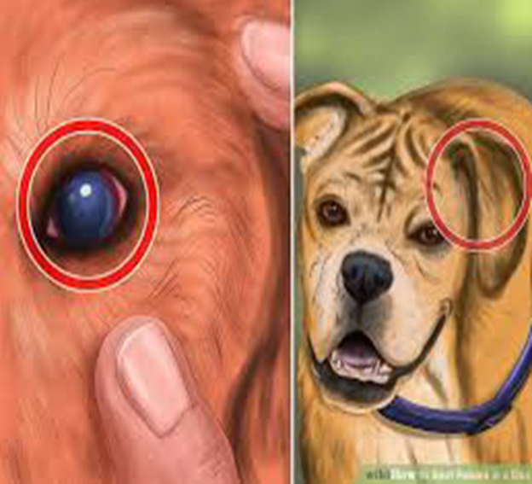
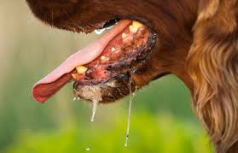
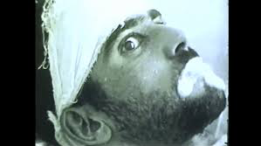
Common Carriers
Cats
Dogs
Raccoons
Skunks
Bats
Foxes
Transmission
Animal Bite
Contact with infected tissue, fluids or feces
Clinical presentation
Fever
Headache
Agitation
Confusion
Seizures
Excessive salivation

Slide 15
RESERVOIR OF INFECTION
From Dogs and cats.
99% cases in India
A single infected dog
is capable of transmitting
over an area of 40km
INFECTIVE MATERIAL
• Rabid animals- saliva, serum, urine and milk
• Human cases- saliva, sweat, semen and tears
PERIOD OF INFECTIVITY
• The rabid dog is infectious during last 3-5 days of incubation period and during the entire period of
illness, 8-10 days

Slide 16
INCUBATION PERIOD:
In human normally 3 weeks – 3 months May be short that is 15 days or may be prolonged for
years.
Depends on
site of bite
Severity of bite
Richness of nerve supply
Amount of saliva deposited
Species of biting animal
Protection provided by clothing
MODES OF TRANSMISSION
Bites from infected animals
Licks on Broken Skin or Mucous
Membrane
Scratches
Inhalation
Organ transplantation

Slide 17
PATHOGENESIS OF RABIES

Slide 18
Clinical Rabies in Humans
Prodromal stage:
First clinical symptoms: non-specific, i.e., malaise, fever, headache, tingling and numbness at the site of bite
Stage of excitement:
CNS is affected in the following order- sensory, motor and sympathetic system
Stage of paralysis

Slide 19
Diagnostic tests
Histopathology & Electron Microscopy
Detection of antigen by taking skin biopsy using
Direct fluorescent antibody test (DFA)
Virus isolation from saliva & other secretions
CSF analysis and CT scan
ELISA
RT-PCR- saliva & skin biopsy
Negri bodies
Vaccines
Cell Culture Vaccines
Purified Duck Embryo Vaccine (PDEV)

Slide 20
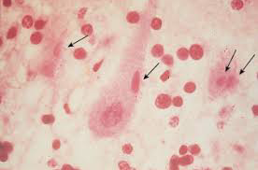
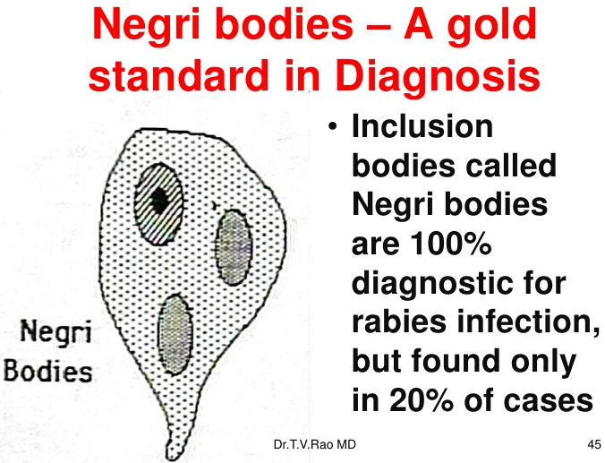
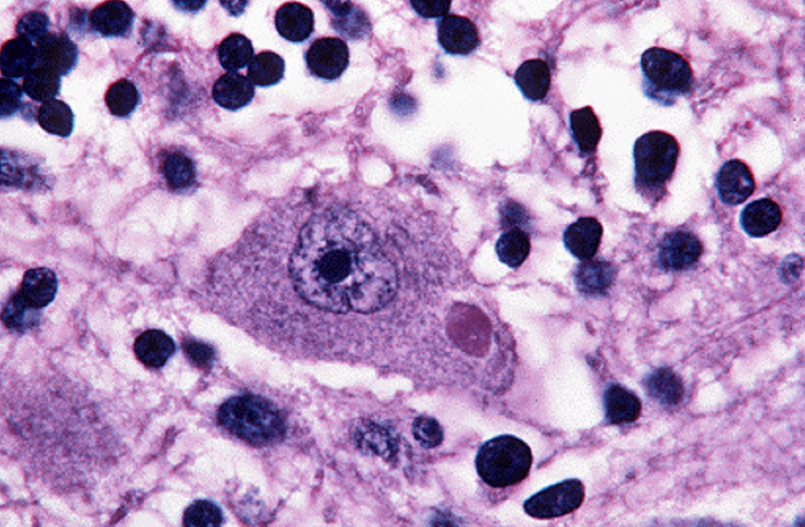

Slide 21
1 mL (IM) into
deltoid (adults) or
into anterolateral
area of thigh
(children)
8 doses – 4 visits
always recommended for transdermal wounds

