Slide 1
Mustansiriyah University
College of science
Biology Dept.
Zoology
4th class
Zoonoses lab. (3)

Slide 2
Salmonella
Causes Infections in Humans and
vertebrates,
• Enteric Fever ( Typhoid fever )
• Gastroenteritis
• Septicemias,
• Carrier state.

Slide 3
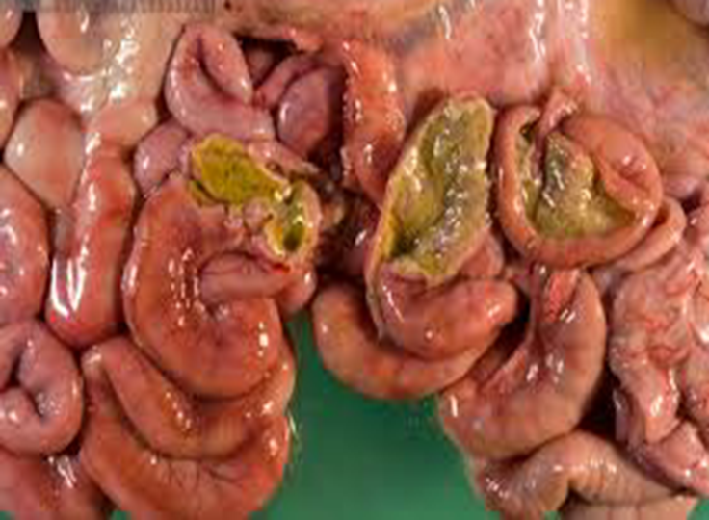
Salmonella
A Very complex group
Contains more > 2,000 spp
Typed on the basis of Serotyping, and
species typing
Divided into two groups
1 Enteric fever group
2 Food poisoning group –
Septicemias

Slide 4
Salmonella
Common carriers
Cattle
Cats
Dogs
Horses
Poultry
Transmission
-Direct contact with animal or feces
-Contaminated food
Clinical Presentation
Chills
Fever
Headache
Diarrhea
Vomiting

Slide 5
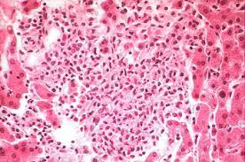
Morphology of Salmonella
Resistance of Salmonella
55º c – 1 hour
60º c – 15 MT
Boiling ,Chlorination,
Pasteurization Destroy the
Bacilli.
Gram negative
bacilli
3 / 0.5
microns,
Motile by
flagella

Slide 6
Diagnose Typhoid Fever
Diagnosis is made by any blood, bone marrow or stool cultures and with the Widal test (demonstration of salmonella antibodies against antigens O-somatic and H-flagellar ).
1} Isolation of Bacilli. -----A Gold standard
2} Diagnosis for presence of Antibodies,
Isolation from Feces and Urine
XLD agar
Mac Conkey's agar

Slide 7
Slide agglutination tests
- In slide agglutination
tests a known serum
and unknown culture
isolate is mixed,
clumping occurs
within few minutes
- Commercial sera are
available for detection
of A, B,C1,C2,D,and E.

Slide 8
WIDAL Test – Tube agglutination test.
• Detects O and H antibodies
• Diagnosis of Typhoid and Paratyphoid
• Testing for H agglutinins in Dryers tubes, a
narrow tube floccules at the bottom
• Testing for O agglutinins in Felix tubes.
• Incubated at 37º c overnight
diagnosing typhoid fever based on the fact that
antibodies in the blood of an infected individual cause the bacteria to bind together into clumps (the Widal reaction).

Slide 9
Brucellosis
(Malta Fever)
Brucellosis is a zoonosis primarily of domestic animals, causing a chronic debilitating septicemic disease leading to abortion.
The causal Brucella species are named after
Sir David Bruce, who discovered the cause of
one form of the disease while serving in Malta in 1887.

Slide 10
Brucella spp.
-Gram negative, intracellular coccobacilli bacteria.
- Non-motile, non-capsulated, non-spore forming.

Slide 11
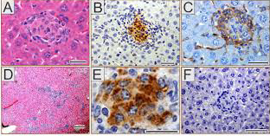
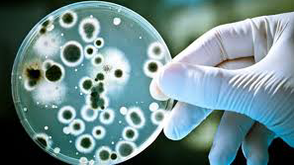

Slide 12
Pathogenesis
1}Ingestion:
• Raw milk & unpasteurized dairy products.
• Rarely through undercooked meat.
2} Inhalation: of placental or uterine discharges, blood and urine
3} Inoculation:
4} Person-to-person transmission is very rare

Slide 13
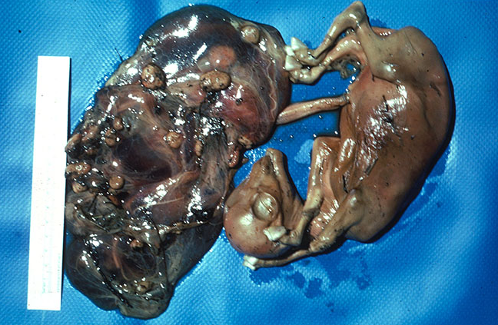
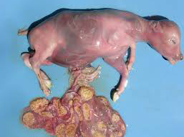
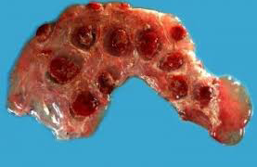

Slide 14
Who is at Risk?
Occupational Disease:
• Cattle ranchers/dairy farmers.
• Veterinarians.
• Abattoir workers.
• Meat inspectors.
• Lab workers.
Hunters.
Travelers.
Consumers of unpasteurized dairy products

Slide 15
Diagnosis
Serologic Tests
1-Clinical features.
2- Serology: brucella agglutinins in the blood.
3- Blood or tissue culture.
4- Polymerase Chain Reaction (PCR).
Tube Agglutination
Complement fixation
Radioimmunoassay
ELISA
Rapid Agglutination
Rose bengal test

Slide 16
Rose Bengal plate test
Is an agglutination test in which the brucella cells are bound to a dye
• Is quick and easy to read
• It is a useful screening test

Slide 17
