Slide 1
Mustansiriyah University College of science Biology Dept. Zoology 4th class
Zoonoses lab. (2)

Slide 2
Anthrax
Malignant Pustule, Malignant Edema, Woolsorters’ Disease, Ragpickers’ Disease, Maladi Charbon, Splenic Fever

Slide 3
Overview
Organism
History
Epidemiology
Transmission
Disease in Animals
Disease in Humans
Prevention and Control

Slide 4
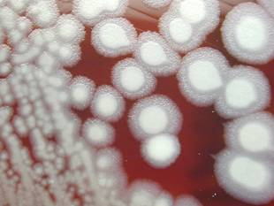
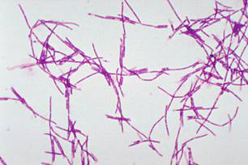
The Organism
Bacillus anthracis
Large, gram-positive, non-motile rod
Two forms [Vegetative, spore]
Over 1,200 strains
Nearly worldwide distribution.

Slide 5
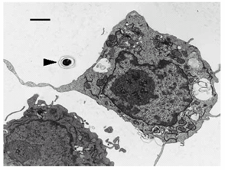
The Spore
Sporulation requires:
Poor nutrient conditions
Presence of oxygen
Spores
Very resistant
Survive for decades
Taken up by host .
Lethal dose 2,500 to 55,000 spores

Slide 6
History
Russia, 1979 94 people sick – 64 died
South Africa, 1978-1980 Thousands of cattle died
10,738 human cases
182 known deaths
Tokyo, 1993
Vaccine strain used
No human injuries

Slide 7
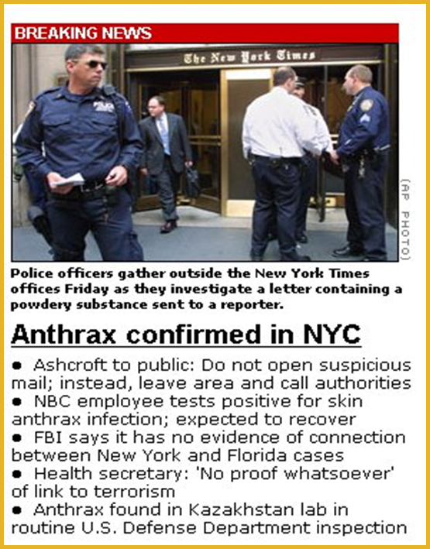
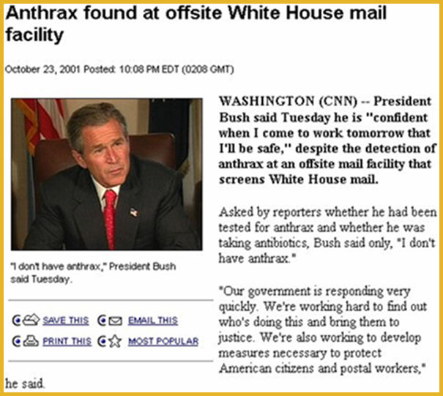
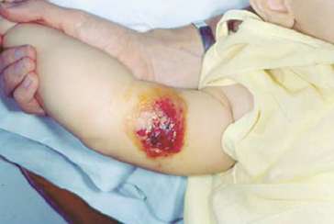
U.S., 2001
22 cases
11 cutaneous
11 inhalational; 5 deaths

Slide 8
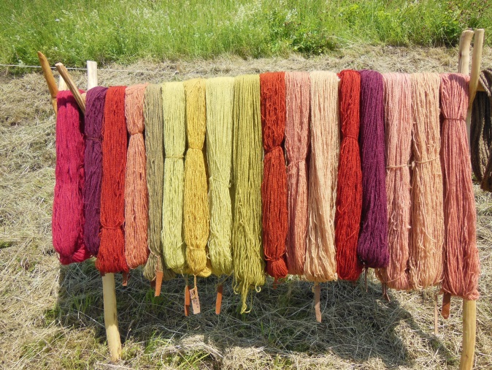
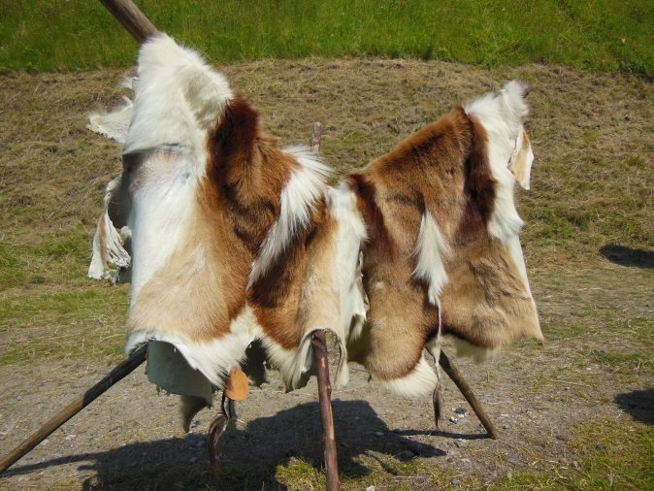
Transmission
Human Transmission
Cutaneous
Contact with infected tissues, wool, soil
Biting flies
Inhalational
Tanning hides, processing wool or bone
Gastrointestinal
Undercooked meat

Slide 9
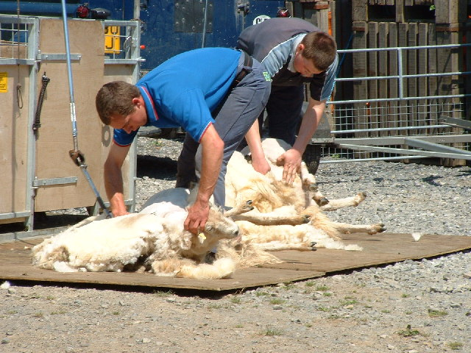
Human Transmission
Tanneries
Textile mills
Wool sorters
Bone processors
Slaughterhouses
Laboratory workers

Slide 10
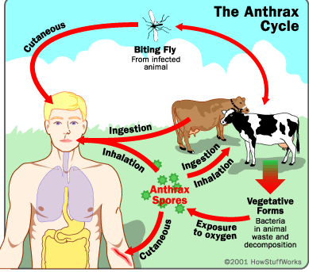

Slide 11
Cutaneous Anthrax
95% of all cases globally
Incubation: 2 to 3 days
Spores enter skin through open wound or abrasion
Papule → vesicle → ulcer → eschar
Case fatality rate 5 to 20%
Untreated – septicemia and death

Slide 12
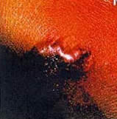
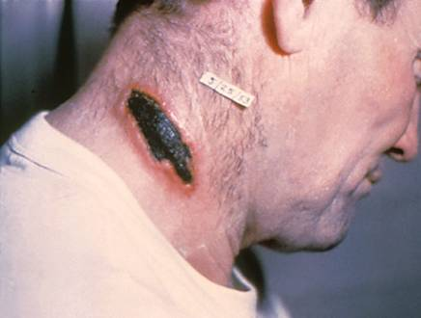
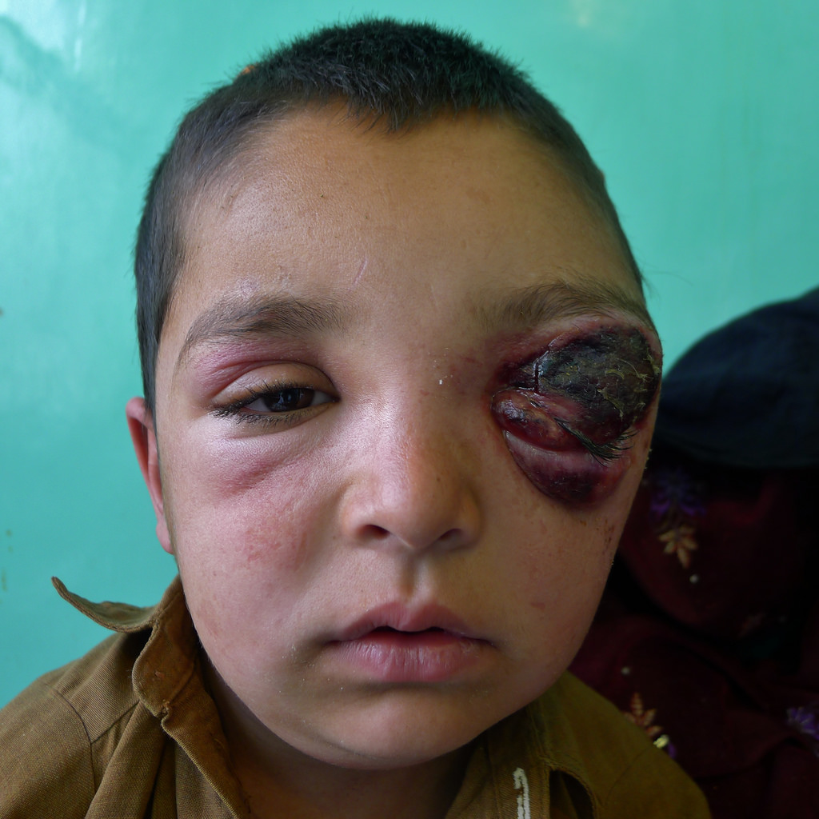
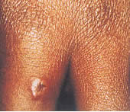
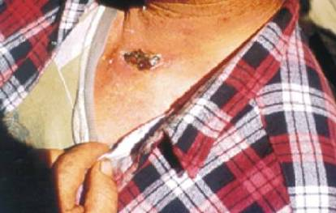
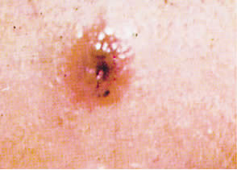
Day 2
Day 4
Day 6

Slide 13
Gastrointestinal Anthrax
Incubation: 2 to 5 days
Severe gastroenteritis common
Consumption of undercooked or contaminated meat
Inhalational Anthrax
Incubation: 1 to 7 days
Initial phase
Nonspecific (mild fever, malaise)

Slide 14
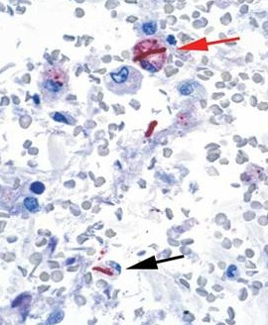
Diagnosis in Humans
Identification of B. anthracis
Blood, skin, secretions
Culture
PCR
Serology
ELISA
Nasal swabs
Day 4

Slide 15
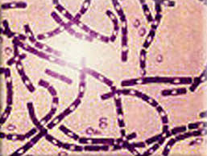
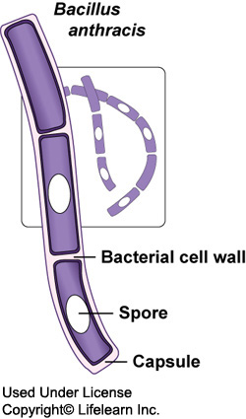
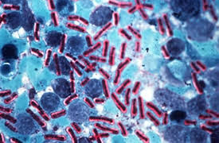
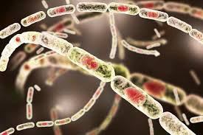
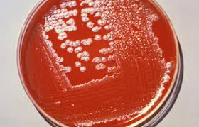

Slide 16
Prevention and Control
Humans protected by preventing disease in animals
Veterinary supervision
Trade restrictions
Improved industry standards
Safety practices in laboratories
Post-exposure antibiotic prophylaxis
Day 6

Slide 17
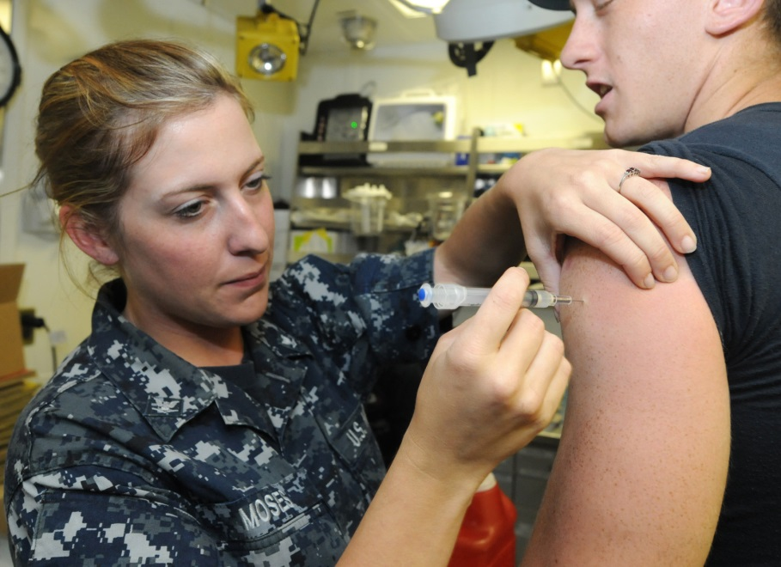
Vaccination
Cell-free filtrate
At risk groups
Veterinarians
Lab workers
Livestock handlers
Military personnel
Immunization series
Five IM injections over 18-week period
Annual booster

