Slide 1
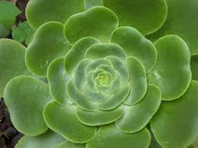
Division Phaeophyta(Brown algae)
The main characteristics of Phaeophyta are: 1- Cell construction: cellulose fibers bound with alginic acid form cell walls.
2- Food reserves: laminarin, a soluble polysaccharide, and mannitol.
3- reproduction of this algae takes place by both sexual and asexual means. Higher phaeophyta have life cycle consisting of both haploid , diploid stages and alternation of generation. The thallus representing haploid stage and diploid stage may be similar (isomorphic) or different (heteromorphic).
4- Photosynthetic pigments: chlorophyll a and c, beta carotene, violaxanthin, and fucoxanthin.

Slide 2
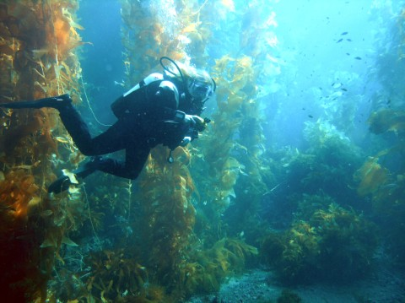
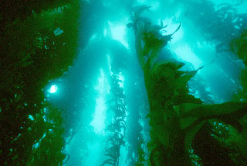
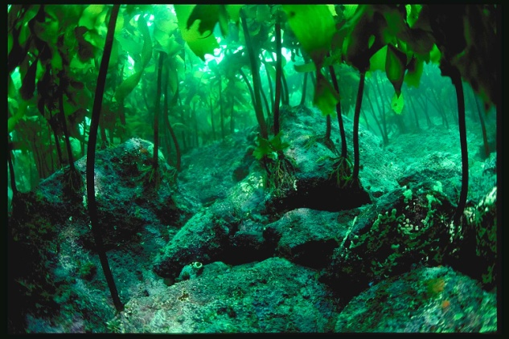
5-The members of phaeophyta belonging to Laminarales are called kelps kelp can reach to about 70 meters in length. Kelps are the only algae with a significant internal tissue differentiation. Though true conductive tissues like xylem and phloem are absent.

Slide 3
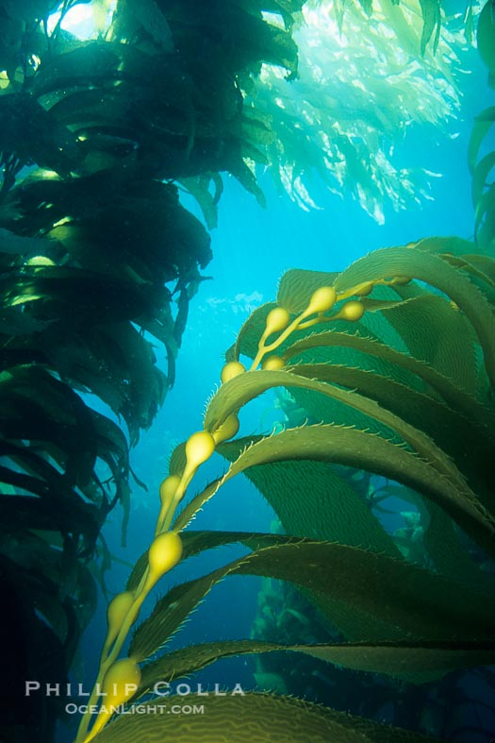
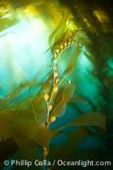
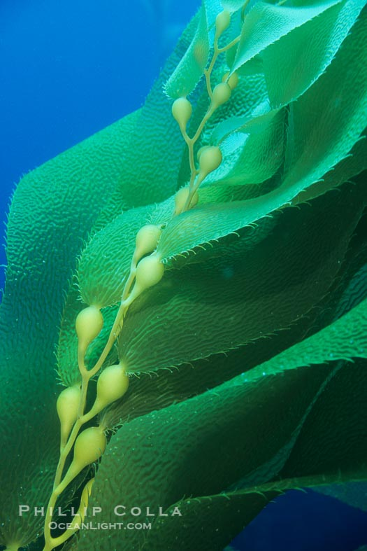
6- They can adapt to a wide marine environment; tidal, intertidal and deep zones.
8- Some members of phaeophyta have adaptive bladders, meant for floating photosynthetic parts on or near the water surface for harvesting light.

Slide 4
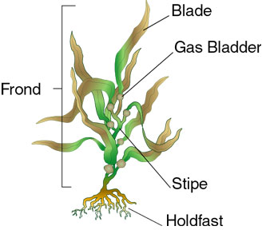
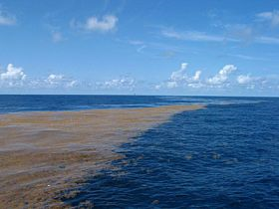
9- They often cause nuisance to aquarium environment by developing brown patches on any exposed surfaces such as glass, rocks or gravel.
11- Morphology Members of this division typically have three parts. They are A] Holdfast which attaches the alga to the substrate, B] Stipe which is stem-like C] Laminae (blades) which are leaf-like
Brown algae

Slide 5
Division of brown algae are classified into three classes depending on the type of life cycles of the species
1-Class :Isogenrate
2-Class:Hetrogenerate
3-Class:Cyclosporea

Slide 6
1-Class :Isogenrate
-Order: Ectocarpales
Ectocarpales is a very large order in the brown algae .
The order includes families with pseudoparenchymatous or true parenchymatous tissue.
Asexual reproduction by zoospores.
Sexual reproduction by Isogamous or anisogamous. and alternation of generation.
Differentiation observed in a small number of species where they differentiate the two regions cortex and medulla .

Slide 7
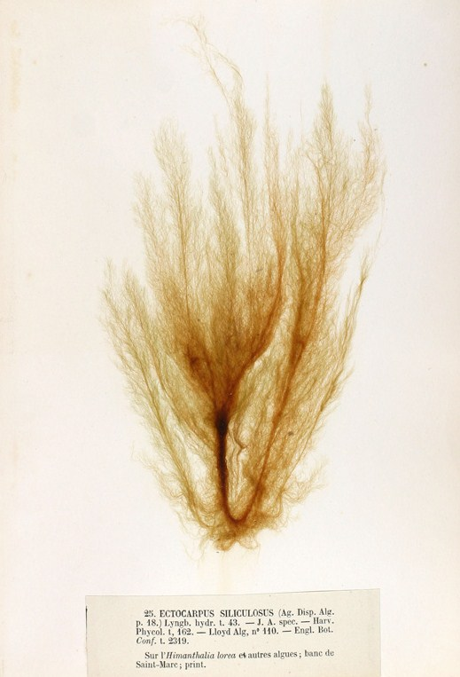
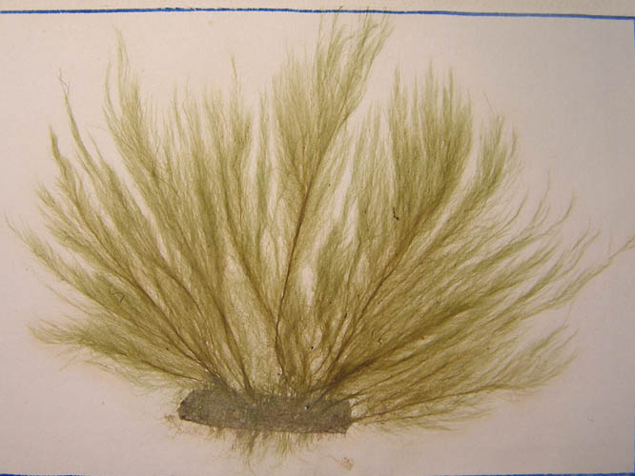
Filamentous algae are composed of cells that divide along a single plane, allowing only elongation to form filaments of one or more rows of cells.
Algae that can divide in two planes can form sheet-like thalli or bodies
and diversification of body plans into an erect thallus of some sort and a holdfast for attaching the upright portion to the substrate.
Ectocarpus is a genus of filamentous brown alga that is a model organism for the genomics of multicellularity.

Slide 8
Ectocarpus is a genus of filamentous brown alga Thallus filamentous, much branched, with most branches tapering gradually to a false hair. Growth diffuse. Cells with several elongate, ribbon-, and each with several pyrenoids.
Reproduction: Reproduction by unilocular (meio-) sporangia, neutral plurilocular sporangia and by plurilocular gametangia, all usually pedicellate; generations isomorphic;.

Slide 9
Life cycle of Ectocarpus siliculosus. Diploid sporophytes produce meiospores (by meiosis) in unilocular sporangia (UL). Meiospores grow into male or female gametophytes .Gametophytes produce gametes in plurilocular gametangia (PL). Fusion of gametes produces a zygote that grows into a diploid sporophyte, completing the sexual cycle.
Unfused gametes may grow parthenogenetically and form a parthenosporophyte, which is indistinguishable from the diploid sporophyte. Both sporophytes and parthenosporophytes can reproduce themselves asexually by the production of mitospores in plurilocular sporangia.

Slide 10
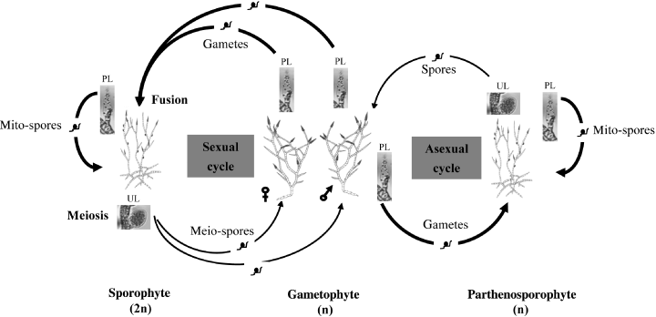

Slide 11
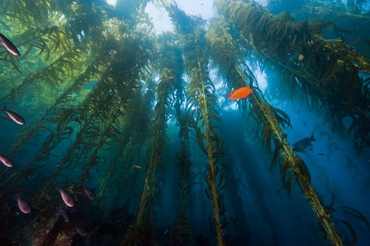
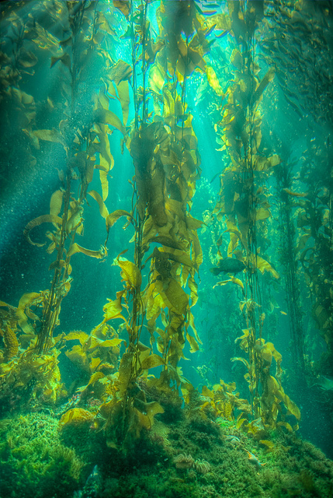
2-Class:Hetrogenerate
Order: Laminarales "Rock weed"
Kelps are large seaweeds (algae) belonging to the brown algae. Kelp grows in underwater (kelp forests) in shallow oceans, The organisms require nutrient-rich water with temperatures between 6 and 14 °C.

Slide 12
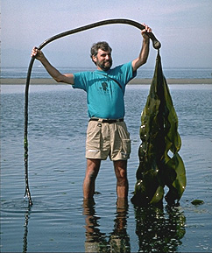
2-Class:Hetrogenerate
Order: Laminarales "Rock weed"
General characteristics
1- individuals with a macroscopic sporophyte generation diploid and a microscopic gametophyte generation haploid.
2- The sporophytes are large (usually over 1 meter tall) with a holdfast, stipe, and one or more blade or blades.
3- The stipe is usually cylindrical. It is either simple or branched.

Slide 13
4-Growth of the sporophyte occurs at an intercalary growth.
5- The sporangia are usually cylindrical, always unilocular, and always found in sori. The sori are borne on the blades.
6- Gametophytes are filamentous. The antheridia of the male gametophyte produce antherozoid. The oogonia of the female gametophyte produces a single egg, with the egg being fertilized after partially emerging from the oogonial wall.
7-The parenchymatous thalli are generally covered with a mucilage layer, rather than cuticle.

Slide 14
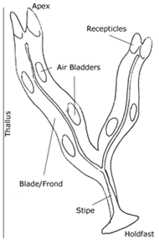
(Notes:The haploid phase begins when the mature organism releases many spores, which then germinate to become male or female gametophytes. Sexual reproduction then results in the beginning of the diploid sporophyte stage, which will develop into a mature individual.)
Laminaria sp

Slide 15
1-Exhibits a life cycle called alternation of generations
2-Two multicellular stages that differ in ploidy
3-The sporophyte is diploid; the gametophyte is haploid
4-The gametophyte produces haploid gametes by mitosis
5-The gametes unite by fertilization to form a zygote that develops into a sporophyte
6-The sporophyte produces haploid spores by meiosis
7-The spores grow up into male or female gametophytes
8-The main form is the sporophyte, the gametophytes are short, branched filaments – the two generations are heteromorphic

Slide 16
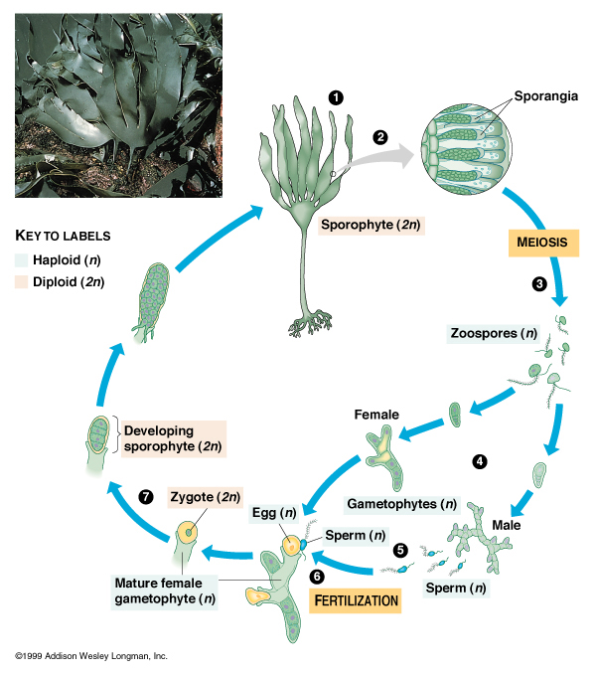

Slide 17
Class:cyclosporea
Order: Fucales
General characteristics
the typical seaweed construction: a holdfast, stipe and lamina.
The lamina is often much branched and may include gas filled bladders.
Growth is by division of the apical cells.
They are oogamous where there is fusion between the small male gamete and the large female gamete.
Tissue differentiation observed in the internal structure of the blade.

Slide 18
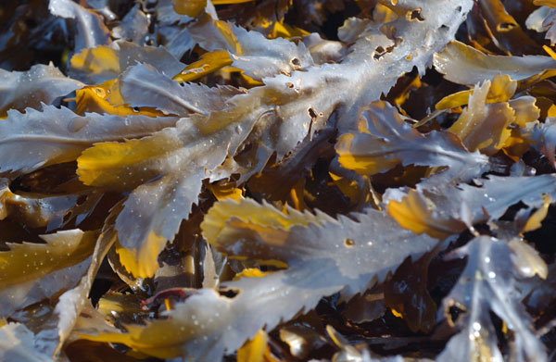
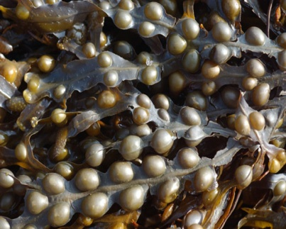
Fucus – flattened thallus and a dichotomous branching pattern. Small cavities called cryptostomates are scattered on the surface. Cryptostomates have sterile hairs that help in the uptake of nutrients from the seawater.
F. vesiculosus –pairs of air bladders along its thallus. These bladders provide buoyancy.

Slide 19
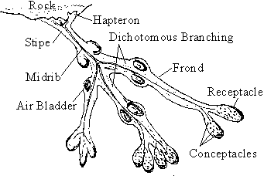
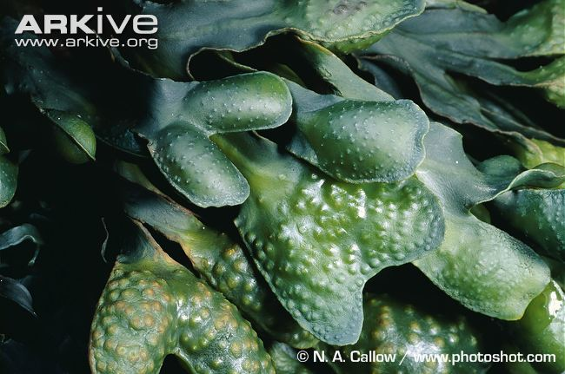
Vegetative structure The plant body is a thallus,The thallus has three major regions: 1. The hapteron or holdfast attaches the plant to the rock. 2. The stipe is a flexible stalk that joins the hapteron to the rest of the plant. 3. The frond is a flat, much branched leathery structure. It is brown in colour due to the pigment fucoxanthin.

Slide 21
Reproduction Asexual reproduction This is not very common. The only method of asexual reproduction shown by fucus is fragmentation when parts which break away become established as new plants. Sexual reproduction This is the usual method of reproduction for the fucus. Fucus vesiculosus is dioecious, i.e. separate male and female plants.
1. The tips of the fronds enlarge to form receptacles. Each receptacle contains conceptacles. 2. The gametes are formed in the conceptacles.

Slide 22
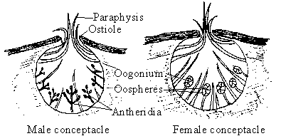

Slide 23
3. Meiosis in the antheridium followed by four mitoses produce sixty four haploid sperm cells. 4. Meiosis in the oogonium followed by one mitosis produces eight haploid egg cells (or oospheres). 5. When the tide is out the plant loses water, which causes it to shrink. The shrinking receptacles squeeze mucilage out of the conceptacles through the ostiole. 6. The mucilage carries the mature oogonia and antheridia onto the surface of the receptacles. The mucilage is secreted by the paraphysis. 7. When the tide comes in, the mucilage is washed away, the antheridia and oogonia rupture releasing the gametes into the open sea.

Slide 24
8. The egg cells being more dense than water sink to the bottom. The sperm cells swim and are attracted to the non-motile eggs by a chemical substance (chemotaxis). Many sperm may surround each egg. 9. One sperm enters and fertilises the egg. This results in a diploid zygote being formed. 10. The zygote germinates immediately. By mitosis and differentiation the zygote develops into a mature diploid plant.

Slide 25
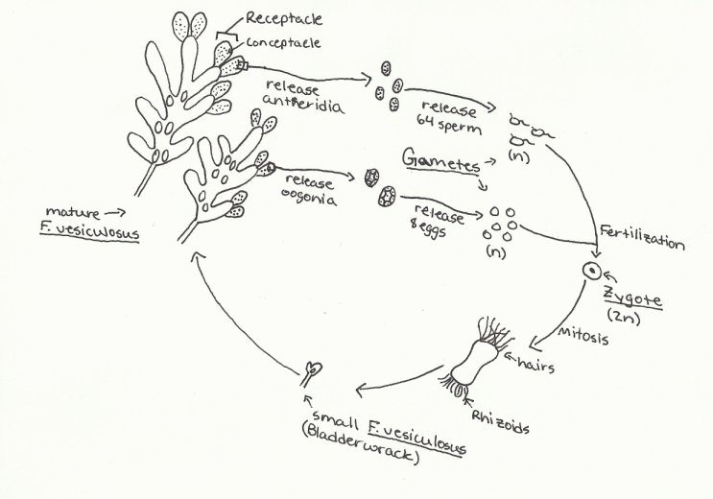

Slide 26
Adaptive of the fucus Structural adaptions
- The holdfast anchors it to the rock.
- The air bladders increase the buoyancy of the plant.
- Mucilage covers the plant which helps prevent desiccation when the tide is low.
- The thallus is tough and leathery which allows it to withstand wave action.
- The stipe and frond are flexible which allows it to bend with the waves .
- The presence of the brown pigment fucoxanthin allows the absorption of wavelengths of light that penetrate the water.

Slide 27
Life cycle adaptions
It uses the tide going out to release the antheridia and oogonia onto the surface of the receptacles.
It uses the tide coming in to release the gametes.The egg releases a chemical substance which attracts the sperm - chemotaxis.
The sperm can swim using their flagella to the egg.

Slide 28
Phaeophyta uses 1- marine seaweeds of phaeophyta are used for the extraction of iodine , potash and alginic acid. This alginic acid is used for deriving alginate, a major colloidal gel used as a stabilizer, emulsifier or binder in many industrial applications. 2-Commercially, alginate is used in printing, toothpastes, soaps, ice creams, meat preservation, etc.
3- use of phaeophyta is in agricultural or horticultural sprays.
4- phaeophyta is used as a food source or food supplements.

Slide 29
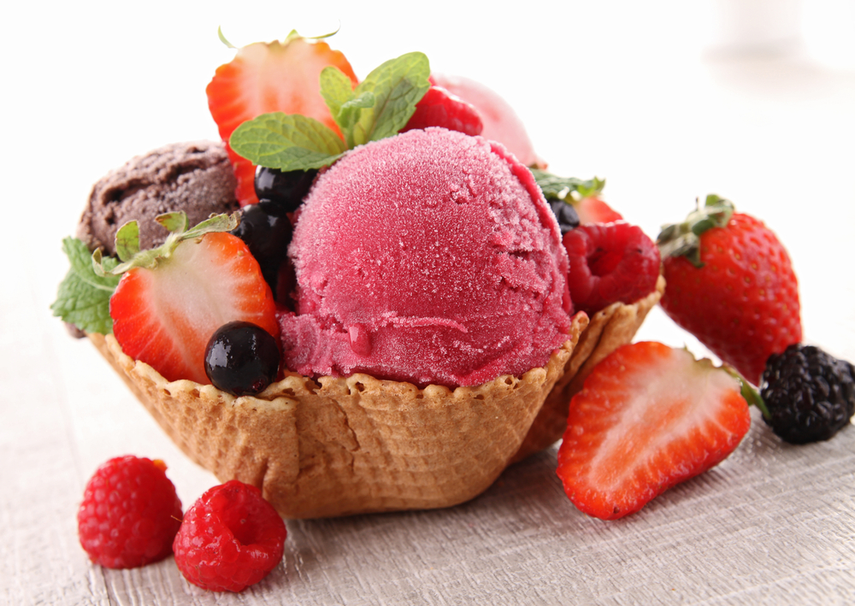
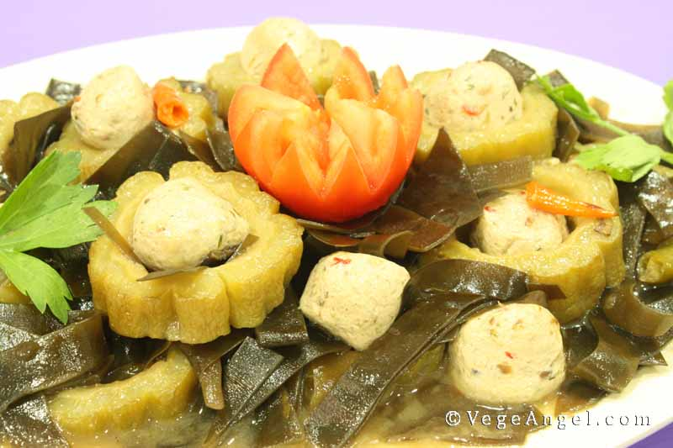
Kelps uses
1-The primary known constituents of Kelp include algin, iodine, potassium, bromine, mucopolysaccharides, mannitol, alginic acid, kainic acid, laminine, histamine, zeaxanthin, protein, and Vitamins B-2 & C.

Slide 30
2-The seaweed Kelp (Fucus vesiculosis) is an excellent source of minerals from the sea, particularly iodine which is very important for the thyroid gland to function properly.
3-Kelp is known for the following properties: antibacterial, antioxidant, diuretic, expectorant, and nutritive, and is generally available in the forms of tea and capsules.
4-kelp have a link to a lower breast cancer rate; less obesity, heart disease, rheumatism, arthritis; lower blood pressure; less thyroid disease.

Slide 31
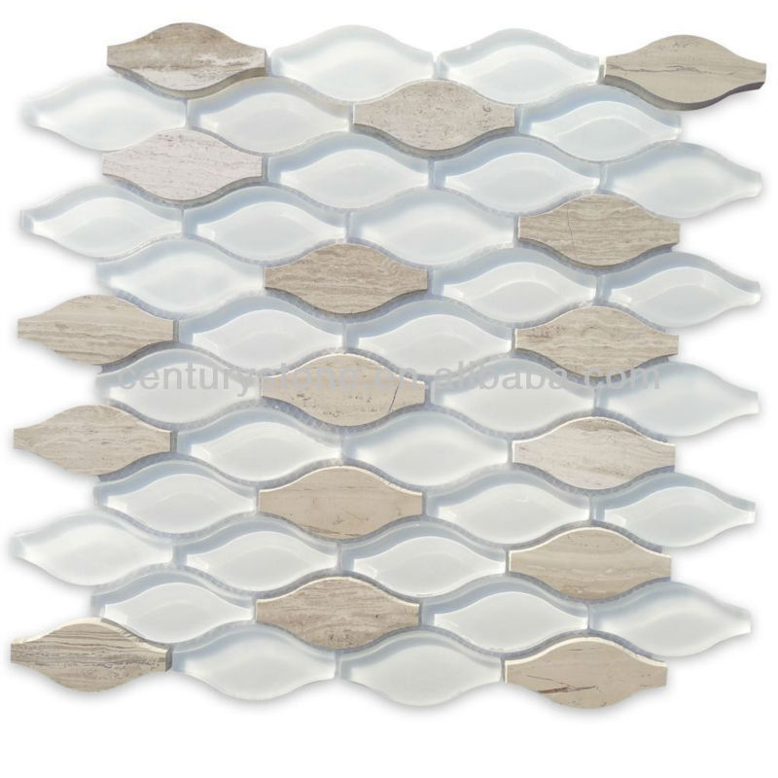
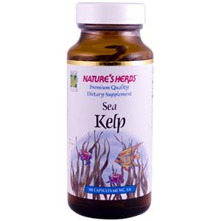
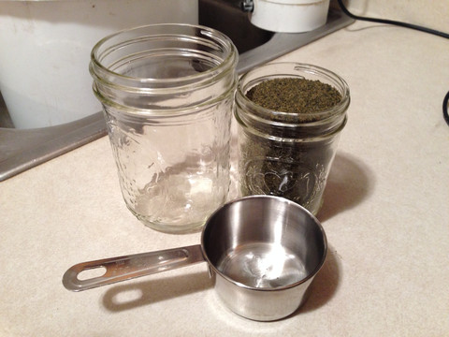

Slide 32
