Slide 1
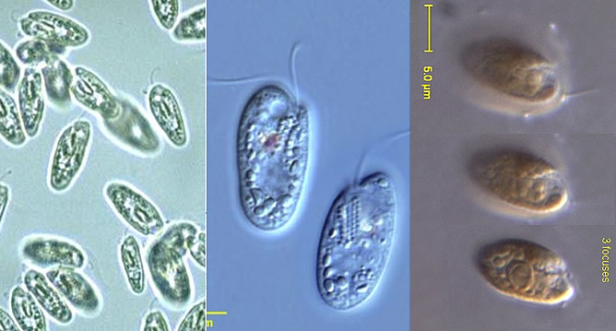
Cryptophyta

Slide 2
Cryptophyta
The principal Characteristics of the Cryptophyta
1- Relatively each small cell is around 10–50 μm in size and flattened in shape, Typically phytoplankton with an anterior groove or pocket. At the edge of the pocket there are typically two slightly unequal flagella.
2- One or two chloroplasts include chlorophylls a and c₂, as well as phycocyanin and phycoerithrin related to but different from phycobilins found in Cyanobacteria, and Rhodophyceae), and yellow pigments (α-carotene and xanthophylls.
3- Storage food Both Starch grains, and lipids .
4- Eyespot, if present, is inside plastid.

Slide 3
5- Reproduction is generally Asexual by longitudinal cell division .
6- Lack cell walls-naked , Cell Covering: Periplast—made up of protein plates.
7-Nutrition is autotrophic or heterotrophic.
8-Flagellate:
Two unequal flagella
Typically the longer flagellum has two rows of mastigonemes, the shorter one a single row. mastigonemes, assist in locomotion by increasing the surface area of a flagellum.
9- They are common in freshwater, and also occur in marine and brackish habitats.

Slide 4
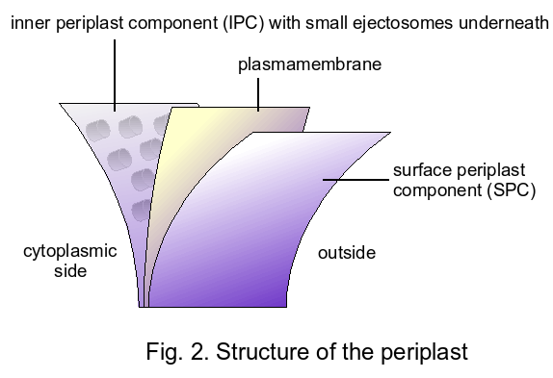

Slide 5
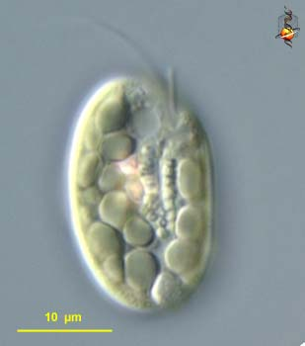
Cryptophyta
Class:Cryptophyceae
1- Order: Cryptomonales
Geuns: Cryptomonas
2-Order:Cryptococcales
Genus:Tetragonduim
Cryptomonas sp.

Slide 6
1- A typical photosynthetic genus, has two unequal
flagellaattached at one end of a flattened oval cell.
that inhabit freshwater aquatic systems.
2- Cells varying in shape between ovoid and
elliptical, averaging 40 μm in size.
3- Most have two chlorplasts, the color of which is
usually yellowish to olive-green, but this may
be red during winter months.
4- Cell division is longitudinal.
5- Cryptomonas can be either protozoa (order Cryptomonadida) or alga (class Cryptophyceae).
6- Cryptomonas phytoplankton function as primary producers in freshwater ecosystems and contribute to the foraging base of many heterotrophs, including macroinvertibrates and fishes.
Cryptomonas

Slide 7
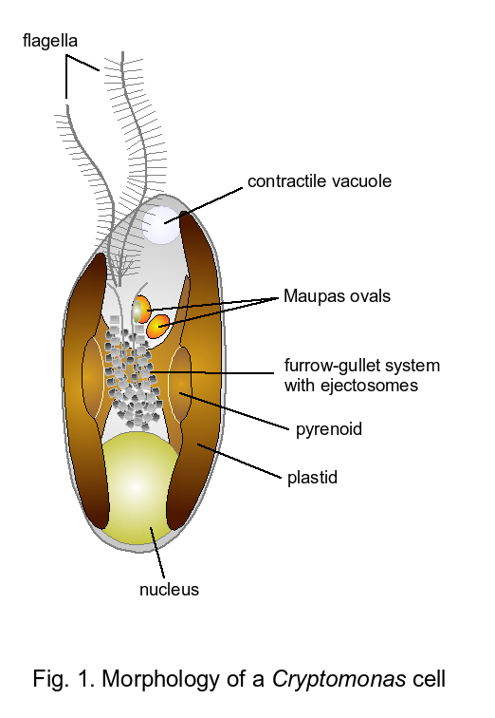

Slide 8
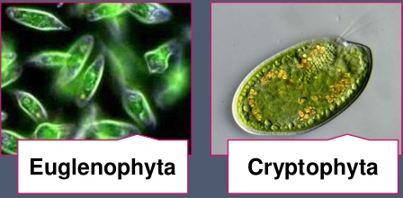

Slide 9
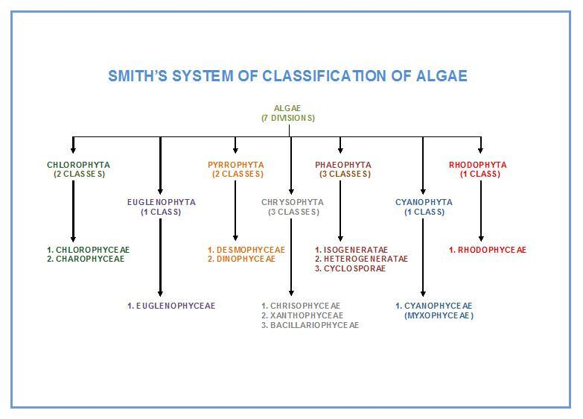

Slide 10
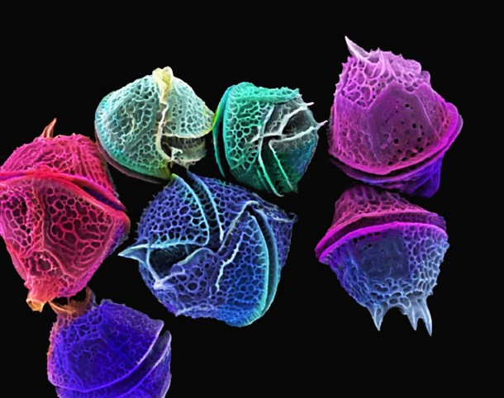
Pyrrophyta (dinoflagellata)

Slide 11
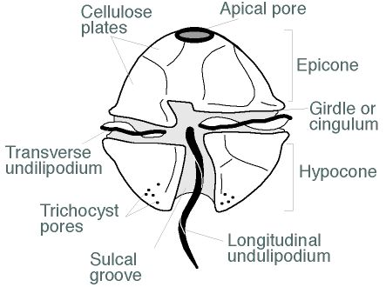
Pyrrophyta (dinoflagellata)
The principal Characteristics of the Pyrrophyta.
1- microscopic ,unicellular organisms.
2-The name "dinoflagellate" refers to the forward- spiraling swimming motion of these organisms.
3-Transverse and longitudinal flagella ;-transverse flagellum is flat and encircles the body.-Longitudinal flagellum is perpendicular to the transverse and is responsible for swimming .- Beating flagellum produce a forward ,spiraling motion.

Slide 12
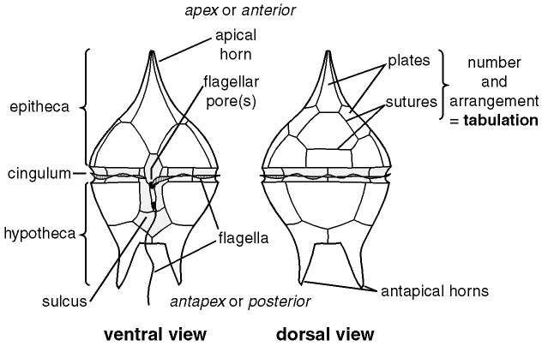
A representation of thecal plates on a typical armored dinoflagellate. Image by A. MacRae Univ. Calgary, after Evitt (1985).

Slide 13
4-photosynthetic species possess green pigments, chlorophylls a and c, and golden brown pigments, including peridinin. 5-Dinoflagellates primarily exhibit Asexual cell division, some species reproduce Sexually.
6-Their nutrition varies from Autotrophy (photosynthesis; in-nearly 50% of the known species) to Heterotrophy (absorption of organic matter) to Mixotrophy (autotrophic cells engulf other organisms, including other dinoflagellates).
7-Storage food Both starch grains, and lipids.

Slide 14
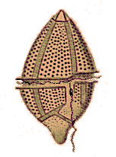
8-Dinoflagellates exhibit a wide variety in morphology and size (from 0.01 to 2.0 mm). They commonly have a cell covering structure (theca) that differentiates them from other algal groups.
9-. Cells are either armored or unarmored. Armored species have thecae divided into plates composed of cellulose or polysaccharides which are key features used in their identification. The cell covering of unarmored species is comprised of a membrane complex. The theca can be smooth and simple or laced with spines, pores and/or grooves and can be highly ornamented.
10- Most dinoflagellates have dinokaryon nucleus in which the chromosomes are attached to the nuclear membrane. These lack histones and remain condensed throughout inter phase rather than just during mitosis.
The nuclear envelope does not break down during mitosis, which is thus termed closed mitosis. The mitotic spindle is extranuclear

Slide 15
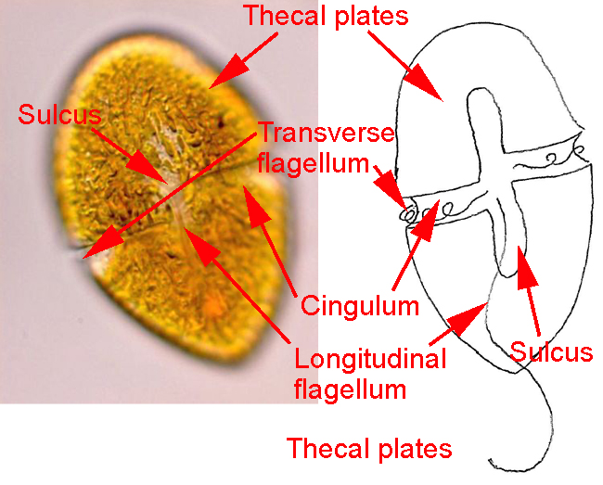

Slide 16
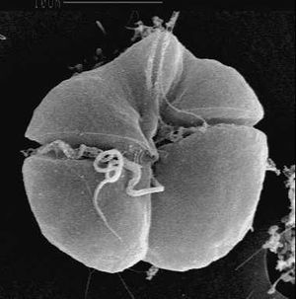
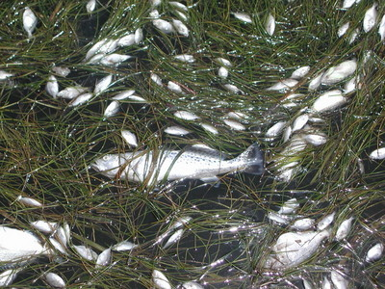
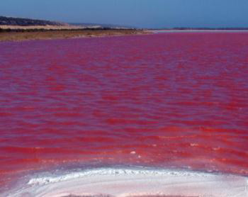
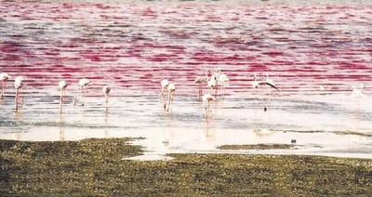
11- Dinoflagellates. known for producing toxins when in large numbers
-Refered to as Red tides
Toxins affect both marine life and humans .

Slide 17
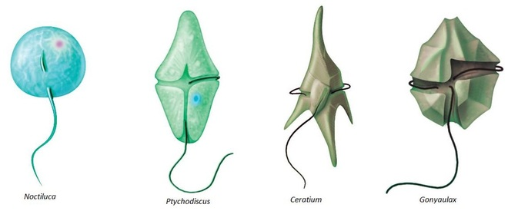
Pyrrophyta includes two class;
1-class:Desmophyceae
2-class; Dinophyceae
The main characteristics of Dinophyceae are:
The algae coming under this class is known as dark yellow to brown algae.
They are commonly known as sea water planktons.
They are free living, symbiotic or parasitic organisms.
The reserve food materials are starch and oil.
They possess characteristic nucleus which is condensed and banded chromosomes. called dinokaryotic (dinokaryon)
The motile phases possess two dissimilar flagella.

Slide 18
Gymnodinium, genus of marine or freshwater dinoflagellates. Members of the genus are bilaterally symmetrical with a delicate pellicle (or envelope) and disk-shaped chromatophores, which, when present, contain yellow, brown, green, or blue pigments. The genus is claimed by both botanists and zoologists, for, like all dinoflagellates, it has both plant-like and animal-like species. Some species are photosynthetic; others require solid food. Some may be bioluminescent or form periodic blooms that may colour water yellow or red. A few species produce a toxin similar to that of the dinoflagellate Gonyaulax; both toxins are fatal to fish and can irritate the nose and throat of human .

Slide 19
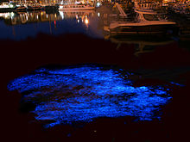
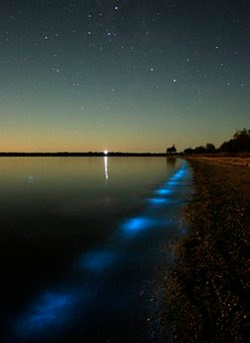
Bioluminescent

Slide 20
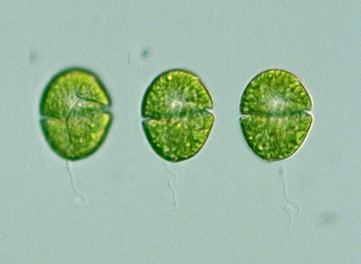
Gymnodinium
genus of marine or freshwater dinoflagellates . Members of the genus are bilaterally symmetrical with a delicate pellicle (or envelope) and disk-shaped chromatophores, which, when present, contain yellow, brown, green, or blue pigments.

Slide 21
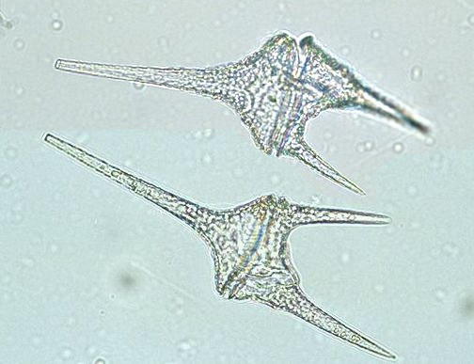
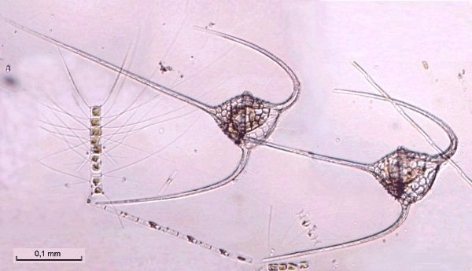
Ceratium species are easily identifiable because of their unique shape. They are covered with an armor-like cell wall, made out of polysaccharidel. The most distinguishing characteristic are the arms (also known as horns), the shape and size of which vary from species to species. Ceratium monoceras has a single, apical horn. The arms help Ceratium float, but prevent them from moving very quickly. Another important feature is that they contain small plasmids.

Slide 22
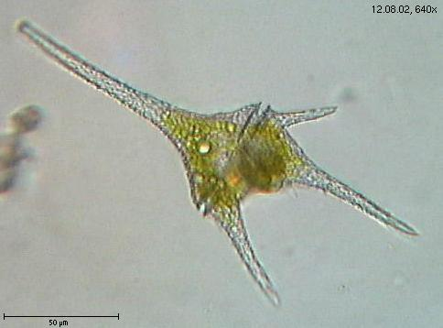
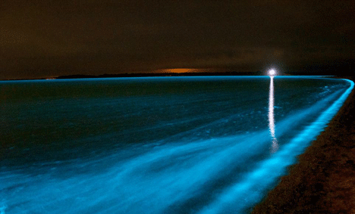
Ceratium have two flagella. These wind around the cell body. The flagella each have different movements and shapes. The transverse flagellum beats in a spiral motion, while the longitudinal flagellum pulses in waves..Certain species are bioluminescent . Under adverse conditions, Ceratium are able to Encyst themselves as a form of protection. Ceratium are mixotrophs, obtaining food both through photosyntheis and phagocytosis. Asexual reproduction is most common in Ceratium. However, sexual reproduction is also possible, usually taking place under adverse conditions.

Slide 23
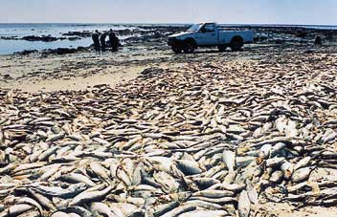
Harmful algal blooms
Dinoflagellates sometimes bloom in concentrations of more than a million cells per millilitre. Under such circumstances they can produce toxins (generally called dinotoxins) in quantities capable of killing fish and accumulating in filter feeders such as shellfish, which in turn may be passed on to people who eat them. This phenomenon is called a red tide, from the color the bloom imparts to the water.

