Slide 1
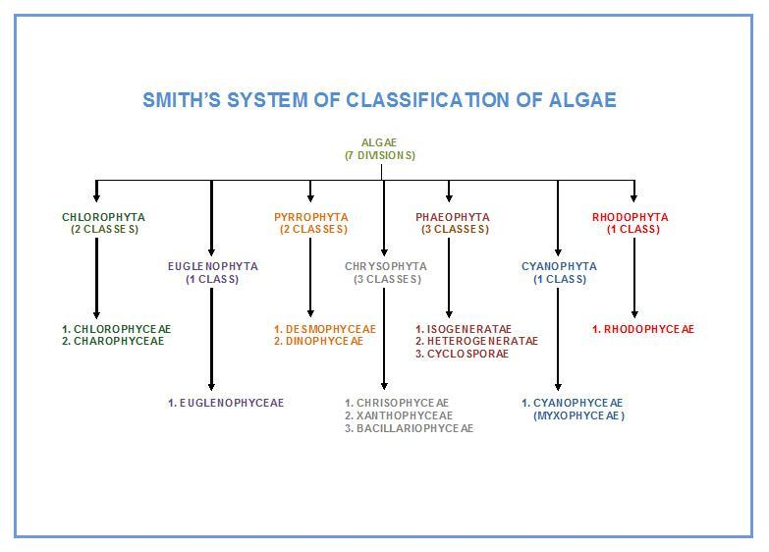

Slide 2
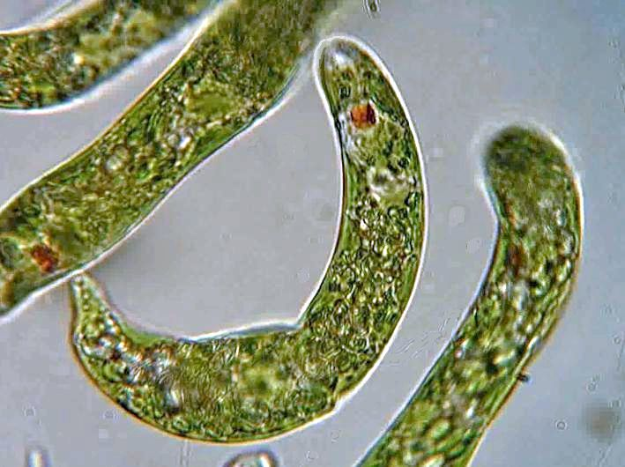
Division Euglenophyta

Slide 3
The principal Characteristics of the Euglenophyta
1-Chlorophyll a , b ,carotene and xanthophylls are dominant pigments.
2-Reserve food is Paramylum and fats.
3- Two apically or laterally placed flagella present, inserted into a narrow gullet for locomotion.
4- lack a true cell wall, and The body covered by flexible pellicle Consists of four components:
-Plasma membrane ,
-Proteinacous unit ,
-Subtending microtubules called (strips ) ,
-tubular cisternae of endoplasmic reticulum.( Pellicle:keep a definite shape)

Slide 4
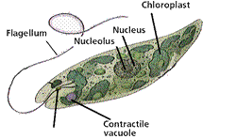
5- Large nucleus and a contractile vacuole.
6- Nutrition is autotrophic or heterotrophic
7-Reproduction occurs by longitudinal cell division
8- Eyespot (stigma) - near the flagella eyespot used for sensing light and dark.
9- Only fresh water forms are present.

Slide 5
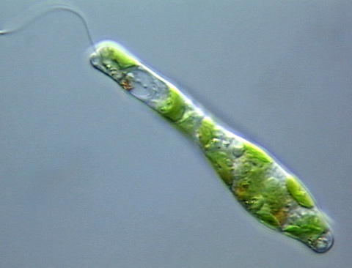
There are approximately 1000 species of euglenoids. Euglenophyta includes only one class:
Class:Euglenophyceae
Geuns: Euglena
Euglenoids are typically elongate, spindle shaped organisms usually contain several chloroplasts per cell Which vary in appearance from discoid to star or ribbon –shaped .
The presence of a surface pellicle, which gives the cell a striated appearance , In some the pellicle is flexible while in other the pellicle is completely rigid a permanent outline to the cell.
Euglanas have chloroplasts, to absorb sunlight (autotrophic). If sunlight is not available, it can absorb nutrients from decayed organi material (heterotrophic).

Slide 6
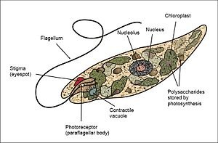

Slide 7
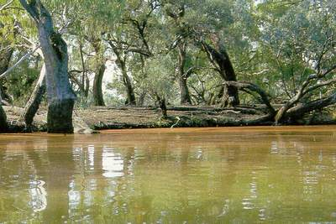
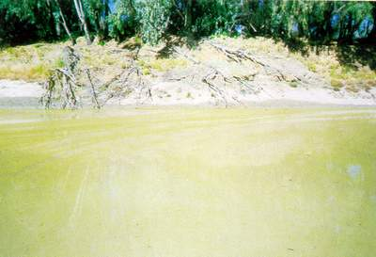
Ecology
Certain euglenoid algae are able to tolerate extreme environmental conditions . one of these ,Euglena mutabilis ,is able to grow in very low pH waters .this algae has pH optimum of pH 3.0 can tolerate values below pH 1.0 and is typical of acidic metal-contaminated ponds and streams draining mines. other euglenoids .
Euglena can be khaki or reddish and this may change during the day.

Slide 9
Division:Chrysophyta
1-Class:Chrysophyceae(golden algae)
2-Class:Xanthophyceae(yellow-green algae)
3-Class:Bacillariophyceae (Diatoms)

Slide 10
The principal Characteristics of the Chrysophyta
1. The chloroplasts contain chlorophyll a, c_{l} and c₂ ; chlorophyll b is never present. Also have accessory pigment carotene and xanthophylls .
2. The main reserve polysaccharide are chrysolaminaran, Leucosin and oil.
3- Notes the diversity flagellate systems ,The flagellate cells are Heterokont, bearing a long flagellum(Pantonematic), and a shorter smooth flagellum(Acronematic). And some species have Haptonema
is a "flagellum like" structure arising from the cell apex near the other flagella. It contains several microtubules. Its exact function is unknown, but is thought to aid in attachment, feeding, or responses.
4-The eyespot lies at the anterior of the cell, enclosed within the chloroplast.
5- Sexual reproduction varies from isogamous, Anisogamous, oogamous
7- Most of the plants are fresh water (about 75 %) and rest are marine.

Slide 11
Division:Chrysophyta
1-Class:Chrysophyceae(golden algae)
2-Class:Xanthophyceae(yellow-green algae)
3-Class:Bacillariophyceae (Diatoms)

Slide 12
1- Class: Chrysophyceae (Golden algae)
The main characteristics of Chrysophyceae are:
1-is commonly known as golden algae.
2-It’s a group of algae which is found in fresh water forms.
3-is unicellular or colonial.
4-The pigments are chlorophyll a, c and fucoxanthin; this fucoxanthin which give the characteristic color.
5-It stores energy in the form both as carbohydrate and oil droplets.
6-different types of cell wall covers : by cellulosic envelopes (lorica)or by silica scales , whereas others miss the outer cell wall.
7-flagella apical and unequal in length, and some species have haptonema .
8-Asexual reproduction by Binary fission, Sporogenesis.
9-Sexual reproduction isogamous ,Anisogamous, oogamous.
10-The lifecycle is haplontic.

Slide 13
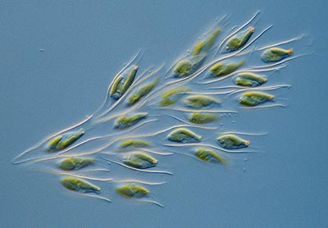
Dinobryon sp.

Slide 14
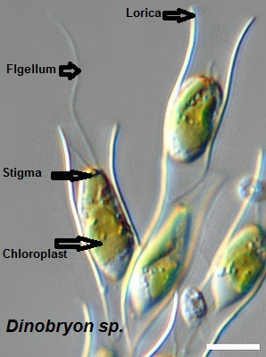
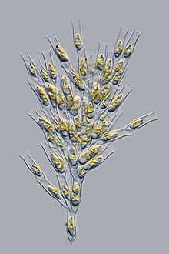
Example of chrysophyceae: Dinobryon sp.
Dinobryon sp.: Cells are housed in individual loricae, which is funnel-shaped. Cells have two unequal flagella and one or two chloroplasts. Species are determined by lorica and colony morphology. Dinobryon are very common in freshwater lakes, and some species can be found in estuarine or coastal
marine waters. Blooms of Dinobryon can have an unpleasant odor.

Slide 15
Division:Chrysophyta
1-Class:Chrysophyceae(golden algae)
2-Class:Xanthophyceae(yellow-green algae)
3-Class:Bacillariophyceae (Diatoms)

Slide 16
2- Class: Xanthophyteceae (Yellow-green algae)
The main characteristics of xanthophyteceae are:
1- Most live in freshwater, but some are found in marine and soil.
2-They vary from single-celled flagellates to simple colonial and filamentous forms and others are multinucleate siphonal (Vaucheriales).
3- contain the photosynthetic pigments Chlorophyll a, Chlorophyll c,
β-Carotene, and the carotenoid diadinoxanthin.
4- chloroplasts do not contain fucoxanthin
5- Its storage polysaccharide is chrysolaminarin.
6- cell walls are produced of cellulose and hemicellulose. They appear to be the closest relatives of the brown algae.
7- Pyrenoids are absent.
8- Sexual reproduction is isogamous.
9- Zoospores having unequal flagella.

Slide 17
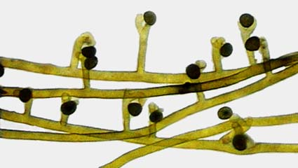
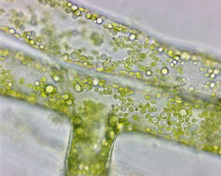
antheridium
oogonium
Vaucheria genus of yellow-green algae characterized by multinucleate tubular branches lacking cross walls (called Coenocyte ) except in association with reproductive organs or an injury. Food is stored as oil globules.
Asexual reproduction is by motile multiflagellate zoospores and nonmotile aplanospores.

Slide 18
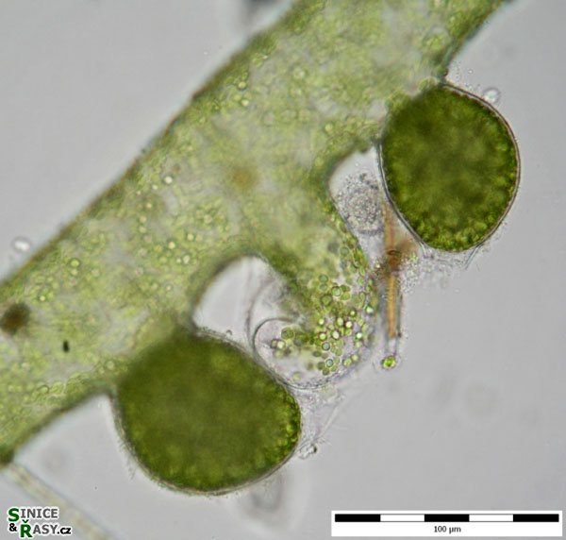
Sexual reproduction
Both antheridia and oogonia are formed.
In some forms, this happens on different filaments,
- (oogonium) The spherical female sex organ
-(antheridium) the slender hook-shaped male sex organ
-The sperms are released from a small opening
-will swim away to fertilize an egg which they enter through a small hole in the Oogonial wall.
-After the non motile egg is fertilized by a biflagellate sperm,
-the zygote may enter a resting phase for several weeks before germinating into a new plant.
antheridium
(oogonium)

Slide 19
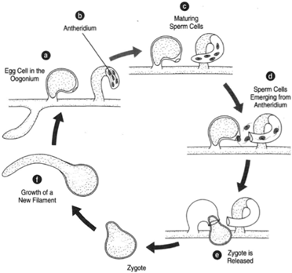
Sexual reproduction in Vaucheria. (a) An egg cell in the oogonium; (b) antheridium; (c) maturing sperm cells; (d) sperm cells emerging from the antheridium;(e) and (f) the zygote and growth of a new filament.

Slide 20
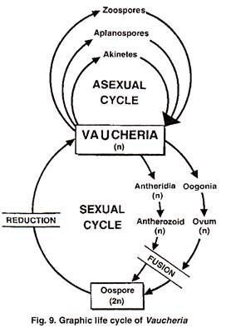

Slide 21
Division:Chrysophyta
1-Class:Chrysophyceae(golden algae)
2-Class: Xanthophyceae(yellow-green algae)
3-Class:Bacillariophyceae (Diatoms)

Slide 22
3- Class:Bacillariophyceae
The main characteristics of Bacillariophyceae are:
this class are commonly known as Diatoms.
are mostly unicellular or colonial algae.
Both the marine as well as fresh water forms are there.
The cell is golden brown in colour; the pigments are chlorophyll a, chlorophyll c, Xanthophyll.
The reserve food material is present as oil and chrysolaminarin.
cell wall saturated for silica material about 50% of the dry weight.
Asexual reproduction produce unique types of spores called Auxopsores.
A rigid overlapping cell wall is present which is known as frustule.
The shell or frustule is composed of two halves; larger epitheca and smaller hypotheca.
Large depositions of fossil diatoms are known as diatomaceous earth.

Slide 23
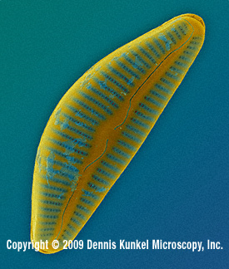
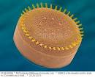
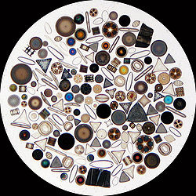
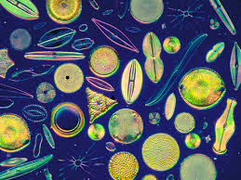
Diatoms are traditionally divided into two orders:
(Centrales), which are Radically symmetrical.
(Pennales), which are Bilaterally symmetrical.

Slide 24
Characteristic | Centric aiatoms | Pennate diatoms
Symmetry | Radial | Bilateral
Example | Cyclotella,Stephanodiscus | Navicula,Pinnularia
Gliding motility | Non-motile | Some diatoms are motile
Plastids | Many discoid | Two large plate-like plastids
Egg cells | Oogamous-production of one or two eggs per parent cell | Isogamous
Sperm cells | 4-128 sperm per parent cell. Each with a single flagellum bearing two rows of mastigoneme | Few amoeboid, non –flagellate sperm cells
Ecology | Mainly planktonic ,typical of open water | Planktonic ,epiphytic and benthic forms

Slide 25
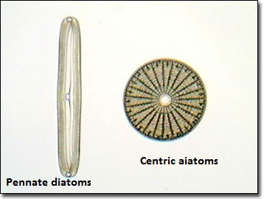

Slide 28
