Slide 1
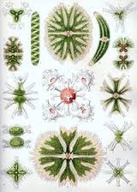
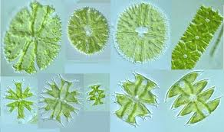
Order :Zygnematales
1Family : Zygnemaceae 2- Family: Desmidiaceae
1- Family Zygnemaceae comprising several thousand different species in genera such as Zygnema and Spirogyra.
2- All the members of this group develop into unbranched filaments.which grow longer through normal cell division.
3-Most live in freshwater, and form an important component of the algal that grows on or near plants, rocks, and various debris.
Sexual reproduction in Zygnematales takes place through a process called conjugation.

Slide 2
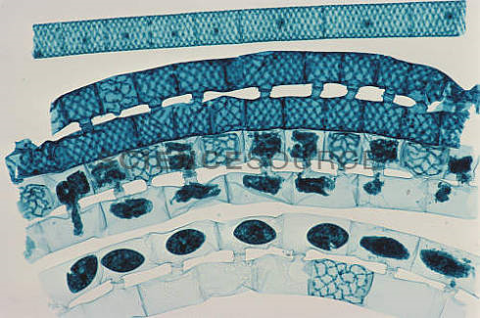
Sexual reproduction for Spirogyra.
Conjugation tube
zygote

Slide 3
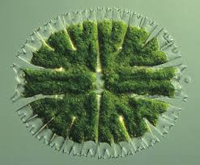
2- Family: Desmidiaceae
1-Mostly freshwater such as ponds, rivers, and lakes. There, they may live as phytoplankton, on the bottom as benthic dwellers
2- While most desmids are unicellular, many species grow as long filamentous colonies.
3-Two semi cells joined at an isthmus
4- like many other charophytes desmids have no flagella
5- planes of symmetry

Slide 4
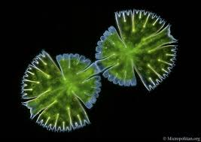
Reproduction
Asexual: division along the isthmus, each new cell re grows its sister semi cell.
Sexual: conjugation, with dormant zygote

Slide 5
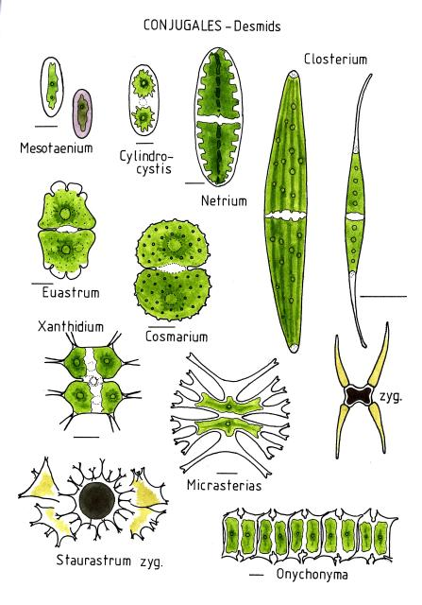

Slide 6
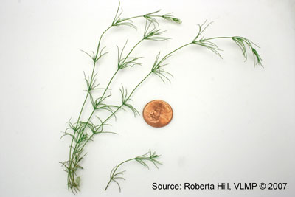
2)Class :Charaphycae (stonewort)
The members of this class of algae greens link between the rest of the algae and mosses
And differs from the class algae greens with features the following: -
1-consist of erect axis is divided into nodes and internodes, the provider side branched
Members of reproduction complex is surrounded by sterile tissue
Vary the male gametes swimming in the shape of the male in class green algae .
Zygote grow to give Protonemal stage then grows into an adult plant.

Slide 7
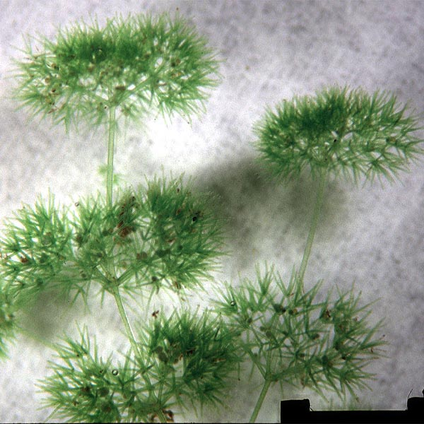
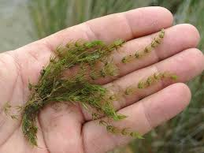
The principal Characteristics of the Charophyceae:
1-These algae can occur in fresh or brackish waters, and they have cell walls that contain large concentrations of calcium carbonate.
2- Cells of this class are asymmetrical.
Some are calcified (Chara) and may accumulate as calcium carbonate deposits..
3- resembling the structures of some higher plants,
4-Stonewort structures include root like( rhizoids), whorls of branches at regular intervals, and an erect cylindrical axis, which may be surrounded by a sheath of small cells.
5-Charophytes are also the only algae that develop multicellular sex organs, although these are not comparable to those of the higher plant.

Slide 8
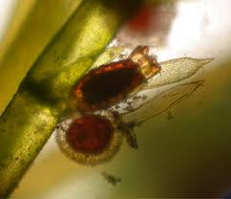
6 - In sexual reproduction each female sex organ (oogonium) contains one large, immobile egg, and each male sex organ (antheridium) produces one small, biflagellate sperm. An envelope of sterile cells surrounds the reproductive structures. No motile spores are formed

Slide 9
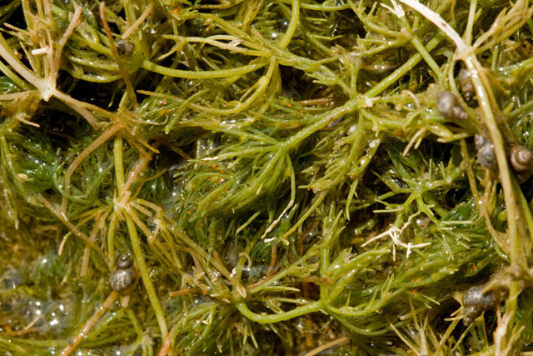
Chara is a genus of charaphyta ,The branching system of Chara species is complex with branches derived from apical cells which cut off segments at the base to form nodal and intermodal cells alternately. They are typically anchored to the littoral substrate by means of branching underground rhizoids. Chara plants are rough to the touch because of deposited calcium salts on the cell wall. The metabolic processes associated with this deposition often give Chara plants a distinctive and unpleasant smell of hydrogen sulfide.

Slide 10
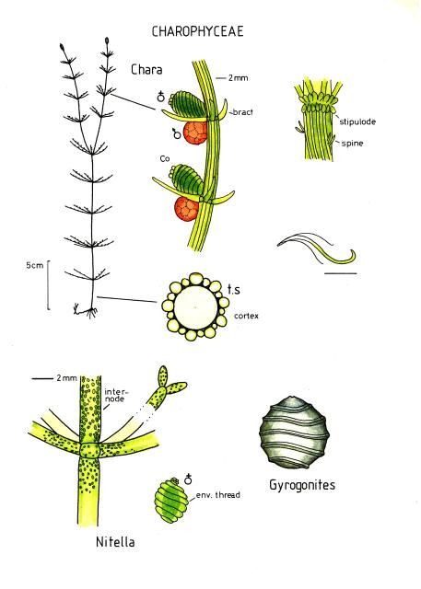
Reproduction
the sex organs can be readily identified by their shape and color. The sperm-bearing antheridia are bright orange, while the egg-bearing oogonium is green with a distinctive crown of cells. This is an excellent alga for studying life cycles in general biology and botany classes.

Slide 11
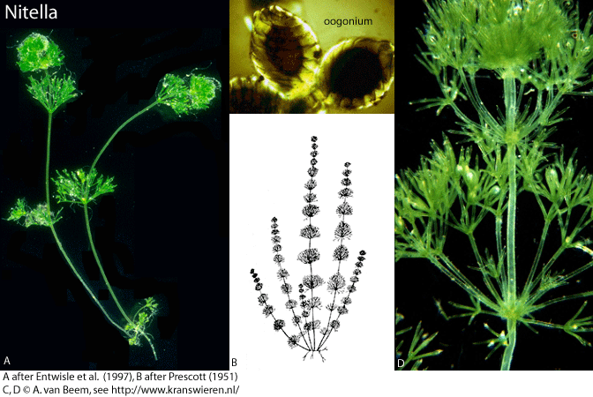
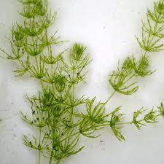
Nitella Chara
•Light to dark green color •Grey-green color
•Less than 8 cm to 2 m long •5 cm to 1 m long
•Forked bushy branches •Cylindrical whorled branches
•Soft to touch •Crunchy texture (Calcium deposits)
•No odor •Musty, garlic, or skunk like odor
•Fresh water •Fresh to brackish water
•Prefers slightly acidic water •Prefers slightly alkaline water
Nitella prefers more acidic Chara prefers . ponds with soft sediments alkaline, hard water

Slide 12
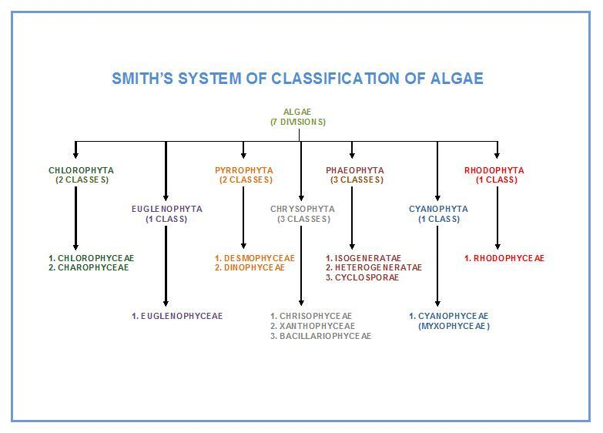

Slide 13
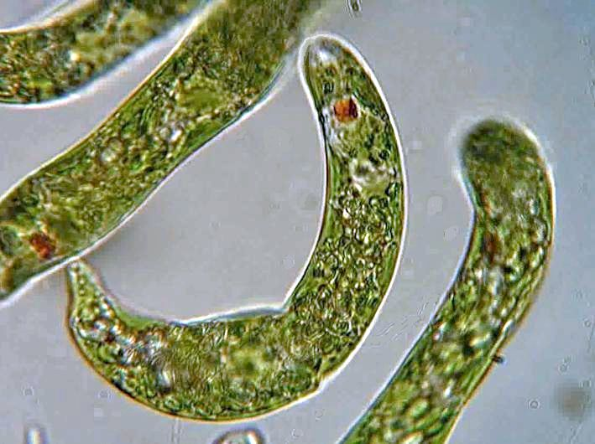
Division Euglenophyta

Slide 14
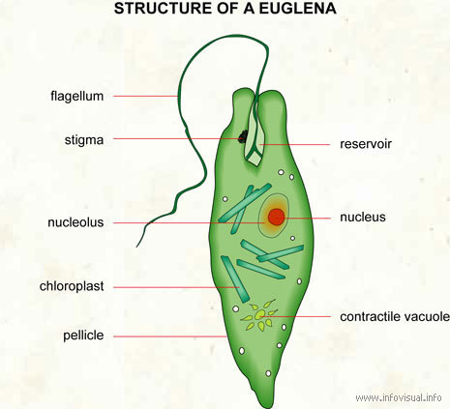
The principal Characteristics of the Euglenophyta
1-Chlorophyll a , b ,carotene and xanthophylls are dominant pigments.
2-Reserve food is Paramylum and fats.
3- Two apically or laterally placed flagella present, inserted into a narrow gullet for locomotion.
4- lack a true cell wall, and The body covered by flexible pellicle Consists of four components:-Plasma membrane ,-Proteinacous unit ,-Subtending microtubules called (strips ) ,-tubular cisternae of endoplasmic reticulum.( Pellicle:keep a definite shape)

Slide 15
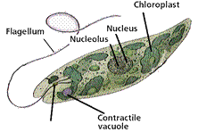
5- Large nucleus and a contractile vacuole.
6- Nutrition is autotrophic or heterotrophic
7-Reproduction occurs by longitudinal cell division
8- Eyespot (stigma) - near the flagella eyespot used for sensing light and dark.
9- Only fresh water forms are present.

Slide 16
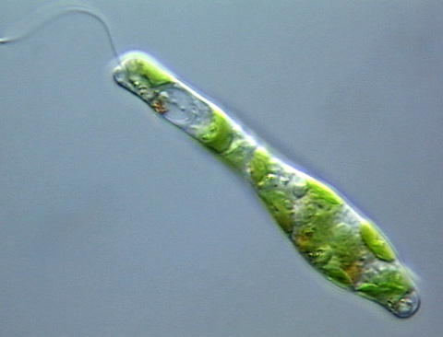
There are approximately 1000 species of euglenoids. Euglenophyta includes only one class:
Class:Euglenophyceae
Geuns: Euglena
Euglenoids are typically elongate, spindle shaped organisms usually contain several chloroplasts per cell Which vary in appearance from discoid to star or ribbon –shaped .
The presence of a surface pellicle, which gives the cell a striated appearance , In some the pellicle is flexible while in other the pellicle is completely rigid a permanent outline to the cell.
Euglanas have chloroplasts, to absorb sunlight (autotrophic). If sunlight is not available, it can absorb nutrients from decayed organimaterial (heterotrophic).

Slide 17
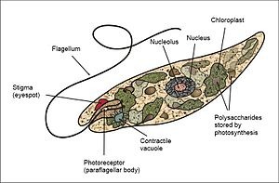

Slide 18
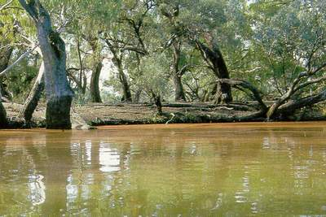
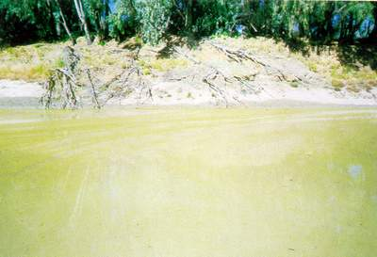
Ecology
Certain euglenoid algae are able to tolerate extreme environmental conditions . one of these ,Euglena mutabilis ,is able to grow in very low pH waters .this algae has pH optimum of pH 3.0 can tolerate values below pH 1.0 and is typical of acidic metal-contaminated ponds and streams draining mines. other euglenoids ,found in brackish and salinity.
Euglena can be khaki or reddish and this may change during the day.

Slide 20
Division:Chrysophyta
1-Class:Chrysophyceae(golden algae)
2-Class:Xanthophyceae(yellow-green algae)
3-Class:Bacillariophyceae (Diatoms)

Slide 21
The principal Characteristics of the Chrysophyta
1. The chloroplasts contain chlorophyll a, c_{l} and c₂ ; chlorophyll b is never present. Also have accessory pigment carotene and xanthophylls .
2. The main reserve polysaccharide is chrysolaminaran, Leucosin and oil.
3- Notes the diversity flagellate systems ,The flagellate cells are Heterokont, bearing a long flagellum(Pantonematic), and a shorter smooth flagellum(Acronematic). And some species have Haptonema
is a "flagellum like" structure arising from the cell apex near the other flagella. It contains several microtubules. Its exact function is unknown, but is thought to aid in attachment, feeding, or responses.
4-The eyespot lies at the anterior of the cell, enclosed within the chloroplast.
5- Sexual reproduction varies from isogamous, Anisogamous, oogamous
7- Most of the plants are fresh water (about 75 %) and rest are marine.

Slide 22
Division:Chrysophyta
1-Class:Chrysophyceae(golden algae)
2-Class:Xanthophyceae(yellow-green algae)
3-Class:Bacillariophyceae (Diatoms)

Slide 23
1- Class: Chrysophyceae(Golden algae)
The main characteristics of Chrysophyceae are:
1-is commonly known as golden algae.
2-It’s a group of algae which is found in fresh water forms.
3-is unicellular or colonial.
4-The pigments are chlorophyll a, c and fucoxanthin; this fucoxanthin which give the characteristic color.
5-It stores energy in the form both as carbohydrate and oil droplets.
6-different types of cell wall covers : by cellulosic envelopes (lorica)or by silica scales , whereas others miss the outer cell wall.
7-flagella apical and unequal in length, and some species have haptonema .
8-Asexual reproduction by Binary fission, Sporogenesis.
9-Sexual reproduction isogamous ,Anisogamous, oogamous.
10-The lifecycle is haplontic.

Slide 24
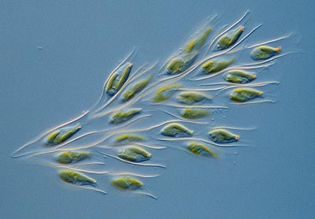
Dinobryon sp.

Slide 25
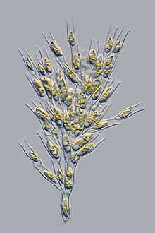
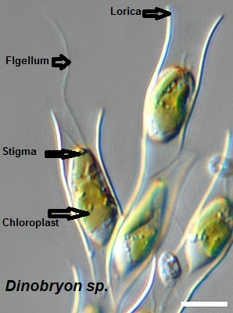
Example of chrysophyceae: Dinobryon sp.
Dinobryon sp.: Cells are housed in individual loricae, which is funnel-shaped. Cells have two unequal flagella and one or two chloroplasts. Species are determined by lorica and colony morphology. Dinobryon are very common in freshwater lakes, and some species can be found in estuarine or coastal
marine waters. Blooms of Dinobryon can have an unpleasant odor.

Slide 26
Division:Chrysophyta
1-Class:Chrysophyceae(golden algae)
2-Class:Xanthophyceae(yellow-green algae)
3-Class:Bacillariophyceae (Diatoms)

Slide 27
2- Class: Xanthophyteceae(Yellow-green algae)
The main characteristics of xanthophyteceae are:
1- Most live in freshwater, but some are found in marine and soil.
2-They vary from single-celled flagellates to simple colonial and filamentous forms and others are multinucleate siphonal (Vaucheriales).
3- contain the photosynthetic pigments Chlorophyll a, Chlorophyll c,
β-Carotene, and the carotenoid diadinoxanthin.
4- chloroplasts do not contain fucoxanthin
5- Its storage polysaccharide is chrysolaminarin.
6- cell walls are produced of cellulose and hemicellulose. They appear to be the closest relatives of the brown algae.
7- Pyrenoids are absent.
8- Sexual reproduction is isogamous.
9- Zoospores having unequal flagella.

Slide 28
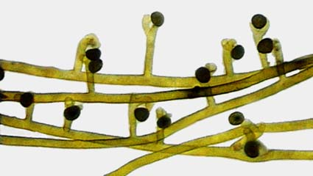
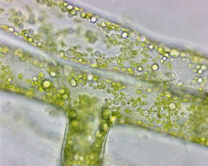
antheridium
oogonium
Vaucheria genus of yellow-green algae characterized by multinucleate tubular branches lacking cross walls (called Coenocyte ) except in association with reproductive organs or an injury. Food is stored as oil globules.
Asexual reproduction is by motile multiflagellate zoospores and nonmotile aplanospores.

Slide 29
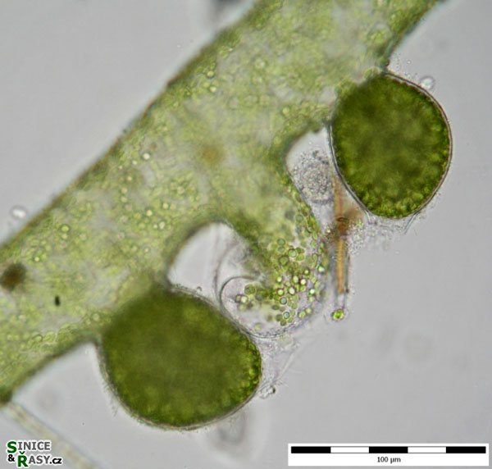
Sexual reproduction
Both antheridia and oogonia are formed.
In some forms, this happens on different filaments,
- (oogonium) The spherical female sex organ
-(antheridium) the slender hook-shaped male sex organ
-The sperms are released from a small opening
-will swim away to fertilize an egg which they enter through a small hole in the Oogonial wall.
-After the non motile egg is fertilized by a biflagellate sperm,
-the zygote may enter a resting phase for several weeks before germinating into a new plant.
antheridium
(oogonium)

Slide 30
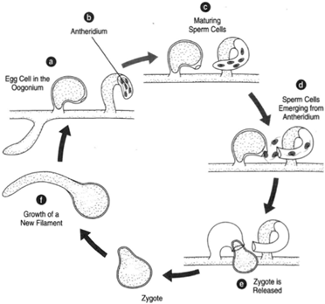
Sexual reproduction in Vaucheria. (a) An egg cell in the oogonium; (b) antheridium; (c) maturing sperm cells; (d) sperm cells emerging from the antheridium;(e) and (f) the zygote and growth of a new filament.

Slide 31
Division:Chrysophyta
1-Class:Chrysophyceae(golden algae)
2-Class: Xanthophyceae(yellow-green algae)
3-Class:Bacillariophyceae (Diatoms)

Slide 32
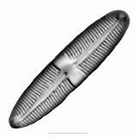
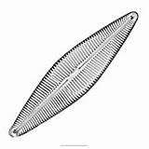
3-Class:Bacillariophyceae
The main characteristics of Bacillariophyceae are:
characteristics of Bacillariophyceae are:
this class are commonly known as Diatoms.
are mostly unicellular or colonial algae.
Both the marine as well as fresh water forms are there.
The cell is golden brown in colour; the pigments are chlorophyll a, chlorophyll c, Xanthophyll.
The reserve food material is present as oil and chrysolaminarin.
cell wall saturated for silica material about 50% of the dry weight.
Asexual reproduction produce unique types of spores called Auxopsores.
A rigid overlapping cell wall is present which is known as frustule.
The shell or frustule is composed of two halves; larger epitheca and smaller hypotheca.
Large depositions of fossil diatoms are known as diatomaceous earth.

Slide 33
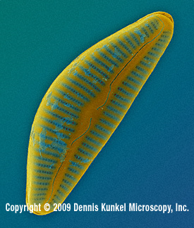
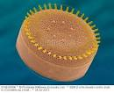
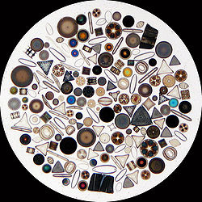
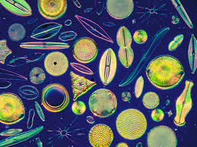
Diatoms are traditionally divided into two orders:
(Centrales), which are Radically symmetrical.
(Pennales), which are Bilaterally symmetrical.

Slide 34
Characteristic | Centric aiatoms | Pennate diatoms
Symmetry | Radial | Bilateral
Example | Cyclotella,Stephanodiscus | Navicula,Pinnularia
Gliding motility | Non-motile | Some diatoms are motile
Plastids | Many discoid | Two large plate-like plastids
Egg cells | Oogamous-production of one or two eggs per parent cell | Isogamous
Sperm cells | 4-128 sperm per parent cell. Each with a single flagellum bearing two rows of mastigoneme | Few amoeboid, non –flagellate sperm cells
Ecology | Mainly planktonic ,typical of open water | Planktonic ,epiphytic and benthic forms

Slide 35
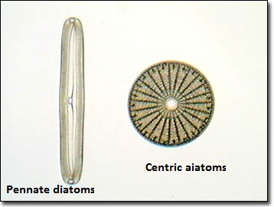

Slide 38
