Slide 1
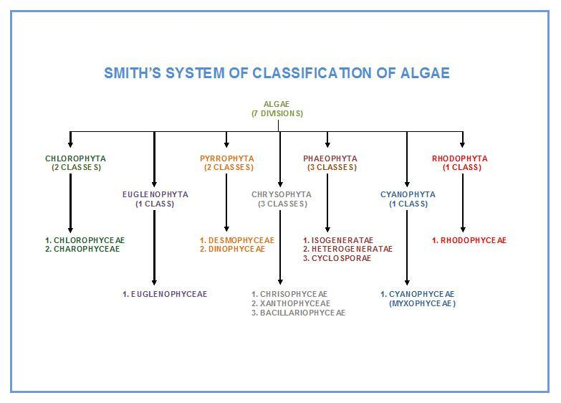

Slide 2
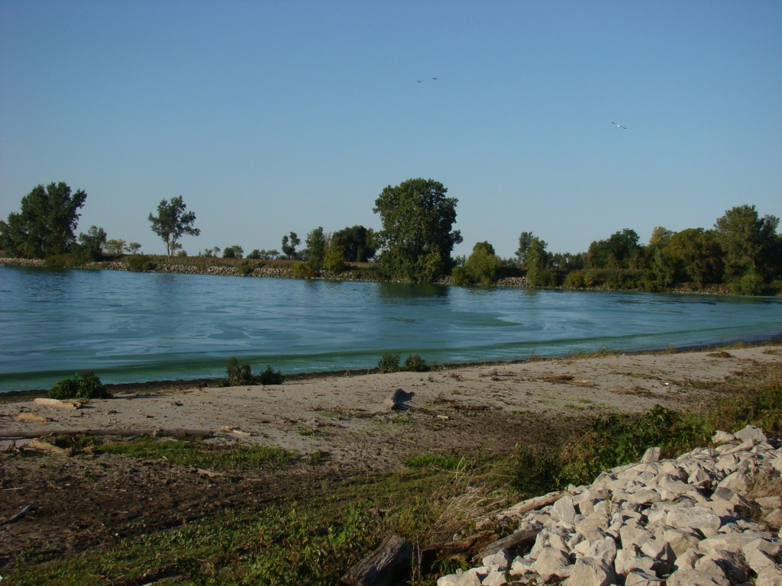
Blue-green algae as bio-indicators
The presence or absence of particular species can be a useful indicator of ecological statue .the dominant presence of colonial blue-green .forming dense summer blooms .has been useful as an indicator of high nutrient status .

Slide 3
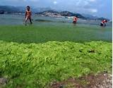
Algae blooms
In mid to late summer eutrophic temperate lakes frequently develop massive population of colonial blue green algae these may rise to surface of the lake . forming thick layer of algae biomass at the top of the water column ,other algae having major impacts on zooplankton and fish populations
The ability of blue greens to out –compete other fresh water algae has been attributed to arrange of characteristics including;
Optimum growth at high temperatures
Low light tolerance
Tolerance of low N/P ratios
Depth regulation by buoyancy
Resistance to zooplankton grazing
Tolerance of high pH/ low Co2 concentration
Symbiotic association with aerobic bacteria

Slide 4
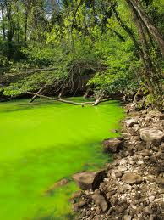
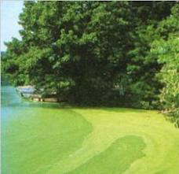
Eutrophication is when the environment becomes enriched with nutrients. This can be a problem in marine habitats such as lakes as it can cause algal blooms. Fertilizers are often used in farming, sometimes these fertilizers run-off into nearby water causing an increase in nutrient levels.
.

Slide 6
Division:Chlorophyta(Green algae)
The principal Characteristics of the Chlorophyta:
1- flagellate cells are isokont. Which means that the flagella are similar in structure . there are usually tow flagella per cell or four .
2-the chlorophyll a and b present , also have accessory pigments , including B-carotene and Xanthophylls .
3-Pyrenoids, where present ,are embedded within the chloroplast , Each is surrounded starch grains.
4- Food storge as starch , is similar in the seed plants
5-Chloroplast vary in shape ,size , and number ,in unicellular species they tend to be cup-shaped but in filamentous form may be annular ,reticulate ,discoid or ribbon-like .
6- motile species an eyespot is frequently present,
7- Cell walls mainly cellulose, but some marine forms add CaCO₃
8- May live symbiotically as lichens
9- Habitat may be freshwater, moist surfaces, or marine environments

Slide 7
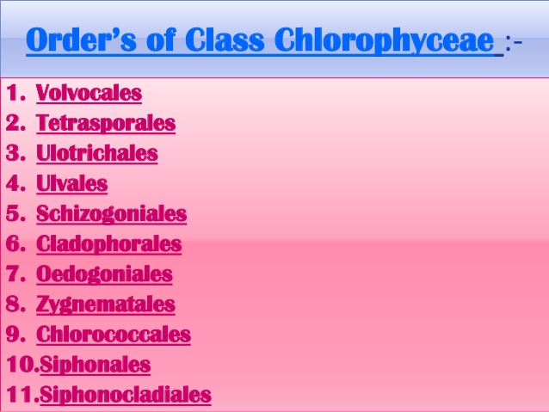
Chlorophyta includes two classes:
Class:Chlorophyceae
Class:Charaphyceae
Division:Chlorophyta
1)Class:Chlorophycaea

Slide 8
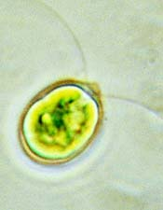
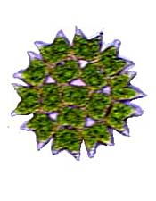
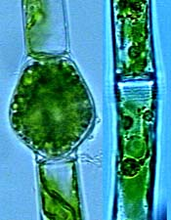
Class:chlorophyceae
The Chlorophyceae are a large and important group of freshwater. They include some of the most common species, as well as many members that are important both ecologically and scientifically.
variety of shapes and forms, including free-swimming unicellular species, colonies, non-flagellate unicells, filaments.
They also reproduce in a variety of ways, although all have a haploid life-cycle, in which only the zygote cell is diploid.
Chlorophyceae Diversity : Above are shown representatives of the three major groups of Chlorophyceae. From left to right, these are Chlamydomonas (Volvocales); Pediastrum (Chlorellales); and Oedogonium (Oedogoniales).

Slide 9
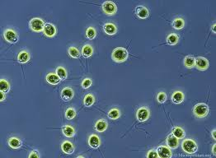
Most famous and important chlorophyceae:
Chlamydomonas:is a genus of green alga from order vovocales. occurring in stagnant water and on damp soil, in freshwater, seawater, and even in snow as "snow algae"Chlamydomonas is used as a model organism for molecular biology, especially studies of flagellar motility and chloroplast dynamics, biogenesis, and genetics. It is generally found in habitat rich in ammonium salt. reproduces by both asexual and sexual means.Chlamydomonas's asexual reproduction through Zoospores, Palmella stage, Aplanospores and Hypnospores (resting spore ,a thick walled ) sexual reproduction through isogamy, anisogamy or oogamy.

Slide 10
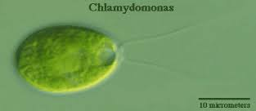
Morphology
Motile unicellular algae.
Generally oval in shape.
Cell wall is made up of glycoprotein
Two anteriorly flagella. Flagella originates from a basal granule located in the anterior papillate or non-papillate region of the cytoplasm.
Contractile vacuoles found at near the bases of flagella.
cup or bowl shaped chloroplast is present., which has a single large pyrenoid where starch is formed from photosynthetic products.
Eye spot present in the anterior portion of the chloroplast for photosensitivity

Slide 11
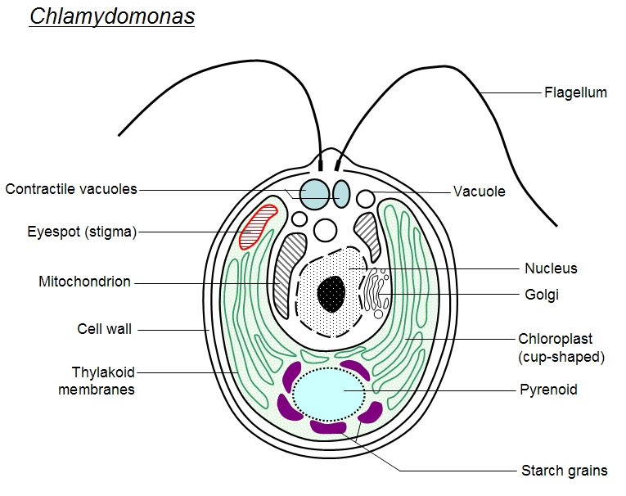

Slide 12
Reproduction:
a sexaul reproduction
1- reproduce by cell division, -The flagella are withdrawn,- the cytoplasm shrinks slightly within the cell wall, -the nucleus and then the cytoplasm divide once, twice, or occasionally three times.
2- Each of these units forms a new cell wall and a pair of flagella. The parent cell wall bursts open and releases the daughter individuals.
Sexual reproduction
-produces up to sixteen new individuals which do not develop cell walls. release from the parental cell they swim about and may meet other individuals and fuse in pairs to form a zygote.
-The zygote eventually rounds off, with draws the flagella, secretes a thick wall forming a zygospore which sinks to the bottom of the pond. The cytoplasm in the zygospore will divide, usually into four units, which are released as new chlamydomonas individuals.

Slide 13
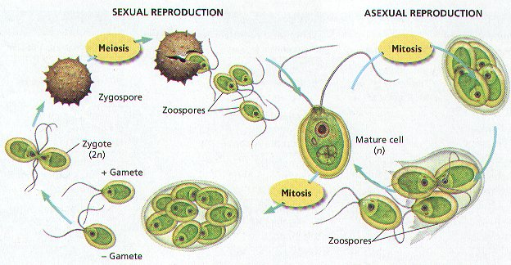

Slide 14
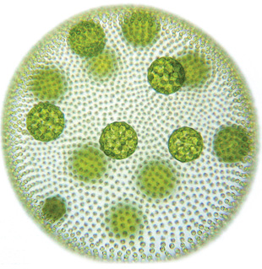
Volvox

Slide 15
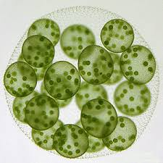
Volvox: is that form spherical colonies Each mature Volvox colony is composed of numerous flagellte cells similar to Chlamydomonas cell, up to 50,000 in total, and embedded in the surface of a hollow sphere called Intercellular gel . And present .Daughter colony .The individual algae are interconnected by thin strands of cytoplasm called cytoplasmic bridge volvox is composed of numerous cells. These cells are called Somatic cell , and big circular objects found inside a volvox are called Reproductive cells

Slide 16
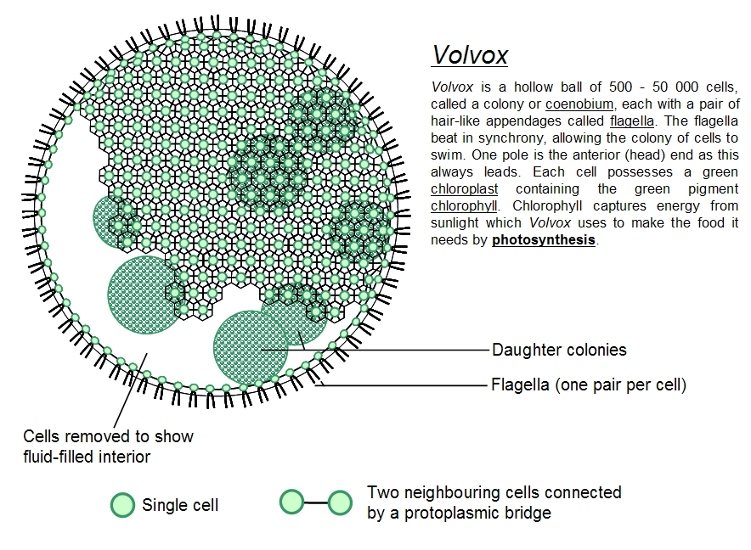

Slide 17
Reproduction
Asexual reproduction: colony includes both somatic (vegetative) cells, which do not reproduce, and gonidia near the posterior, which produce new colonies through repeated division. The daughter colonies are initially held within the parent colony and have their flagella directed inwards. Later, the parent disintegrates and the daughters invert.
B) Sexual reproduction :two types of gametes are produced . fusion of sperms and egg cells. that volvox can be monoecious or dioecious. The fertilization of male and female gametes in sexual reproduction leads to the formation of zygotes.

Slide 18
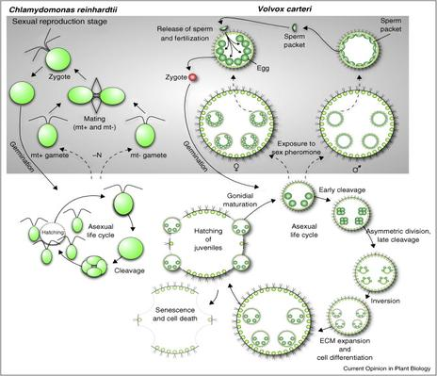

Slide 19
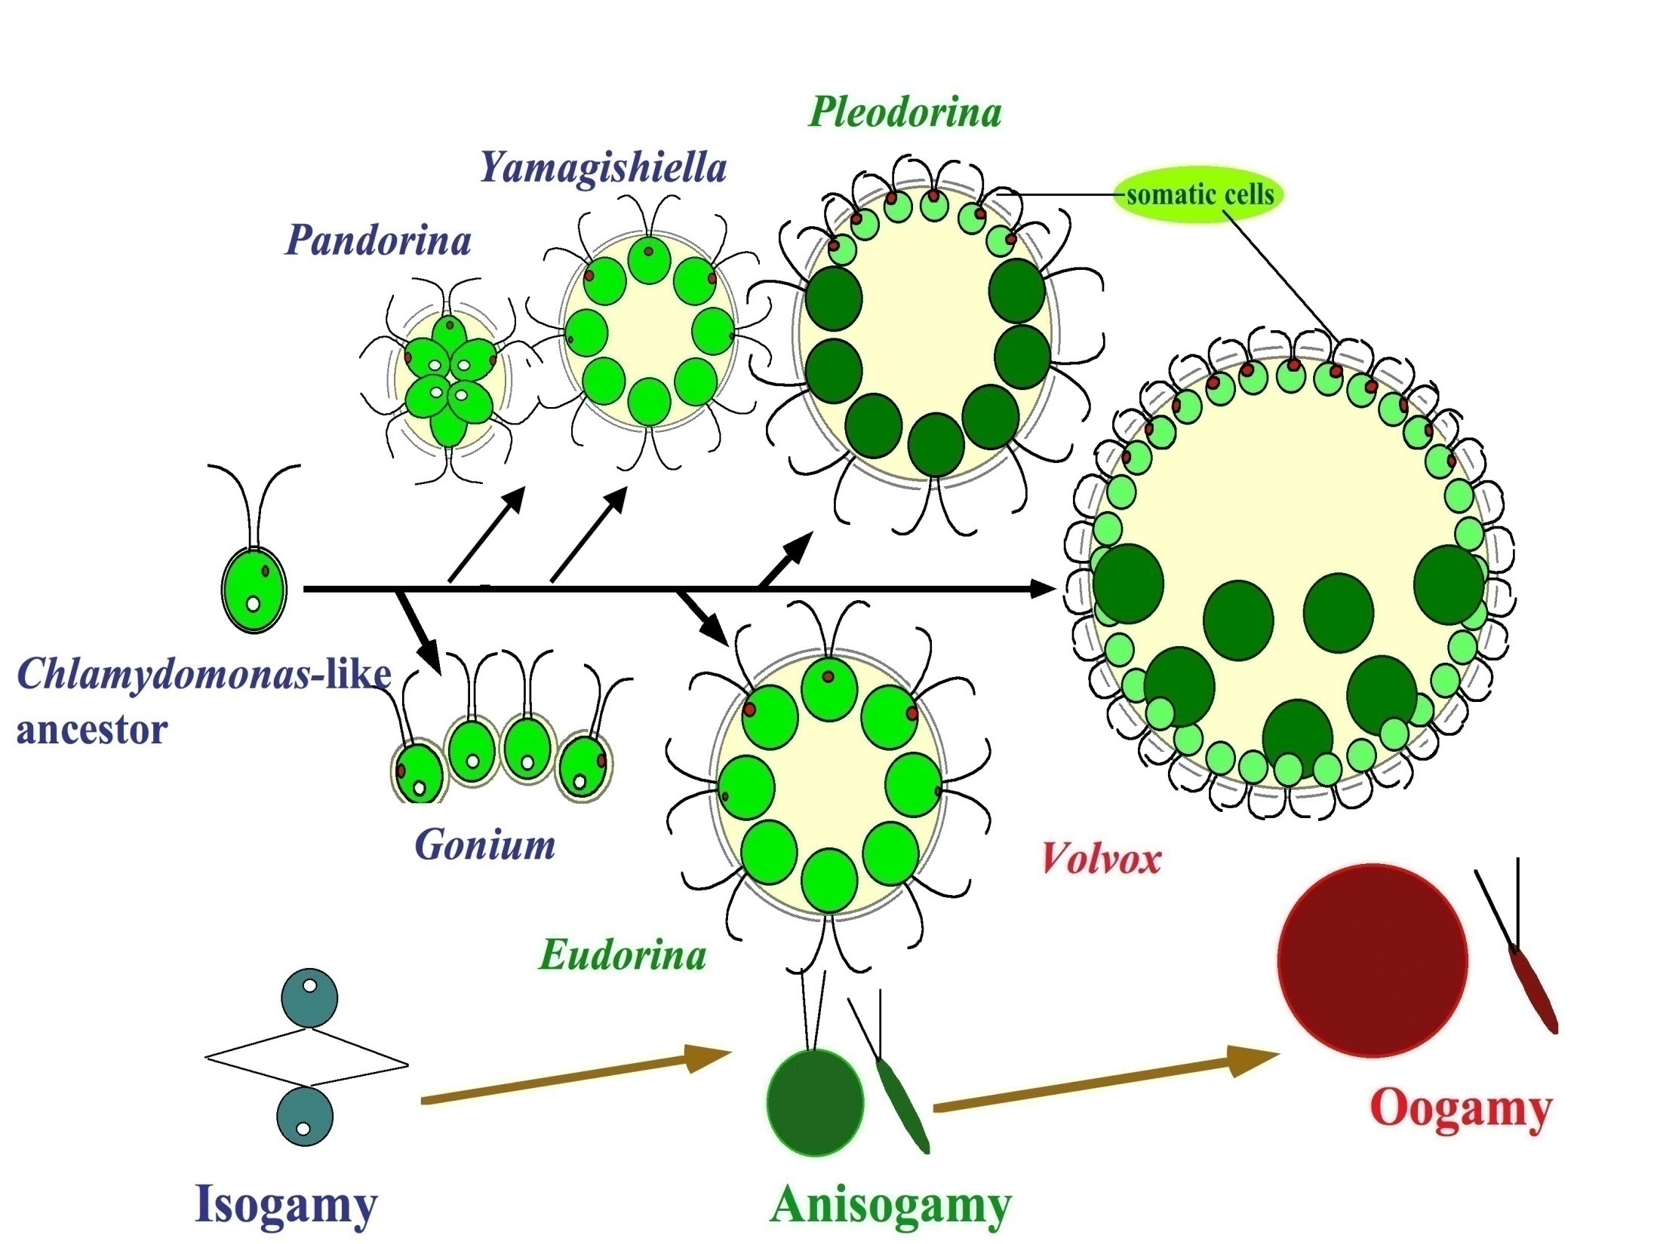

Slide 20
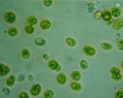
Chlorella
belonging to the order Chlorococcales it plays an important role as Endosymbionts inside the tissues of other organisms. Sponge,Polyps, Ciliates, and Forams all may house Chlorella internally, providing a home for the alga in exchange for its photosynthesis. More recently, this tiny alga has become popular as a "health food" for its concentrated proteins and chlorophyll, and is now raised commercially in large numbers, especially in Asia.
Chlorella is a genus of single-cell green algae. It is spherical in shape, about 2 to 10 μm in diameter, and is without flagella.. Chlorella contains the green photosynthetic pigments chlorophyll a and b in its chloroplast. it multiplies rapidly, requiring only Co2,water,sunlight, and a small amount of minerals to reproduce
. In recent years, researchers have use of Chlorella as an experimental organism because it lacks a sexual cycle ,the research advantages of genetics and source of food .

Slide 21
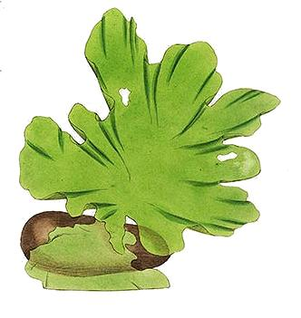
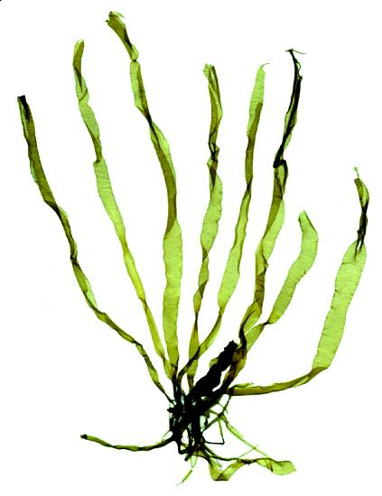
Ulvales
uninucleate cells with a parietal chloroplast; thallus is a hollow cylinder or a sheet, one or two cells thick.
ex: Ulva, Entero morpha

Slide 22
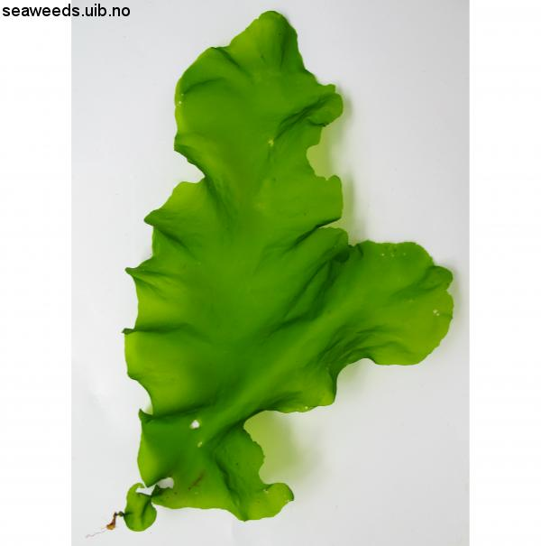
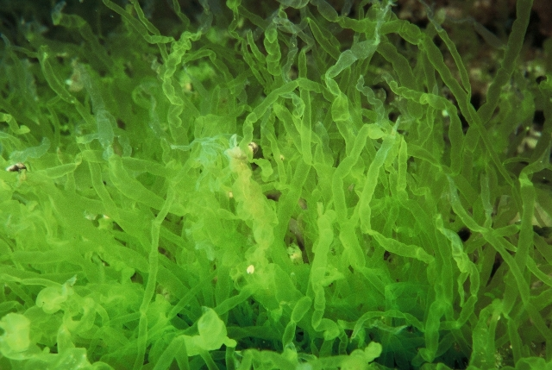
Ulva can also occur as a hollow cylinder. The genus Enteromorpha was previously erected for those Ulva in a hollow cylinder. These thalli composed of hollow cylinders are now recognized as species of Ulva

Slide 23
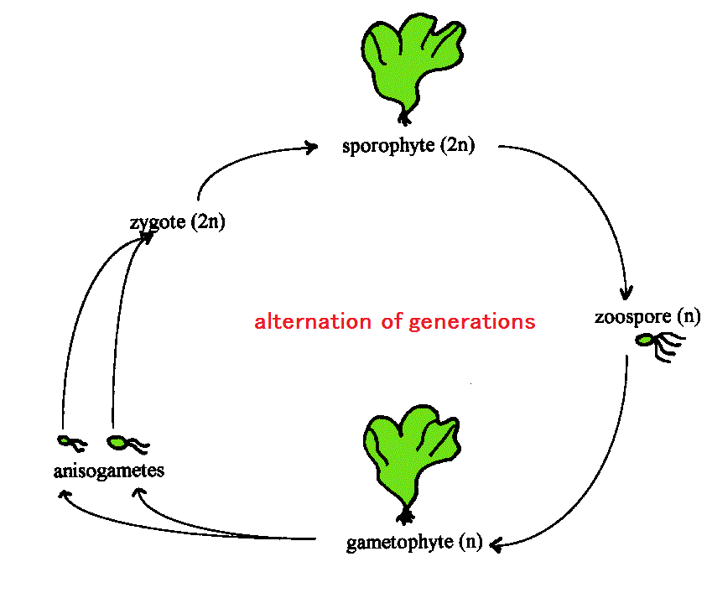

Slide 24
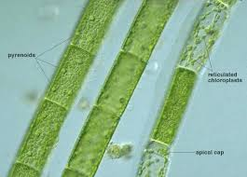
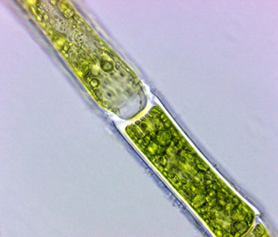
Oedogoniales
uninucleate filamentous freshwater algae with a unique type of cell division; motile spores and gametes with a whorl of flagella at one pole

Slide 25
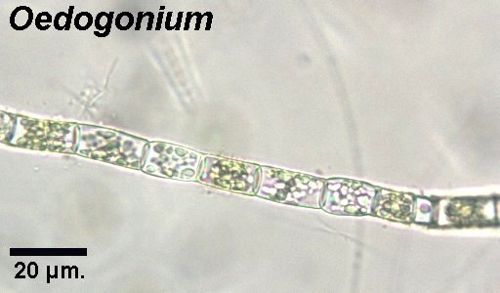
Oedogonium.
is Epiphytic on other aquatic algae or water plants. it may also be attached to stones or free floating objects. It is usually found in small permanent bodies of water like pools and ponds. The filaments may also occur as free floating masses.

Slide 26
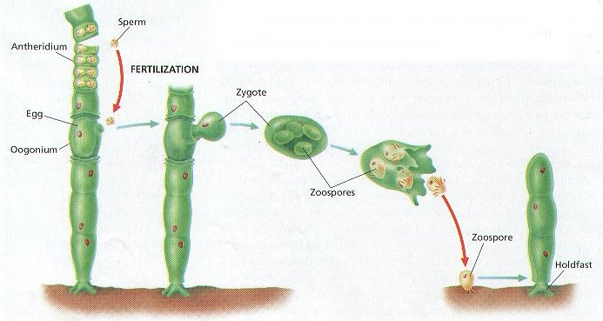
Reproduction
Vegetative reproduction is by fragmentation of the filaments.
Asexual reproduction is through zoospores, formed singly within a cell. The zoospores are ovoid to pyriform, each with a ring of flagella at the anterior end. On germination, the zoospore gives rise and that anchors itself to the substratum and begins to divide and subdivide into a filament. Asexual reproduction may also take place through aplanospores and akinetes.

Slide 27
Sexual reproduction :
is oogamous. Thalli are monoecious or dioecious forming antheridium and/or oogonium. Some dioecious species produce androspores that attache and form small male gametophytes (dwarf males) near oogonium (nannandrous). Other dioecious species have the male gametophytes simillar to female in size (macrandrous). The zygote becomes resting oospore and usually releases four zoospore via meiosis. Zoospores undergo meiosis so one cell attaches to the bottom & develops a holdfast while the other zoospores divide & form a filament

Slide 28
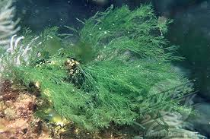
Order: Cladophorales
The filamentous genera in this order have multinucleate cells, usually with a parietal or reticulate chloroplast. The filaments may be branched or unbranched. The reticulate chloroplast has pyrenoids at the intersections of the reticulum

Slide 29
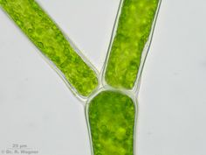
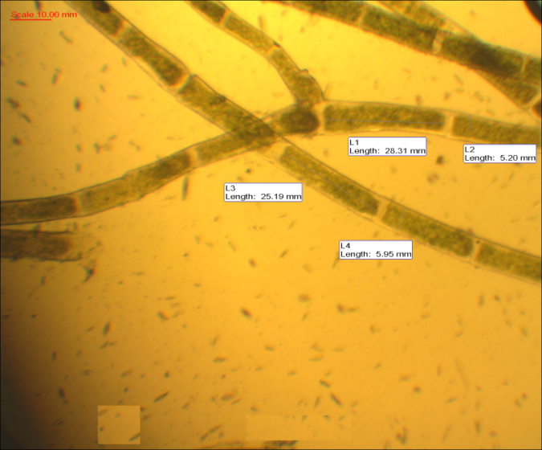
Cladophora
belonging to the order Cladophorals, genus of green algae found growing attached to rocks . in appearance regular-branching filaments, Cladophora grows in the form of a tuft or ball with filaments that may range up to 13 cm (5 inches) in length.

Slide 30
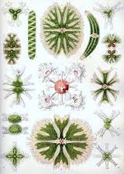
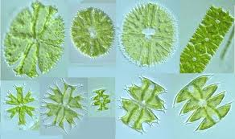
Order :Zygnematales
1Family : Zygnemaceae 2- Family: Desmidiaceae
1- Family Zygnemaceae comprising several thousand different species in genera such as Zygnema and Spirogyra.
2- All the members of this group develop into unbranched filaments.which grow longer through normal cell division.
3-Most live in freshwater, and form an important component of the algal that grows on or near plants, rocks, and various debris.
Sexual reproduction in Zygnematales takes place through a process called conjugation.

Slide 31
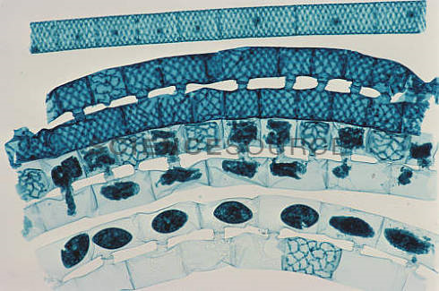
Sexual reproduction for Spirogyra.
Conjugation tube
zygote

Slide 32
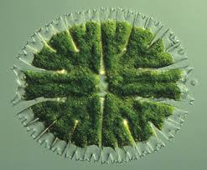
2- Family: Desmidiaceae
1-Mostly freshwater such as ponds, rivers, and lakes. There, they may live as phytoplankton, on the bottom as benthic dwellers
2- While most desmids are unicellular, many species grow as long filamentous colonies.
3-Two semi cells joined at an isthmus
4- like many other charophytes desmids have no flagella
5- planes of symmetry

Slide 33
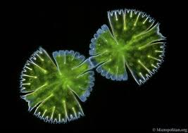
Reproduction
Asexual: division along the isthmus, each new cell re grows its sister semi cell.
Sexual: conjugation, with dormant zygote

Slide 34
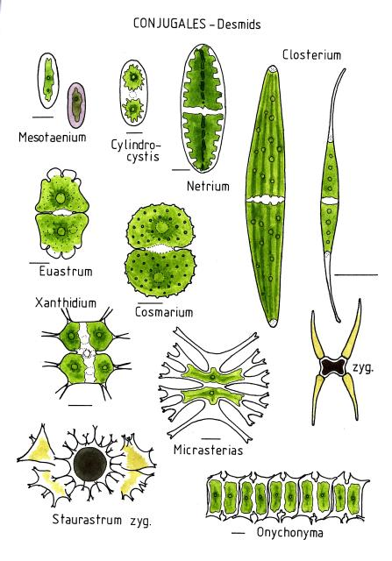

Slide 35
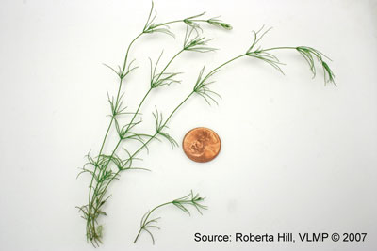
2)Class :Charaphycae (stonewort)
The members of this class of algae greens link between the rest of the algae and mosses
And differs from the class algae greens with features the following: -
1-consist of erect axis is divided into nodes and internodes, the provider side branched
Members of reproduction complex is surrounded by sterile tissue
Vary the male gametes swimming in the shape of the male in class green algae .
Zygote grow to give Protonemal stage then grows into an adult plant.

Slide 36
The principal Characteristics of the Charophyceae:
1-These algae can occur in fresh or brackish waters, and they have cell walls that contain large concentrations of calcium carbonate.
2- Cells of this class are asymmetrical.
Some are calcified (Chara) and may accumulate as calcium carbonate deposits..
3- resembling the structures of some higher plants,
4-Stonewort structures include root like( rhizoids), whorls of branches at regular intervals, and an erect cylindrical axis, which may be surrounded by a sheath of small cells.
5-Charophytes are also the only algae that develop multicellular sex organs, although these are not comparable to those of the higher plant.

Slide 37
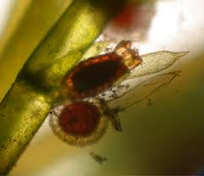
6 - In sexual reproduction each female sex organ (oogonium) contains one large, immobile egg, and each male sex organ (antheridium) produces one small, biflagellate sperm. An envelope of sterile cells surrounds the reproductive structures. No motile spores are formed

Slide 38
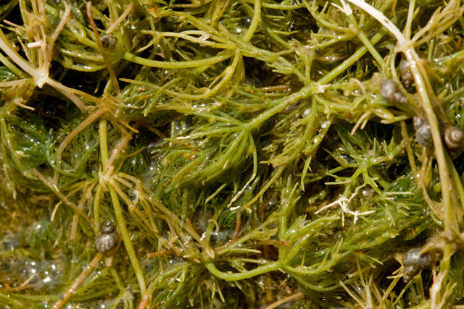
Chara is a genus of charaphyta ,The branching system of Chara species is complex with branches derived from apical cells which cut off segments at the base to form nodal and intermodal cells alternately. They are typically anchored to the littoral substrate by means of branching underground rhizoids. Chara plants are rough to the touch because of deposited calcium salts on the cell wall. The metabolic processes associated with this deposition often give Chara plants a distinctive and unpleasant smell of hydrogen sulfide.

Slide 39
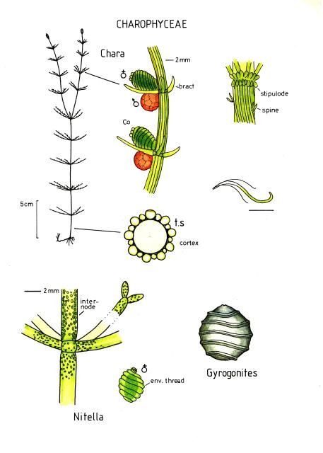
Reproduction
the sex organs can be readily identified by their shape and color. The sperm-bearing antheridia are bright orange, while the egg-bearing oogonium is green with a distinctive crown of cells. This is an excellent alga for studying life cycles in general biology and botany classes.

Slide 40
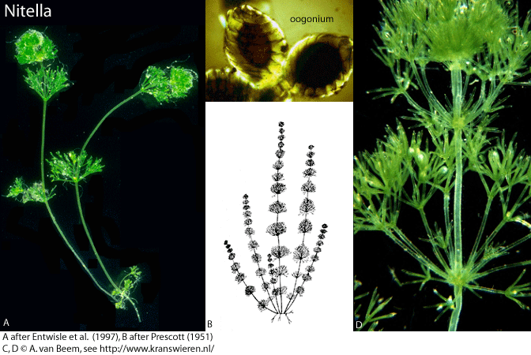
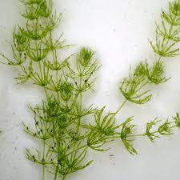
Nitella Chara
•Light to dark green color •Grey-green color
•Less than 8 cm to 2 m long •5 cm to 1 m long
•Forked bushy branches •Cylindrical whorled branches
•Soft to touch •Crunchy texture (Calcium deposits)
•No odor •Musty, garlic, or skunk like odor
•Fresh water •Fresh to brackish water
•Prefers slightly acidic water •Prefers slightly alkaline water
Nitella prefers more acidic Chara prefers . ponds with soft sediments alkaline, hard water

