Slide 1
The algae grow
1- Diffuse growth: every cell in algal body will shared and grow such as Ulva .
2- Localized growth:
a- Apical: it happens in one cell or group of cells but the growth only happen at the apex such as Fucus .
b- Intercalary: the growth happen between the apex and the base position ( in the middle) such as Laminaria.
c- Basal: only happens in the basal site of algae.

Slide 2
Algal seasonal life
1- Annual : the algal body found completely lysed during Autumn.
2- Perennial : the algal body found partially lysed during Autumn.
3- Pseudoperennial : the algal body about to completely lysed during Autumn
Algal cultures
1- Crud culture: algae in sea water which changed intervally from time to time , this way of culturing might let most of microalgae to be lost during this type of culturing.
2- Enriched culture: in this type of culture nutrients will be added to stimulate specific type of algae to grow.
3- Unialgal culture: it is culture contain only one type of algae but with contaminant bacteria and fungi
4- Axenic culture: it is culture contain only one type of algae free of any contaminant such as bacteria and fungi.

Slide 3
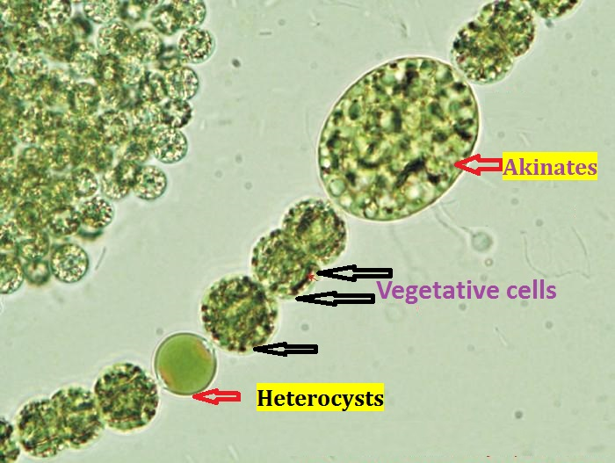
NOTE
The Trichome consist of Vegetative cells in addition to Heterocysts and Akinates in some of blue-green algae .The mucilaginous sheath is surrounding the Trichome.
Filament = Trichome + mucilaginous sheath.
Trichome = row of cells ( Vegetative cells+ Heterocysts+Akinates)

Slide 4
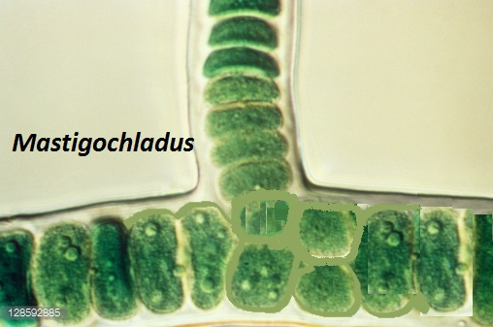
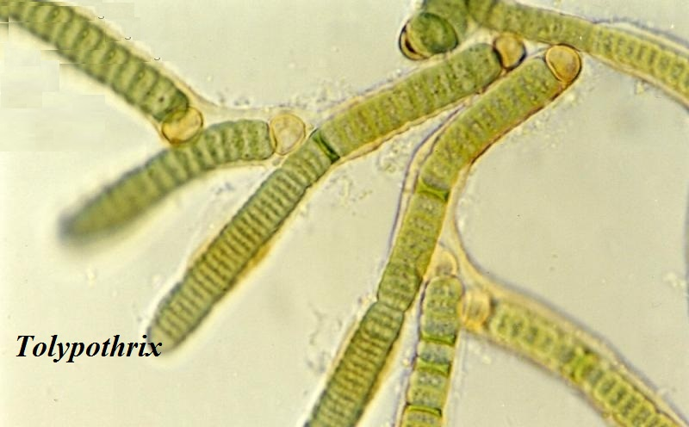
Type of Branching
1- True branching: in this the trichome is branched and the mucilaginous sheath is surrounding them such as Mastigochladus .
2- False branching: in this the trichome is not branched but the mucilaginous sheath is surrounding more than on branch which make some confusing for researchers in algae such as Calothrix and Tolypothrix

Slide 5
Arrangement of flagella in algae

Slide 6
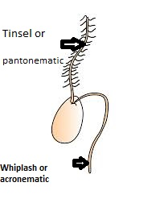
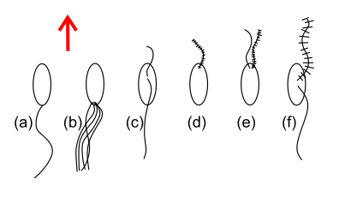
All algae have Flagella except the groups of Cyanophyta and Rhodophyta.
Flagella are the locomotors organ found in the algae
Flagella are different in their :number , positions, lengths and evaluated as an important part in algal.
There are2 kind of Flagella in algae as follows:
1- Acronematic ,whiplash , smooth(no hairs).
2- Pantonematic, tinsel , rough( with thin hairs).

Slide 7
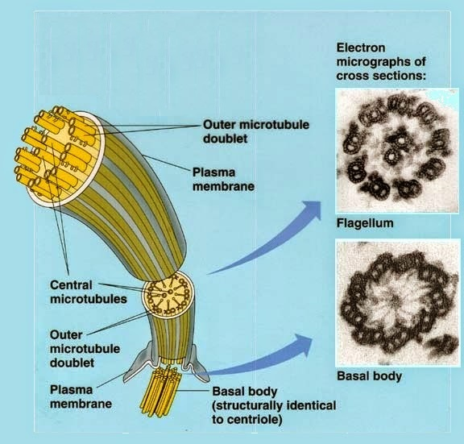
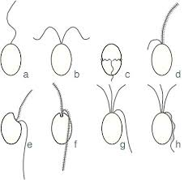
Motile cells of algae are biflagellate; if it is of equal length then it is known as isokont. If the two flagella are of dissimilar type and unequal length; then it is known as heterokont.
The flagellum consists of two central microtubules and a layer of nine doublet peripheral microtubules which is surrounded by a membrane. So this arrangement is referred as 9+2 pattern which is the important feature of eukaryotic flagella. Flagella is absent in the members of Red algae and Blue green algae.

Slide 8
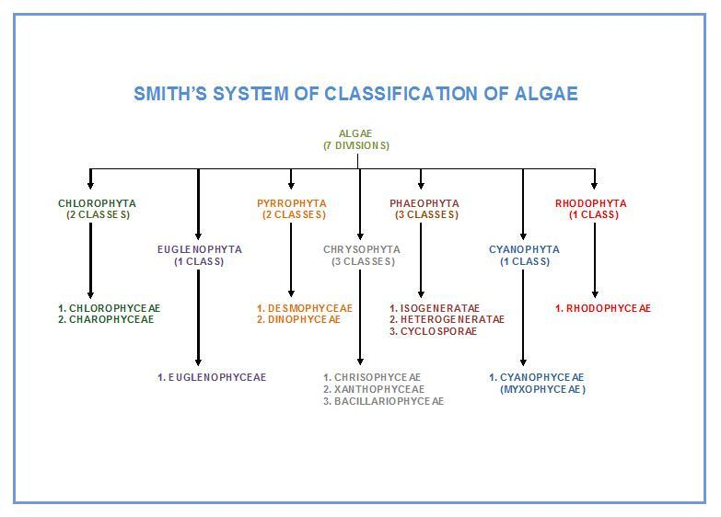

Slide 9
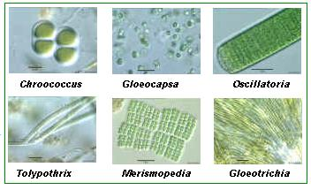
Division :Cyanobacteria or Cyanophyta (Blue green algae)

Slide 10
Division :Cyanobacteria or Cyanophyta (Blue green algae)
Called blue-green bacteria( Cyanobacteria) because there are similarities between division and bacteria, including:
1- Both are prokaryotic organisms.
2- Both have no sexual reproduction.
3- Both are sensitive to antibiotics.
4- Both are able to biosynthetic of Ornithine.
The different between cyanobacteria and bacteria
1- Cyanobacteria have no flagella.
2- Cyanobacteria filaments are possible branched but the bacteria are not.
3- Cyanobacteria able for photosynthesis.
4- Cyanobacteria have chlorophyll a
5-Cyanobacteria could live with fungi and produce lichen in environment.

Slide 11
The principal Characteristics of the Cyanophyta
1-Among the blue algae there are unicellular ,colonial , and filamentous form and there are even some with a simple paranchymatous organization , Flagellate cells never occur at any stage in the life cycle .
2-They lack a nucleus and organelles (chloroplast, mitochondria) 3-The photosynthetic pigments are located in thylakoids , which lie free in the cytoplasm .
4-the thylakoids contain chlorophyll a, but chlorophylls b,c are
absent . Present B-carotine , xanthophylls such as Myxoanthin ,Zeaxanthin.

Slide 12
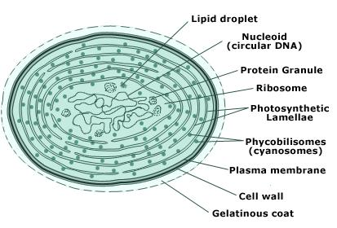
5-as well as Biloproteins pigment Represented green pigment C-phycocyanin,andAll-phycocyanin .also C-phycoerythrin (red pigment).
6-The reserve polysaccharide is cyanophycean starch .
7-The DNA lie bundled up in the centre of the protoplasm .
8-The structural part of the cell wall consists of Peptidoglycan , the cell are often embedded in sheaths of mucilage .
9-blue green algae reproduce asexually ,sexual reproduction is absent .
10-blue green algae occur in marine ,freshwater, terrestrial habitats.

Slide 13
Heterocysts

Slide 14
Heterocysts:
Are specialized cells, large, empty looking found in the trichomes of certain filamentous blue –green algae. Heterocysts are place of N2- Fixation due to present of Nitrogenase enzyme which only present in Heterocysts or any place responsible for N2- Fixation.
Heterocysts are photosynthetically inactive, they do not fix CO2, nor do they produce O2. They also exhibit a high rate of respiratory O2 consumption and are surrounded by a thick, laminated cell wall that limits ingress of atmospheric gases, including O2.
However, any factor affecting the N₂- Fixation procedure will affect the heterocysts development in the filament. Such as the presence or absence of comibined (Nitrogen) in the culture media of algae.

Slide 15
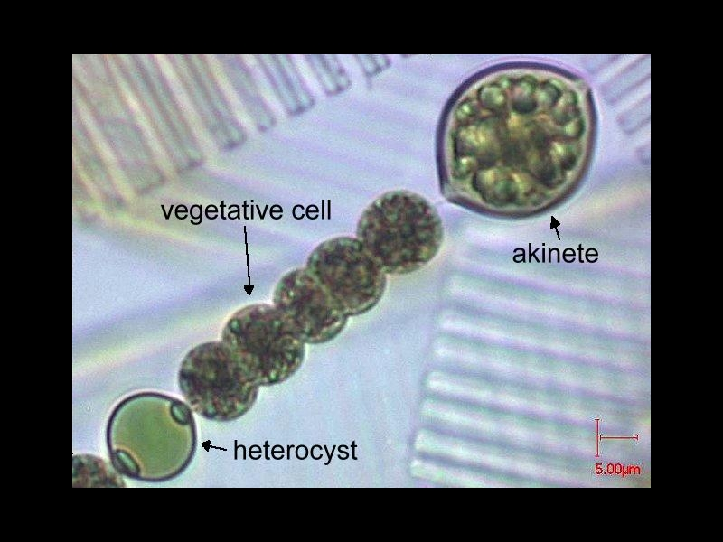
In addition to that N2- Fixation could be happened in any type of cells if the Nitrogenase enzyme is present in it, because is the responsible for these action(N2- Fixation ).
The Heterocysts can easily be distinguished from the vegetative cells of the trichome by their
1- Large size
2- Thick walls
3- Homogeneous transparent ,pale yellowish contents a distinct pore either at one or at both ends.

Slide 16
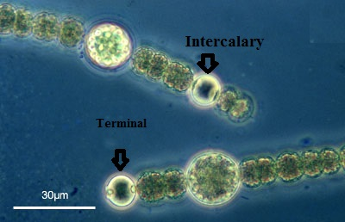
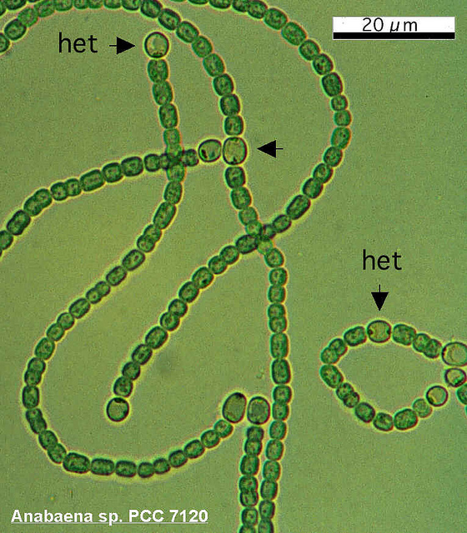
Position of Heterocysts in the trichomes :
The Heterocysts usually occur singly.
1- Terminal in position ( Gloeotricia).
2- Intercalary in position( Nostoc).
3- Lateral in position (Nostochopsis).
4- In some genera they occur in pairs( Anabaenopsis ).
5- Rarely in chain.

Slide 17
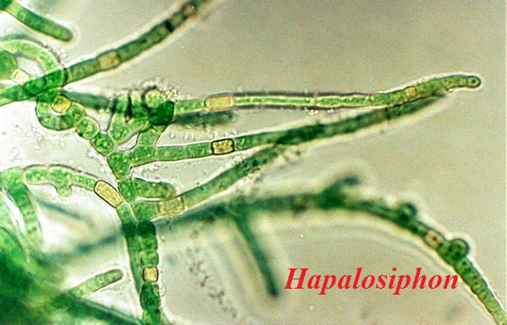
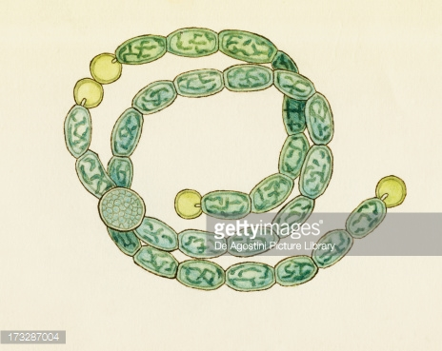
Shape of Heterocysts
1- They are identical to the vegetative cells.
2- They are also round Nostoc, anabena , Rivularia
3- Some time rectangular in Hapalosiphon, Aulosira, Scytonema.

Slide 18
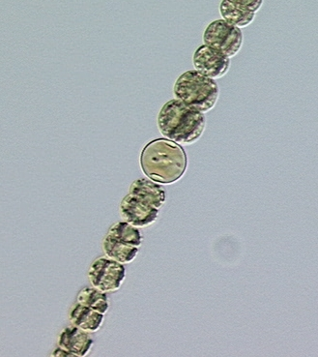
Form Heterocyst

Slide 19
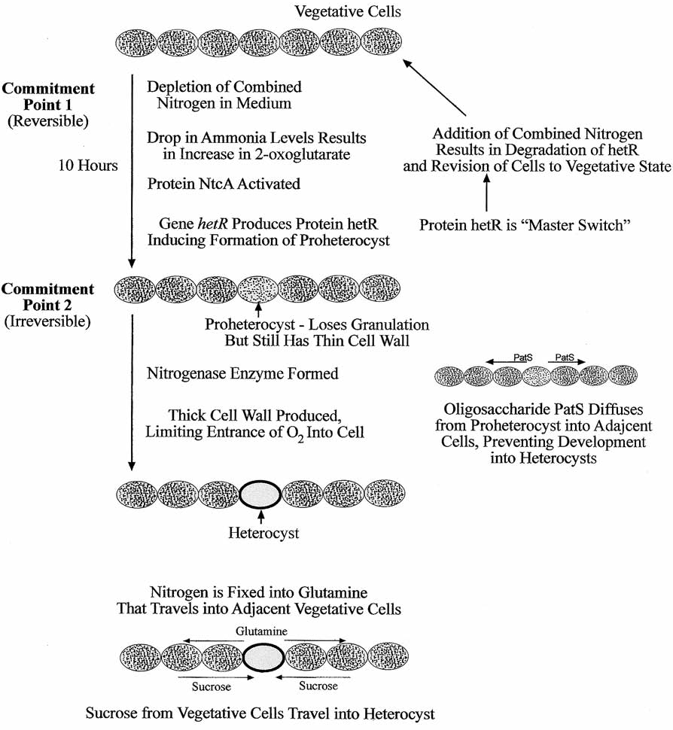

Slide 20
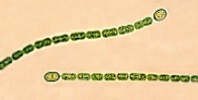
Heterocysts and nitrogyen fixation
Cyanobacteria Nitrogen Fixation Cyanobacteria are the only phototrophic organisms that perform N₂ fixation
Nitrogenase converts N₂ into NH₄⁺; encoded by nif genes and requires 32 Fe per enzyme molecule
High energy required: 12-15 ATP per fixed N, H provided by NADPH
Heterocysts are special cells for N₂ fixation: thick cell wall, low oxygen concentration, photosystem II (light reaction) inactive but photosystem I active to provide ATP; connected to vegetative cells by cell wall pores
Nitrogenase activity: during the day in heterocystous species, at night in non-heterocystous species; induced by low NH₄⁺ concentrations in the environment

Slide 21
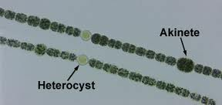
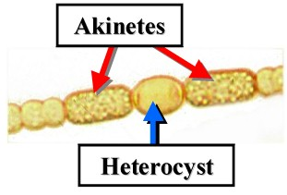
Akinetes : are large(giant) thick –walled cells , full of reserve material, which enable the algae to survive periods when environmental conditions are not favourable to growth (drought ,cold, nutrient deficiency etc...) .they develop from
vegetative cells and contain large amount of cyanophycin .(

Slide 22
Akinates responsible for asexual reproduction in cyanobacteria during un convenient environmental circumstance.
Q:why Akinates full with food stored?
Because to avoid these un convenient environmental factors such as PH, Nutrient , Temperature, light tensile, toxin…..etc.
Gas vacuoles
Gas vacuoles aid buoyancy in planktonic species allowing the cells to control their position in the water column.

Slide 23
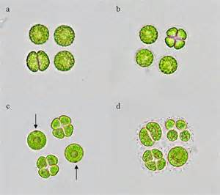
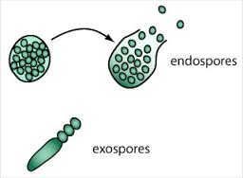
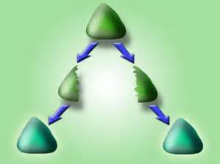
Reproduction
They are tow type for reproduction :
1-Vegetative reproduction
a-Binary fission
b-Fragmentation
2-Asexual reproduction
a-endospores:spores that form following division of the protoplast , enclosed within the parent cell wall.
b-exospores; blue green algae spores produced by budding form .

Slide 24
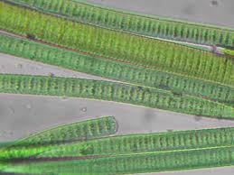
c-Hormogonia: Short pieces of trichome that become detached from the parent filament and move away by gliding ,subsequently developing in to new filaments
e-Conjugation;The formation of abridge between two cells during asexual
d- Nanocytes; Dwarf cells formed from normal cells following a series of cells divisions , between which there is no significant growth.

Slide 25
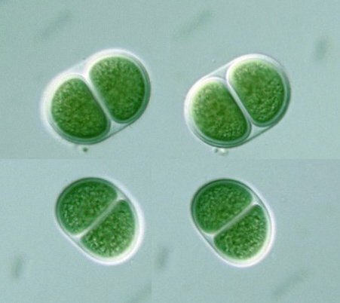
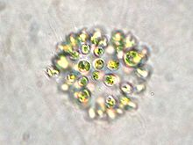
Taxonomic diversity
Freshwater cyanophyta can be divided into five main groups in relation to general morphology :
1-Chroococcales(Chroococcus) :the simplest blue –green algae occurring essentially as solitary cells (no filaments form ). a thin layer of mucilage .the cells may remain as single cells . or be aggregated into plate –like or globular colonies.Typically planktonic with some colonial form (e.gMicrocytis) forming massive surface blooms containing individual colonies that are recognizable with the neck eye . which lack individual sheaths
The coloration of the protolast is a light blue-green, appearing dark or brown due to optical effects of gas-filled vesicles; this can be useful as a distinguishing characteristic when using light microscopy.

Slide 26
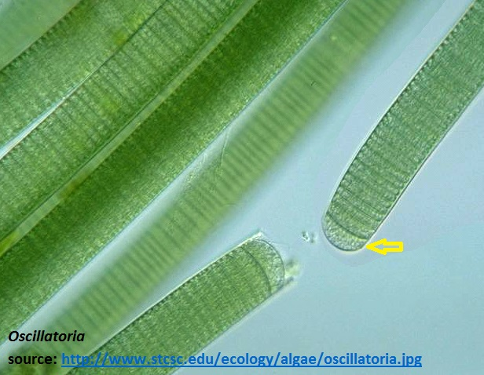
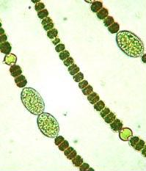
2-Oscillatoriales; single filamentous forms consisting of a trichome(Thread-like of cell, exclusive of the sheath) .lacking heterocysts and akinetes .these relatively simple algae occur as planktonic or benthic aggregations. In some cases they form dense mats on mud or rocky substrata . ex
;Oscilatoria sp.
.
ex ;Oscilatoria sp.
3-Nostocales ;diverse group of filamentous algae . planktonic or benthic.with heterocysts and akinetes, Heterocysts are thought to be associated with Nitrogen fixation,. but not showing true branching . filaments may be unbranched or show false branching . these algae are able form large colonies by lateral association of filaments .ex. Anabaena sp.

Slide 27
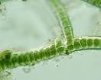
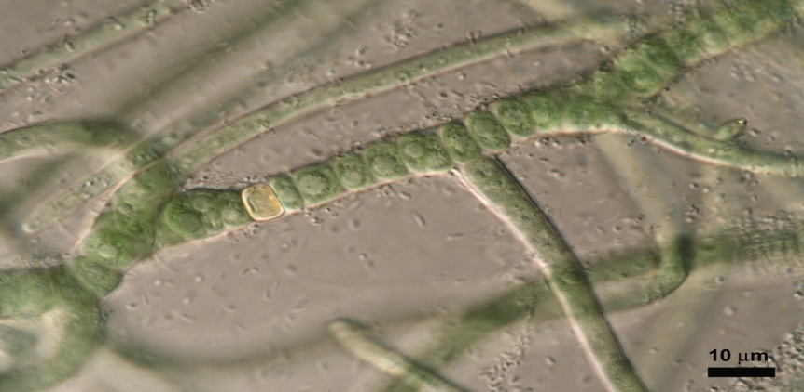
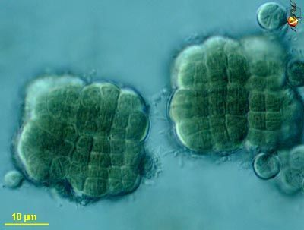
4-Stigonematales;filamentous algae , with hetercysts and akinetes and showing true branching structurally the most complex blue green algae. largely benthic algae with genera such stigonema commonly attached to substrata in standing and flowing waters .
stigonema
5-Pleurocapsales: coccoidal cells that form a thallus (clusters of cells) via 3-dimensional divisions.

Slide 28
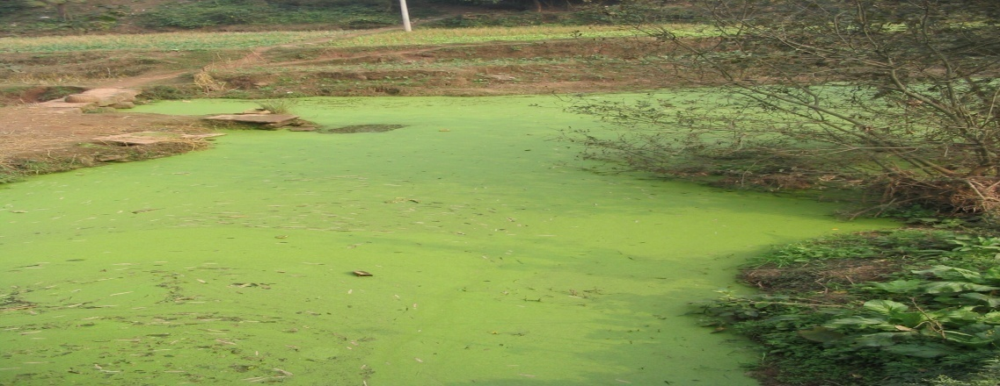
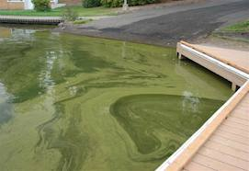
Cyanotoxins for cyanobacteria
Cyanobacteria can produce several toxins, but two types of toxins are of particular concern and tested for: Microcystins and Anatoxin.
Microcystins are a group of hepatoxins (toxins that affect the liver). the toxins most responsible for human and animal poisonings.
Anatoxin :A is a potent neurotoxin (toxins that affect the nervous system) which can cause lethargy, muscle aches, confusion, memory impairment, and, at sufficiently high concentrations, death.
Nerve toxins: alkaloid are compounds defines two types of these toxins which anatoxin, saxitoxin .Excreted by:anabaena,aphanizomenon ,oscillatoria ,…
Hepatic toxins; inhibitor phosphotase enzymeis where cause bleeding in the liver and there are two types of toxins produced by blue-greens, such as: microcystins(Excreted by :Anabaena,nostoc,Oscillatoria) and nodularins Excreted by:Nodularia)

Slide 29
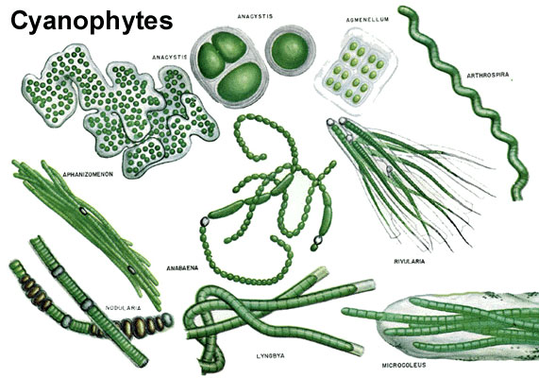

Slide 30
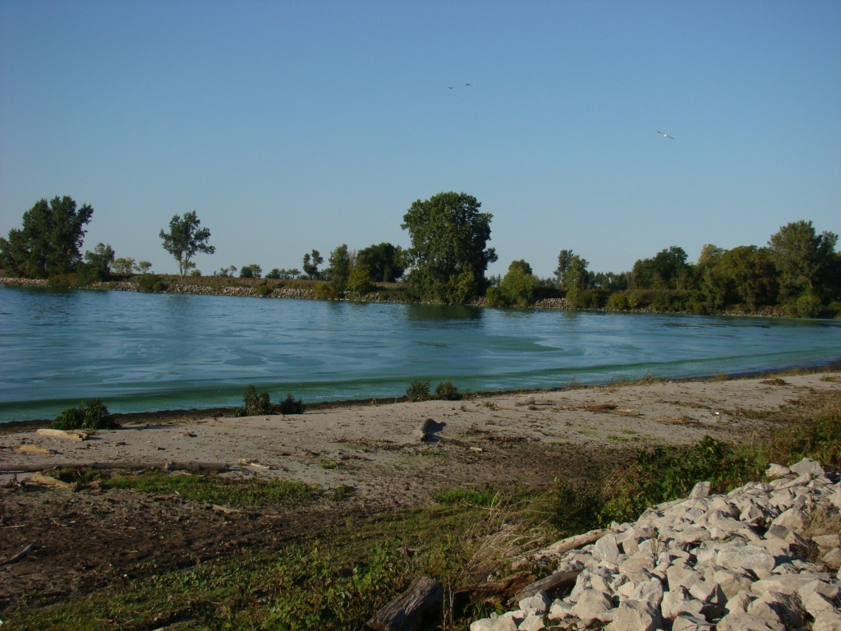
Blue-green algae as bio-indicators
The presence or absence of particular species can be a useful indicator of ecological statue .the dominant presence of colonial blue-green .forming dense summer blooms .has been useful as an indicator of high nutrient status .

Slide 31
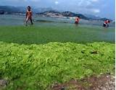
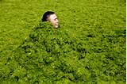
Algae blooms
In mid to late summer eutrophic temperate lakes frequently develop massive population of colonial blue green algae these may rise to surface of the lake . forming thick layer of algae biomass at the top of the water column ,other algae having major impacts on zooplankton and fish populations
The ability of blue greens to out –compete other fresh water algae has been attributed to arrange of characteristics including;
Optimum growth at high temperatures
Low light tolerance
Tolerance of low N/P ratios
Depth regulation by buoyancy
Resistance to zooplankton grazing
Tolerance of high pH/ low Co2 concentration
Symbiotic association with aerobic bacteria

Slide 32
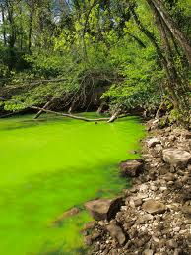
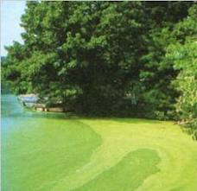
Eutrophication is when the environment becomes enriched with nutrients. This can be a problem in marine habitats such as lakes as it can cause algal blooms. Fertilizers are often used in farming, sometimes these fertilizers run-off into nearby water causing an increase in nutrient levels.
.

