Slide 1
Mustansiriyah University
College of science
Biology Dept.
Zoology
4th class
Zoonoses lab. (1)

Slide 2
What are zoonoses
Zoonotic :diseases that are transmitted from animals to humans and may give problems in humans.
direct zoonoses the disease is directly transmitted from animals to humans through media such as air , saliva.
reverse zoonoses: Diseases that are transmitted from humans to animals.

Slide 3
transmission
Zoonotic transmission can occur in any context in which there is companion (pets), economic (farming, etc.), predatory (hunting, butchering or consuming wild game) or research contact with or consumption of animals, animal products, or animal derivatives (vaccines, etc.).

Slide 4
What kind of animals transmit zoonoses
Farm Animals
Cattle
Swine
Goats
Cats & dogs
Poultry
Wild Animals
Ticks
Squirrels
Raccoons
Mice/rodents
others

Slide 5
Farmers more susceptible to contracting zoonoses
More likely to share air and space with animals
More contact with domestic and wild animals

Slide 6
How are disease transmitted?
Every day contact with animals.
Transporting carcasses.
By-products (feces/urine).
Scratches or bites.
From milk and milking.
Contaminated soils.
Contaminated meats.

Slide 7
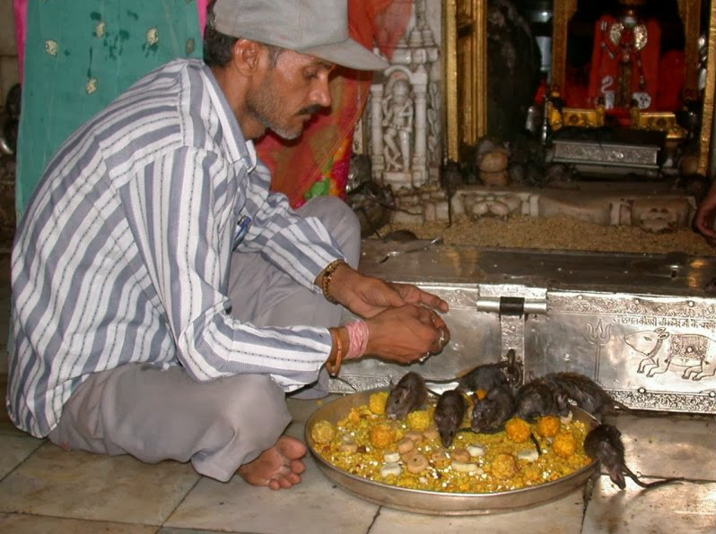
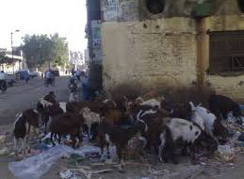
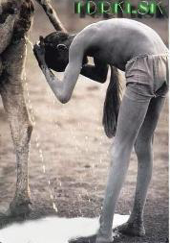
Healthy animals, healthy people

