Slide 1
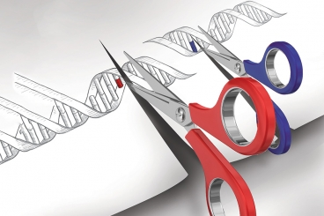
GENETIC ENGINEERING
College of Science/ biology department
fourth class
Assistant professor Dr. Munim Radwan Ali
Lecture six

Slide 2
Cloning Vectors
is a stable, replicating DNA molecule to which a foreign DNA fragment can be attached for introduction into a cell. An effective cloning vector has three important characteristics:
(1) an origin of replication, which ensures that the vector is replicated within the cell;
(2) selectable markers, which enable any cells containing the vector to be selected or identified;
(3) one or more unique restriction sites into which a DNA fragment can be inserted.
The restriction sites used for cloning must be unique; if a vector is cut at multiple recognition sites, generating several pieces of DNA, there will be no way to get the pieces back together in the correct order.

Slide 3
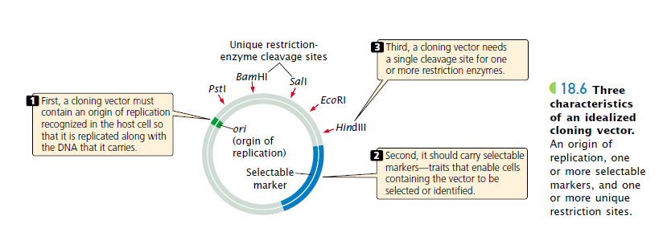
Three types of cloning vectors are commonly used for cloning genes in bacteria: plasmids, bacteriophages, and cosmids.

Slide 4
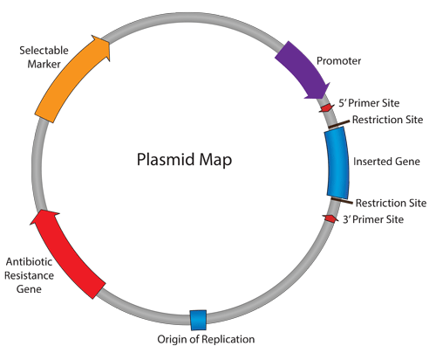
Plasmid vectors
Plasmids are circular DNA molecules that exist naturally in bacteria. They contain origins of replication and are therefore able to replicate independently of the bacterial chromosome. Plasmids are the most used cloning tools because they are easy to purify, to manipulate in vitro and to introduce into cells in culture, whether they multiply apart from the host genome or they integrate totally or partially (the sequence of interest carried by the plasmid) into the genome.
One of the first vectors to be developed was
pBR322. pBR322 lacks the more sophisticated
Features of the newest cloning vectors, and so is
no longer used extensively in research, it still
illustrates the important, fundamental properties
of any plasmid cloning vector.

Slide 5
The nomenclature of plasmid cloning vectors
The name “pBR322” conforms with the standard rules for vector nomenclature: l “p” indicates that this is indeed a plasmid. l “BR” identifies the laboratory in which the vector was originally constructed (BR stands for Bolivar and Rodriguez, the two researchers who developed pBR322). l “322” distinguishes this plasmid from others developed in the same laboratory (there are also plasmids called pBR325, pBR327, pBR328, etc.)

Slide 6
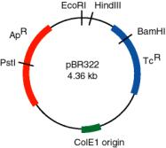
The useful properties of pBR322
size. it was stated that a cloning vector ought to be less than 10 kb in size, to avoid problems such as DNA breakdown during purification. pBR322 is 4363 bp, which means that not only can the vector itself be purified with ease, but so can recombinant DNA molecules constructed with it.
carries two sets of antibiotic resistance genes. Either ampicillin or tetracycline resistance can be used as a selectable marker for cells containing the plasmid, and each marker gene includes unique restriction sites that can be used in cloning experiments
high copy number. Generally there are about 15 molecules present in a transformed E. coli cell, but this number can be increased, up to 1000–3000, by plasmid amplification in the presence of a protein synthesis inhibitor such as chloramphenicol

Slide 7
pUC8—a Lac selection plasmid
is descended from pBR322, although only the replication origin and the amp^{R} gene remain. The nucleotide sequence of the amp^{R} gene has been changed so that it no longer contains the unique restriction sites: all these cloning sites are now clustered into a short segment of the lacZ′ gene carried by pUC8. three important advantages that have led to it becoming one of the most popular E. coli cloning vectors.
1- the manipulations involved in construction of pUC8 were accompanied by a chance mutation, within the origin of replication, which results in the plasmid having a copy number of 500–700 even before amplification. This has a significant effect on the yield of cloned DNA obtainable from E. coli cells transformed with recombinant pUC8 plasmids.
11 is that identification of recombinant cells can be achieved by a single step process, by plating onto agar medium containing ampicillin plus X-gal . (With both pBR322 and pBR327, selection of recombinants is a two-step procedure, requiring replica plating from one antibiotic medium to another) .
111pUC8 lies with the clustering of the restriction sites, which allows a DNA fragment with two different sticky ends (say EcoRI at one end and BamHI at the other) to be cloned without resorting to additional manipulations such as linker attachment.

Slide 8
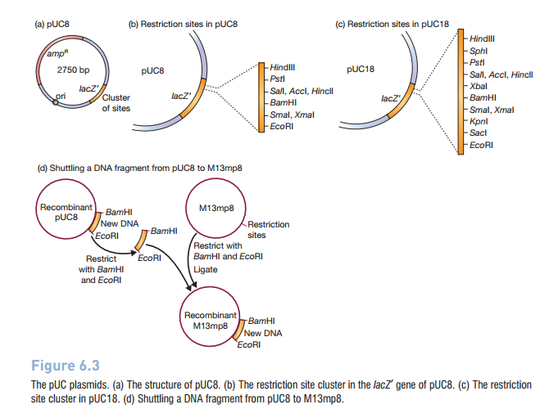

Slide 9
Bacteriophage vectors
The bacteriophages used for cloning are the phage λ and M13 phage. There is an upper limit on the amount of DNA that can be packed into a phage (a maximum of 53 kb), therefore to allow foreign DNA to be inserted into phage DNA, phage cloning vectors need to have some non-essential genes deleted, for example the genes for lysogeny in phage λ.^{[15]} There are two kinds of λ phage vectors - insertion vector and replacement vector. Insertion vectors contain a unique cleavage site whereby foreign DNA with size of 5–11 kb may be inserted. In replacement vectors, the cleavage sites flank a region containing genes not essential for the lytic cycle, and this region may be deleted and replaced by the DNA insert in the cloning process, and a larger sized DNA of 8–24 kb may be inserted. There is also a lower size limit for DNA that can be packed into a phage, and vector DNA that is too small cannot be properly packaged into the phage. This property can be used for selection - vector without insert may be too small, therefore only vectors with insert may be selected for propagation

Slide 10
Phage lambda is a bacteriophage or phage, i.e. bacterial virus, that uses E. coli as host.
• Its structure is that of a typical phage: head, tail, tail fibres.
• Lambda viral genome: 48.5 kb linear DNA with a 12 base ssDNA "sticky end" at both ends; these ends are complementary in sequence and can hybridize to each other (this is the cos site: cohesive ends).
• Infection: lambda tail fibres adsorb to a cell surface receptor, the tail contracts, and the DNA is injected.
• The DNA circularizes at the cos site, and lambda begins its life cycle in the E. coli host.

Slide 11
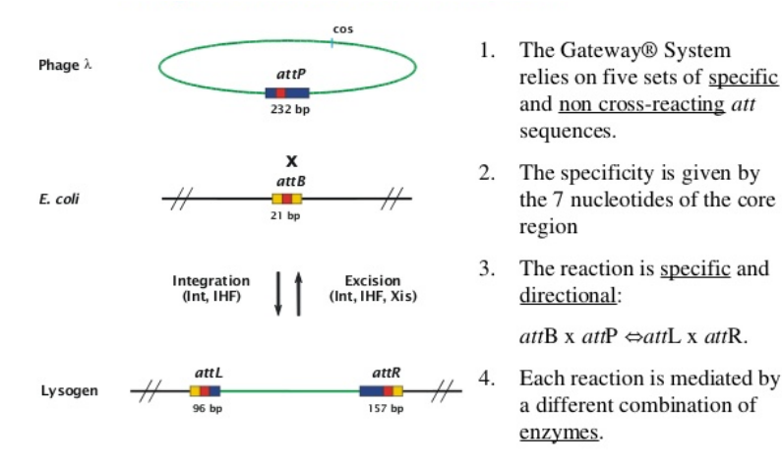

Slide 12
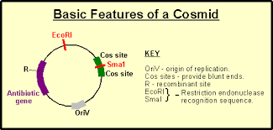
Cosmid vectors=cos+ plasmid
Cosmid vector
is a combination of the plasmid vector and the COS site which allows the target DNA to be inserted into the λ head. It has the following advantages: – High transformation efficiency. – The cosmid vector can carry up to 45 kb whereas plasmid and λ phage vectors are limited to 25 kb.

Slide 13
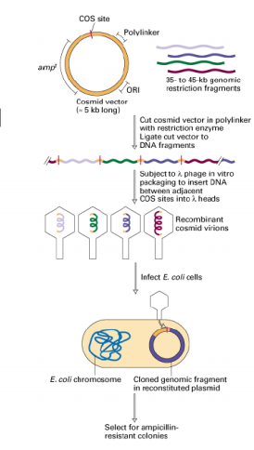

Slide 14
