Slide 1
GENETIC ENGINEERING
College of Science/ biology department
fourth class
Assistant professor Dr. Munim Radwan Ali
Lecture eight

Slide 2
DNA fragment sequencing
In order to establish exactly what changes have occurred in the gene under study, it will be necessary determine the DNA sequence of that gene. This is now a routine procedure in molecular biology laboratories, extending not just to individual genes or fragments but to the complete sequence of the DNA (the genome) of the organism.
The two main in vitro DNA sequencing methods were published in 1977, a few months apart, by Maxam and Gilbert and by Sanger et al. and will revolutionize in the same way as for PCR molecular biology and its applications in fundamental research as well as in diagnosis. Because it is simple and adaptable to the technological evolutions, the Sanger method is now universally used.

Slide 3
Principle of the Sanger method: the sequencing reaction
The Sanger sequencing method is applicable to a target fragment purified or specifically accessible. It is based on the possibility of performing in vitro replication of one of the two strands of the target, which supposes that a primer capable of hybridizing to the other strand that will be used as a template can be designed and added together with the trinucleotides and the DNA pol.
If the target fragment was obtained by PCR, its extremities are known and the problem of the sequencing primers is solved. If the target fragment is unknown, it is necessary to clone it into a vector whose sequences at the border of the cloning site are known and can be used to design primers.

Slide 4
The principle of the Sanger method consists of starting the synthesis of one of the two strands of the target fragment in vitro in the presence of small quantities of dideoxynucleotides (deoxy in 2_ but also in 3_) that will stop the elongation in the event that they are incorporated because in the absence of a 3_ OH, it is impossible to add another nucleotide . The analysis of the size of the different randomly interrupted synthesized fragments with respect to dideoxynucleotide incorporation will allow the deduction of the sequence of the studied strand (the one synthesized starting from the primer). It is possible, and even recommended, to realize the sequence of the other strand in four other tubes with a primer b/− that can hybridize with the (+) strand that will become the template.

Slide 5
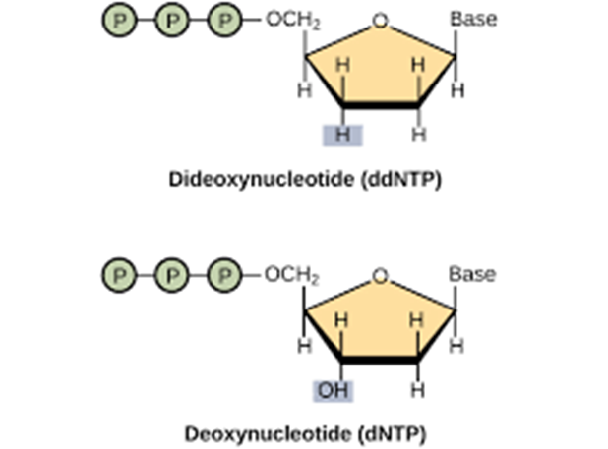
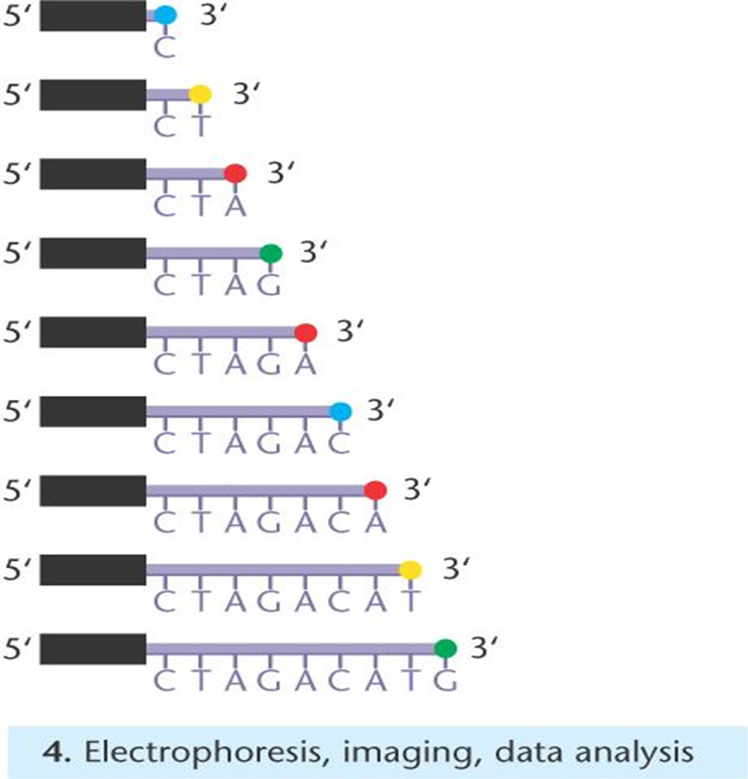

Slide 6
Reading of the sequencing reaction products
After the sequencing reaction, the goal is to measure, with single-base precision, the length of the newly synthesized strands, which can only be done by separating the fragments by high-resolution gel electrophoresis (precise separation of strands differing by one single nucleotide) and considering that the newly synthesized fragments can be distinguished from the other DNA fragments that are not relevant (primers, fragment of interest, etc.). Therefore, it is necessary for the newly synthesized strands to be labelled in a way so that they can be specifically identified.

Slide 7
There are two ways of labelling synthesized strands: using a labelled primer (which is done with universal primers corresponding to the sequences in the cloning vector), or using labelled dideoxynucleotides (see below for the labelling techniques).
Even if radioactive labelling is now obsolete, the associated reading technique will be described in order to understand better the improvements made by fluorescent labelling and the use of automated sequencers.

Slide 8
Reading of a sequence with the labelled fragment emitting only one type of signal (radioactivity or cold labelling)
Using high-resolution polyacrylamide gel electrophoresis capable of separating fragments differing only by one nucleotide, it is possible to load on the gel the products of the four sequencing reactions and migrate them in four parallel lanes.

Slide 9
The DNA fragments will migrate according to their size and the revelation of the signal of the labelled molecules, meaning the newly synthesized strands whose size is the direct consequence of the sequence of the (+) strand, will allow the direct deduction of this sequence . The labelling signal never allows direct reading of the gel; in the case of a radioactive labelling (low intensity) the gel should be applied on a negative that will be revealed a few days later; in the case of a cold labelling, the gel should be revealed and exposed with an autoradiogram.

Slide 15
Using the Polymerase Chain Reaction to Amplify DNA
A major problem in working at the molecular level is that each gene is a tiny fraction of the total cellular DNA. Because each gene is rare, it must be isolated and amplified before it can be studied. Before mid-1980, the only procedure available for amplifying DNA was gene cloning—placing the gene in a bacterial cell and multiplying the bacteria. Cloning is labor intensive and requires at least several days to grow the bacteria. In 1983, Kary Mullis discovered a new technique for amplifying DNA in a test tube. The polymerase chain reaction allows DNA fragments to be amplified a billion fold within just a few hours. It can be used with extremely small amounts of original DNA, even a single molecule. The polymerase chain reaction has revolutionized molecular biology and is now one of the most widely used of all molecular techniques.

Slide 16
The polymerase chain reaction in outline
PCR is based on ability of DNA polymerase to synthesize complementary strand to the template strand. As DNA polymerase can add a nucleotide only onto a 3'-OH group, it needs an artificial DNA strand (called DNA primer) of about 18 to 25 nucleotides complementary to 3’ end of the DNA template. As shown below, each polynucleotide has a free 3’ –OH group and 5’ phosphate group. Moreover, a DNA strand has complimentary sequence, already paired by hydrogen bonding. Thus, primer can bind only when DNA strands are separated. This is generally done by heating. The primers anneal to the single-stranded DNA template at specific temperature (depends on primer sequence) and then DNA-Polymerase binds to this double stranded DNA produced. The again reaction mixture is heated to 72°C (extension); a temperature optimum for DNApolymerase functions. This starts synthesis of the new DNA strand. Than reaction mixture is cooled to lower temperature for short term storage, if required. This completes one cycle. After first cycle, one DNA molecule has become two. After multiple cycle of the PCR reaction, the specific sequence will be accumulated in billions of copies.

Slide 17
The PCR reaction requires the following components:
DNA template: DNA template is DNA target sequence. As explained earlier, at the beginning of the reaction, high temperature is applied to separate both the DNA strands from each other so that primers can bind during annealing.
DNA polymerase: DNA polymerase sequentially adds nucleotides complimentary to template strand at 3’-OH of the bound primers and synthesizes new strands of DNA complementary to the target sequence. The most commonly used DNA polymerase is Taq DNA polymerase (from Thermus aquaticus, a thermophillic bacterium) because of high temperature stability. Pfu DNA polymerase (from Pyrococcus furiosus) is also used widely because of its higher fidelity (accuracy of adding complimentary nucleotide). Mg2+ ions in the buffer act as co-factor for DNA polymerase enzyme and hence are required for the reaction.

Slide 18
Primers: Primers are synthetic DNA strands of about 18 to 25 nucleotides complementary to 3’ end of the template strand. DNA polymerase starts synthesizing new DNA from the 3’ end of the primer
Two primers must be designed for PCR; the forward primer and the reverse primer. The forward primer is complimentary to the 3’ end of antisense strand (3’-5’) and the reverse primer is complimentary to the 3’ end of sense strand (5’-3’). If we consider the sense strand (5’-3’) of a gene, for designing primers, then forward primer is the beginning of the gene and the reverse primer is the reverse-compliment of the 3’ end of the gene. Nucleotides (dNTPs or deoxynucleotide triphosphates): All types of nucleotides are "building blocks" for new DNA strands and essential for reaction. It includes Adenine(A), Guanine(G), Cytosine(C), Thymine(T) or Uracil(U).

Slide 20
Procedure
There are three major steps in a PCR, which are repeated for 30 or 40 cycles. This is done on an automated cycler, which can heat and cool the tubes with the reaction mixture in a very short time.
1. Denaturation at 94°C : During the heating step (denaturation), the reaction mixture is heated to 94°C for 1 min, which causes separation of DNA double stranded. Now, each strand acts as template for synthesis of complimentary strand.
2. Annealing at 54°C : This step consist of cooling of reaction mixture after denaturation step to 54°C, which causes hybridization (annealing) of primers to separated strand of DNA (template). The length and GC-content (guanine-cytosine content) of the primer should be sufficient for stable binding with template.

Slide 22
Please recall our discussion about DNA structure during earlier lectures. Guanine pairs with cytosine with three hydrogen bonding adenine binds with thymine with two hydrogen bonds. Thus, higher GC content results in stronger binding. In case GC content is less, length may be increased to have stronger binding (more number of H bonding between primer and template).
3. Extension at 72°C : The reaction mixture is heated to 72°C which is the ideal working temperature for the Taq polymerase. The polymerase adds nucleotide (dNTP's) complimentary to template on 3’ –OH of primers thereby extending the new strand.
4. Final hold: First three steps are repeated 35-40 times to produce millions of exact copies of the target DNA. Once several cycles are completed, during the hold step, 4–15 °C temperature is maintained for short-term storage of the amplified DNA sample.

Slide 23
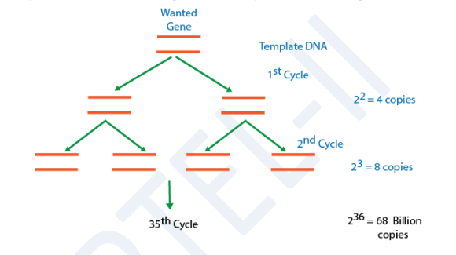
PCR-an exponential cycle
As both strands are copied during PCR, there is an exponential increase of the number of copies of the gene as shown in the figure. Suppose there is only one copy of the desired gene before the PCR starts, after one cycle of PCR, there will be 2 copies, after two cycles of PCR, there will be 4 copies. After three cycles there will be 8 copies and so on.

Slide 24
Various PCR methods
Nested PCR - use to synthesize more reliable product - PCR using a outer set of primers and the product of this PCR is used for further PCR reaction using an inner set of primers.
Inverse PCR - for amplification of regions flanking a known sequence. DNA is digested, the desired fragment is circularise by ligation, then PCR using primer complementary to the known sequence extending outwards.
AP-PCR (arbitrary primed)/RAPD (random amplified polymorphic DNA) - methods for creating genomic fingerprints from species with little-known target sequences by amplifying using arbitrary oligonucleotides. It is normally done at low and then high stringency to determine the relatedness of species or for analysis of Restriction Fragment Length Polymorphisms (RFLP).

Slide 25
RT-PCR (reverse transcriptase) - using RNA-directed DNA polymerase to synthesize cDNAs which is then used for PCR and is extremely sensitive for detecting the expression of a specific sequence in a tissue or cells. It may also be use to quantify mRNA transcripts. See also Quantiative RT-PCR, Competitive Quantitative RT-PCR, RT in situ PCR, Nested RT-PCR.
RACE (rapid amplificaton of cDNA ends) - used where information about DNA/protein sequence is limited. Amplify 3' or 5' ends of cDNAs generating fragments of cDNA with only one specific primer each (+ one adaptor primer). Overlapping RACE products can then be combined to produce full cDNA. See also Gibco manual.

Slide 26
DD-PCR (differential display) - used to identify differentially expressed genes in different tissues. First step involves RT-PCR, then amplification using short, intentionally nonspecific primers. Get series of band in a high-resolution gel and compare to that from other tissues, any bands unique to single samples are considered to be differentially expressed.
Multiplex-PCR - 2 or more unique targets of DNA sequences in the same specimen are amplified simultaneously. One can be use as control to verify the integrity of PCR. Can be used for mutational analysis and identification of pathogens.

Slide 27
