Slide 1
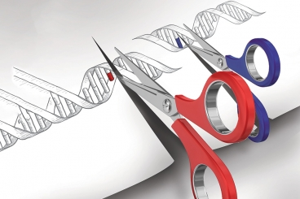
GENETIC ENGINEERING
College of Science/ biology department
fourth class
Assistant professor Dr. Munim Radwan Ali
Lecture four

Slide 2
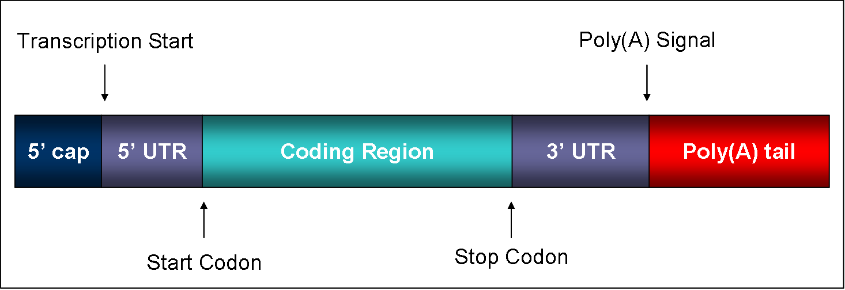
ENZYMES IN MODIFICATION
Polynucleotide phosphorylase: was first discovered from extracts of Azotobacter agile by Grunberg-Manago and Ochoa. catalyzes the synthesis of long chain polyribonucleotides (RNA) in 5’ to 3’ direction from nucleotide diphosphates as precursors and reversibly catalyzes phosphorolytic cleavage of polyribonucleotides in 3’ to 5’ direction with a release of orthophosphate in presence of inorganic phosphate.
PNPase is a bifunctional enzyme and functions in mRNA processing and degradation inside the cell.
RNA structure

Slide 3
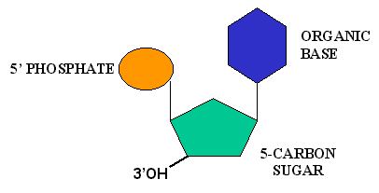
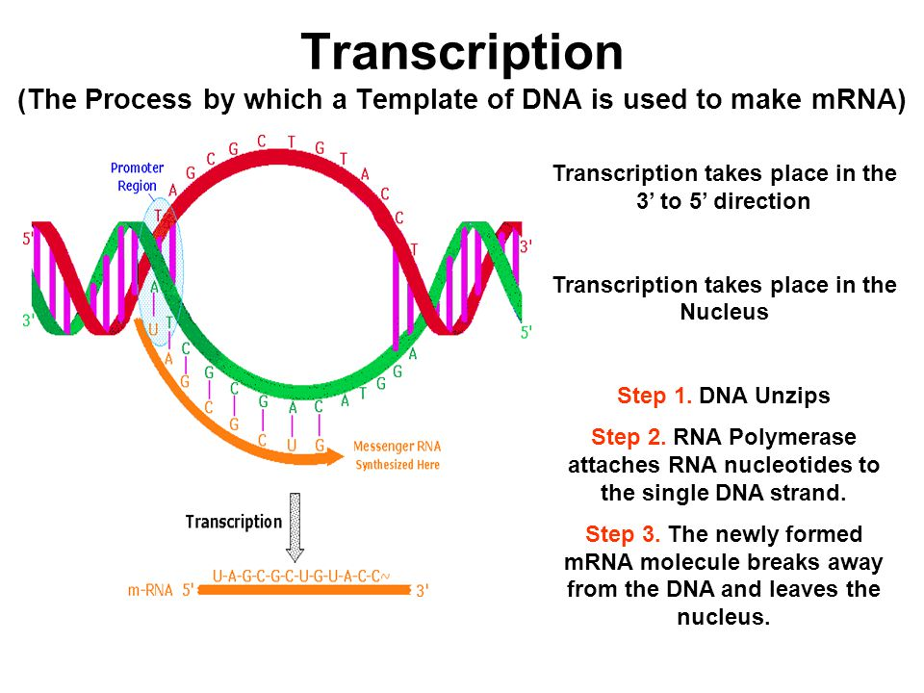
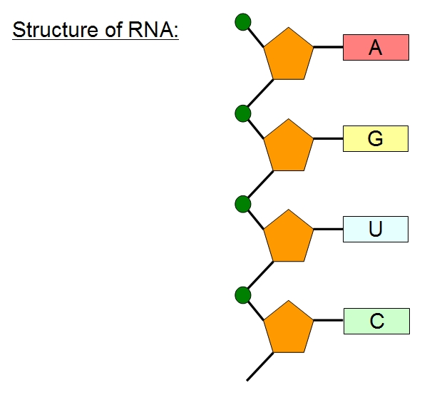

Slide 4
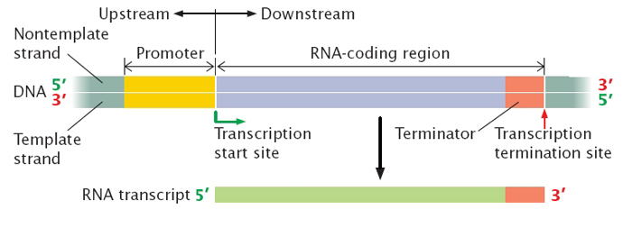

Slide 5
These enzyme can catalyze not only the synthesis of RNA from the mixtures of naturally occurring ribonucleoside diphosphates, but also that of non-naturally occurring polyribonucleotides. In rDNA cloning technology, it has been used to synthesize radiolabelled polyribonucleotides from nucleoside diphosphate monomers.
In E.coli, polynucleotide phosphorylase regulates mRNA processing either by adding ribonucleotides to the 3’ end or by cleaving bases in 3’ to 5’ direction. The function of PNPase depends upon inorganic phosphate (Pi) concentration inside the cell. The transcripts are polyadenylated using enzyme polyadenylate polymerase I (PAPI). After primary polyadenylylation of the transcript by PAP I, PNPase may bind to the 3′ end of the poly(A) tail. PNPase works either degradatively or biosynthetically inside the cell depending on the Pi concentration. Under high Pi concentration, it degrades the poly(A) tail releasing adenine diphosphates. If the Pi concentration is low, PAP I initiates addition of one or more nucleotides to the existing poly (A) tail and in the process generates inorganic phosphate. On dissociation of PNPase, the 3′ end again is available to PAP I for further polymerization.

Slide 6
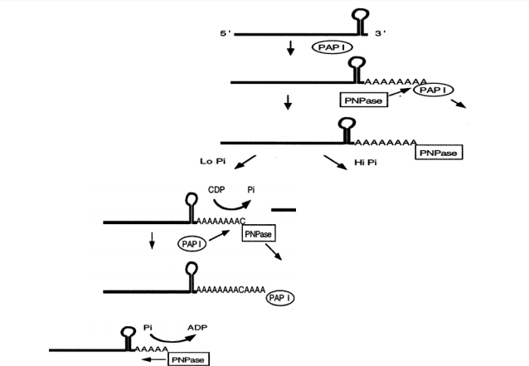
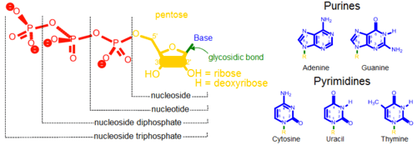
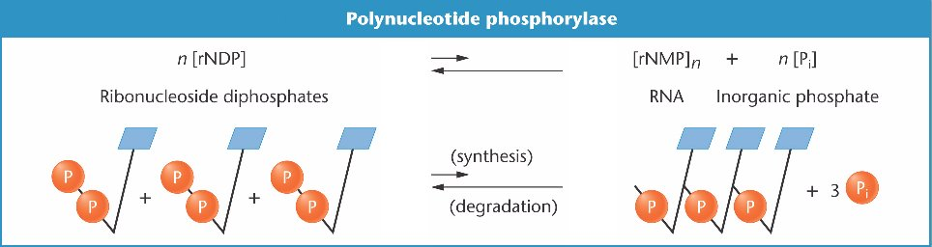

Slide 7
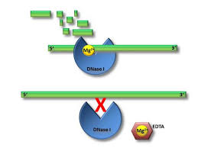
Deoxyribonuclease (DNase)
A nuclease enzyme that can catalyze the hydrolytic cleavage of phosphodiester bonds in the DNA backbone are known as deoxyribonuclease (DNase).
Based on the position of action, these enzymes are broadly classified as endodeoxyribonuclease (cleave DNA sequence internally) and exodeoxyribonuclease (cleave the terminal nucleotides).
Unlike restriction enzymes, DNase does not have any specific recognition/restriction site and cleave DNA sequence at random locations.

Slide 8
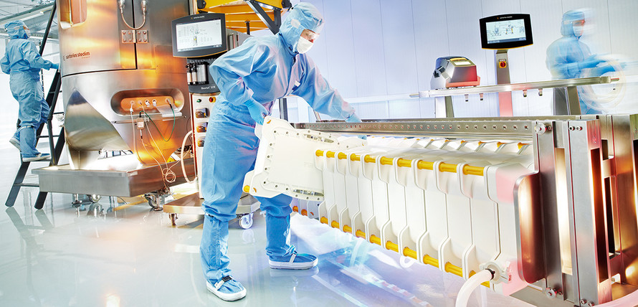

Slide 9
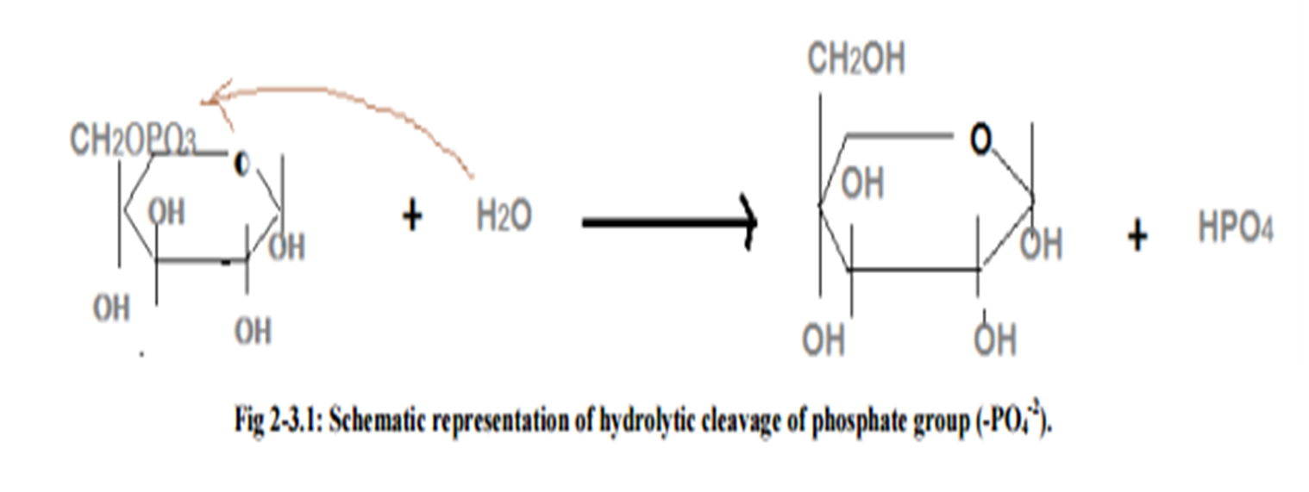
Phosphatase
catalyses the cleavage of a phosphate (PO4 -2 ) group from substrate by using a water molecule (hydrolytic cleavage). This reaction is not reversible.
On the basis of their activity there are two types of phosphatase i.e acid phosphatase and alkaline phosphatase. In both forms the alkaline phosphatase are most common. Special class of phosphatase that remove a phosphate group from protein, called “Phosphoprotein phosphatase”

Slide 10
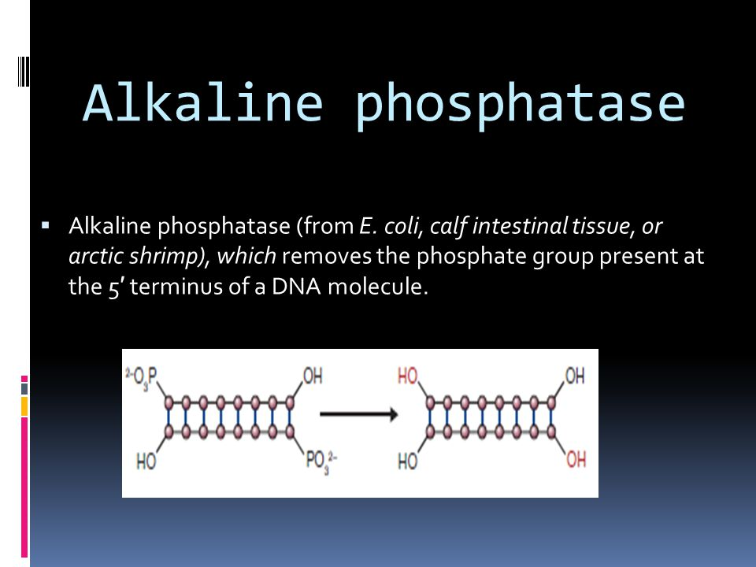

Slide 11
Methylase:
Methyltransferase or methylase catalyzes the transfer of methyl group (-CH3) to its substrate. The process of transfer of methyl group to its substrate is called methylation.
Methylation is a common phenomenon in DNA and protein structure.
Methyltransferase uses a reactive methyl group that is bound to sulfur in Sadenosyl methionine (SAM) which acts as the methyl donor.
Methylation normally occurs on cytosine (C) residue in DNA sequence. In protein, methylation occurs on nitrogen atom either on N-terminus or on the side chain of protein.
DNA methylation regulates gene or silence gene without changing DNA sequences, as a part of epigenetic regulation.

Slide 12
In bacterial system, methylation plays a major role in preventing their genome from degradation by restriction enzymes. It is a part of restriction – modification system in bacteria. Methyltransferase can be classified in three groups:
a) m6A-generates N6 methyladenosine,
b) m4C-generates N4 methylcytosine,
c) m5C-generatesN5 methylcytosine.
m6A and m4C methyltransferase are primarily found in prokaryotes. These enzymes are responsible for methylation of DNA sequences in order to prevent the host from digesting its own genome via its restriction enzyme.

Slide 13
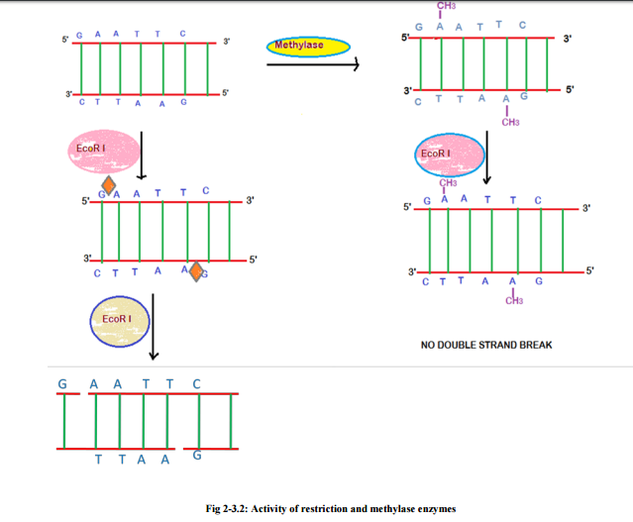

Slide 14
ligase
DNA ligase catalyses the formation of phosphodiester bond between two deoxynucleotide residues of two DNA strands.
DNA ligase enzyme requires a free hydroxyl group at the 3´ -end of one DNA chain and a phosphate group at the 5´-end of the other and requires energy in the process.
The role of DNA ligase is to seal nicks in the backbone of double-stranded DNA after lagging strand formation to join the okazaki fragments. This joining process is essential for the normal synthesis of DNA and for repairing damaged DNA. It has been exploited by genetic engineers to join DNA chains to form recombinant DNA molecules. Usually single stranded break are repaired using the complimentary strand as the template but sometimes double stranded breaks can also be repaired with the help of DNA ligase IV.

Slide 15
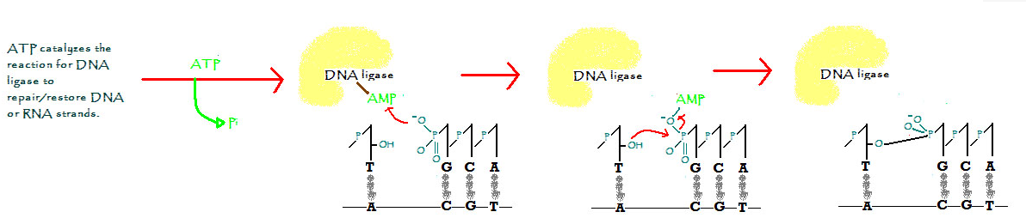
Application:
DNA ligase enzyme is used by cells to join the “okazaki fragments” during DNA replication process. In molecular cloning, ligase enzyme has been routinely used to construct a recombinant DNA. Followings are some of the examples of application of ligase enzyme in molecular cloning.Joining of adapters and linkers to blunt end DNA molecule.
Cloning of restricted DNA to vector to construct recombinant vector.

Slide 16
Polynucleotide Kinase
PNK is a homotetramer with phosphatase activity at 3’ end and kinase activity at 5’ end with a tunnel like active site. The active site has side chains which interact with NTP donor’s beta-phosphate and 3’ phosphate of acceptor with an acid which activated 5’ –OH. Lys-15 and Ser-16 are important for the kinase activity of the enzyme.
The basic residues of active site of PNK interact with the negatively charged phosphates of the DNA.
Polynucleotide kinase (PNK) catalyzes the transfer of a phosphate group (PO4 -2 ) from γ position of ATP to the 5' end of either DNA or RNA and nucleoside monophosphate.
PNK can convert 3' PO4/5' OH ends into 3' PO4/5' PO4 ends which blocks further ligation by ligase enzyme.
PNK is used to label the ends of DNA or RNA with radioactive phosphate group.

Slide 17
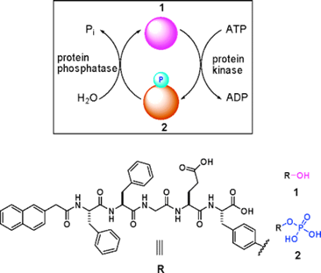

Slide 18
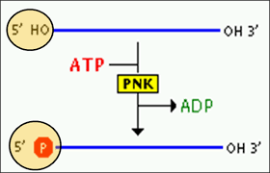
T4 polynucleotide kinase is the most widely used PNK in molecular cloning experiments, which was isolated from T4 bacteriophage infected E.coli.
There are two major uses of PNK: The linkers and adopters are phosphorylated along with the fragments of DNA before ligation, which requires a 5' phosphate. This includes products of polymerase chain reaction, which are generated by using non-phosphorylated primers. PNK is also used for radio labelling oligonucleotides, generally with ³²P for preparing hybridization probes.

Slide 19
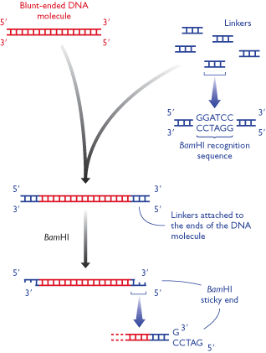

Slide 20
Ribonuclease (RNase):
Nuclease that can catalyze hydrolysis of ribonucleotides from either single stranded or double stranded RNA sequence are called ribonucleotides (RNase).
RNase are classified into two types depending on position of cleavage, i.e. endoribonuclease (cleave internal bond) and exoribonuclease (cleave terminal bond).
RNase is important for RNA maturation and processing.
RNaseA and RNaseH play important role in initial defense mechanism against RNA viral infection
Application:
RNaseA is used to remove RNA contamination from DNA sample.
During cDNA library preparation from RNA sample, RNaseH enzyme is used to cleave RNA strand of DNA-RNA duplex

