Slide 1
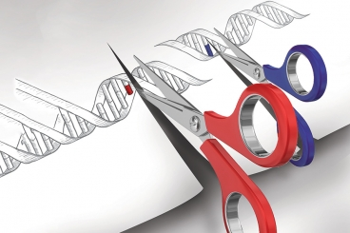
GENETIC ENGINEERING
College of Science/ biology department
fourth class
Assistant professor Dr. Munim Radwan Ali

Slide 2
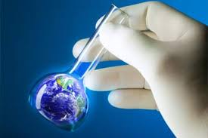
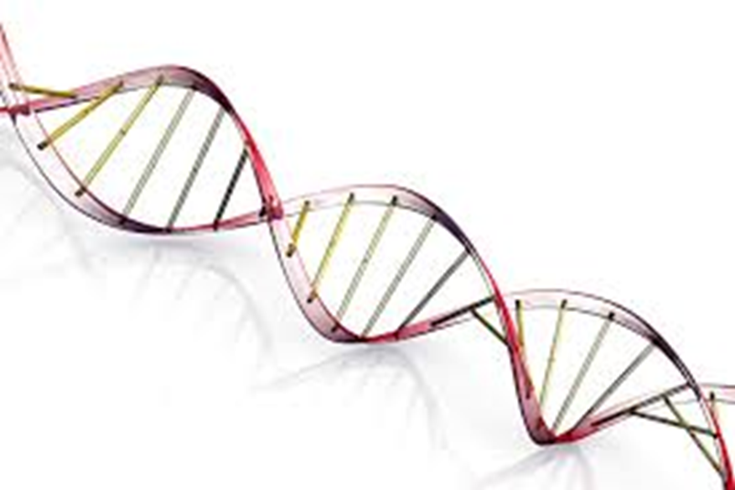
Genetic Engineering
The term genetic engineering is probably the label that most people would Several terms may be used to describe the technologies involved in manipulating genes. However, there are several other terms that can be used to describe the technology, including gene manipulation, gene cloning, recombinant DNA technology, genetic modification, and the new genetics. There are also legal definitions used in administering regulatory mechanisms in countries where genetic engineering is practiced.
Genetic engineering is the direct manipulation of an organism's genome using biotechnology. It is a set of technologies used to change the genetic makeup of cells, including the transfer of genes within and across species boundaries to produce improved or novel organisms. New DNA may be inserted in the host genome by first isolating and copying the genetic material of interest using molecular cloning methods to generate a DNA sequence, or by synthesizing the DNA, and then inserting this construct into the host organism.

Slide 3

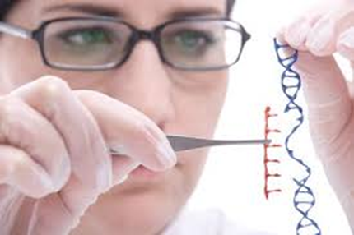
The science of genetic engineering originated in the late 1960s, the enzyme DNA ligase was isolated. This enzyme can join two strands of DNA together, a prerequisite for the construction of recombinant molecules, and can be regarded as a sort of molecular glue. and early 1970s with the discovery of restriction enzymes . The 1978 Nobel Prize for physiology went to the discoverer of restriction enzymes, Hamilton O. Smith, and the first people to use these tools to analyze the genetics of a virus, Daniel Nathans and Werner Arber.
The science of genetic engineering originated in the late 1960s, the enzyme DNA ligase was isolated. This enzyme can join two strands of DNA together, a prerequisite for the construction of recombinant molecules, and can be regarded as a sort of molecular glue. and early 1970s with the discovery of restriction enzymes . The 1978 Nobel Prize for physiology went to the discoverer of restriction enzymes, Hamilton O. Smith, and the first people to use these tools to analyze the genetics of a virus, Daniel Nathans and Werner Arber.
Restriction enzymes make it possible to remove a bit of DNA from one organism's chromosome and to insert it into another organism's chromosome . This allows for the production of new combinations of genes that may not exist in nature.

Slide 4
The first recombinant DNA molecules were generated at Stanford University in 1972, utilizing the cleavage properties of restriction enzymes (scissors) and the ability of DNA ligase to join DNA strands together (glue). The importance of these first tentative experiments cannot be overestimated. Scientists could now join different DNA molecules together and could link the DNA of one organism to that of a completely different organism. The methodology was tended in 1973 by joining DNA fragments to the plasmid pSC101, ensure that the target sequence is replicated in a suitable host cell. which is an extrachromosomal element isolated from the bacterium Escherichia coli. These recombinant molecules behaved as replicons; that is, they could replicate when introduced into E. coli cells. Thus, by creating recombinant molecules in vitro, and placing the construct in a bacterial cell where it could replicate in vivo, specific fragments of DNA could be isolated from bacterial colonies that formed clones (colonies formed from a single cell, in which all cells are identical) when grown on agar plates. This development marked the emergence of the technology that became known as gene cloning

Slide 5
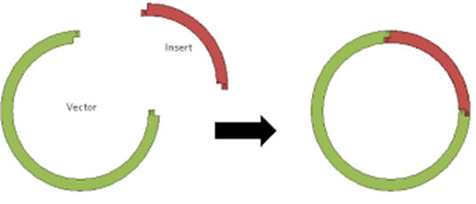
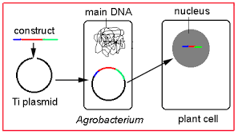
DNA Strand cleavage by restriction enzyme
DNA fragment
Ligation the fragment with plasmid
Cleavage the plasmid with RE

Slide 6


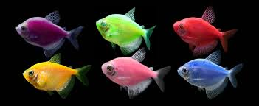
is any organism whose genetic material has been altered using genetic engineering techniques (i.e. genetically engineered organism). GMOs are the source of medicines and genetically modified foods and are also widely used in scientific research and to produce other goods. The term more specifically defined type of GMO is a "Transgenic Organism".
The first GMOs were bacteria generated in 1973 and GM mice in 1974. Insulin-producing bacteria were commercialized and the first diabetic patient in the world was injected with human insulin made in bacteria in December 1980, making this the first genetically engineered product to enter medical practice , and genetically modified food has been sold since 1994. GloFish, the first GMO designed as a pet, was first sold in the United States in December 2003.

Slide 7
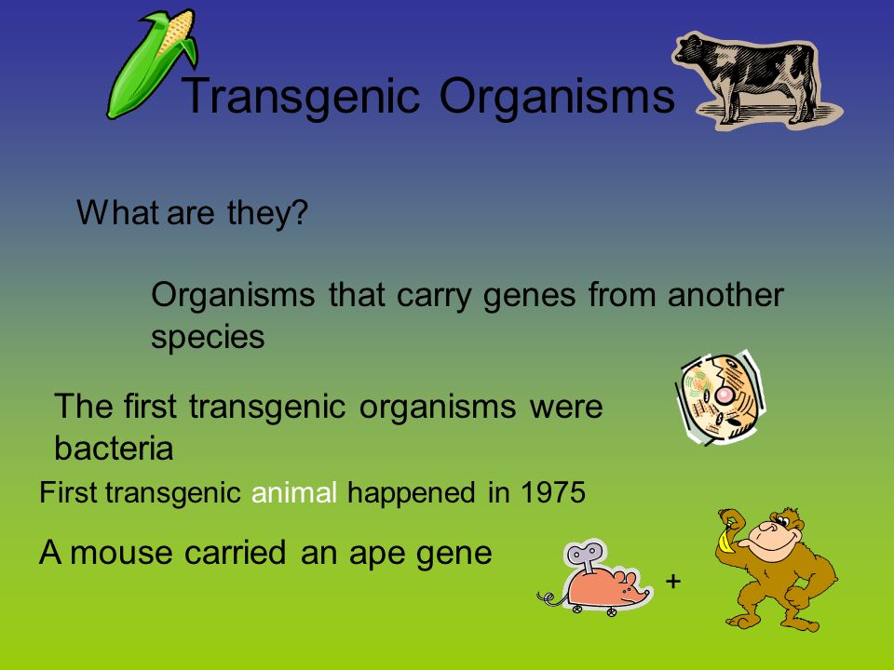

Slide 8
The interferons are another medically important group of peptides that became available in abundance only after the development of genetic engineering techniques. Interferon was useful for treating viral infections, and there were strong indications that it might be effective against some cancers. Before the advent of genetic engineering techniques, it took laborious processing of thousands of units of human blood to obtain enough interferon to treat a few patients. Other medically useful human peptides that have been made widely available because of genetic engineering are human growth hormone, which is used to treat persons with congenital dwarfism and tissue-type plasminogen activator (t-PA), which is a promising new treatment for persons who suffer a heart attack. With the development of retroviral vectors in the early 1980s, the possibility of efficient gene transfer into mammalian cells for the purpose of gene therapy became widely accepted.

Slide 9
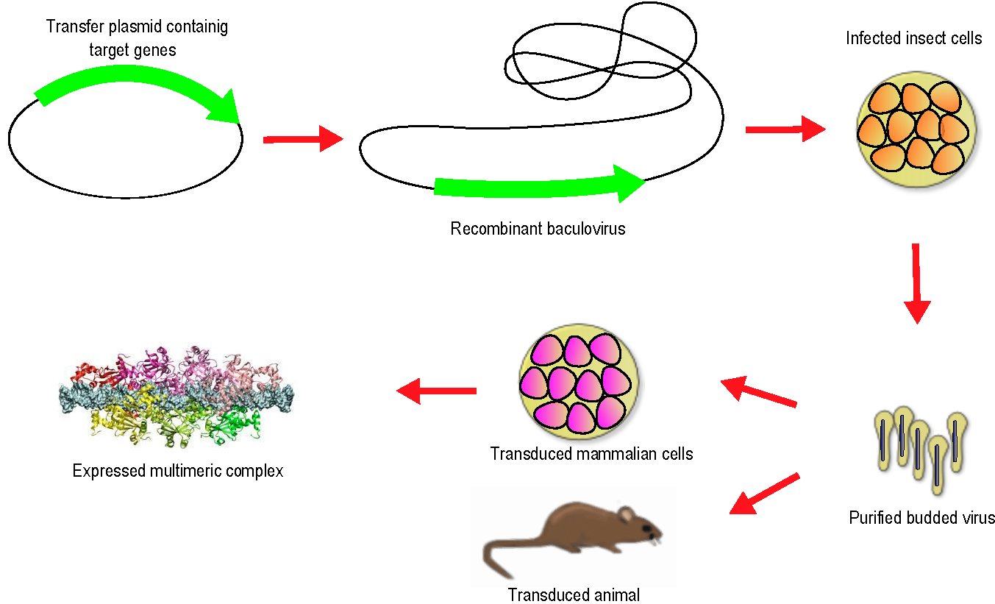

Slide 10
1990 deemed America to became the first country to allow new genes be introduced into human beings . A gene drug was used to treat a 4 year-old girl with severe combined immune deficiency (SCID). Victims of SCID the lack of gene that controls the production commands vital to immune functioning. SCID patients prior to gene treatment had to live inside sanitized plastic bubbles. In early 1991, a 9 year-old girl with SCID deficiency was also treated with the same gene therapy. In 2000 it was announced that three French infants born with SCID had been cured using a more refined version of this technique

Slide 11
A genetically modified organism (GMO) This is an organism whose genetic makeup has been altered by the addition of genetic material from another, unrelated organism. This should not be confused with the more general way in which "GMO" is used to classify genetically altered organisms, as typically GMOs are organisms whose genetic makeup has been altered without the addition of genetic material from an unrelated organism.
if genetic material from another species is added to the host, the resulting organism is called transgenic. If genetic material from the same species or a species that can naturally breed with the host is used the resulting organism is called cisgenic. Genetic engineering can also be used to remove genetic material from the target organism, creating a gene knockout organism

Slide 12
Genetic Engineering Applications
Medicine
Genetic engineering has resulted in a series of medical products. The first two commercially prepared products from recombinant DNA technology were insulin and human growth hormone, both of which were cultured in the E. coli bacteria. Since then a plethora of products have appeared on the market, including the following abbreviated list, all made in E. coli:
BIOnate :A vaccine is usually a harmless version of a bacterium or virus that is injected into an organism to activate the immune system to attack and destroy similar substances in the future.
Tumor necrosis factor. Treatment for certain tumor cells
Interleukin-2 (IL-2). Cancer treatment, immune deficiency, and HIV infection treatment
Prourokinase. Treatment for heart attacks
Taxol. Treatment for ovarian cancer
Interferon. Treatment for cancer and viral infections

Slide 13

In addition, a number of vaccines are now commercially prepared from recombinant hosts. At one time vaccines were made by denaturing the disease and then injecting it into humans with the hope that it would activate their immune system to fight future intrusions by that invader. Unfortunately, the patient sometimes still ended up with the disease.
With DNA technology, only the identifiable outside shell of the microorganism is needed, copied, and injected into a harmless host to create the vaccine. This method is likely to be much safer because the actual disease-causing microbe is not transferred to the host. The immune system is activated by specific proteins on the surface of the microorganism -e. DNA technology takes that into account and only utilizes identifying surface features for the vaccine. Currently vaccines for the hepatitis B virus, herpes type 2 viruses, and malaria are in development for trial use in the near future.

Slide 14
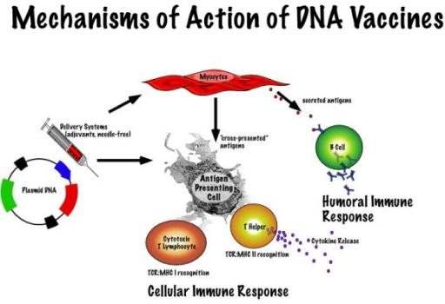

Slide 15
Agriculture :Crop plants have been and continue to be the focus of biotechnology as efforts are made to improve yield and profitability by improving crop resistance to insects and certain herbicides and delaying ripening (for better transport and spoilage resistance). The creation of a transgenic plant, one that has received genes from another organism, proved more difficult than animals. Unlike animals, finding a vector for plants proved to be difficult until the isolation of the Ti plasmid, harvested from a tumor-inducing (Ti) bacteria found in the soil. The plasmid is “shot” into a cell, where the plasmid readily attaches to the plant's DNA. Although successful in fruits and vegetables, the Ti plasmid has generated limited success in grain crops.
Creating a crop that is resistant to a specific herbicide proved to be a success because the herbicide eliminated weed competition from the crop plant. Researchers discovered herbicide-resistant bacteria, isolated the genes responsible for the condition, and “shot” them into a crop plant, which then proved to be resistant to that herbicide. Similarly, insect-resistant plants are becoming available as researchers discover bacterial enzymes that destroy or immobilize unwanted herbivores, and others that increase nitrogen fixation in the soil for use by plants.

Slide 16
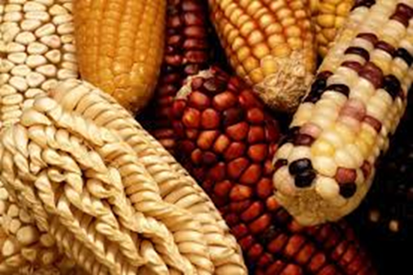
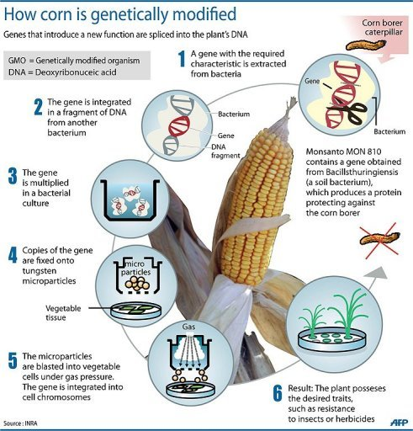
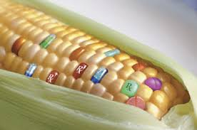
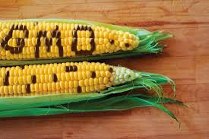

Slide 17
Geneticists are on the threshold of a major agricultural breakthrough. All plants need nitrogen to grow. In fact, nitrogen is one of the three most important nutrients a plant requires. Although the atmosphere is approximately 78 percent nitrogen, it is in a form that is unusable to plants. However, a naturally occurring rhizobium bacterium is found in the soil and converts atmospheric nitrogen into a form usable by plants. These nitrogen-fixing bacteria are also found naturally occurring in the legumes of certain plants such as soybeans and peanuts. Because they contain these unusual bacteria, they can grow in nitrogen-deficient soil that prohibits the growth of other crop plants. Researchers hope that by isolating these bacteria, they can identify the DNA segment that codes for nitrogen fixation, remove the segment, and insert it into the DNA of a profitable cash crop! In so doing, the new transgenic crop plants could live in new fringe territories, which are areas normally not suitable for their growth, and grow in current locations without the addition of costly fertilizers!

Slide 18
Projects with genetically modified products
Bt cotton: Since we began developing cotton varieties in 1984, using GM technologies, enormous improvements have been made. Australia now has the highest cotton yields in the world, exporting cotton worth $2.5 billion each year. We've reduced Australian growers’ reliance on insecticides and improved their water use efficiency. Currently, more than 95 per cent of the Australian cotton crop is grown from CSIRO bred varieties, which have reduced pesticide use by up to 85 per cent and herbicide use by about 52 per cent.
DHA canola: We have developed canola plants which produce high quality oils rich in omega-3 DHA (docosahexaenoic acid). This nutrient is currently only found in beneficial quantities in ocean-based algae, and the fish that eat it. This product could break the world's reliance on fish stocks while meeting the increasing demand for these healthy long-chain omega-3 oils.

Slide 19
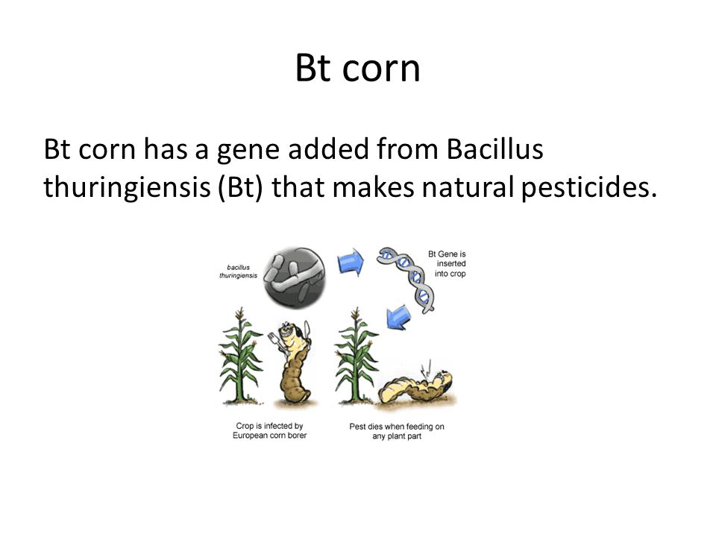

Slide 20
SHO Safflower: By engineering safflower to contain 94 per cent oleic acid, we've produced the world’s highest source of oleic acid. This chemical can be used in lubricants, oleochemicals and transformer oil.
Leaf oil: We have engineered tobacco plants to have oilseed-like levels of oil in their leaves (around 35 per cent). This product could provide an economically competitive renewable alternative to petroleum diesel.
BT cowpeas: We are part of a global project to improve cowpea production in Africa and are making progress towards incorporating ‘built-in’ insect pest protection that could help reduce food shortages in some African regions.

Slide 21
Animal Husbandry
Neither the use of animal vaccines nor adding bovine growth hormones to cows to dramatically increase milk production can match the real excitement in animal husbandry: transgenic animals and clones.
Transgenic animals model advancements in DNA technology in their development. The mechanism for creating one can be described in three steps:
Healthy egg cells are removed from a female of the host animal and fertilized in the laboratory.
The desired gene from another species is identified, isolated, and cloned.
The cloned genes are injected directly into the eggs, which are then surgically implanted in the host female, where the embryo undergoes a normal development process.

Slide 22
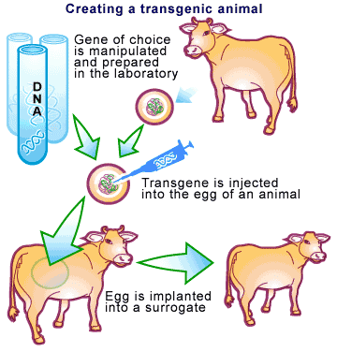

Slide 23
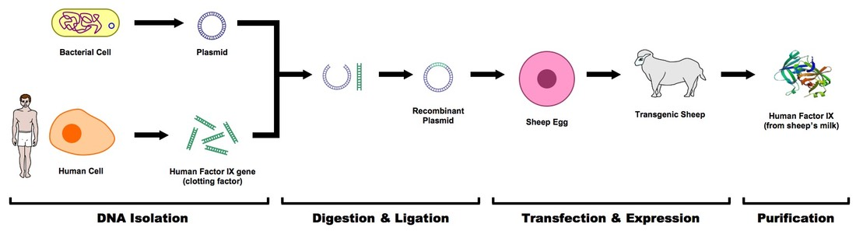

Slide 24
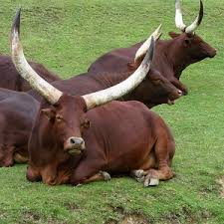
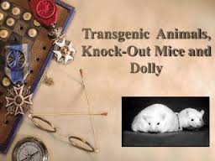
It is hoped that this process will provide a cheap and rapid means of generating desired enzymes, other proteins, and increased production of meat, wool, and other animal products through common, natural functions.
Ever since 1997 when Dolly was cloned, research and experimentation to clone useful livestock has continued unceasingly. The attractiveness of cloning is the knowledge that the offspring will be genetically identical to the parent as in asexual reproduction. Four steps describe the general process:

Slide 25
A differentiated cell, one that has become specialized during development, with its diploid nucleus is removed from an animal to provide the DNA source for the clone.
An egg cell from a similar animal is recovered and the nucleus is removed, leaving only the cytoplasm and cytoplasm organelles.
The two egg cells are fused with an electric current to form a single diploid cell, which then begins normal cell division.
The developing embryo is placed in a surrogate mother, who then undergoes a normal pregnancy.

Slide 26
