Slide 1
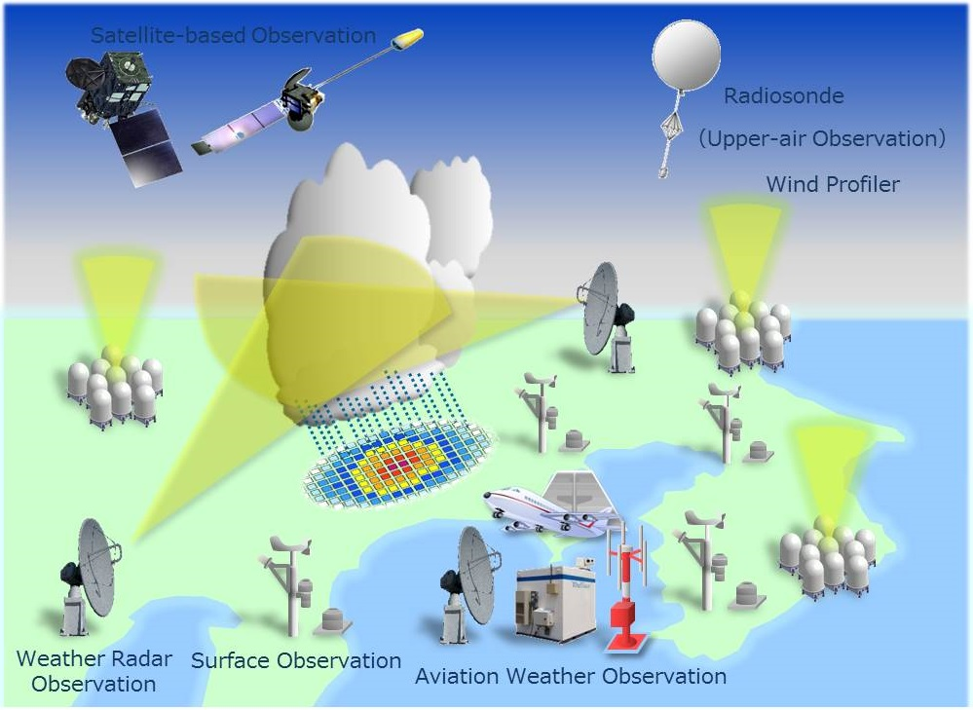
AL-MUSTANSIRIYAH UNIVERSITY COLLEGE OF SCIENCES ATMOSPHERIC SCIENCES DEPARTMENT /second class
The Course of
Meteorological Instrumentation and Observations
Dr. Sama Khalid Mohammed

Slide 2
Welcome Students! ☺
LECTURE ONE

Slide 3
What are covered in this course?
1. Data Processing
6. Wind measurement
Mechanical method
Electrical method
2. Temperature measurement
Basic principles
Sensor types
Response time
7. Radiation
Basic principles
Sensors
3. Pressure measurement
Basic principles
Sensors
8. Clouds measurement
9. Upper atmosphere measurement
4. Moisture measurement
Moisture Variables
Basic Principles
Sensors
10. Weather radar
11. Satellite observations
5. Precipitation measurement
Rain gauges
Radars for precipitation
12. Weather Maps and how to represent Weather Phenomena

Slide 4
Chapter 1: Introduction
Why do we make atmospheric observations?
For current weather observation, now-casting, and forecasting
For climatologically purposes, and to measure climate variability
Vital for atmospheric research, and process studies
The Basic parameters that describe the surface & upper air
Properties include:
pressure,
temperature,
humidity,
winds,
clouds,
precipitation,
etc ….
Notes:
Now-casting is weather forecasting on a very short term mesoscale period of up to 2 hours according to the World Meteorological Organization
Forecasting is the process of making predictions of the future based on past and present data and most commonly by analysis of trends.

Slide 5
We can make these observations in two ways:
In situ measurement
Remote sensing measurement
acquisition of information of an object or phenomenon, by the use of either recording or
real-time sensing devices that are wireless, not in physical or
intimate contact with the object.
measurements obtained through direct contact with the respective object(basically you take measurements of the parameters right were you are)
they measure the parameters from where they are located at that moment, Surface(stations, ships, or, buoys), or upper-air(rockets; balloons, and aircrafts)
Active remote sensing
Passive remote sensing
Notes:
The in-situ observations can be surface based measurements, such as, those collected by surface meteorological stations, ships, or, buoys, but may also include those collected by rockets; balloons, and even aircrafts because they measure the parameters from where they are located at that moment.

Slide 6
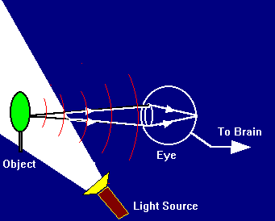
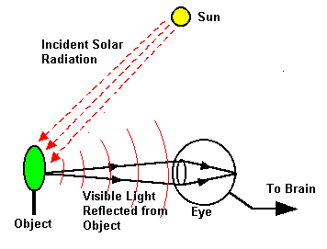
Active remote Sensing: Makes
use of sensors that detect
reflected responses from
objects that are irradiated from
artificially-generated energy
sources, such as radar(send out radiation, hoping to get it back to analyze it ).
Passive Remote Sensing:
Makes use of sensors that
detect the reflected or emitted
electro-magnetic radiation
from natural sources (wait for radiation to come to them so that they can analyze the data)

Slide 7
Steps needed to make measurements for a specific application:
1. Define and research the problem (literature review is advised).
What parameters are required and what must be measured.
What is the frequency of the observations that will be required?
How long will the observations be made?
What level of error is acceptable?
2. Know and understand the instruments that will be used
(consider cost, durability, and availability).
3. Apply instruments and data processing
(consider deployment, and data collection).
4. Analyze the data (apply computational tools, statistics, etc..).

Slide 8
A measurement is a quantity that has both a number and a unit.
2.34 g
36.1 mL
16.5 Years Old
Measurements are fundamental to the experimental sciences. For that reason, it is important to be able to MAKE measurements and to decide whether a measurement is CORRECT.
-- Are you “certain” that your measurement is correct? HOW “certain” are you???

Slide 9
General Concepts
Understanding measurement:
Accurcy
The ability of the instrument to measure a quantity with little or no deviation among measurements (describes the degree to which measurements show the same or similar results)
Precision
How close the measurement made is to the actual value(is the difference between what we measured and the true (yet unknown) value).
Sensitivity
Ability of instrument to detect change.
also called reproducibility or repeatability

Slide 10
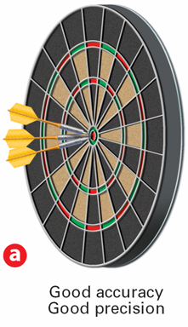
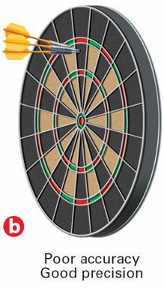
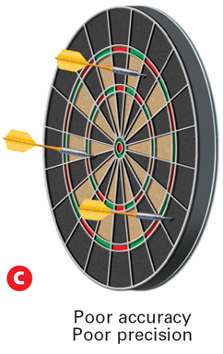
Accuracy – closest to TRUE Value
Precision – repeated Same Value

Slide 11
Error Error -is the difference between the actual value of a quantity and the value obtained in measurement.
Acutal value– standard or reference of known value or a theoretical value.
There are 2 main types of error:
SYSTEMATICS ERRORS
Random Errors
ERROR IN MEASUREMENT

Slide 12
Systematic errors are biases in measurement which lead to the
situation where the mean of many separate measurements differs
from the actual value of the measured attribute.
Systematic errors: (a) constant, or (b) varying depending on the
actual value of the measured quantity.
When they are constant, they are simply due to incorrect zeroing of the instrument (when the measuring instrument does not start from exactly zero).
When they are not constant, they can change sign.
e.g.
the systematic error is 2% of the actual value
actual value: 100°, 0°, or −100°
+2°
0°
−2°
A common method to remove systematic error is through
calibration of the measurement instrument.

Slide 13
Random errors 1. Random errors arise from unknown and unpredictable variations in condition. 2. It fluctuates from one measurement to the next. 3. Random errors are caused by factors that are beyond the control of the observers. 4. Random error can cause by personal errors such as
human limitations of sight and touch.
lack of sensitivity of the instrument: the instrument fail to respond to the small change.
natural errors such as changes in temperature or wind, while the experiment is in progress.
wrong technique of measurement.
5. One example of random error is the parallax error.
Random error can be reduced by - taking repeat readings
- find the average value of the reading.

Slide 14
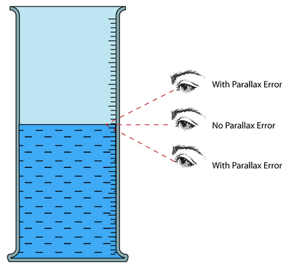
Parallax error A parallax error is an error in reading an instrument due to the eye of the observer and pointer are not in a line perpendicular to the plane of the scale.

Slide 15
How to express errors:
Absolute Error = |Measured Value- Actual Value |
Relative Error = Absolute Error / Actual Value
Percentage Errors = Relative Error x100%
Fundamentals Data processing concepts
Simple statistics
Significant figures

Slide 16
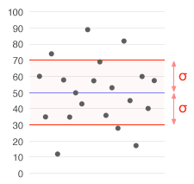
Simple statistics
Averaging
Variance
Standard deviation
covariance
Correlation coefficient

Slide 17
Expressing accuracy and precision
Mean (average)
Percent error
Range
Deviation
Standard deviation
Percent coefficient of variation
accuracy
precision

Slide 18
Significant Figures (Sig Figs) = Known + ESTIMATE
The significant figures in a measurement include all of the digits that are known, plus a last digit that is estimated.
Significant Figures relate to the certainty of a measurement – The PRECISION of the measurement

Slide 19
Precision = Same REPEATABLE Value (Certainty)
More Sig Figs = more certainty = greater precision
_ 1 sig fig (.6 is the estimate)
_ 2 sig figs (.01 is the estimate)
_ 3 sig figs
Most certainty and greatest PRECISION
Which measurement has the most certainty and greatest PRECISION?
Notes:
Three differently calibrated meter sticks are used to measure the length of a board. a) A meter stick calibrated in a 1-m interval. b) A meter stick calibrated in 0.1-m intervals. c) A meter stick calibrated in 0.01-m intervals. Measuring How many significant figures are reported in each measurement?

Slide 20
Rules for Counting Significant Figures - Details
Nonzero integers always count as significant figures.
3456 has
4 sig figs.

Slide 21
Rules for Counting Significant Figures - Details
Zeros
- Leading zeros do not count as significant figures.
0.0486 has
3 sig figs.

Slide 22
Rules for Counting Significant Figures - Details
Zeros
- Captive zeros always count as significant figures.
16.07 has
4 sig figs.

Slide 23
Rules for Counting Significant Figures - Details
Zeros
Trailing zeros are significant only if the number contains a decimal point.
9.300 has
4 sig figs.

Slide 24
Rules for Counting Significant Figures - Details
Exact numbers have an infinite number of significant figures.
1 inch = 2.54 cm, exactly

Slide 25
Sig Fig Practice #1
How many significant figures in each of the following?
1.0070 m →
5 sig figs
17.10 kg →
4 sig figs
100,890 L →
5 sig figs
3.29 x 10³ s →
3 sig figs
0.0054 cm →
2 sig figs
3,200,000 →
2 sig figs

Slide 26
RULE-2: Every digit in scientific notation is Significant
47.3
4.73 x 10¹
= 3 S.F
0.0021
2.1 x 10⁻³
= 2 S.F
1.200
1.200 x 10⁰
= 4 S.F
36
3.6 x 10¹
= 2 S.F
2400
2.4 x 10³
= 2 S.F
0.0600
6.00 x 10⁻²
= 3 S.F
104,000
1.04 x 10⁵
= 3 S.F

Slide 27
Rules for Significant Figures in Mathematical Operations
Multiplication and Division:
# sig figs in the result equals the number in the least precise measurement used in the calculation.
6.38 x 2.0 =
12.76 → 13 (2 sig figs)

Slide 28
Sig Fig Practice #2
Calculation
Calculator says:
Answer
3.24 m x 7.0 m
22.68 m²
23 m²
100.0 g ÷ 23.7 cm³
4.219409283 g/cm³
4.22 g/cm³
0.02 cm x 2.371 cm
0.04742 cm²
0.05 cm²
710 m ÷ 3.0 s
236.6666667 m/s
240 m/s
1818.2 lb x 3.23 ft
5872.786 lb·ft
5870 lb·ft
1.030 g ÷ 2.87 mL
2.9561 g/mL
2.96 g/mL

Slide 29
Rules for Significant Figures in Mathematical Operations
Addition and Subtraction: The number of decimal places in the result equals the number of decimal places in the least precise measurement.
6.8 + 11.934 =
18.734 → 18.7 (3 sig figs)

Slide 30
Sig Fig Practice #3
Calculation
Calculator says:
Answer
3.24 m + 7.0 m
10.24 m
10.2 m
100.0 g - 23.73 g
76.27 g
76.3 g
0.02 cm + 2.371 cm
2.391 cm
2.39 cm
713.1 L - 3.872 L
709.228 L
709.2 L
1818.2 lb + 3.37 lb
1821.57 lb
1821.6 lb
2.030 mL - 1.870 mL
0.16 mL
0.160 mL

Slide 31
Guesses only, don’t write any of this down YET.
There are rules (hints) to help you in determining the number of significant figures there are in a measurement.

Slide 32
3
= __ S.F
= 5 S.F
= 5 S.F
= Unlimited
= 4 S.F
= 2 S.F
Guesses only, don’t write any of this down YET.
There are rules (hints) to help you in determining the number of significant figures there are in a measurement.

Slide 33
3.1 Section Quiz
1. Which set of measurements of a 2.00-g standard is the most precise?
2.00 g, 2.01 g, 1.98 g
2.10 g, 2.00 g, 2.20 g
2.02 g, 2.03 g, 2.04 g
1.50 g, 2.00 g, 2.50 g

Slide 34
3.1 Section Quiz
2. A student reports the volume of a liquid as 0.0130 L. How many significant figures are in this measurement?
2
3
4
5

