Slide 1
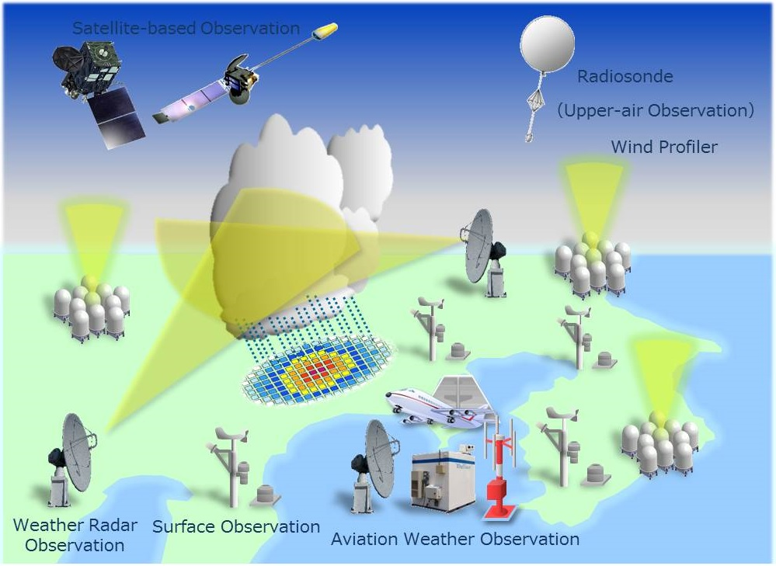
AL-MUSTANSIRIYAH UNIVERSITY
COLLEGE OF SCIENCES
ATMOSPHERIC SCIENCES DEPARTMENT /SECOND CLASS
The Course of
Meteorological Instrumentation and Observations
Dr. Sama Khalid Mohammed

Slide 2
Welcome Students! ☺
The weather is an ever-playing drama before which we are a captive audience. With the lower atmosphere as the stage, air and water as the principal characters, and clouds for costumes, the weather’s acts are presented continuously somewhere about the globe. The script is written by the sun; the production is directed by the earth’s rotation; and, just as no theatre scene is staged exactly the same way twice, each weather episode is played a little differently, each is marked with a bit of individuality.
Clyde Orr, Jr., Between Earth and Space
LECTURE SIX – part 1

Slide 3
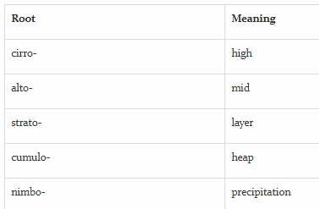
A cloud is a visible collection of billions of small water and/or ice particles suspended in the atmosphere above Earth’s surface. Clouds form when water vapor condenses.
Clouds come in all shapes and colors, and exist at all levels of the troposphere. Their unique features can tell us something about the atmospheric processes that led to their formation, or indicate impending weather changes.
Cloud names are derived from the Latin roots listed in the table below.
For example, a layered cloud producing rain would be named nimbostratus and a high cloud appearing in heaps would be called cirrocumulus.

Slide 4
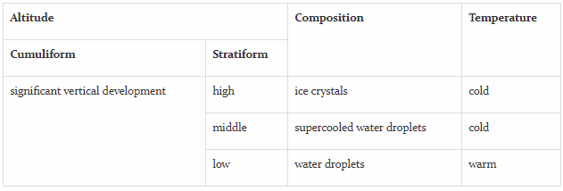
Clouds can be categorized based on general appearance (wispy, layered, or puffy) and by other factors such as altitude, composition, and temperature (see table below).

Slide 5
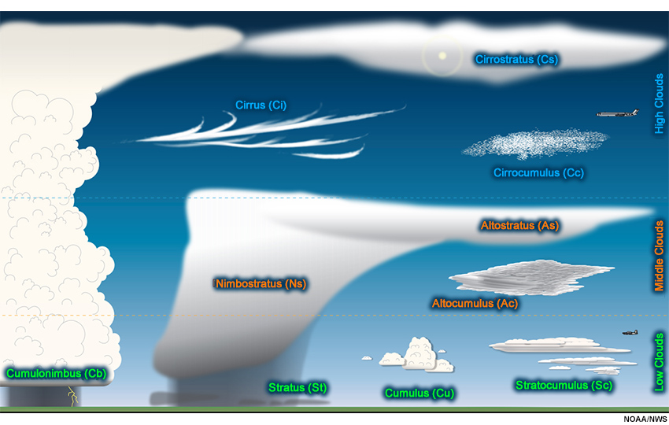
Clouds is a collection of droplets of water floating in the air, found in the lower part of the atmosphere “troposphere”. Some clouds are formed in the stratosphere,too
The shape and the position of the clouds tell the direction and speed of the wind in the sea, and clouds tells how much water vapor is in the air

Slide 6
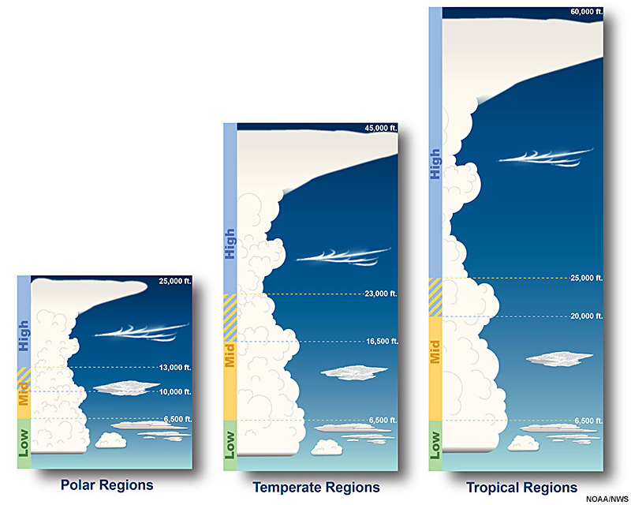
Cloud Altitude Observations
Because the troposphere is much warmer in the tropics than at higher latitudes, the cloud base height differs for mid and high clouds across these regions. For instance, mid-level clouds near the equator generally have heights between 2 km and 7.5 km, while closer to the poles, these cloud heights are likely to be in 2-4 km range.

Slide 7
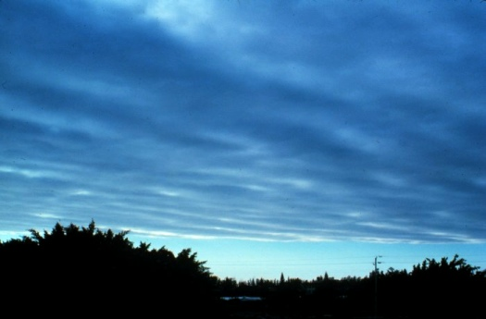
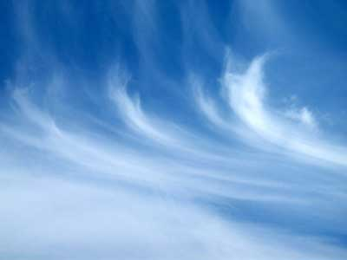
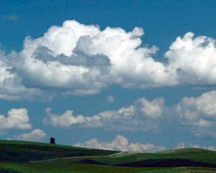
What are the main three cloud types?
Cumulus
Cirrus
Stratus

Slide 8
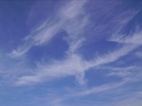
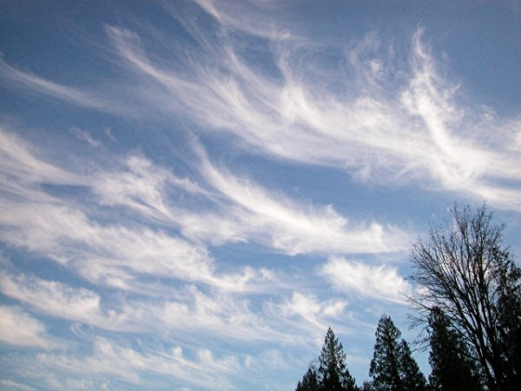
Cloud classification
High level clouds at heights of 5-13 km
Cirrus, Ci
Fibrous, threadlike, white
feather clouds composed of ice of ice crystals, whose form resembles hair curls and predict fair to pleasant weather. the water vapor rises straight up high into the sky to form small lumps of clouds that look like feathers,
they are formed when there is not much moisture in air

Slide 9
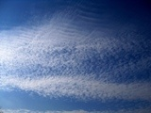

Cirrocumulus, Cc
Fleecy cloud; Cloud banks
of small, white flakes.
Cirrostratus, Cs
Milky, translucent cloud
veil of ice crystals, which
sometimes causes halo
appearances around moon
and sun.

Slide 10
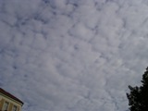
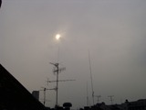
Medium level clouds at heights of 2-7 km
Altocumulus, Ac
Grey cloud bundles, sheds
or rollers, compound like
rough fleecy cloud, which
are often arranged in banks.
Altostratus, As
Dense, gray layer cloud,
often evenly and opaquely,
which lets the sun shine
through only a little.

Slide 11
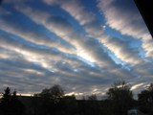
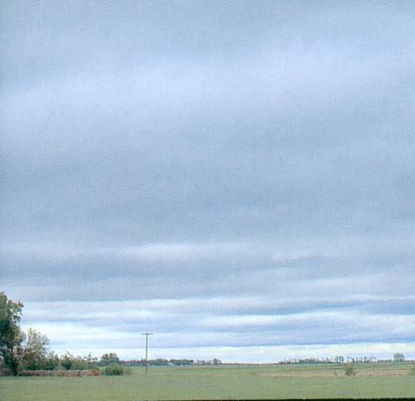
Low level clouds at heights of 0-2 km
Stratocumulus, Sc
Cloud plaices, rollers or
banks compound dark
gray layer cloud.
Stratus, St
Evenly grey, low layer cloud,
which causes fog or fine
precipitation, Often cover the entire sky, can be seen early in the morning or late in afternoon
they are formed when the wind moves horizontally,

Slide 12
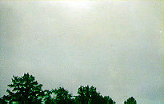
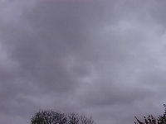

Slide 13
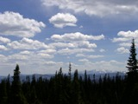
Clouds with large vertical extending at heights of 0-13 km
Cumulus, Cu
Cumulus clouds are white, puffy clouds that look like pieces of floating cotton.
Cumulus clouds are often called "fair-weather clouds". but when they become too big and grayish, they may bring bad weather characterized by lightning , thunder, and strong rain.
The bottom of each cloud is flat and the top of each cloud has rounded towers.
When the top of the cumulus clouds resemble the head of a cauliflower, it is called a towering cumulus.
These clouds grow upward and they can develop into giant clouds, which are thunderstorm clouds.

Slide 14
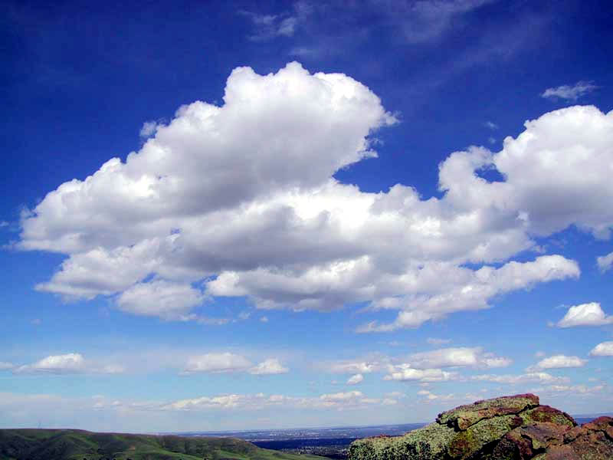
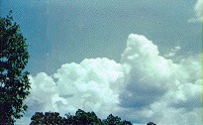
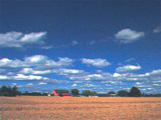

Slide 15
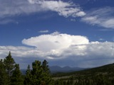
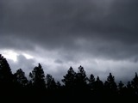
Cumulonimbus, Cb
In the middle or lower level
developing thundercloud,
which mostly up-rises into
the upper level.
Nimbostratus, Ns
Rain cloud. Grey, dark
layer cloud, indistinct
outlines.

Slide 16
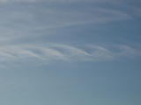
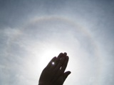
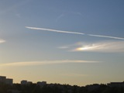
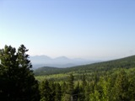
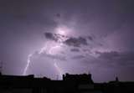
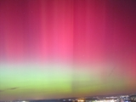
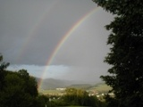
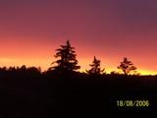
Other appearances
Kelvin-Helmholtz
Wave
sun dog
halo
haze
aurora
borealis
lightning
rainbow
dawn

Slide 17
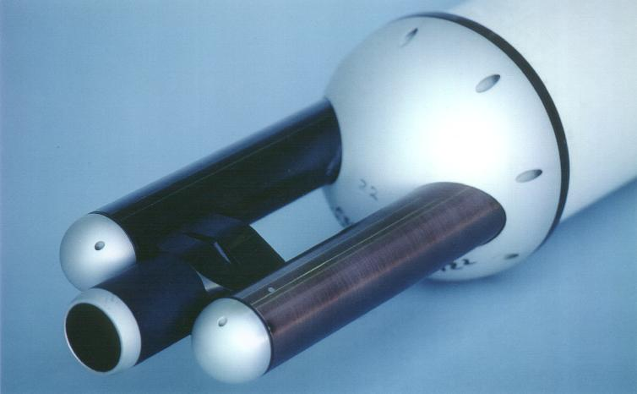
Cloud Measurement
FSSP (forward scattering spectrometer probe)
The FSSP is of the general class of instruments called optical
particle counters (OPCs) that detect single particles and size
them by measuring the intensity of light that the particle scatters
when passing through a light beam.
FSSP
The following schematic diagram illustrates the optical path of this instrument.

Slide 18
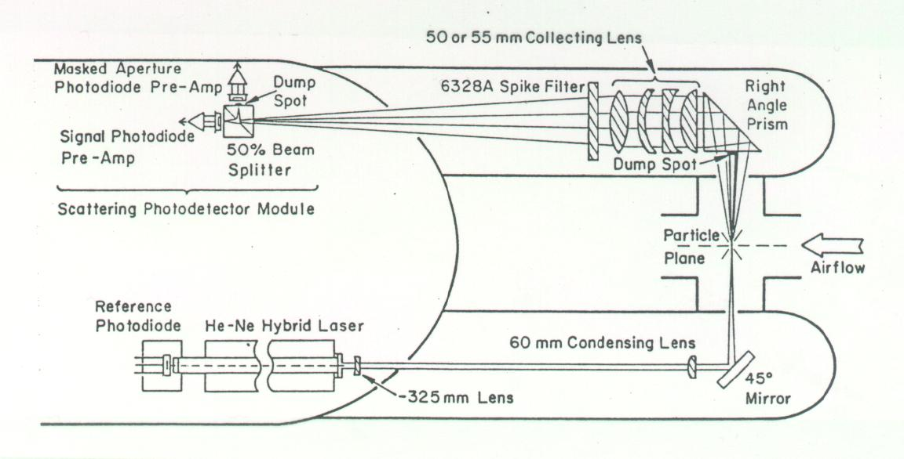
A Helium Neon laser is focused to a concentrated beam at the center of an inlet that faces into the oncoming airstream.
This laser beam is blocked on the opposite side of the inlet with an optical stop, a "dump spot" to prevent the beam from entering the collection optics.
Particles that encounter this beam scatter light in all directions and some of that scattered in the forward direction is directed by a right angle prism though a condensing lens and onto a Scattering Photo-detector Module.

Slide 19
The size of the particle is determined by measuring the light scattering intensity and using Mie scattering theory to relate this intensity to the particle size.
The size is categorized into one of 15 channels and this information sent to the data system where the number of particles in each channel is accumulated over a preselected time period.
Probes for liquid water measurements are usually made from aircraft and usually gives the number of droplets in a certain size bin.

Slide 20
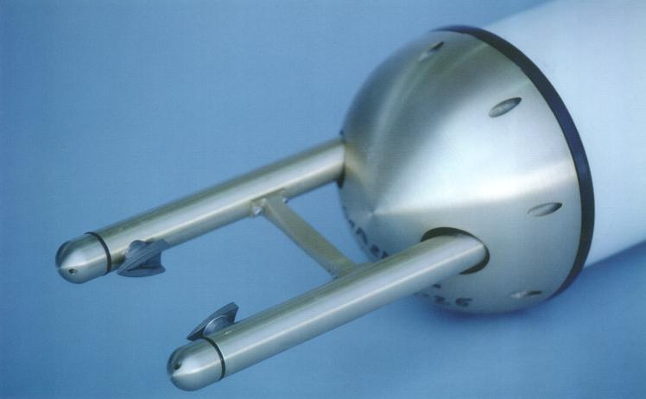

Optical Array probe
Developed for the measurement of cloud droplet size distributions.
The 2Ds record the two dimensional shadows of hydrometeors.
It uses the same technique as the FSSP but instead of a detector, they use an array of photodiodes to measure the size of hydrometeors as they pass through a focussed He-Ne laser beam.
The shadow is cast onto a linear diode array and the on/off state of these diodes is stored during the particle's passage through the laser beam. This information, along with the time that has passed since the previous particle, is sent to the data system and recorded for post-flight analysis.

Slide 21
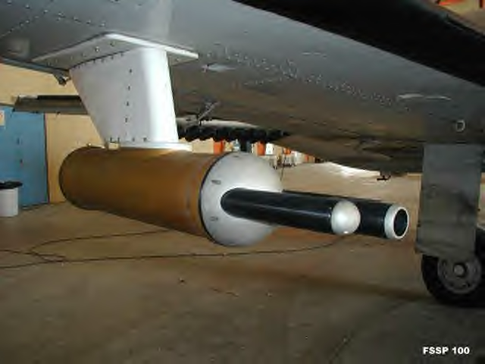
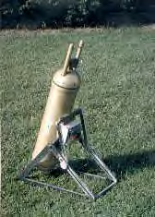

The size is categorized into one of 60 channels and this information is sent to the data system where the number of particles in each channel is accumulated over a preselected time period.
The optical array probe is a particle sizing instrument, not a liquid water content probe. If liquid water content information is desired, some fairly loose assumptions must be made with regard to the phase, habit, and density of the particles.
measure cloud drops
measure precipitation
Below is a photodiode of some ice crystals in a cloud, where it shows a typical output from one of these devices.

Slide 22
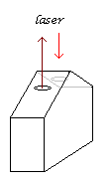
Laser ceilometer
is an instrument for the measurement of cloud base.
It has a transmitter and a receiver, and it measures the
time of return from scattering of the laser off from the
cloud; it’s ideal because it can work during the day and
night, but it only gives cloud observations from overhead
(principle: light detection and ranging, LIDAR)..
The returns are much stronger for water droplets than for aerosol, allowing the cloud base to be distinguished from other particles present in the lower atmosphere
Low power laser ceilometer
It uses an eye-safe, low-power laser to transmit light pulses to
the cloud base, up to 40,000 feet (13 km).

Slide 23
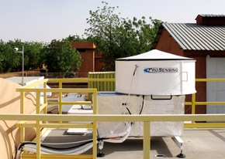
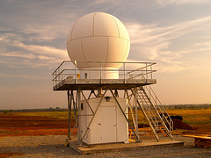
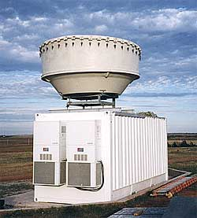
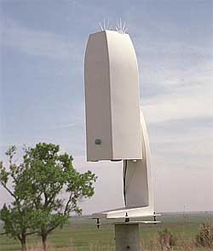
Latest version W-band (95 GHz)cloud radar
X-band scanning ARM precipitation radar
Millimeter Wave Cloud Radar (35 GHz)
Vaisala Ceilometer

Slide 24
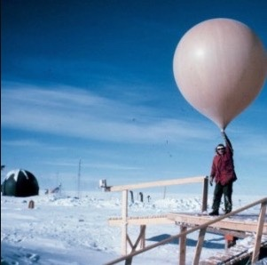
Measurement of cloud height using a balloon
Cloud height may be measured in daylight by determining the time taken by a small rubber balloon, inflated with hydrogen or helium, to rise from ground level to the base of the cloud.
The base of the cloud should be taken as the point at which the balloon appears to enter a misty layer before finally disappearing.
The rate of ascent of the balloon is determined mainly by the free lift of the balloon and can be adjusted by controlling the amount of the gas in the balloon.
The time of travel between the release of the balloon and its entry into the cloud is measured by means of a stop‑watch. If the rate of ascent is n metres per minute and the time of travel is t minutes, the height of the cloud above ground is n * t metres, but this rule must not be strictly followed.
Care should be taken if there is eddies, precipitation.
This method can be used at night by attaching an electric light to the balloon.

Slide 25
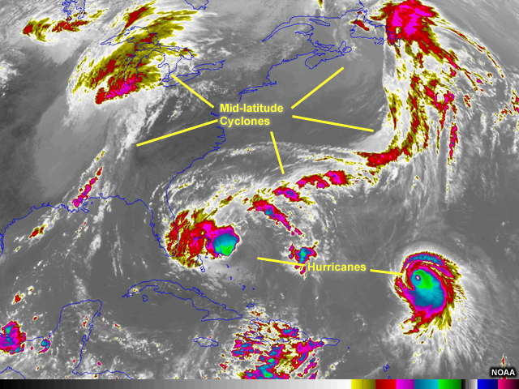
Cloud Height and Remote Sensing
Weather satellites orbiting Earth carry instruments that sense radiation in the infrared wavelengths (10.2 to 11.2 micrometers). This radiation is essentially heat radiated back to space from Earth’s surface, atmosphere, and clouds. Clouds typically have the coldest temperatures compared to the surface and the atmosphere.
Because infrared measurements are based on sensing heat, the infrared imagery is a useful tool for estimating the temperatures of cloud tops. These temperatures can then be translated to cloud height. High altitude clouds have colder cloud-top temperatures than lower altitude clouds. These different cloud-top temperatures mean that low and high clouds appear differently in the infrared imagery.

