Slide 1
Humidity

Slide 2
The partial pressure of water vapor, or water vapor pressure, is the force exerted on a unit area solely by water molecules in the gaseous state. It has units of pressure (Pa).
a liquid water surface that is included in a container with a vacuum in the column above the water surface
water vapor molecules evaporate
the vapor pressure will increase
there will be condensation of water vapor molecules at the surface
evaporation rate is equal to the condensation rate is defined as saturation vapor pressure
As temperature increases, the saturation vapor pressure increases
The condensation rate will increase as the vapor pressure increases.

Slide 3
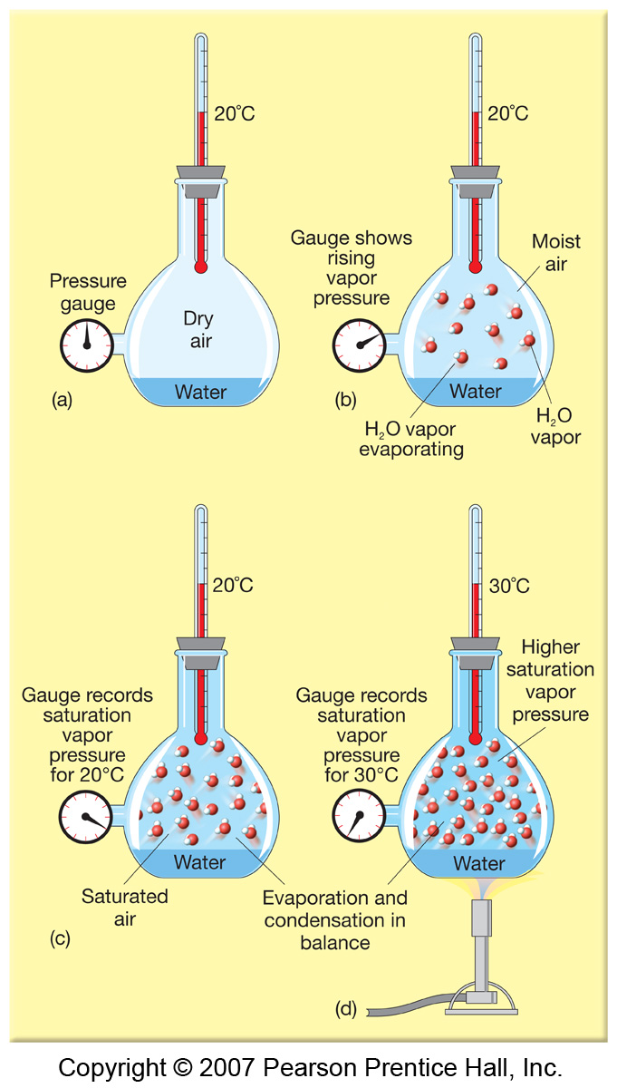
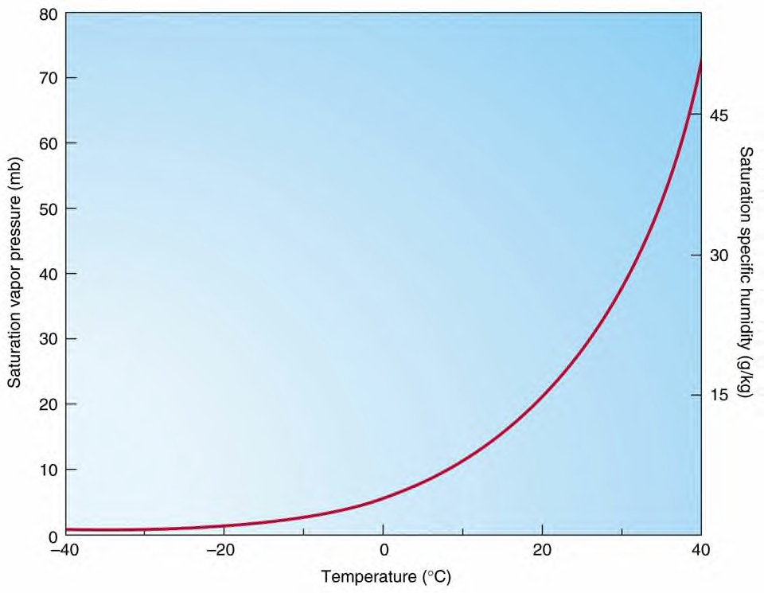
For unsaturated air, e < e_{s}
For supersaturated (e > e_{s})
Fig.(3-1): SVP (saturation vapor pressure) Curve

Slide 4
The ideal gas law provides the relationship between e, and water vapor density ρv as
Relative humidity, RH is the ratio of the air’s water vapor content (vapor pressure) to its capacity (saturation vapor pressure), thus is the ratio of the vapor pressure e to the saturation vapor pressure es(T), such that
A change in relative humidity can be brought by :
1. by changing the air’s water vapor content.
2. by changing the air temperature.
Dew point, TD, is the temperature to which air would have to be cooled isobarically (with no change in air pressure or moisture content) to reach saturation.

Slide 5
Mixing ratio, r, is the ratio of the mass of the vapor m_{v} to the mass of the dry air m_{d} in a parcel
Wet bulb temperature, Tw, is the coldest temperature that air can be cooled to by evaporation.
if 1gram of liquid water is evaporated or condensed isobarically in 1 kg of air, the air will cool (warm) by 1ºC as the mixing ratio increases (decreases) by 1 g/kg.
If liquid water is evaporated in a parcel, the parcel will cool as the water vapor mixing ratio increases (r=m_{v}/m_{d}).
since and ,
it follows that and that

Slide 6
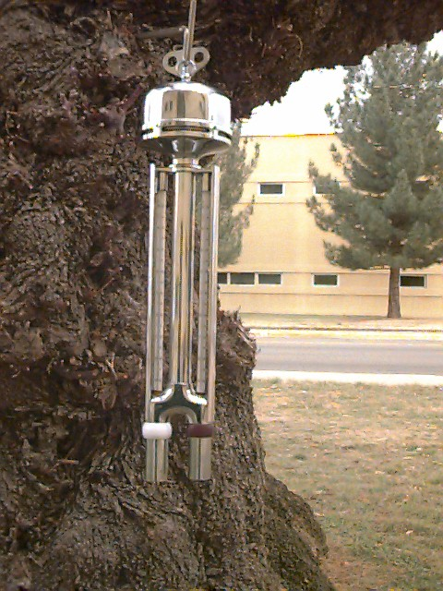
Hygrometry is the measurement of the amount of water vapor in the atmosphere. There are many ways to measure and describe the amount of water vapor in the air.
Psychrometers allow us to calculate water vapor in air by comparing the temperature of a dry thermometer to one enclosed in a wetted material which is cooled by evaporation.
It consists of two thermometers mounted in such a way that they can be ventilated by slinging.
The bulb of one of the thermometers is covered by a muslin cloth that is wetted with distilled water. The two thermometers are then ventilated by slinging.
The temperature of the wet bulb will lower as water from the wick is evaporated.
The lower the humidity, the greater the difference between the wet and dry bulb temperatures. The lowest that can be reached by evaporative cooling is the wet bulb temperature.

Slide 7
Optical hygrometers detect the absorption of electromagnetic radiation at selective wavelengths to determine water vapor content.
At certain wavelengths the absorption and scattering of light can be a strong function of water vapor density.
Lyman alpha hydrometer
They have fast repose (rest) and are precise, but not very accurate, because of temperature and pressure sensitivity, plus salts may get in the way. Some times it is used in combination with slower but more accurate sensors.

Slide 8
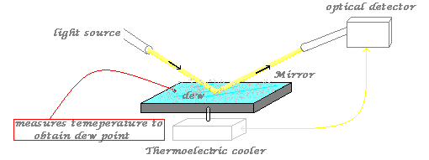
Physical principles: condensation
The thermoelectric cooler will cool the mirror to the point that dew will form, so that when a light source shines on the mirror, the optical detector would not pick it up. Then we may use a thermometer to measure the dew point. This process can be repeated until they get a precise measurement.
The advantage is that it is capable of high accuracy;
the disadvantage though is its slow repose (rest), because of the cooling of the mirror takes time.

Slide 9
Electronic hygrometers
Capacitive sensor
Capacitive sensors sense water vapor by measuring the change in capacitance caused by the amount of water vapor present
Capacitance is
the ability of a body to hold an electrical charge, or a measure of the amount of electric charge stored (or separated) for a given electric potential.
Resistive sensor
Resistive sensors use a thin film that changes conductivity
according to absorbed water.
Polymer membrane

Slide 10
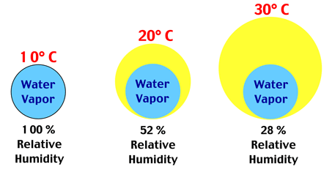
Over the last several sections we saw that, as the air cools, the air temperature approaches the dew-point temperature and the relative humidity increases. When the air temperature reaches the dew point, the air is saturated with water vapor and the relative humidity is 100 percent. Continued cooling, however, causes some of the water vapor to condense into liquid water. The cooling may take place in a thick portion of the atmosphere, or it may occur near the earth’s surface.

