Slide 1
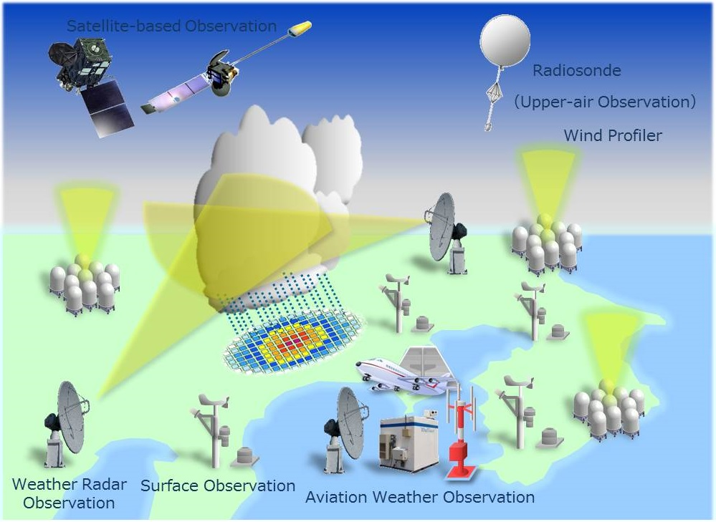
AL-MUSTANSIRIYAH UNIVERSITY COLLEGE OF SCIENCES ATMOSPHERIC SCIENCES DEPARTMENT /SECOND CLASS
The Course of
Meteorological Instrumentation and Observations
Dr. Sama Khalid Mohammed

Slide 2
Welcome Students! ☺
LECTURE FIVE

Slide 3
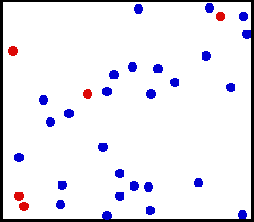
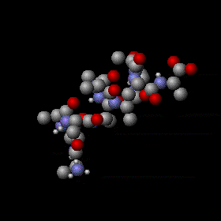
Temperature
Temperature is a measure of the average speed of the atoms and molecules, where higher temperatures correspond to faster average speeds, it is a physical property of a system that underlies the common notions of hot and cold.
Suppose we examine a volume of surface air about the size of a large flexible balloon:
If we warm the air inside, the molecules would move faster, but they also would move slightly farther apart—the air becomes less dense.
If we cool the air, the molecules would slow down, crowd closer together, and the air would become more dense.

Slide 4
Suppose we continue to slowly cool the air. Its atoms and molecules would move slower and slower until the air reaches a temperature of –273°C, which is the lowest temperature possible. At this temperature, called absolute zero, the atoms and molecules would possess a minimum amount of energy and theoretically no thermal motion. at absolute zero, we can begin a temperature scale called the absolute, or Kelvin scale.
Heat, is energy in the process of being transferred from one object to another because of the temperature difference between them. In the atmosphere, heat is transferred by conduction, convection, and radiation.
After heat is transferred, it is stored as internal energy. The atmosphere contains internal energy, which is the total energy stored in its molecules.

Slide 5
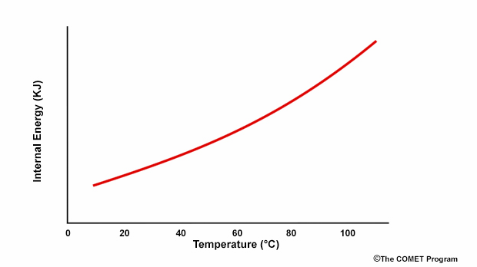
The change in temperature is equal to the specific energy that flows to or from the object divided by its heat capacity.
ΔT = Q / mc
where Q equals energy transferred, m equals mass, and c is the specific heat capacity.

Slide 6
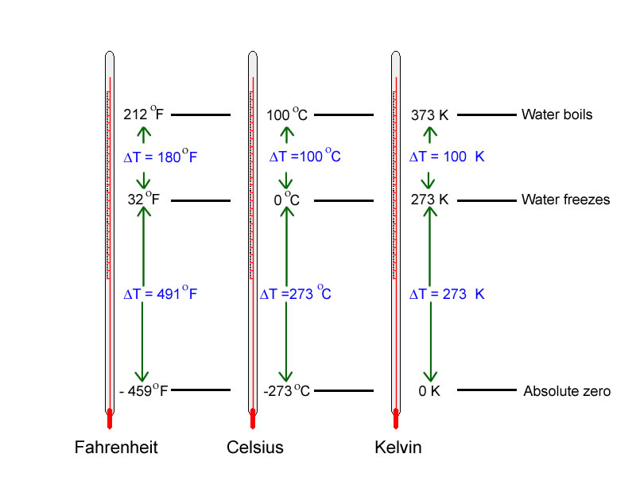
Temperature units and scales
Thermometer Calibrations
There are three reference points; Extra care must be taken, in order to get a good ice point and boiling point values…
 | Ice | Triple Point | Steam
Kelvin | 273.15 | 273.16 | 373.15
Celsius | 0.00 | 0.01 | 100.00
Notes:
For a linear
Where x is some quantity that varies with temperature
Two calibration points will give you two equations for the two unknowns a and b as
That can be solved to give the calibration coefficients.

Slide 7
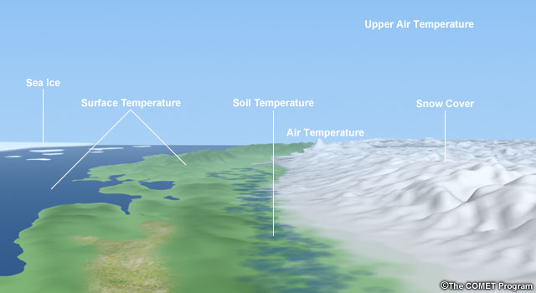
The meteorological requirements for temperature measurements primarily relate to the following:
The air near Earth’s surface
The surface of the ground
The soil at various depths
The surface of the sea and lakes
The upper air

Slide 8
Why Measure Temperature?
Temperature is a very important property of the atmosphere. For example, temperature determines the maximum water vapor pressure that can be present in an air parcel, the value corresponding to 100% relative humidity, except in rare cases when air is supersaturated.
Temperature also determines the phase of the water in the atmosphere (liquid vs. ice), which in turn determines precipitation type and the habit of the ice crystal for a given cloud super-saturation.
Knowing the temperatures at all levels of the atmosphere, as well as the amount of water vapor present in an air parcel, is vital for understanding atmospheric processes. As air rises and cools, the latent heat release that accompanies condensation provides energy for thunderstorms, hurricanes, and many other weather events.

Slide 9
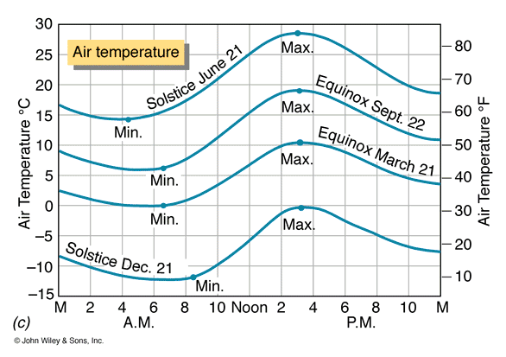
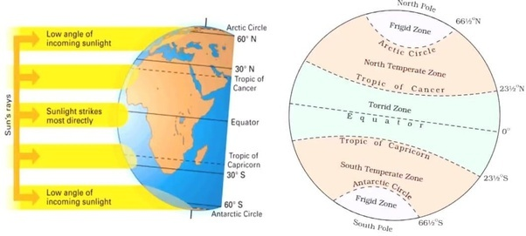
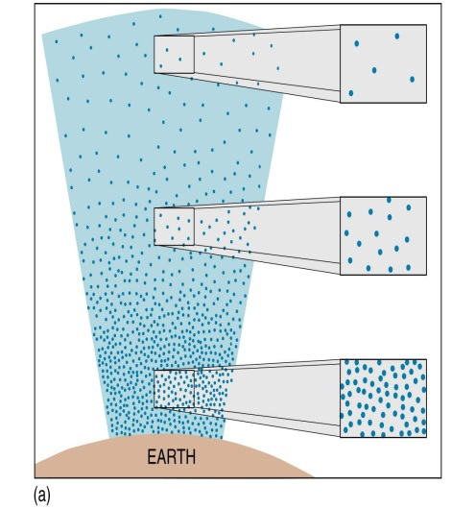
What determines the temperature of a place?
Insolation (daily and annual cycles)
Latitude
Urban/Rural Surface
Coastal vs. Interior location
Elevation

Slide 10
MEASUREMENT OF TEMPERATURE
A thermometer is an instrument that measures the temperature of a system in a quantitative way. The easiest way to do this is to find a substance having a property that change in a regular way with its temperature. The most direct 'regular' way is a linear one:
t(x) = ax + b,
where t is the temperature of the substance and changes as the property x of the substance changes. The constants a and b depend on the substance used and may be evaluated by specifying two temperature points on the scale, such as 32° for the freezing point of water and 212° for its boiling point.

Slide 11
Types of Thermometers
Primary thermometers: the measured property of matter is known so well that temperature can be calculated without any unknown quantities. Examples of these are thermometers based on the equation of state of a gas, on the velocity of sound in the atmosphere, and other mechanisms. Primary thermometers are relatively complex.
Secondary thermometers are most widely used because of their convenience. Also, they are often much more sensitive than primary ones. For secondary thermometers knowledge of the measured property is not sufficient to allow direct calculation of temperature. They have to be calibrated against a primary thermometer at least at one temperature or at a number of fixed temperatures. Such fixed points, for example, triple points and boiling point.

Slide 12
Temperature Sensors
A variety of sensors can be used to measure temperature. The chosen instrument depends on factors such as:
measurement uncertainty and resolution,
the type of environment being measured,
cost,
design,
height, and
need for protective housing.

Slide 13
Liquid-in-Glass Thermometer
The most familiar instrument for measuring temperature, most commonly used for surface-based measurements. These thermometers are based on the principle that substances expand when temperatures increase and contract when temperatures decrease.
This expansion and contraction is true for almost all substances; solid, liquid, or gas. Liquid water is an exception in that between 0°C and 4°C it contracts with increasing temperature and expands with decreasing temperature.
Liquid has the advantage of being visible (compared with gases) and it expands and contracts much more than a solid substance over a relatively small temperature range.
The calibration needed depends on the liquid, size of the capillary bore and reservoir, and the type of glass. Most liquid-in-glass thermometers use alcohol or mercury, but these liquids have various benefits and drawbacks, as summarized in the table.

Slide 14
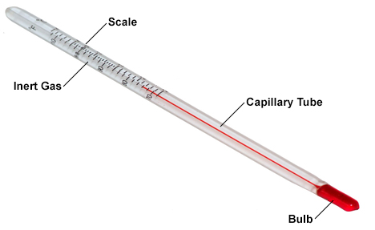
A typical liquid-in-glass thermometer
has four main parts
The bulb holds the highest volume of liquid and, therefore, has the most response to a change in temperature. the liquid also fills part of the capillary tube or stem
The stem is made from glass that does not expand or contract significantly with temperature in the range of operation.
In the part of the capillary not filled with liquid is an inert gas such as nitrogen, which prevents separation of the liquid column.
The scale on the thermometer allows the expansion and contraction of the liquid to be converted into a temperature measurement. It is based on the volume and thermal expansion coefficient of the liquid. The scale also indicates the highest and lowest temperatures that can be measured with the thermometer (referred to as the range, usually from about -90°C to 60°C) .

Slide 15
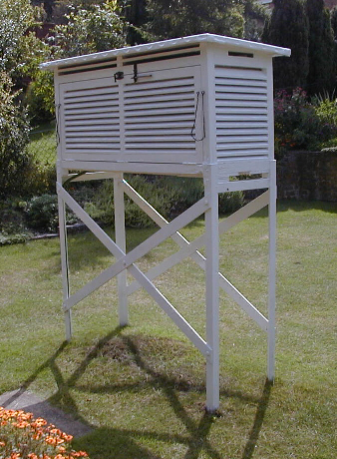

Slide 16
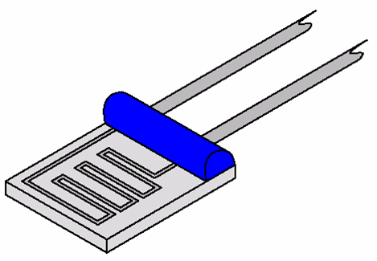
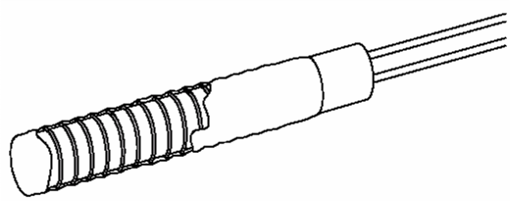
Resistance Thermometer
Electrical resistance of some materials changes with changing Temperature have known resistance-temperature (R-T) relationships. Resistance thermal sensor can be made with small wires such as platinum wire to give fast response
film
Wire-wound

Slide 17
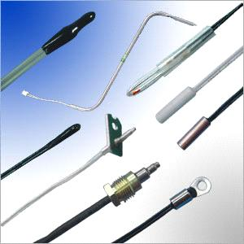
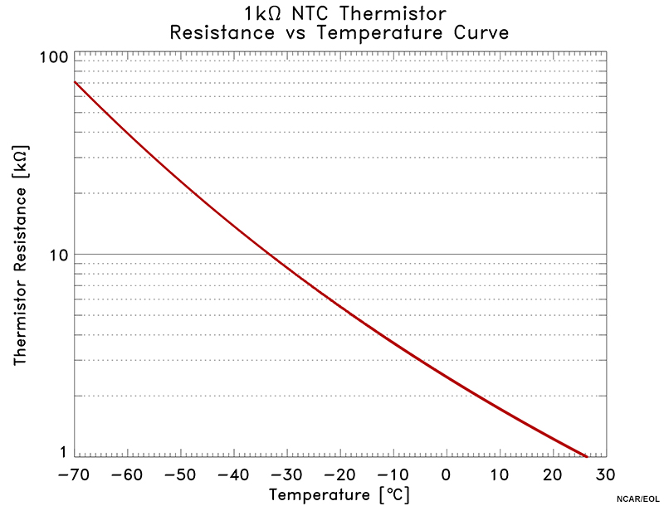
Thermistors
A thermistor is a type of resistor whose resistance varies with temperature. Thermistors differ from resistance temperature sensors in that the material used in a thermistor is generally semi-conductor, such as ceramic or polymer, while the latter uses pure metals. The temperature response is also different; the resistance temperature sensors are used for larger temperature ranges, while thermistors typically achieve a higher precision within a limited temperature range

Slide 18
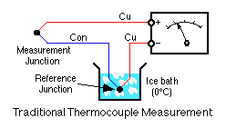
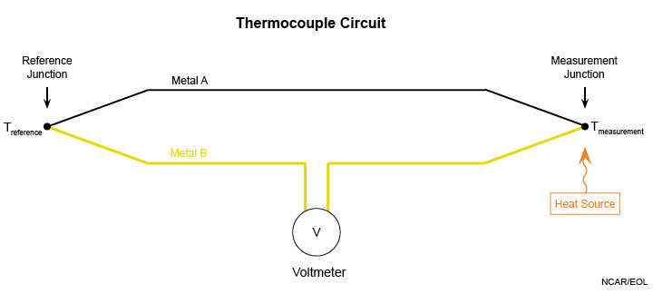
A thermocouple consists of two wires of dissimilar metals connected together (usually by welding) to create two junctions. At each junction, there will be a voltage difference across the junction (arising from the thermoelectric effect, also called the Peltier-Seebeck effect) that depends on the temperature at that junction. When the wires are connected as shown in the diagram below, the voltmeter reading will depend on the difference in temperature at the two junctions and so can be used to measure that difference. The temperature sensitivity of a thermocouple depends on the metals used. A common combination is copper and constantan, which has a sensitivity of 43 µV/°C.

Slide 19
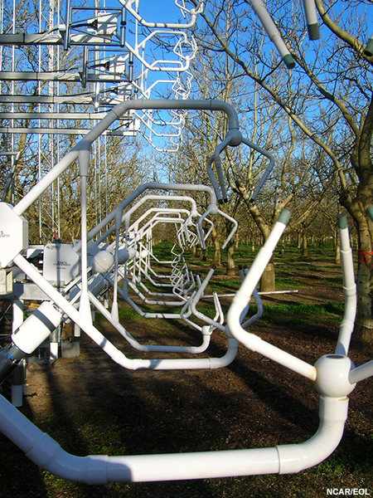
Sonic thermometers operate on the principle that the speed of sound in air is dependent on the virtual temperature. In still air, the speed of sound can be measured by sending an acoustic pulse from one transducer and timing how long it takes to be received by a second transducer.
When wind is present, the measured time delay in the sonic thermometer is affected by the wind component along the path as well as the speed of sound. Thus, it is necessary to send sound in both directions and use the speed of sound estimated from the average of those two measurements. The virtual temperature depends on the amount of water vapor in the air, so to convert to a measurement of temperature the moisture content must also be measured.

Slide 20
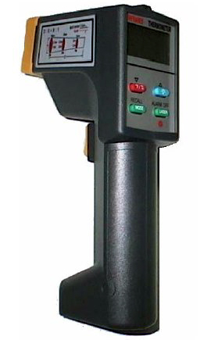
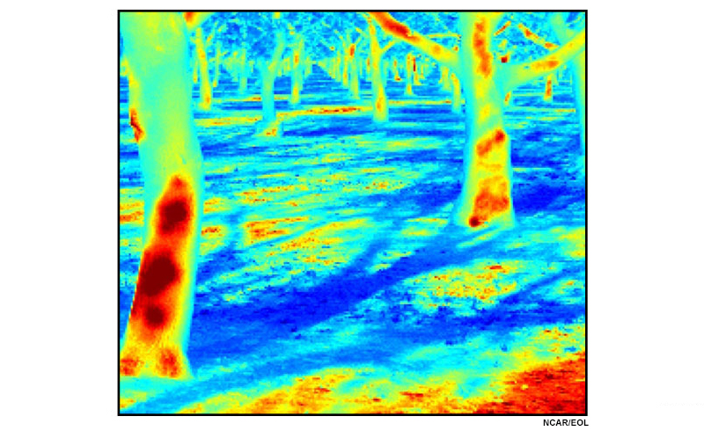
Radiation thermometers
Based on the principle that the radiation emitted from an object depends on its temperature. By knowing the amount of infrared energy emitted by the object and its emissivity, the object's temperature can be determined. They are, sometimes, called laser thermometers if a laser is used to help aim the thermometer to enhance the device’s ability to measure temperature from a distance.
Radiometric temperature measurements can also be made from instrumentation aboard research aircraft.

Slide 21
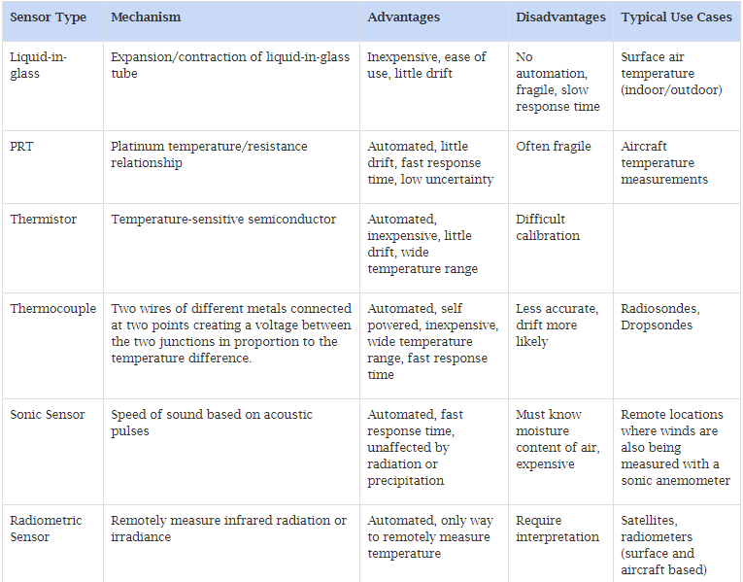
Advantages and Disadvantages of Sensor Types

Slide 22
Thermometer Response Time
The time a system or sensor takes to react to a given input
Factors that control the time constant
The constant τ will be proportional to the heat capacity and inversely proportional to heat transfer rate.
proportional to the heat capacity
In air, the rate of energy loss from the sensor due to convective processes will be proportional to the area of the sensor A and the convective heat flux H_{conv} that depends on the ventilation of the sensor and sensor geometry.
in a liquid or solid, the relevant energy transfer will be associated with conductive properties of the medium. The total heat transfer from the sensor can then be written as AH_{conv}.
inversely proportional to heat transfer rate.
This expression shows that the smaller the sensor the higher the convective heat transfer rate, then the smaller the time constant.

Slide 23
Sensor exposure
Exposure standards are necessary to define what is meant by adequate exposure for certain applications. For example,
What is meant by surface temperature on synoptic scales?
Is it acceptable to mount the temperature sensor besides a building?
How about on the roof of a building?
For synoptic observations, we want the measurement to be representative of a large area. At what height above the ground should measurements be made?
Siting Surface Sensors
Radiation can cause measurement errors by heating the sensor. Temperatures are much higher in direct sunlight than in the shade or in a shelter. Another source of error is wetting. When a sensor gets wet evaporation can cool the sensor and a wet sensor is slower to respond to changing ambient temperatures. Steps must be taken to shield the thermometer from direct sunlight and precipitation, while also allowing air to flow around the sensor.

Slide 24
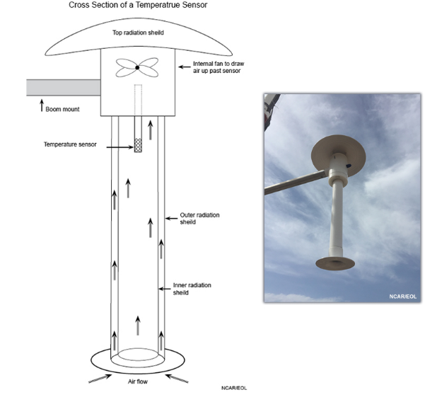
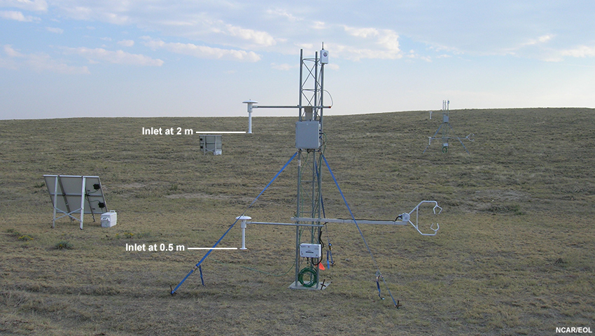
This is an instrument called the TR/H for Temperature, and Relative Humidity. It uses a fan to draw ambient air up and over the sensor. The radiation shield prevents direct and diffuse solar radiation from heating the sensor and introducing error in the temperature measurement. TR/H sensors are hung at discrete points on a tower to make measurements at specific heights above the ground. Images from NCAR/EOL.

