Slide 1
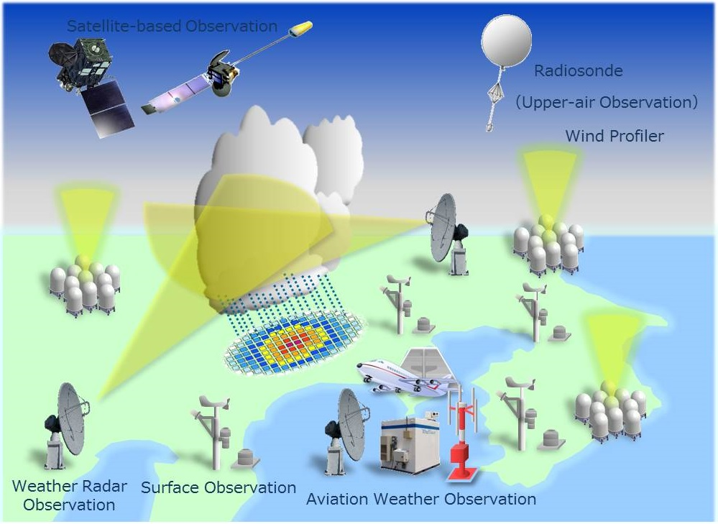
AL-MUSTANSIRIYAH UNIVERSITY COLLEGE OF SCIENCES ATMOSPHERIC SCIENCES DEPARTMENT /SECOND CLASS
The Course of
Meteorological Instrumentation and Observations
Dr. Sama Khalid Mohammed

Slide 2
Welcome Students! ☺
LECTURE TWO

Slide 3
World Weather Watch Programme
To predict the weather, modern meteorology depends upon near instantaneous exchange of weather information across the entire globe. Thus , the World Weather Watch Programme - the core of the WMO Programmes - comprises the design, implementation, operation and further development of the three interconnected, and increasingly integrated, core components to make available meteorological and related environmental information needed to provide efficient services in all countries.

Slide 4
Global Observing System (GOS)
Global Telecommunication System (GTS)
Global Data-processing and Forecasting System (GDPFS)
Consisting of facilities and arrangements for making meteorological observations (including climatological observations) and other related environmental observations at stations on land and at sea, and from aircraft, meteorological environmental satellites and other platforms.
Consisting of integrated networks of telecommunications facilities and services for the rapid, reliable collection and distribution of observational data and processed information.
Consisting of World, Regional Specialized, and National Meteorological Centres that provide quality-assured, processed data, analyses, and forecast products on a wide range of temporal and spatial scales.

Slide 5
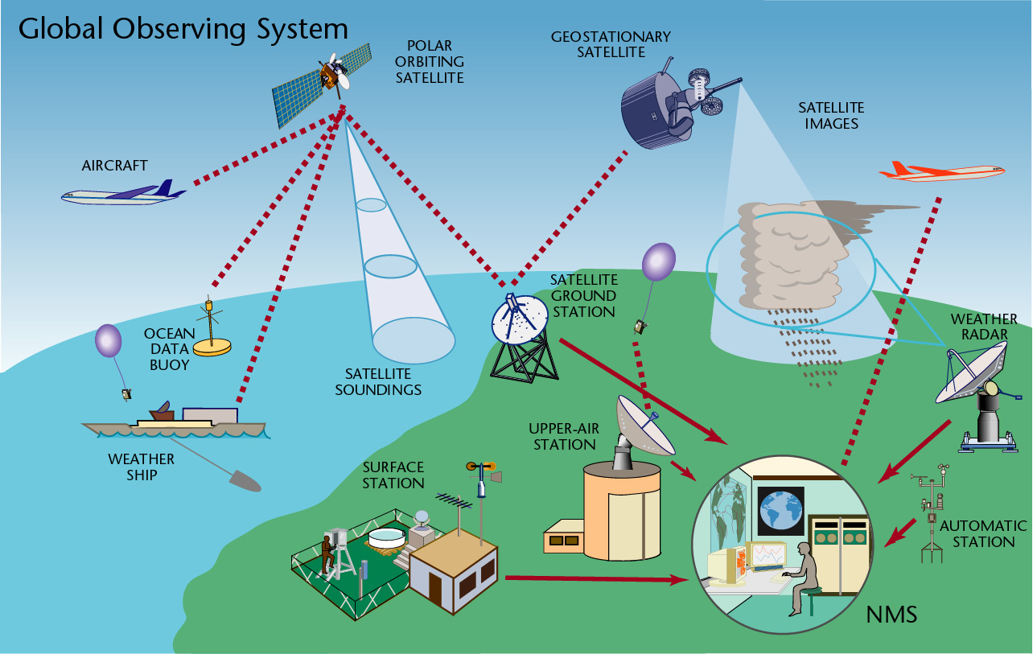
Global Observing System (GOS) and its components
The WMO (GOS) comprised of operationally reliable surface- and space-based subsystems.
Its components are :
Surface observations
Upper-air observations
Marine observations
Aircraft-based observations
Satellite observations
Weather Radar observations
Other observation platforms
For more information, visit this website http://www.wmo.int/pages/prog/www/OSY/Gos-components.html

Slide 6
OBSERVING PARAMETERS
PARAMETER | SENSOR | UNIT | MEASURING RANGE
Wind speed | Anemometer | m/sec, knot | 0..75 m/sec
Wind direction | Wind vane | Degree | 0..360 º
Air temperature | Thermometer | º C | -60 º C..+60 º C
Wet bulb temp.(*) | Thermometer | º C | 0...+40 º C
Dew point (*) | Thermometer | º C | -60 º C...+50 º C
Rel. Humidity (*) | Hygrometer | % | 0%...100%
Soil Terre. Temp. | Thermometer | º C | -60 º C...+70 º C
Soil temp. | Thermometer | º C | -50 º C...+70 º C
Soil moisture | Moisture sensor | % H₂O | Undefined

Slide 7
OBSERVING PARAMETERS
PARAMETER | SENSOR | UNIT | MEASURING RANGE
Pressure | Barometer | hPa | 600....1100 hPa
Precipitation | Pluviometer | mm | Unlimited
Snow depth | Depth sensor | cm | 0..1000 cm
Evaporation | Evap. Pool | mm | 0...100 mm/day
Global radiation | Pyranometer | Watt/m² | 0...1500 W/m²
Direct radiation | Pyrheliometer | Watt/m² | 0...1500 W/m²
Diffuse radiation | Pyranometer | Watt/m² | 0...1500 W/m²
Net radiation | Pyranometer | Watt/m² | Undefined
Sunshine duration | Heliometer | Hour | 120 W/m² (threshold)

Slide 8
OBSERVING PARAMETERS
PARAMETER | SENSOR | UNIT | MEASURING RANGE
Leaf wetness | Wetness sensor | Kg/m², capacity% | Undefined
Soil heat flux | Flux sensor | Watt/m² | Undefined
Lightning | Lightning Detector | Count | 0....9999
Cloud height | Ceilometer | M, feet | 30...25.000 m
Visibility | Transmissometer Forward scatt. | M, km | 25....50.000 m
Present weather | Pre. Weat. Sen. | Phenomena code | ----

Slide 9
OBSERVING SYSTEMS
There are two main types of the observations:
Surface observations
Conventional (un-automated) observing systems.
Modern (automated) observing systems.
Upper air observations
CONVENTIONAL OBSERVING SYSTEMS
It consist of observer and some instruments for some essential parameters. Those systems can be described in general as follows:
Observation of certain parameters such as wind, temperature, relative humidity, air pressure, precipitation, clouds and visibility
Conventional instruments with dependency on observer for reading with subjectivity in observations
Limited observation frequency due to the number of the observers at the station and limited observation parameters.
Mechanical instruments recording on charts

Slide 10
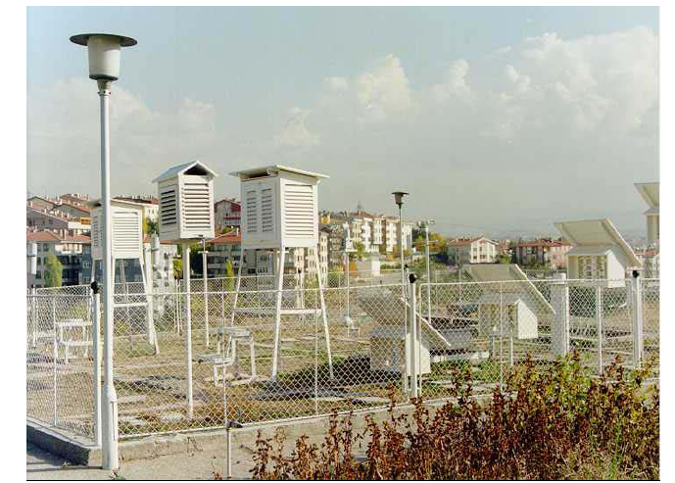
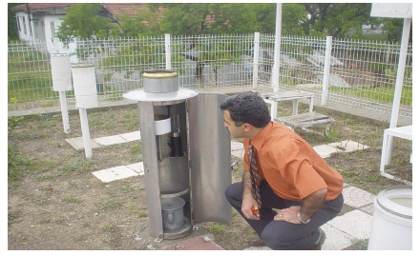
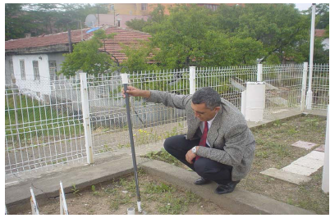
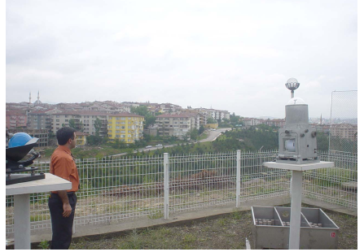

Slide 11
MODERN OBSERVING SYSTEMS AWOS
Automated Weather Observing Systems (AWOS) is defined as any system which creates and archives a digital (computer-readable) record of one or more weather ‘elements’, such as air temperature, precipitation, sunshine, wind speed or other parameters.
It can only observe the atmosphere continuously by recording all significant changes and phenomena, and it is able to collect and maintain a greater volume of continuous data, report or log data at much higher resolution rates.
AWOSs can take samples and report messages every second indefinitely if required, as compared with manual observations, which are restricted to a set observation program, which may not include observations at weekends or overnight.
In its simplest form, an AWS can be a single sensor integrated with a small, inexpensive electronic data recorder (a ‘data logger’ or simply ‘logger’). Loggers that can record only one input signal, or ‘channel’, are therefore ‘single-channel loggers’; those that can handle two or more are ‘multi-channel’.

Slide 12
Most such systems can be left exposed as a whole unit including the logger, perhaps for several months in a remote location, before the recorded data are retrieved. The most advanced AWSs are completely automated remote multi-element single-site observing systems, requiring only the minimum of human attention and maintenance, self-powered by a solar cell array or wind turbine and communicating observations at regular intervals over a telecommunications system to a collecting centre. Telecommunications may be direct to satellite in the most remote areas.
Most of the world’s meteorological services are moving towards such devices as replacements for costly human observers. But even with today’s most sophisticated technology and sensors, human observers are still required for many weather observing tasks; for example, AWSs are still very poor at telling the difference between rain and wet snow, nor can they report shallow fog just starting to form across the low lying parts of an airfield or see distant lightning flashes on the horizon which warn of an approaching thunderstorm. Human weather observers will continue to be required for a long while to come!

Slide 13
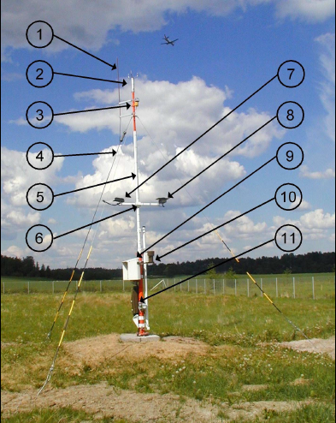
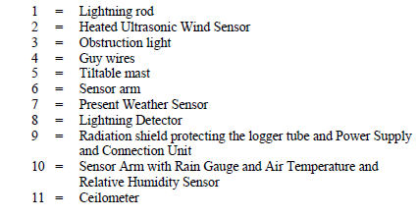

Slide 14
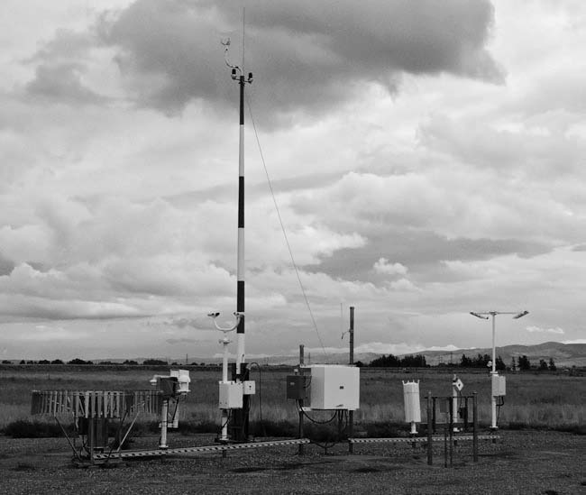
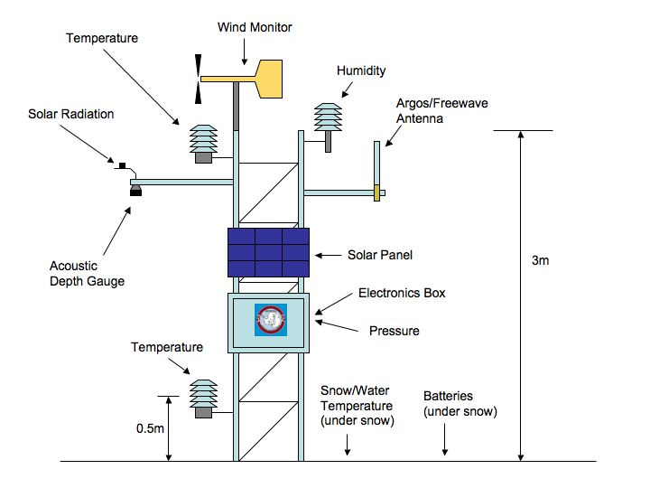
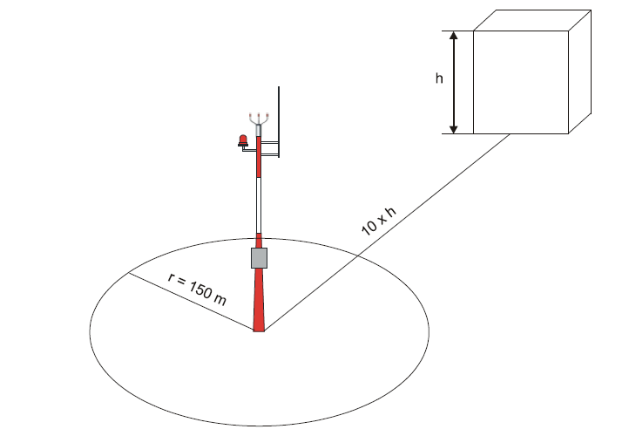
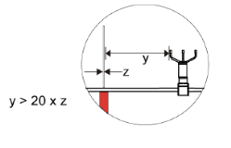
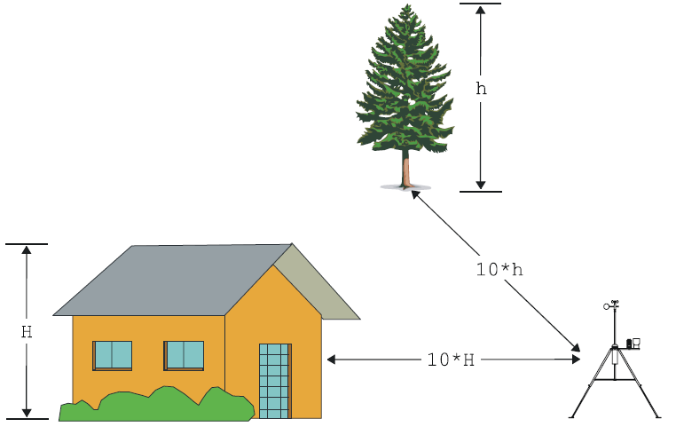

Slide 15
MODERN OBSERVING SYSTEMS
sensors and sensor interfaces: sense the certain changes in the meteorological parameters; measuring range, resolution, uncertainty, response time can be defined in accordance with the requirements.
data collection unit: collect the data from the sensor outputs in the form of the engineering units e.g. Ohm, ampere, and converts them to the meteorological units e.g. Degree, Celsius, m/sec.
central control and processing unit: receives data from data collection unit, generates meteorological reports & messages, transmit to the local or remote terminals, archives all data and log files
display unit: displays the meteorological data and reports where it is required
communication interfaces: performs the communication between data collection unit, central processing unit and remote and local terminals
power supplies: supply the power for the system

Slide 16
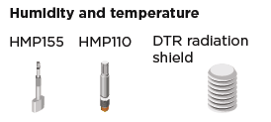
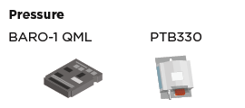
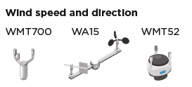
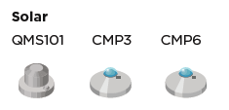
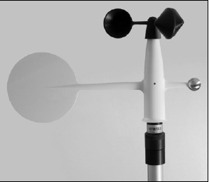
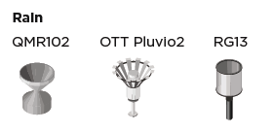

Slide 17
Types of Automated Weather Observing Systems (AWOS)
Real-time AWS: A station providing data to users of meteorological observations in real time, typically at programmed times, but also in emergency conditions or upon external request. Typical real-time use of an AWS is the provision of synoptic data and the monitoring of critical warning states such as storms and river or tide levels.
Off-line AWS: A station recording data on site on internal or external data storage devices possibly combined with a display of actual data. The intervention of an observer is required to send stored data to the remote data user. Typical stations are climatological and simple aid-to-the-observer stations.
Both types of stations can optionally be set up with means both for manual entry and for the editing of visual or subjective observations that cannot yet be made fully automatically. This includes present and past weather or observations that involve high costs, such as cloud height and visibility. Such a station could be described as partially or semi-automated.

Slide 18
Although the main components are almost same, AWOS can be classified as follows by considering the purpose of their use:
AWOS for Synoptic Meteorology: observes and calculates the parameters and generates the reports for weather forecast analysis
AWOS for Climatological Meteorology: observes and calculates the parameters and generates the reports for climate and research studies
AWOS for Agricultural Meteorology (Agrometeorology): observes and calculates the parameters including soil and plants to support agricultural activities
AWOS for Aviation Meteorology: observes and calculates the parameters required for supporting flight security and aviation
AWOS for Marine Meteorology: observes and calculates the parameters required for supporting navigation and maritime
AWOS for Road Meteorology: observes and calculates the parameters required for supporting road administration and security
AWOS for Hydrology: observes and calculates the parameters required for hydrology and irrigation

Slide 19
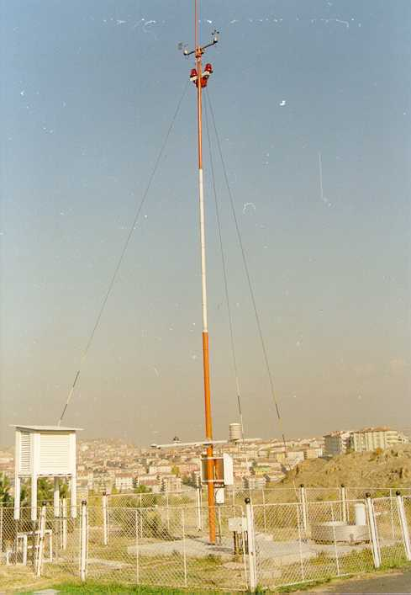
Types of Automated Weather Observing Systems (AWOS)
AWOS for Synoptic Meteorology
AWOS for Climatological Meteorology
AWOS for Agrometeorology

Slide 20
Site selection
Determination of the correct locations to install AWOSs is the first and the most important step for overall success of an AWOS network. These locations should be determined by considering WMO recommendations. During that determination study following criteria should be considered:
types of meteorological parameters to be measured
purpose of obtaining those parameters
variability of parameters according to the other places around the station
the size of the area presented by the station
suitability for meteorological observation
infrastructure and communication facilities

Slide 21
Advantages of automated weather observing systems
As it is expected, automated observations have a great advantages over manual ones. Advantages of automated systems can be summarised as follows:
Standardisation of observations (both time and quality)
Real-time continuous measuring of parameters daytime and night-time
More accurate
More reliable
Automatic data archiving
Higher resolution
Collection of data in a greater volume
Adjustable sampling interval for different parameters
Free from reading errors
Free from subjectivity
Automatic QC in both collection and reporting stages
Automatic message generation and transmission
Monitoring of meteorological data
Access of archived data locally or remotely
Data collection from harsh environments

Slide 22
Disadvantages of automated observations
Automated observations have also some disadvantages as follows:
Limited represented area of 3-5 km of sensor site
It is not possible to observe all parameters automatically, e.g. Cloud coverage and types
Ongoing periodic maintenance
Periodic test and calibration
Well trained technicians and specialists
Well trained operators
High cost of instrumentation and operation
Types of Observations
Current weather information for a location includes observations recorded by:
Humans through visual observation.
Automated systems such as sensors at airports.
A combination of human and automated data gathering.

Slide 23
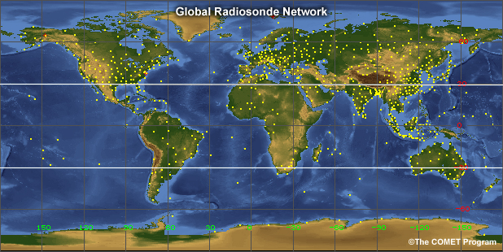
Once collected, the observations from both human and automated data sources are reported using symbols, codes, and written text. They can then be plotted on maps for a view of conditions and patterns across various spatial scales.
Many routine observations are collected using weather balloons, which rely on both a human observer and an automatic-reporting technology. Once or twice per day, observers at locations around the world release large balloons to carry lightweight sensors upward through the atmosphere. These sensors, called radiosondes, can sometimes be launched more frequently during severe weather or focused observation campaigns. The resulting radiosonde observations (RAOBs) provide vertical profiles of temperature, moisture, and winds in the atmosphere. Radiosondes are launched from over 800 locations around the world, represented by the yellow dots on the map.

Slide 24
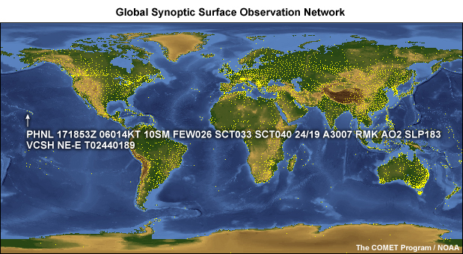
One of the most commonly reported weather observations is the METAR. METAR is not an acronym. Rather, it refers to the format for standardized weather reports used primarily by meteorologists and pilots. METARs are hourly observations taken at numerous airports or official observing stations around the globe, providing fairly good coverage over land areas. Pilots worldwide depend on METARs because these observations represent the most current conditions for an area.
If conditions change significantly before the next METAR, a special report (SPECI) will be issued. METARs and SPECIs use a particular format for presenting weather information.

Slide 25
At six hour intervals, a more comprehensive set of weather observations called a synoptic observation is reported manually by an observer or transmitted directly from an automated observing system. These synoptic observations include: Precipitation, temperature, cloud base and type, visibility, wind, barometric pressure, climate, sea conditions
Synoptic observations are reported in SYNOP, or SHIP, format. This format accommodates more information than the METAR, including additional codes to help abbreviate the information.
METARs are likely to be the most common observation format used by meteorological technicians and forecasters, but familiarity with SYNOP, SHIP, and CLIMAT formats is also useful.
A land-based meteorological station transmits a CLIMAT report typically once per month. The CLIMAT format is used to summarize the average values computed from daily observations and typically includes monthly mean temperature and pressure, mean daily maximum and minimum temperatures for the month, and monthly totals for precipitation and sunshine.

Slide 26
Universal Time
To ensure that the observations are taken and reported at the correct times, and to ensure that the radiosondes are launched simultaneously, a common time system is required. This provides a view of atmospheric conditions for broad areas of the world.
To work within a common time system, weather communities use a 24-hour clock based on the 0° longitude meridian, known as the Greenwich Meridian.
On this clock, 00:00 UTC is 12:00 a.m. local Greenwich time and the hours and minutes increment through the course of the day so that 23:59 UTC is 11:59 p.m. local Greenwich time.
Before 1972, this universal clock was referred to as Greenwich Mean Time (GMT), but is now known as Universal Time Coordinated (UTC) or Coordinated Universal Time. It is also sometimes referred to as Zulu Time or Z time.

Slide 27
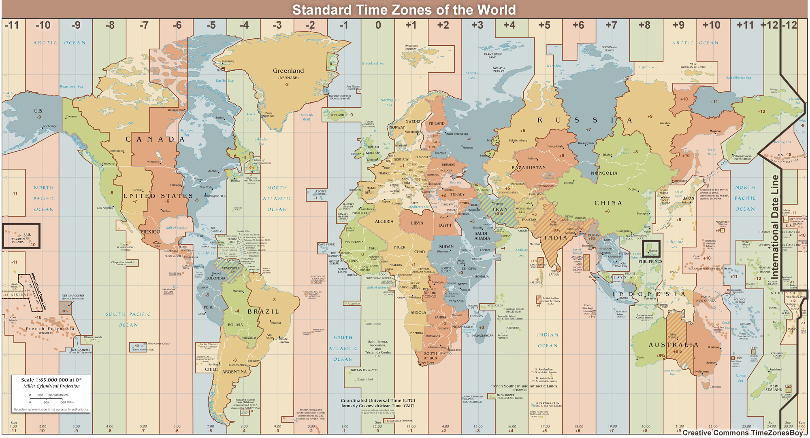

Slide 28
UTC is used to specify the set times that observations are taken and reported worldwide:
METARs: hourly, with SPECIs as conditions change
Balloon-borne radiosondes: 00:00 UTC and 12:00 UTC
Synoptic observations: 00:00 UTC, 06:00 UTC, 12:00 UTC, 18:00 UTC
Working with UTC takes some practice. You can determine your local time by adding or subtracting a set number of hours from UTC. The number of hours you add or subtract corresponds to the number of time zones you would cross if you were to travel from Greenwich, England to your local location. You will need to consider if you cross the international date line (shown in black toward the right edge of the image) or if your location has special time considerations such as daylight saving time, which might require that you add or subtract an additional hour depending on the time of year. How and when these special circumstances affect your local time will be specific to your location.
Let's look at an example.

Slide 29
If you are located in Manila in the Philippines, what local time would correspond to 09:00 UTC? The Philippines are located in the South China Sea, directly north of Indonesia. From the map, Manila is +8 hours from UTC, so eight hours ahead of UTC or Greenwich Mean Time. To find the local time, add the UTC conversion to the current time: Local time = UTC + offset PHT (Philippine Standard Time) = UTC + 8 PHT = 09:00 UTC + 8 hours (UTC conversion) = 17:00 hours The local time is 17:00, or 5:00 p.m.

