Slide 1
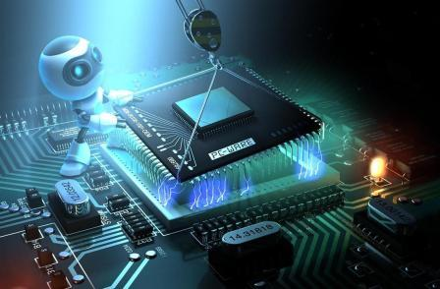
Real-Time Embedded System
By Noor Thamer

Slide 2
Contents
What is a Real Time (RT)?
What is an Embedded System (ES)?
Real Time Embedded System (RTES).
Requirements for RTES
Characteristics of Embedded Systems
Embedded system components Hardware and Software
examples of Embedded operating systems
Examples of RTES in Past, Present, and Future.

Slide 3
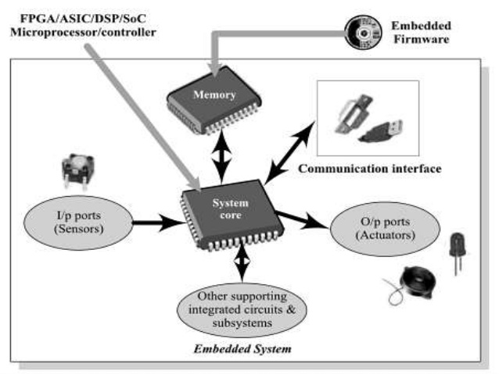
What is a Real Time (RT)?
Real-time systems can be defined as those systems that respond to external events in a timely fashion. The response time is guaranteed.
needs timely computation
deadlines, jitters, periodicity
temporal dependency

Slide 4
What is an Embedded System (ES)?
Embedded system
The software and hardware component that is an essential part of, and inside another system
Conventional Dedicated Systems
Unique solution (HW/SW/tool) for each application System + domain knowledge

Slide 5
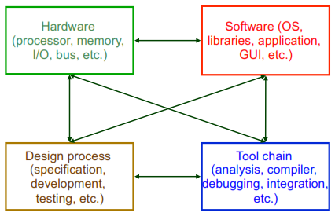
Embedded Systems

Slide 6
Embedded Systems
are everywhere
How many embedded processors in your home?
What are they?
40-50 estimated in 1999.
Hardware (chips) + Software (program)
CPU processor (ARM, PowerPC, Xscale/SA, 68K)
Memory (256MB or more)
Input/output interfaces (parallel and serial ports)

Slide 7
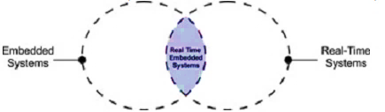
Real-time Embedded Systems (RTES)
A good way to understand the relationship between real-time systems and embedded systems is to view them as two intersecting circles.

Slide 8
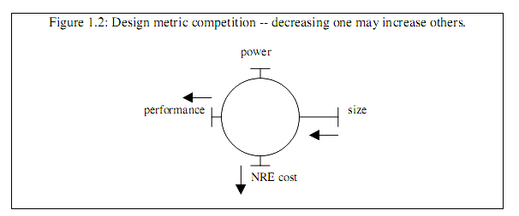
Requirements for RTES
Environmental – size, power (heat), weight, and
radiation-hardened
Performance –responsive, predictable (fast?)
Economics – low cost and time-to-market
Consequence – safety, faulty-tolerance, security
Smaller, cheaper, better, and faster

Slide 9
Characteristics of Embedded Systems
Reactive and real-time: Many embedded systems must continually react to changes in the system’s environment, and must compute certain results in real time without delay.
For example, a car have different tasks for controls such as for the following:
Driving Gears
Windows
Temperature
Door-lock/ Theft-lock-alarm
Brakes/ Accelerator
Air-Bag, Accident/ Emergency
Ignition, Fuel Tank/ Brake Oil

Slide 10
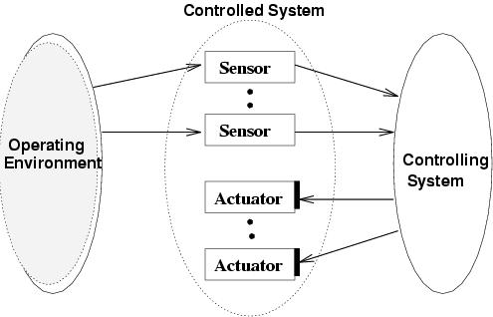
A typical real-time embedded system

Slide 11
Car example
Mission: Reaching the destination safely.
Controlled System: Car.
Operating environment: Road conditions.
Controlling System
- Human driver: Sensors - Eyes and Ears of the driver.
- Computer: Sensors - Cameras, Infrared receiver, and Laser telemeter.
Controls: Accelerator, Steering wheel, Break-pedal.
Actuators: Wheels, Engines, and Brakes.

Slide 12
Car example (contd)
Critical tasks: Steering and breaking.
Non-critical tasks: Turning on radio.
Cost of fulfilling the mission → Efficient solution.
Reliability of the driver → Fault-tolerance needs to be considered.

Slide 13
Characteristics of Embedded Systems(Con.)
Digital camera illustrates some of the embedded system characteristics described above. First, it performs a single function repeatedly. The system always acts as a digital camera Second, it is tightly constrained. The system must be low cost since consumers must be able to afford such a camera.

Slide 14
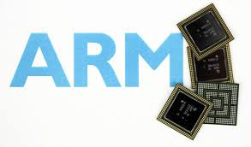
Embedded system components Hardware and Software
To meet those constraints, Hardware/software codesign is the simultaneous design of the hardware and software components of a digital system.
hardware Components
The hardware components are:
Processor (e.g ARM)
Memory
peripherals

Slide 15
software components (embedded operating system)
Except for very simple systems, scheduling, task switching, and I/O require the support of an operating system suited for embedded applications.
The following are essential features of real-time and embedded operating systems:
  Configurability is therefore one of the main characteristics of embedded OSs.Configurability in its simplest form might just remove unused functions (to some extent, this can be done by a linker).
  Dynamic data might be replaced by static data.
  Advanced compile-time evaluation and advanced compiler optimizations may also be useful in this context.
  Object-orientation could lead to a derivation of proper subclasses.
  There is a large variety of peripheral devices employed in embedded systems. Many embedded systems do not have a hard disc, a keyboard, a screen or a mouse.
  Protection mechanisms are not always necessary, since embedded systems are typically designed for a single purpose and untested programs are hardly ever loaded.

Slide 16
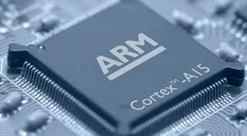


examples of Embedded operating systems
The ARM architecture is supported by a large number of embedded and real-time operating systems, including Android, Linux, Microsoft Windows System, Symbian. The following are some of the embedded OSs:
Android: is a Linux-based operating system for mobile devices such as smartphones and tablet computers. It is developed by the Open Handset Alliance, led by Google, and other companies.
Linux: Almost everyone in the computer business knows the history of Linux - started in 1991 by Linus Torvalds as a simple hobby project, grown-up to a full-featured UNIX-like operating system.

Slide 17
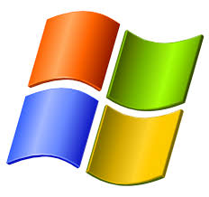
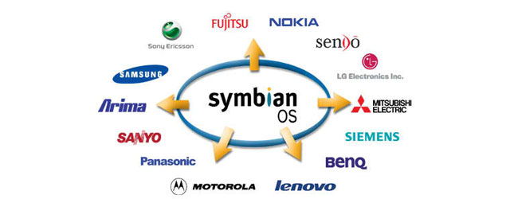
examples of Embedded operating systems (Con.)
Microsoft Windows Systems: At present, there are two operating systems for embedded systems from Microsoft – Windows CE and Windows XP Embedded.
  Windows CE (WinCE) is an operating system for minimalistic computers and embedded systems.
  Windows XP Embedded, or XPe, is a modularised variant of Microsoft Windows XP Professional.
Symbian: OS is the successor of 32-bit EPOC Platform from Psion. Symbian is currently owned by Ericsson (15.6%), Nokia (47.9%), Panasonic (10.5%), Samsung (4.5%), Siemens AG (8.4%), and Sony Ericsson (13.1%). All of the owners are (or were) manufacturers of mobile phones.

Slide 18
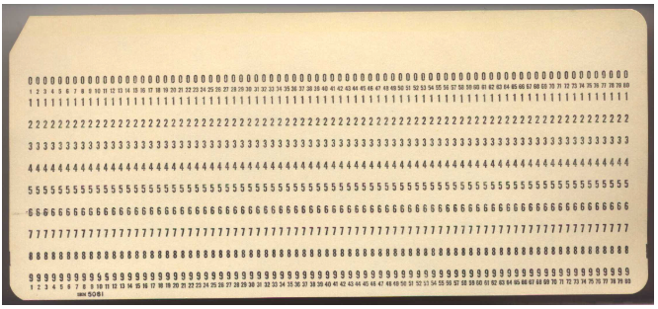
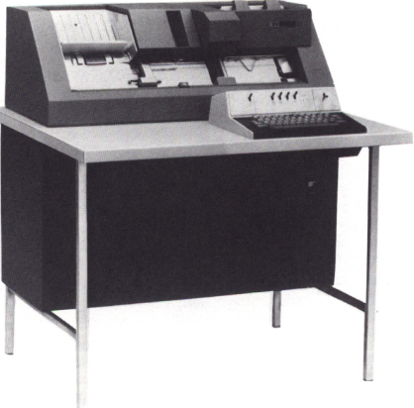
Examples In Past

Slide 19
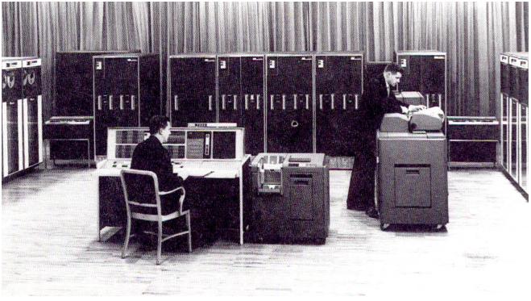
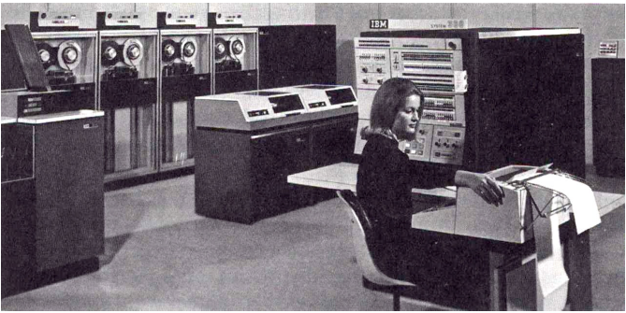
Examples In Past (Con.)

Slide 20
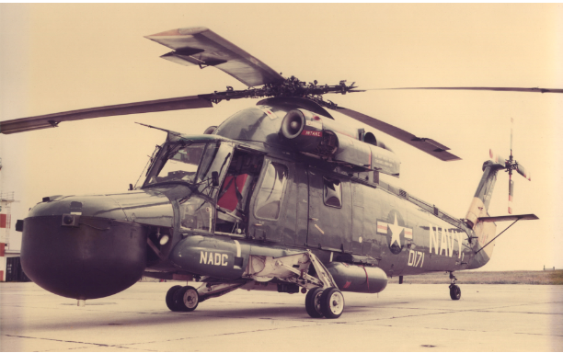
LAMPS Radar Test

Slide 21
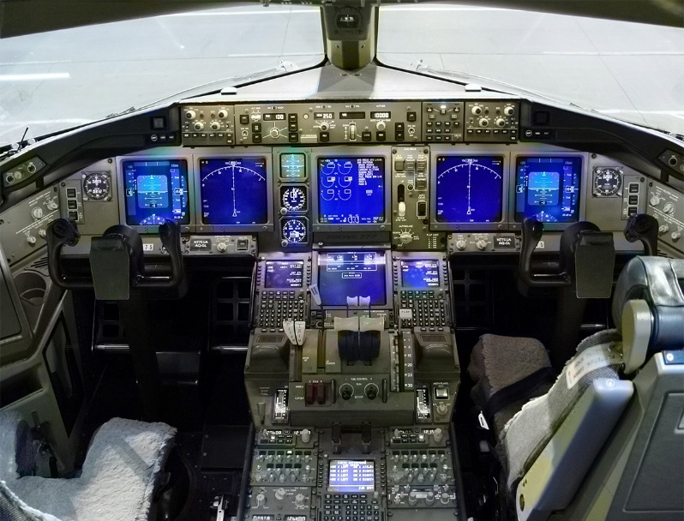
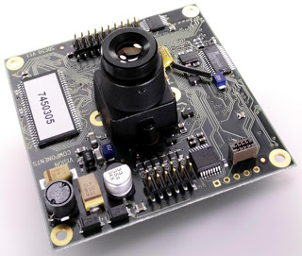
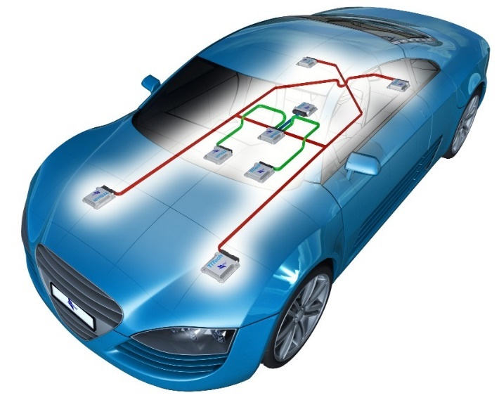
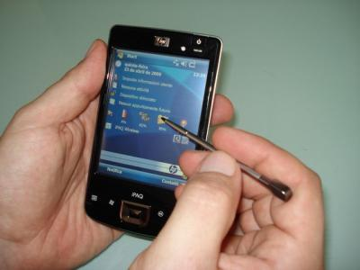
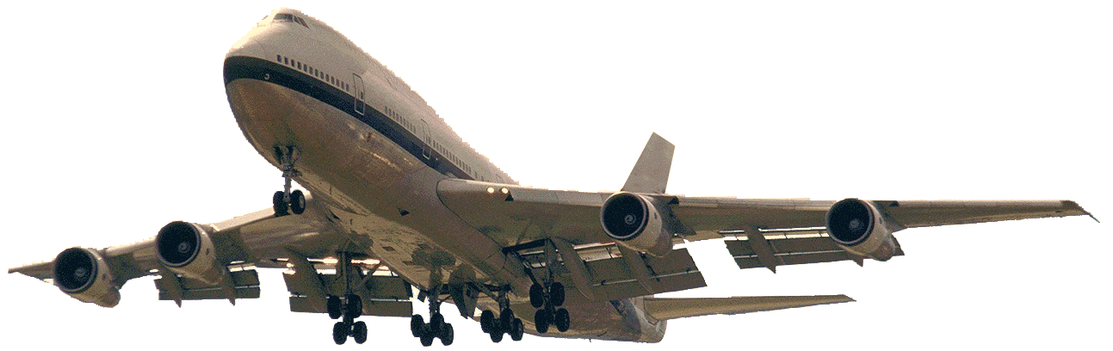
Examples in Present and Future

Slide 22
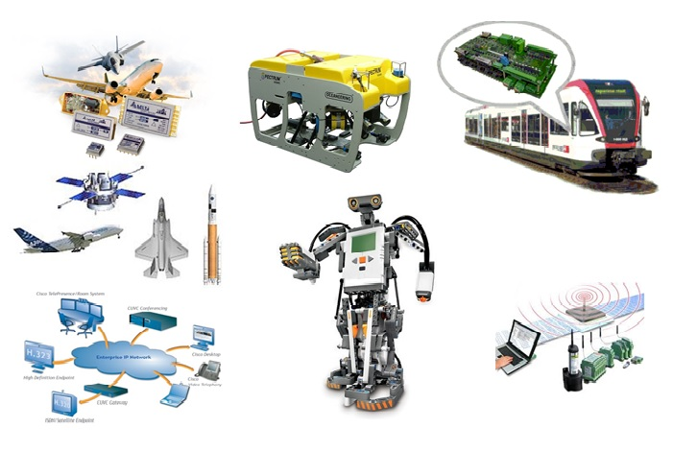
Examples in Present and Future

Slide 23
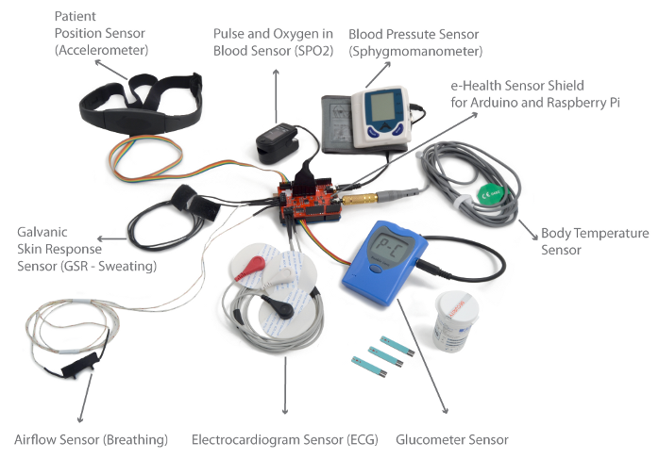
Examples in Present and Future

Slide 24
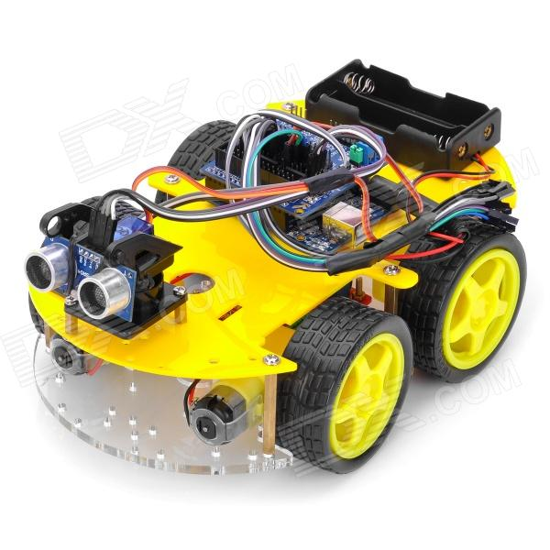
Examples in Present and Future

Slide 25
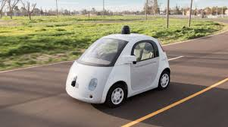
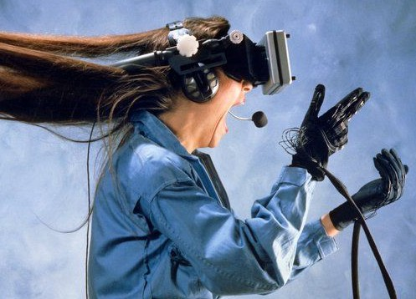
Examples in Present and Future

Slide 26


