Slide 1




Enzymes
Assistant professor
Dr. Mustafa Taha Mohammed

Slide 2
Enzymes
Enzyme Action
Factors Affecting Enzyme Action
Enzyme Inhibition

Slide 3
ENZYMES
A protein with catalytic properties due to its power of specific activation

Slide 4
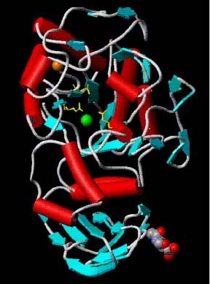
Enzyme structure
Enzymes are proteins
They have a globular shape
A complex 3-D structure
Human pancreatic amylase

Slide 5
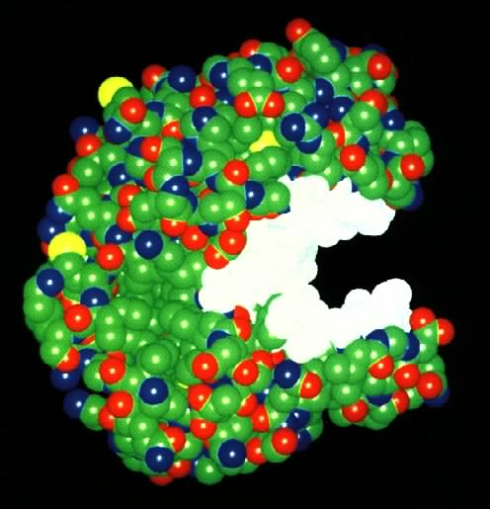
What Are Enzymes?
Most enzymes are Proteins (tertiary and quaternary structures)
Act as Catalyst to accelerates a reaction
Not permanently changed in the process

Slide 6
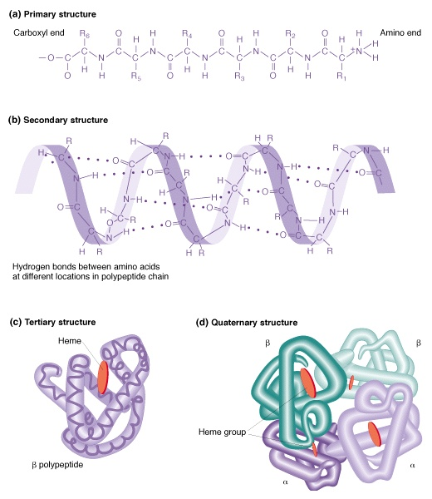
Enzymes
An enzyme is a biological catalyst
The pockets formed by tertiary and quaternary structure can hold specific substances (SUBSTRATES).
These pockets are called ACTIVE SITES.
When all the proper substrates are nestled in a particular enzyme's active sites, the enzyme can cause them to react quickly
Once the reaction is complete, the enzyme releases the finished products and goes back to work on more substrate.

Slide 7
What is an enzyme?
Almost all enzymes are proteins that act as biological catalysts.
A catalyst speeds up chemical reactions. Enzymes speed up biological chemical reactions.
Enzymes are highly specific to a type of reaction.
Enzymes must maintain their specific shape in order to function. Any alteration in the primary, secondary, tertiary, or quaternary forms of the enzyme are detrimental.

Slide 8
Function of enzymes
Enzymes have many jobs. They:
Break down nutrients into useable molecules.
Store and release energy (ATP).
Create larger molecules from smaller ones )
Coordinate biological reactions between different systems in an organism. )

Slide 9
Enzymes
Catalysts for biological reactions
Most are proteins
Lower the activation energy
Increase the rate of reaction
Activity lost if denatured
May be simple proteins
May contain cofactors such as metal ions or organic (vitamins)

Slide 10
Enzyme Catalyzed Reactions
When a substrate (S) fits properly in an active site, an enzyme-substrate (ES) complex is formed:
E + S  ES
Within the active site of the ES complex, the reaction occurs to convert substrate to product (P):
ES → E + P
The products are then released, allowing another substrate molecule to bind the enzyme
- this cycle can be repeated millions (or even more) times per minute
The overall reaction for the conversion of substrate to product can be written as follows:
E + S  ES → E + P

Slide 11
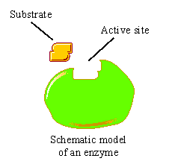
Enzymes
Are specific for what they will catalyze
Are Reusable
End in –ase
-Sucrase
-Lactase
-Maltase

Slide 12
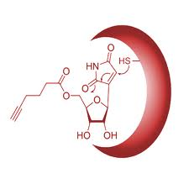
A E B

Slide 13
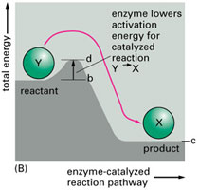
How do enzymes Work?
Enzymes work by weakening bonds which lowers activation energy

Slide 14
Enzymes
Without Enzyme
With Enzyme
Free
Energy
Free energy of activation
Reactants
Products
Progress of the reaction

Slide 15
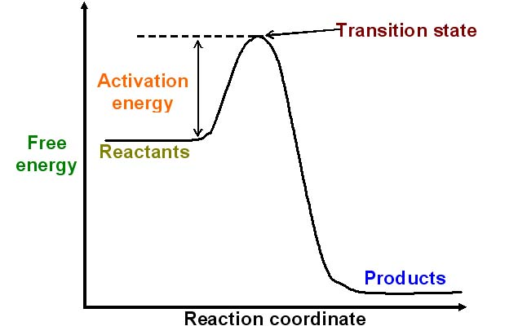
Reaction pathway

Slide 16
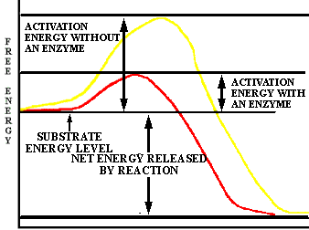
HOW ENZYMES WORK
Enzymes are ORGANIC CATALYSTS. A CATALYST is anything that speeds up a chemical reaction that is occurring slowly. How does a catalyst work?
The explanation of what happens lies in the fact that most chemical reactions that RELEASE ENERGY (exothermic reactions) require an INPUT of some energy to get them going. The initial input of energy is called the ACTIVATION ENERGY

Slide 17
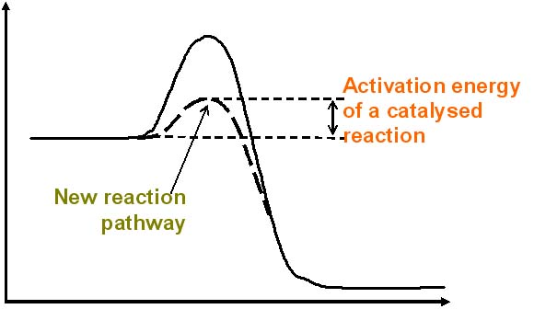
An enzyme controlled pathway
Enzyme controlled reactions proceed 108 to 1011 times faster than corresponding non-enzymic reactions.

Slide 18
The substrate
The substrate of an enzyme are the reactants that are activated by the enzyme
Enzymes are specific to their substrates
The specificity is determined by the active site

Slide 19
Active Site
A restricted region of an enzyme molecule which binds to the substrate.
Active Site
Substrate
Enzyme

Slide 20
Enzyme-Substrate Complex
The substance (reactant) an enzyme acts on is the substrate
Substrate
Joins
Enzyme

Slide 21
Making reactions go faster
Increasing the temperature make molecules move faster
Biological systems are very sensitive to temperature changes.
Enzymes can increase the rate of reactions without increasing the temperature.
They do this by lowering the activation energy.
They create a new reaction pathway “a short cut”

Slide 22
Chemical reactions
Chemical reactions need an initial input of energy = THE ACTIVATION ENERGY
During this part of the reaction the molecules are said to be in a transition state.

Slide 23
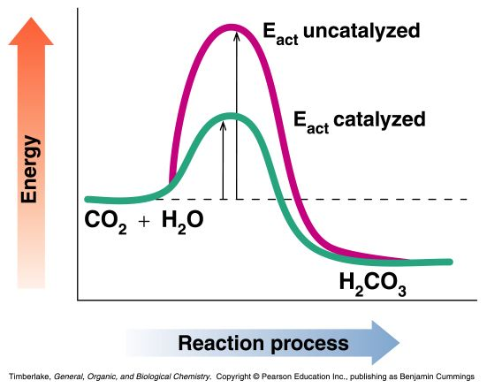
Enzymes as Biological Catalysts
Enzymes are proteins that increase the rate of reaction by lowering the energy of activation
They catalyze nearly all the chemical reactions taking place in the cells of the body
Enzymes have unique three-dimensional shapes that fit the shapes of reactants (substrates)

Slide 24
Enzyme Activity
The properties of enzymes related to their tertiary structure.The effects of change in temperature,pH,substrate concentration,and competitive and non-competitive inhibition on the rate of enzyme action

Slide 25
The substrate
The substrate of an enzyme are the reactants that are activated by the enzyme
Enzymes are specific to their substrates
The specificity is determined by the active site

Slide 26
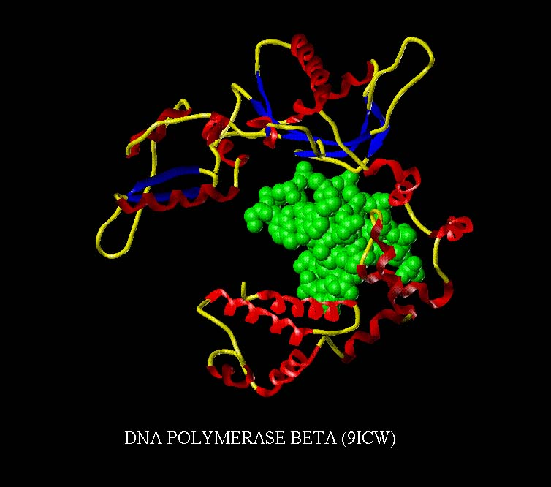
The active site
One part of an enzyme, the active site, is particularly important
The shape and the chemical environment inside the active site permits a chemical reaction to proceed more easily

Slide 27
Making reactions go faster
Increasing the temperature make molecules move faster
Biological systems are very sensitive to temperature changes.
Enzymes can increase the rate of reactions without increasing the temperature.
They do this by lowering the activation energy.
They create a new reaction pathway “a ”

Slide 28
What Affects Enzyme Activity?
Three factors:
1. Environmental Conditions
2. Cofactors and Coenzymes
3. Enzyme Inhibitors

Slide 29
Classification of Enzymes
Enzymes are classified according to the type of reaction they catalyze:
Class Reactions catalyzed
  Oxidoreductases Oxidation-reduction
  Transferases Transfer groups of atoms
  Hydrolases Hydrolysis
  Lyases Add atoms/remove atoms to/from a double bond
  Isomerases Rearrange atoms
  Ligases Use ATP to combine
  molecules

Slide 30
Examples of Classification of Enzymes
Oxidoreductoases
oxidases - oxidize ,reductases – reduce
Transferases
transaminases – transfer amino groups
kinases – transfer phosphate groups
Hydrolases
proteases - hydrolyze peptide bonds
lipases – hydrolyze lipid ester bonds
Lyases
carboxylases – add CO₂
hydrolases – add H₂O

Slide 31
Learning Check E1
Match the type of reaction with the enzymes:
(1) aminase (2) dehydrogenase
(3) Isomerase (4) synthetase
Converts a cis-fatty acid to trans.
Removes 2 H atoms to form double bond
Combine two molecules using ATP
Adds NH₃

Slide 32
Solution E1
Match the type of reaction with the enzymes:
(1) aminase (2) dehydrogenase
(3) Isomerase (4) synthetase
3 Converts a cis-fatty acid to trans.
2 Removes 2 H atoms to form double bond
4 Combine two molecules using ATP
1 Adds NH₃

Slide 33
Name of Enzymes
End in –ase
Identifies a reacting substance
sucrase – reacts sucrose
lipase - reacts lipid
Describes function of enzyme
oxidase – catalyzes oxidation
hydrolase – catalyzes hydrolysis
Common names of digestion enzymes still use –in
pepsin, trypsin

Slide 34
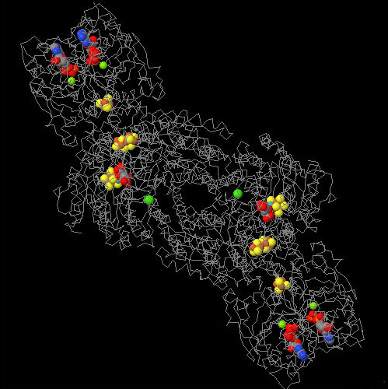
Cofactors
An additional non-protein molecule that is needed by some enzymes to help the reaction
Tightly bound cofactors are called prosthetic groups
Cofactors that are bound and released easily are called coenzymes
Many vitamins are coenzymes
Nitrogenase enzyme with Fe, Mo and ADP cofactors
)
©

Slide 35
Enzyme cofactors cont.
An enzyme that is bonded to its cofactor is called a holoenzyme.
An enzyme that requires a cofactor, but is not bonded to the cofactor is called an apoenzyme. Apoenzymes are not active until they are complexed with the appropriate cofactor.

Slide 36
Enzyme cofactors
A cofactor is a substance that is not a protein that must bind to the enzyme in order for the enzyme to work.
A cofactor can be of organic origin. An organic cofactor is called a coenzyme.
Cofactors are not permanently bonded. Permanently bonded cofactors are called prosthetic groups.

Slide 37
Enzyme action overview
Enzymes are large molecules that have a small section dedicated to a specific reaction. This section is called the active site.
The active site reacts with the desired substance, called the substrate
The substrate may need an environment different from the mostly neutral environment of the cell in order to react. Thus, the active site can be more acidic or basic, or provide opportunities for different types of bonding to occur, depending on what type of side chains are present on the amino acids of the active site.

Slide 38
Enzyme action theories
Lock and Key: This theory, postulated by Emil Fischer in 1894, proposed that an enzyme is “structurally complementary to their substrates” and thus fit together perfectly like a lock and key. This theory formed the basis of most of the ideas of how enzymes work, but is not completely correct. .,

Slide 39
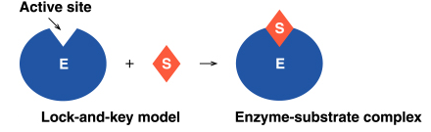
Lock-and-Key Model
In the lock-and-key model of enzyme action:
- the active site has a rigid shape
- only substrates with the matching shape can fit
- the substrate is a key that fits the lock of the active site
This is an older model, however, and does not work for all enzymes

Slide 40
Enzyme Action:
Lock and Key Model
An enzyme binds a substrate in a region called the active site
Only certain substrates can fit the active site
Amino acid R groups in the active site help substrate bind
Enzyme-substrate complex forms
Substrate reacts to form product
Product is released

Slide 41
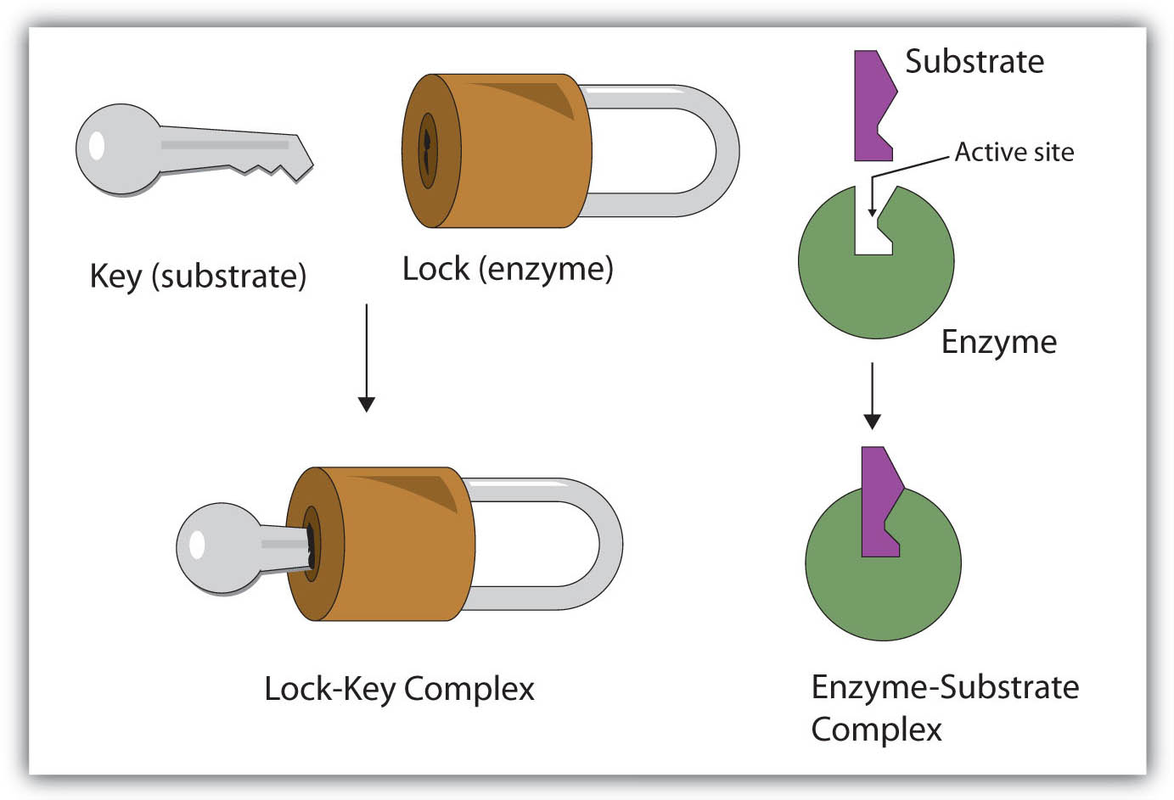

Slide 42
Lock and Key Model
    + +
E + S ES complex E + P
P
S
S
P

Slide 43
The Lock and Key Hypothesis
Fit between the substrate and the active site of the enzyme is exact
Like a key fits into a lock very precisely
The key is analogous to the enzyme and the substrate analogous to the lock.
Temporary structure called the enzyme-substrate complex formed
Products have a different shape from the substrate
Once formed, they are released from the active site
Leaving it free to become attached to another substrate

Slide 44
The Lock and Key Hypothesis
S
E
E
E
Enzyme may be used again
Enzyme-substrate complex
P
P
Reaction coordinate

Slide 45
Enzyme Action:
Induced Fit Model
Enzyme structure flexible, not rigid
Enzyme and active site adjust shape to bind substrate
Increases range of substrate specificity
Shape changes also improve catalysis during reaction

Slide 46
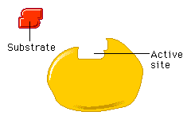
Induced Fit
A change in the shape of an enzyme’s active site
Induced by the substrate

Slide 47
Induced Fit
A change in the configuration of an enzyme’s active site (H+ and ionic bonds are involved).
Induced by the substrate.
Active Site
substrate
Enzyme
induced fit

Slide 48
Enzyme Action:
Induced Fit Model
E + S ES complex E + P
P
S
S
S
P

Slide 49
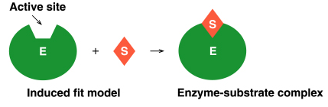
Induced Fit Model
In the induced-fit model of enzyme action:
- the active site is flexible, not rigid
- the shapes of the enzyme, active site, and substrate adjust to maximumize the fit, which improves catalysis
- there is a greater range of substrate specificity
This model is more consistent with a wider range of enzymes

Slide 50
Learning Check E2
The active site is
(1) the enzyme
(2) a section of the enzyme
(3) the substrate
B. In the induced fit model, the shape of the enzyme when substrate binds
(1) Stays the same
(2) adapts to the shape of the substrate

Slide 51
Solution E2
The active site is
(2) a section of the enzyme
B. In the induced fit model, the shape of the enzyme when substrate binds
(2) adapts to the shape of the substrate

Slide 52
2. Cofactors and Coenzymes
Inorganic substances (zinc, iron) and vitamins (respectively) are sometimes need for proper enzymatic activity.
Example:
  Iron must be present in the quaternary structure - hemoglobin in order for it to pick up oxygen.

Slide 53
Coenzyme reactions
Coenzymes help transfer a functional group to a molecule.
For example, coenzyme A (CoA) is converted to acetyl-CoA in the mitochondria using pyruvate and NAD
Acetyl-CoA can then be used to transfer an acetyl group (CH₃CO) to aid in fatty acid synthesis.

Slide 54
1. Environmental Conditions
1. Extreme Temperature are the most dangerous
- high temps may denature (unfold) the enzyme.
2. pH (most like 6 - 8 pH near neutral)
3. Ionic concentration (salt ions)

Slide 55
Factors that affect enzyme action
Enzymes are mostly affected by changes in temperature and pH.
Too high of a temperature will denature the protein components, rendering the enzyme useless.
pH ranges outside of the optimal range will protonate or deprotonate the side chains of the amino acids involved in the enzyme’s function which may make them incapable of catalyzing a reaction.

Slide 56
Factors Affecting Enzyme Action: Temperature
Little activity at low temperature
Rate increases with temperature
Most active at optimum temperatures (usually 37°C in humans)
Activity lost with denaturation at high temperatures

Slide 57
The effect of temperature
For most enzymes the optimum temperature is about 30°C
Many are a lot lower,
cold water fish will die at 30°C because their enzymes denature
A few bacteria have enzymes that can withstand very high temperatures up to 100°C
Most enzymes however are fully denatured at 70°C

Slide 58
Factors Affecting Enzyme Action
Optimum temperature
Reaction
Rate
Low High
Temperature

Slide 59
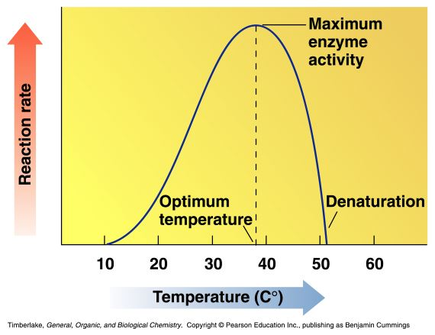
Temperature and Enzyme Activity
Enzymes are most active at an optimum temperature (usually 37°C in humans)
They show little activity at low temperatures
Activity is lost at high temperatures as denaturation occurs

Slide 60
Factors Affecting Enzyme Action: Substrate Concentration
Increasing substrate concentration increases the rate of reaction (enzyme concentration is constant)
Maximum activity reached when all of enzyme combines with substrate

Slide 61
Substrate concentration: Non-enzymic reactions
Reaction velocity
Substrate concentration
The increase in velocity is proportional to the substrate concentration

Slide 62
Substrate concentration: Enzymic reactions
V_{max}
Reaction velocity
Substrate concentration
Faster reaction but it reaches a saturation point when all the enzyme molecules are occupied.
If you alter the concentration of the enzyme then V_{max} will change too.

Slide 63
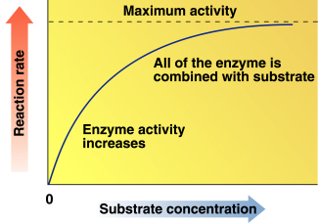
Substrate Concentration and Reaction Rate
The rate of reaction increases as substrate concentration increases (at constant enzyme concentration)
Maximum activity occurs when the enzyme is saturated (when all enzymes are binding substrate)
The relationship between reaction rate and substrate concentration is exponential, and asymptotes (levels off) when the enzyme is saturated

Slide 64
Factors Affecting Enzyme Action
Maximum activity
Reaction
Rate
substrate concentration

Slide 65
Factors Affecting Enzyme Action: pH
Maximum activity at optimum pH
R groups of amino acids have proper charge
Tertiary structure of enzyme is correct
Narrow range of activity
Most lose activity in low or high pH

Slide 66
Factors Affecting Enzyme Action
Reaction
Rate
Optimum pH
3 5 7 9 11
pH

Slide 67
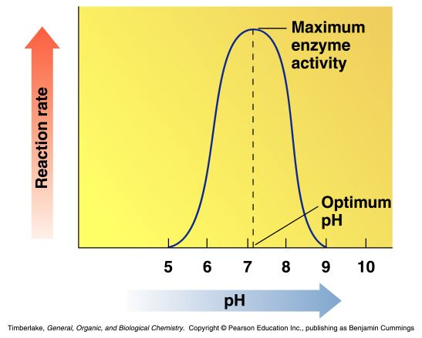
pH and Enzyme Activity
Enzymes are most active at optimum pH
Amino acids with acidic or basic side-chains have the proper charges when the pH is optimum
Activity is lost at low or high pH as tertiary structure is disrupted

Slide 68
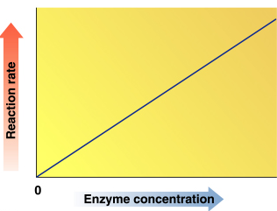
Enzyme Concentration and Reaction Rate
The rate of reaction increases as enzyme concentration increases (at constant substrate concentration)
At higher enzyme concentrations, more enzymes are available to catalyze the reaction (more reactions at once)
There is a linear relationship between reaction rate and enzyme concentration (at constant substrate concentration)

Slide 69
Factors that affect enzyme action
Enzymes that can be activated will be affected by the amount of activator or inhibitor attached to its allosteric site. An abundance of an allosteric activator will convert more enzymes to the active form creating more product.
Enzymes that are part of a metabolic pathway may be inhibited by the very product they create. This is called feedback inhibition. The amount of product generated will dictate the number of enzymes used or activated in that specific process.

Slide 70
Factors that affect enzyme action
Enzymes are also affected by the concentration of substrate, cofactors and inhibitors, as well as allosteric regulation and feedback inhibition. (Campbell & Reece, 2002, pp. 99-102)
The concentration of substrate will dictate how many enzymes can react. Too much substrate will slow the process until more enzyme can be made.
The availability of cofactors also dictate enzyme action. Too little cofactors will slow enzyme action until more cofactors are added.
An influx of competitive or non-competitive inhibitors will not necessarily slow the enzyme process, but will slow the amount of desired product.

Slide 71
Learning Check E3
Sucrase has an optimum temperature of 37°C and an optimum pH of 6.2. Determine the effect of the following on its rate of reaction
(1) no change (2) increase (3) decrease
A. Increasing the concentration of sucrose
B. Changing the pH to 4
C. Running the reaction at 70°C

Slide 72
Solution E3
Sucrase has an optimum temperature of 37°C and an optimum pH of 6.2. Determine the effect of the following on its rate of reaction
(1) no change (2) increase (3) decrease
A. 2, 1 Increasing the concentration of sucrose
B. 3 Changing the pH to 4
C. 3 Running the reaction at 70°C

Slide 73
Enzyme Inhibition
Inhibitors
cause a loss of catalytic activity
Change the protein structure of an enzyme
May be competitive or noncompetitive
Some effects are irreversible

Slide 74
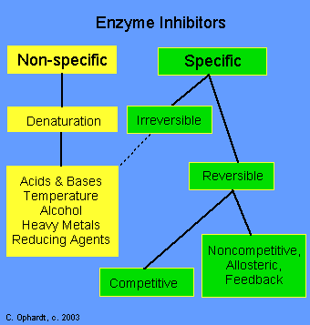

Slide 75
Two examples of Enzyme Inhibitors
a. Competitive inhibitors: are chemicals that resemble an enzyme’s normal substrate and compete with it for the active site.
Substrate
Enzyme
Competitive inhibitor

Slide 76
Inhibitors
b. Noncompetitive inhibitors:
Inhibitors that do not enter the active site, but bind to another part of the enzyme causing the enzyme to change its shape, which in turn alters the active site.
Substrate
Noncompetitive
Inhibitor
Enzyme
active site
altered

Slide 77
Enzyme Inhibitors
Inhibitors (I) are molecules that cause a loss of enzyme activity
They prevent substrates from fitting into the active site of the enzyme:
E + S  ES → E + P
E + I  EI → no P formed

Slide 78
Competitive Inhibition
A competitive inhibitor
Has a structure similar to substrate
Occupies active site
Competes with substrate for active site
Has effect reversed by increasing substrate concentration

Slide 79
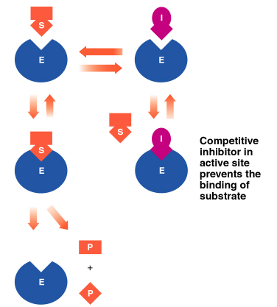
Reversible Inhibitors (Competitive Inhibition)
A reversible inhibitor goes on and off, allowing the enzyme to regain activity when the inhibitor leaves
A competitive inhibitor is reversible and has a structure like the substrate
- it competes with the substrate for the active site
- its effect is reversed by increasing substrate concentration

Slide 80
Noncompetitive Inhibition
A noncompetitive inhibitor
Does not have a structure like substrate
Binds to the enzyme but not active site
Changes the shape of enzyme and active site
Substrate cannot fit altered active site
No reaction occurs
Effect is not reversed by adding substrate

Slide 81
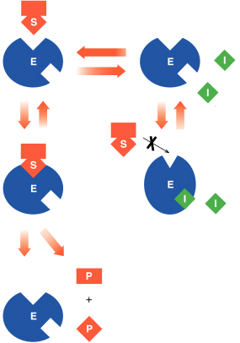
Reversible Inhibitors (Noncompetitive Inhibition)
A noncompetitive inhibitor has a structure that is different than that of the substrate
- it binds to an allosteric site rather than to the active site
- it distorts the shape of the enzyme, which alters the shape of the active site and prevents the binding of the substrate
The effect can not be reversed by adding more substrate

Slide 82
Learning Check E4
Identify each statement as describing an inhibitor that is
(1) Competitive (2) Noncompetitive
A. Increasing substrate reverses inhibition
B. Binds to enzyme, not active site
Structure is similar to substrate
D. Inhibition is not reversed with substrate

Slide 83
Solution E4
Identify each statement as describing an inhibitor that is
(1) Competitive (2) Noncompetitive
A. 1 Increasing substrate reverses inhibition
B. 2 Binds to enzyme, not active site
C. 1 Structure is similar to substrate
D. 2 Inhibition is not reversed with substrate

Slide 84
The switch: Allosteric inhibition
Allosteric means “other site”
Active site
E
Allosteric site

Slide 85
End point inhibition
The first step (controlled by e_{A}) is often controlled by the end product (F)
Therefore negative feedback is possible
A B C D E F
e_{A}
e_{B}
e_{C}
e_{D}
e_{F}
Inhibition
The end products are controlling their own rate of production
There is no build up of intermediates (B, C, D and E)

Slide 86
The allosteric site the enzyme “on-off” switch
Active site
E
Allosteric site empty
Conformational change
Substrate
fits into the active site
E
Inhibitor molecule is present
Substrate
cannot fit into the active site
The inhibitor molecule is absent
Inhibitor fits into allosteric site

Slide 87
Switching off
These enzymes have two receptor sites
One site fits the substrate like other enzymes
The other site fits an inhibitor molecule
Inhibitor molecule
Substrate
cannot fit into the active site
Inhibitor fits into allosteric site

Slide 88
Isoenzymes
Isoenzymes are different forms of an enzyme that catalyze the same reaction in different tissues in the body
- they have slight variations in the amino acid sequences of the subunits of their quaternary structure
For example, lactate dehydrogenase (LDH), which converts lactate to pyruvate, consists of five isoenzymes

Slide 89
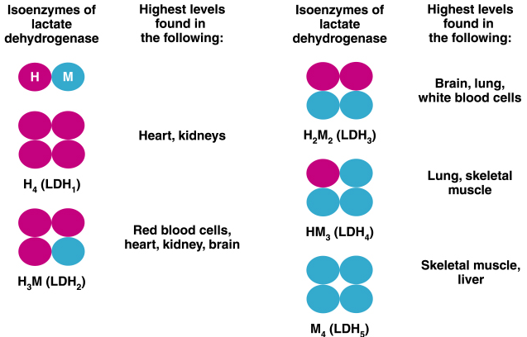

Slide 90
Main Tissue Distribution of Enzymes
AST ALT LD CK GMT ALP ACP AMS LPS CHS | liver, myocard liver not specific myocard, muscles liver biliary tract, bones prostate pancreas pancreas liver

Slide 91
Intracellular Location of Enzymes
Intracellular Location | Enzymes
Cytoplasm Mitochondria Golgi complex, ER Lysosome Membrane | LD, ALT, 30 % AST 70 % AST CHS, AMS ACP GMT, ALP

Slide 92
Enzymes of Clinical Significance
Enzyme | Source of blood elevation
ALT AST GMT ALP ACP CK AMS LPS CHS | hepatopathy MI, hepatopathy hepatopathy (alcohol, drugs) biliary tract diseases, bone diseases prostatic cancer MI (CK-MB), muscle diseases pancreatitis pancreatitis hepatopathy (alcohol, drugs) – decreased

Slide 93
Enzymatic antioxidant
1. superoxide dismutase (SOD)
SOD
2O₂·⁻+ 2H⁺ H₂O₂ + O₂
SOD is present in essentially every cell in the body which actually represented by a group of metalloenzymes with various prosthetic groups. SOD appears in three forms:
a) Cu-Zn SOD: in the cytoplasm with two subunits
b) Mn-SOD: in the mitochondrion
c) Cu-SOD: extracellular SOD
This is the first line of defence to protect cells from the injurious effects of superoxide.

Slide 94
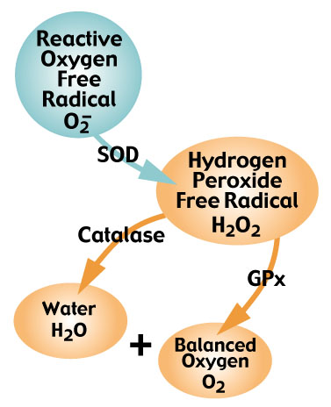
Enzymatic antioxidant
2. catalase, CAT
catalase
2H₂O₂ 2H₂O + O₂
Catalase, iron dependent enzyme, is present in all body organs being especially concentrated in the liver and erythrocytes. The brain, heart and skeletal muscle contains only low amounts.

Slide 95
Enzymatic antioxidant
3. glutathione peroxidase, GPx
ROOH+ 2GSH ROH+ GSSG + H₂O
GPx is a selenium-dependent enzyme.
The entire process is driven by energy production at the cellular level, which involves proper thyroid hormone levels, healthy mitochondrial function, and an active pentose-phosphate metabolic pathway.

Slide 96
Oxygen Radical Defense Enzyme
CuZnSOD
GSH
Peroxidase
O₂•¯
H₂O₂
H₂O + O₂
Fe²⁺
Mn SOD
Catalase
OH•

Slide 97
Application of Enzymatic antioxidant
1. superoxide dismutase (SOD)
essential in skin to generate fibroblasts.
Play important role to prevent the development of Leu Gehrig`s disease.
Used for treatment of inflammatory diseases, burn injuries, prostate problems, arthritis and corneal ulcer.

Slide 98
Application of Enzymatic antioxidant
Help carry nitric oxide into hair follicles (nitric oxide relaxes the blood vessels and allow more blood to circulate to their follicles and SOD helps to remove free radicals).

Slide 99
Application of Enzymatic antioxidant
2. catalase, CAT
Used in the food industry for removing hydrogen peroxide from milk prior to cheese production.
Used in the food wrappers it prevent food from oxidation.
Several mask treatment combine the enzyme with hydrogen peroxide.

Slide 100
Application of Enzymatic antioxidant
3. glutathione peroxidase, GPx
The main role of glutathione is immune system boosters.

Slide 101
Clinical applications of antioxidant enzymes
1. Chronic Inflammation.
2. Acute Inflammation.
3. Respiratory Diseases.
4. Diseases of the Eye.
5. Shock Related Injury.
6. Arthrosclerosis and Myocardial Infraction.
7. Peptic Ulcer.
8. Skin Diseases.
9. Cancer Treatment.

Slide 102


شكرا لاصغائكم
الفيس بوك: د. مصطفى طه محمد
البريد الالكتروني: Tahabiochem@yahoo.com

