Slide 1
Fermentation by microorganisms
Lec.2

Slide 2
Bioprocess or fermentation technology is an important component in biotechnology process and involve complete living cells(microbe, mammalian or plant), organelles or enzymes as the biocatalyst,
and will aim to bring about specific chemical and/or physical changes in organic materials.
The reasons for using microorganisms in fermentation:
1-The ratio of surface area to volume is high, so that the nutrients in the medium consumed quickly forced the metabolic reactions.

Slide 3
2- Adaptation for different ecological conditions that facilitates its transfer from natural habitat to the lab and growth on cheap carbon and nitrogen sources then production compounds that higher economical value.
3-The ability to achieve huge chemical reactions.
4- By easy dealing with microorganisms in field genetic mutation and genetic engineering easing for designing genetically modified organisms produced higher amounts of product in comparison with wild type.

Slide 4
Stages of fermentation
1-Screening and isolation of microorganisms
Microorganisms holds the key to the success or failure of a fermentation process.
It is therefore important to select the most suitable microorganisms to carry out the desired industrial process. It is highly desirable to use a production strain possessing the following four characteristics:
1- It should be high-yielding strain.
2-It should have stable biochemical/genetical characteristics.
3- It should not produce undesirable substances.
4- It should be easily cultivated on large-scale.

Slide 5
Screening may be defined as the use of highly selective procedures to allow the detection and isolation of only those microorganisms of interest from among a large microbial population.
The techniques that used for screening:
1-Crowded plate technique: This technique is the simplest screening technique employed in detecting and isolating antibiotic producers.

Slide 6
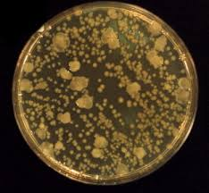
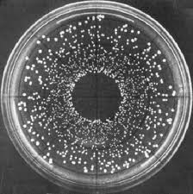

Slide 7
2-Auxanography technique: This technique is largely employed for detecting microorganisms able to produce growth factors (e.g. Amino acid and Vitamins) extracellular.
3-Enrichment culture technique: This technique was used to isolate the desired microorganisms form a heterogeneous microbial population present in the sample.
Either medium or incubation conditions are adjusted so as to favor the growth of the desired microorganism.

Slide 8
Many ways were used for enhance the productivity such as:
1- Ecological ways:
Provision of the optimal growth conditions for microorganism such as temperature, pH, aeration, humidity, media.....etc.
2-Genetic ways:
Any alteration in the inherited nucleic acid sequence of the genotype of an organism by using:
1-Genetic mutation
The mutation is defined as a permanent change in the sequence of DNA that alter the sequence of amino acids in the protein.
There are two types of mutations:
a- Spontaneous mutation
Spontaneous mutations occur without exposure to any obvious mutagenic agent.

Slide 9
b-Induced mutation
Induced mutation occur by treatment the cells with mutagens such as physical mutagens which including ultraviolet and X-rays, and chemical mutagens such as mitomycin C, nitrosoguanidine etc.
The cells that result from mutation called mutants which divided to:
1-Major mutants: The mutant strains have appeared a big and clear change in biochemical characteristics. The mutants had easily lost and were important in genetic studies.
2-Minor mutants: The mutant strains have appeared a little change in some features and don't recognize in the external shape. This mutants is genetically constant and important in development the productivity of strains.

Slide 10
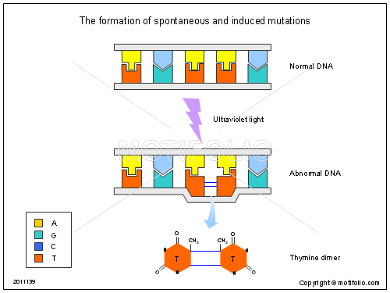

Slide 11
2-Transfer of genetic material (hybridization)
The process of transfusion the genetic material between genetically different two bacterial cells and produced hybrid cell.
This process was done by:
a-Transformation:
It is the genetic alteration of a cell resulting from the direct uptake, incorporation and expression of exogenous genetic material (exogenous DNA) from its surroundings and taken up through the cell membrane.

Slide 12
b-Transduction
Transduction is the process by which DNA is transferred from one bacterium to another by a virus.
c- conjugation
is transfer of genetic material between two bacterial cells in direct contact and formation of bridge between them, one of these cells is donating cell and the other is receiving cell.

Slide 13
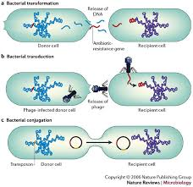

Slide 14
3-Gene amplification
Gene amplification, also known as gene duplication or chromosomal duplication, is a cellular process in which multiple copies of a gene are produced.
4-Genetic recombination
Genetic Recombination is the process by which an organism's offspring's combination of genes becomes different than the organism's combination of genes. This process is a natural process, such as the crossing over between homologous chromosomes during meiosis.
It can also be done artificially by applying genetic engineering techniques.

Slide 15
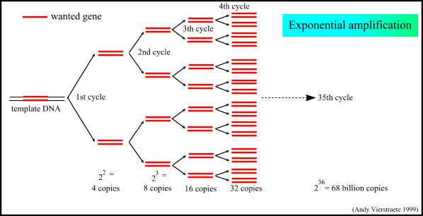

Slide 16
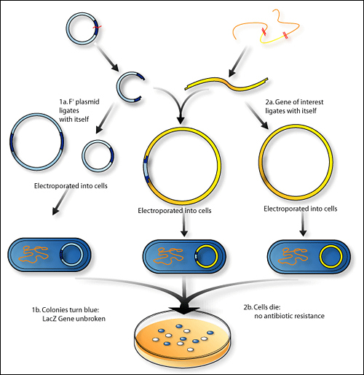

Slide 17
5-Protoplast fusion
A protoplast is a plant, bacterial or fungal cell that had its cell wall completely or partially removed using either mechanical or enzymatic means.
During and subsequent to digestion of the cell wall, the protoplast becomes very sensitive to osmotic stress, therefore;
it treats with chemical stabilizers such as inorganic salts, sugars as sucrose and alcohols to give the plasma membrane osmotic helpful to prevent rupture of it.

Slide 18
l
Type of cell | Enzyme
Plant cells | Cellulase, pectinase, xylanase
Gram-positive bacteria | Lysozyme (+EDTA
Fungal cells | Chitinase
.
Type of cell | Enzyme
Plant cells | Cellulase, pectinase, xylanase
Gram-positive bacteria | Lysozyme (+EDTA)
Fungal cells | Chitinase

Slide 19
However, isolated protoplasts will not aggregate and fuse easily in the absence of an fusogenic agents. The most widely used at the present time is polyethylene glycol (PEG).
also Ca⁺² was necessary to obtain the fusion at high frequency.
Fusion in bacteria:
The process was observed between two protoplast of Bacillus at high frequency.
Fusion in fungi:
The first attempt in protoplast fusion was done for Geotrichum candidum then for Cephalosporium that produced cephalosporin.

Slide 20
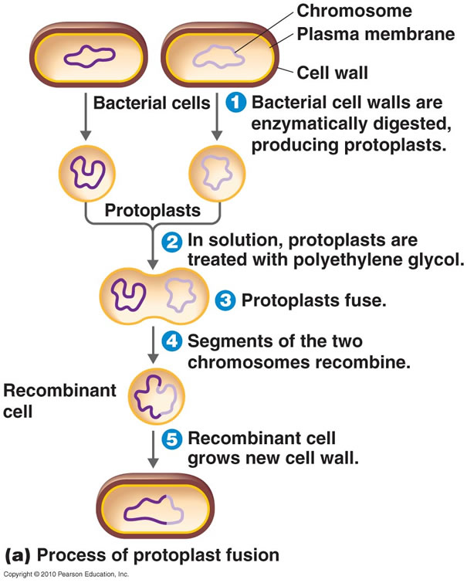

Slide 21
2- Fermentation medium(raw material)
General media requirements include a carbon source, which in virtually all industrial fermentations provides both energy and carbon units for biosynthesis, and sources of nitrogen, phosphorus and sulphur.
Other minor and trace elements must also be supplied, and some microorganisms require added vitamins, such as biotin and riboflavin.
Many considerations have made when choosing media for fermentation such as cheapness and availability of material and product yield.

Slide 22
3-Controlled favorable environment
To achieve optimization of the fermentation process the following must be adhered:
1-Biological environment: Excluding entrance of contaminating organisms and using the desired organisms.
2-Physical environment: supplement the optimal temperature for production and agitation for aerobic organisms.
3-Chemical environment: including pH ,dissolved oxygen and excluding the inhibitors.

Slide 23
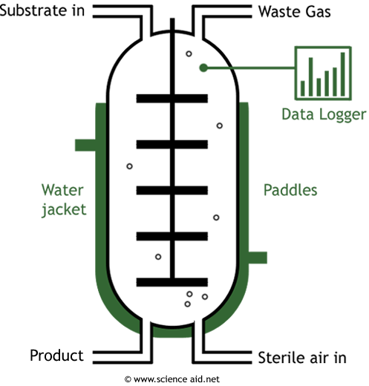
Fermenter (Bioreactor)
Below is a diagram of a simple fermenter. In industry, these would be very large and would have lots of different pipes and tubes coming out of it for various functions.

Slide 24
Fermentation products
1-Microbial biomass: The production of SCP that used as food for human and animals also the yeast was used in bread industry.
2-Microbial enzymes: Animal, plant and microorganisms produce different enzymes, but the last produce huge amounts of enzymes by fermentation process.
3-Microbial metabolites:
a-Primary metabolites:
A primary metabolite is a kind of metabolite that is directly involved in normal growth, development, and reproduction.

Slide 25
It produces during lag and log phases that together called trophophase and including proteins, lipids, carbohydrates, nucleic acids and amino acids.
b-Secondary metabolites:
The metabolites that don't appear to have an obvious role in the metabolism of the producer organism, but usually has an important ecological function.
They produce during stationary phase and including antibiotics, toxins and hormones.

Slide 26
4- Bioconversion:
Bioconversion refers to the use of live organisms often microorganisms to carry out a chemical reaction that is more costly.
These organisms convert a substance found in the medium to a chemically modified form that has high commercial level such as the bioconversion of progesterone to Hydroxy progesterone by Rhizopus nigricans.
Bioconversion differ from chemical conversion in highly specificity, needing to low temperature and don't need to use the heavy metals.

Slide 27
Inoculum
The inoculum was very important to success the fermentation process. The laboratory inoculum differs from an industrial inoculum in:
1- Industrial inoculum prepares in large amounts.
2-Industrial inoculum passes with different conditions in particular nutritional media and supplement with oxygen in pre-productivity and productivity stages.
Inoculum parameters
1- The cells should be active .
2-The volume of inoculum proportional with the volume of culture medium
3-Approperate phenotype
4-Free from contamination
5-The cells should be having genotype that gives the desired product.

Slide 28
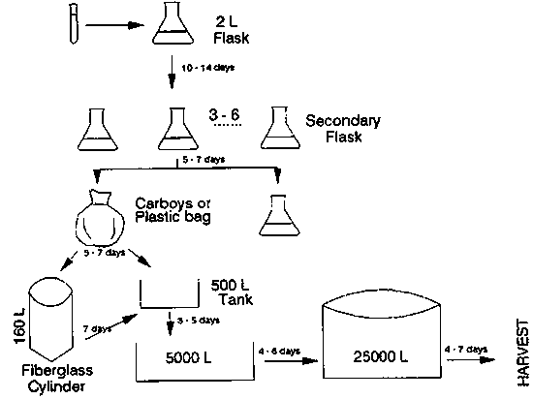

Slide 29
Factors affecting on the efficiency of the inoculum
1-Inoculum volume
The volume of bacterial inoculum was 1-3% dependent on the type of product. The fungi and actinomycetes were added to the medium at 5-10%, but the spore suspension was added at about 1-2ᵡ10⁵ spore/liter of the medium.
2- Inoculum age
In the case of primary metabolites production the cells in inoculum should be active and in logarithmic phase, while the production of secondary metabolites need cells in the case of non-division.
3-nutrition medium
The medium in the last stage for inoculum production similar to production medium but it poorer in all contents in order to increase the induction that lead to decrease or remove the lag phase.

Slide 30
There are three reasons lead to failure the inoculation process:
1-Contamination:The contamination was recognized by microscopic examination and culturing in solid media.
2-Bacteriophage: The bacteriophage infection was recognized by decreasing or stopping the growth of cells.
3-Mutation:The mutation was recognized by decreasing the productivity, since the most of mutations lead to decrease of the productivity.

