Slide 1

Techniques of microbial cultures
Lec.3

Slide 2
Microbial growth: refers to the increasing number of cells, not to the changes in the size of cells.
Microbial growth can be measured by two ways:
Gravimetrical methods and Numerical methods.
Generation Time
The time required for a cell to divide or the population to double is called generation (doubling) time.
Four characteristic phases of the growth cycle are recognized:
1- Lag phase: is the first phase observed. It is characterized by no increase in cell number; however, the cells are actively metabolizing, in preparation for cell division.
2- Exponential or log phase: This is the period in which the cells grow most rapidly, doubling at a fairly constant rate.
Primary metabolites are produced in this phase.

Slide 3

3- Stationary phase: the number of viable cells is equal to the number of dead cells.
The factors that cause cells to enter stationary phase are related to changes in the environment, typically caused by high cell density, depletion of nutrients and accumulation of waste products.
Secondary metabolites are produced in this phase.
4- Death phase: the number of viable cells decreases geometrically (exponentially), therefore, cells die quickly.

Slide 4
Growth estimates by:
Gravimetrical methods
includes (measuring dry weight or wet weight, estimate the DNA or protein estimation).
Numerical methods
as in the measurement of cell numbers.

Slide 5
Growth phases
Lag phase
Logarithmic phase
Stationary phase
Death phase

Slide 6

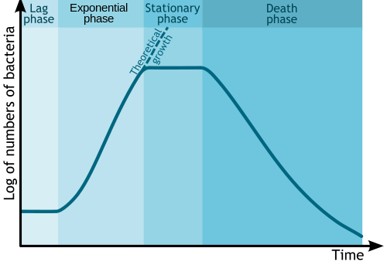
Growth curve

Slide 7
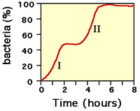
“Diauxie” or double or biphasic growth:
This phenomenon is characterized by two growth cycles —the first one on the preferred sugar, followed by a second one on the less-preferred sugar. Both are separated by a short period during which the population apparently does not grow. This period is known as the diauxie lag phase.

Slide 8

There are two groups of fermentation processes:
• Liquid fermentation: cells are suspended in aqueous medium. There are three types of liquid fermentation;
Batch, Fed-batch and continuous.
• Solid fermentation: The volume of free liquid is minimal and the cells are adsorbed to a solid and nutrient rich material.

Slide 9

Fermentation
Liquid State Fermentation
Batch culture
Continuous culture
Fed-batch system
Solid substrate fermentation
Mixed culture
Pure culture

Slide 10
I) Batch Fermentation (also is known as a closed system)
1- The culture is inoculated into the sterile medium contained in a closed vessel.
2- No additional nutrients are added once the fermentation process starts (the nutrients of the medium is neither renewed nor metabolic wastes removed).
3- Basic controls for pH, temperature, dissolved oxygen, and foam of the fermentation medium are regulated in this type of fermentation.
4- Exponential growth last only for a few generations.
5- The growth rate is not constant due to lack of stability of the optimal conditions.
6- Growth curve with four phases is observed.
7- The products, be they intra- or extracellular, are harvested only at the end of the run.

Slide 11
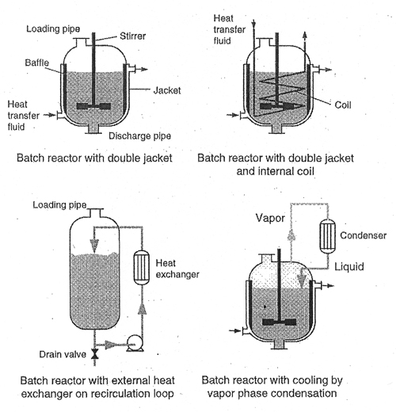

Slide 12

II) Fed Batch fermentation (also known as semi-continuous or semi- batch system)
1- It is quite similar to Batch fermentation except that the nutrients or one or two components of nutrients are added periodically in the fermentation medium, therefore, the culture volume increases during the course of operation until the volume is full.
2- This type of fermentation lengthens the log and stationary phase of the cells thereby causing increased amount of bioproduct.
3- The growth rate is semi constant.
4- The products, be they intra- or extracellular, are harvested only at the end of the run.

Slide 13
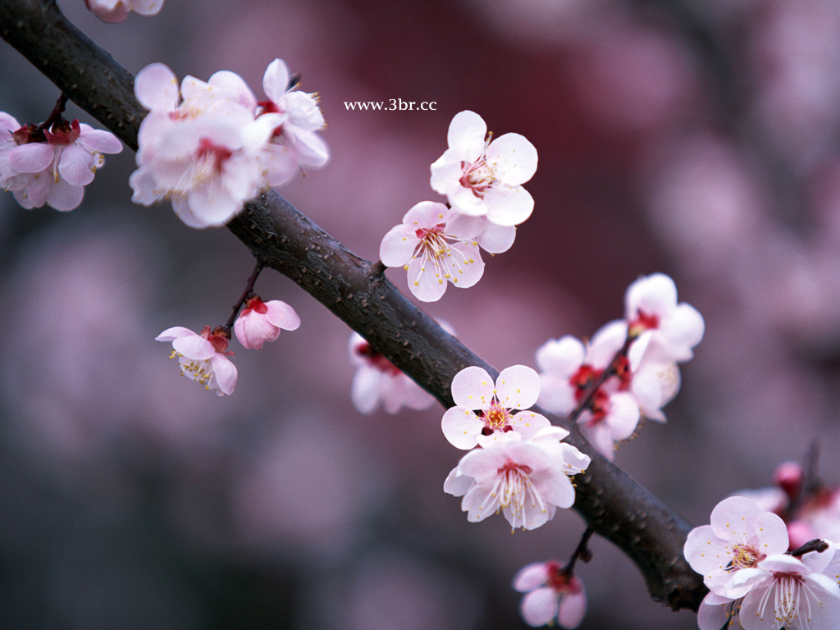
Reasons for Fed-Batch Cultures
● To remove repressive effects of rapidly utilized carbon sources.
● To reduce the toxic effect of some medium components.
Applications of Fed-Batch Cultures
1- The yeast cell production
The yeast cell production, in which sugar (glucose) was added periodically during the course of fermentation to maintain a low sugar concentration to suppress alcohol formation.
2- Penicillin production
Penicillin fermentation, in which the energy source (e.g., glucose) and precursors (e.g., phenyl acetic acid) were added periodically during the course of fermentation to improve penicillin production.

Slide 14
III) Continuous fermentation (is also known as open system or Continuous flow culture (CFC))
1- There is continuous removal of culture medium as well as continuous addition of sterile nutrient medium.
2- Conditions are predetermined as to what should be the flow rate of incoming nutrient solution so that the volume of fermenting medium remains the same and also fermenting microbes remain in same phase of growth termed as steady state of growth.
3- Growth rate is constant.

Slide 15
Control of continuous culture
Chemostat
regulated by control of concentration of limiting nutrient
Turbidostat
regulated by biomass using optical density (photoelectric cell)
Biostat
regulated by systems monitoring biomass other than optical density (e.g CO₂ production)

Slide 16
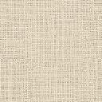
The steady state of growth can be achieved by:
1- Chemostat
The growth factor selected is one of the components of the nutritional medium(e.g. carbon source, Nitrogen source, Magnesium, Sulphate or phosphorus) controls the growth process, and adding continuously to the culture when it depleted.
The volume of the chemostat can be controlled either by using : a pump system or an overflow system.

Slide 17
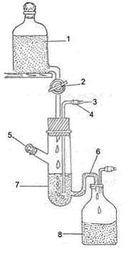
Chemostat, a continuous culture system
Reservoir of Sterile Medium
Flow Rate Regulator
Air inlet
Air Filter
Passage for Inoculation and Air Outlet
Siphon Overflow
Growth Chamber
Receptacle

Slide 18
2- Turbidostat
The cell density in turbidostat is measured by photo electric device, which sends signal to the turbidostat to increase or decrease the flow rate of the medium to the fermentor vessel.
The pump attached to the fermentor for controlling the flow rate will turn on or off depending on the increase or decrease in the level of biomass beyond set point.
3- Biostat
Regulated by measure biomass indirectly by measuring the amount of gas produced by organisms or change in pH due to certain biochemical activity.

Slide 19
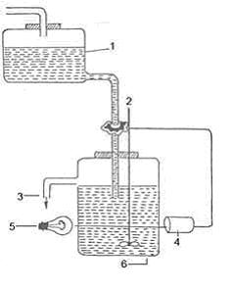
Turbidostat
Reservoir of Sterile Medium
Valve Controlling Flow of Medium
Outlet for Spent Medium
Light Source
Photo cell
Turbidostat

Slide 20
Applications of continuous culture:
1- Industry: Used in the production of therapeutic Pharmaceuticals, antibiotics, ethanol, and fermented foods such as cheese.
2- Research: Used to collect data to be used in the creation of a mathematical model of growth for specific cells or organisms, analysis of biological processes in microorganisms, and study biofilm formation in Pseudomonas aeruginosa.
3- Biological waste treatment.
4- Cell propagation.

Slide 21
Solid State Fermentation (SSF)
Solid-state fermentation (SSF) is defined as the fermentation process in which microorganisms grow on solid materials without the presence of free water. The growth of microorganisms in these cultures depends on Water activity(Aw).
1- Bacteria grow at 0.9(Aw)
2- Fungi grow at 0.6-0.7(Aw), the molds are largely used because they can tolerate the low levels of Aw.
The source of solid material as well as culture is cereal grains of wheat, rice, maize etc. SSFs are used for production of food, enzymes, organic acids, SCP...etc.
أهم تطبيقاته :

Slide 22

Steps of SSF:
1- The grains are moistened with water and ground to form a paste. Additional supplements like salts etc. may be added to the solids prior to sterilization.
2- The solid material is then transferred to shallow metallic containers and is steam sterilized.
3- This is followed by the spraying of culture inoculum on to the surface of sterilized medium and incubation is carried out under controlled conditions of temperature, air and humidity.
SSF processes can be classified based on the seed culture for fermentation into:
1- Pure culture, such as lactic acid production from wheat bran using Lactobacillus amylophilus.
2- Mixed culture, such as cellulase production using Trichoderma reesei with Aspergillus spp.

Slide 23

Dialysis fermentation
Dialysis is a membrane process where solutes (MW~<100 Da) diffuse from one side of the membrane (feed side) to the other (dialysate side) according to their concentration gradient.
In Dialysis fermentation, a selectively permeable membrane separates a culture chamber, in which fermentation takes place, from a medium reservoir.
Nutrients in the reservoir diffuse to the culture chamber while metabolite products diffuse to the medium reservoir. Low product concentrations are maintained in the culture chamber, minimizing the effects of metabolic inhibition.

Slide 24
Features of Membranes
1- Homogeneous.
2- Thickness: 0.3 – 200 nm.
3- Membrane material: hydrophilic polymers (regenerated cellulose such as cellophane, cellulose acetate, copolymers of ethylene-vinyl alcohol and ethylene-vinyl acetate).
Advantages
1- Minimize product inhibition.
2- Retains cells, so that high cell densities are achieved.
3- Smaller, less expensive fermenters could be used .
4- Can be applied to any diffusible fermentation product.
Disadvantages
1- Proteins and other components of the medium can contaminate membranes and the accumulation of non-diffusing metabolites will inhibit the cells.
2- Membranes are expensive and their lifetimes are hard to predict.

Slide 25


