Slide 1
Introduction to Biotechnology
Lec.1

Slide 2

In 1919, Karl Ereky, a Hungarian engineer, coined the term biotechnology for the first time to describe the interaction of biology and human technology.
Bio: the use of biological processes, and technology: to solve problems or make useful products = biotechnology.
Biotechnology is the use of living systems and organisms to develop or make useful products. Or its any technological application that uses biological systems, living organisms or derivatives, thereof, to make or modify products or processes for specific use.

Slide 3
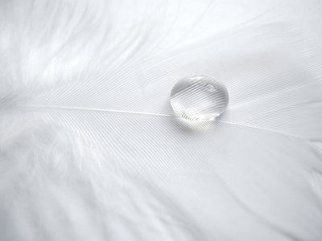
Stages of biotechnology
Stage I : Pre- Pasteur Era (before 1885)
Discovering of microorganisms
● Traditional microbial industry(bread, cheese, beer and wine)
Stage II : Pasteur Era or Fermentation Era (1885 – 1940)
Production of gunpowder by soil microorganisms
● The fermentative ability of microorganisms
● Production of chemicals like acetone, butanol, ethanol and organic acids
Stage III : Antibiotics Era (1940 -1960)
Production of antibiotics
● Production of enzymes and vitamins
● Production of gibberellins ,amino acids, nucleotides and steroids
●Tissue cultures techniques

Slide 4
Stage IV : Post antibiotics Era (1960 -1975)
Production of single cell protein (SCP)
●Production of sterilants and disinfectants
●Enhancement of microorganisms productivity by genetic engineering techniques
Stage V : Genetic engineering Era (1975 - 2000)
Production of therapeutic proteins (insulin, interferon,....etc)
●Production of new sources of energy (Biogas and biodiesel)
● Production of monoclonal antibodies
● Production of hybrid antibodies
● Production of biodetergents
●Immobilization of enzymes and cells
Stage VI : Era of transgenic organisms (2000 - 2025)
Production of vaccines by plants
●Production of therapeutic proteins by animals
●Production of genetically modified foods.
●Production of artificial chromosomes

Slide 5

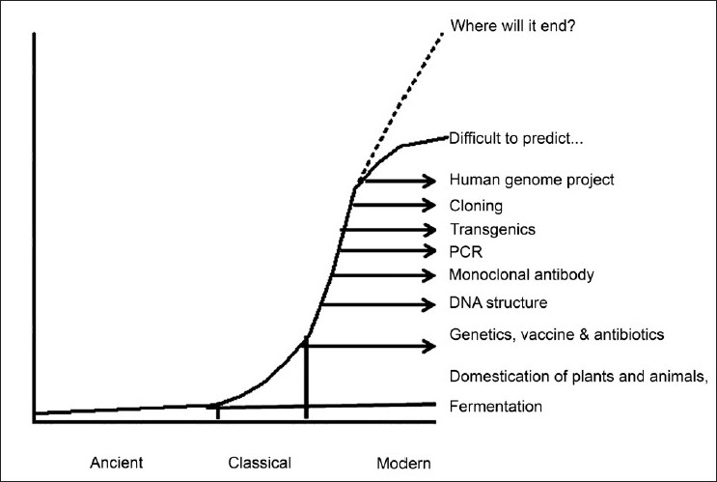
Figure 1: History of the development of biotechnology.
Another division for biotechnology was included:
Ancient Biotechnology (stage I)
Classical Biotechnology (stages II , III and IV)
Modern Biotechnology (stages V and VI )

Slide 6
Generations of biotechnology
1- Blue biotechnology: is a term that has been used to describe the marine and aquatic applications of biotechnology.
2-Green biotechnology :is biotechnology applied to agricultural processes.
3-Red biotechnology :is applied to medical processes.
4- White or grey biotechnology: is biotechnology applied to industrial processes or environment.

Slide 7

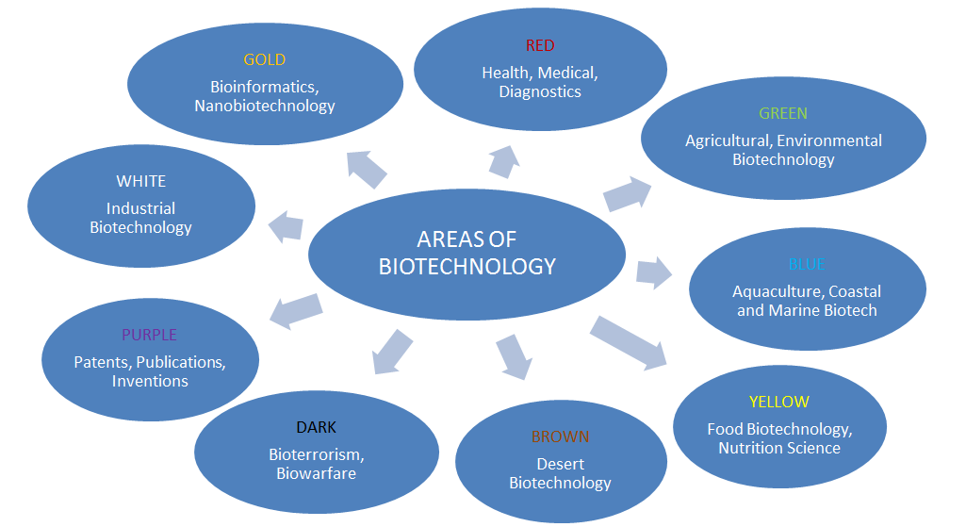
Figure 2: Generations of biotechnology

Slide 8

6-Hybrid technology
Biosensors
Tissue engineering
DNA chips
Bioinformatics
1-Monoclonal antibodies
Inputs of Biotechnology
5- protein engineering
2-Tissue culture technology
3-Cloning
Molecular cloning
Cellular cloning
Reproductive cloning
4-Genetic modification

Slide 9

1- Monoclonal antibodies
Using immune system cells that build antibodies which are characterized by very highly specialized and therefore can determine and discover the vital elements accurately even if very small quantities, and its applications:
● Identify and detect environmental pollutants.
● To detect harmful microorganisms in food.
● differentiate between normal cells and cancer cells.

Slide 10
2- Tissue culture technology
It is the cultivation of animal or plant cells in vitro (in the laboratory), and their applications:
●Cellular therapy.
● the production of drugs from plant cells directly instead of the plant.
● The use of animal cells in the detection efficiency of drugs instead of animals, reflecting the safety and accuracy.
● Propagation and doubled of the plant tissues in the laboratory.

Slide 11

3- Cloning
Production numbers and models of genetically identical molecules, cells and animals and plants which are of three types:
Molecular or DNA cloning,
cells cloning
and animal or reproductive cloning.
4- Genetic modification
It happens to modify the genes of the same type or the transfer of genes from one species to another and its applications:
● production of drugs and vaccines.
●Treatment of certain genetic diseases.
●To increase agricultural production and reduce cost.
● Increase the value of the nutritional content in food.

Slide 12

5- Protein engineering
This technique depends on the concept of genetic modification in order to produce specific proteins or new proteins have useful applications such as enzymes or biocatalysts.
6- Hybrid technology
It is intended to link biological sciences with other sciences to give useful applications such as:
a- Biosensors
This technology connects between biology and microelectronics, and their applications:
• measuring the content and quality of food and safety.
• measurement of environmental contaminants.
• helping doctors to measure specific components in the blood directly.

Slide 13
b-Tissue engineering
This technology connects between cytology and materials science to produce artificial tissues in the laboratories with its scaffolds. The successful examples of this technique the building of skin and cartilage.
c- DNA chips
This technology connects between the semiconductor industry and the genes making it possible to analyze tens of thousands of genes in a single-chip area does not exceed per square centimeter, and their applications:
●detection of mutations in specific genes.
● measurement of gene activity.
●Identification of genes important for crop production.
● Studying the structural sequence of genetic material.

Slide 14
d- Bioinformatics
This technology link between computer science and the genetic material, especially the programs of statistical analysis, graph simulation and databases and that utilized in the analysis of the vast amount of information derived from genetic material, and their applications:
• Genetic mapping and identification of sites and the number of genes in each map.
• determination of the shape and construction of proteins.
• Simulation the way of proteins work and thread.
• The discovery of the causes and locations of genetic diseases and design appropriate treatment.
Hybrid technology
Biology + Microelectronics= Biosensors
Cytology + Materials = Tissue engineering
Genes + Semi conductive = DNA chips
Genetic material + Computer science = Bioinformatics

Slide 15
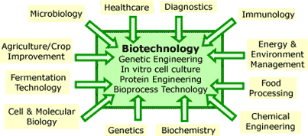
Figure 2: Generations of biotechnology

Slide 16

Outputs
1-Health care
2-Agriculture
applications
3-Industrial
applications
4-Environmental
applications
5-Space
applications
6-Animal health
7-Other applications:
1-Aquaculture
2-Finger printing
3-Crimes detection
4-Fatherhood examination
5-Anthropology
6-Biological weapons

Slide 17
1- Outputs in the medical field:
The most important outputs areas of medical biotechnology are:
• The treatment of certain diseases such as cancer.
• The production of vaccines and immunizations.
• Diagnosis of diseases.
• Gene therapy.
• Stem cell research.
• Production of proteins and genes

Slide 18
2- Outputs of the agricultural field:
The most important outcomes in this area are:
• Food production, such as genetically modified foods.
• Hybridization between plant species.
• Production of Biocides.
• Natural protection for plants.
• Production of food additives.
• Reducing the use of herbicides.
• The production of drugs and medicines for the treatment of animals which used as food for the people.

Slide 19
3- Industrial outputs:
An enzymes are the most important outputs in this area and there are currently more than 450 enzyme works as a catalyst in various industrial applications, such as: carbohydrases, proteases, peptidases, lipases, oxireductases and transferases.
4- outputs in the environmental field:
Some techniques are used for removing of pollutants from an environment and useful thing is that genetically modified organisms are used for this purpose can be left to live naturally in the environment, especially places of contaminants and in turn without a problem or an additional cost, and examples rid the gasoline from a substance Methyl tertiary butyl ether (MTBE) using bacteria, are also used in biotechnology to get rid from the remnants of the oil in the reservoirs of oil in the Gulf states.

Slide 20
5-For aerospace applications:
The U.S. space agency NASA in 2000 signed agreement with the biotechnology industry Organization and the National Institute of Cancer Research for the use of biotechnology in space exploration, as well as micro-gravity research.
6-Other uses:
Biotechnology applications exceeded the key areas mentioned earlier have to other areas such as:
• Aquaculture
•Fingerprinting
• Criminal tests
• Establish paternity
• Anthropology
• Biological weapons

