Slide 1
4th lecture in Antibiotics 4th class \biology department
The Antimicrobial agents Sulpha drug &Quinolones
Prepared by
Dr.Sawsan Sajid AL-Jubori
Dr.Saad L. Hammed

Slide 2
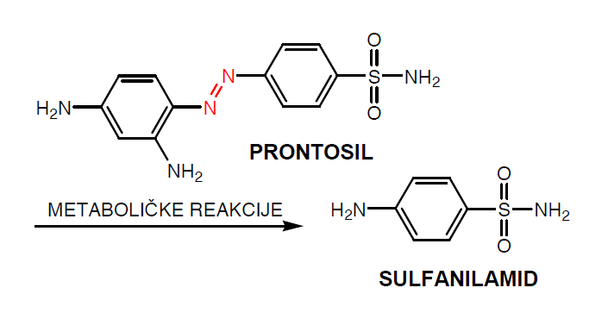
Sulfonamide (also called sulphonamide, sulfa drugs or sulpha drugs)
Sulfonamides are synthetic antimicrobial agents that contain the active antibacterial sulfonamide group which is the first synthetic antibacterial agent acting on a wide range of infections
The early used drug related to this group was Prontosil )red day1933) ,used against staphylococcal septicemia and in (1935)Gerhard Domagk used it to cure streptococcal infections in mice and rabbits
By the discovery of Penicillin G (1929 by Alexander Fleming
and shown to be successful as antibacterial agent in humans( in 1941 ) which Lead to a decline تقلليل in use of sulfa drug
However, sulfa drugs are still used for
malaria, tuberculosis, leprosy, meningitis
, pneumonia, scarlet fever, plague,
respiratory, infections, and
intestinal/urinary tract infections

Slide 3
Sulfa mode of action
Antibacterial sulfonamides kill bacteria and fungi by interfering with their metabolism targeting their metabolic pathway as competitive inhibitors of the enzyme dihydropteroate synthetase, DHPS. Dihydropteroate synthetase activity is essiantial in the synthesis of folate, and folate is required for cells to make nucleic acids, such as DNA or RNA. So if DNA molecules cannot be built, the cell cannot divide,
the effect is bacteriostatic (rather than bactericidal) unless one of sulfa derivatives is mixed with trimethoprim in this condition it will be bacteriocidal .راجع المحاضرتين السابقتين فيها التفاصييل كاملة عن المسار الايضي والتثبيطي
Because sulfa drugs concentrate in the urine before being excreted, treating urinary tract infections is one of their most common uses .
Sulfa drugs do not cause the same disruption in animal cells, because our cells do not synthesize folate. Since we can’t make folate, we need to consume it, and folate is a dietary requirement.

Slide 4
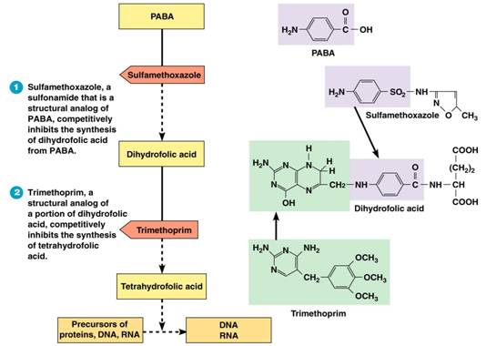

Slide 5
Examples of Sulfonamides : co –trimoxazole bactericidal
It is a combination between Trimethoprim (one part) / sulfamethoxazole (five parts ) انتبه لنسبة الخلط مهمه (TMP/SMX), also known as co-trimoxazole , is an antimicrobial agent used to treat a variety of bacterial infections.It is used for urinary tract infections خط علاجي اول لالتهاب المجاري البولية , MRSA skin infections, travelers' diarrhea, respiratory tract infections, and cholera. It may be used both to treat and prevent pneumocystis pneumonia in people with HIV/AIDS. It can be given by mouth or intravenously.
Common side effects : include nausea, vomiting, rash, and diarrhea. Severe allergic reactions and Clostridium difficile diarrhea may occasionally occurs. Because sulfonamides displace bilirubin from albumin, kernicterus (brain damage due to excess bilirubin) is an important potential side effect of sulfonamide

Slide 6
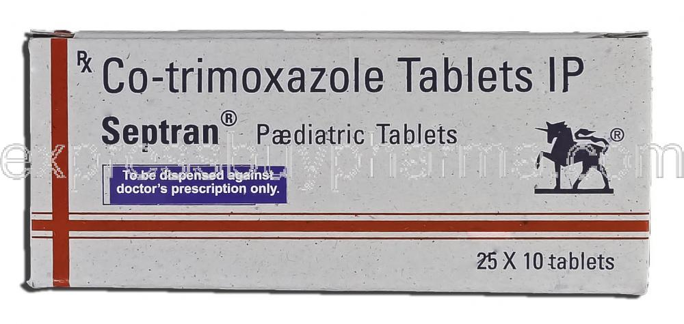
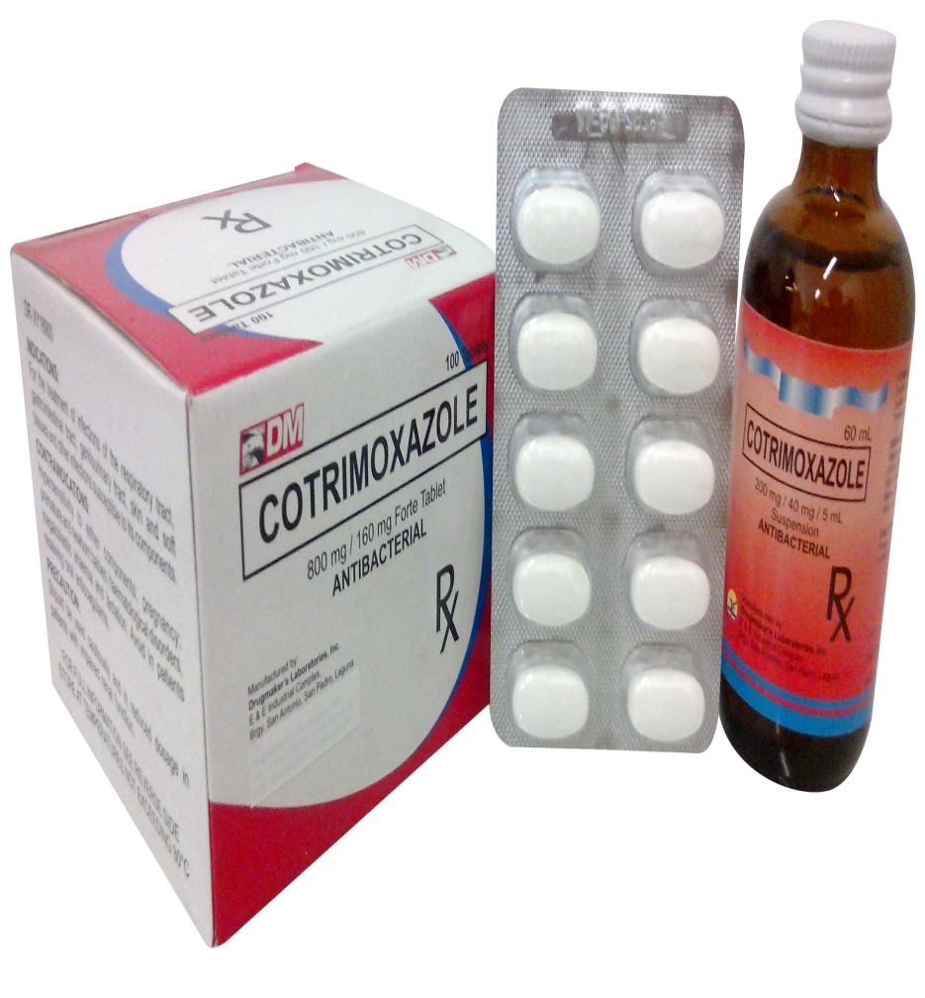

Slide 7
Examples of Sulfonamides
1=Sulfadoxine
Belongs to a new generation of sulfonamides
Long lasting antibacterial agent
Once weekly dosing regime
Used for the treatment of malaria
2=Succinyl sulfathiazol
Acts as a prodrug of sulfathiazole
Ionized in the alkaline conditions of the intestine
Too polar to cross the gut wall
Concentrated in the gut and Slowly hydrolysed by enzymes in the gut
Used for gut infections
3=Sulfonamides with reduced toxicity
Thiazole ring is replaced with a pyrimidine ring
Sulfadiazine and its metabolite are more water soluble
Reduced toxicity
Silver sulfadiazine is used topically to prevent infection of burns

Slide 8
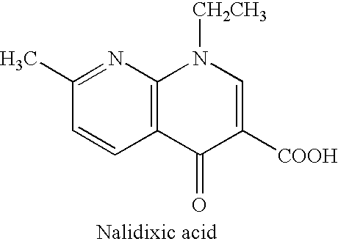
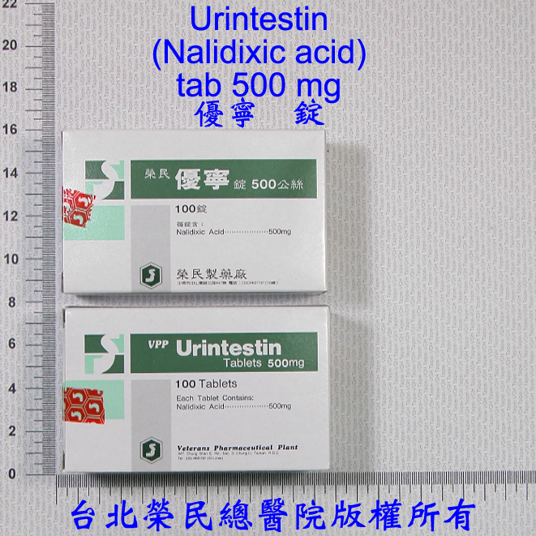
Quinolones
Quinolones were first developed in the 1960s and can be classified into generations based on antimicrobial activity.
The first quinolone used was nalidixic acid ( 1962).was marketed in many countries as Negram followed by many derivatives, such as flumequine (Apurone in France ), which are not marketed now. They had an antibacterial effect on Escherichia coli, Proteus, Enterobacter and because of their urinary elimination in high concentrations they were used for treatment of urinary tract infections
it cant reach the blood stream thus it doesn't used to treat systemic infection

Slide 9
Fluoroquinolones
Quinolones with a fluorine atom are called fluoroquinolones; Because of their very good diffusion, they act on infections with different locations. The fluoroquinolones used in the treatment of the urinary tract infections are eliminated in the urine in high concentration. The fluoroquinolones used in urogenital infections due to sensitive microorganisms are norfloxacin, enoxacin and lomefloxacin.لاحظو ان هذه المجموعة تصل لمستويات عاليه بل الجسم لذلك تستخدم لعلاج امراض جهازيه وافضل مثل عليها السبرودار او سايبروفلوكزازين
The microorganisms sensitive to fluoroquinolones are very numerous: Gram-negative bacilli, salmonellas, Escherichia coli, shigella, gonococci, Proteus, Enterobacter, Helicobacter, Gram-positive bacilli, staphylococci, streptococci…
The fluoroquinolones indicated in general infections (septicemia) or localized infections (meningeal, respiratory, osteoarticular, urogenital) are pefloxacin, ciprofloxacin and ofloxacin.
The majority of fluoroquinolones is active against Mycobacterium tuberculosis and can be useful for the treatment of resistant tuberculosis.

Slide 10
Generational Classification
First Generation Quinolones (1stgeneration)
-- Active against Gram-negative, but Pseudomonas spp.
Highly protein bound
Mostly used in UTIs
Fluoroquinolones (2nd, 3rd and 4th generation)
Modified 1st generation quinolones
Not highly protein bound
Wide distribution to urine and other tissues; limited CSF penetration.
Second Generation
Gram-negative, some gram-positive and mycobacteria.
Third and Fourth Generation
Have increased activity against gram-positive pathogens including S. pneumoniae. They are also active against many agents causing zoonotic infection and against Mycobacteria.

Slide 11
Generational Classification
Generation | Drug Names | Spectrum
1st | nalidixic acid cinoxacin | Gram- but not Pseudomonas species
2nd | norfloxacin ciprofloxacin enoxacin ofloxacin | Gram- (including Pseudomonas species), some Gram+ (S. aureus) and some atypicals
3rd | levofloxacin sparfloxacin moxifloxacin gemifloxacin | Same as 2nd generation with extended Gram+ and atypical coverage
4th | *trovafloxacin | Same as 3rd generation with broad anaerobic coverage
First Generation
Cinoxacin
Nalidixic Acid
Oxolinic acid
Second Generation
Ciprofloxacin
Enoxacin
Fleroxacin
Lomefloxacin
Levofloxacin
Norfloxacin
Ofloxacin
rulfloxacin
Third Generation
Gatifloxacin
Grepafloxacin
Pazufloxacin
Sparfloxacin
Tosufloxacin
Fourth Generation
Clinafloxacin
Gemifloxacin
Moxifloxacin
Trovafloxacin

Slide 12
Mechanism of Action( Bactericidal)
The quinolones act by inhibiting type 2 bacterial DNA topoisomerases, DNA gyrase and topoisomerase IV. They bind to and trap the enzyme-DNA complex. This blocks DNA synthesis and cell growth and ultimately has a lethal effect on the cell.
Inhibition of bacterial DNA Gyrase (Topoisomerase II)
Formation of quinolone-DNA-Gyrase complex
Induced cleavage of DNA
Inhibition of bacterial Topoisomerase IV
Mechanism poorly understood
Mechanism of DNA Gyrase

Slide 13
Spectrum of activity
The fluoroquinolones are potent bactericidal agents against:
E.coli and various species of Salmonella, Shigella, Enterobacter, Campylobacter, and Neisseria
Ciprofloxacin is more active than norfioxacin against
P. aeruginosa
Fluoroquinolones also have good activity against staphylococci, including methicillin­resistant strains
Several intracellular bacteria are inhibited by fluoroquinolones these include species of Chlamydia, Mycoplasma, Legionella, Brucella, and Mycobacterium (including Mycobacterium tuberculosis)

Slide 14
Mechanism of resistance
Resistance to quinolones may develop during therapy via mutations in the bacterial chromosomal genes encoding DNA gyrase or topoisomerase IV, or by active transport of the drug out of the bacteria.
Mechanism of resistance:
Chromosomal:
1-Alter target enzymes: DNA gyrase and topoisomerase IV
2- Decreased drug penetration (Efflux pump): Pseudomonas, E. coli
Plasmid: seen in some K. pneumoniae and E. coli
Mutations in both target enzymes are needed to produce significant resistance

Slide 15
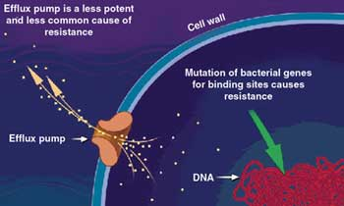

Slide 16
Clinical uses of fluoroquinolones
Disease | Recommendations
RESPIRATORY TRACT INFECTIONS
Pharyngitis, otitis media | Not appropriate
Necrotizing otitis | Ciprofloxacin for Pseudomonas aeruginosa
Sinusitis | Third-generation fluoroquinolone
Community-acquired pneumonia | Third-generation fluoroquinolone
Hospital-acquired pneumonia | Ciprofloxacin, for susceptible gram-negative pathogens
URINARY TRACT INFECTIONS
Cystitis, uncomplicated | All effective (second generation most appropriate)
Pyelonephritis | All effective (second generation most appropriate)
Prostatitis | All effective
SKIN STRUCTURE INFECTIONS
Primary cellulitis | Not appropriate as first line therapy
Anaerobic soft-tissue infections | Not appropriate

Slide 17
Disease | Recommendations
OSTEOMYELITIS
Gram-negative bacterial infections | Ciprofloxacin
BACTERIAL DIARRHEAL DISEASES | Ciprofloxacin used most commonly; all considered likely to be effective
SEXUALLY TRANSMITTED DISEASES
Gonorrhea | Resistance testing required
Chlamydia | Ofloxacin, levofloxacin
Chancroid | All likely to be effective
Mycoplasma | Ofloxacin, levofloxacin
Syphilis | Not appropriate
MYCOBACTERIAL DISEASES
Disseminated M. avium complex | Ciprofloxacin, ofloxacin as fourth agent if needed
M. tuberculosis | Ofloxacin, levofloxacin for drug-resistance or intolerance to first-line agents

Slide 18
Adverse effects:
Gastrointestinal effects : Nausea, vomiting
Central nervous system CNS: Headacheصداع dizzinessدوخه , confusion ارتباك , insomnia ارق , delirium هذيانhallucinations هلوسه
Cardiovascular: rare
Musculoskeletal: Rupture of tendon (rare) Damage to growing cartilage (not recommended for use in children)
Neurologic: Polyneuropathy (rare)
haematological disorders, leukopenia, thrombopenia, anemia
photosensitizations, even after a moderated exposure to light; photosensitization was particularly frequent with sparofloxacin.

Slide 19
Ciprofloxacin (ciprodar )
Administration [Usual Dosage]: IV, tablet [500 – 750 mg each 8-12h]
Spectrum: Gram- aerobic rods, and Legionella pneumophila, and other a typical bacteria . Poor activity against Strep. pneumoniae.
Indications: Nosocomial pneumonia , Intra-abdominal infections (typhoid fever and dysentery) Uncomplicated / complicated UTI , Anthrax exposure
ADRs arrhythmias Nausea, GI upset Interstitial nephritis
Levofloxacin Brand Name: Levaquin®, Quixin®
Administration [Usual Dosage]: IV, and ophthalmic Tablet [500-750 mg q24h]
Spectrum: Gram-, Gram+ (S. aureus including MRSA & S. pneumoniae) and Legionella pneumophila, atypical respiratory . pathogens, and Mycobacterium tuberculosis
Indications: Chronic bronchitis and Nosocomial pneumonia and Intra-abdominal infections
ADRs Blood glucose disturbances in DM , arrhythmias Nausea, GI upset Interstitial nephritis

Slide 20
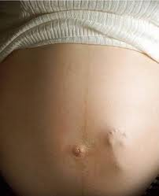
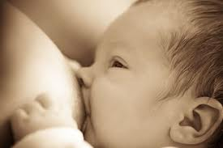
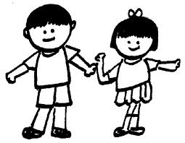
Don’t use fluoroquinolones for pregnant women nor to children under 18 cose it might causes Cartilage erosion and arthropathy ( have been reported) . Fluoroquinolones such as ciprofloxacin have traditionally not been used in infants because of concern about adverse effects on the infants' developing joints and The calcium in milk might decrease absorption of the small amounts when fluoroquinolones in milk

