Slide 1
Molecular biology first and second lectures Introduction and brief history
B y Dr. Sawsan Sajid Al-Jubori
References :
1-Essential of molecular biology by George M. Malacinski 4th edition
2-Second references: Molecular biology (principles and practice)

Slide 2
Identification of molecular biology :
It is the science deals with macromolecules and to understand the five basic behaviors patterns(growth , division , specialization ,movement and interaction)in terms of the fine
molecules responsible for them including (DNA ,RNA and Protein)
Freidrich Miescher (1869) : was a Swiss physician and biologist. He was the first researcher who isolate and identify nucleic acid. It was a phosphate-rich chemicals, which he called nuclein (now nucleic acids), from the nuclei of white blood cells without knowing it responsibility about inheritance. so he knew much of the nucleic acid chemistry but their function remained unknown till a century later . However, his discovery played an important part in the identification of nucleic acids as the carriers of inheritance
His student Altmaan (1889): succeed in isolation of nuclein in pure condition
Warren Weaver(1938):was the first biologist used the term molecular biology as new branch of science at that time the biochemists began to discover many fundamental chemical reactions and numerous properties of the cell

Slide 3
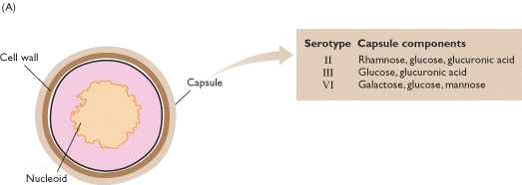
Griffith´s experiment to identify the genetic material(bacterial model)
Griffith's experiment, reported in 1928-29 by Frederick Griffith(british scientist) was one of the first experiments suggesting that bacteria are capable of transferring genetic information through a process known as transformation but he didnt realized the nature of the genetic materials
Griffith used two strains of pneumococcus (Streptococcus pneumoniae)which is gr+ bacteria infect mice – a type III-S (smooth) and type II-R (rough) strain. The III-S strain covers itself with a polysaccharide capsule that protects it from the host's immune system, resulting in the death of the host, while the II-R strain doesn't have that protective capsule and is defeated by the host's immune system.

Slide 4
Griffith's experiment discovering the"transforming principle" in Streptococcus pneumoniae bacteria

Slide 5
Avery–MacLeod–McCarty Experiment to prove the DNA is the genetic material
It was reported in 1944 ( as first described by Griffith's experiment in 1928) by Oswald Avery, Colin MacLeod, and Maclyn McCarty, to proof that DNA is the substance that causes bacterial transformation. They repeated the same steps of Griffith as it Start with
1- heat -killing Streptococcus pneumoniae ( virulent strain type III-S,)
-2- incubation along with living but non-virulent type II-R pneumococci,
-3- resulted in production of smooth colonies on media and a deadly infection of type III-S)
-4-then they designed new experiment depending on cell filtrate rather than the whole cells as follow

Slide 6
Avery and his colleagues زملاء ) (start to prove DNA is the genetic material responsible for heredity by transformation process تحول وراثي
1-They start with distraction cells of virulence s strain سلاله ضاريه to release the genetic material out side the cell then they took the extract and subjected to centrifuge to get read from all intact cells
2-They incubated the extract with R strain in cooled condition(4 cº) with the addition of CaCL2 كلوريد الكالسيوم then transfer to 42 cº (heat shock)
The results showed that the R strain convert to S strain after culturing on agar media.
They repeat the experiment by using only the DNA they notice the R strain converted to →S strain
In the second experiment they used polysaccharide instead of DNA the result was differ cos the R didn’t transform to S
Finally they treat cell filtrate of S strain with protease and ribonuclease and deoxyribonuclease
the process succeed with the first two enzymes but is inactivated by treatment with the third one.

Slide 7
Final conclusion (1944) . 1-The chemical analysis for the transformed cell contain nucleic acid rather than portion or poly-saccarid . 2-The physical analysis revealed that the nucleic acid was highly vicious rich with phosphoric acid Incubation the extract with Trypsin (proteas) or RNase didn’t stop transformation process and only DNase cause complete inhibition to the process thus they realize that the genetic material is the DNA rather than RNA or the protein 3- The final process called Transformation

Slide 8
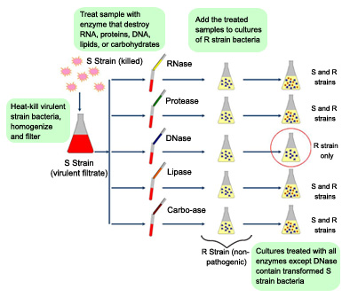

Slide 9
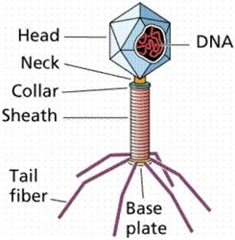
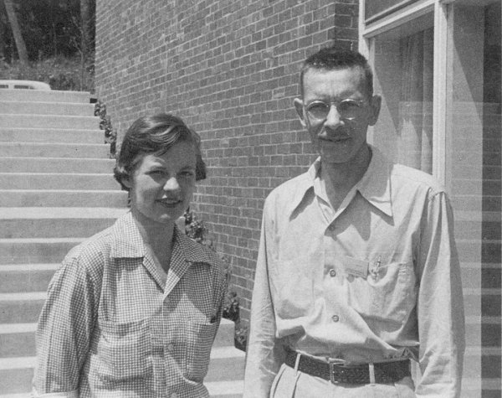
Hershey–Chase experiments to prove that the DNA IS the genetic material using virus (phage) model
Alfred Hershey and Martha Chase (1952)confirming that DNA was the genetic material (first demonstrated in 1944) using T2 phage virus
The phage consists of a protein shell(capsule) containing its genetic material(DNA). The phage infects a bacterium by attaching to its outer membrane by tail fiber then injecting its genetic material leaving its empty shell attached to the bacterium.

Slide 10
ERPIREMENT:
They depend on the differences between protein &DNA chemical structure (DNA contains :C, H,O,N and Ph while protein :C,H.O.N,S)
In their first set of experiments, Hershey and Chase labeled the DNA of phages with radioactive Phosphorus- P32 (the element phosphorus is present in DNA but not present in any of the 20 amino acids from which proteins are made). They allowed the phages to infect E. coli, and through several elegant experiments were able to observe the transfer of P32 labeled phage DNA into the cytoplasm of the bacterium
In their second set of experiments, they labeled the phages with radioactive Sulfur-35 (Sulfur is present in the amino acids cysteine and methionine, but not in DNA). Following infection of E. coli they then sheared the viral protein shells off of infected cells using a high-speed blender and separated the cells and viral coats by using a centrifuge.
After separation, the radioactive S35 tracer was observed in the protein shells, but not in the infected bacteria, supporting the hypothesis that the genetic material which infects the bacteria was DNA and not protein.
Hershey shared the 1969 Nobel Prize in Physiology or Medicine for his “discoveries concerning the genetic structure of viruses.”

Slide 12
Notes:
First figure

Slide 13
Another important findings in molecular biology science
1950 Rosalind franklin& Maurice Wilkins(using X-ray crystallographic equipment to solve the DNA problem at King's College\London to determine the 3 dimensional structure of the DNA or protein, according to this, A- DNA & B- DNA were described
George Beadle , Edward Tatum &Joshua Lederberg (1946-1956) Beadle and Tatum's key experiments involved exposing the bread mold Neurospora crassa to x-rays causing mutations to cause changes in specific enzymes involved in metabolic pathways. The Nobel Prize in Physiology or Medicine 1958 was divided, one half jointly to Beadle and Tatum "for their discovery that genes act by regulating definite chemical events" and the other half to Joshua Lederberg "for his discoveries concerning genetic recombination and the organization of the genetic material of bacteria
(1953)James Watson (USA) &Francis Crick\UK discovered DNA molecule (will be discused latter ) depending on franklin Wilkins X-ray model .they won the 1962 Nobel Prize in Medicine for their discovery of the structure of DNA. This was one of the most significant scientific discoveries of the 20th century
Francis Crick in 1958 established the theory of central dogma of molecular biology that is to say the genetic information follow from
DNA→RNA→PROTEIN

Slide 14
1957 Arthur Kornberg : was an American biochemist who won the Nobel Prize in Physiology or Medicine 1959 for his discovery of "the mechanisms in the biological synthesis of deoxyribonucleic acid by discovering DNA polymerase enzyme. His primary research interests in biochemistry especially enzymes of DNA replication, and studying the nucleic acids which control heredity in animals, plants, bacteria and viruses
1958 The Matthew Meselson and Franklin Stahl experiment : finding the semi conservative replication (discussed latter) . It has been called "the most beautiful experiment in biology
1960 Jacob andMonod (French biologist) : controlling and regulation the cell activity through operon . They shared the 1965 Nobel Prize in Medicine with André Lwoff
1960 Khorana was a biochemist who shared the 1968 Nobel Prize for Physiology or Medicine with Marshall Nirenberg and Robert Holley for research that helped to show how the nucleotides in nucleic acids, which carry the genetic code of the cell, control the cell’s synthesis of proteins
1969 Thomas Brock : is an American microbiologist known for his discovery of hyper thermophiles living in hot springs .In the late 1960s, Brock discovered high-temperature bacteria living in the Great Fountain region with his colleague . they isolated a sample named it Thermus aquaticus. By 1976, T. aquaticus was found useful for artificially amplifying DNA segments. Brock's discoveries led to great progress in biology, contributed to new developments in medicine and agriculture,

Slide 15
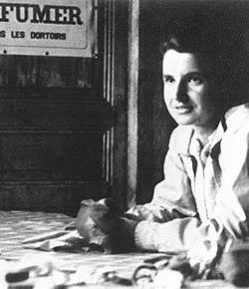
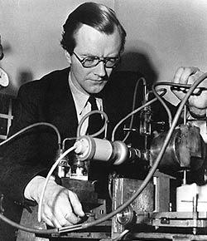
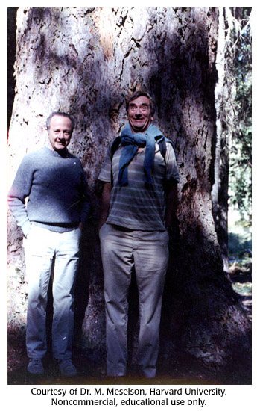
Rosalind franklin 1950
Maurice Wilkins 1950
James Watson(USA)&Francis Crick\UK 1953
Matt Meselson and Frank Stahl 1984

Slide 16
1970 : Arber and Meselson Arber and Meselson discovered type I restriction enzymes which cleave DNA randomly away from the recognition site.
Also In 1970, Smith, Kelly and Welcox isolated and characterized the first type II restriction enzyme, HindII, from the bacterium Haemophilus influenzae that cleave DNA at specific recognition sequence. Their discovery led to the development of recombinant DNA technology that allowed, for example, the large scale production of human insulin for diabetics using E. coli bacteria.
1973:Cohen, Paul Berg and Boyer made what would be one of the first genetic engineering experiments. They demonstrated that the gene for frog ribosomal RNA could be transferred into bacterial cells Escherichia coli by using a vector (plasmid) then expressed by them
Genetic engineering, also called genetic modification, is the direct manipulation of an organism's genome using biotechnology. New DNA may be inserted in the host of interest using molecular cloning methods to generate a modified DNA sequence

Slide 17
1977 Frederick Sanger (95years) :is a British biochemist who was twice awarded the Nobel Prize for Chemistry, the only person to have been so. In 1958 he was awarded a Nobel prize in chemistry "for his work on the structure of proteins, especially that of insulin". In 1980, Walter Gilbertand Sanger shared half of the chemistry prize "for their contributions concerning the determination of base sequences in nucleic acids".
1980 Maxam–Gilbert sequencing is a method of DNA sequencing developed by Allan Maxam and Walter Gilbert in 1976–1977. This method is based on nucleobase-specific partial chemical modification of DNA and subsequent cleavage of the DNA backbone at sites adjacent to the modified nucleotides.
1983 Kary Mullis American chemist start synthesis a desired DNA sequence and to copy it using polymerase chain reaction ( PCR Technique discussed latter ), a technique which would allow a small strand of DNA to be copied almost an infinite number of times. This has created revolutions in biochemistry, molecular biology, genetics, medicine and forensics. he shared the 1993 Nobel Prize in Chemistry with Michael Smith.
2007 The first recorded knockout genes in mouse was created by Mario R. Capecchi, Sir Martin Evans and Oliver Smithies, for which they were awarded the 2007 Nobel Prize in Physiology or Medicinen.

Slide 18
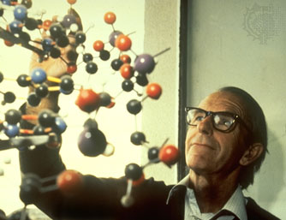
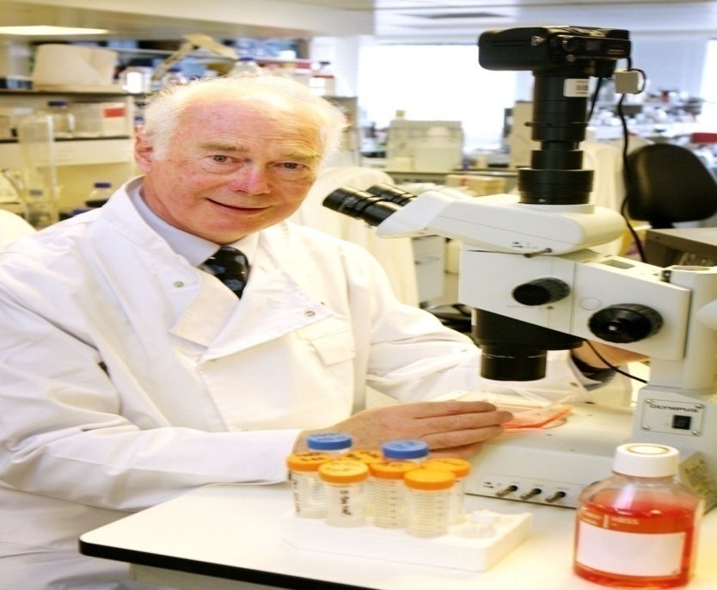
Kary mullis receiving his Nobel price
Frederick Sanger August 13, 1918 (age 95), United Kingdom
Sir Martin Evans Bioscience school cardiff university Nobel price 2007

Slide 19
biological system as experimental models
Bacteria :Prokaryotes unicellular free living cells .only one single chromosome not enclosed inside nucleus but it is free within the cytoplasm called nucleoid .the size of Escherichia coli(E.coli) is about 4,639,221 base pair (bp زوج قاعدة)or 4.6 Kbp (كيلو زوج قاعة نتروجينة) .it represent the best model to be used for many reason like easily to be cultured , relatively simple in their needs , short generation time (20 min for E.coli),best growth temperature 37cº so it complete DNA replication ,RNA transcription and Protein synthesis within few minutes
Bacteriophage : they represent the simplest form of life These infect the bacteria(there are animal ,plant human viruses) .unlike the bacteria, they are not free living (completely inert )once they enter the host they start replication depending on the machines of the host cell .it now used as cloning vector
Yeast: another experimental model but for Eukaryotic cell thus it contains chromosomes within a true nucleus surrounded with nuclear membrane .great deal of early biochemical research was carried out specially fermentation process ..now for molecular biologist, mutant strains of yeast often used to discover genes that control growth ,division ,and cell behavior.
Animal and plant cell : also could be used as a model in genetic experiments

