Slide 1
The 12th lecture in molecular biology by Dr. Sawsan sajid
RNA transcription and Post transcription events

Slide 2
General differences between transcription and replication:
 | Replication | Transcription
purpose | The purpose of replication is to conserve the entire genome for next generation. | The purpose of transcription is to make RNA copies of individual genes that the cell can use in the metabolic activity
Definition | DNA replication is the replication of a strand of DNA into two daughter strands, each daughter strand contains half of the original DNA double helix. | synthesis of RNA from a DNA template. 3 types will transcribed ,r RNA and t RNA are final product ,m RNA will translated to protein
products | One strand of DNA becomes 2 daughter strands. | mRNA, tRNA, rRNA and non-coding RNA( like microRNA)
Timing | It happened once the cell start division | At any time in the cell as required
Enzyme and results | The two strands are separated and then each strand's complementary DNA sequence is synthesized by DNA polymerase. The process required primers. | the codons of a gene are copied into messenger RNA by RNA polymerase. With the help of transfer RNA, which carries amino acids and r RNA the codon will translated to protein . The process required promoter

Slide 3
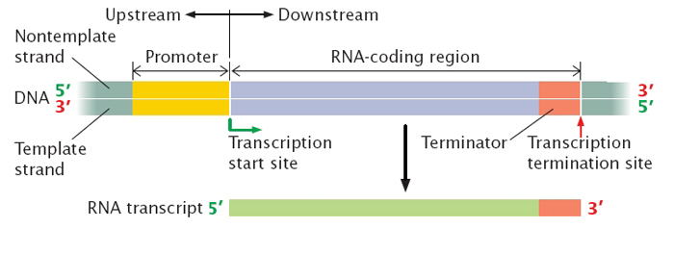
Transcription like replication need free 3́ end to add the complementary nucleotide ,also the direction of movement and polymerization of RNA polymerase from 5́→3́ .The transcript sequence(complete gene ) start with promoter region where the DNA will opened and the RNA polymerase bind to start transcription .After promoter region another region come called +1 (beginning of transcription )then the coding region followed by Terminator .All the mentioned region represent complete structure for one gene
differences | Replication | Transcription
Initiation need | primer ,DnaA box & initiation protein | Require promoter region
Template | The 2 strands serve as a template | Only template strand(3→5)
Involved area | The total genome will replicate | precise part will transcribed

Slide 4
Identifications :
1- promoter (مثير او حفاز): a regulatory nucleotide sequences of DNA (40-60 nts) at the beginning of every gene located upstream (towards the 5' region) of a gene(in prokaryote more than one gene shard the same promoter unlike Eukaryotic cell ) on the template or sense strand. in this site the two DNA strand will opened but it is un translated area by providing a control point for regulated gene transcription. In prokaryotes, the promoter is recognized by RNA polymerase (δ sigma sub unite) cos it has great affinity to bind to this region .There are great differences between promoter area of Pro and Eukaryotic cell as it is divided to many sub regions.
2- Coding region : Nucleotide sequences which will detriment the genetic code then will translated to Amino acid .it start with ATG triplet initiation codon (AUG in m RNA) .the length of coding region depend on type of produced protein
3- Terminator (ناهي او فاصل):Nucleotide sequences exist after the coding region rich with poly G followed by poly C then poly A

Slide 5
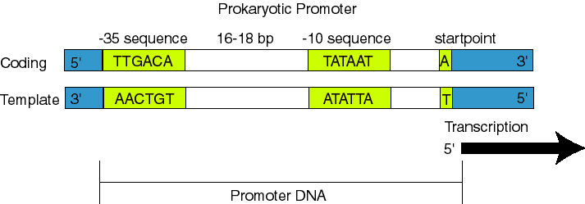
Difference between Eukaryotic and Prokaryotic Promoters
1- Prokaryotic promoters
the promoter consists of two short sequences know as -10 box and -35 box positions upstream from the transcription start site.
The sequence at -10box is also called the Pribnow box(according to David Pribnow how discover this elements 1975) , or the -10 element, and usually consists of the six nucleotides TATAAT. The Pribnow box is absolutely essential to start transcription in prokaryotes since it rich with T & A nitrogen bases .
The other sequence is -35 box ( -35 element) usually consists of the six nucleotides TTGACA. RNA polymerase attached here via its sigma unit . The two boxes separated by 17 ±1 base pairs .

Slide 6
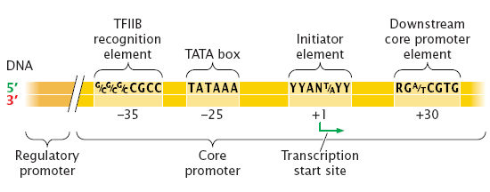
There are differences between promoter region in pro and Eukaryotic cell and for sure this promoter region will not translate to protein .
Eukaryotic promoters more complicated and divided to many sub regions
1- regulatory promoter to regulate promoter activity. …
2-core promoter :divided to many region as with prokaryotic promoter to
A- recognition element at -35 box(in other reference -30 or -75)in all cases it is rich with GC nts thus DNA will not opened here .
B- TATA box at -25 box (in other references at -26 or -29 ) as with -10 box in prokaryotic it is rich with AT nts thus the two DNA strand will opened here( it located 25 nts far away from the start point +1 ). Discovered by David Hogness in 1977 thus it is called Hogness box.RNA polymerase will bind to -35 box but the strand opened here.
C-initiator elements(Inr) : represent transcription start point (from -2 to +4)including +1
D-Down stream core promoter element(DPE): at +20 to +32 region note: TATA –Inr—DPE approximately 80bp play critical role in transcription process . After that the codon region come with only one gene sequence cos it is monocistronic

Slide 7
Structure of RNA polymerase :
RNA polymerase I : it is a large molecule consist from core enzyme (has five subunits (~400 kDa)) + 6th sigma subunit.
1- β‘ it is the largest subunit. The β' subunit contains part of the active center responsible for RNA synthesis and contains some of the determinants for interactions with DNA (binding the enzyme with the template) .
2-β:it is the second-largest subunit contains the rest of the active center responsible for RNA synthesis by binding with the nucleotides(elongation step)
3- α^{I} and α^{II}: The α subunit is the third-largest subunit and is present in two copies per molecule of RNAP, α^{I} and α^{II}. Each α subunit contains two domains for assembly of RNA Polymerase and for interaction with promoter DNA,
4- ω: The ω subunit is the smallest subunit. The ω subunit facilitates assembly of the enzyme and stabilizes assembled RNA Polymerase
5- In order to bind promoters, RNAP core associates with the transcription initiation factor sigma (σ) to form RNA polymerase holoenzyme. Sigma increasing affinity specificity for promoters, allowing transcription to initiate at correct sites. The complete holoenzyme therefore has 6 subunits: β'βα^{I} and α^{II}ωσ (total molecular weight for the enzyme ~450 kDa).

Slide 8
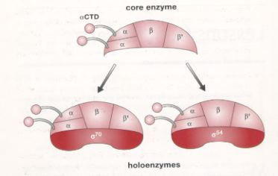
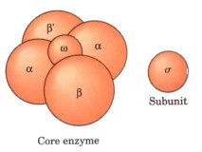
The RNA polymerase enzyme consist from core (5 units ) and another 6th unit called sigma δ 70 is more predominant type in E. coli). after core binding with sigma it will convert to holoenzyme .sigma subunit play significant role in recognition promoter region then it will released leaving core continue transcription RNA from template

Slide 9
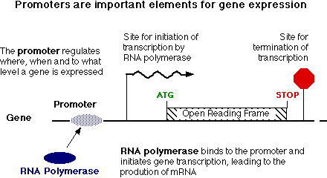
Types of Eukaryotic RNA polymerase. The 3 main types I,II, III beside there are type IV and V in plant
Type of Polymerase | Responsible to Produce | Location
RNA Polymerase I | rRNA(18 s , 5.8s, 28s) | nucleolus
RNA Polymerase II | mRNA and small nuclear RNA | nucleoplasm
RNA Polymerase III | tRNA and 5s r RNA | nucleoplasm

Slide 10
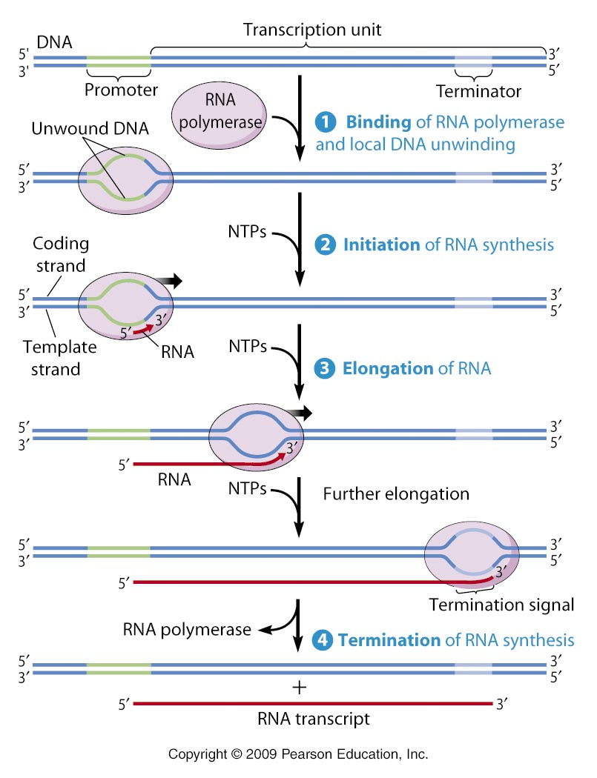
Transcription steps :As with replication ,the 3 steps are:
1-Initiation 2- Elongation 3- Termination

Slide 11
1-Initiation stage : RNA polymerase action and role of sigma factor
RNA polymerase binding in bacteria: involves recognizing core promoter region by sigma factor then binding to -35 box forming closed complex also the α subunit C-terminal domain help in recognizing promoter upstream elements. Usually in E. coli, σ⁷⁰ is expressed under normal conditions and recognizes promoters for genes required under normal conditions (house-keeping genes), while σ³² recognizes promoters for genes required at high temperatures (heat-shock genes).
After binding to the DNA, the RNA polymerase switches from a closed complex to an open complex at -10 box . This change involves the separation of the DNA strands to form an unwound DNA strand of approximately 13 bp, referred to as the transcription bubble. Ribonucleotides are base-paired to the template DNA strand, according to Watson-Crick base-pairing interactions. Super coiling plays an important part in polymerase activity because of the unwinding and rewinding of DNA. Usually regions of DNA in front of RNA Polymerase are unwound while regions behind RNAP are rewound and negative super coiled are present.المنطقة التي قبل الانزيم تكون مفتوحة لتسهل عملية الاستنساخ وحالما تنتهي المنطقة من الاستنساخ فانها تعاود الارتباط والقفل من وراء الانزيم وتتكون فقاعة تمشي على طول الدنا المستنسخة والاشرطة لا تفتح مرة واحدة وانما بمعدل 20- 17قاعدة لتغلق من الجهة الثانية من الاستنساخ ز

Slide 12
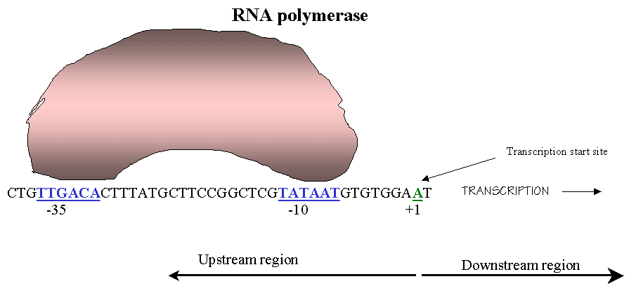
The figure represent binding RNA molecules to promoter region at -35 box then to -10 box at the upstream region from the coding region which represent the stream down region . Movement will be from 5 →3 end as in replication

Slide 13
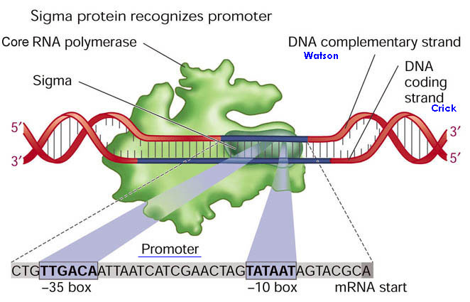
The figure represent transcription initiation complex consist from RNA polymerase binding to DNA template strand which read from 3→5 (not coding strand which read 5→3) .sigma sub unit bind to -35 box then moved to -10 box in which the DNA strand opened . Transcription start at +1 position

Slide 14
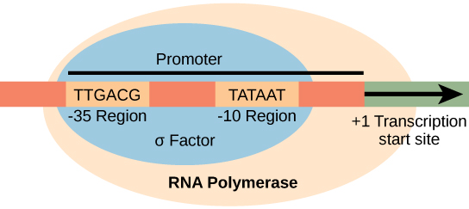
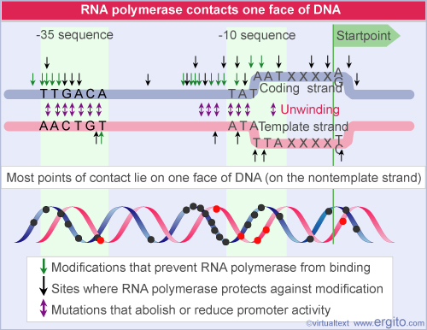
This figure shows formation of opened complex or transcriptional bubble at -10 region . This bubble will move all along the transcript gene till reaching the terminator sequence . At the beginning sigma factor will bind to promoter region when the holo-enzyme reach +1 region it will start adding 9-10 nts according to complementary without moving after that sigma factor will release leaving the core enzyme continue its work transcribed the total gene sequence
ATP-dependent unwinding enzyme

Slide 15
Second step: Elongation
Transcription elongation involves the further addition of ribonucleotides and the change of the open complex(at -10 box) to the transcriptional complex. RNA P cannot start forming full length transcripts because of its strong binding to the promoter so it must leave promoter region and further progress . Transcription at this stage primarily results in short RNA fragments of around 10- 9bp . Once the RNAP starts forming longer transcripts after leaving the promoter ( σ factor falls off RNAP). This allows the rest of the RNAP complex (core RNA polymerase )to move forward.
As transcription progresses, ribonucleotides are added to the 3' end of the RNA transcript and the RNAP complex moves along the DNA. The enzyme is highly possessive ,it can add 30 nts \sec .
Although RNAP does not seem to have the 3'exonuclease activity that characterizes the proofreading activity found in DNA polymerase, there is evidence of that RNAP will halts (يتوقف ) at mismatched base-pairs and correct it.

Slide 16
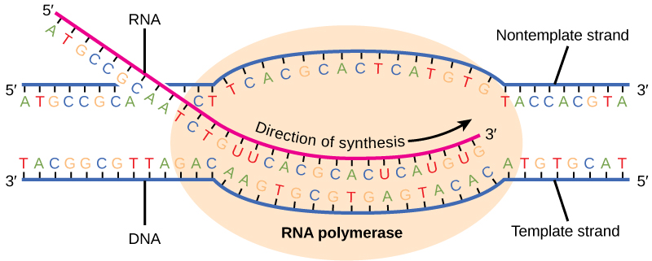
This figure shows transcriptional bubbles moving along the DNA template and the nascent RNA (سلسلة متنامية ) get longer, growing from 5→3 direction . Notice that all T nitrogen base will replaced by U in the transcribed RNA

Slide 17
Termination: In prokaryotes can be rho-independent or rho-dependent
1-Rho-independent transcription termination:Intrinsic termination (also called Rho-independent termination) is a mechanism in prokaryotes that causes RNA transcription to be stopped without the aid of rho protein. When Transcription process reached a region called TERMINTATOR or attenuator ( a Palindrome region of DNA(this will causes the formation of a "hairpin" structure تركيب يشبه دبوس الشعر from the RNA transcription looping and binding upon itself. This hairpin structure is often rich in G-C base-pairs, making it more stable than the DNA-RNA hybrid itself. So In this mechanism, the mRNA contains a sequence that can base pair with itself to form a stem-loop structure(7-20 repeated CG thus RNA here will be double stranded)These bases form three hydrogen bonds between each other therefore are particularly strong. Following the stem-loop structure is a chain of uracil residues (in the DNA there will poly A ) . The bonds between uracil and adenine are very weak. A protein (nusA) binds to RNA polymerase and the stem-loop structure tightly enough to cause the polymerase to temporarily stall يتوقف . The weak Adenine-Uracil bonds lower the energy of destabilization for the RNA-DNA duplex, allowing it to unwind and dissociate from the RNA polymerase.

Slide 18
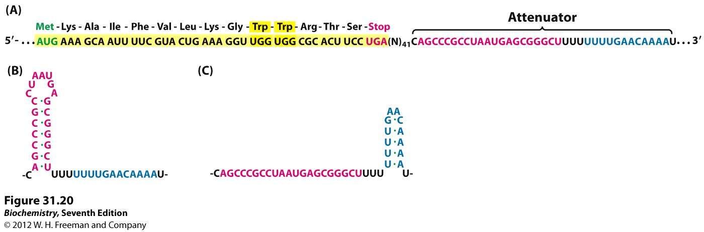
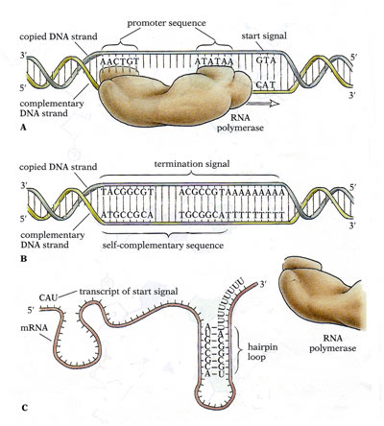

Slide 19
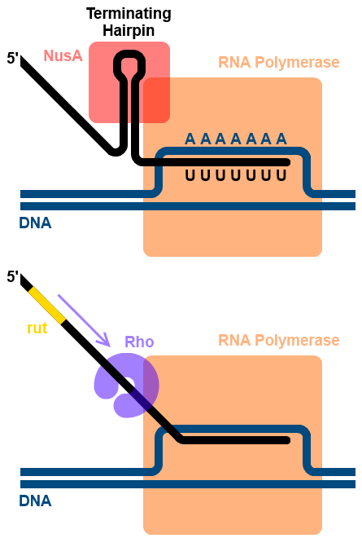
Rho-dependent termination: (Rho factor) is a prokaryotic ATP-dependent unwinding enzyme involved in termination transcription. It discovered by Jeffrey Roberts in 1969 ,consist from 6 subunits arranged as opened hexameric ring and binds to the transcription terminator sit by moving along the newly forming RNA molecule towards its 3' end and unwinding it from the DNA template thus it will release RNA polymerase from the transcription elongation complex leaving RNA molecules free . .

Slide 20
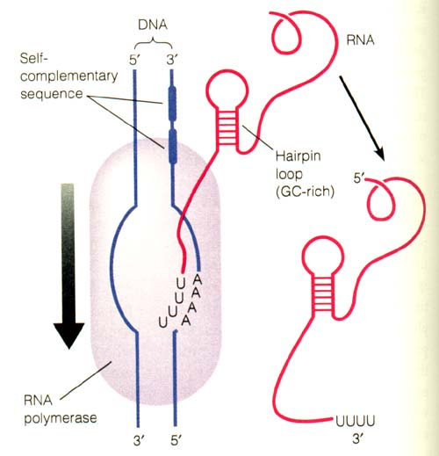
للاطلاع :الية تكون دبوس الشعر وانهاء الاستنساخ بطريقة
RHO- independent termination

Slide 21
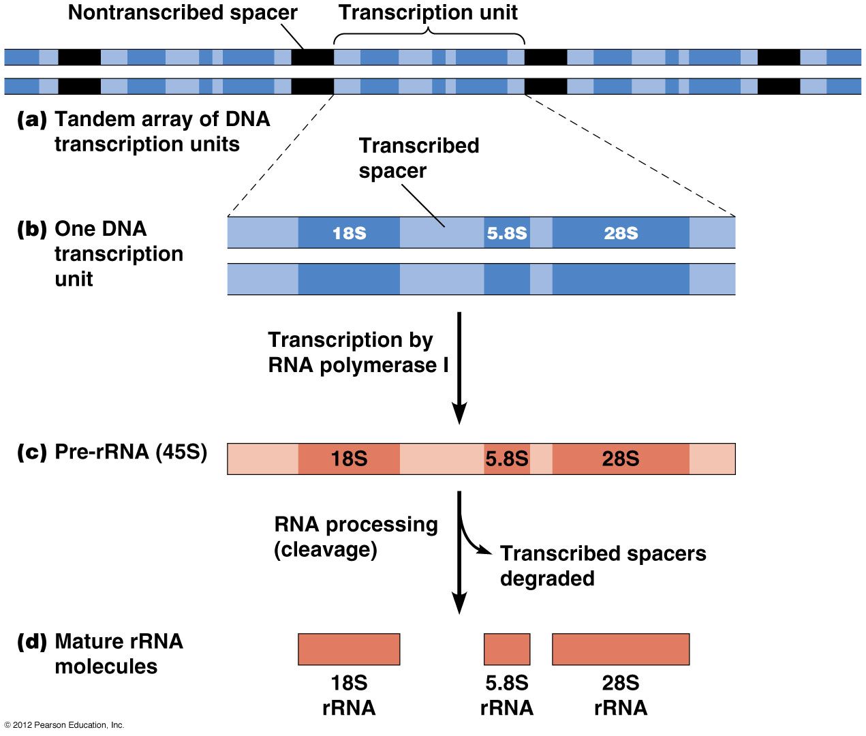
Post transcriptional events :each of transcript RNA type will subjected to modification events after ending transcription as follow : for rRNA, at the beginning it produced as one precursor unit ,in Eukaryotic cell known as 45s pre-RNA it will methelated & cleaved by endonuclease enzyme beside removing all the spaces(spacers) between rRNA types to convert to mature18s, 5.8s and 28s

Slide 22
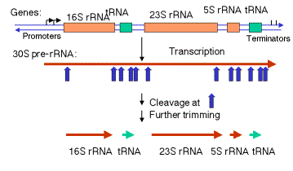
The same events will happened with prokaryotic rRNA . it produced as one segment known as 30s pre-rRNA then it will cleaved by endonuclease followed by Trimming(تعديل )by exonuclease enzyme to convert it to mature 16s,23s and 5s beside the transcript tRNA

Slide 23
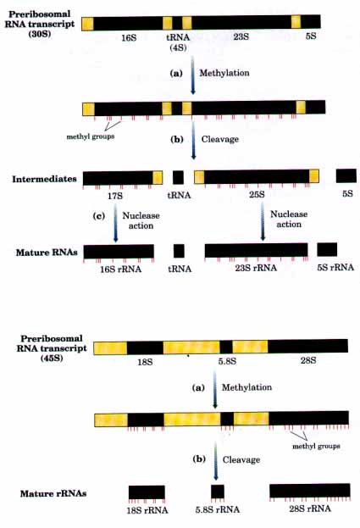
للاطلاع :استنساخ الرنا الرايبوسي بشكل بادئ اولي كقطعة واحدة تتعرض لمثيلة باضافة مجاميع مثيل ثم لتقطيع من قبل انزيمات هضم داخلية وخارجية لتتحول الى رنا رايبوسي كاملة جاهزة للعمل

Slide 24
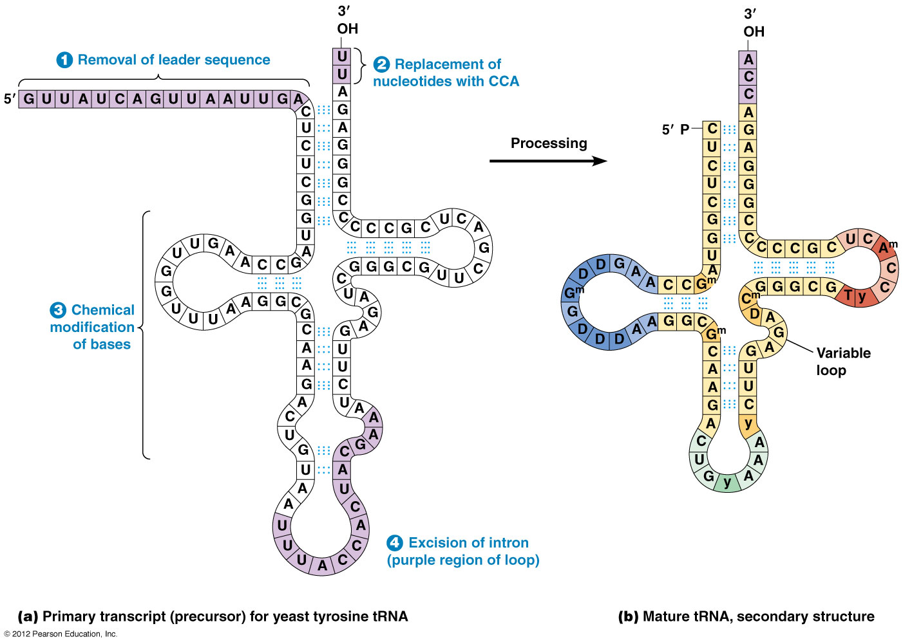
For tRNA molecules ,post transcriptional events include modification of some nitrogen base like pseudouridin and thymine (راجع تركيب الرنا الناقل)but it is more complicated in Eukaryotic cell which involve 1-removel of leader sequence from 5 end 2-replcament of nts at 3 end with CCA3́ OH (Acceptor arm) 3- chemical modification of some nitrogen base 4- Excision of intron region ,

Slide 25
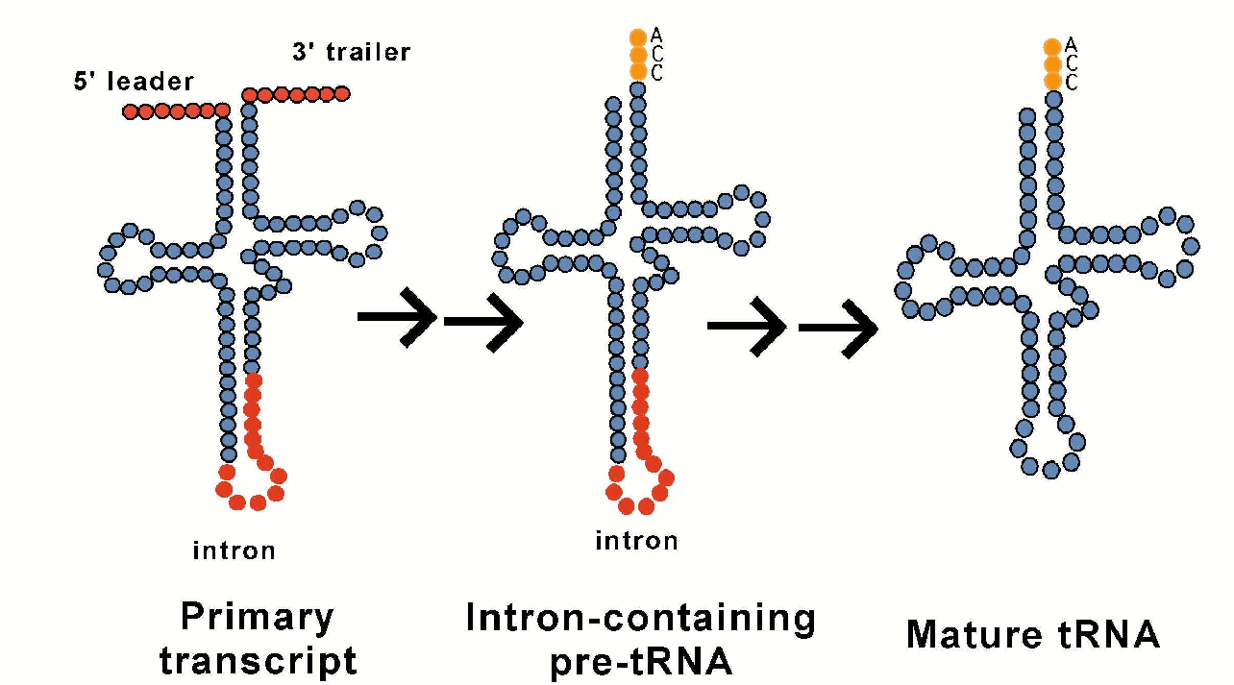
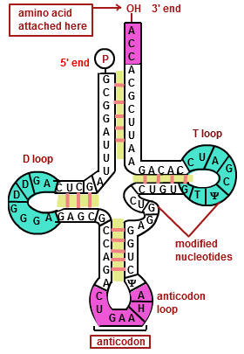
الاشكال توضح خطوات تحوير الرنا الناقل في حقيقية النواة وصولا الى الشكل النهائي

Slide 26
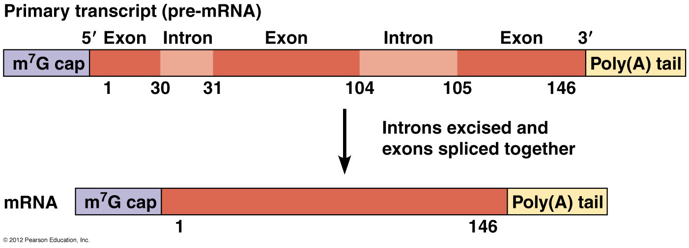
Modification of m RNA :usually m RNA in prokaryotic cell not modified after transcription cos it will be translated to protein immediately but in Eukaryotic cell there will a lot of modification which take place till reaching the final mature form , this modifications include
1- processing: adding cap structure at 5́ end and poly A tail to 3́ end
2- splicing : involve removing all the introns (non coding region )keeping only the exons to create complete sequence for one gene , usually the transcript m RNA is shorter than the origin gene it self

Slide 27
mRNA Processing: Eukaryotic pre-mRNA receives a 5' cap and a 3' poly-A tail before introns are removed and the mRNA is considered ready for translation.
1- For the processing it include 1 -adding cap structure at 5 end to protect mRNA from degradation by endonuclease enzyme thus it may remain for days . Cap structure formed by addding 3 phosphate group for 5 end followed by adding Guanosine residue to form guanosine tri phosphate then guanosine will methylated at 7 carbon atom to become 7 methyl guanosin (m7 G cap) .
2-Polyadenylation (poly Adenine residue ) is the addition of poly(A) tail to a primary transcript mRNA. The poly(A) tail consists of multiple adenosine monophosphates; in other words, it is a stretch of RNA that has only adenine bases. In eukaryotes, polyadenylation is part of the process that produces mature messenger RNA (mRNA) for translation. It, therefore, forms part of the larger process of gene expression.the poly(A) tail will protects the mRNA molecule from enzymatic degradation in the cytoplasm and aids in transcription termination. All Eukaryotic mRNA are methylated . The enzyme responsible for adding a string of approximately 200 poly A residues, is called polyadenylate polymerase.

Slide 28
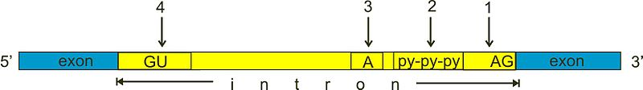
2- Pre-mRNA Splicing (Introns are removed from the pre-mRNA before protein synthesis): Eukaryotic genes are composed of exons, which correspond to protein-coding sequences (ex-on signifies that they are expressedيتم التعبير عنها جينيا ), and intervening sequencesتسلسلات بينية او متبادلة س called introns (non expressed sequence) which may be involved in gene regulation, but are removed from the pre-mRNA during processing. Intron sequences in mRNA do not encode functional proteins All introns in a pre-mRNA must be completely and precisely removed before protein synthesis. 1-The first cleavage occur by Splicesome machine at 5́end of the intron region rich with GU residue 2- then the intron bend back (ينحني للخلف ليكون تركيب يشبه الطوق )to form lariat structure via 5́ 3́ phosphodiester bond 3- cleavage at 3́end of the intron to completely released 4- joining the exons by ligase enzyme to give arise to mature mRNA .
س

Slide 29
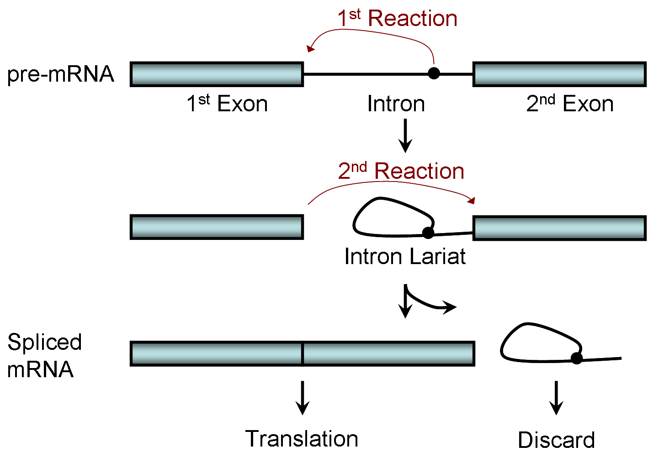
The process of removing introns and reconnecting exons is called splicing. Introns are removed and degraded while the pre-mRNA is still in the nucleus. Splicing occurs by a sequence-specific mechanism that ensures introns will be removed and exons rejoined with the accuracy and precision of a single nucleotide. The splicing of pre-mRNAs is conducted by complexes of proteins and RNA molecules called spliceosomes . The spliced m RNA now is ready for TRANSLATION , the last step in gene processing (اخر خطوة بالتعبير الجيني )

Slide 30
