Slide 1
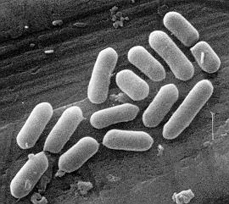
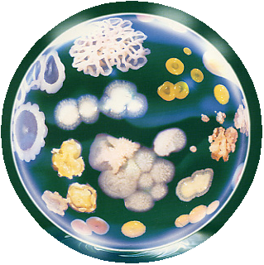
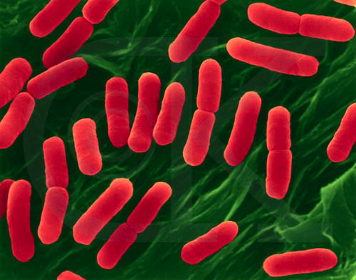
Lecture 14th in molecular biology Control of gene expression in prokaryotes
(Regulation of gene expression)

Slide 2
Bacterial genes
Bacterial genes can be classified according to their expression into:
A constitutive gene is a gene that is transcribed continually as opposed to an inducible gene, which is only transcribed when needed.
A housekeeping gene is typically a constitutive gene that is transcribed at a relatively constant level. The housekeeping gene's products are typically needed for maintenance of the cell. It is generally assumed that their expression is unaffected by experimental conditions.
A inducible gene is a gene only transcribed when needed as opposed to a constitutive gene. An inducible gene is a gene whose expression is either responsive to environmental change or dependent on the position in the cell cycle.
Operons can be found as constitutive genes or inducible genes

Slide 3
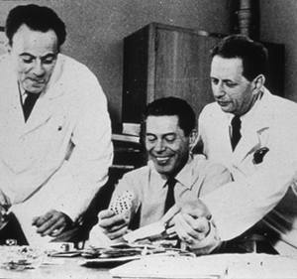
Jacob, Monod & Lwoff
François Jacob and Jacques Monod published in The Journal of Molecular Biology an article presenting the discovery of the first genetic regulation system of protein synthesis called the “operon”system.
Inspired by André Lwoff who was leading the Department of Bacterial Physiology at the Pasteur Institute

Slide 4
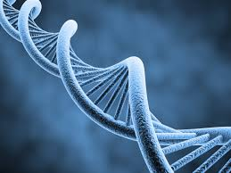
operon is a functioning unit of genomic DNA containing a cluster of genes under the control of a single promoter. The genes are transcribed together into an mRNA strand and either translated together in the cytoplasm, or undergo trans-splicing to create monocistronic mRNAs that are translated separately, i.e. several strands of mRNA that each encode a single gene product. The result of this is that the genes contained in the operon are either expressed together or not at all. Several genes must be co-transcribed to define an operon

Slide 5
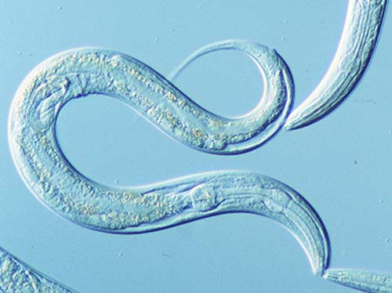
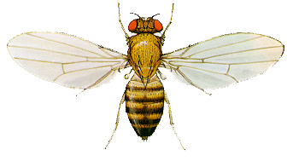
operons were thought to exist solely in prokaryotes, but operons exist also in eukaryotes ( nematodes such as Caenorhabditis elegans and the fruit fly, Drosophila melanogaster) In general, expression of prokaryotic operons leads to the generation of polycistronic mRNAs, while eukaryotic operons lead to monocistronic mRNAs

Slide 6
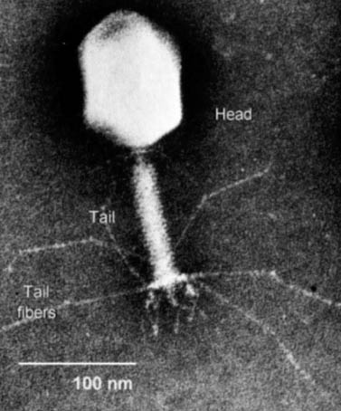
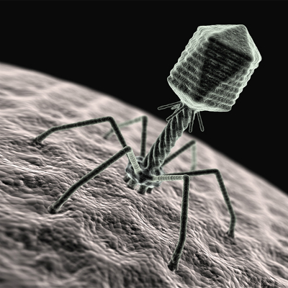
Operons are also found in viruses such as bacteriophages. For example, T7 phages have two operons. The first operon codes for various products, including a special T7 RNA polymerase which can bind to and transcribe the second operon. The second operon includes a lysis gene meant to cause the host cell to burst

Slide 7
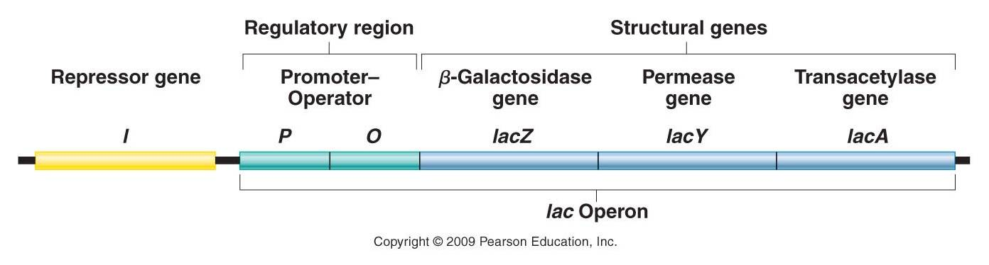
An operon is made up of 3 basic DNA components:
Promoter – a nucleotide sequence recognized by RNA polymerase, which then initiates transcription. In RNA synthesis, promoters indicate which genes should be used for messenger RNA creation – and, by extension, control which proteins the cell produces.
Operator – a segment of DNA that a repressor binds to. It is classically defined in the lac operon as a segment between the promoter and the genes of the operon. In the case of a repressor, the repressor protein physically obstructs the RNA polymerase from transcribing the genes.
Structural genes – the genes that are co-regulated by the operon.

Slide 8
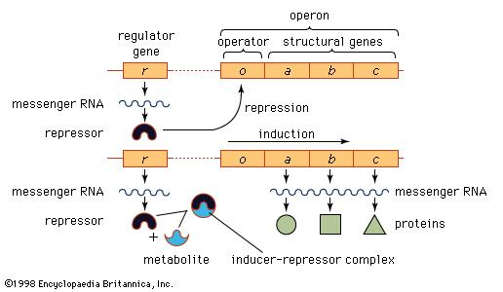
operon

Slide 9
Induction or repression
Operons can be positively controlled. With positive control, an activator protein stimulates transcription by binding to DNA (usually at a site other than the operator).
In positive inducible operons, activator proteins are normally unable to bind to the pertinent DNA. When an inducer is bound by the activator protein, it undergoes a change in conformation so that it can bind to the DNA and activate transcription.
In positive repressible operons, the activator proteins are normally bound to the pertinent DNA segment. However, when an inhibitor is bound by the activator, it is prevented from binding the DNA. This stops activation and transcription of the system.

Slide 10
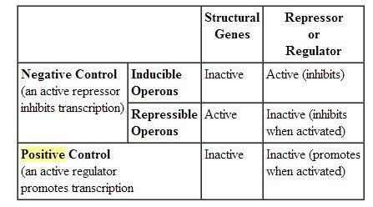

Slide 11
Lac operon
The lac operon (lactose operon) is an operon required for the transport and metabolism of lactose in Escherichia coli and many other enteric bacteria. Although glucose is the preferred carbon source for most bacteria, the lac operon allows for the effective digestion of lactose when glucose is not available. Bacterial operons are polycistronic transcripts that are able to produce multiple proteins from one mRNA transcript. In this case, when lactose is required as a sugar source for the bacterium, the three genes of the lac operon can be expressed and their subsequent proteins translated: lacZ, lacY, and lacA. The gene product of lacZ is β-galactosidasewhich cleaves lactose, a disaccharide, into glucose and galactose. lacY encodes lactose permease, a protein which becomes embedded in the cytoplasmic membrane to enable transport of lactose into the cell. Finally, lacA encodes galactoside O-acetyltransferase.

Slide 12
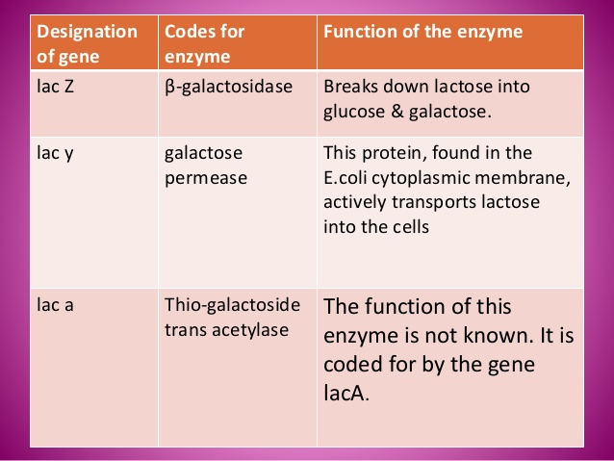
Enzymes of Lac operon

Slide 13
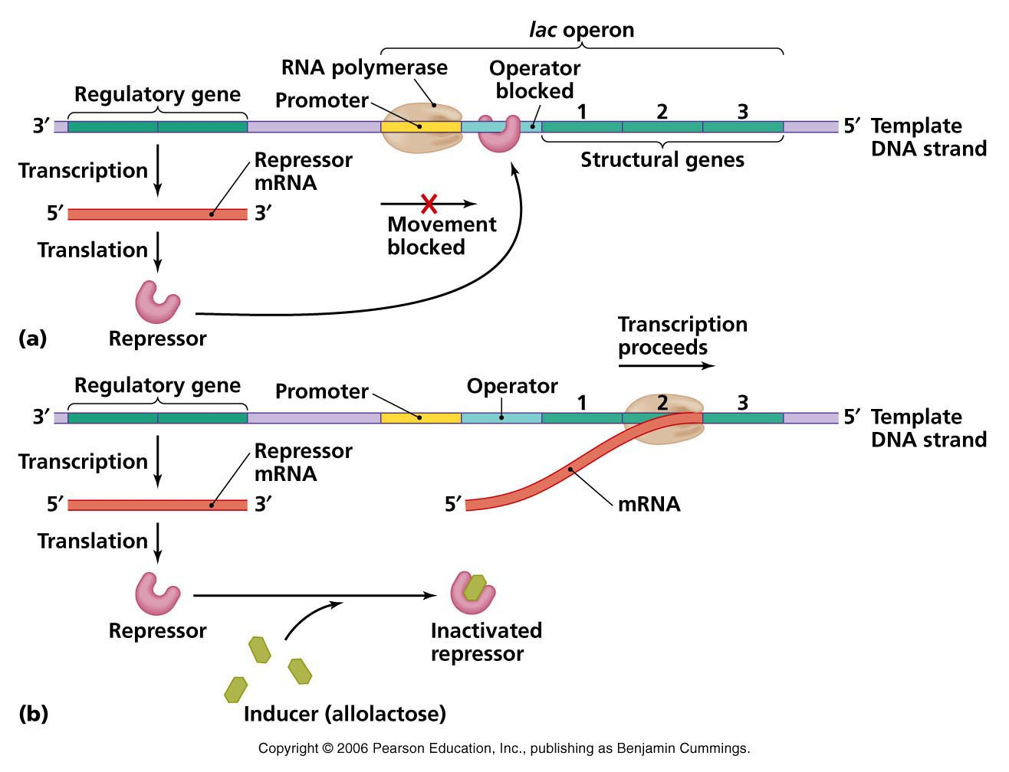

Slide 14
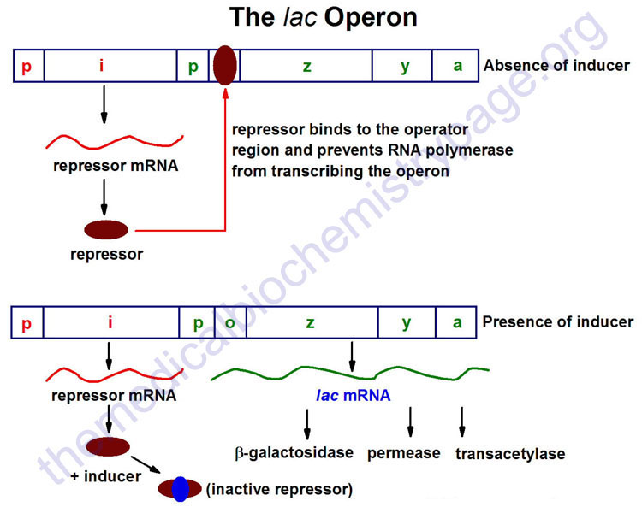

Slide 15
Catabolite Repression of the lac Operon
Lactose is not the preferred carbohydrate source for E. coli. If lactose and glucose are present, the cell will use all of the glucose before the lac operon is turned on. This type of control is termed catabolite repression. To prevent lactose metabolism, a second level of control of gene expression exists. The promoter of the lac operon has two binding sites. One site is the location where RNA polymerase binds. The second location is the binding site for a complex between the catabolite activator protein (CAP) and cyclic AMP (cAMP). The binding of the CAP-cAMP complex to the promoter site is required for transcription of the lac operon. The presence of this complex is closely associated with the presence of glucose in the cell. As the concentration of glucose increases the amount of cAMP decreases. As the cAMP decreases, the amount of complex decreases. This decrease in the complex inactivates the promoter, and the lac operon is turned off. Because the CAP-cAMP complex is needed for transcription, the complex exerts a positive control over the expression of the lac operon.

Slide 16
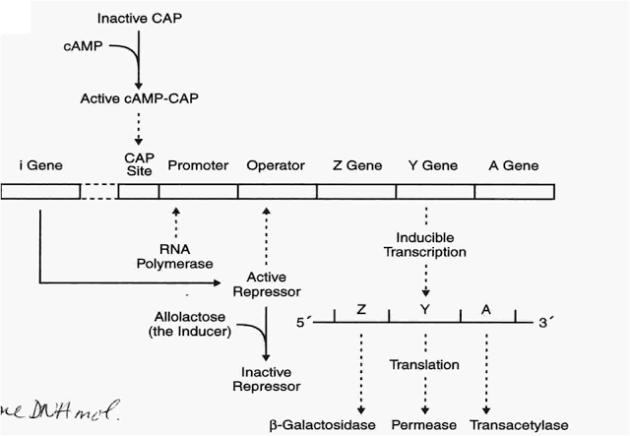
CAP-cAMP binds Lac promoter and induces transcription
When would this occur, when glucose is high low? Answer--low
Glucose high cAMP low
Glucose low cAMP high
  catabolite activator protein (CAP)

Slide 17
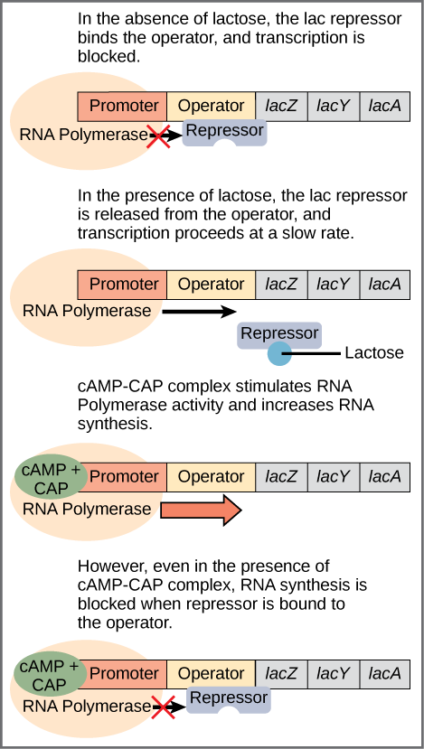

Slide 18
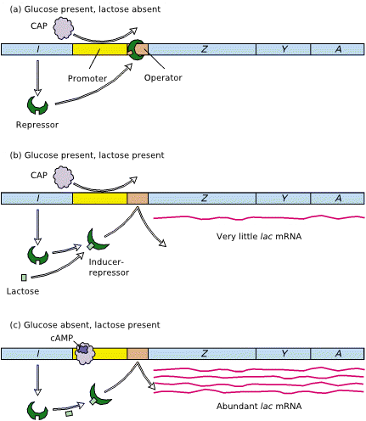
In the presence of glucose and absence of lactose, the transcription of the lac operon is repressed. The lac repressor is bound to the lac operator and CAP is not bound to its control site due to low levels of cAMP. The addition of the inducer lactose to media and its binding to the lac repressor causes the repressor to undergo a conformational change and dissociate from the lac operator sequence . However, if glucose still is present in the medium, CAP cannot bind to its site and transcription is relatively low. Finally, in the absence of glucose and presence of lactose, cAMP levels become high. cAMP binds to CAP, and the complex binds to the control site, strongly activating transcription by RNA polymerase

Slide 19
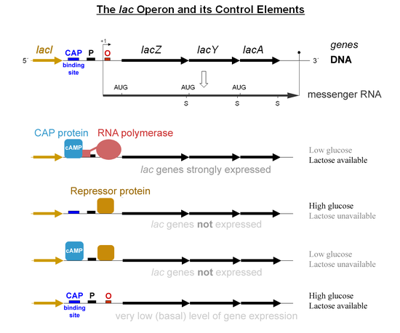

Slide 20
Summary
Carbohydrates | Activator protein | Repressor protein | RNA polymerase | lac Operon
+ GLUCOSE + LACTOSE | Not bound to DNA | Lifted off operator site | Keeps falling off promoter site | No transcription
+ GLUCOSE - LACTOSE | Not bound to DNA | Bound to operator site | Blocked by the repressor | No transcription
- GLUCOSE - LACTOSE | Bound to DNA | Bound to operator site | Blocked by the repressor | No transcription
- GLUCOSE + LACTOSE | Bound to DNA | Lifted off operator site | Sits on the promoter site | Transcription

Slide 21
trp operon
Bacteria such as Escherichia coli need amino acids to survive—because, like us, they need to build proteins. One of the amino acids they need is tryptophan. If tryptophan is available in the environment, E. coli will take it up and use it to build proteins. However, E. coli can also make their own tryptophan using enzymes that are encoded by five genes. These five genes are located next to each If tryptophan is present in the environment, then E. coli bacteria don't need to synthesize it, so transcription of the genes in the trp operon is switched "off." When tryptophan availability is low, on the other hand, the operon is switched "on," the genes are transcribed, biosynthetic enzymes are made, and more tryptophan is produced. These five genes are located next to each other in what is called the trp operon.

Slide 22
operator is recognized by a regulatory protein known as the trp repressor. When the repressor binds to the DNA of the operator, it keeps the operon from being transcribed by RNA polymerase. The trp repressor does not always bind to DNA. Instead, it binds and blocks transcription only when tryptophan is present. When tryptophan is around, it attaches to the repressor molecules and changes their shape so they become active. A small molecule like trytophan, which switches a repressor into its active state, is called a corepressor. When there is little tryptophan in the cell, on the other hand, the trp repressor is inactive (because no tryptophan is available to bind to and activate it). It does not attach to the DNA or block transcription, and this allows the trpoperon to be transcribed by RNA polymerase.

Slide 23
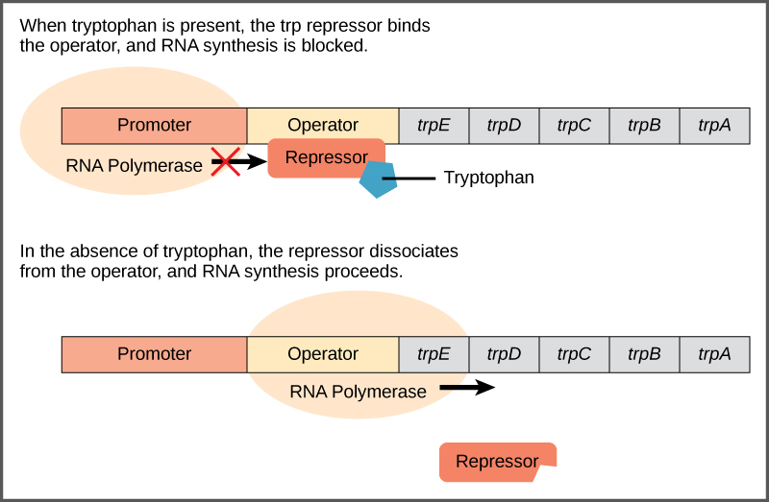

Slide 24
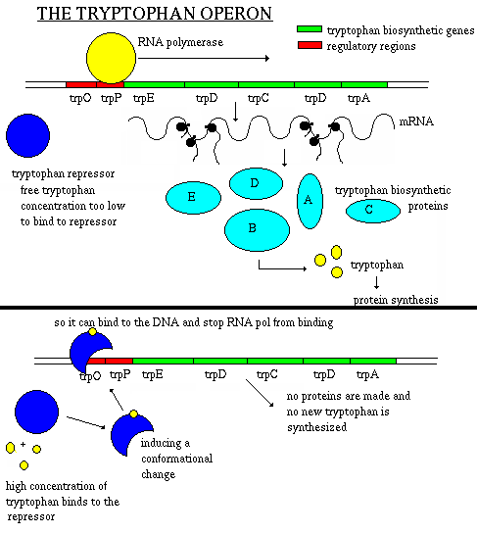

Slide 25
Attenuation
Like regulation by the trp repressor, attenuation is a mechanism for reducing expression of the trp operon when levels of tryptophan are high. However, rather than blocking initiation of transcription, attenuation prevents completion of transcription.
When levels of tryptophan are high, attenuation causes RNA polymerase to stop prematurely when it's transcribing the trp operon. Only a short, stubby mRNA is made, one that does not encode any tryptophan biosynthesis enzymes. Attenuation works through a mechanism that depends on coupling (the translation of an mRNA that is still in the process of being transcribed).

Slide 26
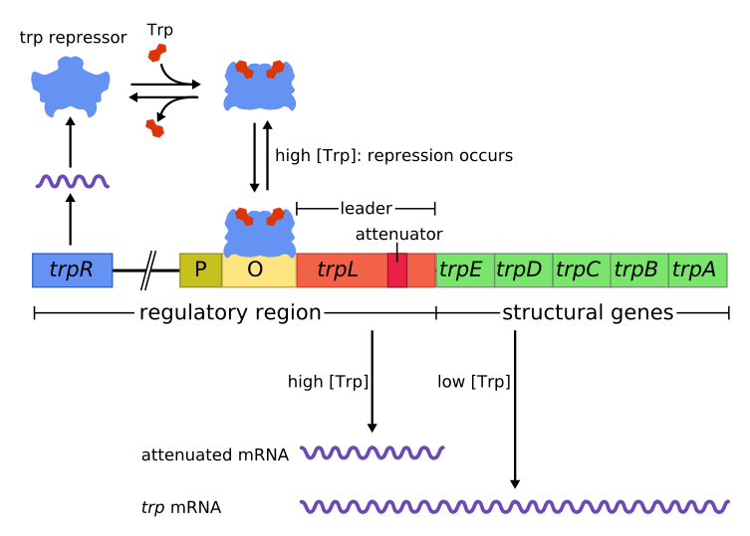

Slide 27
summery
Repressible operon
  usually functions in anabolic pathways
    synthesizing end products
  when end product is present in excess,
  cell allocates resources to other uses
Inducible operon
  usually functions in catabolic pathways,
    digesting nutrients to simpler molecules
  produce enzymes only when nutrient is available
    cell avoids making proteins that have nothing to do, cell allocates resources to other uses

