Slide 1
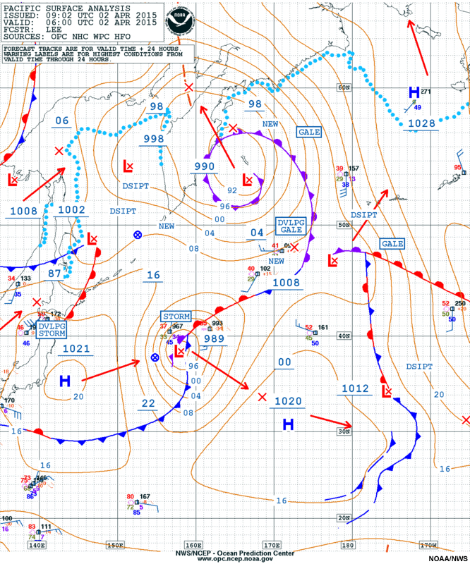
The Course of Synoptic Meteorology
Lecture 3
AL-MUSTANSIRIYAH UNIVERSITY
COLLEGE OF SCIENCES
ATMOSPHERIC SCIENCES DEPARTMENT
Dr. Sama Khalid Mohammed
SECOND CLASS

Slide 3
Upper air observations
Knowledge of temperature, humidity and wind at levels well above the ground form an essential part of the meteorologist’s basic data.
Variations of wind, temperature and water content occurring well above the ground are as important for weather analysis and forecasting as variations in these parameters at the surface.
Clearly, they cannot be measured by equipment on the ground, but information about the state of the upper air can be obtained in many ways, for example, aircraft reports, but the main one is by observations from balloon-borne equipment.
The WMO upper-level pressure, temperature, humidity, and wind report is called:
FM 35-IX Ext. TEMP for reports from land stations
FM 36-IX Ext. TEMP SHIP for reports from sea stations
FM 37-IX Ext. TEMP DROP for sondes released by a carrier balloon or an aircraft
FM 38-IX Ext. MOBIL for mobile land stations.

Slide 4
The code form is divided into four parts (i.e., Parts A, B, C, and D) for coding purposes. The coding procedures provide for coding each part as a separate message suitable for transmission. Each part can be transmitted separately but the complete report actually consists of four separate messages which may be collected individually in a bulletin, or in combinations.
TIME OF OBSERVATION
The standard times of upper-air soundings taken for synoptic purposes are 0000,0600, 1200, and 1800 UTC. If only two upper-air soundings are taken per day for synoptic purposes, they shall be taken at 0000 and 1200 UTC.
In the case of upper-air observations, the actual time of observation is the time the balloon is actually released to the nearest minute. The standard time of observation is the synoptic time, to the nearest whole hour, to which the sounding applies.

Slide 5
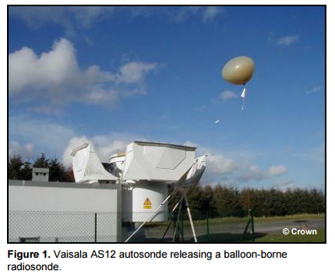
International agreement specifies that the time of regular upper-air sounding observations should be as close as possible to (H-30) and should not fall outside the time range (H-45) to (H), H referring to one of the four standard synoptic times of observations. Thus, the actual time of release of a balloon might be 1130 UTC, but the observation applies to 1200Z.
It should be noted that the time required for a radiosonde balloon to reach 90,000 feet is approximately 1 1/2 hours. Thus measurements of elements from high elevations may be an hour to 1 1/2 hours after the actual time of observation.

Slide 6
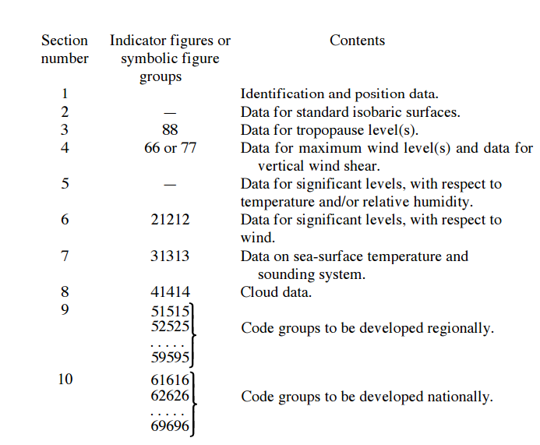
FORMAT OF THE UPPER-AIR REPORT
The code form is divided into ten sections as follows:

Slide 7
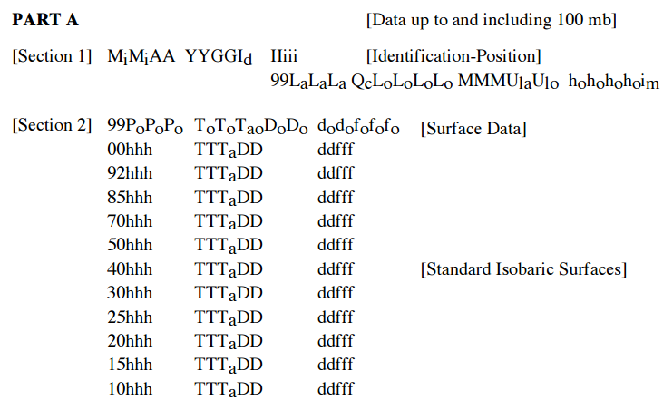
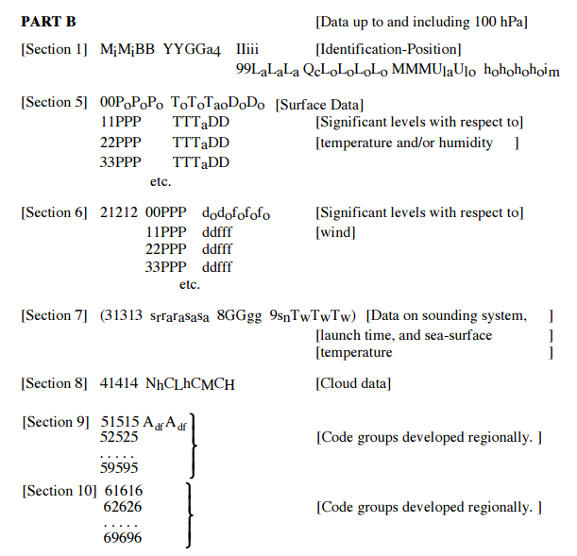
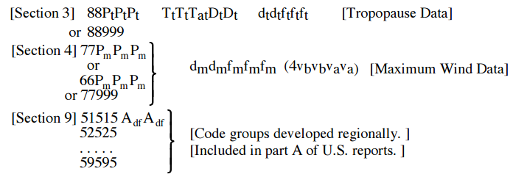
The code form is as follows:

Slide 8
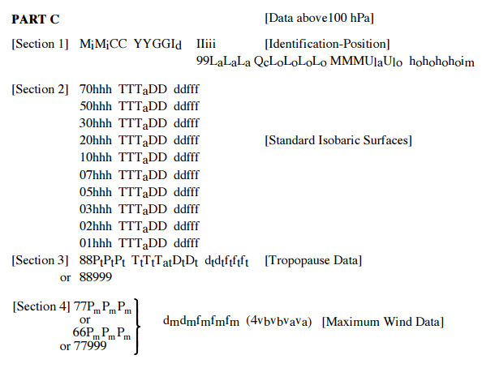
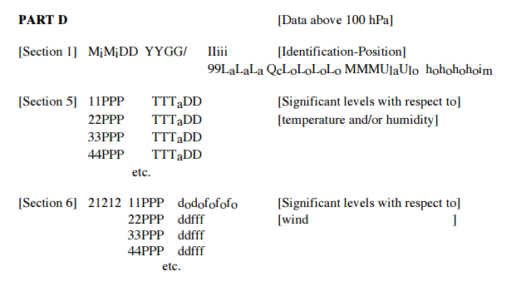

Slide 9
Pressure Surface
Each altitude above a point on the Earth’s surface has a unique value of pressure.
Pressure can be easily substituted for altitude as a coordinate to specify
locations in the vertical.
Rawinsondes determine the height of the instrument above Earth’s
surface by measuring pressure.
Because aircraft fly on constant pressure surfaces, upper air weather maps, first used extensively during World War II, traditionally have been plotted on constant pressure surface.
Fluid dynamics theories and equations that explain atmospheric motions are often in a more concise forms when they use pressure as a vertical coordinate.
A pressure surface is a surface above the ground where the pressure has a specific value, such as 700mb.
Constant pressure surfaces slope downward from the warm to the cold side.
Since the atmosphere in the polar regions is cold and the tropical atmosphere is hot, all pressure surfaces in the troposphere slope downward from the tropics to the polar regions.

Slide 10
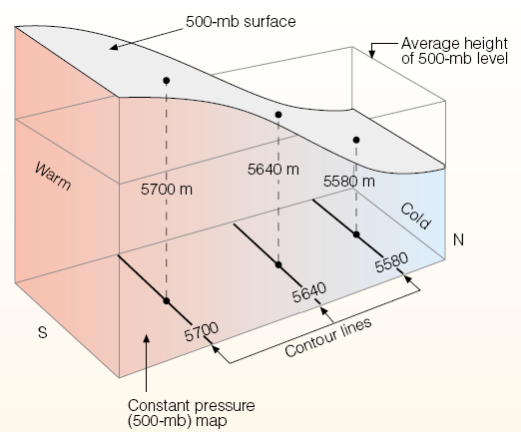
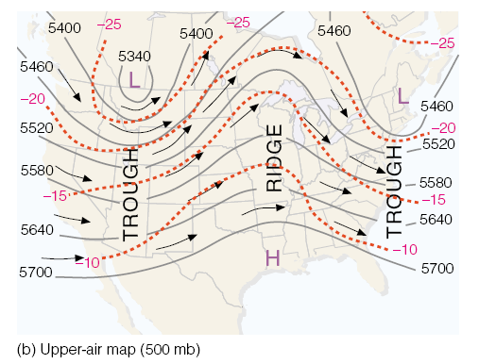
The pressure information on a
constant altitude allow us to visualize
where high- and low-pressure centers
are located.
The height information on a constant
pressure surface convey the same
information.
The intensity of the pressure (or
height) gradients allow us to infer the
strength of the winds.

Slide 11
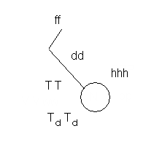
Upper-Level Weather Maps
850mb: to identify fronts
700mb: intersects many clouds; moisture information is important
500mb: used to determine the location of short waves and long waves associated with the ridges and troughs in the flow pattern. Meteorologists examine “vorticity” (i.e. rotation of air) on this pressure level.
300, 250, and 200mb: near the top of the troposphere or the lower stratosphere; these maps are used to identify the location of jetsreams that the movements of mid latitude storms steer mid-storms.
Upper-Level Station Model

Slide 12
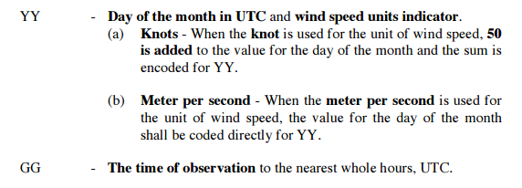
Section 1. Identification and position groups.

Slide 13
I_{d}
Wind Indicator. The last standard isobaric surface for which the wind group (ddfff) is reported in section 2 is coded for I_{d} according to Code Table below. The code figure represents the hundreds digit of the hectopascal value of the last standard isobaric surface for which wind data are available.

Slide 14
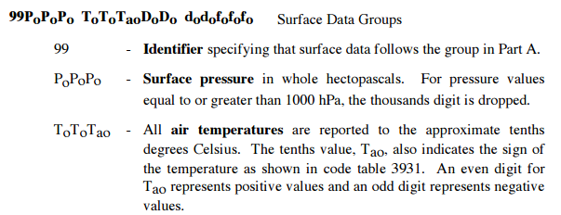
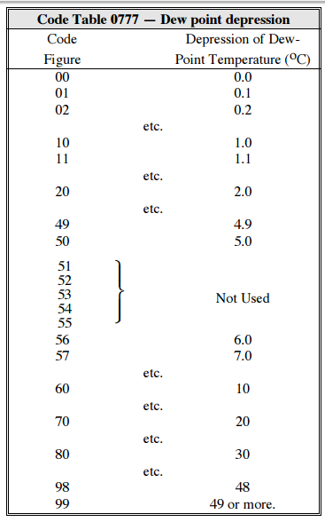

Slide 15
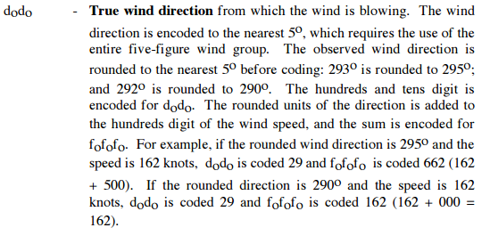

Slide 16
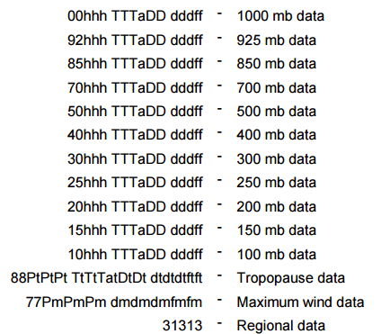
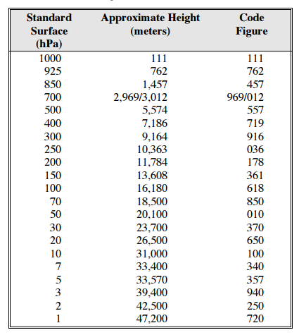

Slide 17
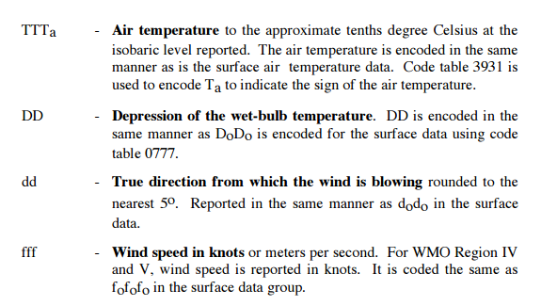

Slide 18
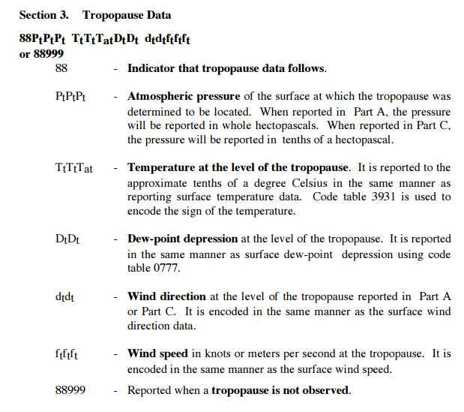

Slide 19
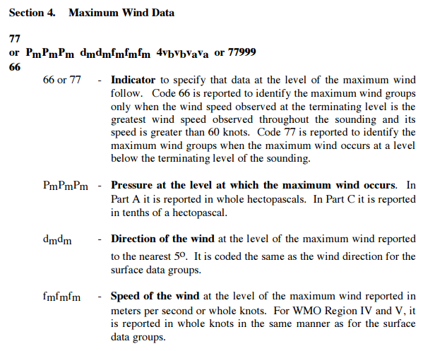

Slide 20
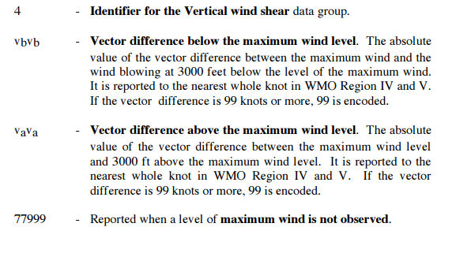
TTAA 26231 13275 99993 05624 23002 00131 09044 23014 92777 02828 27504 85455 02133 23004 70969 11904 32005 50546 29361 30515 40702 39760 31013 30894 49362 28512 25013 50364 34014 20160 49163 33013 15348 50165 34508 10609 57576 33509 88265 51363 29515 77999 31313 47708

