Slide 1


THESIS WRITING & RESEARCH MANAGEMENT
Dr. Alaa A. Jabbar Altaay
College of Science - Dept. of CS.
Mob. : 07905510402 E-mail : sadco99@yahoo.com

Slide 2
A. THESIS WRITING ( 1 hour)
Attributes of A Good Thesis
A Generic Thesis Skeleton
Format of Thesis
Thesis Writing Tools
Common Citation Styles and Its Corresponding References Style
Common Mistakes in Writing Citations and References
Plagiarism
Quality of Thesis

Slide 3
B. RESEARCH MANAGEMENT (1 hour)
Research Management – From Inception to Completion
Challenges Facing A Researcher
Decision Making in Research
Managing Tasks
5) Managing Resources – Time, Finance, etc.
6) Getting Feedback
7) Working with Supervisor

Slide 4
LEARNING OUTCOMES:
At the end of the lecture, the students/ Researchers should be:
able to define and write a good Thesis
able to identify the quality of a written Thesis
able to understand the process of managing postgraduate research activities

Slide 5
THESIS WRITING
Thesis or Dissertation?
US and UK definition difference
Dissertation:
Synthesizing already existing literature
Posting your own thoughts
Part of a Master degree
Thesis : ++
Adding to already existing literature
Have to conduct your own research
Original
To demonstrate good knowledge
To contribute to the body of knowledge

Slide 6
THESIS WRITING
Attributes of A Good Thesis:
It should has an attractive and specific title.
It provides the reader with a map to guide him/her through your work – good thesis flow.
It should answer: So what? or Who cares?
It avoids vague language (like "it seems").
It avoids the first person. ("I believe," "In my opinion").
It should be able to lead the reader toward the topic sentences?
It should be adequately developed in the required length of the paper?

Slide 7
THESIS WRITING
Attributes of A Good Thesis:
It avoids the first person. ("I believe," "In my opinion").
Active | “I completed the test”
Passive | “The test was completed by me”
Passive | "The test was completed."
example of passive sentence:
Cars will be made from plastic in the future. Here the focus is on cars -- not who makes them

Slide 8
THESIS WRITING
Attributes of A Good Thesis
Proficient vs. Excellent
Proficient Thesis
Inspires the reasonable readers to ask “Why” and “How?”
Excellent Thesis
Inspires the reasonable reader to ask “Why” and “How?” and engages the readers in challenging or provocative research and displays a level of thought that breaks new ground.

Slide 9
THESIS WRITING
2) A Generic Thesis Skeleton
Reader’s Attention Level
1. Preliminaries
2. Aims and objectives
3. Literature Review
4. Model Creation
5. Research Methodology
6. Design of experiments
7. Data Collection
8. Data Analyses
9. Model Validation
10. Reporting Findings
11. Future Work
12. Ending
Chapter 1
Intro
Chapter 2
Chapter 3
Your own work in details
Chapter n
Chapter n+1
Summarize

Slide 10
THESIS WRITING
2) A Generic Thesis Skeleton
1. Preliminaries
  Abstract
  Contents
  Lists of Figures, Tables, Abbreviations and Mathematical Symbols
  Preface
  Acknowledgement
  Author's Declaration

Slide 11
THESIS WRITING
2) A Generic Thesis Skeleton
2. Aims and objectives
  Proof of need/ motivation
  Scope
  Limits of model
3. Literature Review
  State of Art – highest level of development of particular time.
  Fundamental - theory

Slide 12
THESIS WRITING
2) A Generic Thesis Skeleton
4. Model Creation
  Hypothesis Development
  Hypothesis Testing
5. Research Methodology
6. Design of experiments
  Practical
  Questionnaire
  Simulation

Slide 13
THESIS WRITING
2) A Generic Thesis Skeleton
7. Data Collection
  Questionnaire Design
  Pretest, etc.
8. Data Analyses
  Analyses
  Verification
9. Model Validation
  Confirmation
  Large Scale Implementation

Slide 14
THESIS WRITING
2) A Generic Thesis Skeleton
10. Reporting Findings
  Summary of Novel Findings
  Discussion of Knowledge Boundary
  Conclusion &/Recommendation
11. Future Work
Suggestion to inspire reader but not showing the weakness of the thesis
12. Ending
  References/Bibliography
  Appendix
  Index

Slide 15
THESIS WRITING
2) A Generic Thesis Skeleton
It is acceptable for individual chapter to be self-contained, including their own introduction, methods, results and discussions, as is often the case where individual chapter being submitted for publication.
However, in such thesis a broader/wide introduction to the whole thesis should be included to tie the chapters or sections together and to provide the framework for the whole thesis.

Slide 16
THESIS WRITING
3) Format of Thesis
  Refer to UoM Thesis Guildline
(a) Language
The thesis must be written in either English or Arabic.
(b) Typing
- MS word or text processor.
Font - size: 12, style: Times New Roman
Spacing – single paged, double spacing, ..
Type Quality – laser printer quality.

Slide 17
THESIS WRITING
3) Format of Thesis
  Refer to UoM Thesis Guildline
(c) Margins – top & bottom & right: 2.5 cm; left: 3 cm
(d) Pagination – begin 1st page on Chapter 1; the first page of all chapters will not be printed.
– Preliminary page – i. ii. Iii. iv,...
(e) Paper – A4 (210 x 297 mm), white, 80 grams paper.

Slide 18
THESIS WRITING
4) Thesis Writing Tools
Word Processors
- Microsoft Word + Mendeley
- LATEX/ BIBTEX – open source, free for download
(b) References/ Bibliographic Software
- EndNote
- Reference Manager
- BibTex

Slide 19
Comparison between MS Word and LATEX
 | MS Word | LaTeX
Ease of Use | Simple | New commands, new learning curve
Small document | WYSIWYG | Slower, Layout in a separate step
Large doc with graphics | Slower - Sporadic (automatic) saves | Faster – No time wasting on layout – done once at the end
Price + Availability | Expensive and troublesome with citation manager-Endnote or Reference Manager | Open source – free to download
Layout Quality | Far from professional | Professional layout
Citation Manager | Not include citation utility | Seamless references database organization with BiBDesk

Slide 20
THESIS WRITING
4) Thesis Writing Tools
Word Processors
- Microsoft Word + Mendeley
- LATEX – open source, free for download
(b) References/ Bibliographic Software
- EndNote
- Reference Manager
- BibTex

Slide 21
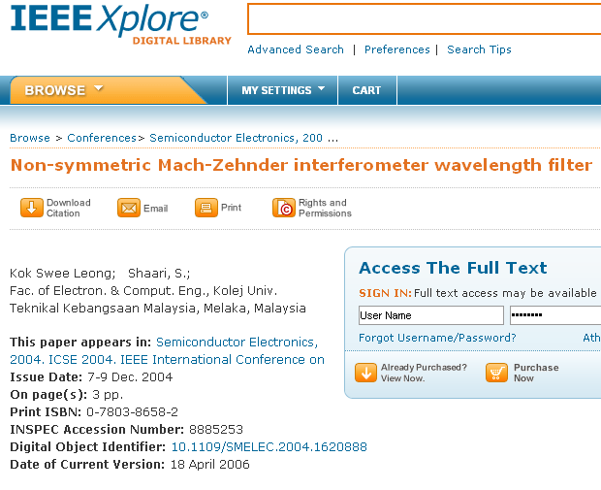
Managing References

Slide 22
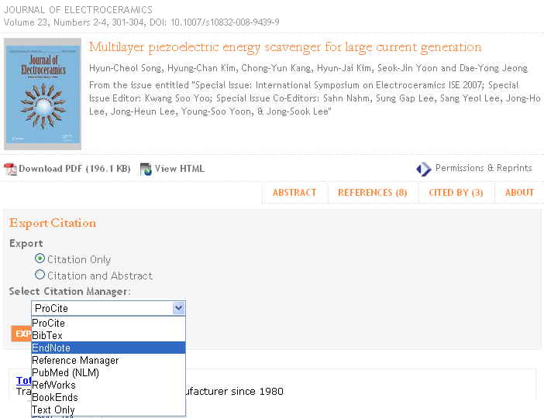
Managing References

Slide 23
THESIS WRITING
5) Common Citation Styles and Its Corresponding References Style
Any thesis which makes use of other works, either in direct quotation or by reference, must contain a bibliography listing of these sources.
Only works directly cited or quoted in the text should be included in the bibliography.

Slide 24
THESIS WRITING
5) Common Citation Styles and Its Corresponding References Style
UoM follows the (Harvard System) for literature citation and referencing.
In the text
The year of publication appears within parenthesis after the author's surname if the latter forms part of a sentence;
Altaay (2014) or Altaay and Aliraqi (2015) or, where there are more than two authors, Altaay et. al. (2015).

Slide 25
THESIS WRITING
5) Common Citation Styles and Its Corresponding References Style
UoM follows the Harvard System for literature citation and referencing.
In the text
If several papers by the same author(s) and from the same year are cited, the letters a, b, c, etc. should be put after the year of publication; e.g. Chazdon and Ibrahim (1988b).
If the author's surname does not form part of a sentence, both the authors’ surname and the year of publication appear within parenthesis; e.g. (Yakub & Chan, 1989).

Slide 26
THESIS WRITING
5) Common Citation Styles and Its Corresponding References Style
UoM follows the Harvard System for literature citation and referencing.
In the text
In any particular sentence, if several publications are cited, the references should be cited in chronological order.
However, if several publications of the same year are cited the references should be cited in alphabetical order and with single author taking precedence over joint authors.

Slide 27
THESIS WRITING
5) Common Citation Styles and Its Corresponding References Style
UoM follows the Harvard System for literature citation and referencing.
At the end of the thesis,
All the references cited are listed in alphabetical order.
There is no necessity to number the references.
The bibliography should be double-spaced as with the rest of the text using font size 12.

Slide 28
THESIS WRITING
5) Common Citation Styles and Its Corresponding References Style
UoM follows the Harvard System for literature citation and referencing.
At the end of the thesis,
The following bibliographic style must be followed:
▪ Reference from journals:-
Kalotas, T.M. & Lee, A.R. (2010). A Simple Device To Illustrate Angular Momentum Conservation And Instability. American Journal of Physics, Vol. 58, pp.80 - 81.

Slide 29
THESIS WRITING
5) Common Citation Styles and Its Corresponding References Style
UoM follows the Harvard System for literature citation and referencing.
At the end of the thesis,
The following bibliographic style must be followed:
▪ Reference from books:-
Conn, E.E., Stumpf, P.K., Bruenmig, G. & Doi, R.H. (2000). Outlines of Biochemistry, 5th ed., New York: John Wiley & Sons.

Slide 30
THESIS WRITING
5) Common Citation Styles and Its Corresponding References Style
UTeM follows the Harvard System for literature citation and referencing.
At the end of the thesis,
The following bibliographic style must be followed:
▪ Reference from conference proceedings:-
Hassan, M.D. &. Norshimah, H. (2010). Designing of Primers For Cloning of Papaya Ringspot Virus Coat Protein Gene. Proceedings of the 8th National Biotechnology Seminar (Hasanah, M.G.: Khatijah, M.Y. & Marziah, M.), pp. 172-174.

Slide 31
THESIS WRITING
5) Common Citation Styles and Its Corresponding References Style
UTeM follows the Harvard System for literature citation and referencing.
At the end of the thesis,
The following bibliographic style must be followed:
▪ Anonymous (authorless) reference:-
Anonymous (2000). External Trade in Shourjah Flour And Shourjah Starch, 1985-1995. Agricultural Statistics, Baghdad. Planning Division, Department of Agriculture, Baghdad, Iraq.

Slide 32
THESIS WRITING
5) Common Citation Styles and Its Corresponding References Style
UoM follows the Harvard System for literature citation and referencing.
At the end of the thesis,
The following bibliographic style must be followed:
▪ Publications of international bodies/agencies:-
WHO (2010). Environmental Health Criteria 39: Paraquat and Diquat. World Health Organization, Geneva.

Slide 33
THESIS WRITING
6) Common Mistakes in Writing Citations and References
(2) Using citations as words
(Author1, 2011) is not a word - it is just a pointer. Never, ever, use a bracketed citation as if it were the name of an author or a work.
So instead of “A similar strategy is described in (Author1, 2011).”, use instead “A similar strategy is discussed by Author1 (2011)”.

Slide 34
THESIS WRITING
6) Common Mistakes in Writing Citations and References
(3) Sorting References
Arrange reference list in alphabetical order by author's last name.
Going in cited order is more common in Journal articles.

Slide 35
THESIS WRITING
7) Plagiarism
In scientific publications, plagiarism is a fraud.
It involves both stealing someone else's work and lying about it afterwards”, and include:
turning in someone else's work as your own.
copying words or ideas from someone else without giving credit.
giving wrong information about the source of a quotation
copying so many words or ideas from a source that it makes up most of your work, whether you give credit or not.
More details can be found in http://www.plagiarism.org/index.html

Slide 36
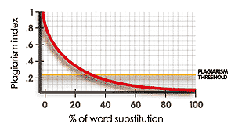
THESIS WRITING
7) Plagiarism
Source: http://www.plagiarism.org/index.html

Slide 37
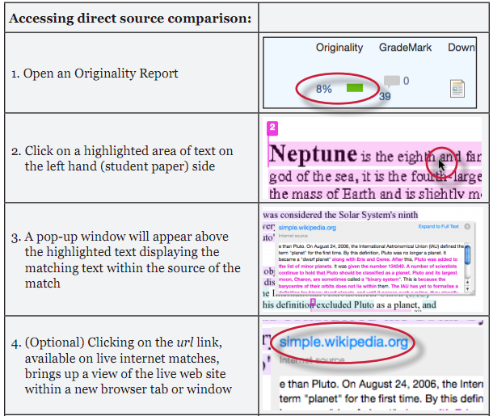
THESIS WRITING
7) Plagiarism
Check your work before submitting:
http://www.turnitin.com

Slide 38
THESIS WRITING
8) Quality of Thesis
Start with a solid thesis statement.
All the materials have to be relevant to your thesis statement which are not too broad/wide or too specific.
Use high-quality and relevant sources.
Use an outline to structure your paper.
Present the thesis in a smooth flow.
Be succinct – short and precise ***
Check your language. Nothing is more distracting than misspelled words and sloppy grammar.
Document your sources using the appropriate citation convention.

Slide 39
B. RESEARCH MANAGEMEN P. II
Research Management – From Inception to Completion
Knowing everything stage
  Student: "I have designed a supercomputer even before graduate school."
  Faculty: speechless
Totally beaten up stage
  Student: speechless
  Faculty: smiling at the student's progress so communication is possible now.

Slide 40
B. RESEARCH MANAGEMENT
Research Management – From Inception to Completion
Confidence buildup stage
  Student: "I am not stupid after all." (student thinks)
  Faculty: "Uh oh, she/he is ready to argue." (faculty think)
Calling the shot stage
  Faculty:"I am going to design an n-processor supercomputer"
  Student: "You are crazy, because ..."

Slide 41
B. RESEARCH MANAGEMENT
2) Challenges Facing A Researcher
Adaptation with
- New to surrounding, people around, language etc.
Dependency
Your work depends on other people's work and vice versa
Isolation
- Research is an individual work
Writing
First major document, English, take longer time than you think!
Rejection
is a part of life…it is also a part of research
Personal Life
- Family, job, financial support etc.

Slide 42
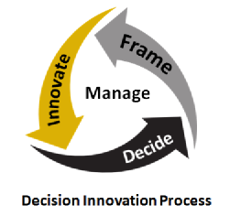
B. RESEARCH MANAGEMENT
3) Decision Making in Research
Frame the decision
Innovate to address needs and identify alternatives
Decide and commit to act
Manage consequences

Slide 43
B. RESEARCH MANAGEMENT
4) Managing Tasks:
Keep a journal of research activities and ideas
Read a lot of technical papers
Maintain Positive Attitude and Stay Motivated
Breaking Down a Project into Smaller Pieces

Slide 44
B. RESEARCH MANAGEMENT
5) Managing Resources – Time, Finance, etc.
Use forcing factors well to speed up the thesis process
  Competing with someone else
  Family pressure
  Financial pressure
  A job is waiting
  Advisor is leaving or project is over
  Equipment is retiring

Slide 45
B. RESEARCH MANAGEMENT
6) Getting Feedback
Supervisor and/ Co-supervisor(s)
Reporting your progress to your supervisor and/ Co-supervisor(s) at a reasonable period of time.
Reviewer(s)’ Comment on your publication(s)
Send your research work to high quality journals – get free professional comments!
Attending Conference(s)
- Present your research work to other researchers of similar interest and get their feedback.

Slide 46
B. RESEARCH MANAGEMENT
7) Working with Supervisor
"A supervisor is a better researcher than me.“
It is true that advisor is experienced, wise, smart (maybe), and knowledgeable in general.
Supervisor also sees a bigger picture, and has contacts in the area.

Slide 47
B. RESEARCH MANAGEMENT
7) Working with Supervisor
"A supervisor is a better researcher than me.“
However, supervisor is not always right.
  Supervisor is not as focused as you in your work.
  Supervisor does not have more time or energy than you do.
  Supervisor may be conservative - they know too many horror stories.

Slide 48
B. RESEARCH MANAGEMENT
7) Working with Supervisor
"A supervisor is a better researcher than me.“
At the end of your research, you must believe that you can do better than your supervisor in your research areas – and only then you will get your graduate degree!

Slide 49

C U in Part II - Thesis Writing Tools

