Slide 1
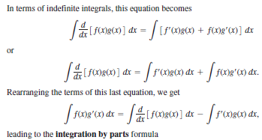



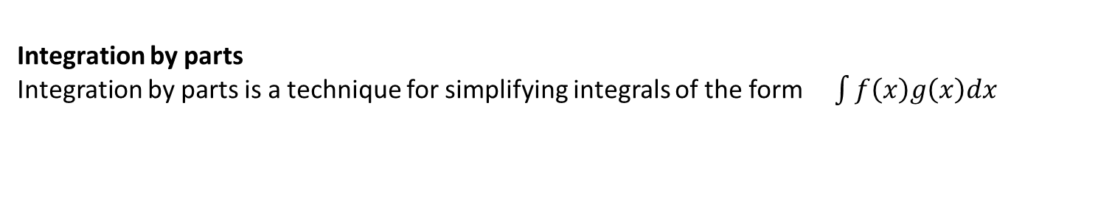
Techniques of Integration
Integration by parts
Integration by parts is a technique for simplifying integrals of the form $\int{f\left(x\right)g\left(x\right)dx}$

Slide 2
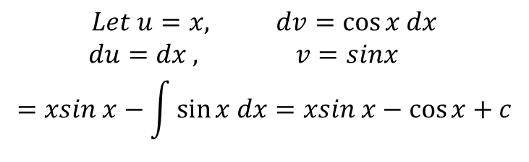
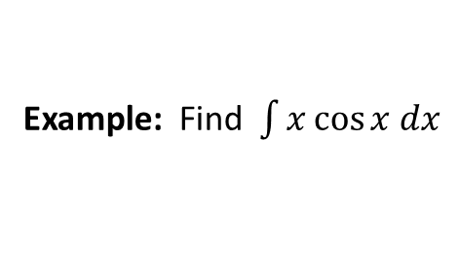
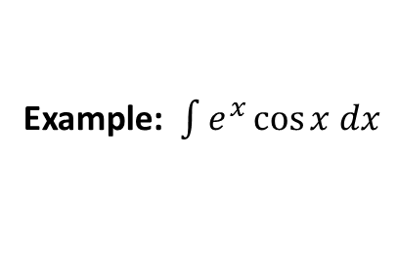
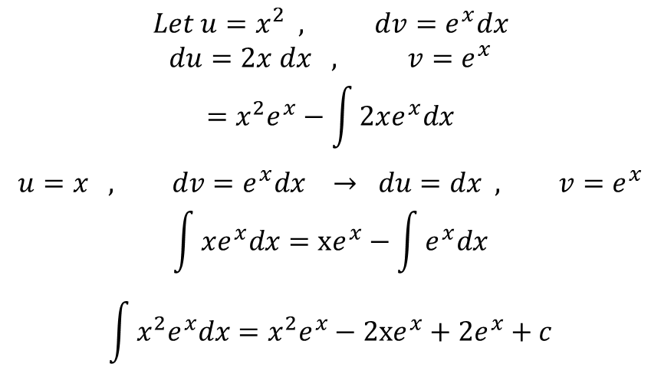

Example: Find $\int{x\cos{x dx}}$
$$Let u=x, dv=\cos{x dx}$$
$$du=dx , v=sinx$$
$$=xsin x−\int{\sin{x dx=xsin x−\cos{x+c}}}$$
Example: Evaluate $\int{x^{2}e^{x}dx}$
$$Let u=x^{2} , dv=e^{x}dx$$
$$du=2x dx , v=e^{x}$$
$$=x^{2}e^{x}−\int{2xe^{x}dx}$$
$$u=x , dv=e^{x}dx → du=dx , v=e^{x}$$
$$\int{xe^{x}dx}=xe^{x}−\int{e^{x}dx}$$
$$\int{x^{2}e^{x}dx}=x^{2}e^{x}−2xe^{x}+2e^{x}+c$$
Example: $\int{e^{x}\cos{x dx}}$
$$u=e^{x} , dv=\cos{x dx → du=e^{x}dx , v=\sin{x}}$$

Slide 3
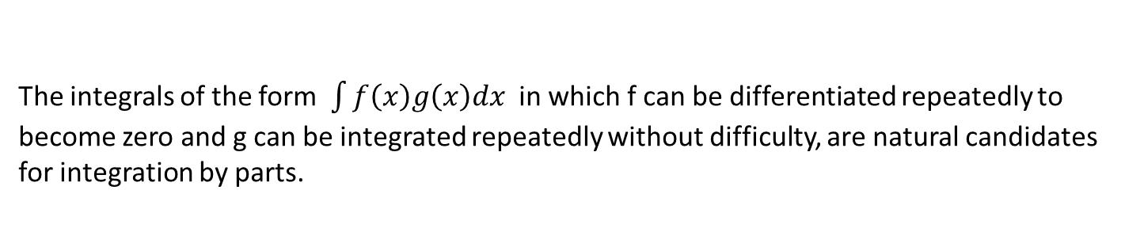
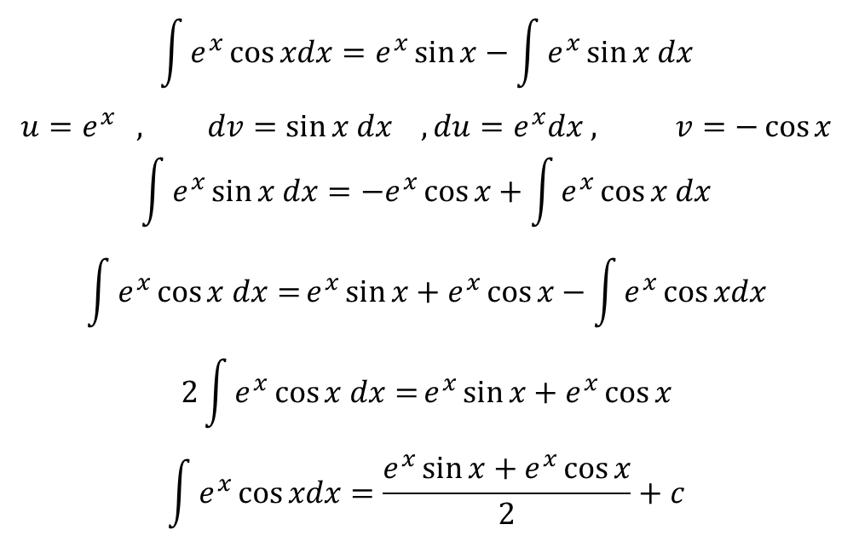
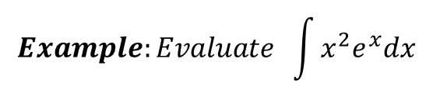
$$\int{e^{x}\cos{xdx=e^{x}\sin{x−\int{e^{x}\sin{x dx}}}}}$$
$$u=e^{x} , dv=\sin{x dx , du=e^{x}dx , v=−\cos{x}}$$
$$\int{e^{x}\sin{x dx}}={−e}^{x}\cos{x+\int{e^{x}\cos{x dx}}}$$
$$\int{e^{x}\cos{x dx=}}e^{x}\sin{x+e^{x}\cos{x−\int{e^{x}\cos{xdx}}}}$$
$$2\int{e^{x}\cos{x dx=}}e^{x}\sin{x+e^{x}\cos{x}}$$
$$\int{e^{x}\cos{xdx=\frac{e^{x}\sin{x+e^{x}\cos{x}}}{2}+c}}$$
Tabular Integration
The integrals of the form $\int{f\left(x\right)g\left(x\right)dx}$ in which f can be differentiated repeatedly to
become zero and g can be integrated repeatedly without difficulty, are natural candidates
for integration by parts.
$$Example:Evaluate \int{x^{2}e^{x}dx}$$

Slide 4
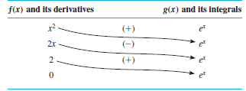

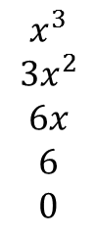



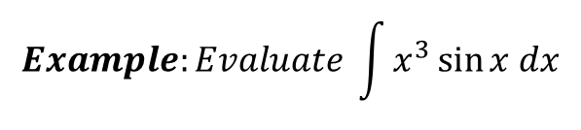
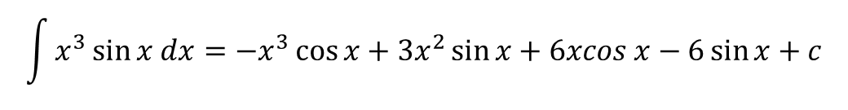
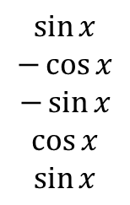
$$f\left(x\right)=x^{2} , g\left(x\right)=e^{x}$$
$$Example:Evaluate \int{x^{3}\sin{x dx}}$$
$$x^{3} and its derivatives$$
$$\sin{x and its integrals}$$
$$x^{3}$$
$$3x^{2}$$
$$6x$$
$$6$$
$$0$$
+
$$\sin{x}$$
$$−\cos{x}$$
$$−\sin{x}$$
$$\cos{x}$$
$$\sin{x}$$
-
+
-
$$\int{x^{3}\sin{x dx=−x^{3}\cos{x+3x^{2}\sin{x}+6xcos x−6\sin{x+c}}}}$$

Slide 5
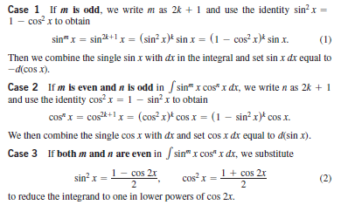
Trigonometric Integrals
Products of powers of Sines and Cosines
$$\int{\sin^{m}}x \cos^{n}x dx , where m and n are nonnegative integer (positive or zero)$$

Slide 6
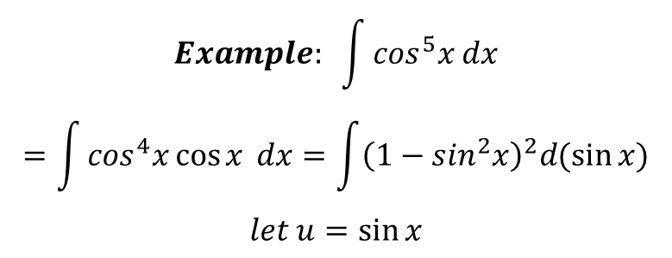
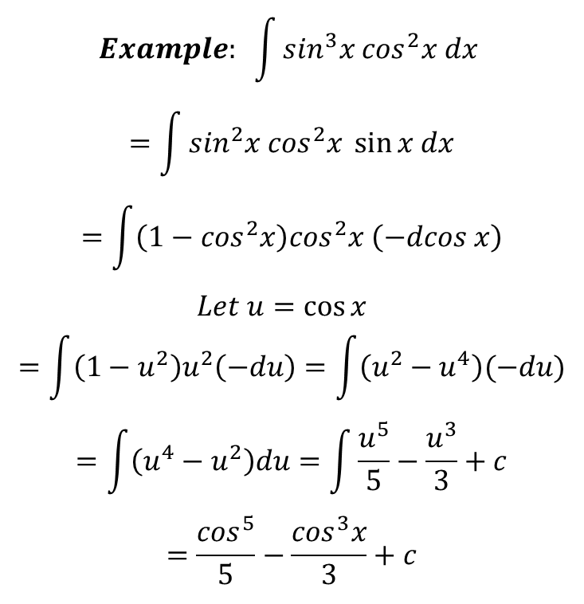
$$Example: \int{\sin^{3}x \cos^{2}x dx}$$
$$=\int{\sin^{2}x \cos^{2}x \sin{x dx}}$$
$$=\int{\left(1−\cos^{2}x\right)\cos^{2}x \left(−dcos x\right)}$$
$$Let u=\cos{x }$$
$$=\int{\left(1−u^{2}\right)u^{2}\left(−du\right)=\int{\left(u^{2}−u^{4}\right)(−du)}}$$
$$=\int{\left(u^{4}−u^{2}\right)du}=\int{\frac{u^{5}}{5}−\frac{u^{3}}{3}+c}$$
$$=\frac{\cos^{5}}{5}−\frac{\cos^{3}x}{3}+c$$
$$Example: \int{\cos^{5}x dx}$$
$$=\int{\cos^{4}x\cos{x} dx=\int{{\left(1−\sin^{2}x\right)}^{2}d(\sin{x)}}}$$
$$let u=\sin{x}$$

Slide 7
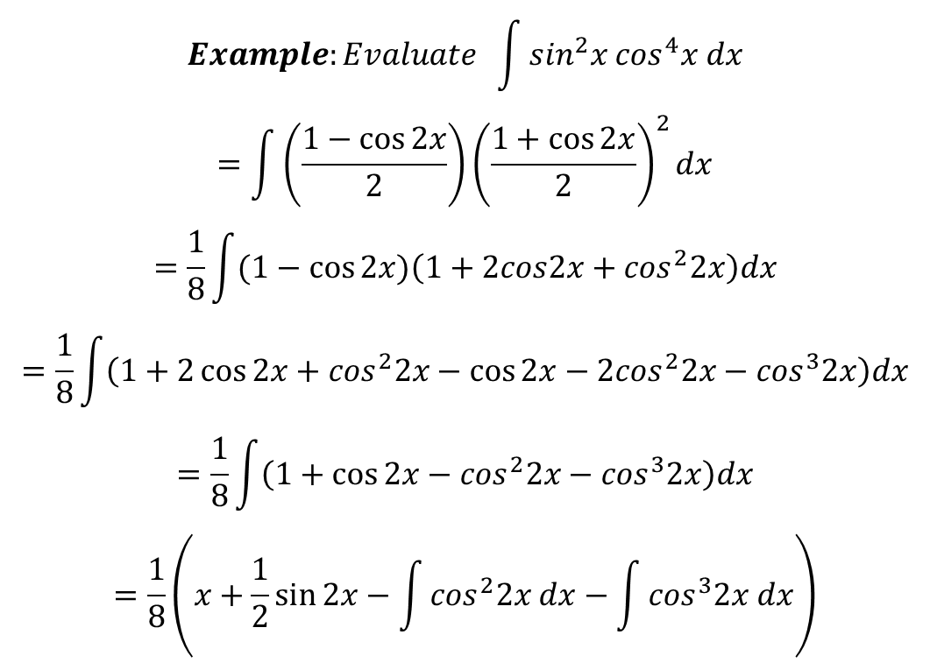
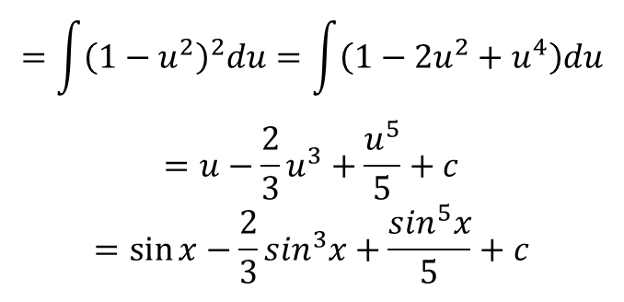
$$=\int{{\left(1−u^{2}\right)}^{2}du=\int{\left(1−2u^{2}+u^{4}\right)du}}$$
$$=u−\frac{2}{3}u^{3}+\frac{u^{5}}{5}+c$$
$$=\sin{x−\frac{2}{3}\sin^{3}x+\frac{\sin^{5}x}{5}+c}$$
$$Example:Evaluate \int{\sin^{2}x \cos^{4}x dx}$$
$$=\int{\left(\frac{1−\cos{2x}}{2}\right){\left(\frac{1+\cos{2x}}{2}\right)}^{2}dx}$$
$$=\frac{1}{8}\int{(1−\cos{2x)\left(1+2cos2x+\cos^{2}2x\right)dx}}$$
$$=\frac{1}{8}\int{\left(1+2\cos{2x+\cos^{2}2x−\cos{2x−2\cos^{2}2x−\cos^{3}2x}}\right)dx}$$
$$=\frac{1}{8}\int{\left(1+\cos{2x−\cos^{2}2x−\cos^{3}2x}\right)dx}$$
$$=\frac{1}{8}\left(x+\frac{1}{2}\sin{2x−\int{\cos^{2}2x dx−\int{\cos^{3}2x dx}}}\right)$$

Slide 8
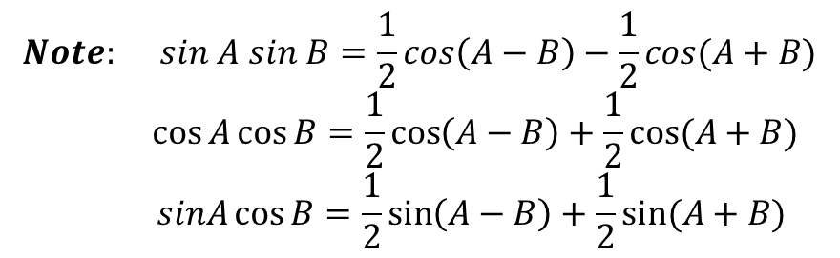
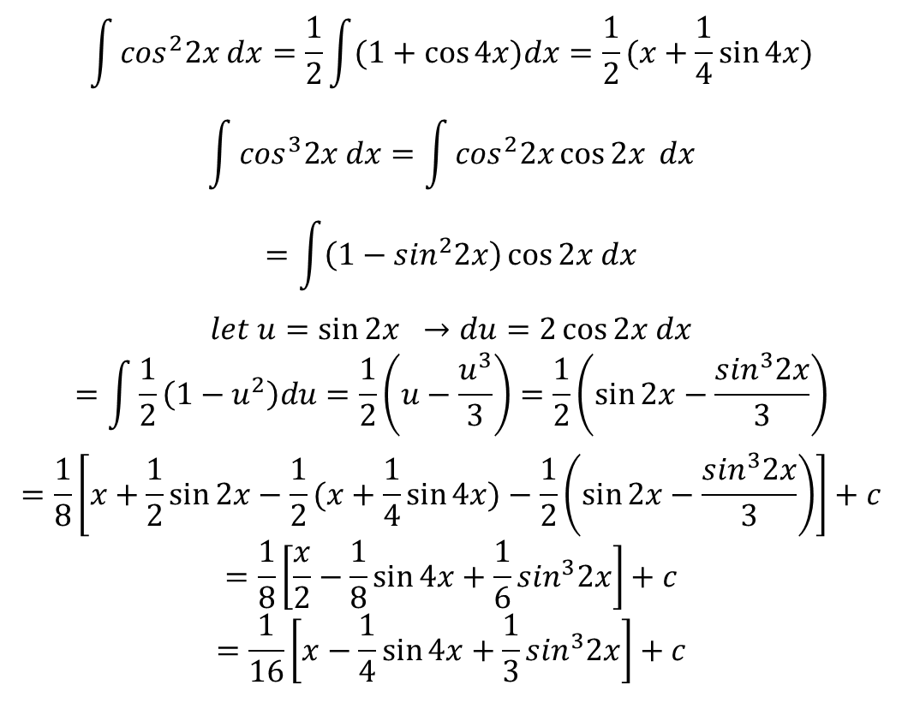
$$\int{\cos^{2}2x dx=\frac{1}{2}\int{(1+\cos{4x)dx=\frac{1}{2}(x+\frac{1}{4}\sin{4x)}}}}$$
$$\int{\cos^{3}2x dx=\int{\cos^{2}2x\cos{2x} dx}}$$
$$=\int{\left(1−\sin^{2}2x\right)\cos{2x dx}}$$
$$let u=\sin{2x →du=2\cos{2x dx}}$$
$$=\int{\frac{1}{2}\left(1−u^{2}\right)du=\frac{1}{2}\left(u−\frac{u^{3}}{3}\right)=\frac{1}{2}\left(\sin{2x−\frac{\sin^{3}2x}{3}}\right)}$$
$$=\frac{1}{8}\left[x+\frac{1}{2}\sin{2x−\frac{1}{2}(x+\frac{1}{4}\sin{4x)−\frac{1}{2}\left(\sin{2x−\frac{\sin^{3}2x}{3}}\right)}}\right]+c$$
$$=\frac{1}{8}\left[\frac{x}{2}−\frac{1}{8}\sin{4x+\frac{1}{6}\sin^{3}2x}\right]+c$$
$$=\frac{1}{16}\left[x−\frac{1}{4}\sin{4x+\frac{1}{3}\sin^{3}2x}\right]+c$$
$$Note: sin A sin B=\frac{1}{2}cos\left(A−B\right)−\frac{1}{2}cos(A+B)$$
$$\cos{A\cos{B=\frac{1}{2}\cos\left(A−B\right)+\frac{1}{2}cos⁡(A+B)}}$$
$$sinA\cos{B=\frac{1}{2}\sin\left(A−B\right)+\frac{1}{2}sin⁡(A+B)}$$

Slide 9
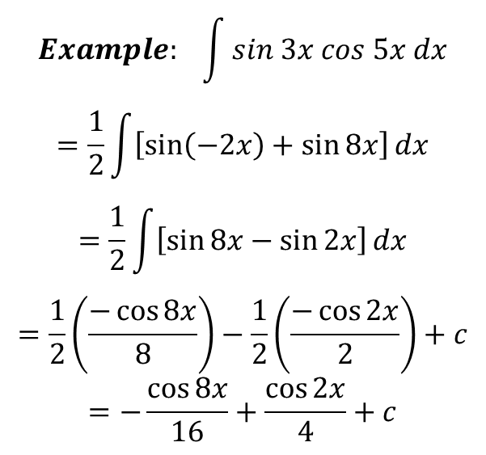
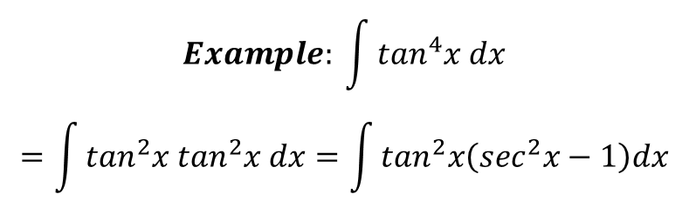
$$Example: \int{sin 3x cos 5x dx}$$
$$=\frac{1}{2}\int{\left[\sin\left(−2x\right)+\sin{8x}\right]}dx$$
$$=\frac{1}{2}\int{\left[\sin{8x−\sin{2x}}\right]}dx$$
$$=\frac{1}{2}\left(\frac{−\cos{8x}}{8}\right)−\frac{1}{2}\left(\frac{−\cos{2x}}{2}\right)+c$$
$$=−\frac{\cos{8x}}{16}+\frac{\cos{2x}}{4}+c$$
Integrals of powers of tan x and sec x
To integrate higher powers, we use the identities $\tan^{2}x=\sec^{2}x−1 and \sec^{2}x=\tan^{2}x+1$
and integrate by parts.
$$Example: \int{\tan^{4}x dx}$$
$$=\int{\tan^{2}x \tan^{2}x dx=\int{\tan^{2}x\left(\sec^{2}x−1\right)dx}}$$

Slide 10
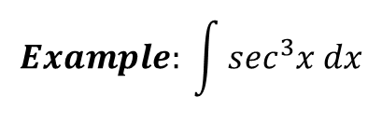

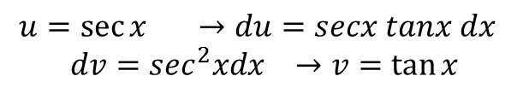
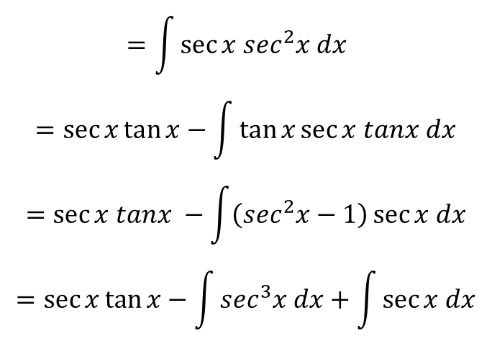
$$=\int{\tan^{2}x \sec^{2}x dx−\int{\tan^{2}x dx}}$$
$$=\int{\tan^{2}x\sec^{2}x dx}−\int{\left(\sec^{2}x−1\right)}dx , u=tanx →du=\sec^{2}xdx$$
$$=\int{u^{2}du−\tan{x+x}}$$
$$\int{\tan^{4}xdx=\frac{\tan^{3}x}{3}−\tan{x+x+c}}$$
$$Example: \int{\sec^{3}x dx}$$
$$=\int{\sec{x \sec^{2}x dx }}$$
$$=\sec{x\tan{x−\int{\tan{x\sec{x tanx dx}}}}}$$
$$=\sec{x tanx −\int{\left(\sec^{2}x−1\right)\sec{x dx}}}$$
$$=\sec{x\tan{x−\int{\sec^{3}x dx+\int{\sec{x dx}}}}}$$
$$u=\sec{x →du=secx tanx dx }$$
$$dv=\sec^{2}xdx →v=\tan{x}$$

Slide 11
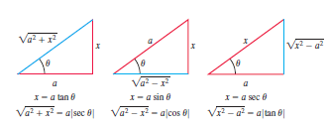
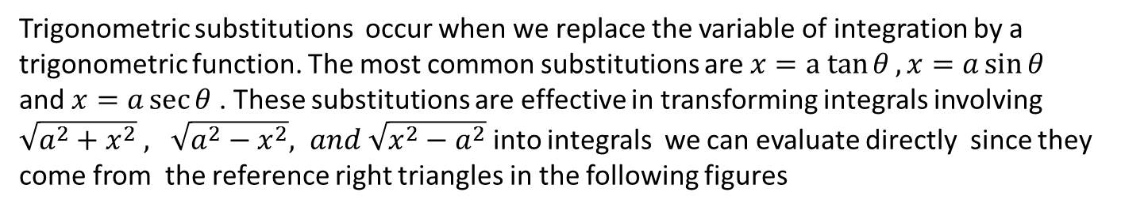
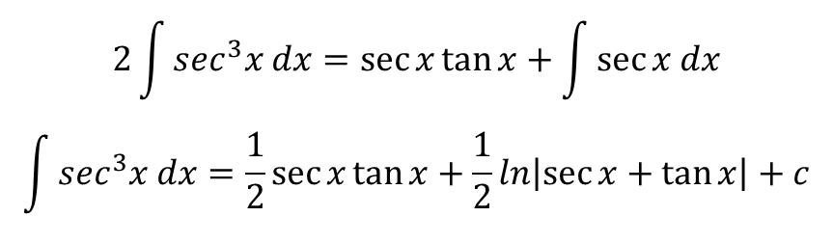
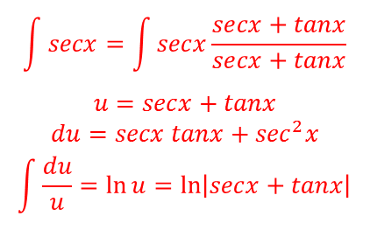
$$2\int{\sec^{3}x dx=\sec{x\tan{x+\int{\sec{x dx}}}}}$$
$$\int{\sec^{3}x dx=\frac{1}{2}\sec{x\tan{x+\frac{1}{2}ln\left|\sec{x+\tan{x}}\right|}}}+c$$
$$\int{secx=\int{secx\frac{secx+tanx}{secx+tanx}}}$$
$$u=secx+tanx$$
$$du=secx tanx+\sec^{2}x$$
$$\int{\frac{du}{u}=\ln{u=\ln\left|secx+tanx\right|}}$$
Trigonometric substitutions
Trigonometric substitutions occur when we replace the variable of integration by a
trigonometric function. The most common substitutions are $x=a tan{θ}, x=a\sin{θ}$
and $x=a\sec{θ}$ . These substitutions are effective in transforming integrals involving
$\sqrt{a^{2}+x^{2}} , \sqrt{a^{2}−x^{2}}, and \sqrt{x^{2}−a^{2}}$ into integrals we can evaluate directly since they
come from the reference right triangles in the following figures

Slide 12

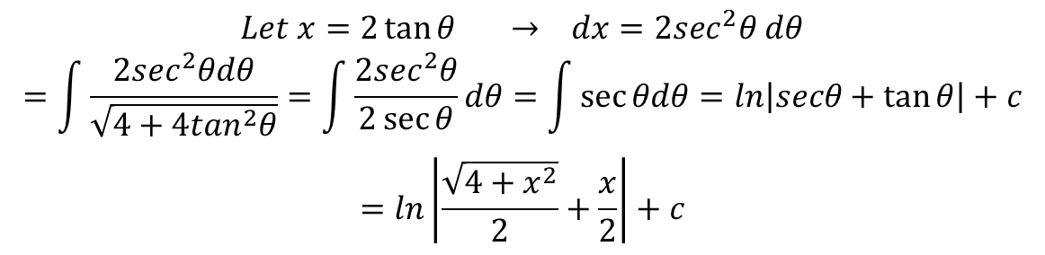
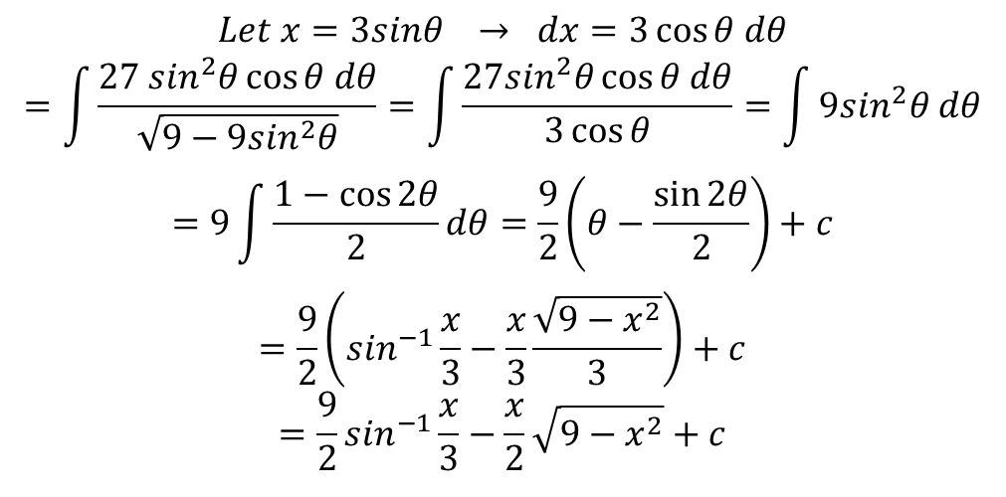
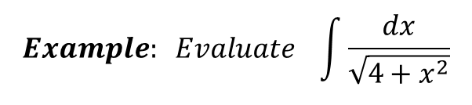
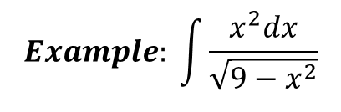
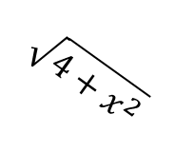


$$Example: Evaluate \int{\frac{dx}{\sqrt{4+x^{2}}}}$$
$$Let x=2\tan{θ → dx=2\sec^{2}θ dθ}$$
$$=\int{\frac{2\sec^{2}θdθ}{\sqrt{4+4\tan^{2}θ}}=\int{\frac{2\sec^{2}θ}{2\sec{θ}}dθ=\int{\sec{θdθ}}=ln\left|secθ+\tan{θ}\right|}}+c$$
$$=ln\left|\frac{\sqrt{4+x^{2}}}{2}+\frac{x}{2}\right|+c$$
$$\sqrt{4+x^{2}}$$
x
$$θ$$
$$Example: \int{\frac{x^{2}dx}{\sqrt{9−x^{2}}}}$$
2
$$Let x=3sinθ → dx=3\cos{θ dθ}$$
$$=\int{\frac{27 \sin^{2}θ\cos{θ dθ}}{\sqrt{9−9\sin^{2}θ}}=\int{\frac{27\sin^{2}θ\cos{θ dθ}}{3\cos{θ}}=\int{9\sin^{2}θ dθ}}}$$
$$=9\int{\frac{1−\cos{2θ}}{2}dθ=\frac{9}{2}\left(θ−\frac{\sin{2θ}}{2}\right)+c}$$
$$=\frac{9}{2}\left(\sin^{−1}\frac{x}{3}−\frac{x}{3}\frac{\sqrt{9−x^{2}}}{3}\right)+c$$
$$=\frac{9}{2}\sin^{−1}\frac{x}{3}−\frac{x}{2}\sqrt{9−x^{2}}+c$$
3
x
$$θ$$
$$\sqrt{9−x^{2}}$$

Slide 13
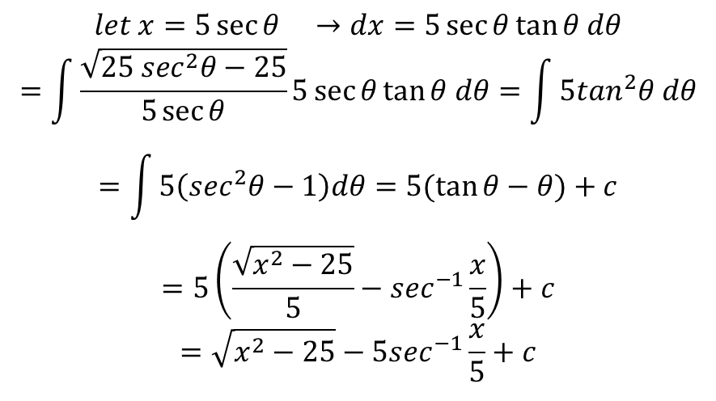
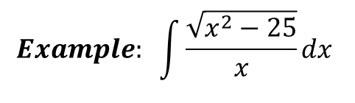


$$Example: \int{\frac{\sqrt{x^{2}−25}}{x}dx }$$
$$let x=5\sec{θ →dx=5\sec{θ\tan{θ dθ}}}$$
$$=\int{\frac{\sqrt{25 \sec^{2}θ−25}}{5\sec{θ}}}5\sec{θ\tan{θ dθ=\int{5\tan^{2}θ dθ}}}$$
$$=\int{5\left(\sec^{2}θ−1\right)dθ=5(\tan{θ−θ)+c}}$$
$$=5\left(\frac{\sqrt{x^{2}−25}}{5}−\sec^{−1}\frac{x}{5}\right)+c$$
$$=\sqrt{x^{2}−25}−5\sec^{−1}\frac{x}{5}+c$$
x
$$\sqrt{x^{2}−25}$$
$$θ$$
5

