Slide 1
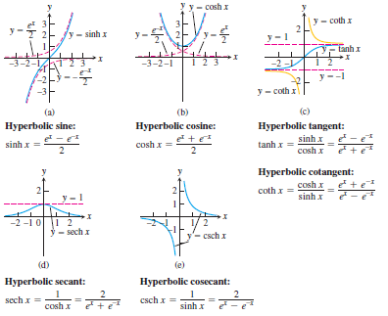
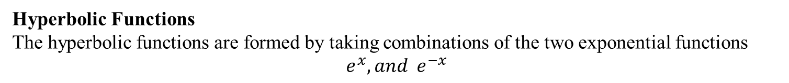
Hyperbolic Functions
The hyperbolic functions are formed by taking combinations of the two exponential functions
$$e^{x}, and e^{−x}$$

Slide 2
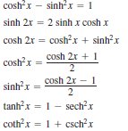
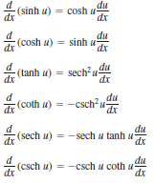
Identities for hyperbolic functions
Derivatives of hyperbolic functions

Slide 3
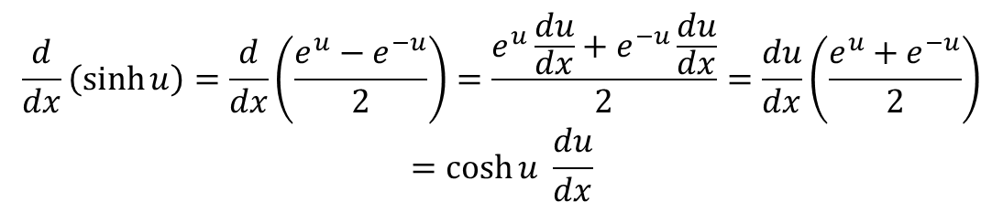
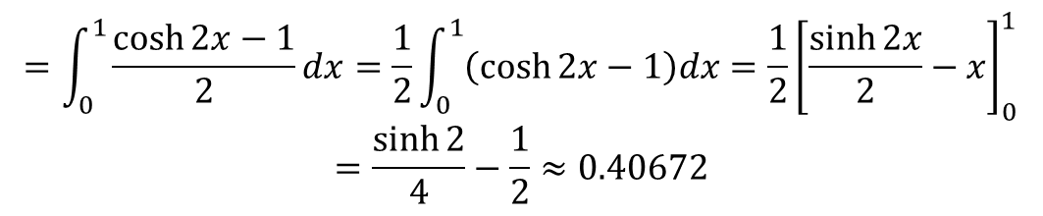
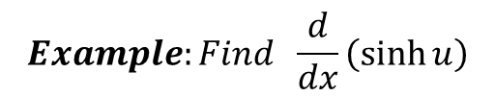
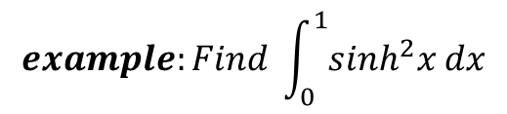
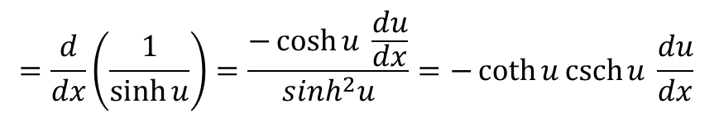
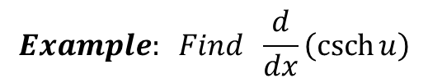
$$Example:Find \frac{d}{dx}\left(\sinh{u}\right)$$
$$\frac{d}{dx}\left(\sinh{u}\right)=\frac{d}{dx}\left(\frac{e^{u}−e^{−u}}{2}\right)=\frac{e^{u}\frac{du}{dx}+e^{−u}\frac{du}{dx}}{2}=\frac{du}{dx}\left(\frac{e^{u}+e^{−u}}{2}\right)$$
$$=\cosh{u \frac{du}{dx}}$$
$$Example: Find \frac{d}{dx}\left(\operatorname{csch}{u}\right)$$
$$=\frac{d}{dx}\left(\frac{1}{\sinh{u}}\right)=\frac{−\cosh{u} \frac{du}{dx}}{\sinh^{2}u}=−\coth{u\operatorname{csch}{u \frac{du}{dx}}}$$
$$example:Find \int_{0}^{1}{\sinh^{2}x dx}$$
$$=\int_{0}^{1}{\frac{\cosh{2x−1}}{2}dx=\frac{1}{2}\int_{0}^{1}{\left(\cosh{2x−1}\right)dx=\frac{1}{2}{\left[\frac{\sinh{2x}}{2}−x\right]}_{0}^{1}}}$$
$$=\frac{\sinh{2}}{4}−\frac{1}{2}≈0.40672$$

Slide 4
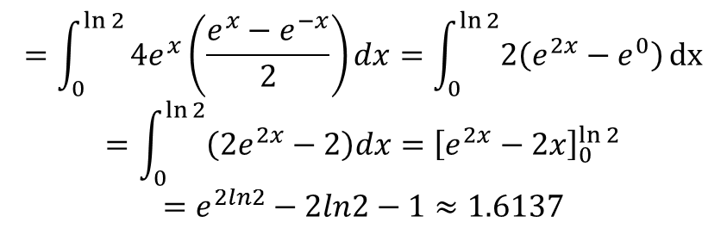
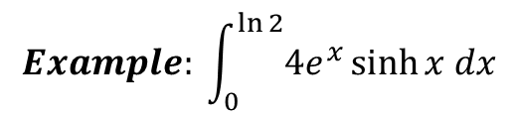
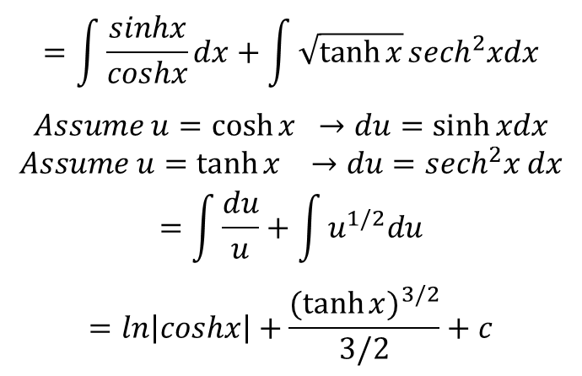
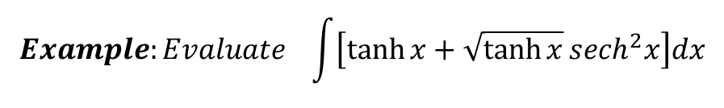
$$Example: \int_{0}^{\ln{2}}{4e^{x}\sinh{x dx}}$$
$$=\int_{0}^{\ln{2}}{4e^{x}\left(\frac{e^{x}−e^{−x}}{2}\right)}dx=\int_{0}^{\ln{2}}{2\left(e^{2x}−e^{0}\right)}dx$$
$$=\int_{0}^{\ln{2}}{\left(2e^{2x}−2\right)dx={\left[e^{2x}−2x\right]}_{0}^{\ln{2}}}$$
$$=e^{2ln2}−2ln2−1≈1.6137$$
$$Example:Evaluate \int{\left[\tanh{x+\sqrt{\tanh{x}}{sech}^{2}x}\right]dx}$$
$$=\int{\frac{sinhx}{coshx}dx+\int{\sqrt{\tanh{x}}{sech}^{2}xdx}}$$
$$Assume u=\cosh{x →du=\sinh{xdx}}$$
$$Assume u=\tanh{x →du={sech}^{2}x dx}$$
$$=\int{\frac{du}{u}+\int{u^{1/2}du}}$$
$$=ln\left|coshx\right|+\frac{({\tanh{x)}}^{3/2}}{3/2}+c$$

Slide 5
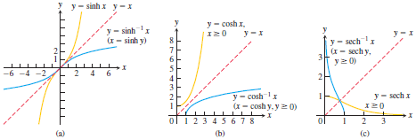
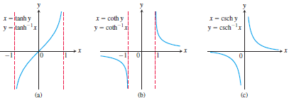
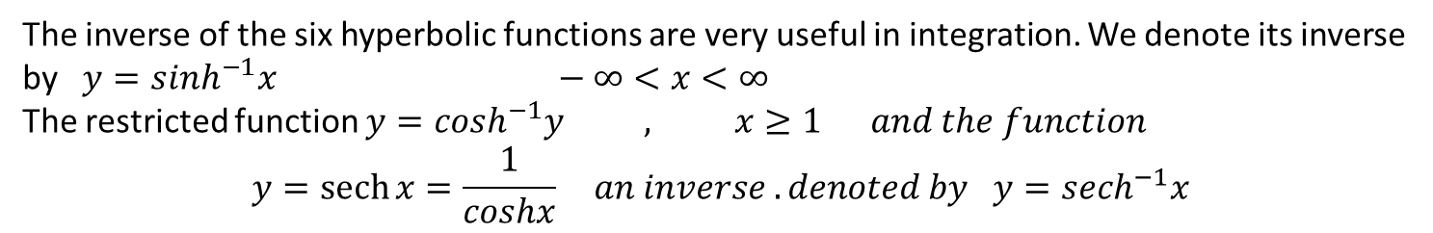
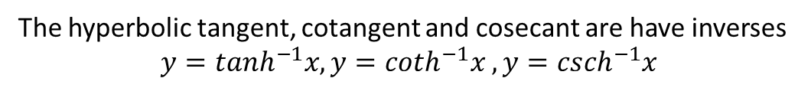
Inverse Hyperbolic functions
The inverse of the six hyperbolic functions are very useful in integration. We denote its inverse
by $y=\sinh^{−1}x −∞<x<∞$
The restricted function $y=\cosh^{−1}y , x≥1 and the function$
$$y=\operatorname{sech}{x=\frac{1}{coshx} an inverse . denoted by y={sech}^{−1}x}$$
The hyperbolic tangent, cotangent and cosecant are have inverses
$$y=\tanh^{−1}x, y=\coth^{−1}x , y={csch}^{−1}x$$

Slide 6


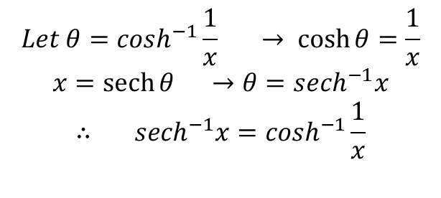
Identities for inverse hyperbolic functions
To prove that ${sech}^{−1}x=\cosh^{−1}\frac{1}{x}$
$$Let θ=\cosh^{−1}\frac{1}{x} → \cosh{θ=\frac{1}{x}}$$
$$x=\operatorname{sech}{θ} →θ={sech}^{−1}x$$
$$∴{ sech}^{−1}x=\cosh^{−1}\frac{1}{x}$$

Slide 7
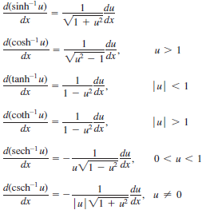
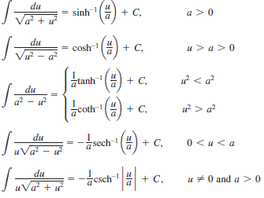
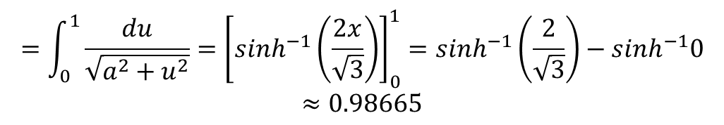
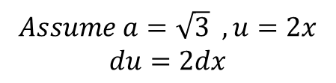
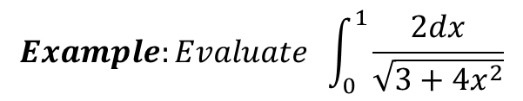
Derivatives of inverse hyperbolic functions
Integral to inverse Hyperbolic functions
$$Example:Evaluate \int_{0}^{1}{\frac{2dx}{\sqrt{3+4x^{2}}}}$$
$$Assume a=\sqrt{3} , u=2x$$
$$du=2dx$$
$$=\int_{0}^{1}{\frac{du}{\sqrt{a^{2}+u^{2}}}={\left[\sinh^{−1}\left(\frac{2x}{\sqrt{3}}\right)\right]}_{0}^{1}=\sinh^{−1}\left(\frac{2}{\sqrt{3}}\right)−\sinh^{−1}0}$$
$$≈0.98665$$

Slide 8
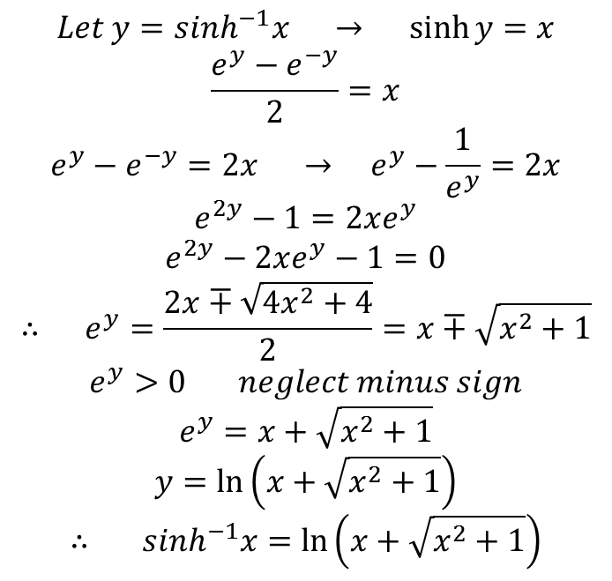


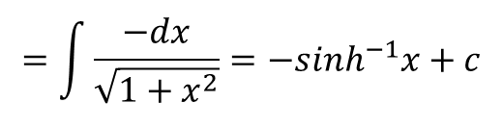
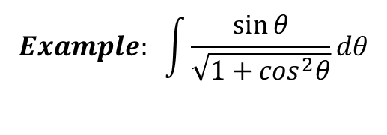
$$Example: Prove that \sinh^{−1}x=\ln\left(x+\sqrt{x^{2}+1}\right)$$
$$Let y=\sinh^{−1}x → \sinh{y=x}$$
$$\frac{e^{y}−e^{−y}}{2}=x$$
$$e^{y}−e^{−y}=2x → e^{y}−\frac{1}{e^{y}}=2x$$
$$e^{2y}−1=2xe^{y}$$
$$e^{2y}−2xe^{y}−1=0$$
$$∴ e^{y}=\frac{2x∓\sqrt{4x^{2}+4}}{2}=x∓\sqrt{x^{2}+1}$$
$$e^{y}>0 neglect minus sign$$
$$e^{y}=x+\sqrt{x^{2}+1}$$
$$y=\ln\left(x+\sqrt{x^{2}+1}\right)$$
$$∴ \sinh^{−1}x=\ln\left(x+\sqrt{x^{2}+1}\right)$$
$$Example: \int{\frac{\sin{θ}}{\sqrt{1+\cos^{2}θ}}dθ}$$
$$x=\cos{θ} →dx=−\sin{θdθ}$$
$$=\int{\frac{−dx}{\sqrt{1+x^{2}}}=−\sinh^{−1}x+c}$$
$$=−\sinh^{−1}(\cos{θ)+c}$$

Slide 9
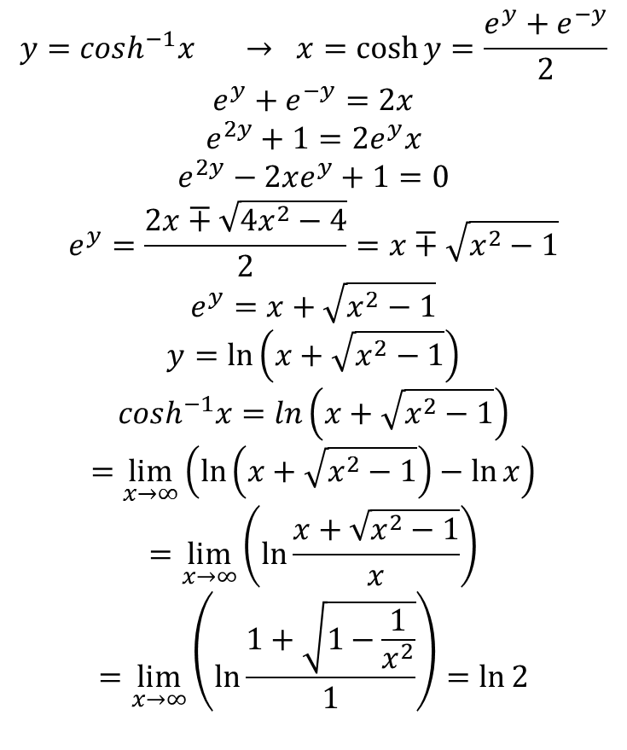

$$Example: Find \lim_{x→∞}\left(\cosh^{−1}x−\ln{x}\right)$$
$$y=\cosh^{−1}x → x=\cosh{y=\frac{e^{y}+e^{−y}}{2}}$$
$$e^{y}+e^{−y}=2x$$
$$e^{2y}+1=2e^{y}x$$
$$e^{2y}−2xe^{y}+1=0$$
$$e^{y}=\frac{2x∓\sqrt{4x^{2}−4}}{2}=x∓\sqrt{x^{2}−1}$$
$$e^{y}=x+\sqrt{x^{2}−1}$$
$$y=\ln\left(x+\sqrt{x^{2}−1}\right)$$
$$\cosh^{−1}x=ln\left(x+\sqrt{x^{2}−1}\right)$$
$$=\lim_{x→∞}\left(\ln\left(x+\sqrt{x^{2}−1}\right)−\ln{x}\right)$$
$$=\lim_{x→∞}\left(\ln{\frac{x+\sqrt{x^{2}−1}}{x}}\right)$$
$$=\lim_{x→∞}\left(\ln{\frac{1+\sqrt{1−\frac{1}{x^{2}}}}{1}}\right)=\ln{2}$$

