Slide 1
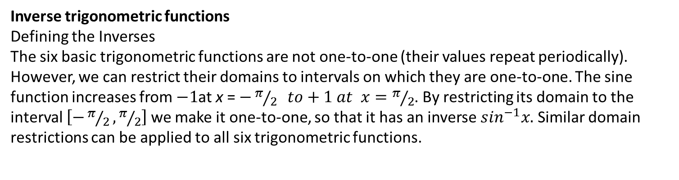
Inverse trigonometric functions
Defining the Inverses
The six basic trigonometric functions are not one-to-one (their values repeat periodically).
However, we can restrict their domains to intervals on which they are one-to-one. The sine
function increases from $−1$at x = $−π/2 to+1 at x=π/2$. By restricting its domain to the
interval $\left[−π/2, π/2\right]$ we make it one-to-one, so that it has an inverse $\sin^{−1}x.$ Similar domain restrictions can be applied to all six trigonometric functions.

Slide 3

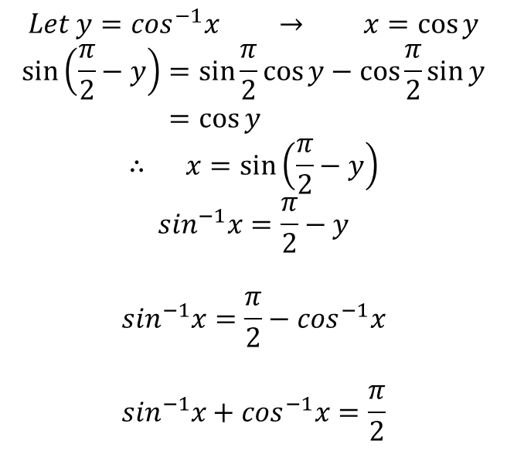

Example: Evaluate $\sin^{−1}\left(\frac{\sqrt{3}}{2}\right)$
$$Assume y=\sin^{−1}\left(\frac{\sqrt{3}}{2}\right) →\sin{y=\frac{\sqrt{3}}{2}}$$
$$y=\frac{π}{3}={60}^{°}$$
Example: Prove that $\sin^{−1}x+\cos^{−1}x=\frac{π}{2}$
$$Let y=\cos^{−1}x → x=\cos{y}$$
$$\sin\left(\frac{π}{2}−y\right)=\sin{\frac{π}{2}\cos{y−\cos{\frac{π}{2}\sin{y}}}}$$
$$=\cos{y }$$
$$∴ x=\sin\left(\frac{π}{2}−y\right)$$
$$\sin^{−1}x=\frac{π}{2}−y$$
$$\sin^{−1}x=\frac{π}{2}−\cos^{−1}x$$
$$\sin^{−1}x+\cos^{−1}x=\frac{π}{2}$$

Slide 4
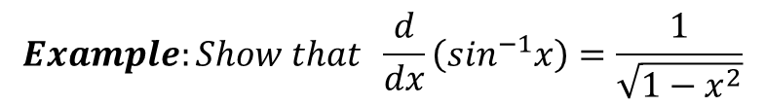
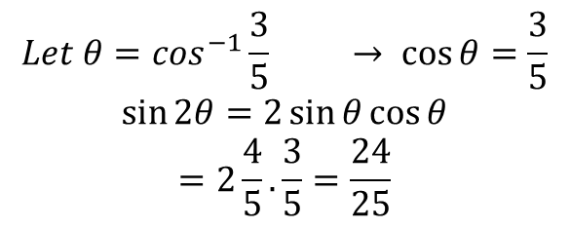




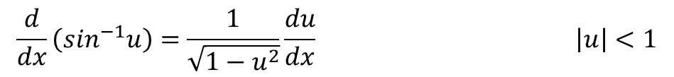

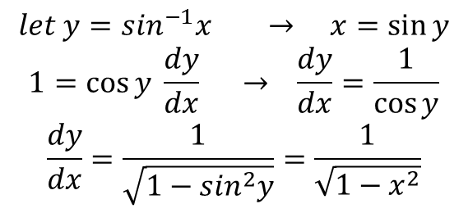
Example: Find the value of $\sin\left({2 cos}^{−1}(\frac{3}{5})\right)$
$$Let θ=\cos^{−1}\frac{3}{5} → \cos{θ=\frac{3}{5}}$$
$$\sin{2θ=2\sin{θ\cos{θ}}}$$
$$=2\frac{4}{5}. \frac{3}{5}=\frac{24}{25}$$
$$5$$
$$4$$
$$θ$$
$$3$$
Derivative of Trigonometric Functions
$$Example:Show that \frac{d}{dx}\left(\sin^{−1}x\right)=\frac{1}{\sqrt{1−x^{2}}}$$
$$let y=\sin^{−1}x → x=\sin{y}$$
$$1=\cos{y \frac{dy}{dx} → \frac{dy}{dx}=\frac{1}{\cos{y}}}$$
$$\frac{dy}{dx}=\frac{1}{\sqrt{1−\sin^{2}y}}=\frac{1}{\sqrt{1−x^{2}}}$$
$$\frac{d}{dx}\left(\sin^{−1}u\right)=\frac{1}{\sqrt{1−u^{2}}}\frac{du}{dx} \left|u\right|<1$$

Slide 5
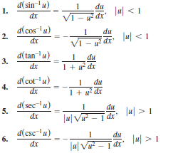

Slide 6
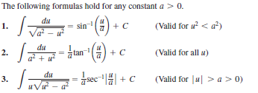
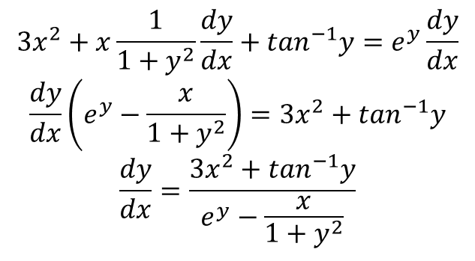

Example: $Find \frac{dy}{dx} of x^{3}+x\tan^{−1}y=e^{y}$
$$3x^{2}+x\frac{1}{1+y^{2}}\frac{dy}{dx}+\tan^{−1}y=e^{y}\frac{dy}{dx}$$
$$\frac{dy}{dx}\left(e^{y}−\frac{x}{1+y^{2}}\right)=3x^{2}+\tan^{−1}y$$
$$\frac{dy}{dx}=\frac{3x^{2}+\tan^{−1}y}{e^{y}−\frac{x}{1+y^{2}}}$$
Integration formulas

Slide 7
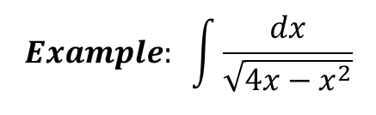
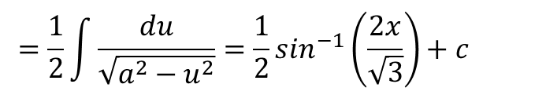
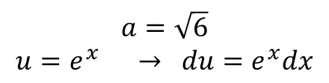
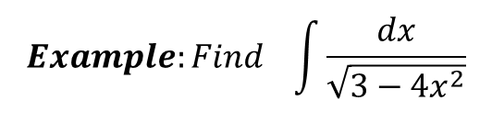
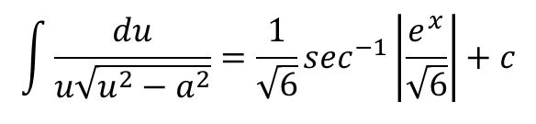
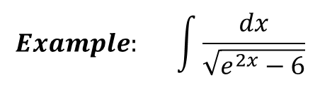
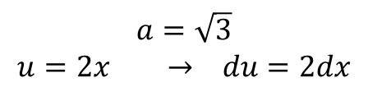
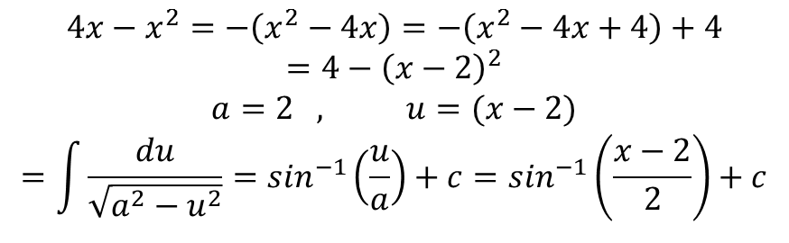
$$Example:Find \int{\frac{dx}{\sqrt{3−4x^{2}}}}$$
$$a=\sqrt{3}$$
$$u=2x → du=2dx$$
$$=\frac{1}{2}\int{\frac{du}{\sqrt{a^{2}−u^{2}}}=\frac{1}{2}\sin^{−1}\left(\frac{2x}{\sqrt{3}}\right)+c }$$
$$Example: \int{\frac{dx}{\sqrt{e^{2x}−6}}}$$
$$a=\sqrt{6}$$
$$u=e^{x} → du=e^{x}dx$$
$$\int{\frac{du}{u\sqrt{u^{2}−a^{2}}}=\frac{1}{\sqrt{6}}\sec^{−1}\left|\frac{e^{x}}{\sqrt{6}}\right|+c}$$
$$Example: \int{\frac{dx}{\sqrt{4x−x^{2}}}}$$
$$4x−x^{2}=−\left(x^{2}−4x\right)=−\left(x^{2}−4x+4\right)+4$$
$$=4−{\left(x−2\right)}^{2}$$
$$a=2 , u=(x−2)$$
$$=\int{\frac{du}{\sqrt{a^{2}−u^{2}}}=\sin^{−1}\left(\frac{u}{a}\right)+c=\sin^{−1}\left(\frac{x−2}{2}\right)+c}$$

Slide 8
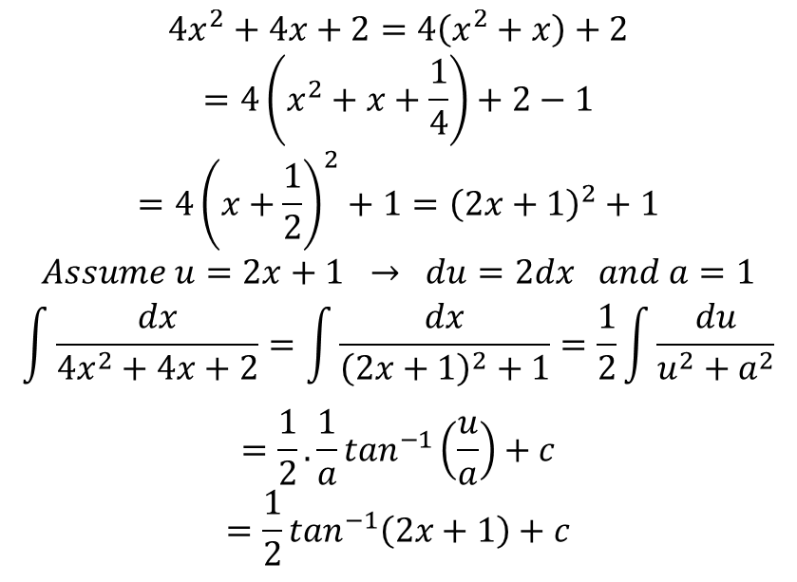
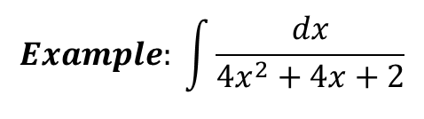
$$Example: \int{\frac{dx}{4x^{2}+4x+2}}$$
$$4x^{2}+4x+2=4\left(x^{2}+x\right)+2$$
$$=4\left(x^{2}+x+\frac{1}{4}\right)+2−1$$
$$=4{\left(x+\frac{1}{2}\right)}^{2}+1={\left(2x+1\right)}^{2}+1$$
$$Assume u=2x+1 → du=2dx and a=1$$
$$\int{\frac{dx}{4x^{2}+4x+2}=\int{\frac{dx}{{\left(2x+1\right)}^{2}+1}=\frac{1}{2}\int{\frac{du}{u^{2}+a^{2}}}}}$$
$$=\frac{1}{2}. \frac{1}{a}\tan^{−1}\left(\frac{u}{a}\right)+c$$
$$=\frac{1}{2}\tan^{−1}\left(2x+1\right)+c$$

